Slide 1




Development of the Control Plane and Data Path for a 1MHz Continuous Frame Rate Spectroscopic X-ray Imaging Detector System
Joseph Nobes
Detector & Electronics Division
UKRI STFC, RAL
iWoRiD 28th June 2022
Notes:
Do not introduce myself, remember agenda is on next slide, so no need to waffle

Slide 2
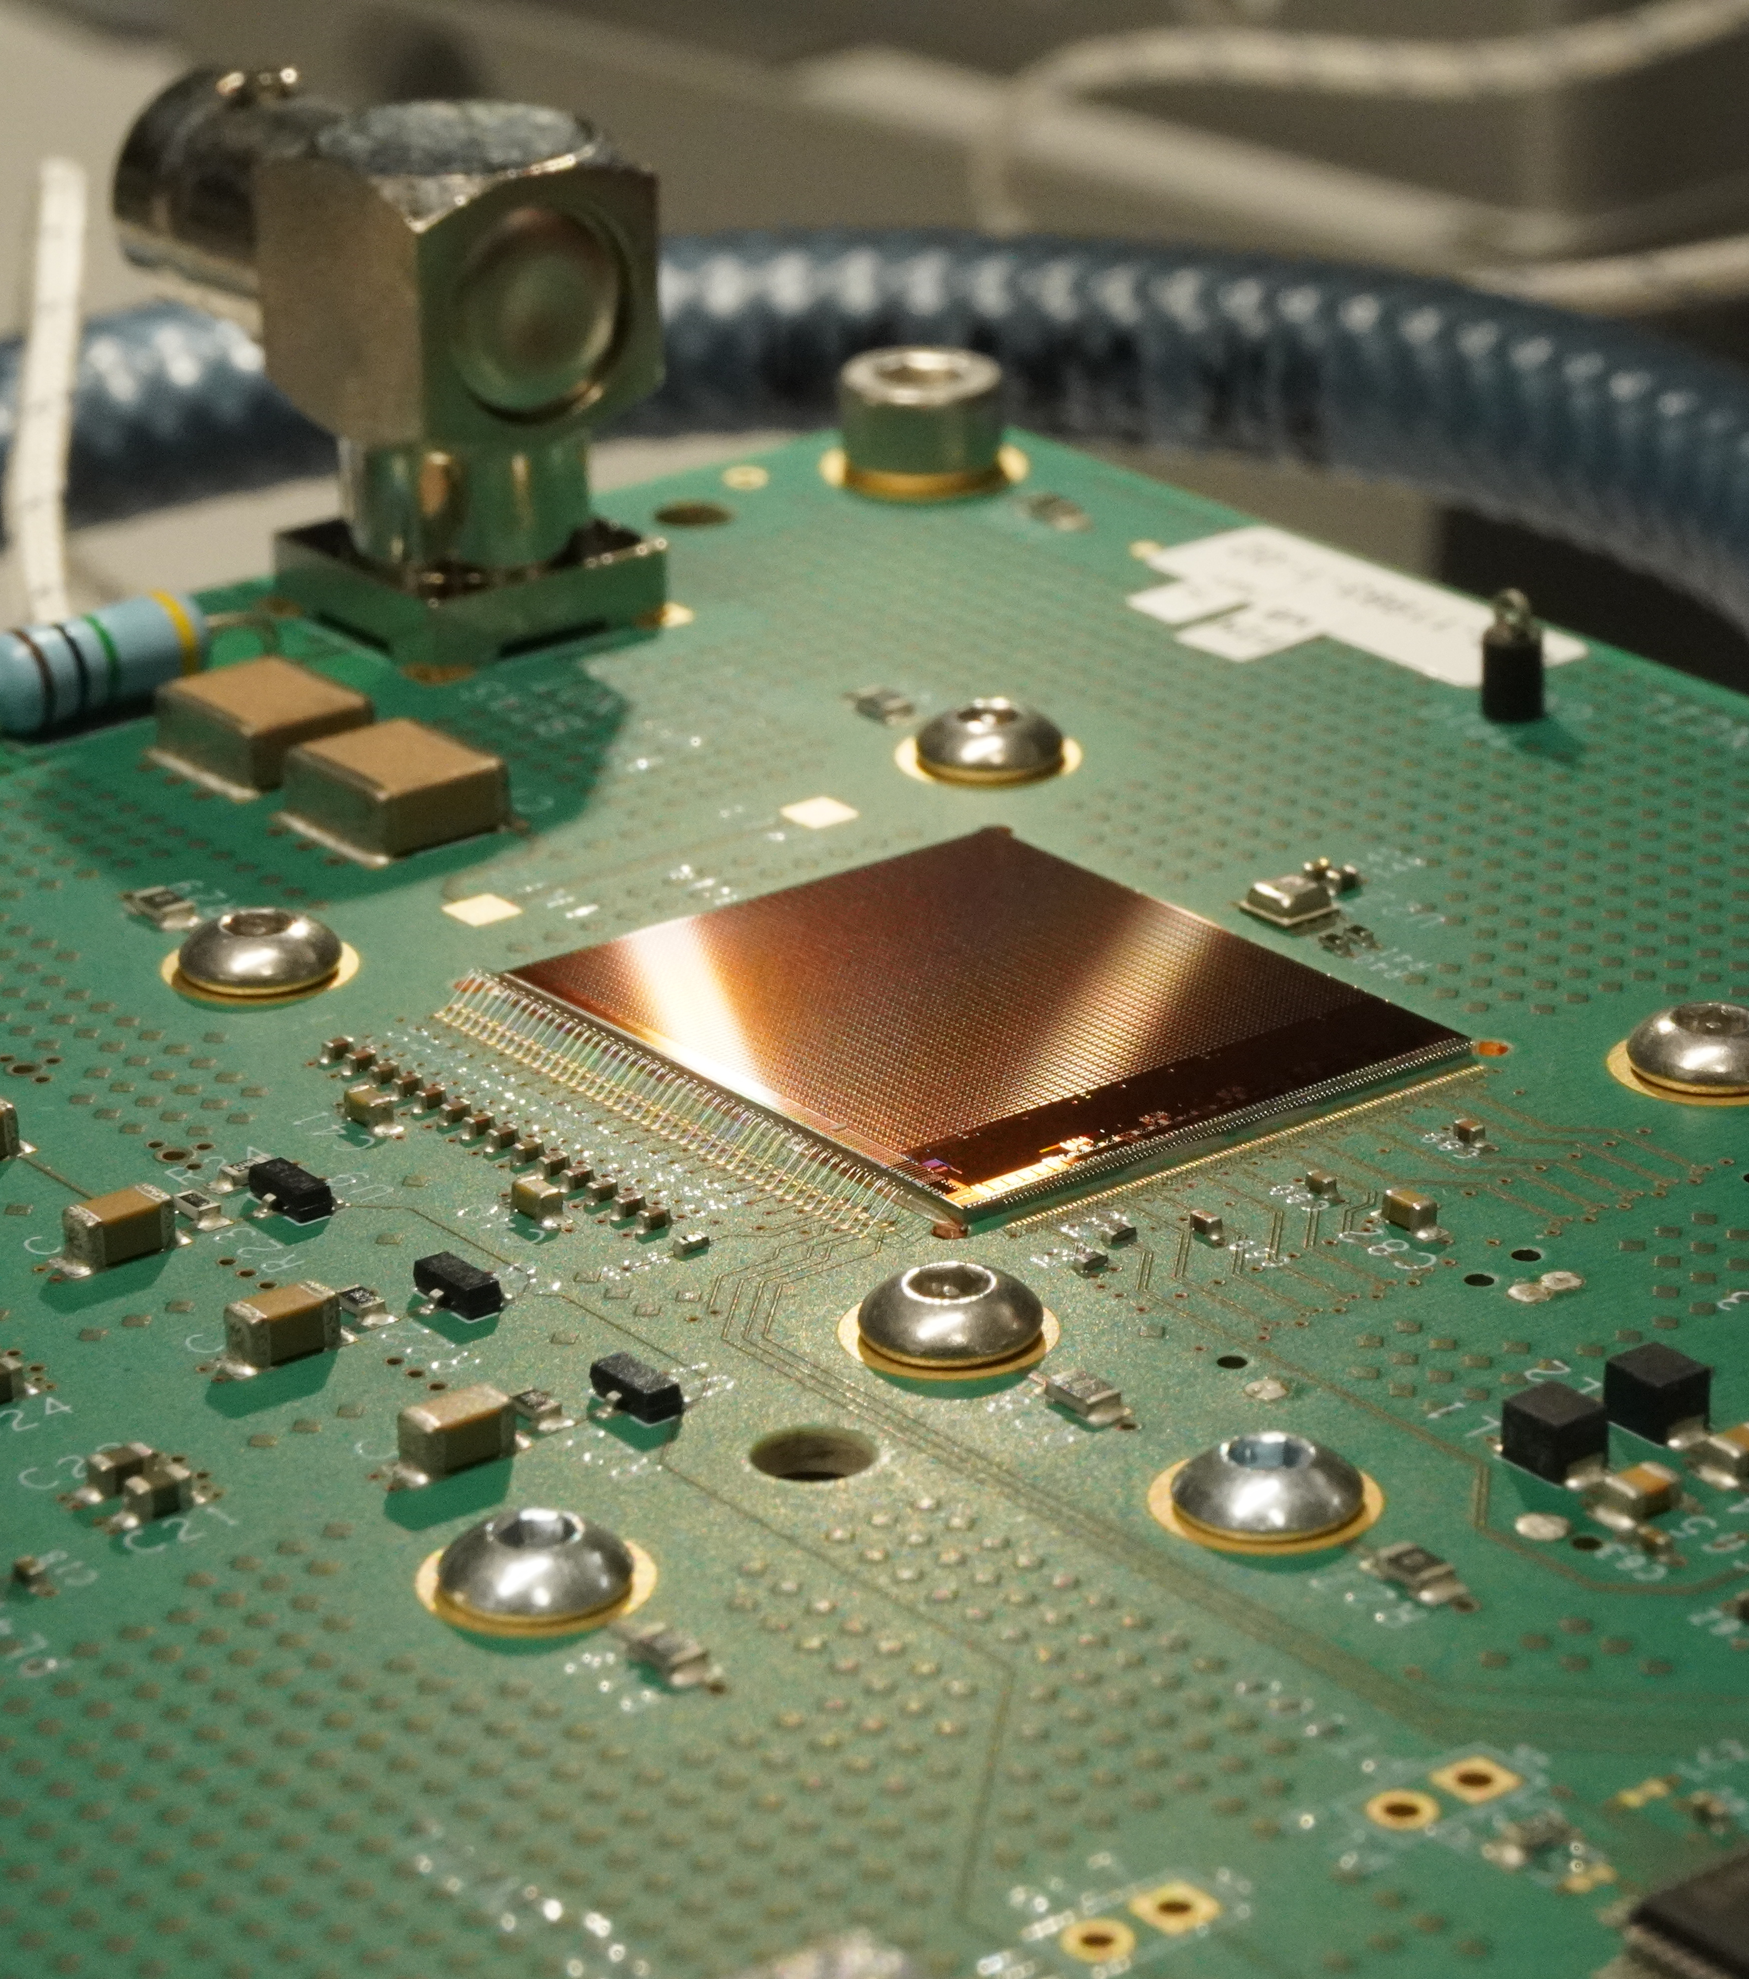

Agenda
HEXITEC
HEXITEC-MHz
Data Plane
Control Plane
Status
Detector Testing
DAQ
Next Steps
Notes:
To replace photo with one of your own. 1) Send the geometric shape overlay to the back – Right-Click > Send to Back > Send to Back. 2) Replace image – use the guides provided to correctly position it. 3) Send your image to the back so that the geometric overlay re-appears over the image. Remember to delete the image credit if using your own image.

Slide 3

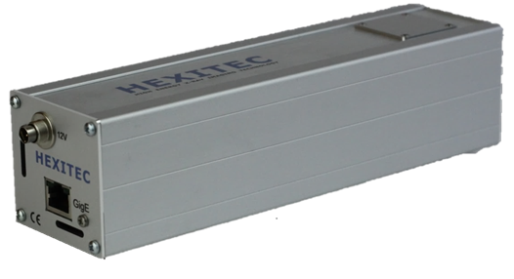
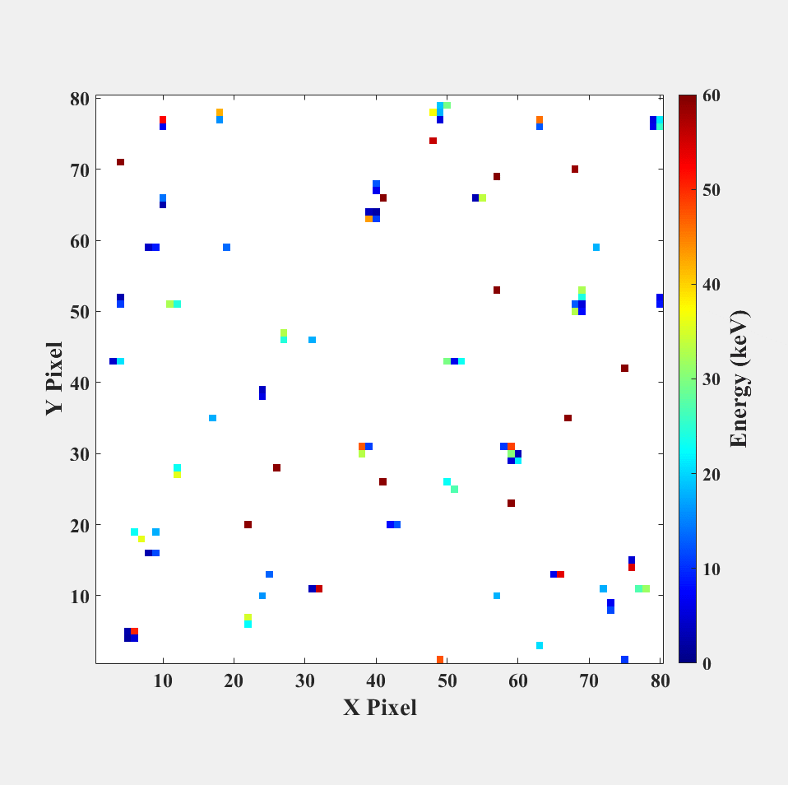
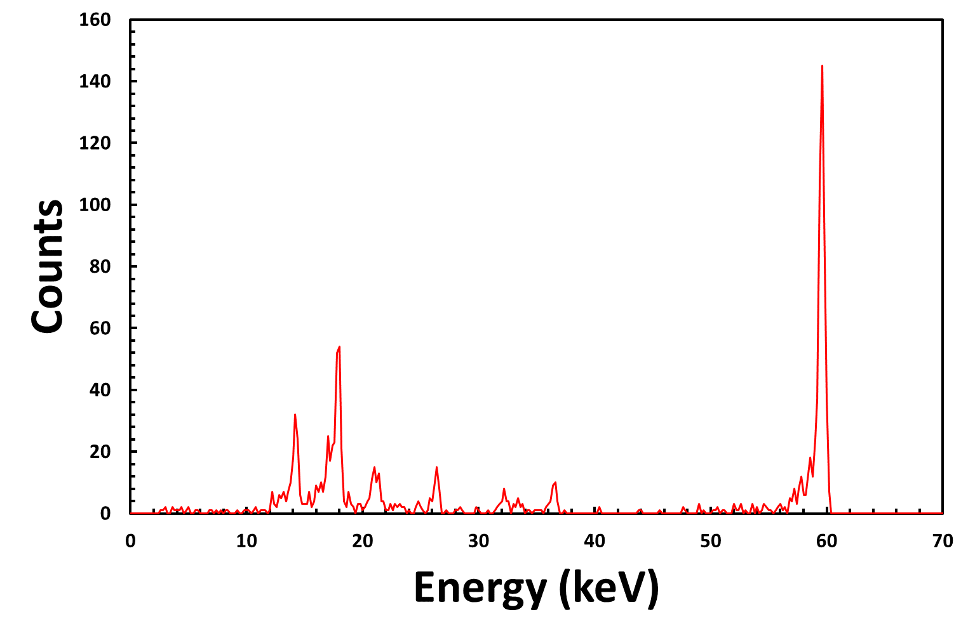
HEXITEC
‘GigE’ HEXITEC
detector system
80 x 80 pixel array with 250 µm pitch
Fully spectroscopic X-ray Imaging with CdZnTe or CdTe detectors
Analogue readout via rolling shutter to 4x ADCs in DAQ
10 kHz data output over GigE
Data rates ~100Mbyte s⁻¹
Uses include materials science, medical imaging, security…
Limitation:
  Ability to correct for charge sharing is limited by occupancy, which with a defined frame rate results in maximum X-ray fluxes of <10⁴ photons s⁻¹ mm⁻²
Per-pixel energy spectrum
Multiple
frames
Parameter | HEXITEC
Pixel Pitch (µm) | 250
Array Size | 80 x 80
Max Frame Rate (kHz) | 10
High Gain (keV) | 2 – 200
Medium Gain (keV)
Low Gain (keV) | 6 – 600
FWHM@100keV (keV) | < 1
Image © STFC John Dawson
[1] HEXITEC: A High-Energy X-ray Spectroscopic Imaging Detector for Synchrotron Applications
[2] HEXITEC ASIC—a pixellated readout chip for CZT detectors
Notes:
Full 80x80 system delivered in 2014. Aimed to deliver UK capability for high energy X-Ray imaging, with priority on spectroscopic resolution
250um chosen to limit charge sharing events while retaining moderate spatial resolution.
Fully spectroscopic rather than photon counting means precise energy deposited in each pixel recorded, gives spectra per pixel after multiple AQ. High energy values histogrammed -> high resolution spectra.
Output is analogue, digitization in the DAQ.
Commercialized with Quantum Detectors.

Slide 4

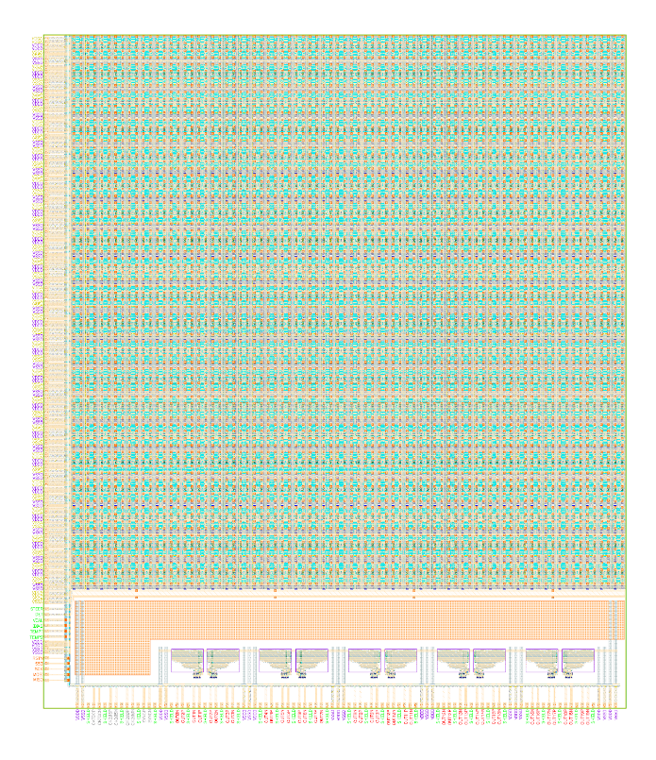
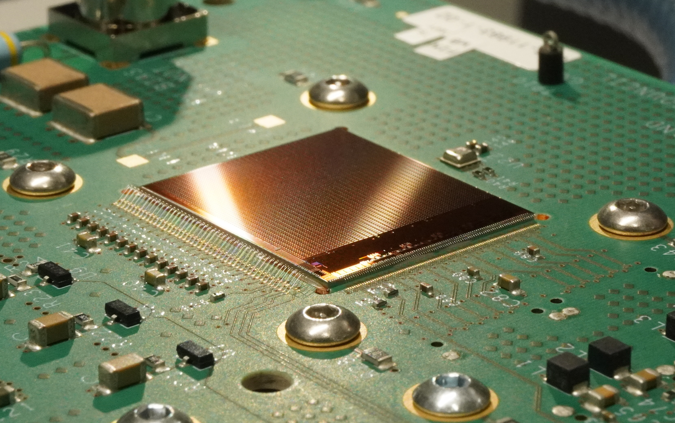
HEXITEC-MHz
Greater fluxes will demand a significantly faster readout
HEXITEC-MHz:
80 x 80 pixels @250um pitch, Fully Spectroscopic Imaging
1MHz continuous frame rate
On-chip digitisation removes requirement for external ADCs
  800 ADCs internally
On-chip serialisation outputs data via 20x 4.1Gbps CML links
12-bit count per pixel
Parameter | HEXITEC | HEXITEC-MHz
Pixel Pitch (µm) | 250 | 250
Array Size | 80 x 80 | 80 x 80
Max Frame Rate (kHz) | 10 | 1000
High Gain (keV) | 2 – 200 | 2 – 100
Medium Gain (keV) |  | 2 – 200
Low Gain (keV) | 6 – 600 | 2 – 300
FWHM@100keV (keV) | < 1 | < 1
Image © STFC John Dawson
Notes:
PLEASE DELETE/REPLACE PHOTO CREDIT IF CHANGING THE IMAGE.

Slide 5

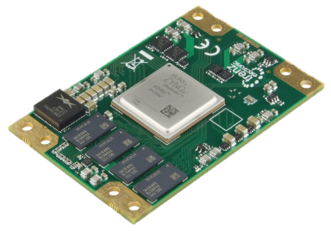
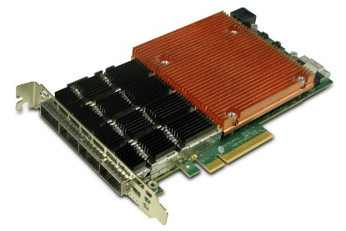

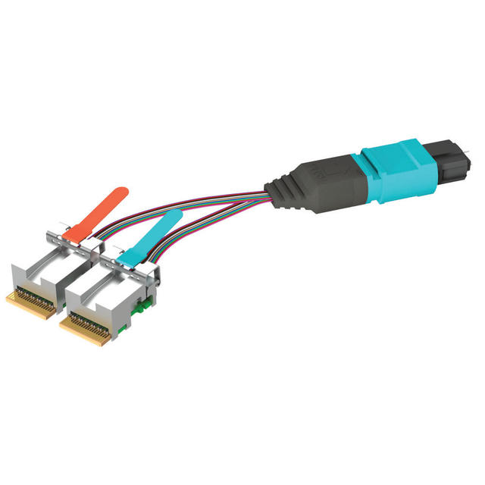

DAQ Architecture
Control Path
ODIN Control
Control – Zynq SoC
1st Level Receiver FGPA
2nd Level Processing FPGA
ASIC
20x 4.1G CML Aurora
(10mm)
20x 4.1G Optical
Aurora (10m+)
ODIN Data
2x 100G Optical Network Protocol
2x 100G Optical Network Protocol
Image © STFC John Dawson
Data Path
Path to Disk
Notes:
Mention that only control and ASIC have to actually be in the chamber, with everything on the data path located elsewhere over fibre

Slide 6

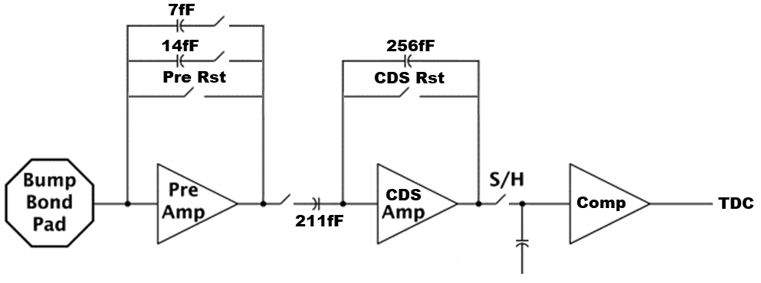
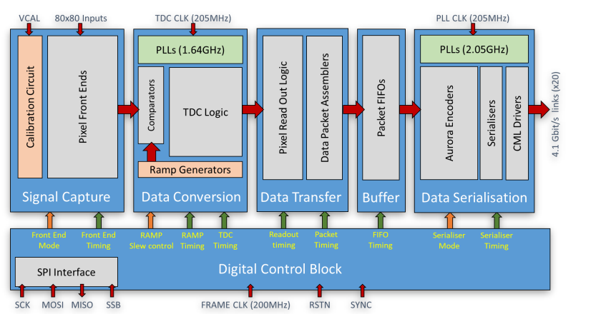
HEXITEC-MHz: On-Chip Digitisation
Per-pixel Front End:
Preamplifier captures detector charge, converts to voltage
  Selectable gain
CDS amplifier corrects for preamplifier reset level
  At CDS output, noise specification is 1keV FWHM
Sample & Hold on output of CDS amplifier

Slide 7
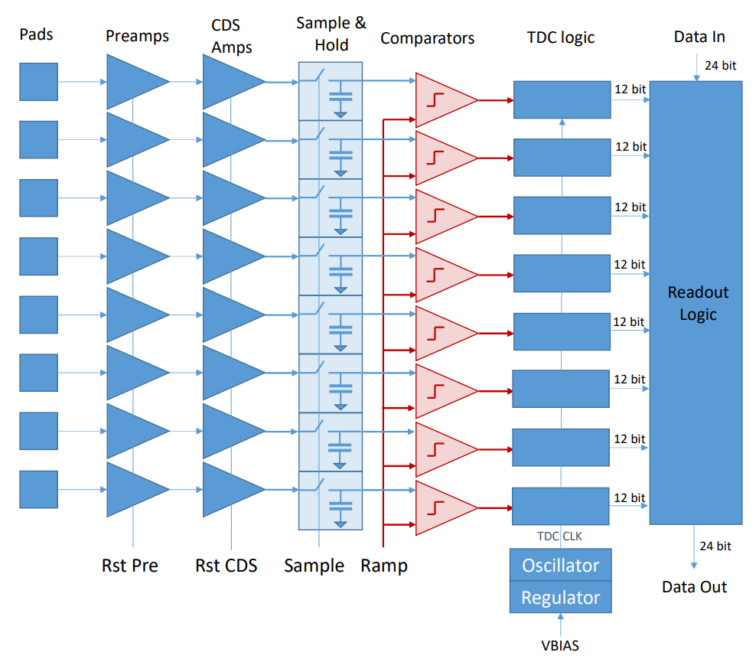
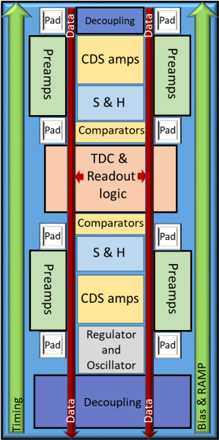
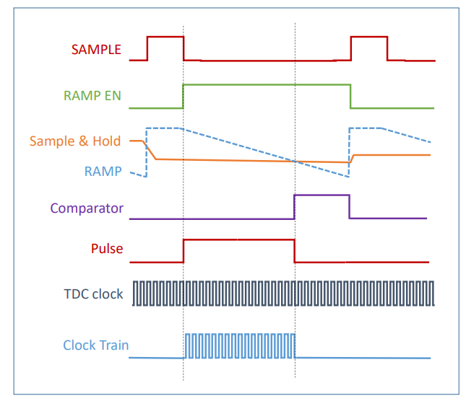
HEXITEC-MHz: On-Chip Digitisation
Super-pixel block diagram
ASIC consists of 800 super-pixels of 8 containing one TDC block, as well as shared readout logic
Digitisation performed by TDC (Time-to-Digital-Converter)
  Input signal from S&H is compared to a lowering ramp with programmable slew
  12-bit ripple counter incremented until ramp matches input
  Count proportional to voltage at sample and hold input

Slide 8
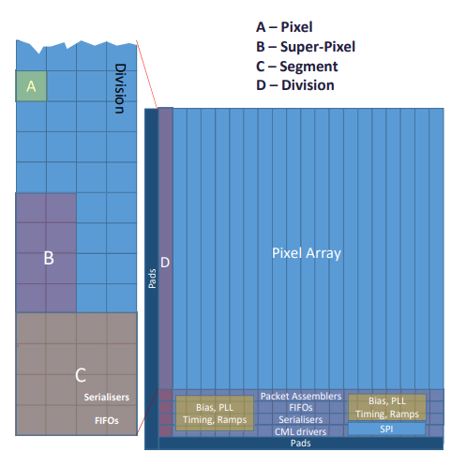
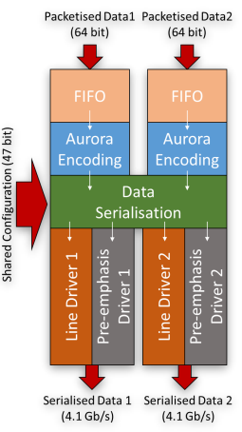
HEXITEC-MHz: On-Chip
Packaging & Serialisation
Packaging:
Each vertical division (4 columns) has a packet assembler
Pixels are handled in 4x4 chunks, split across 3 64-bit words (one nibble per pixel in each)
Therefore for each column, 60 64-bit words are required
Serialisers:
Each division has one dedicated serialiser
Serialisers construct proprietary Xilinx aurora 64/66b frames
Output via 20 4.1Gbps CML logic lanes to Samtec FireFly flyovers

Slide 9
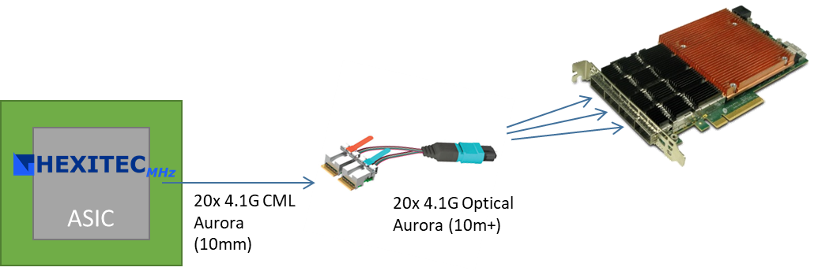
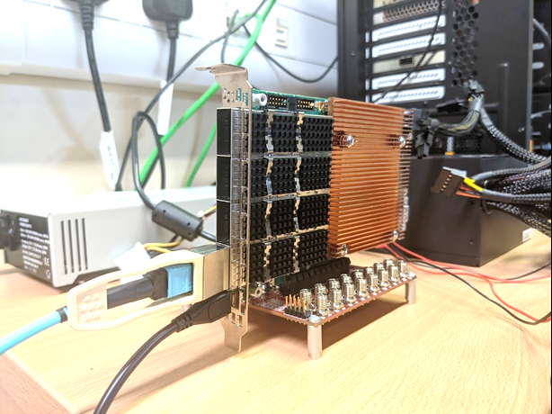
Data Plane
20x 4.1 Gbps
Aurora (8, 8, 4)
First-stage FPGA: Alpha Data (Xilinx Virtex with 4x QSFP-DD)
For each lane (division), 3 64-bit words recovers the 12-bit pixel data for one 4x4 grid
Once all 20 4x4 grids are recovered, the entire division is complete
This is conducted asynchronously between lanes, which must then be aligned so that data can be re-ordered as a single image
Pixel data is also padded to 16-bit boundaries:
Full image read of 80x80x12bit pixels at 1MHz generates 76800 Gbps
Padded to 16-bit values → 102400 Gbps
2x 100GbE
First stage: Alpha Data for re-ordering
Justification for the 2x 100GbE interfaces
Packets sent out over alternating interfaces
Notes:
Ensure DDs are mentioned

Slide 10
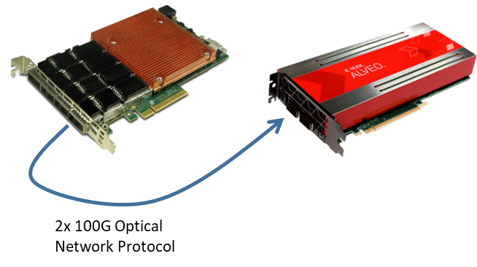
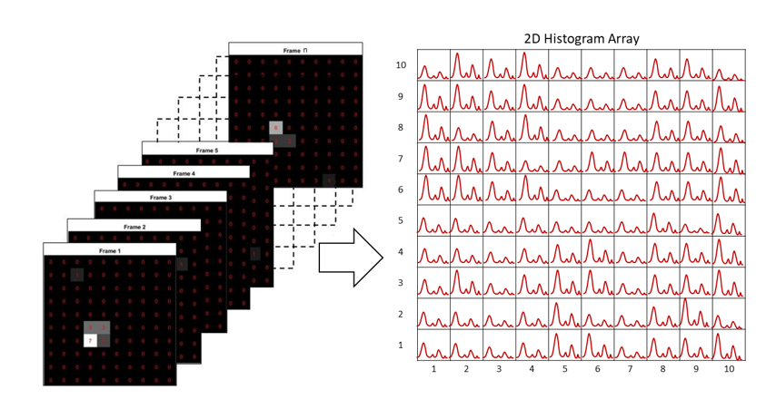
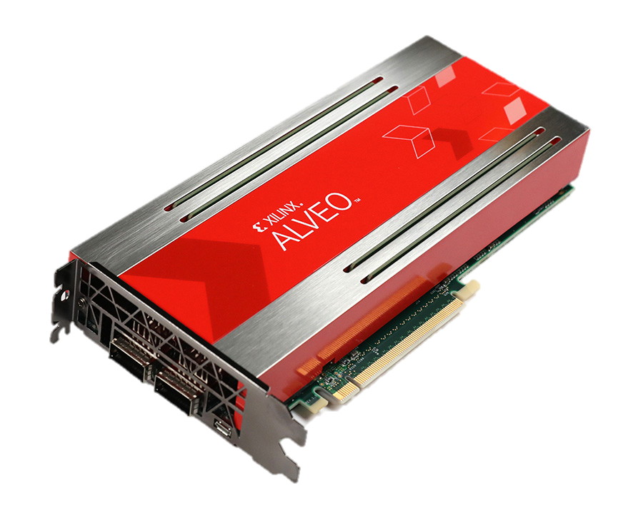
Data Plane
Second stage FPGA: Xilinx Alveo
Data Corrections (darks, energy calibration)
Data Reduction (charge sharing, histogramming)
Current status: fast histogramming firmware blocks designed and tested
20x 4.1 Gbps
Aurora (8, 8, 4)
2x 100GbE
First stage: Alpha Data for re-ordering
2x 100GbE
Data reduction via histogramming
Reduced Data
to ODIN Data
Second stage: Alveo for correction/reduction
Notes:
Data is reduced variably depending on sample rate. This would be customised to the application (which is why commercial hardware is in use).
One of the only off-the-shelf acceleration boards available (not a development platform), deals only in Ethernet, which could otherwise bypass it and feed straight into ODIN or a switch etc…

Slide 11
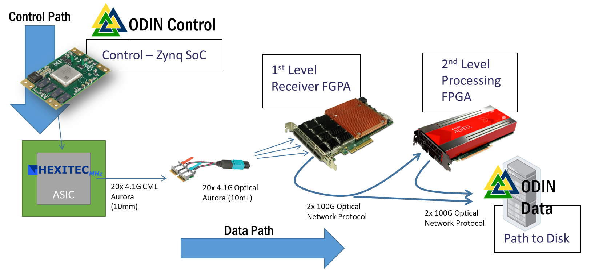
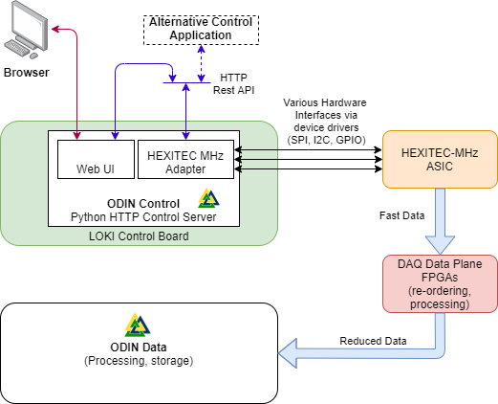
ODIN Detector: Control & Data
ODIN Control and ODIN Data combined form odin-detector^{[1][2]}
ODIN Data is a scalable data processing and acquisition framework
  Expanded with decoder and processing plugins to suit the application (from file storage to pixel processing)
  Receives fast data from data plane FPGA over 100 GbE in the case of HEXITEC-MHz
ODIN Control is a detector agnostic control system
  Adapters are loaded to provide support for detector hardware
  A web server provides access to an HTTP Rest API, which allows flexible control via the inbuilt web page, or custom software
  HEXITEC-MHz Adapter can be found at
  stfc-aeg/mercury-detector^{[3]}
ODIN
[1] https://accelconf.web.cern.ch/icalepcs2017/papers/tupha212.pdf
[2] https://github.com/odin-detector/odin-control
[3] https://github.com/stfc-aeg/mercury-detector

Slide 12
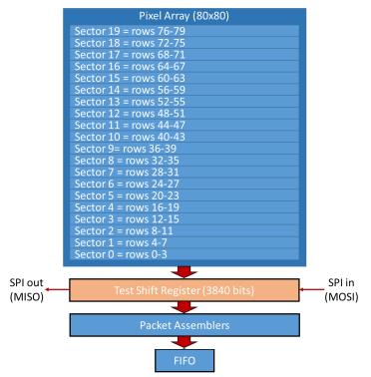
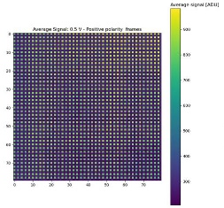
HEXITEC-MHz: ASIC Control Interface
The HEXITEC-MHz ASIC provides an SPI interface for configuration and control
Internal settings and bring-up stages are all modified / triggered via SPI
Test shift register provides dual-functionality for debugging horizontal sectors (80x4)
  Write: Any sector of the image can be overwritten continuously with test data, which will be propagated through packetisation and the fast data output
  Read: Any sector of the pixel output can be read at low speed
Test Pattern allows a semi-arbitrary pattern to be injected prior to the pixel front-ends, allowing front-end performance to be characterized without sensor material
Repeating test
pattern read
over full ASIC

Slide 13
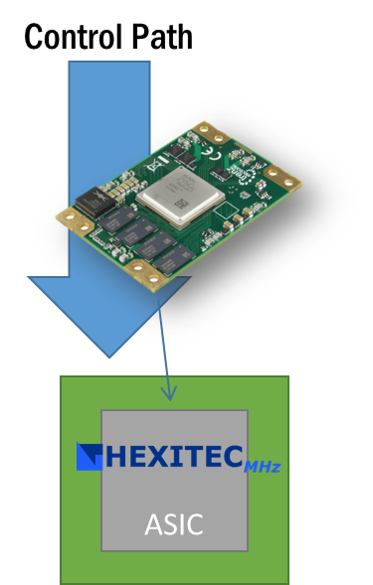
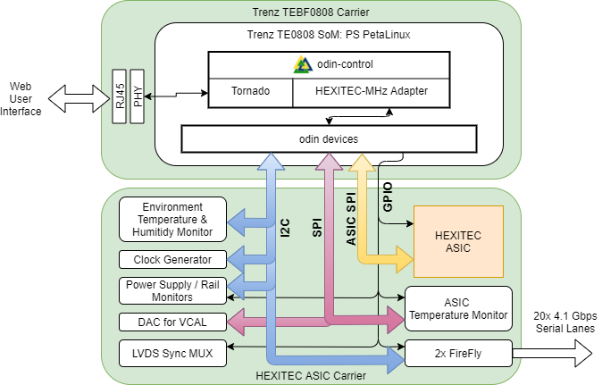
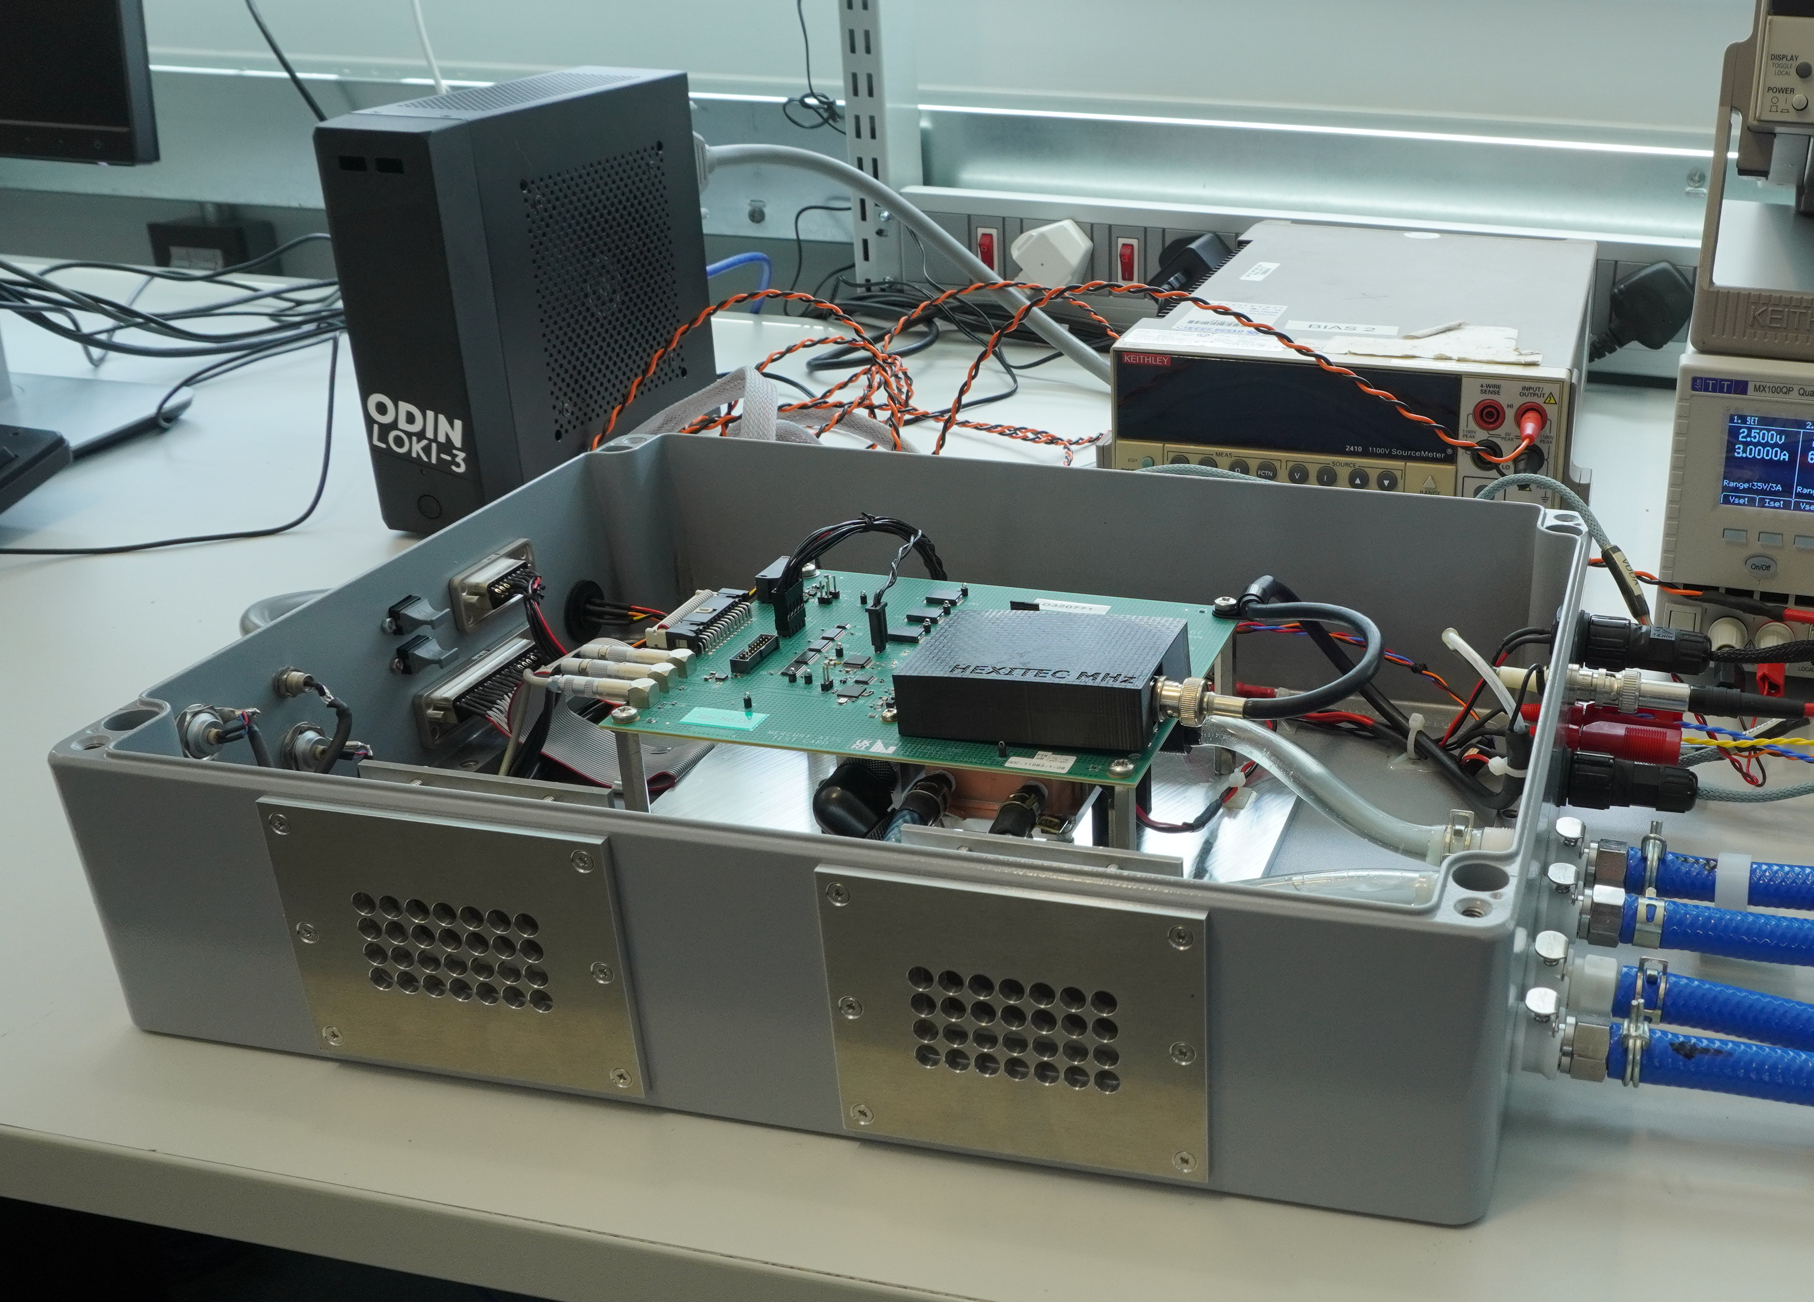
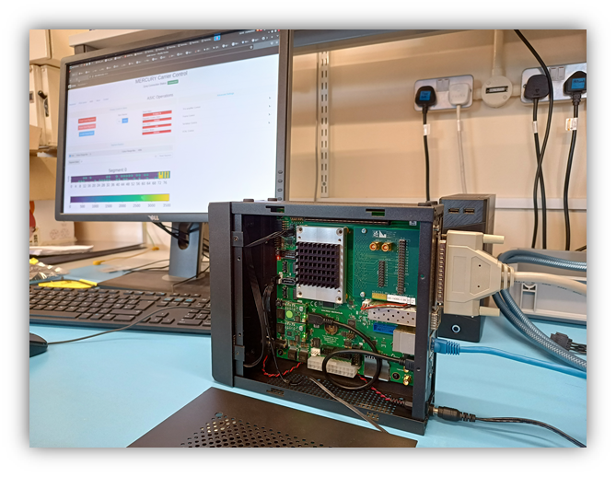
Control Plane: LOKI
Prototype of the LOKI^{[1]} detector controller:
Trenz TE0803 SoM featuring Zynq UltraScale+ MPSoC
  Dual-core Arm Cortex-A53 up to 1.3GHz
  81k - 600k PL logic cells
Yocto-based Xilinx PetaLinux Embedded Linux built alongside HW to contain:
  Drivers^{[2]} for ASIC carrier peripherals (2x Samtec FireFly, Clock Generation, Power Monitoring…
  Direct control of HEXITEC-MHz ASIC SPI interface for configuration and test
  Host of odin-control^{[3]} to consolidate control and provide a user interface
Readout PCB
in climate-
controlled box
TE0803 and carrier
Behind: Web UI
[1] https://github.com/stfc-aeg/loki
[2] https://github.com/stfc-aeg/odin-devices
[3] https://accelconf.web.cern.ch/icalepcs2017/papers/tupha212.pdf
Notes:
At this time primarily making use of the PS

Slide 14
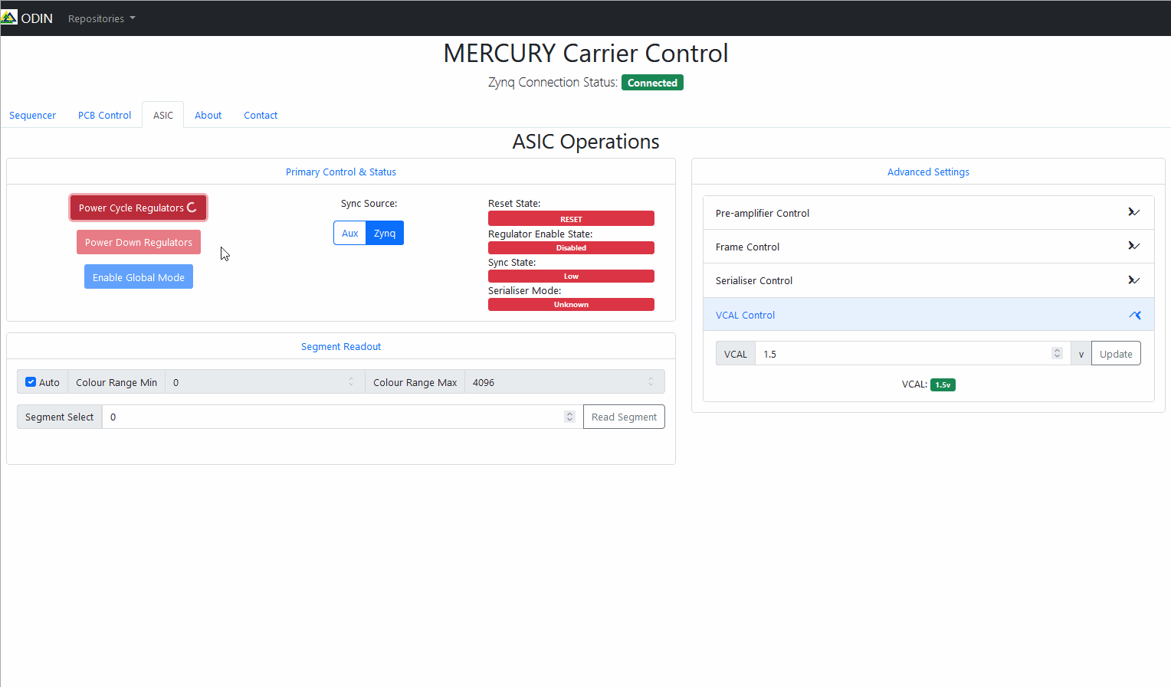
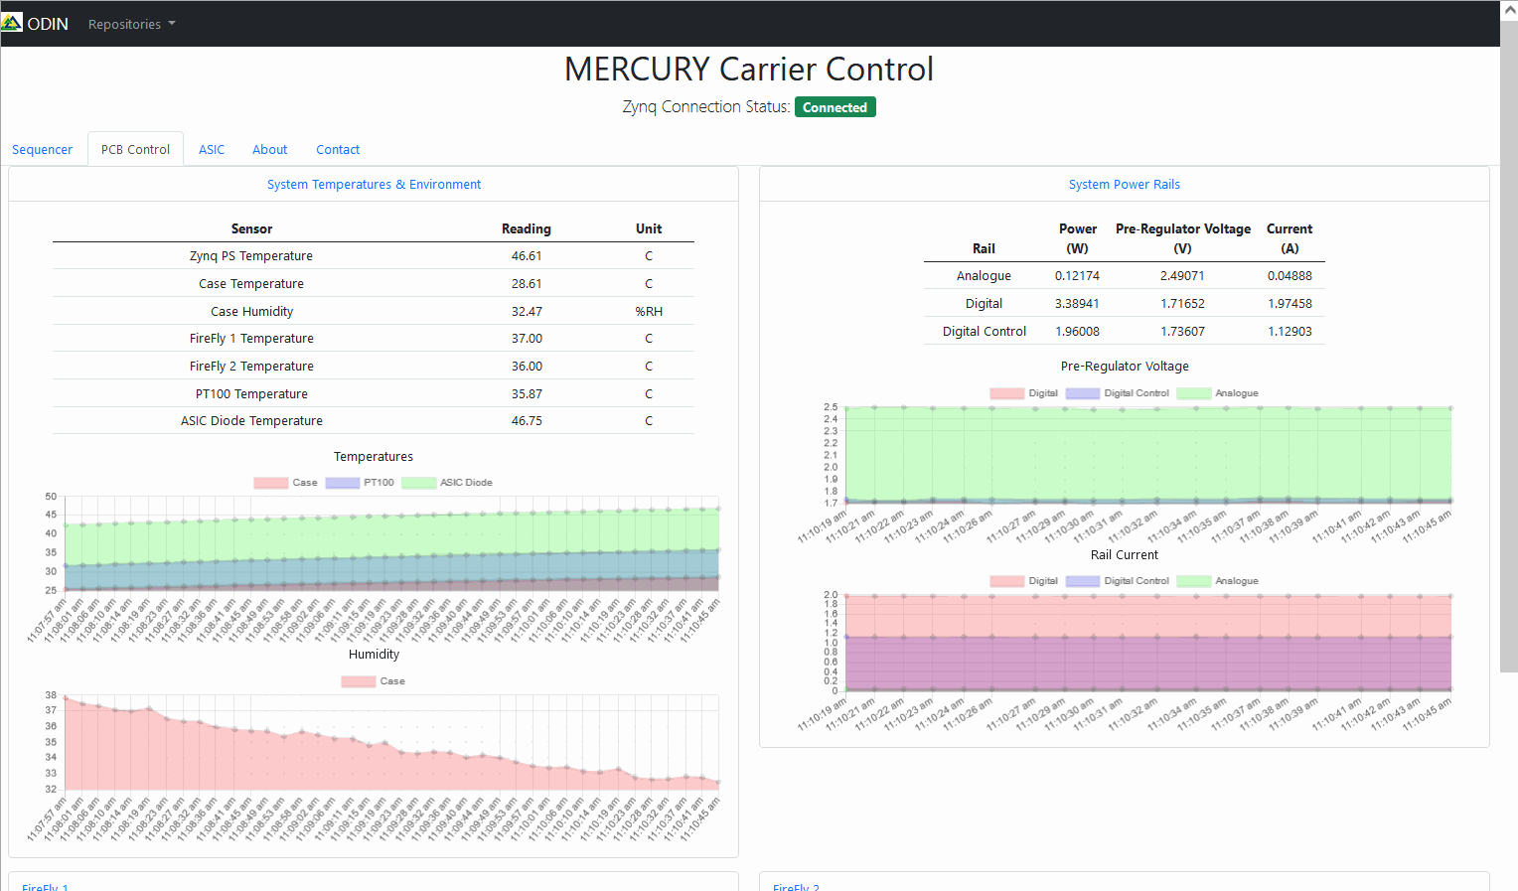
Control Plane: LOKI
Existing user interface:
Board power enable, and power rail monitoring
ASIC initialisation and parameter configuration
  Register programming and enables in correct order
  Dynamic altering of integration time, frame length, pre-amplifier feedback capacitance…
Segment readout using the test shift register
ASIC temperature and case environment monitoring
Execute & edit live Python sequences^{[1]} to manipulate system beyond options presented by the UI
  Allows scripting of ASIC register settings; useful for cycling configuration values under test
  Quicker iteration when creating new features while debugging on a live system
[1] https://github.com/stfc-aeg/odin-sequencer
Notes:
Put emphasis on the fact that this is not the final operator’s view; odin-data will take over?

Slide 15
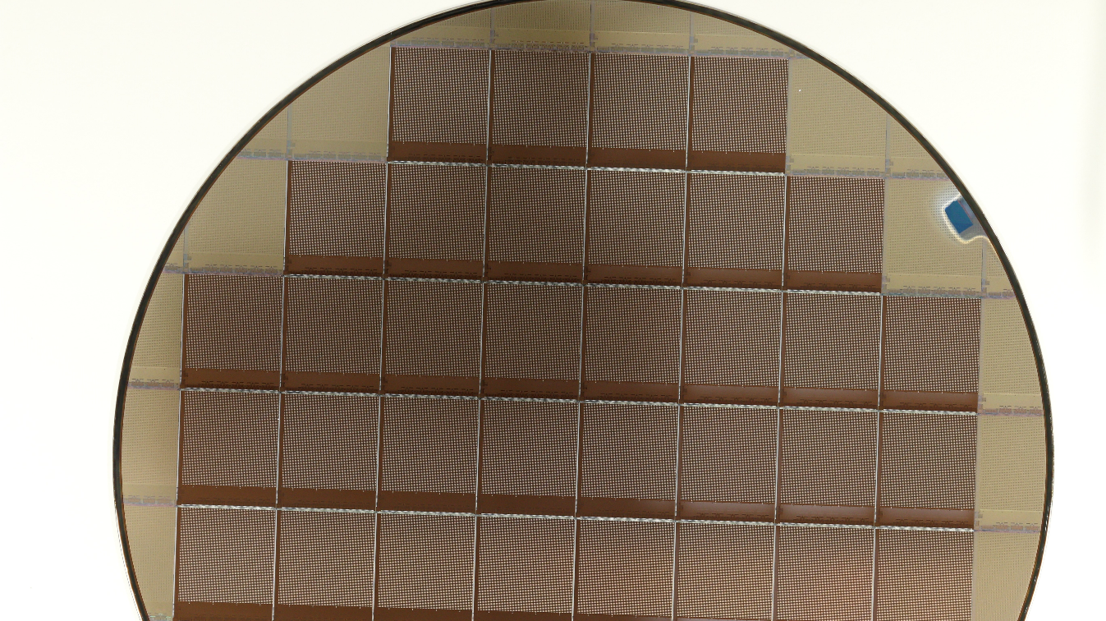
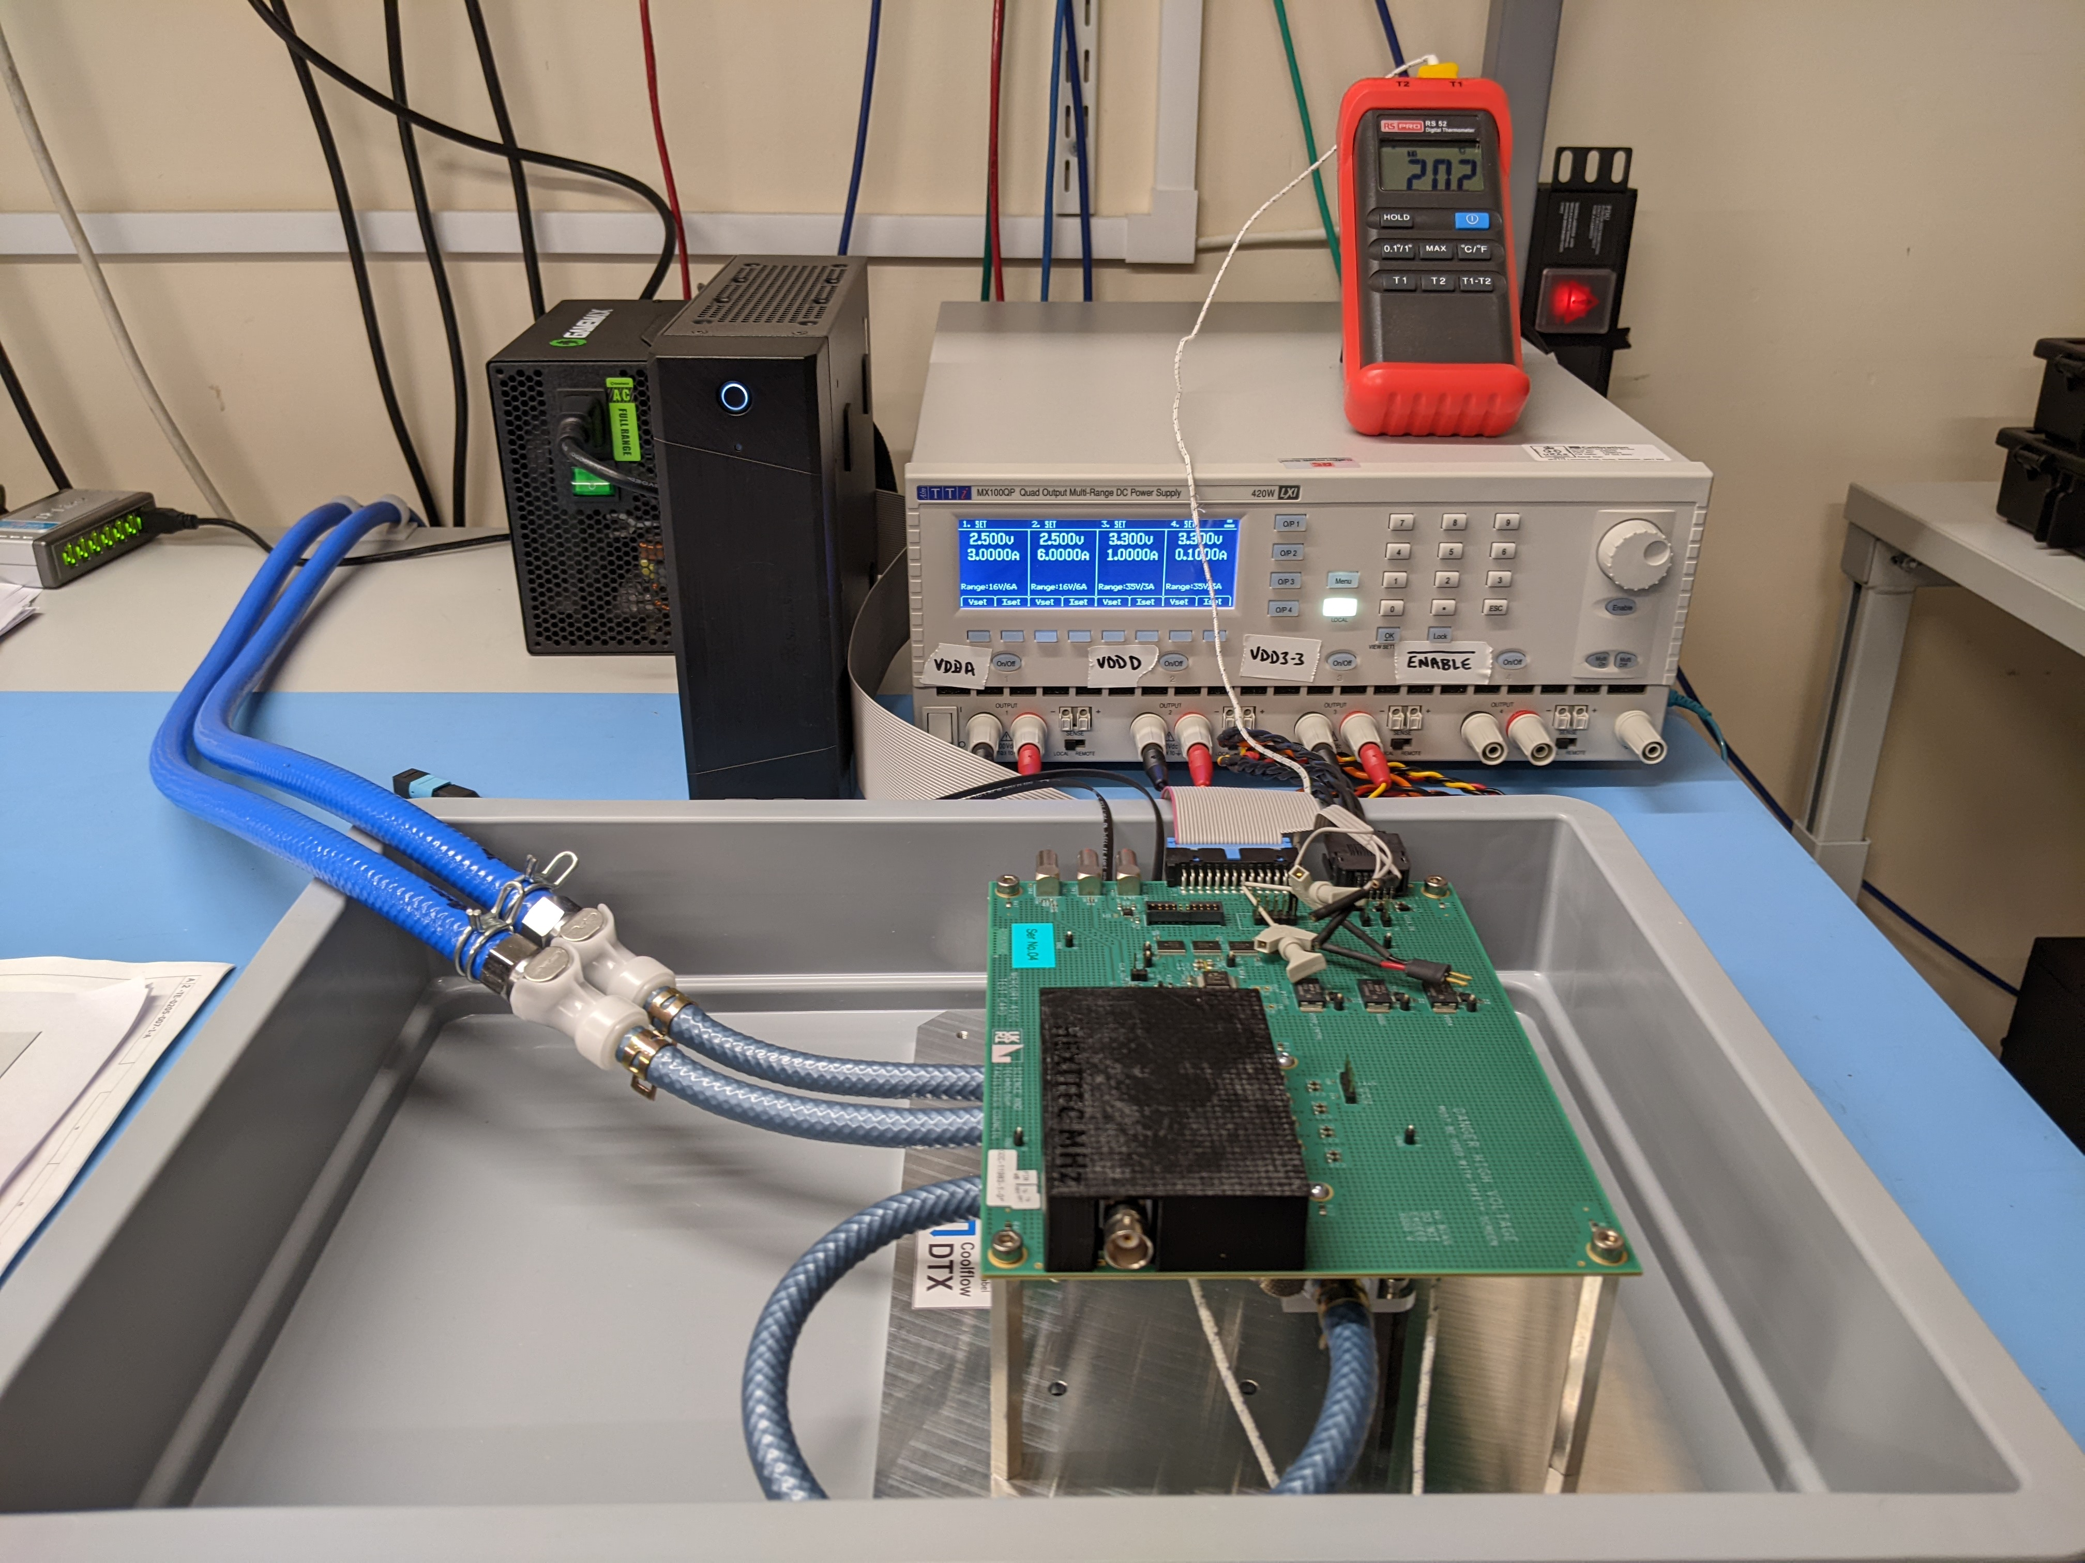
Detector Testing
Wafers delivered in January 2022
ASICS initially bonded to test readout PCBs to without bonded sensors
  Results obtained using the test shift register over SPI
  LOKI Control System developed while interacting with the ASIC’s control plane
  Initial characterisation of front-end performance
Bare ASIC bonded to readout PCB

Slide 16
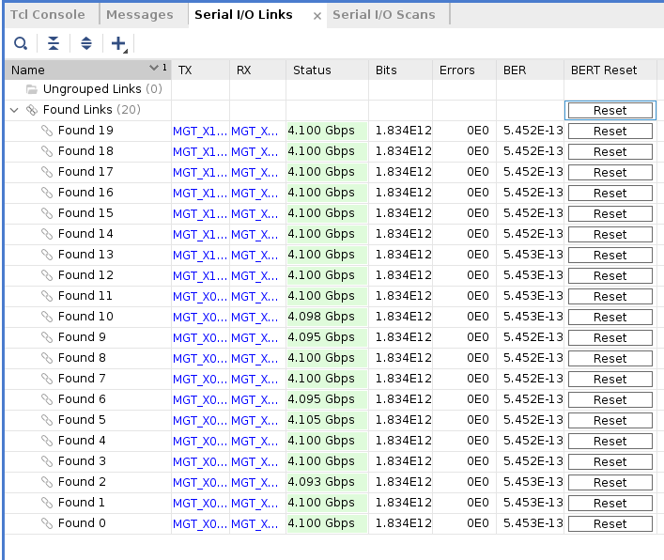
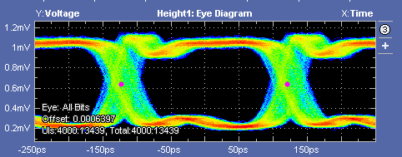
Detector Testing
  Fast Data output over 20x 4.1GHz aurora links established with First DAQ FPGA
Xilinx iBERT Diagnostic Tool
20x lanes running fast_clk test pattern from ASIC
447 second capture, 0 errors

Slide 17
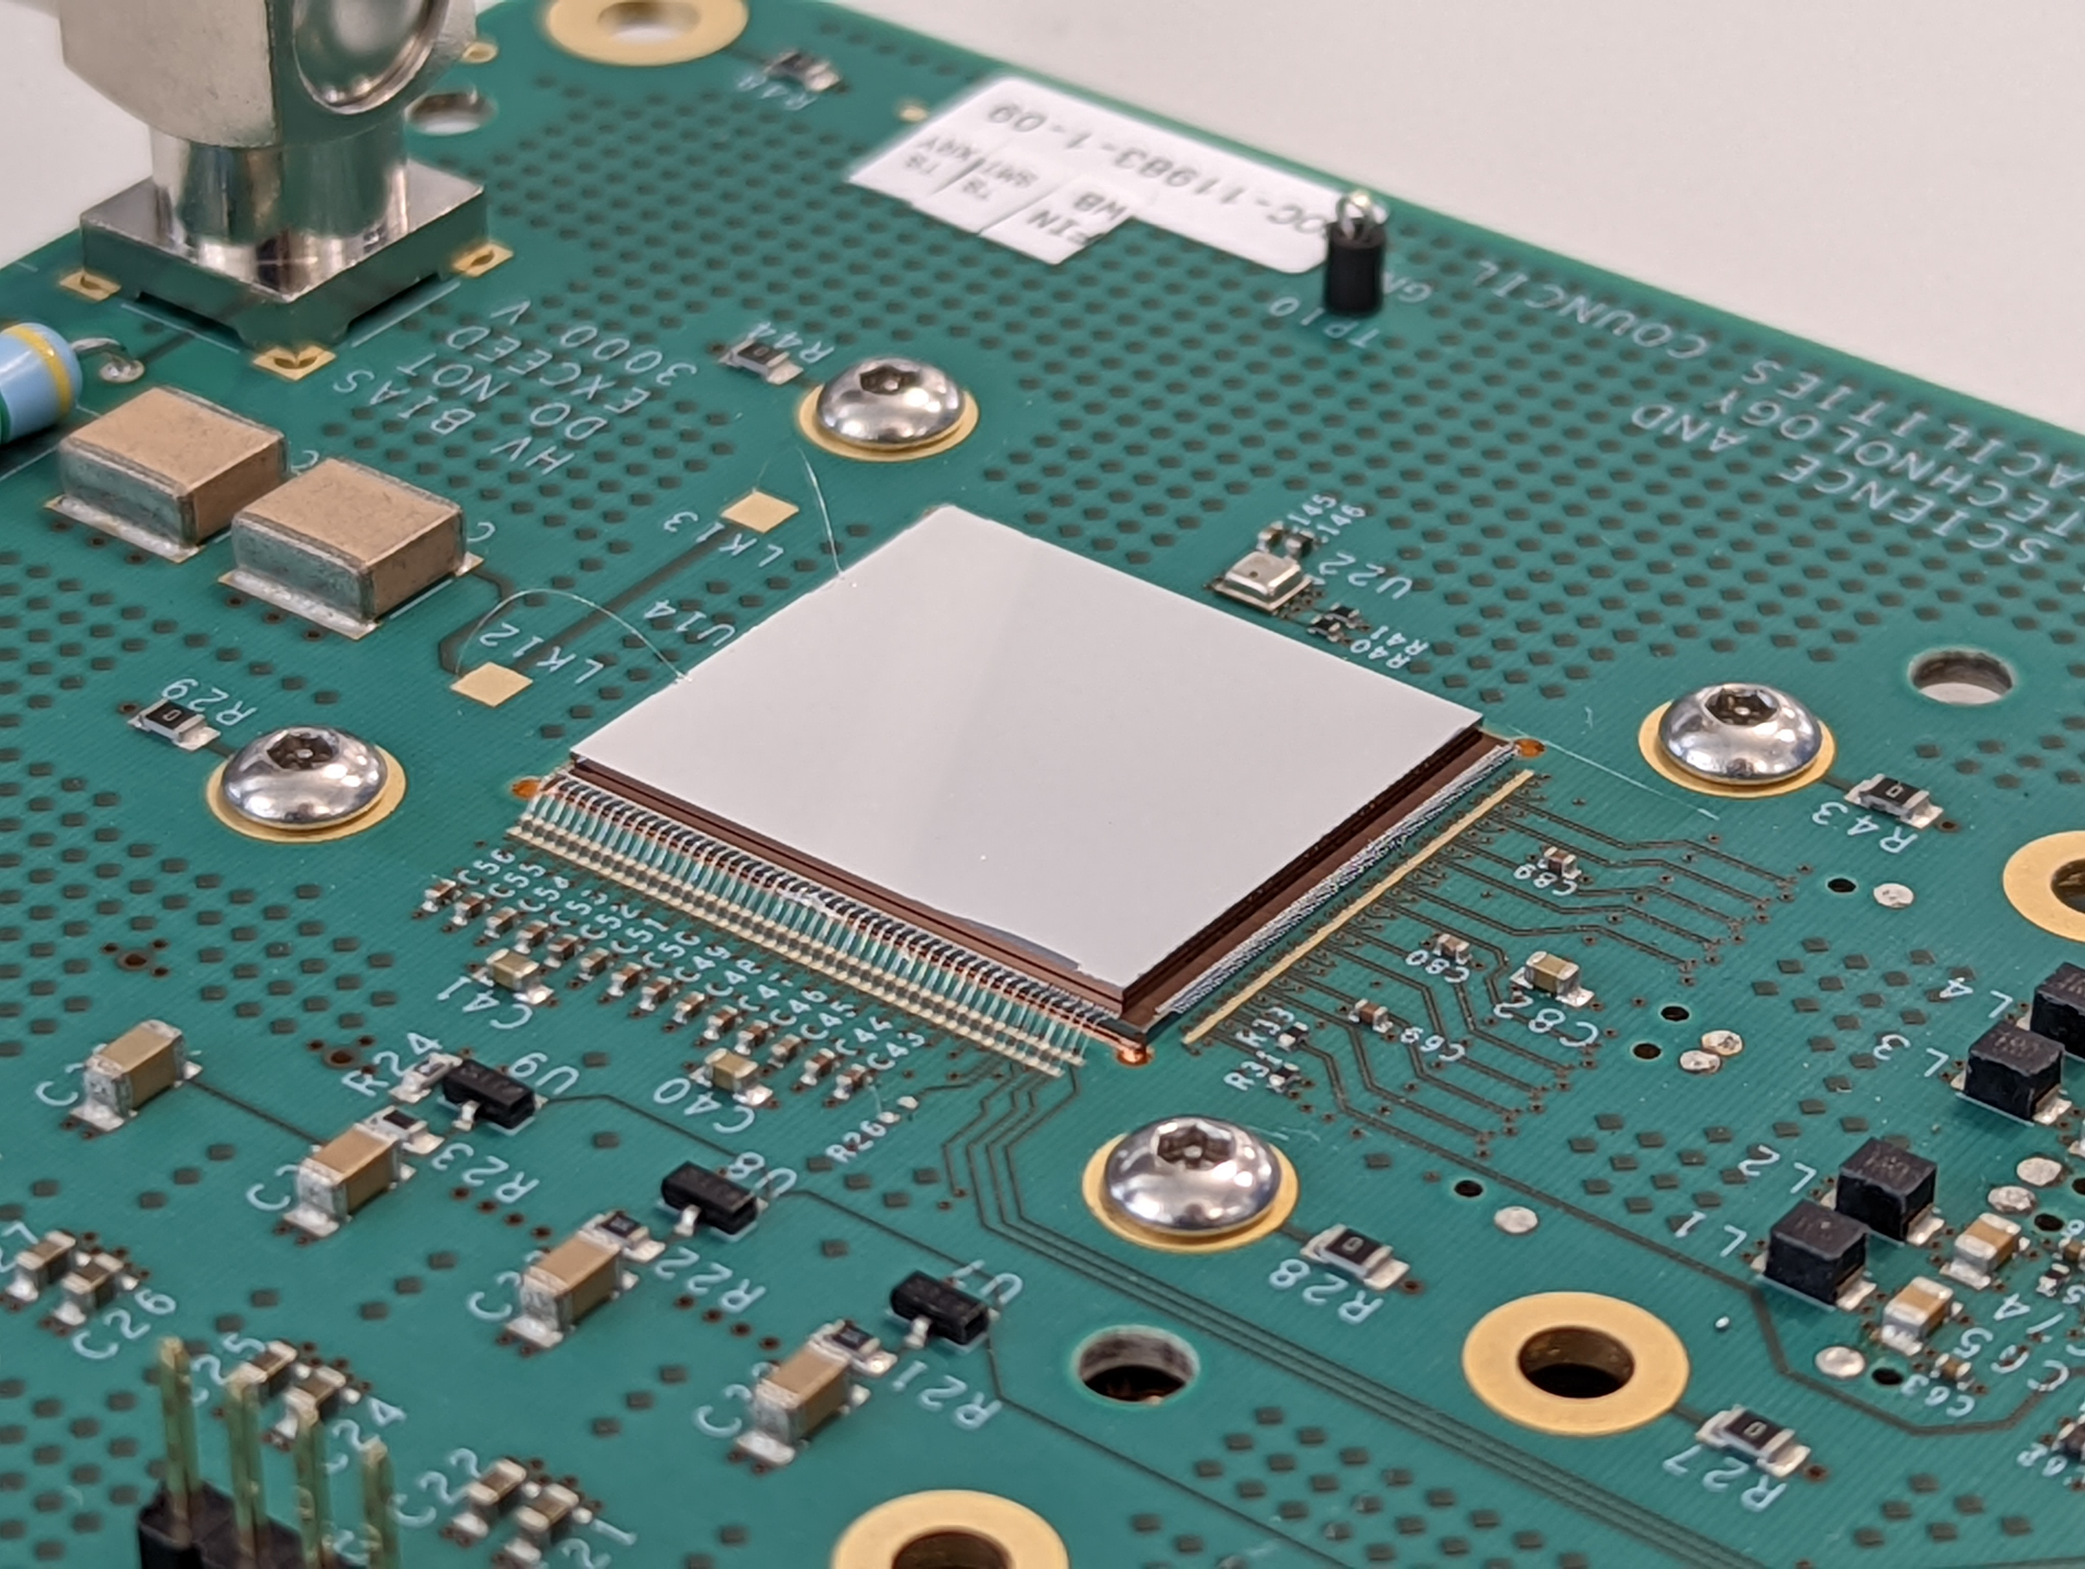
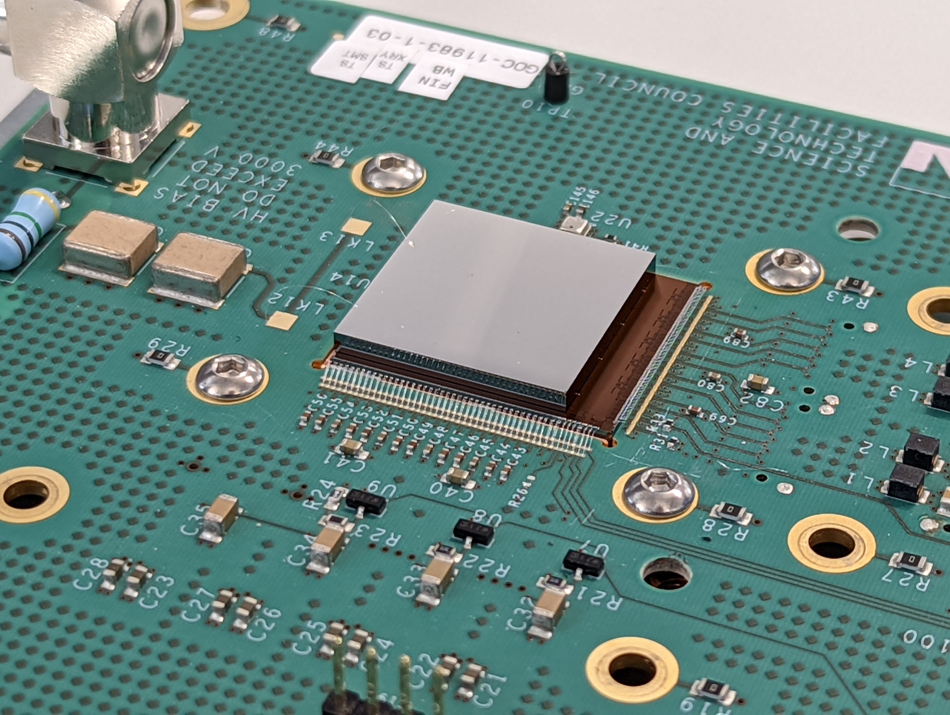

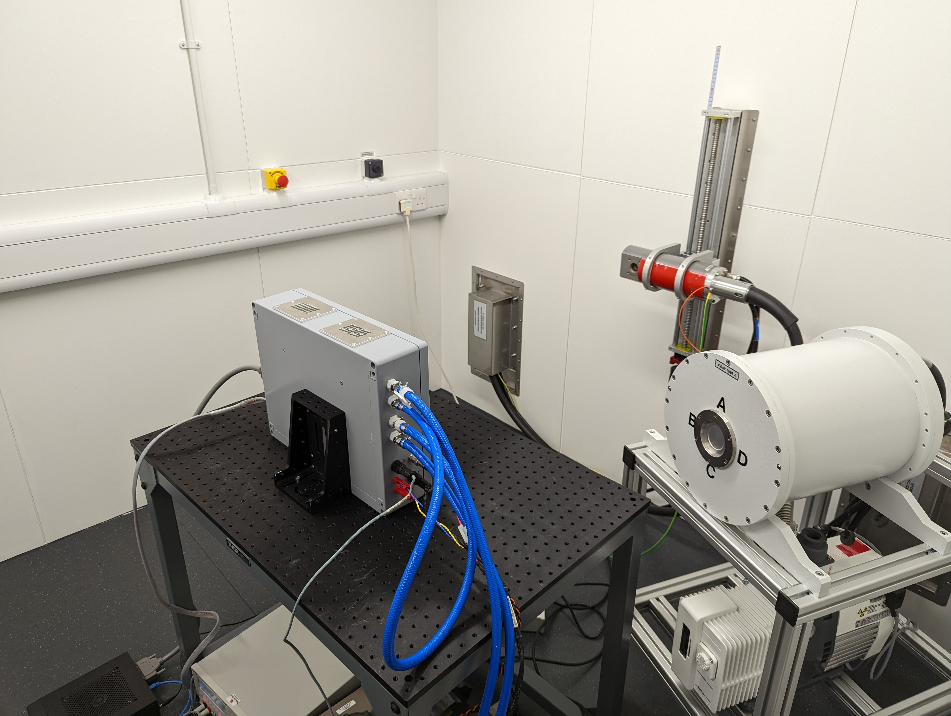
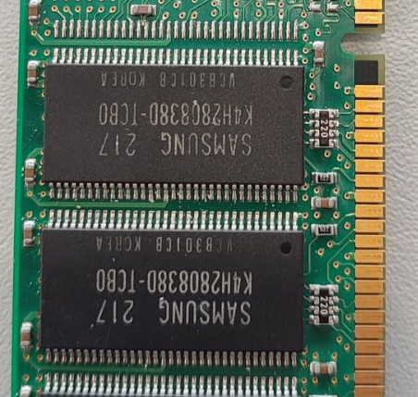
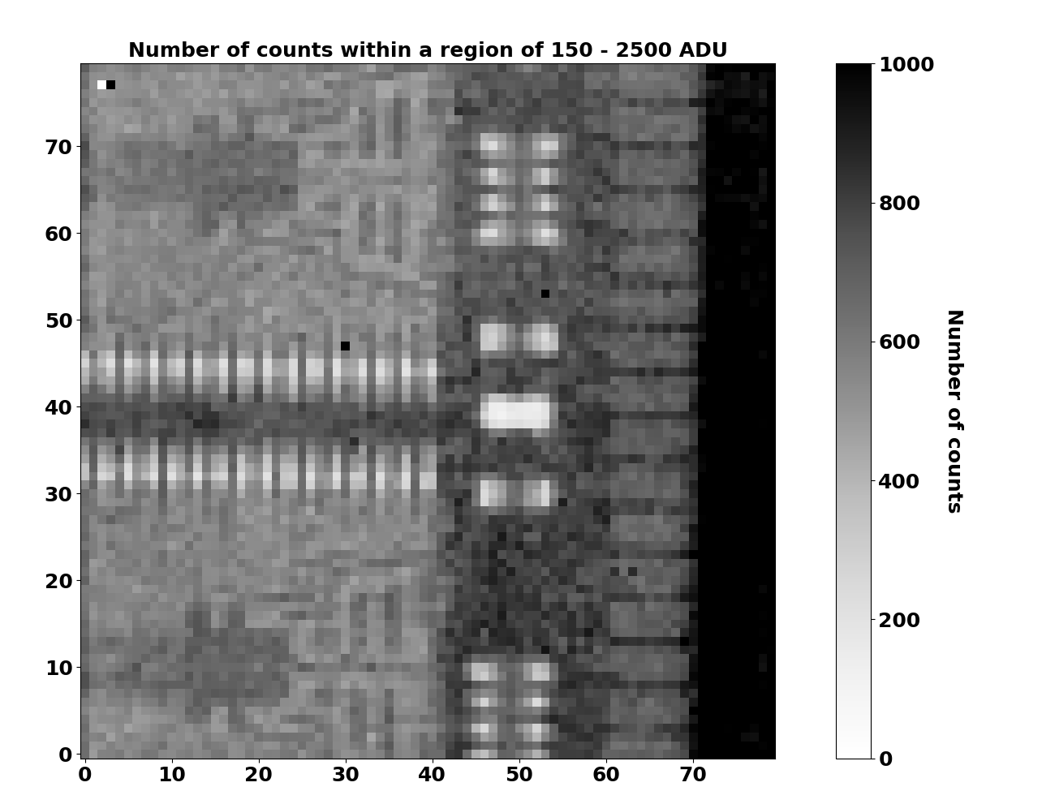
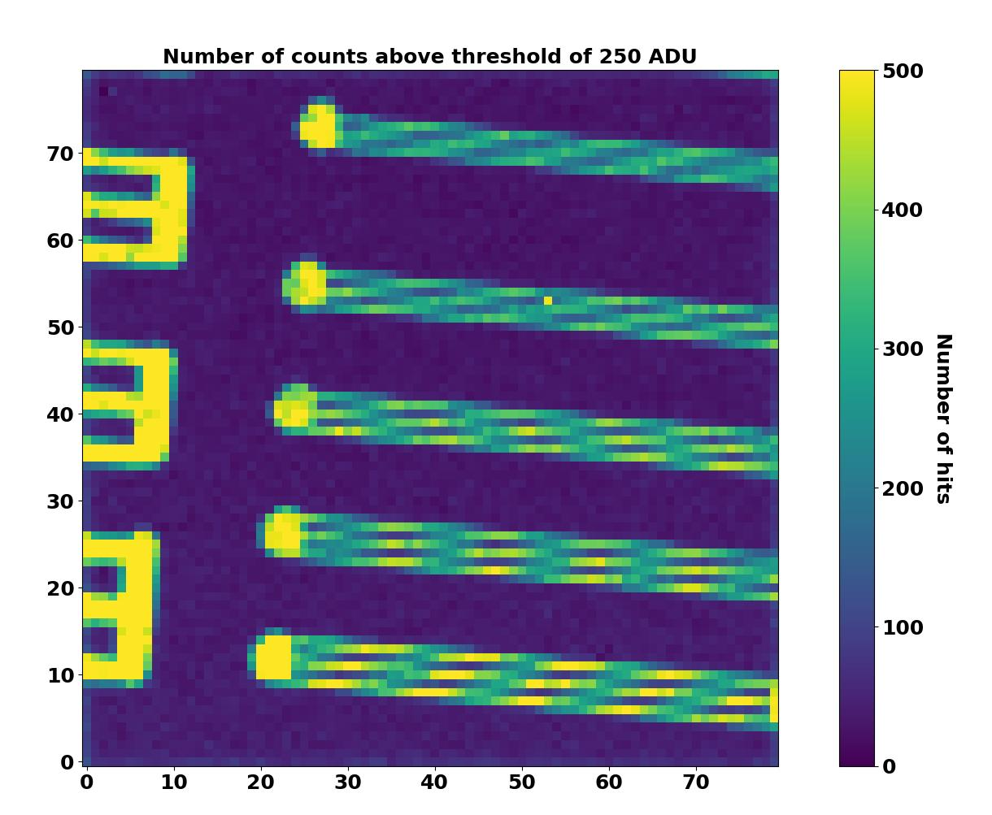
Detector Testing
  Characterisation of CdZnTe performed by Ben Cline (ben.cline@stfc.ac.uk)
    Poster: HEXITEC-MHz – Spectroscopic Imaging at a continuous 1MHz Frame Rate 27/06
  Initial X-Ray radiation testing encouraging
GaAs
CdZnTe
  CdZnTe (CZT), GaAs:Cr and p-type Si sensors bonded to ASIC
Readout PCB & ASIC in climate-controlled box
in continuous X-ray beam (W tube)
Transmission X-ray
Imaging of DDR RAM
Line pair per
mm slide

Slide 18
Next Steps
  DAQ Firmware nearing readiness for fast data output on one channel initially (single division, 4x80 vertical slice), followed by all channels aligned
  LOKI Control Plane SoM carrier and ASIC carrier subject of redesigns for more compact form factors
  Characterisation will continue with other bonded sensors in the coming months
  Beamline testing at DIAMOND scheduled August 2022
Notes:
When talking about LOKI, mention made to target multiple applications. Extra slide may include potential designs?

Slide 19

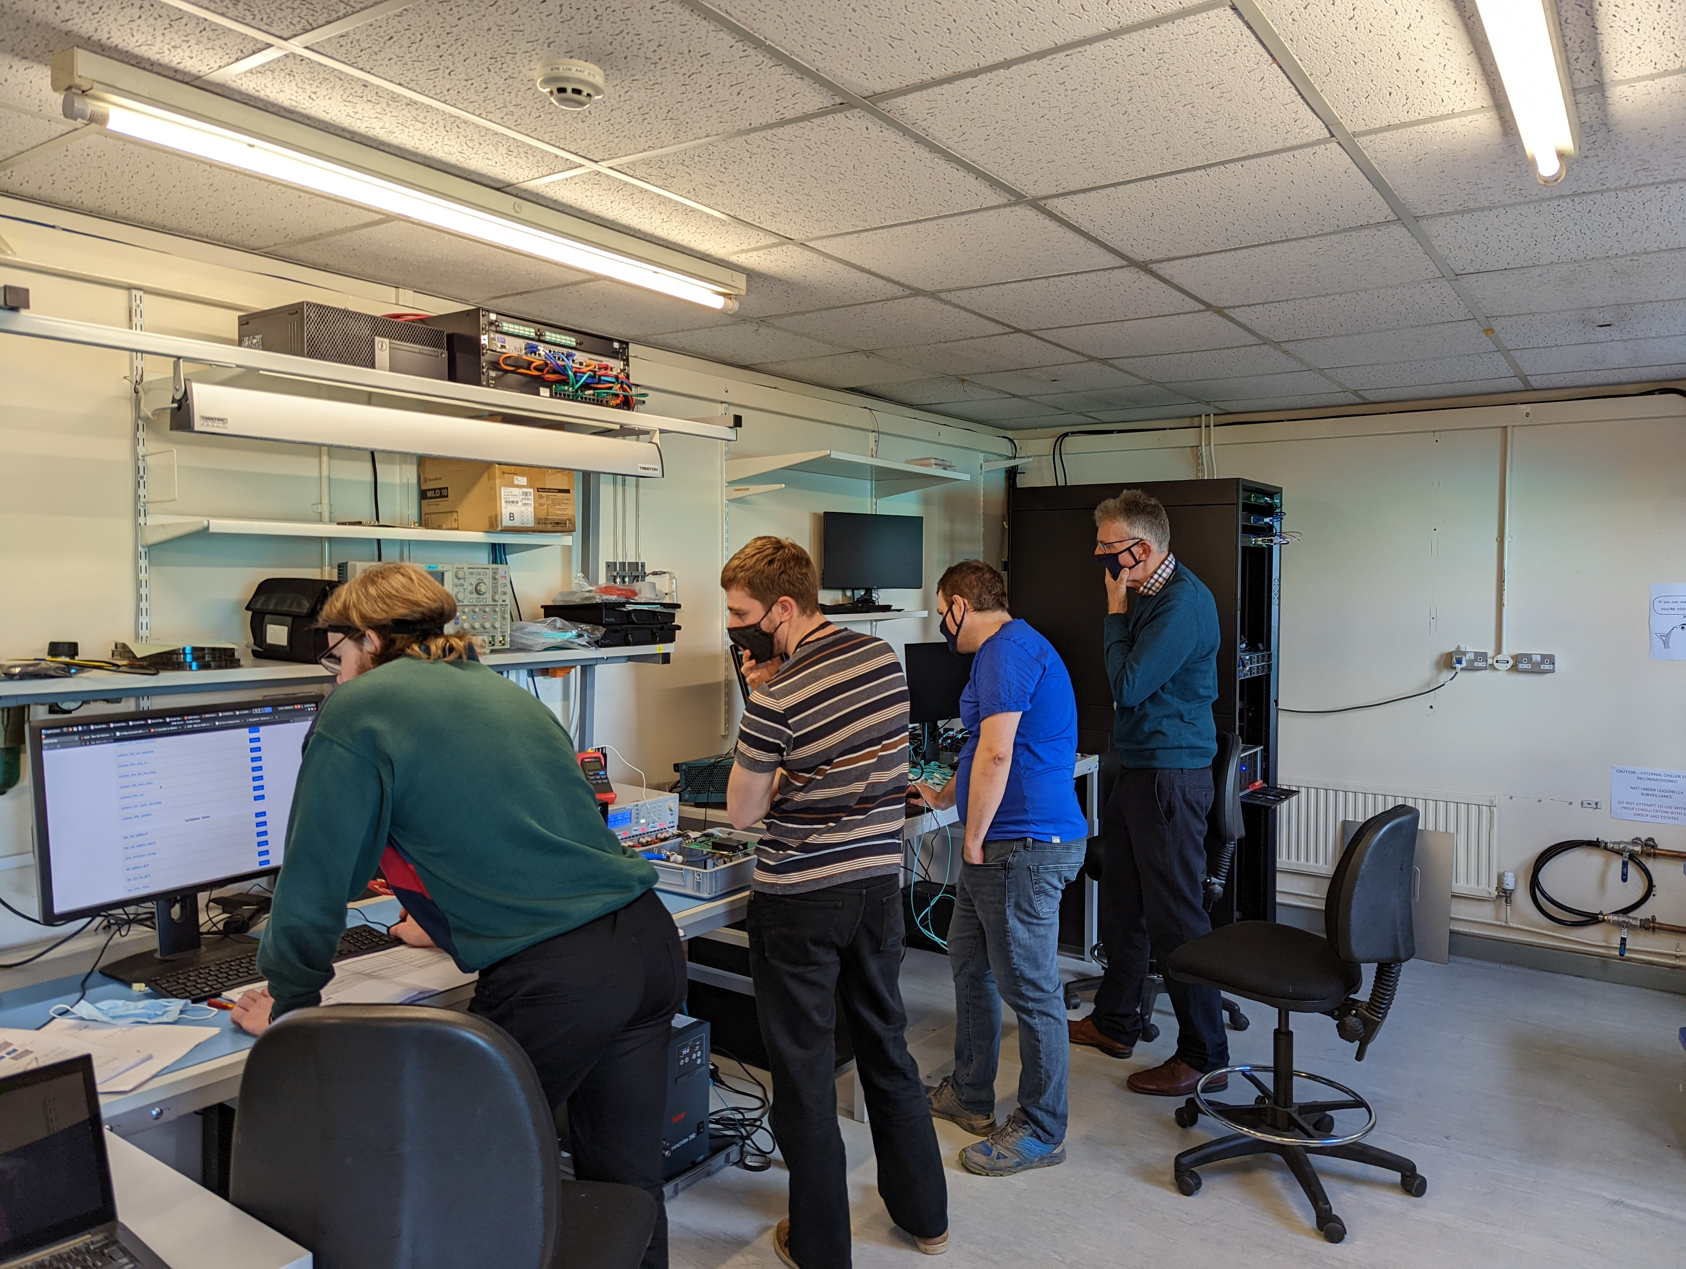
Summary
  HEXITEC-MHz is a fully spectroscopic X-ray imaging ASIC
    80 x 80 pixel array @250µm pitch
    Continuous digital readout at 1MHz
    Output to DAQ via 20x 4.1Gbps Aurora Links
  DAQ system has shown that ASIC can be operated and fast-data links established
  Tests underway to characterise CdZnTe; GaAs:Cr and p-type Si to follow
  In coming months, firmware for first-stage FPGA will allow fast image readout, and beamline tests will begin
If interested in access to this technology, please get in contact!
joseph.nobes@stfc.ac.uk
Joseph Nobes, Detector & Electronics Division
Notes:
When talking about LOKI, mention made to target multiple applications. Extra slide may include potential designs?

Slide 20
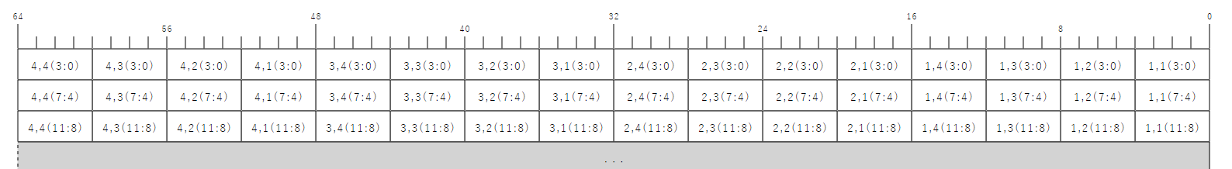
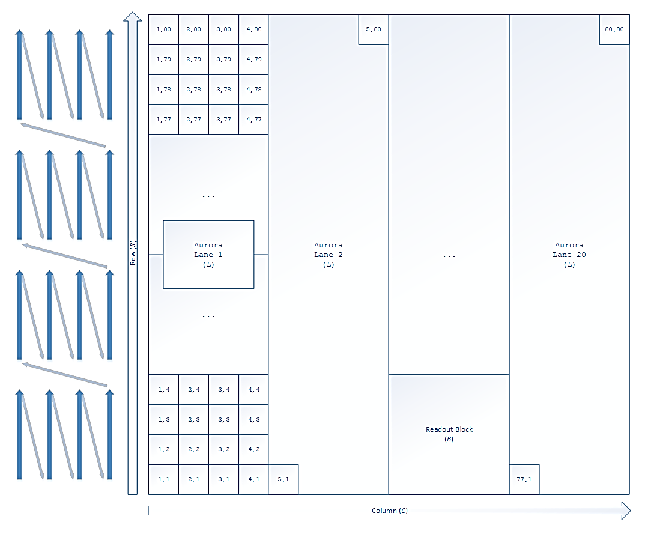
Ordering of nibbles received by 1st stage FPGA
Example of full set of 3 64-bit packets to complete
a single 4x4 grid of 12-bit pixels
Required 20 times for each division (60 packets)

