Slide 1

Timepix detectors in space:
From radiation monitoring in low earth orbit to astroparticle physics
B. Bergmann
Institute of Experimental and Applied Physics, Czech Technical University in Prague
Benedikt.bergmann@utef.cvut.cz

Slide 2
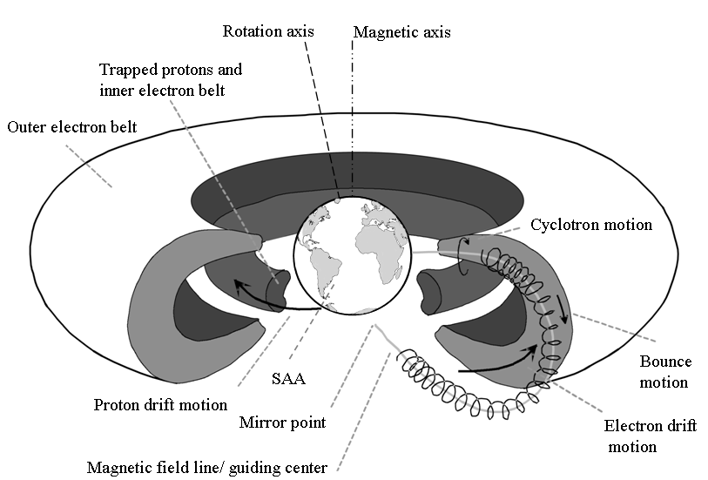
Radiation environment in LEO
E_{p} < 400 MeV
E_{e} < 7 MeV
Mauk, B.H., Fox, N.J., Kanekal, S.G. et al. Space Sci Rev (2013) 179: 3.

Slide 3
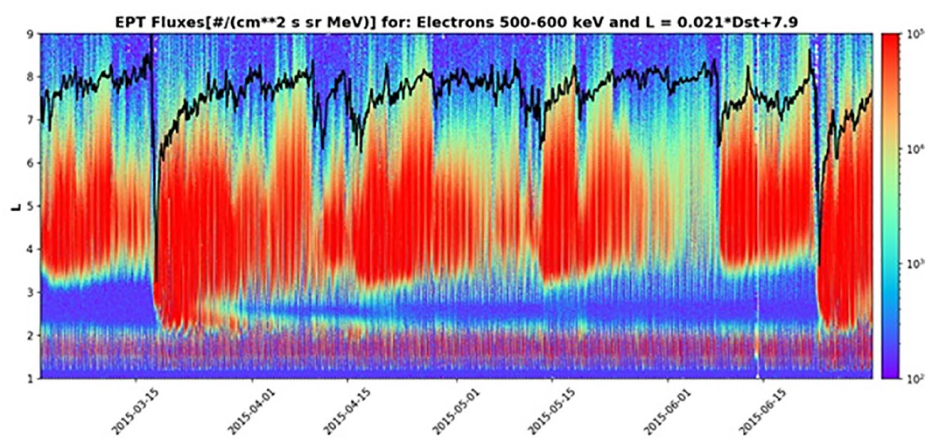
Temporal fluctuations of the radiation belts
Radiation belts structure highly dynamic.
Solar Flares
Solar Particle Events
Interplanetary shock waves
...
V. Pierrard et al., “Electron dropout events and flux enhancements associated with geomagnetic storms observed by PROBA-V/Energetic Particle Telescope from 2013 to 2019”, Journal of Geophysical Research: Space Physics 125, e2020JA028487 (2020).
https://doi.org/10.1029/2020JA028487

Slide 4
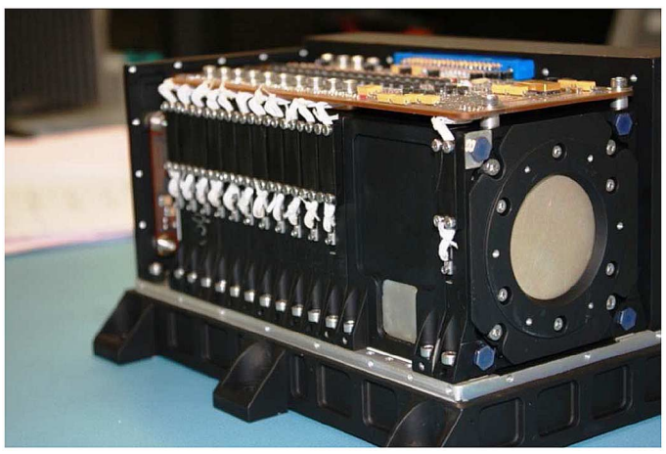
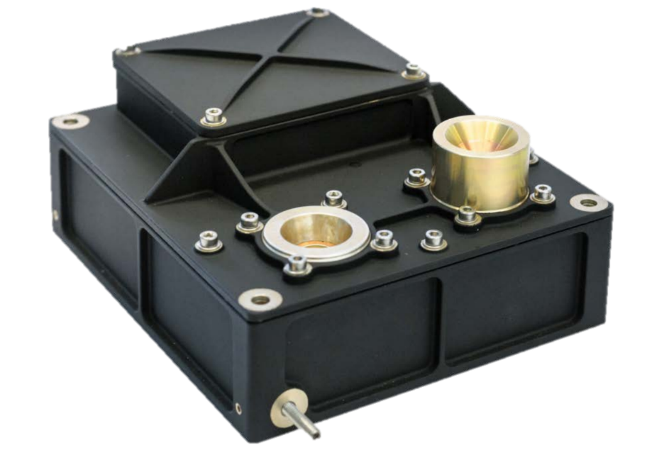
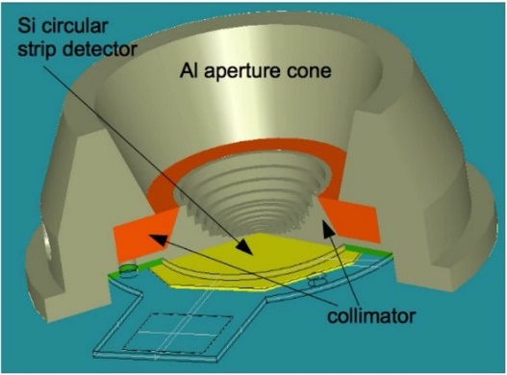
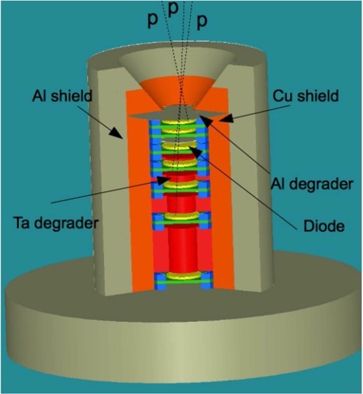
Instruments for measurements in LEO
EPT (Energetic Particle Telescope)
Mass: 4.6 kg
Consumption: 5.6 W
Next Generation Radiation Monitor (NGRM)
Mass ~ 1 kg
Consumption ~1-2 W
ICARE-NG:
Mass: 2.4 kg
Consumption: 3 W

Slide 5
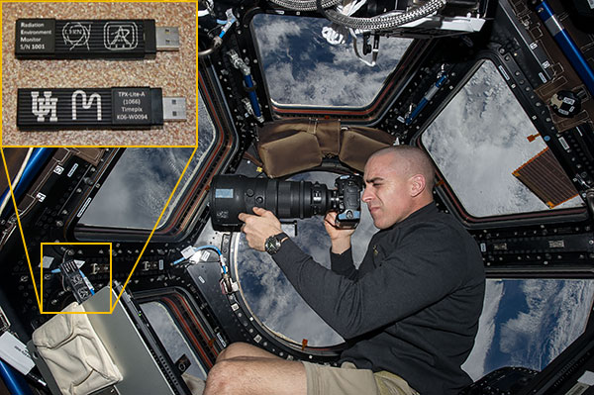
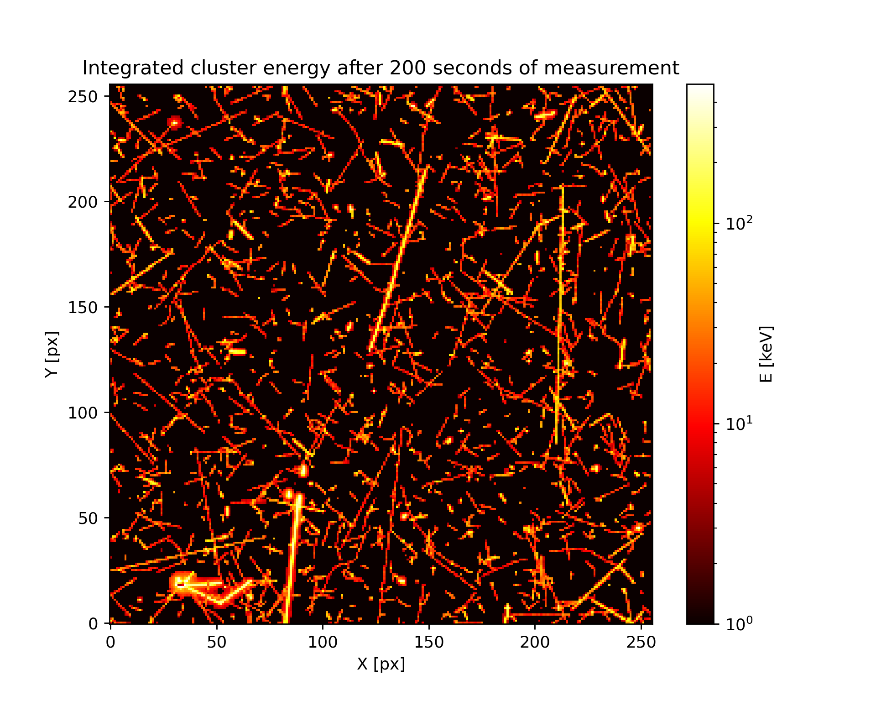
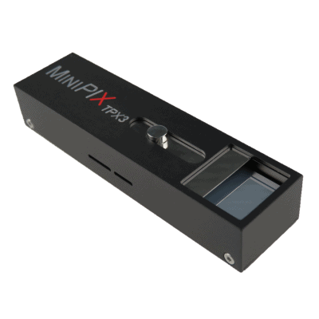

Timepix devices in Space
Single-layer particle discrimination
Small dimensions and low mass
Large field of view
Current missions (chronologically sorted):
REM on ISS (since 2012: different versions; MiniPIX TPX3 by Advacam deployed in 2021)
SATRAM on Proba-V (launch in 2013, 820 km)
LUCID-Timepix (2014-2017, 635 km)
VZLUSAT-1 (launch in 2017, 510 km)
RISESAT (launch in 2019, 500 km)
VZLUSAT-2 (launch in 2022, 500 km, CdTe 2 mm)
Space radiation in LEO measured by TPX3, integrated frame, 200 s, energy display
Minipix TPX3 and shielding by ADVACAM
*
First deployment of TPX3 detector in space
Notes:
The key advantage of Timepix is that if provides particle species separation by track analysis in single layers.
This allows a production of radiation monitors with small dimension and low mass, while providing a large field of view and a large dynamic range.
The first Timepix in Space was in 2021 the USB lite on ISS, which was then soon followed by SATRAM which was the first Timepix deployed in open space.

Slide 6



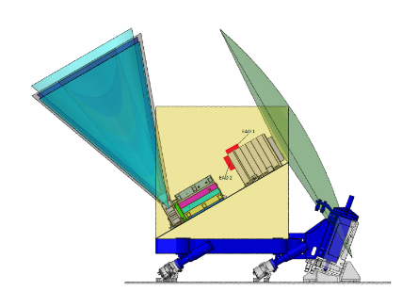
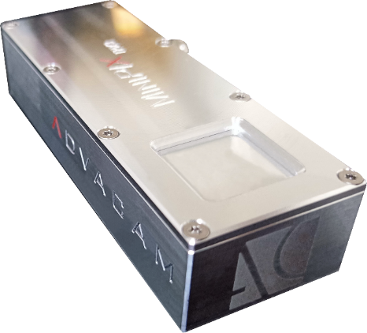
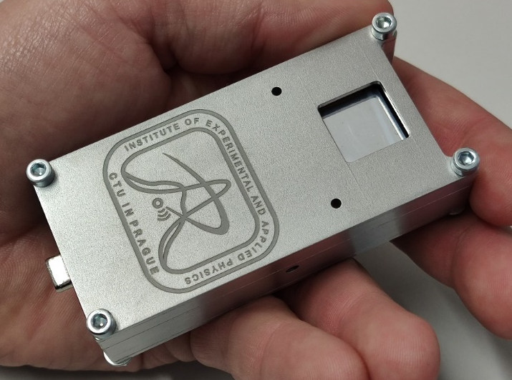
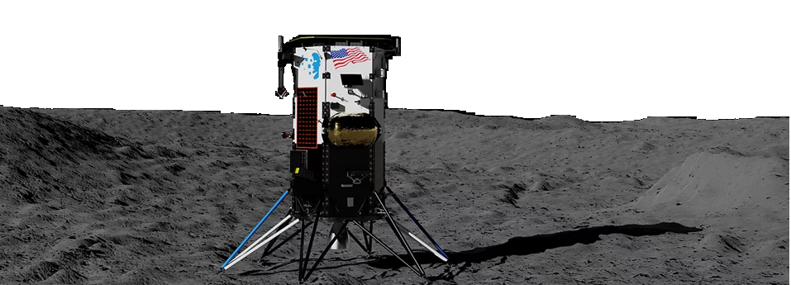

(Near future) flights
*⁾ St. Gohl et al., “A Miniaturized Radiation Monitor for Continuous Dosimetry and Particle Identification in Space“, JINST 17 C01066 (2022).
MIRAM (Miniaturized Radiation Monitor)*⁾
GOMX-5 cubesat mission (12U, 20 kg) – 2023
2 Modules outside of the Lunar Gateway as a part of the ESA ERSA (European Radiation Sensors Array) – 2024
Scientific payload for ASE EL3 rover (neutron spectrometer for water mapping on the moon)
MiniPIX TPX3:
IM Nova-C lunar landing module, carried by a SpaceX Falcon 9 rocket 2022/23 (Minipix Timepix3 will measure during the entire duration of the mission)
2x Minipix TPX3 silicon sensor with hardened shielding and space RO port by ADVACAM
Two detector units
Nova-C lunar landing module by Intuitive Machines

Slide 7
C. Granja et al., “The SATRAM Timepix spacecraft payload in open space on board the Proba-V satellite for wide range radiation monitoring in LEO orbit”, Planetary and Space Science 125, pp. 114-129, ISSN 0032-0633 (2016).
https://doi.org/10.1016/j.pss.2016.03.009
Timepix
256 x 256 pixels
pixel pitch 55 µm
Energy measurement in each pixel
Sensor: Si 300 µm
SATRAM
Space Application of Timepix Radiation Monitor

Slide 8
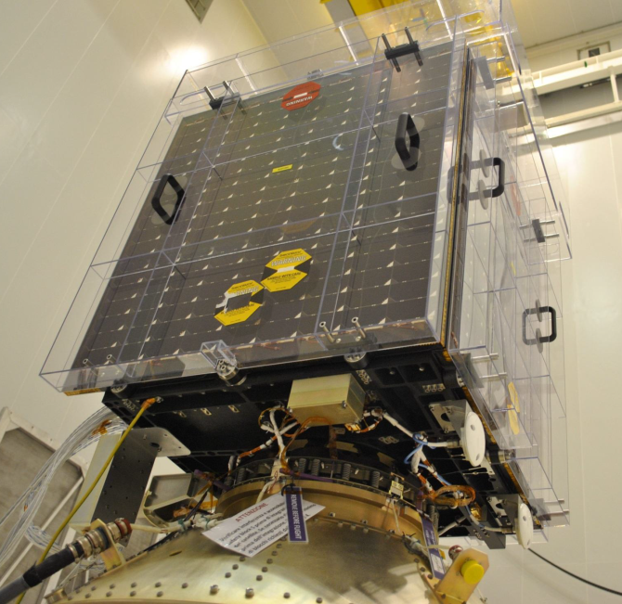
SATRAM:
Space Application of Timepix Radiation Monitor
First Timepix in open space
Power consumption of 2.5 W
Total mass 380 g (107 x 70 x 55 mm)
SATRAM is a platform technology demonstrator
Proba-V
Minisatellite (158 kg)
Altitude ~ 820 km (LEO)
101.21 minutes orbit duration
Inclination 98.6°
Sun-synchronous
Launched 7th March 2013

Slide 9
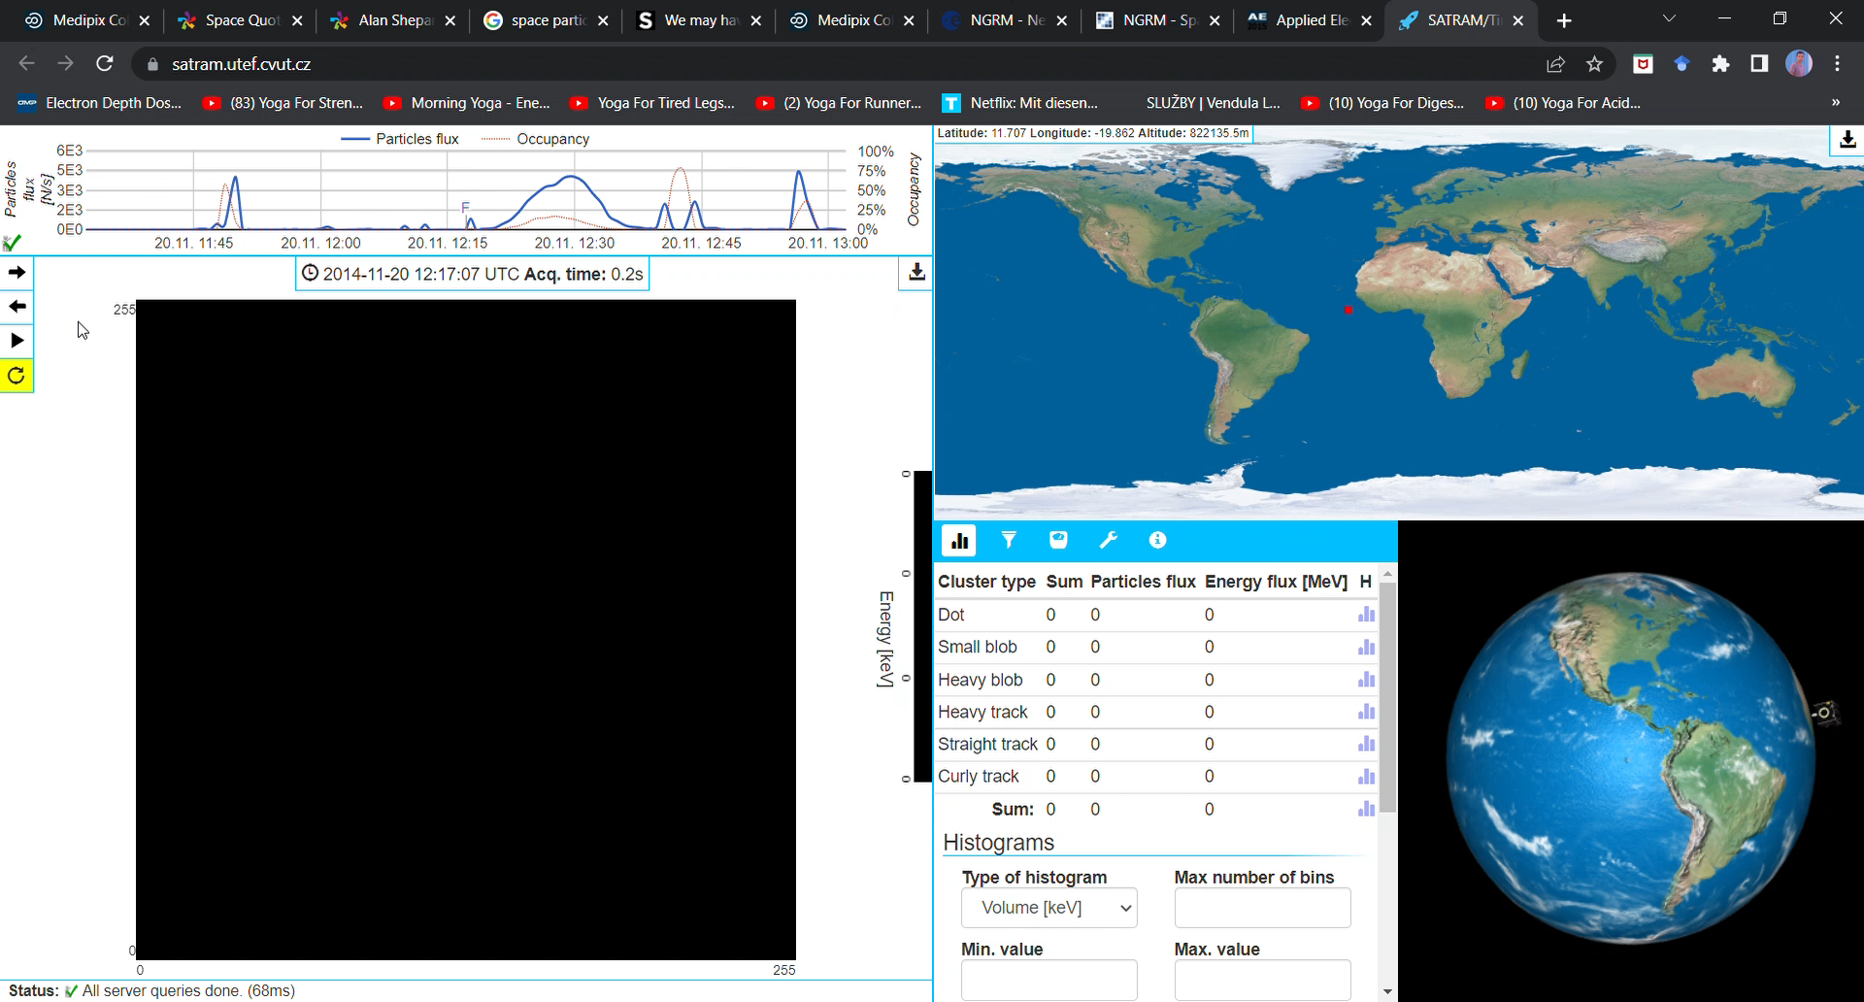
https://satram.utef.cvut.cz/

Slide 10
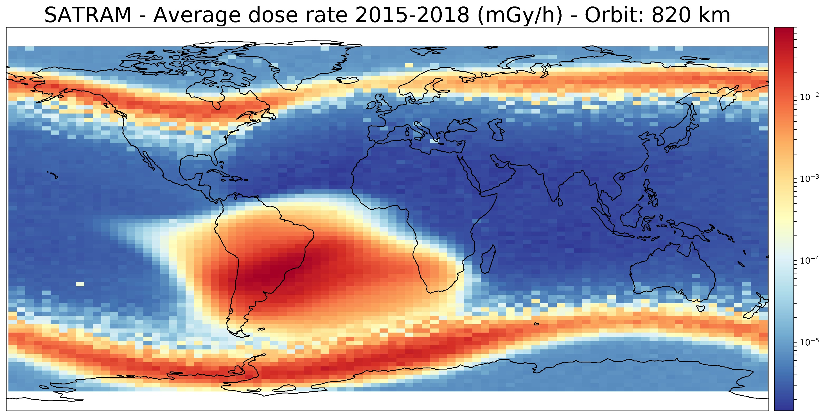
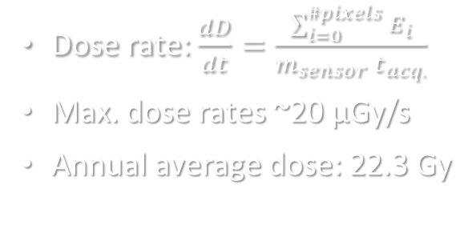
Dose rate: $\frac{dD}{dt}=\frac{\sum_{i=0}^{\#pixels}{E_{i}}}{m_{sensor} t_{acq.}}$
Max. dose rates ~20 µGy/s
Annual average dose: 22.3 Gy
Notes:
You can see there the typical structures which are the polar horns (outer belt) and the SAA (inner belt)

Slide 11
Solar proton event
September 10, 2017
Reference period
SPE - Sept. 2017

Slide 12
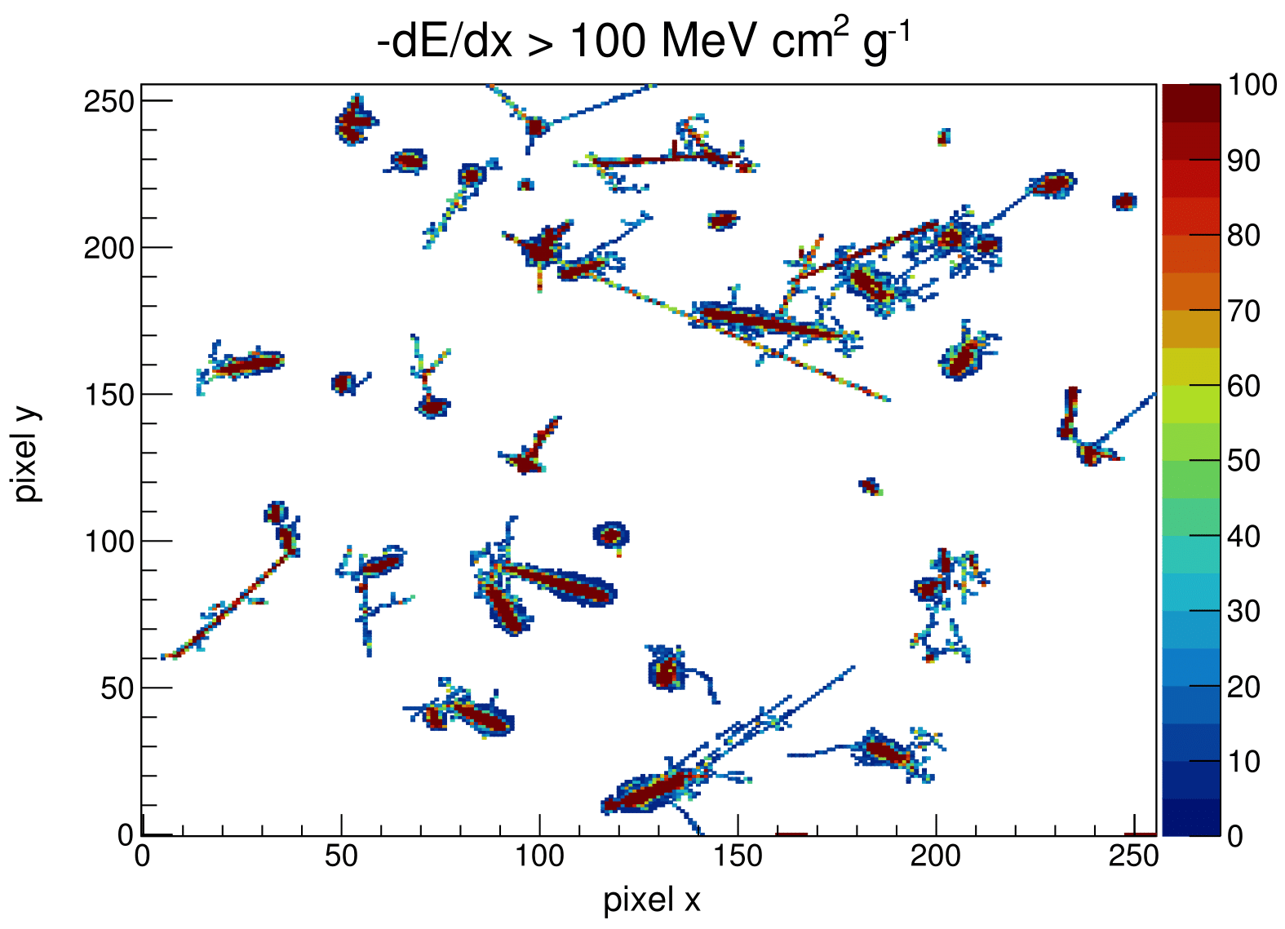
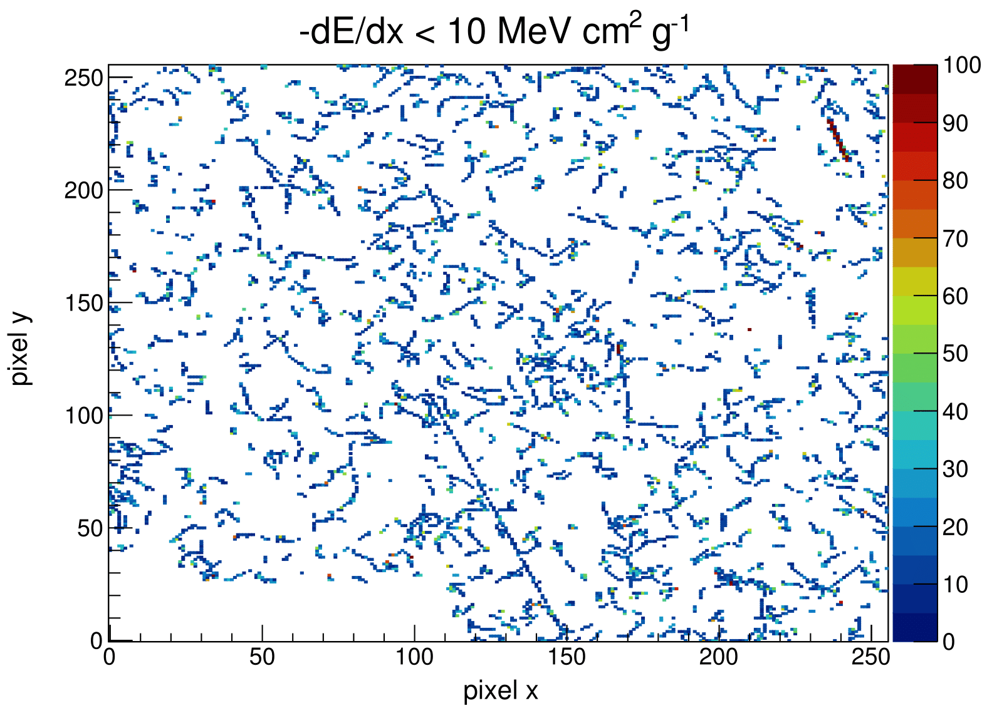
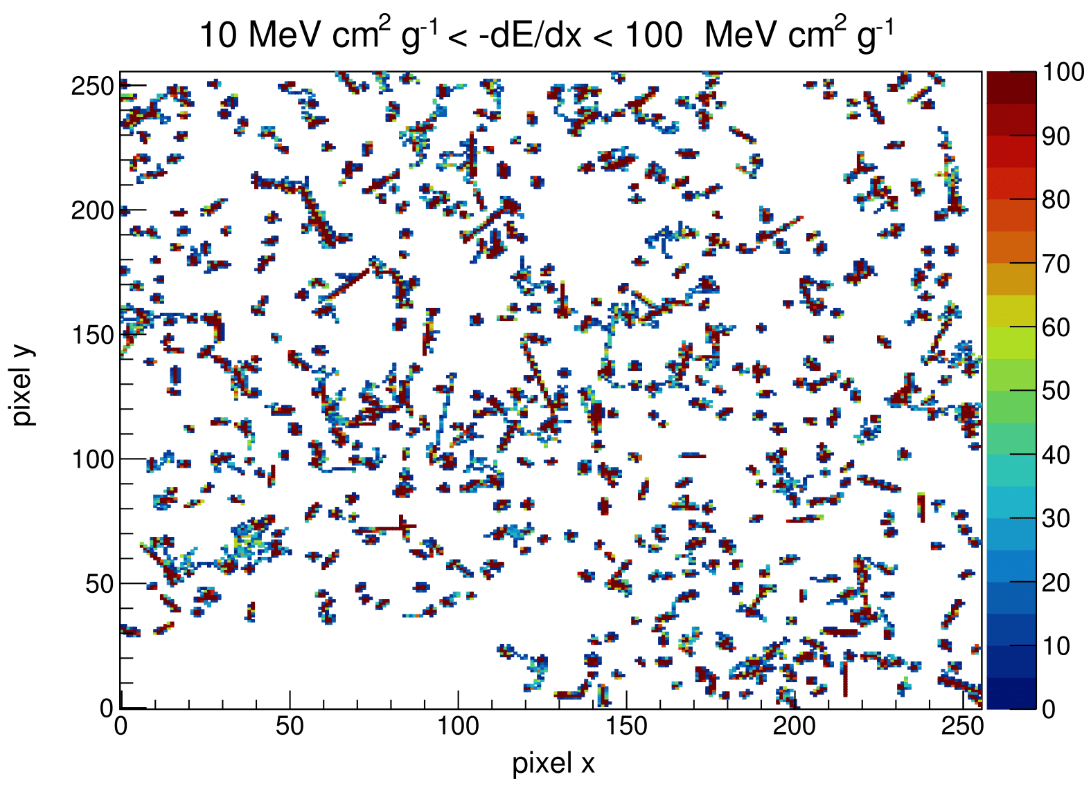
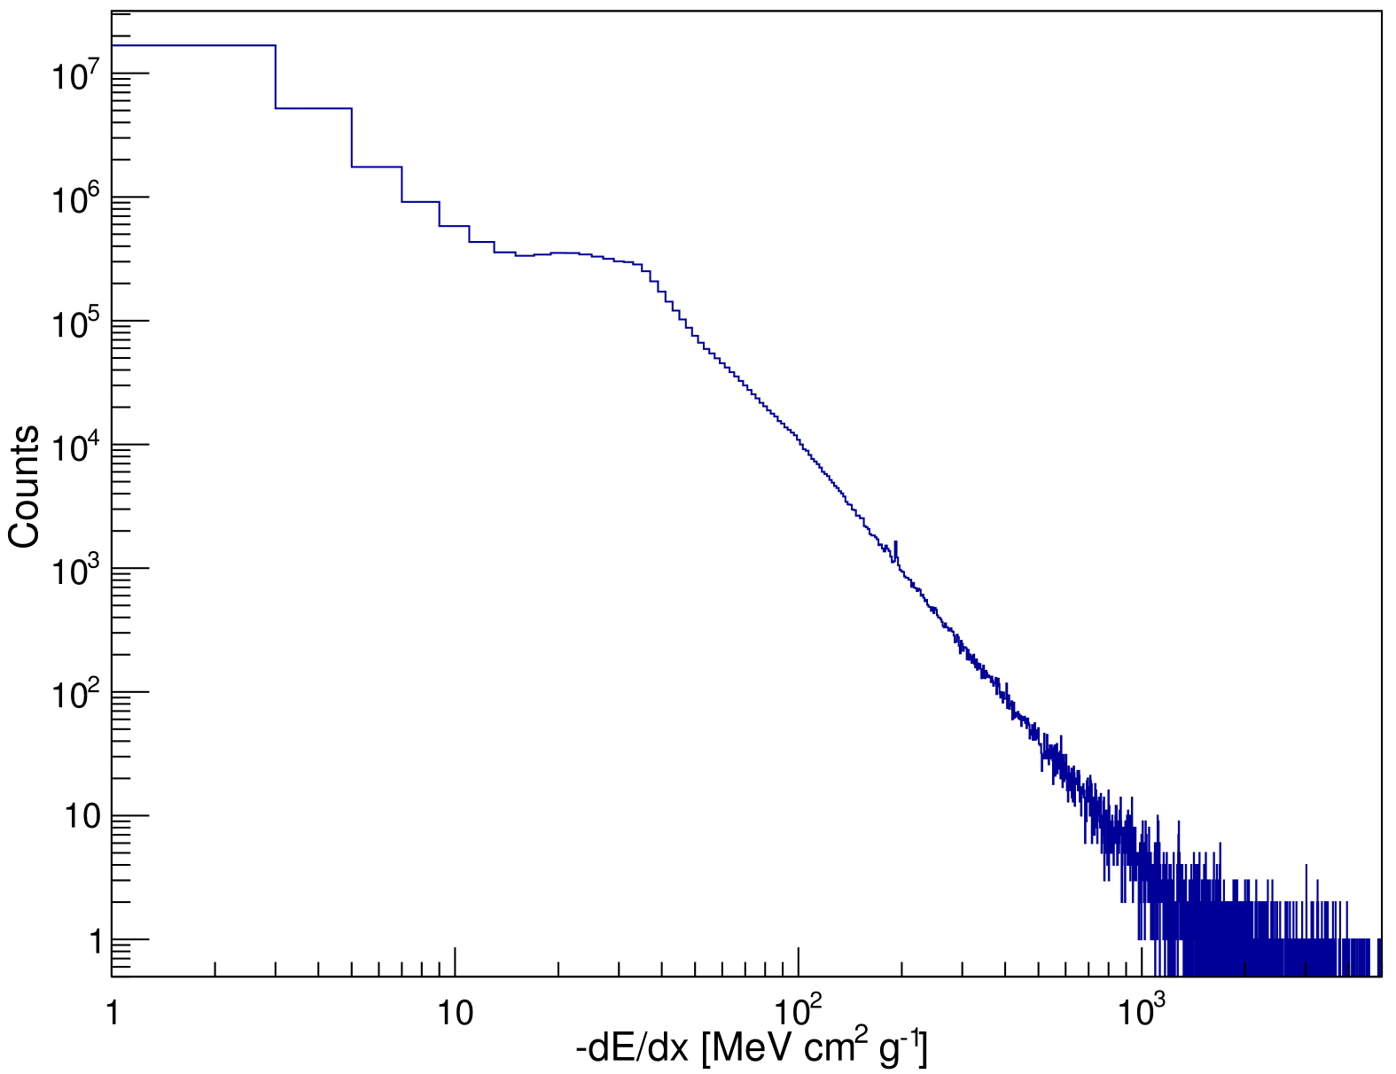
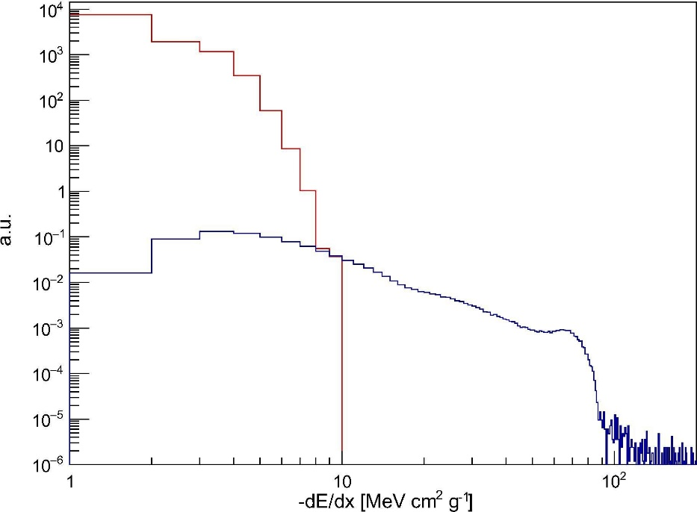
dE/dX and particle classification
Simulation
e⁻
p⁺
St. Gohl et al., “Study of the radiation fields in LEO with the Space Application of Timepix Radiation Monitor (SATRAM)”, Advances in Space Research 63, Issue 5, pp. 1646-1660, (2019).
HZE

Slide 13
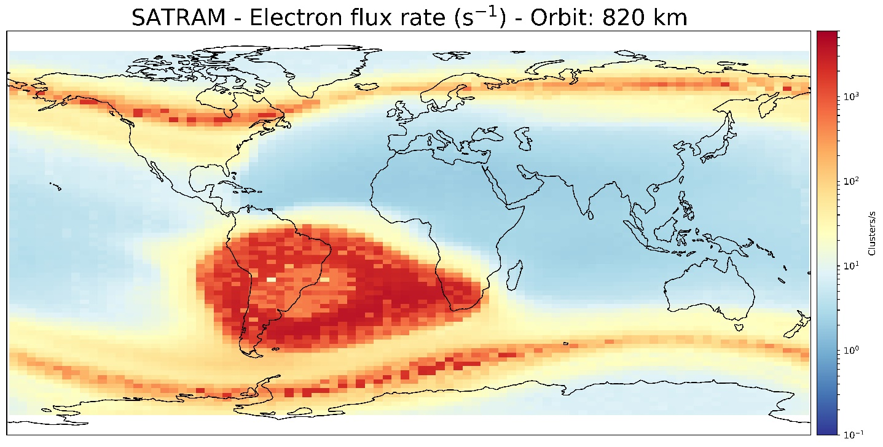
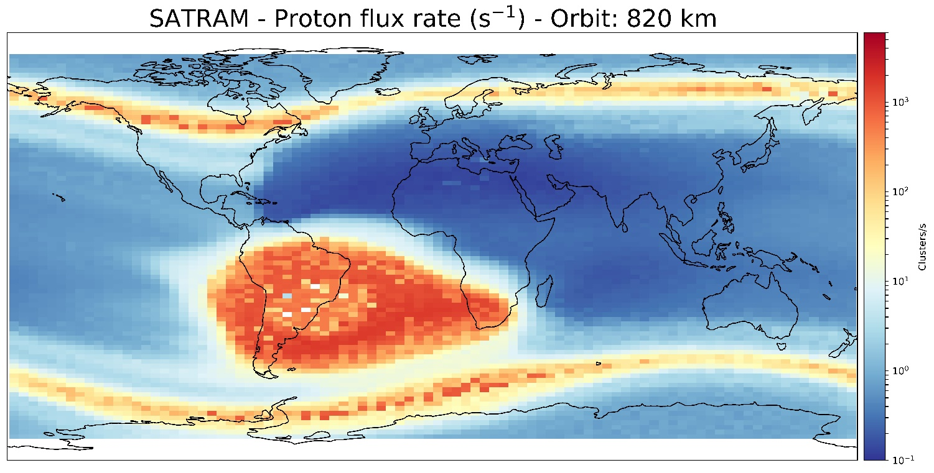
Average electron and proton flux rates for 2015-2018
St. Gohl et al., “Study of the radiation fields in LEO with the Space Application of Timepix Radiation Monitor (SATRAM)”,
Advances in Space Research 63, Issue 5, pp. 1646-1660 (2019).
For the analysis only frames whith an occupancy of less than 20% and t_{acq}>= 0.2 s were selected
Less track overlap
Proper particle identification
Occupancy and frame-length cuts strongly reduced available frames in SAA

Slide 14
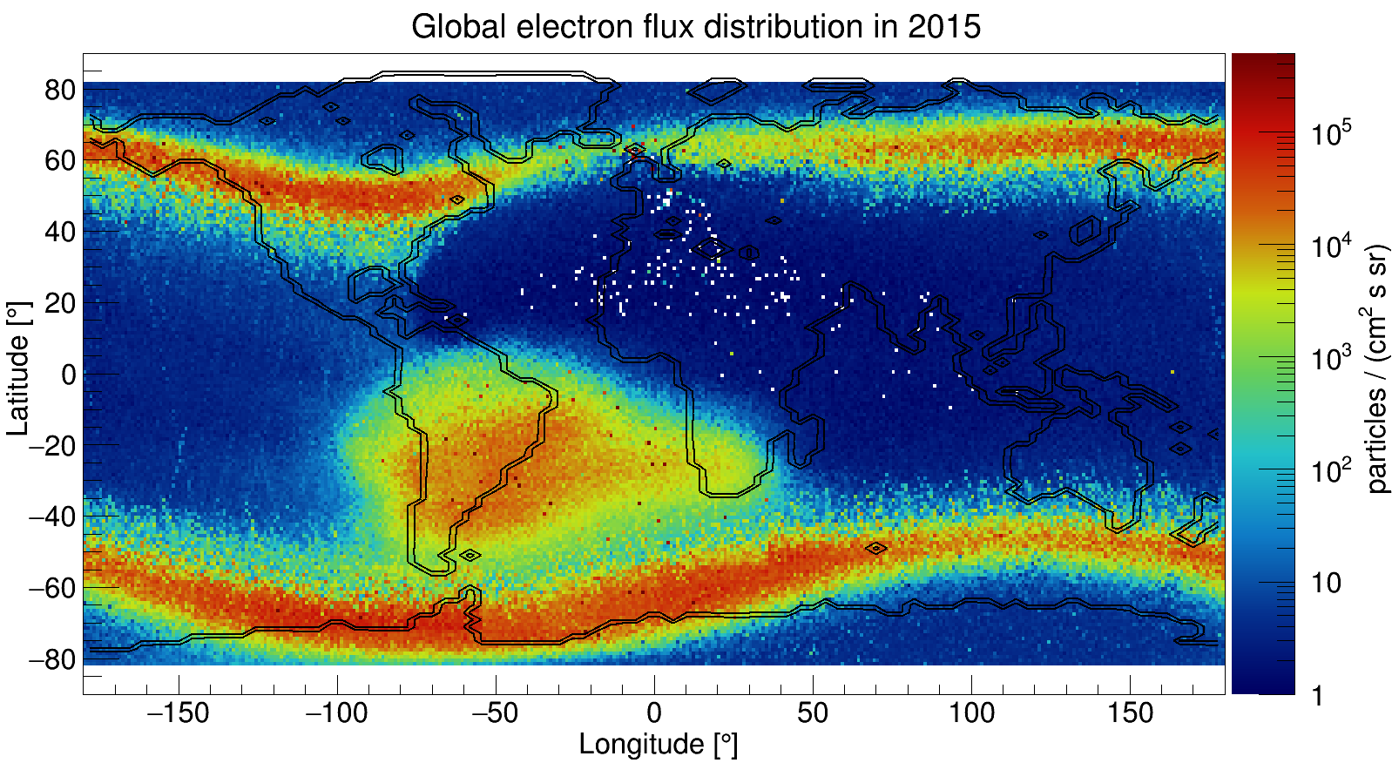
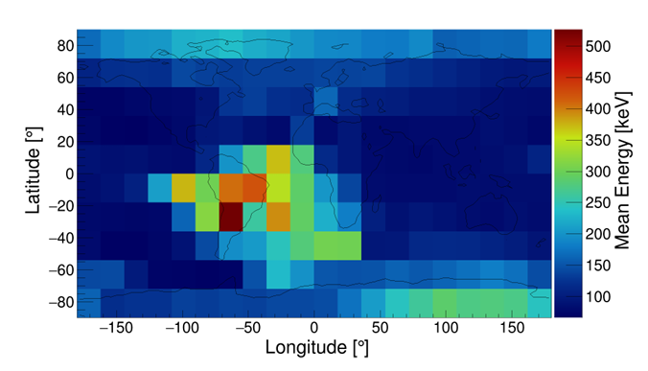
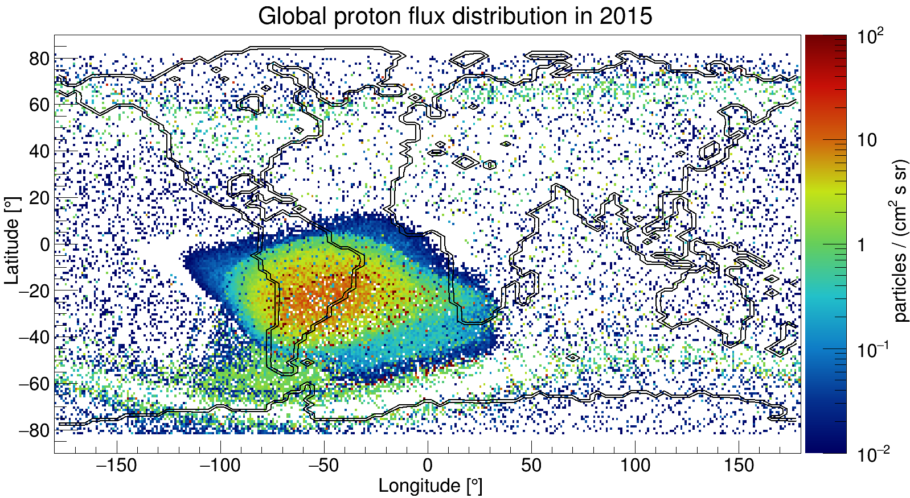
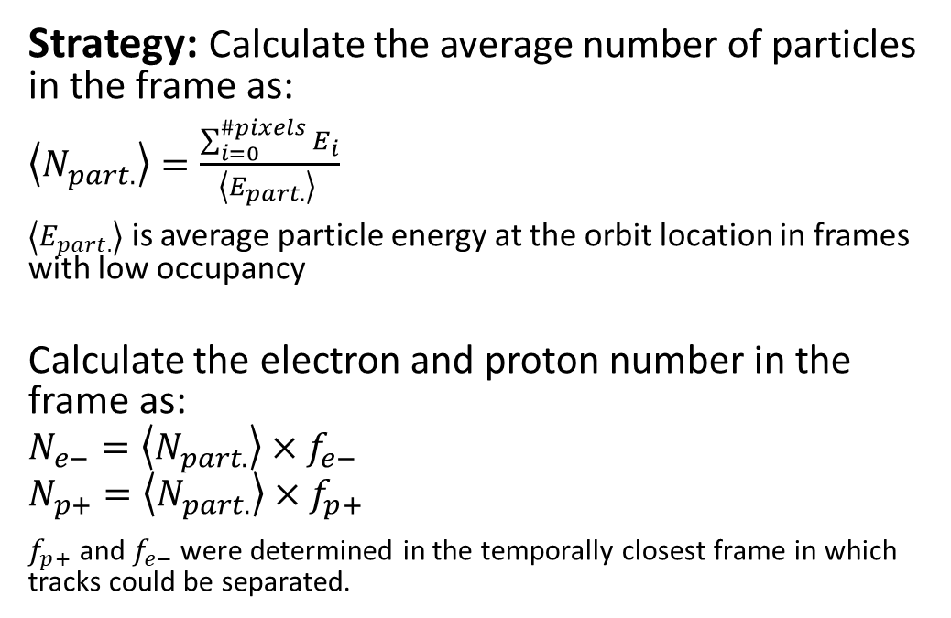

SATRAM electron flux measurement:
Interpolation method based on statistical consideration
$$\left\langle E_{part.}\right\rangle$$
Strategy: Calculate the average number of particles in the frame as:
$\left\langle N_{part.}\right\rangle =\frac{\sum_{i=0}^{\#pixels}{E_{i}}}{\left\langle E_{part.}\right\rangle }$
$\left\langle E_{part.}\right\rangle$ is average particle energy at the orbit location in frames with low occupancy
Calculate the electron and proton number in the frame as:
$$N_{e−}=\left\langle N_{part.}\right\rangle ×f_{e−}$$
$$N_{p+}=\left\langle N_{part.}\right\rangle ×f_{p+}$$
$f_{p+}$ and $f_{e−}$ were determined in the temporally closest frame in which tracks could be separated.

Slide 15
Improving particle identification and spectroscopy using machine learning

Slide 16


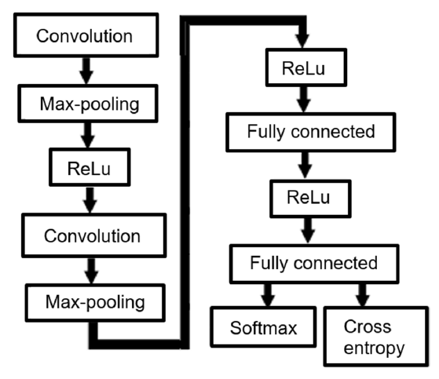
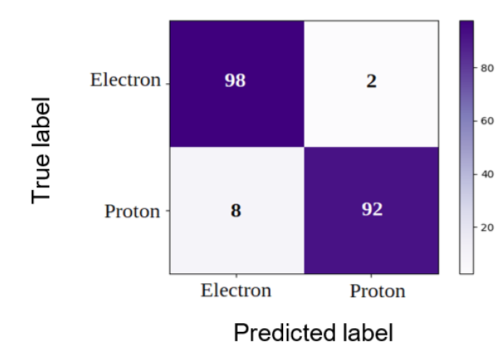
CNN – convolution neural network for separation of electrons and protons
Ground truth - simulation:
Spherical source with cosine distributed angles
10 Mio electrons from 0.4 to 5 MeV
10 Mio protons from 17 to 200 MeV
M. Ruffenach et al., “A new technique based on convolutional neural networks to measure the energy of protons and electrons with a single Timepix detector”, in IEEE TNS, 68, 8, pp. 1746-1753, (2021). doi: 10.1109/TNS.2021.3071583

Slide 17
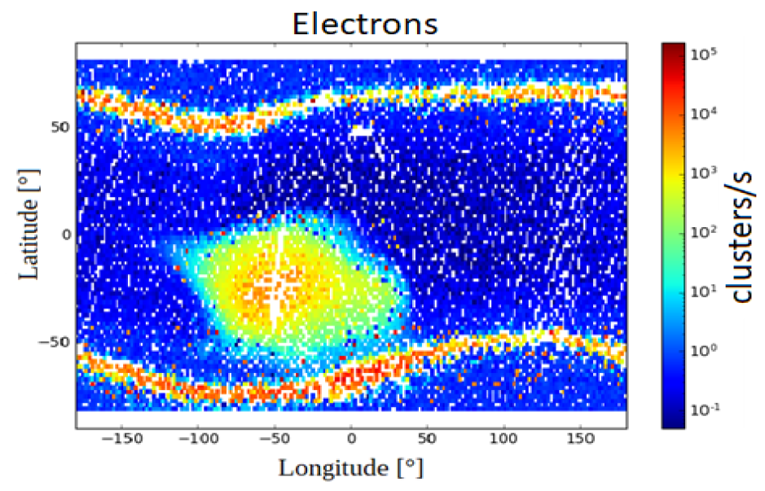
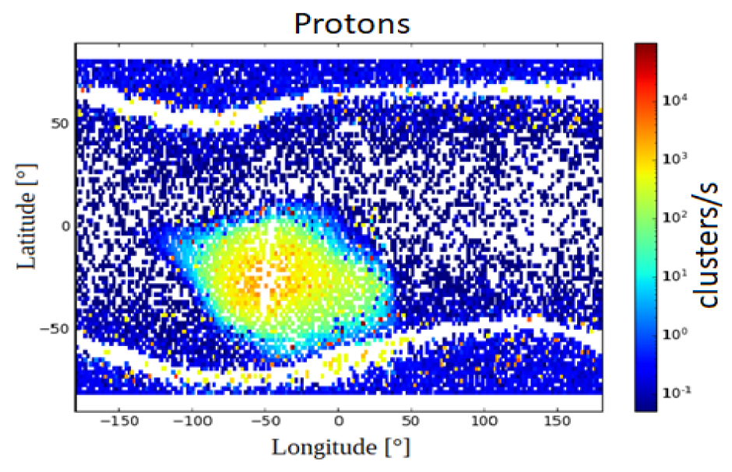
CNN – convolution neural network for separation of electrons and protons
M. Ruffenach et al., “A new technique based on convolutional neural networks to measure the energy of protons and electrons with a single Timepix detector”, in IEEE TNS, 68, 8, pp. 1746-1753, (2021). doi: 10.1109/TNS.2021.3071583

Slide 18
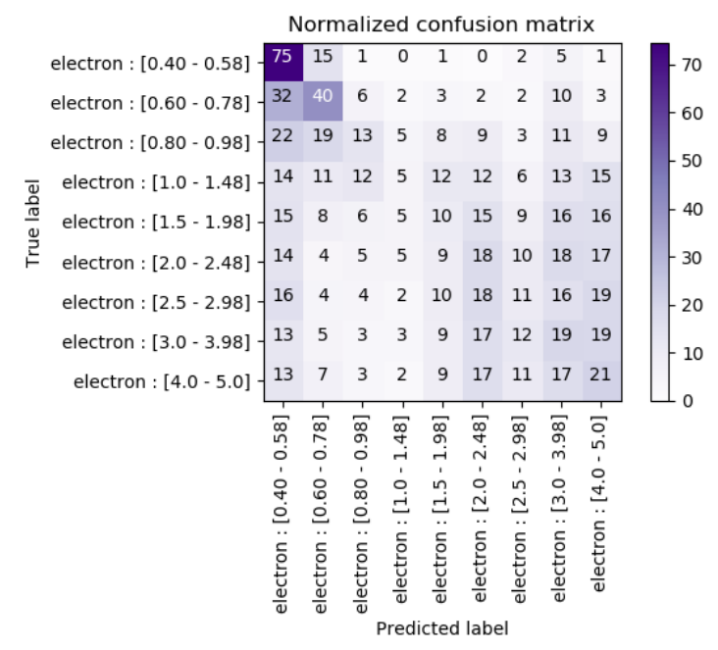
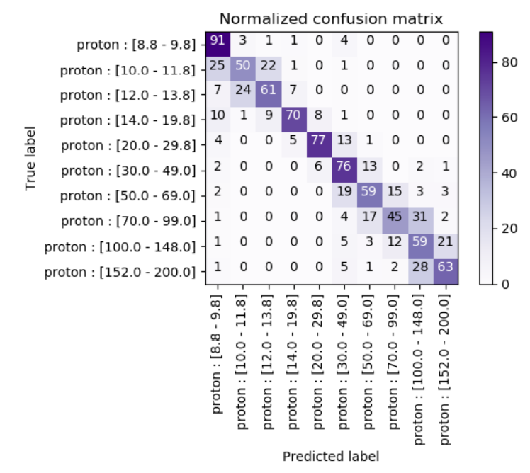
CNN – convolution neural network for incident energy determination
Particle spectroscopy capability is key for improvements of models in space physics
Proton incident energy determination with reasonable accuracy
Electron incident energy determination was not possible with good accuracy
Use e.g. stopping filters defining different regions on the sensor and do statistical analysis

Slide 19
Comparison with other radiation detectors in LEO

Slide 20
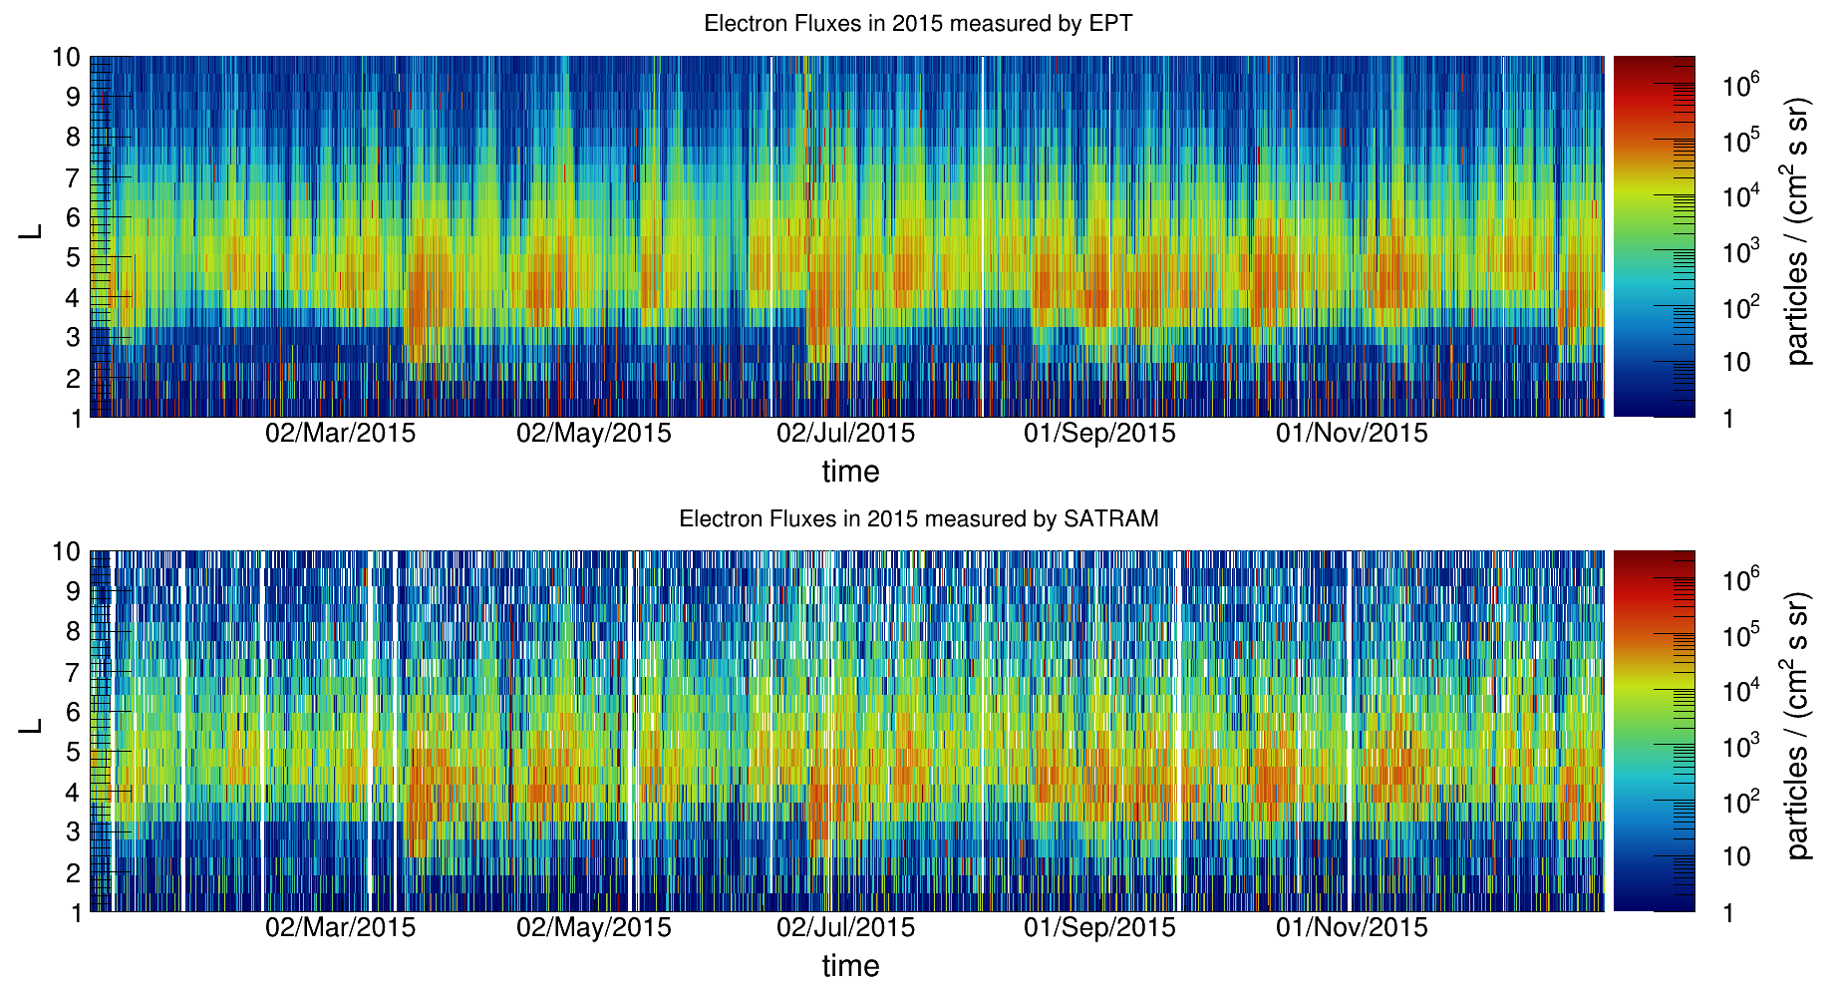
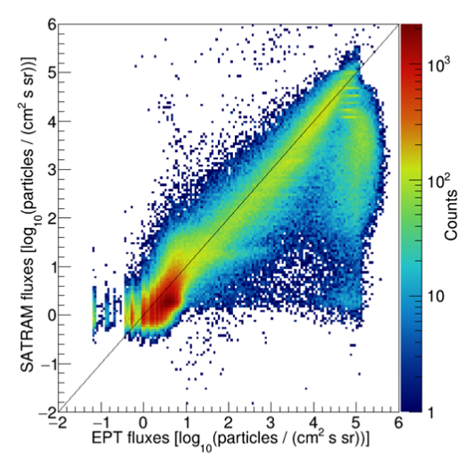
SATRAM vs. EPT (Energetic Particle Telescope)*⁾:
Electron fluxes
*⁾ EPT and SATRAM are both on Proba-V.
60 seconds integration time

Slide 21
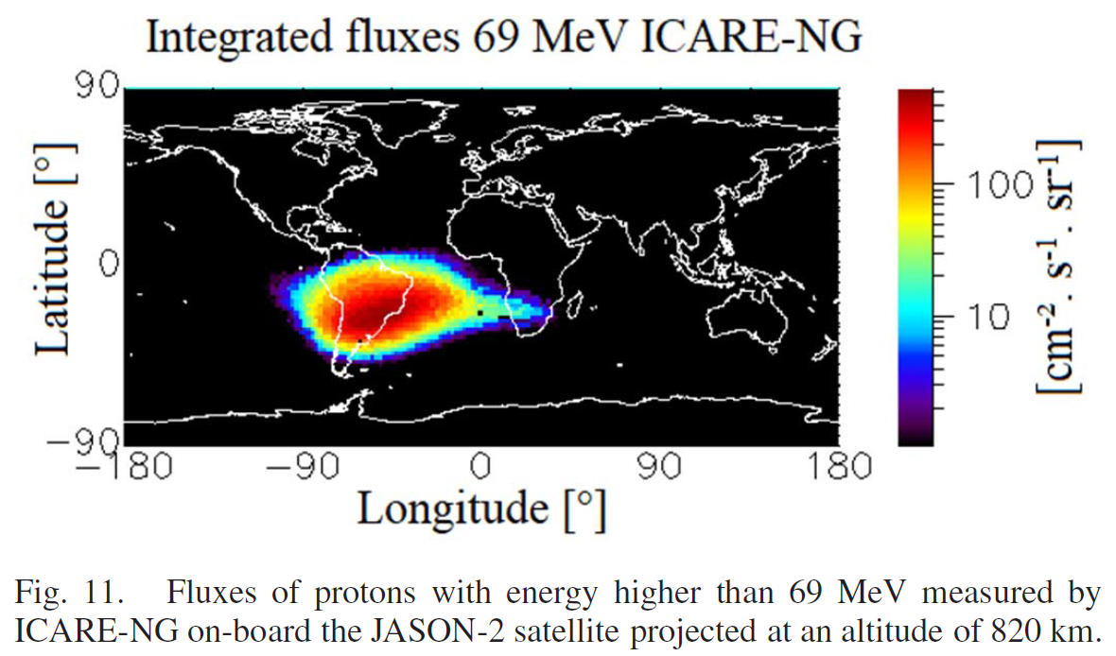
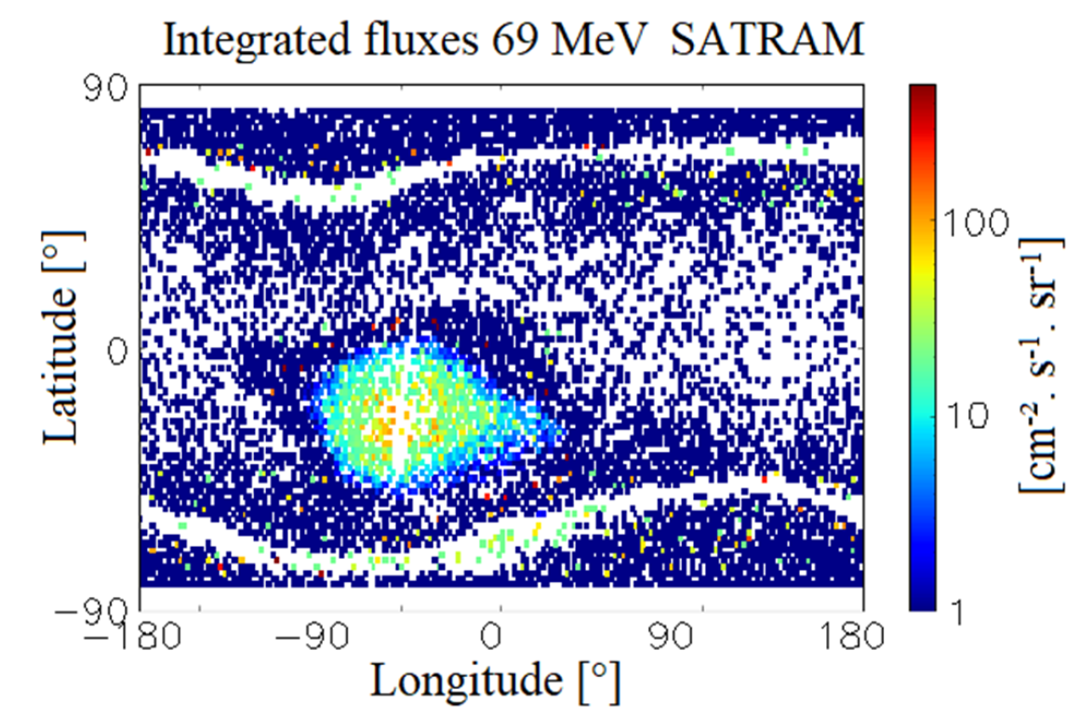
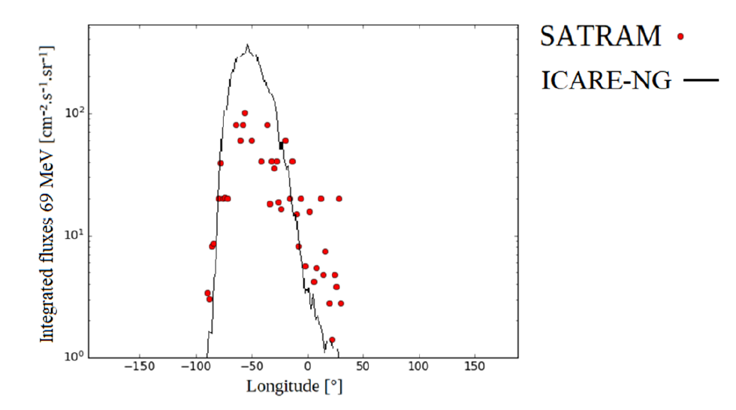
SATRAM vs. ICARE-NG:
Proton fluxes
Latitude = -30°
M. Ruffenach et al., “A new technique based on convolutional neural networks to measure the energy of protons and electrons with a single Timepix detector”, in IEEE TNS, 68, 8, pp. 1746-1753, (2021). doi: 10.1109/TNS.2021.3071583

Slide 22




Development of a demonstrator penetrating particle analyzer (mini.PAN) for deep space missions
This project has received funding from the European Union's Horizon 2020 research and innovation programme under grant agreement No 862044.
X.Wu et al., Penetrating Particle ANalyzer (PAN), Adv. Space Res. 63, 8, 2672-2682 (2019) https://doi.org/10.1016/j.asr.2019.01.012
http://www.pan-space.eu/

Slide 23
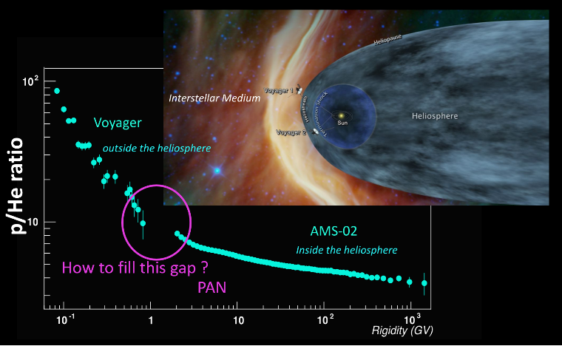
Scientific objectives
  Precisely measure and monitor flux, composition, and direction of penetrating particles ( up to ~20 GeV/nucleon)
Galactic cosmic ray (GCR) physics:
Understand origin, acceleration mechanisms and propagation properties
Antimatter content
Dosimetric aspect:
GCR major source of dose for astronauts on (interplanetary) missions

Slide 24
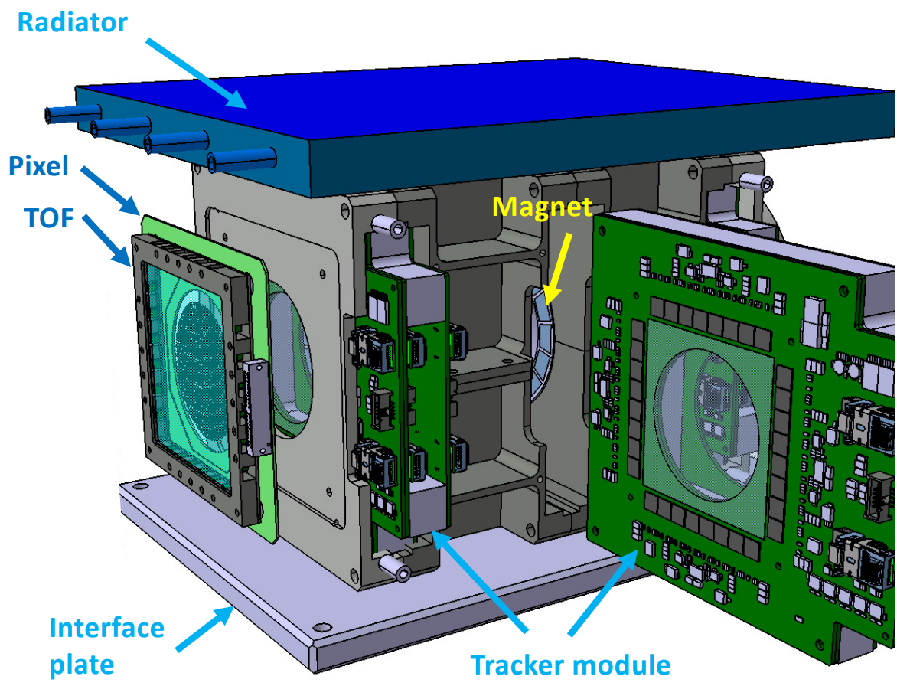
Conceptual design
Expected performance:
Magnetic spectrometer:
2 magnet sectors in Halbach geometry 0.4 T
3 Tracker modules with 3 layers of strip detectors
  2 StripX (bending direction) – pitch: 25 µm
  1 StripY – pitch: 500 µm
2 Pixel modules
  Timepix3 quad (262,144 pixels, pitch: 55 µm)
2 ToF modules (time resolution < 100 ps):
  Scintillators (EJ230) coupled with SiPMs
  Mini.PAN ~10 kg, ~20-30 W

Slide 25
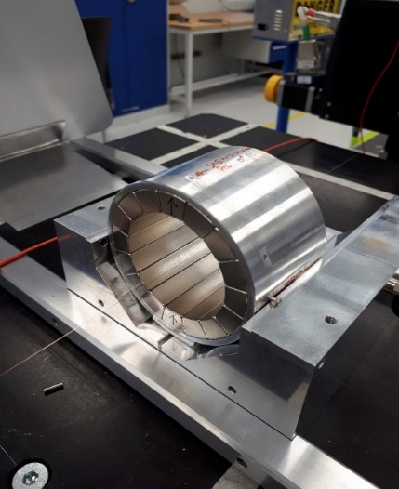
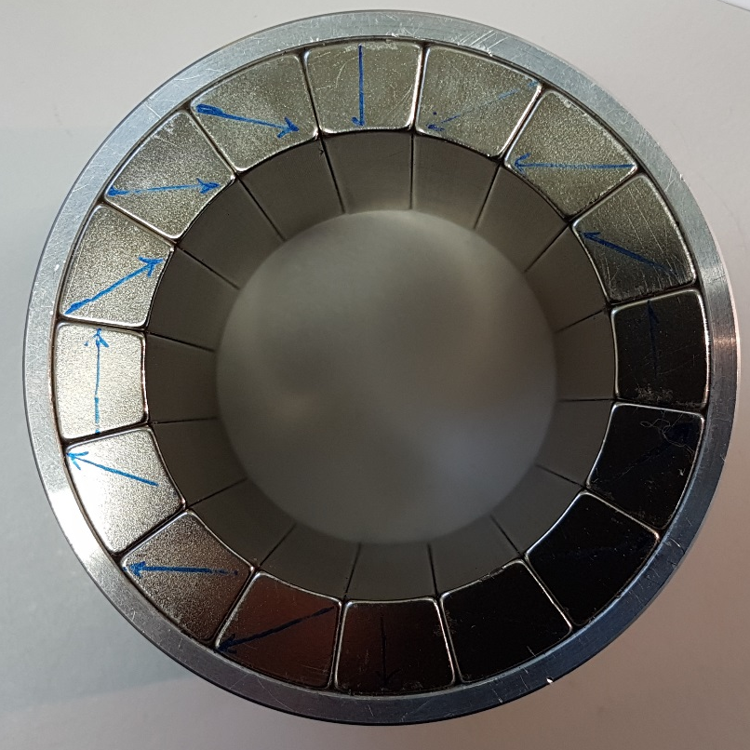
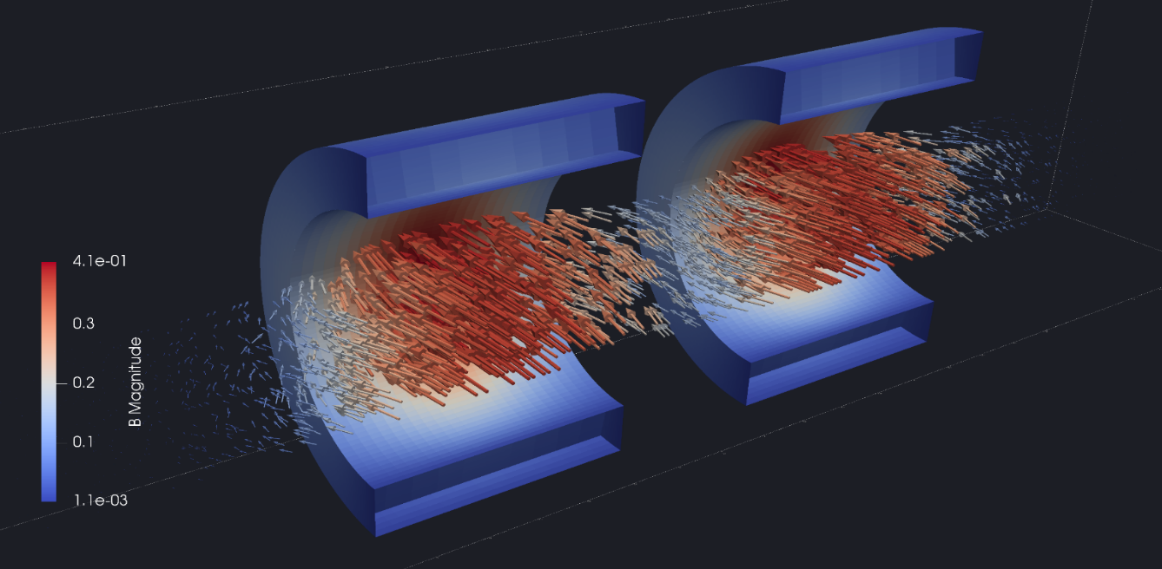
Magnet sectors
Ring, aluminium
Permanent magnet block, NdFeB
120 mm
50 mm
Mapping the B-field strength

Slide 26
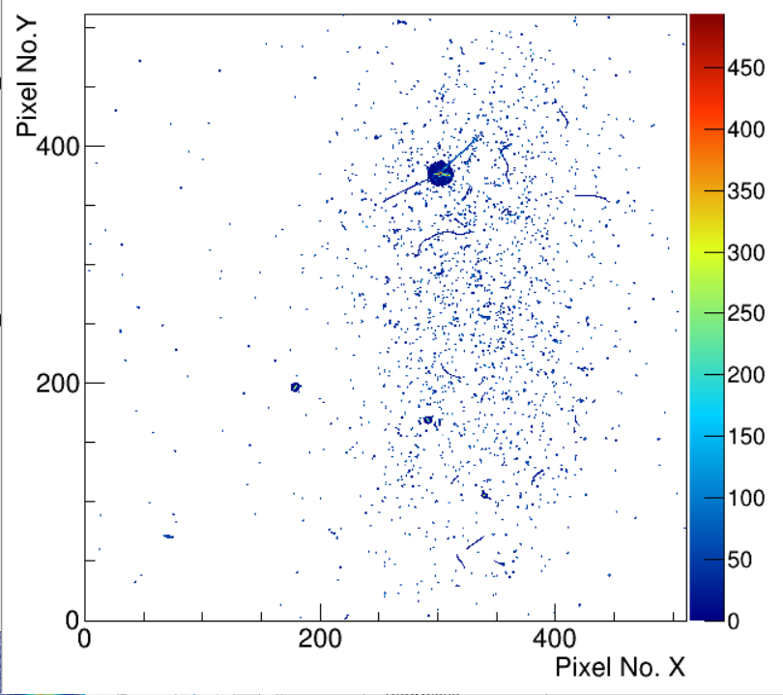
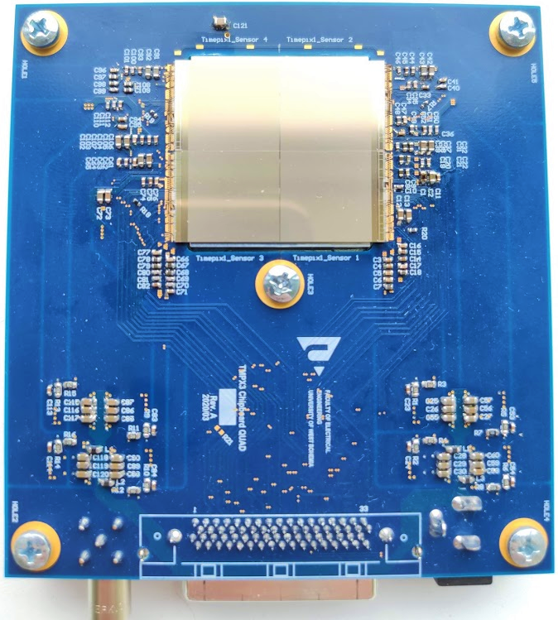
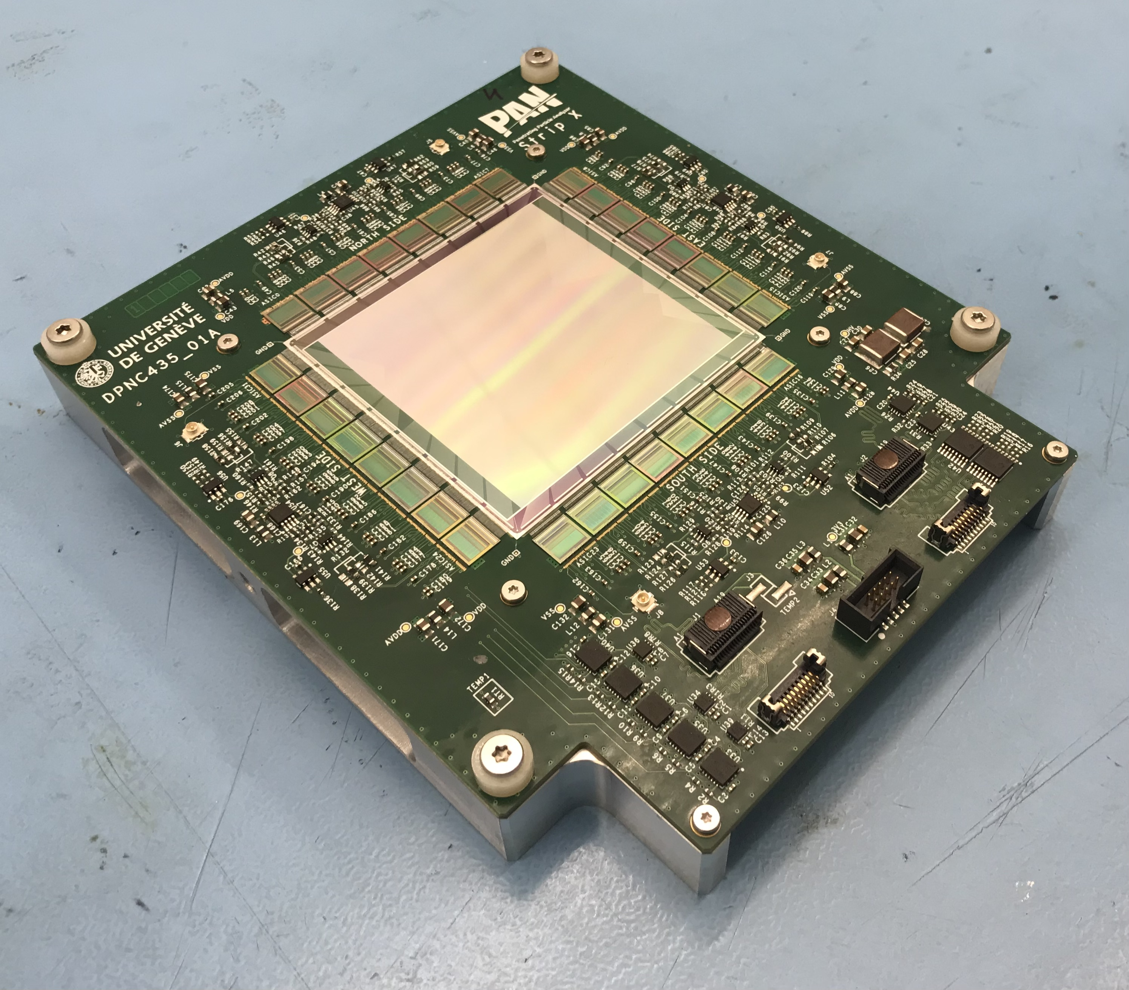
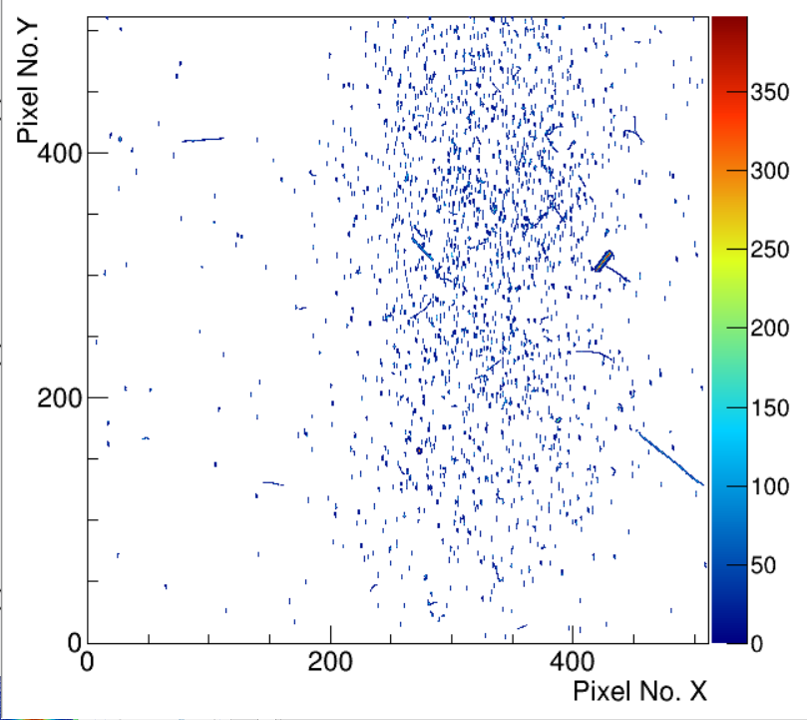
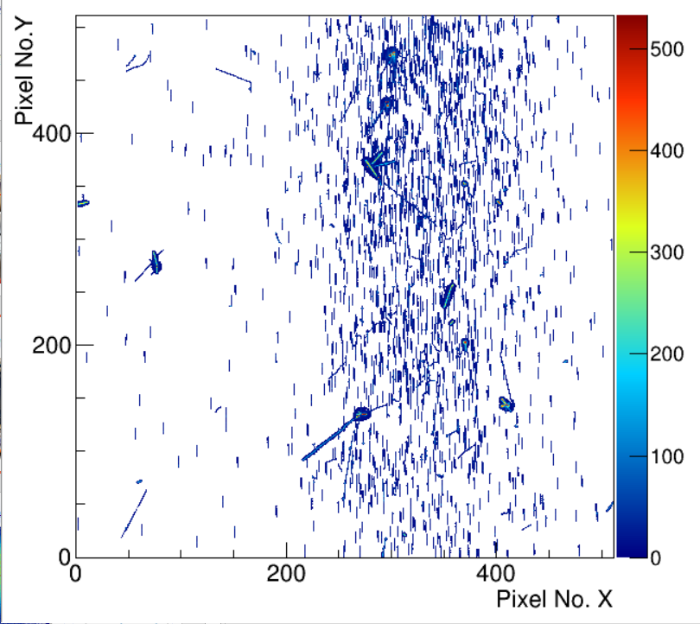
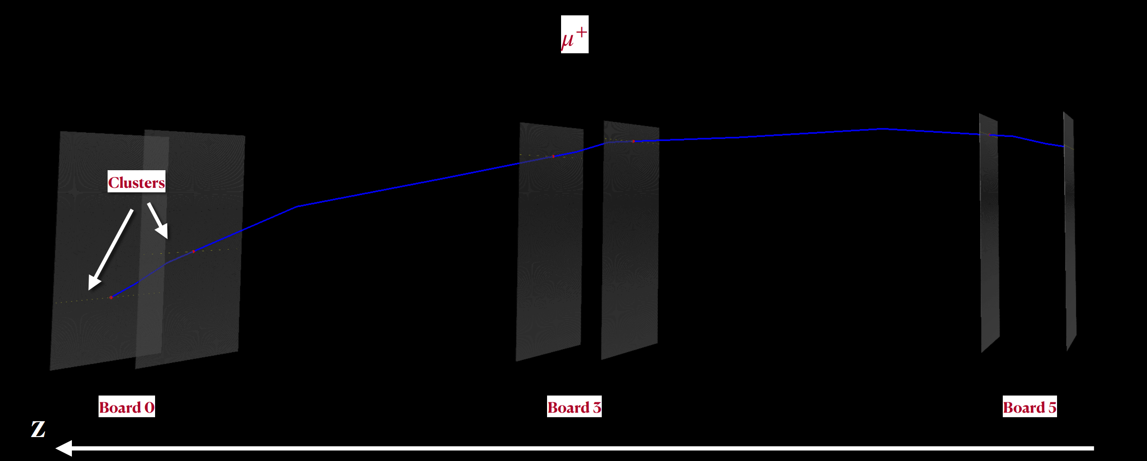


Tracking modules
See the poster presentation by P. Burian “Characterization of a Timepix3 quad for space application in the penetrating particle analyzer (PAN)“.
Mapping the B-field strength

Slide 27
Penetrating particle analyzer based on Timepix4 - Pix.PAN

Slide 28



Pix.PAN:
Performance considerations and Timepix4
Mini.PAN with 3 tracking station consisting of 2 Timepix4 quads as sensing element
Significant simplification of mini.PAN
Add high rate capability
Self-triggered operation in data-driven mode
5D vector ($\overset{⃑}{x}$,$t$,$\frac{dE}{dX}$) with $∆t<200$ ps in each station
Requirements/challenges:
Thin sensor and ASIC (total thicknesss < 400 µm)
Synchronization of 24 Timepix4 with low jitter
Desired power consumption < 20 W (vs 60 W)
Bending direction spatial resolution needed is < 5µm (vs current Timepix4 baseline design 16 µm)
(optional)

Slide 29

Pix.PAN:
Rectangular pixel design as solution?
Pitch in non-bending direction is not crucial for particle kinetic energy determination
Use asymmetric “long thin“ pixels with a “pitch adapter“ for oversampling in one direction and connect only 1/8 pixels!
Pixel 13.75 x 1760 µm - creates a matrix of 8224 in bending by 56 pixels in non-bending direction with $dx=3.7$ µm
Power consumption reduced to ~25 W. Further reduction by explointing chip configurations (operation at reduced clock, ... )
32 Timepix4 pixels

Slide 30
Acknowlegdements
St. Gohl, M. Kaplan, S. Pospisil, M. Ruffenach, X. Wu
Advacam s.r.o. (L. Marek, J. Jakubek, C. Granja)
PAN collaboration
Medipix collaborations

Slide 31
Conclusion and outlook
The Timepix detector‘s capability of single-layer particle tracking and particle species separation allows production of competitive radiation monitors with one order of reduction in mass
Future development should focus on improving
  Resource-efficient algorithms for on-board processing and data compression
  Electron and proton spectroscopy
Latest generation of Timepix detectors could be the baseline for particle spectrometers for astroparticle physics

Slide 32
Thank you for your attention!

Slide 33
Back up

Slide 34


Slide 36





Slide 37
Steady flux of Galactic Cosmic Rays
98% Baryonic component
87% protons
12% alpha-particles
1% heavy ions (Z > 2)
2% Leptons (electrons and positrons)
Galactic cosmic ray flux modulated by solar activity

Slide 38

Electronics integration
Preparation of a common readout system after mission requirements are known
Mapping the B-field strength

