Slide 1

Imaging and time-stamping single optical photons with nanosecond resolution for quantum applications
Andrei Nomerotski,
Brookhaven National Lab, Upton NY, USA

Slide 2
Will talk about
Fast, data driven approach to optical imaging
Quantum applications
Quantum assisted telescopes

Slide 3
Optical cameras: normally signal is integrated in a slice of time and whole frame is read out
5 kframe per second camera
0.2 msec
Quite far from 1 nanosecond!

Slide 4
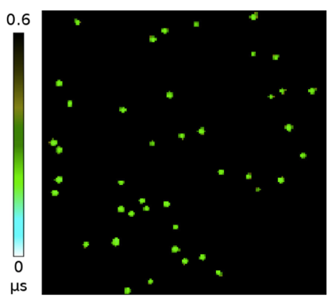
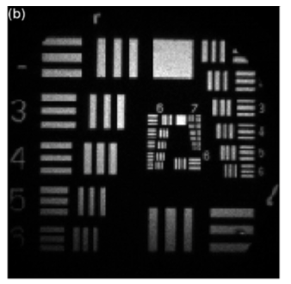

Imaging with photon counting
Photons appear as standalone objects ←→ data driven readout
Has parallels with x-ray imaging and particle detection in HEP
Low occupancy
Integrated image

Slide 5
Alternative Approach to Optical Imaging
Detect and time stamp photons, one by one, using intelligent pixels with data-driven readout
Accumulate statistics for images, also for more complex analysis (coincidences, correlations etc)
Frame-by-frame imaging →
continuous stream of time stamped single photons
Tpx3Cam: time-stamp 10 MHz flux of photons with 1 ns precision
A.Nomerotski, Imaging and time stamping of photons with nanosecond resolution in Timepix based optical cameras, Nuclear Instruments and Methods Sec A, Volume 937 (2019) pp 26-30
Also: PImMS1 & PImMS2 – monolithic version with different architecture
PImMS, a fast event-triggered monolithic pixel detector with storage of multiple timestamps,
JJ John et al, Journal of Instrumentation 7 (08), C08001 (2012)

Slide 6
Timepix Optical Cameras

Slide 7
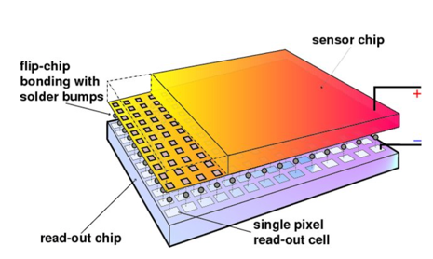
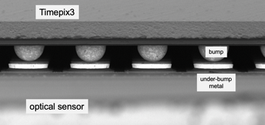
Hybrid pixel detectors
Have roots in R&D for LEP/LHC vertex detectors
credit: IZM
Lukas Tlustos and Erik H. M. Heijne, Performance and limitations of high granularity single photon processing X-ray imaging detectors, in CERN proceedings (2005)
Decouple readout chip and sensor
Optimize technologies for chip and sensor separately
Use different sensors with same readout, versatile approach for x-rays (Si, CZT)
→ we will use OPTICAL sensors

Slide 8
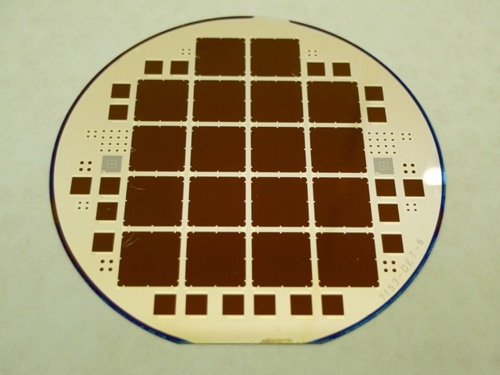
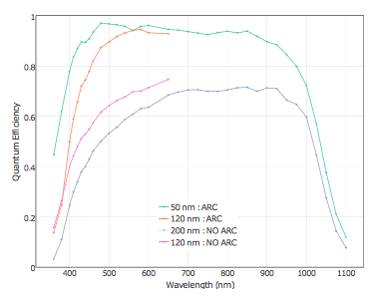
Thin window optical sensors
High QE
M. Fisher-Levine, A. Nomerotski, Timepixcam: a fast optical imager with time-stamping,
Journal of Instrumentation 11 (03) (2016) C03016.
Backside illuminated optical sensors
Anti-reflective coating, thickness 300 um
Nomerotski et al, Characterization of TimepixCam, a fast imager for the time- stamping of optical photons,
Journal of Instrumentation 12 (01) (2017) C01017.
Developed at BNL, first produced at CNM (Barcelona, Spain) in 2015
Surface preparation is very important, inspired by astronomical CCDs (LSST)

Slide 9
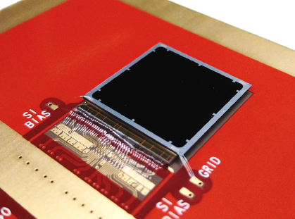
Timepix3 Camera → Tpx3Cam
Camera = sensor + ASIC + readout
Timepix3 ASIC:
256 x 256 array, 55 x 55 micron pixel
  14 mm x 14 mm active area
1.56 ns timing resolution
Data-driven readout, 600 e min threshold, 80 Mpix/sec, no deadtime
each pixel measures time and flux, ~1μs pixel deadtime when hit
Sensor is bump-bonded to chip
Use existing x-ray readouts:
SPIDR (Nikhef & ASI)
www.amscins.com
T. Poikela et al, Timepix3: a 65k channel hybrid pixel readout chip with simultaneous ToA/ToT and sparse readout,
Journal of Instrumentation 9 (05) (2014) C05013.
Zhao et al, Coincidence velocity map imaging using Tpx3Cam, a time stamping optical camera with 1.5 ns timing resolution,
Review of Scientific Instruments 88 (11) (2017) 113104.

Slide 10
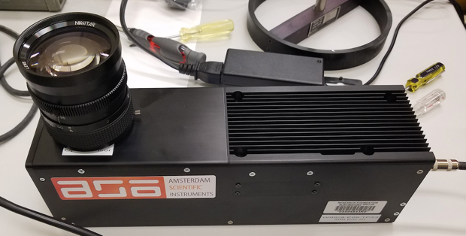
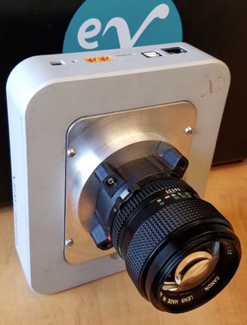
Use existing readouts of x-ray detectors:
TPX3Cam @ ASI
SPIDR readout for Timepix3 (Nikhef, ASI)
J. Visser et al, SPIDR: a readout system for Medipix3 and Timepix3, Journal of Instrumentation 10 (12) (2015) C12028.
eX readout for Timepix2 (Imatek)

Slide 11
Single (optical) photons

Slide 12
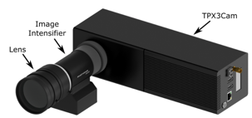
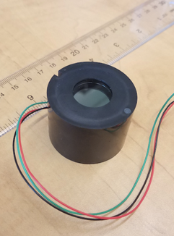
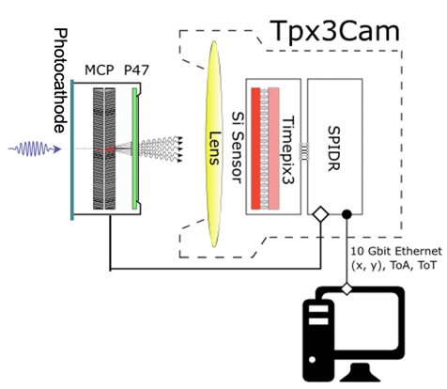
Intensified camera: use off-the-shelf image intensifier
Image intensifier (Photonis PP0360EG)
Cricket@
Intensifier
Intensified cameras are common:
  iCCD
  iCMOS cameras

Slide 13
Choice of photocathodes
Photonis photocathodes

Slide 14
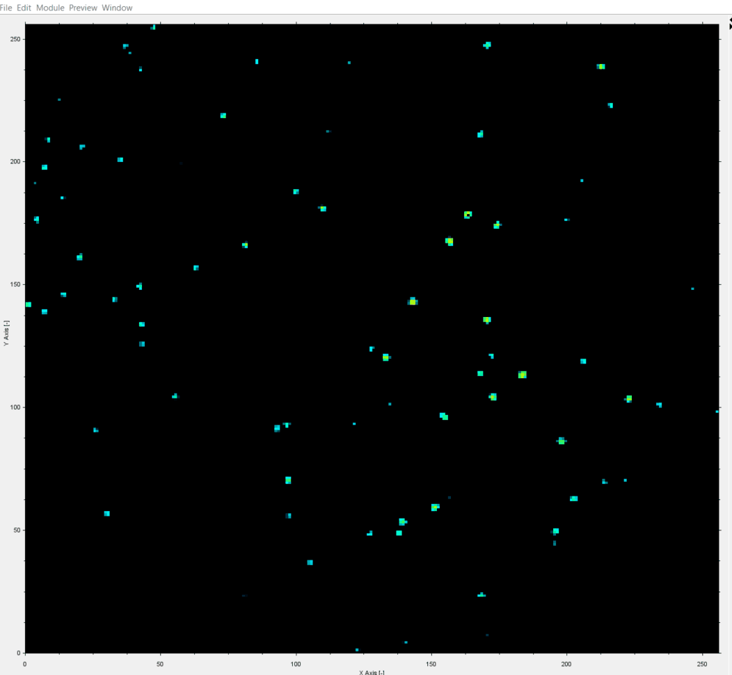
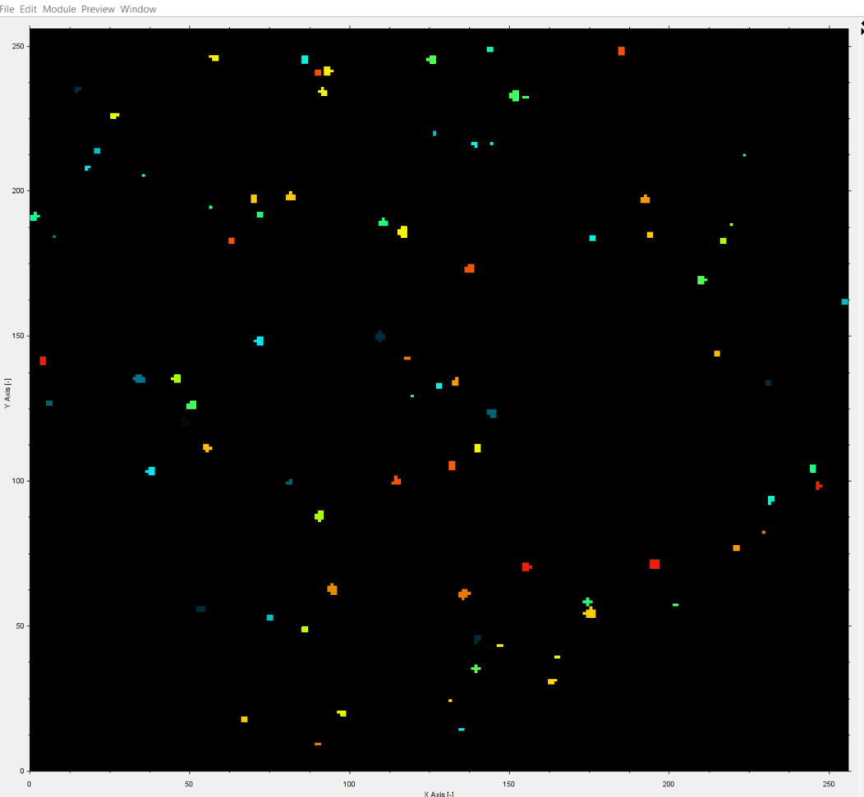
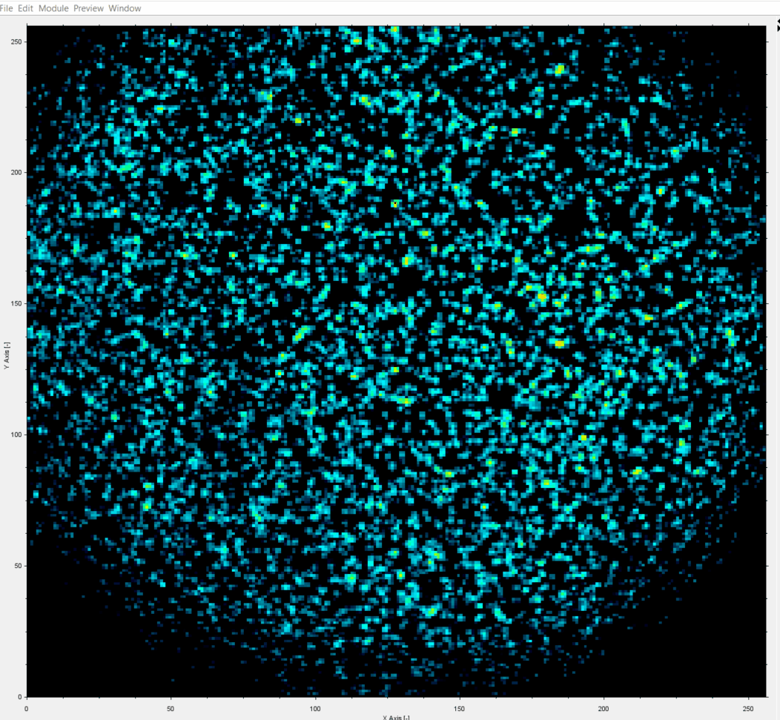
Single Photons in Tpx3Cam
1 ms slice of data
1.5 ns time-stamping
TOT
TOA
Tpx3Cam + intensifier by Photonis
data taken by J. Long (ASI)
TOT

Slide 15


TOA
TOT
Each photon is a cluster of pixels
3D (x,y,t) centoiding
Spatial resolution: 0.1 pixel / photon
Time resolution: < 1 ns / photon

Slide 16
Applications & Results
Quantum imaging
High Energy Physics applications
Neutron imaging
Lifetime imaging
Ion imaging

Slide 17
Quantum Applications

Slide 18
Quantum Astrometry
Idea: employ quantum entanglement to improve precision of optical interferometers

Slide 19
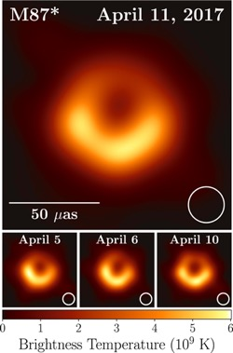
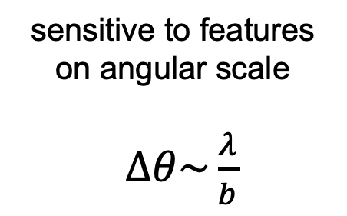
Astronomy picture of the decade
sensitive to features
on angular scale
$∆θ\sim \frac{λ}{b}$
2019 ApJL 875
Black hole in the center of M87 imaged at 1.3mm
Achieved by radio interferometry with ~10000 km baselines

Slide 20
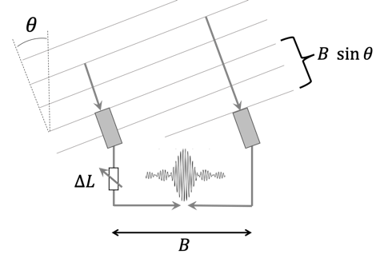
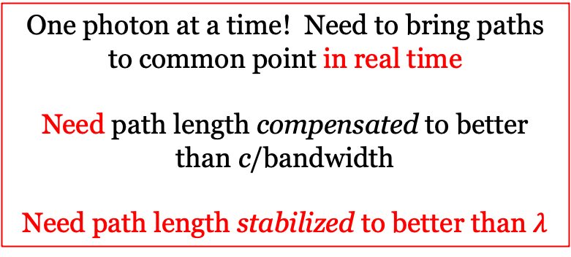


Radio
Optical
$$\overline{n}≫1$$
$$\overline{n}≪1$$
One photon at a time! Need to bring paths to common point in real time
Need path length compensated to better than c/bandwidth
Need path length stabilized to better than $λ$
Can literally record entire waveform, over some band, separately at each receiver station and interfere later offline
Accuracy ~ 1 mas
Max baselines to ~ 100 m

Slide 21
Two-photon techniques

Slide 22
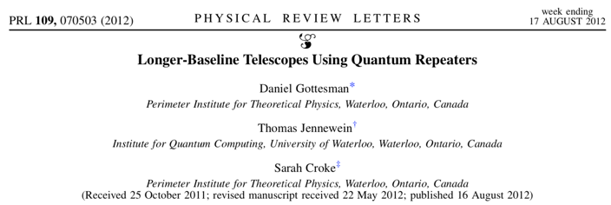
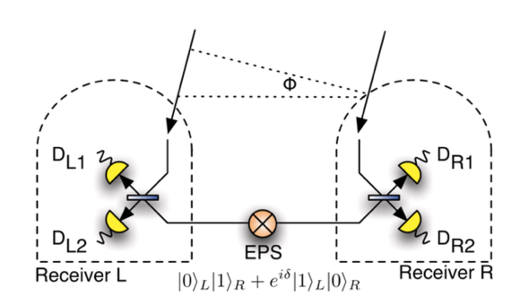
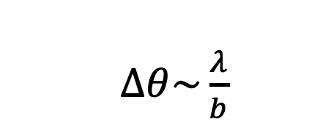
Second photon for quantum assist
Quantum (two-photon) interferometer
$∆θ\sim \frac{λ}{b}$
Measure photon wave function phase difference performing Bell State Measurement at one station so teleporting the sky photon to the other station
Enables long baselines and could improve astrometric precision by orders of magnitude
Major impact on astrophysics and cosmology

Slide 23
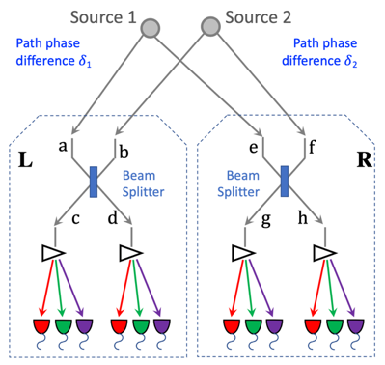
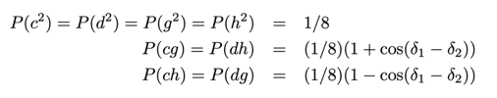
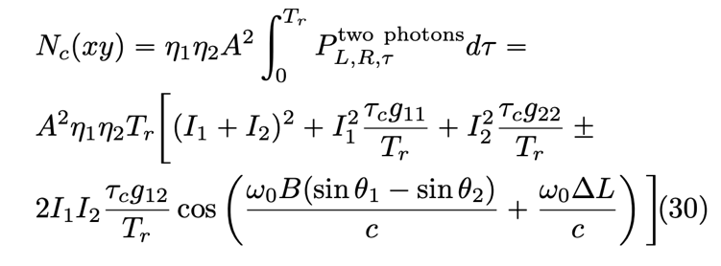
Quantum Astrometry
Idea: use another star as source of entangled states for the interference
Full QFT calculation
Rates
HBT
New oscillatory term!
Relative path phase difference δ₁ − δ₂ can be extracted from the coincidence rates of four single photon counters: c, d, g and f
Can provide 10 microarcsec resolution for bright stars
Allows to start exploring this approach experimentally
Stankus, Nomerotski, Slosar, Vintskevich, Two-photon amplitude interferometry for precision astrometry
arxiv.org/abs/2010.09100

Slide 24
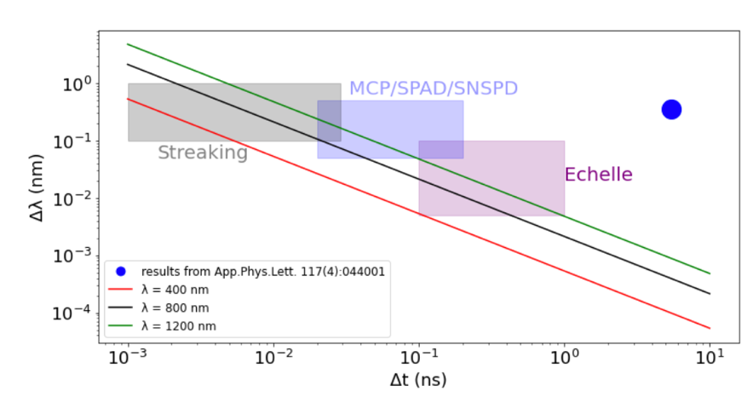
Requirements for detectors
Photons must be indistinguishable = close enough in frequency and time to interfere → temporal & spectral binning: need ~ 20 ps * 0.1 nm for 800 nm
Fast imaging techniques are the key: target 1-100 ps resolution
Spectral binning: diffraction gratings, Echelle spectrometers
Photon detection efficiency: high
Quantum-Assisted Optical Interferometers: Instrument Requirements; Andrei Nomerotski et al, Proceedings Volume 11446, Optical and Infrared Interferometry and Imaging VII; 1144617 (2020) SPIE Astronomical Telescopes +Instrumentation, https://doi.org/10.1117/12.2560272; arxiv:2012.02812

Slide 25
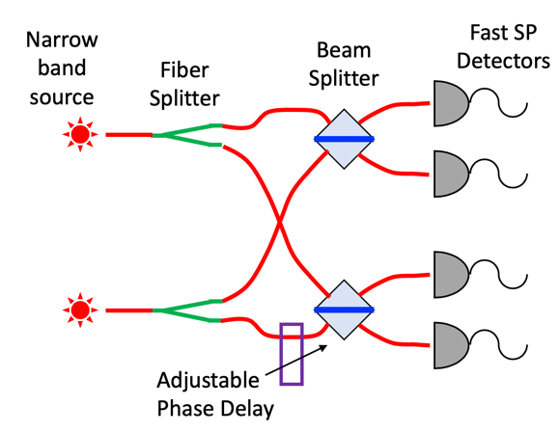
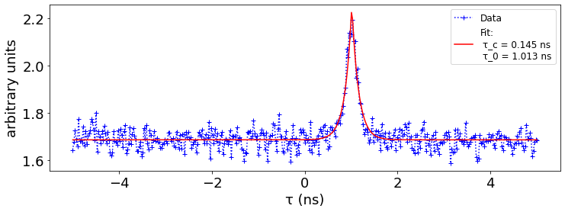
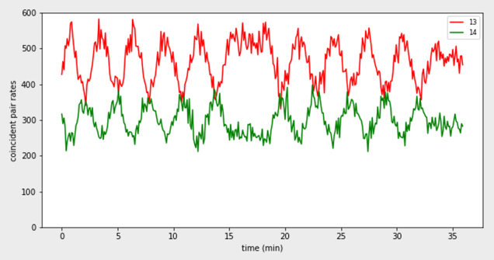
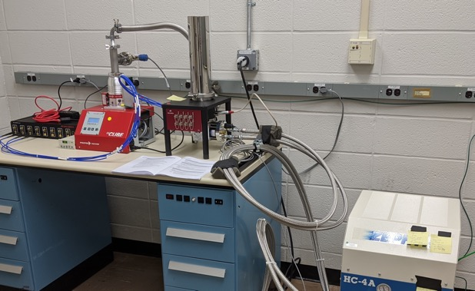
Experiments in progress
Strong HBT peak
photon phase shifting
Bench-top model of two-photon interferometry
Ar vapor lamps with ultra-narrow band filters
Superconducting nanowire single-photon detectors
See correlations of counters as expected
8 ch. SNSPD
A.Nomerotski et al, arxiv.org/abs/2107.09229

Slide 26
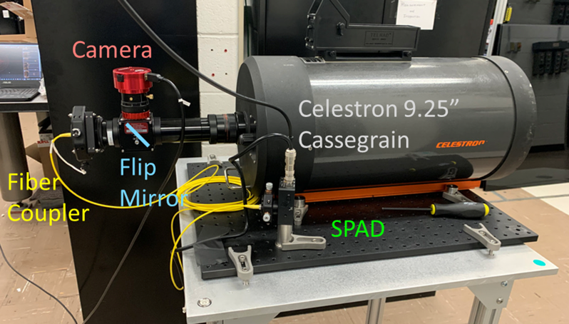
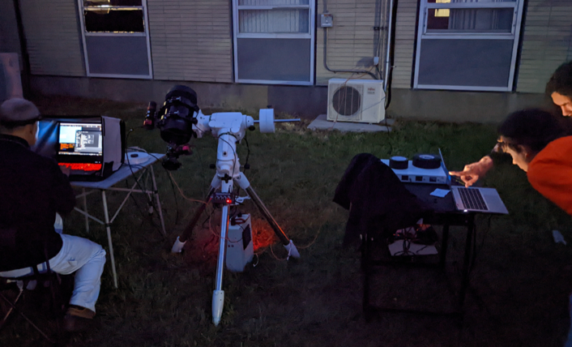
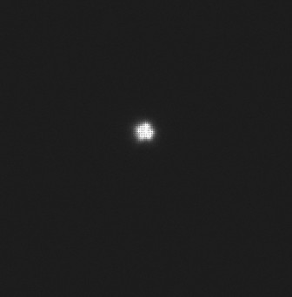
On-sky experiments in progress
Arcturus, PSF ~ 1 arcsec
Chen, Stankus, Nomerotski, Slosar, Vintskevich, Astrometry in two-photon interferometry using Earth rotation fringe scan, arxiv.org/abs/2205.09091

Slide 27
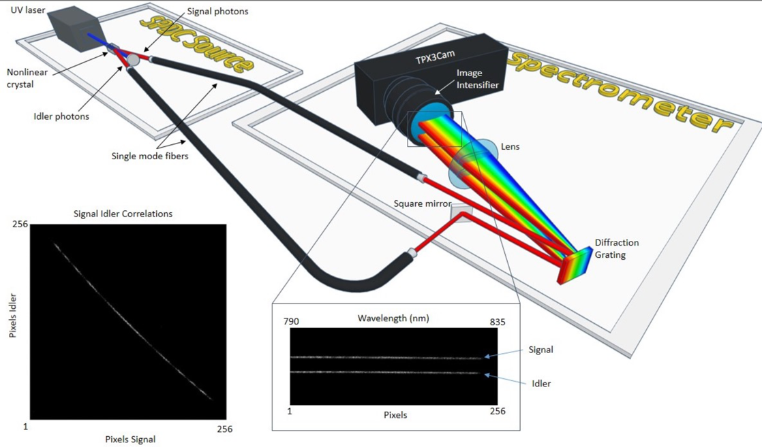
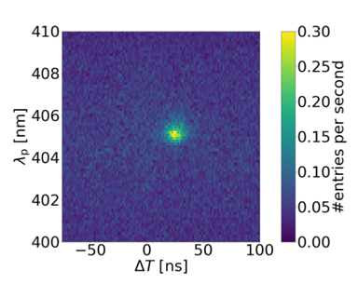
Spectroscopic binning
In collaboration with NRC (Ottawa) D.England, Y.Zhang et al
δλ∗δt ~ 5 ns * 0.5 nm
Pump photon wavelength vs time difference
Y Zhang, D England, A Nomerotski, P Svihra et al, Multidimensional quantum-enhanced target detection via spectrotemporal-correlation measurements, Physical Review A 101 (5), 053808
P Svihra et al, Multivariate Discrimination in Quantum Target Detection, Appl. Phys. Lett. 117, 044001 (2020)

Slide 28
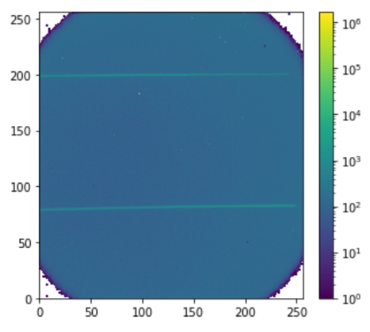
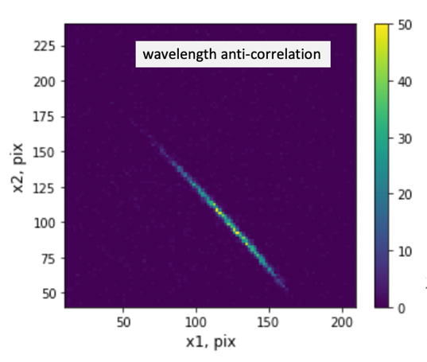
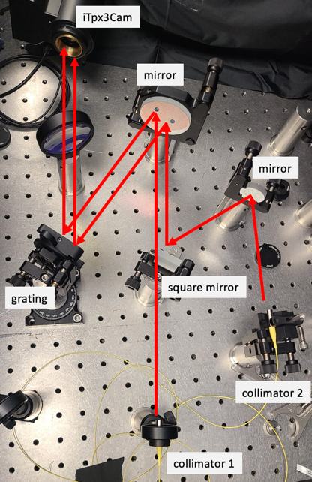
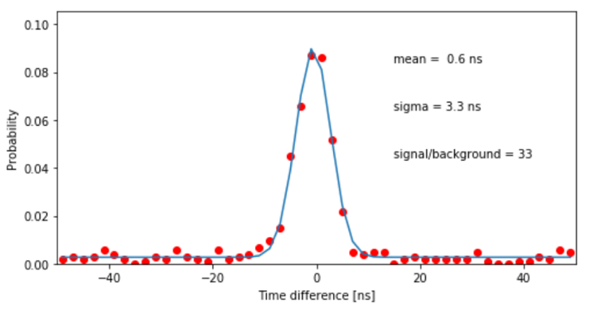
Current setup at BNL: SPDC source as spectrometer characterization tool

Slide 29
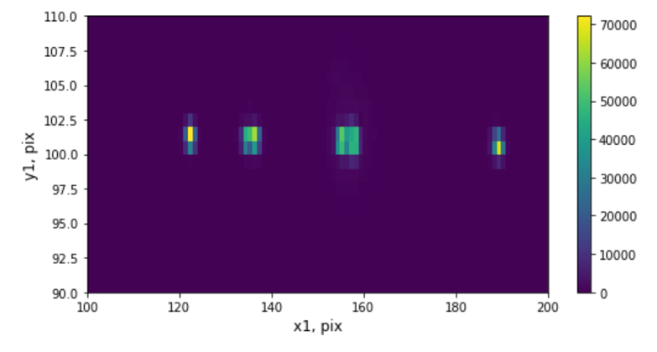
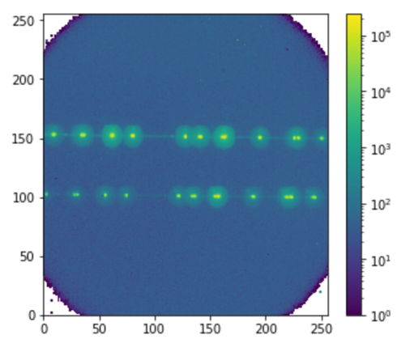
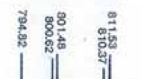
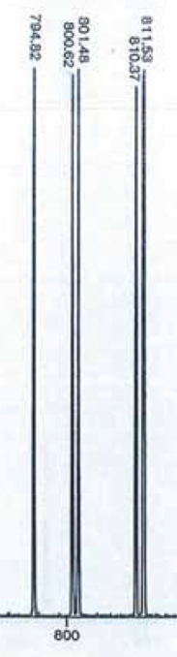
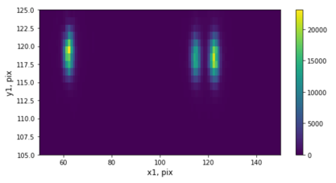
Argon lamp spectrum
better magnification:
0.1 nm resolution

Slide 30
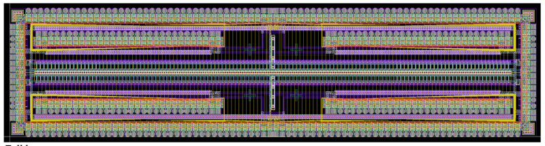
Next steps: spectrometer based on LinoSPAD2
Diffracted photon stripes projected on to single linear array
Collaboration with E.Charbon EPFL
LinoSPAD2
Spectrometer time resolution: ns → 100 ps

Slide 31
More Quantum Imaging
Take home message: two-photon interference requires fast imaging ~10-100 ps

Slide 32
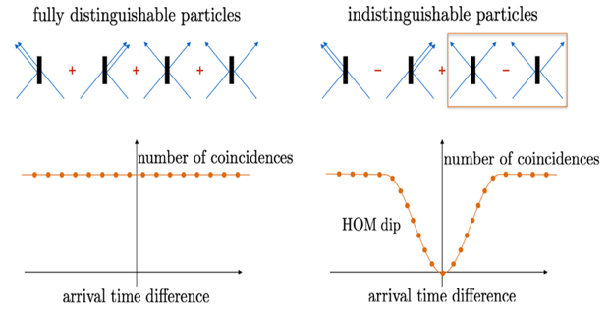
Hong-Ou-Mandel effect
time
50/50 beam splitter
credit: Wikipedia HOM article
HOM dip for coincidences of two fibers
Bunched photons in single fibers

Slide 33
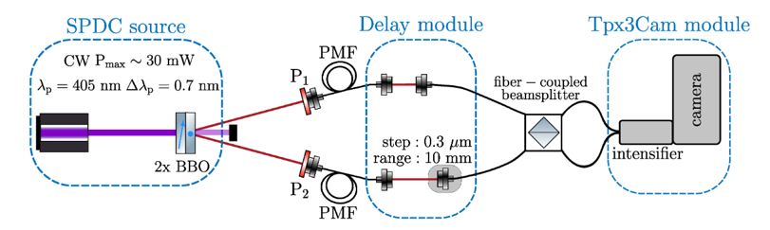
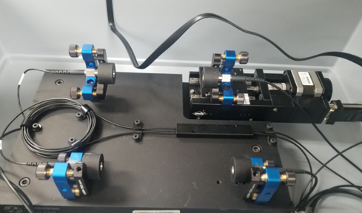
HOM Setup
qutools.com

Slide 34
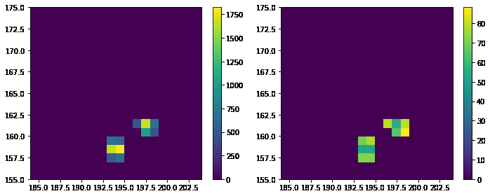
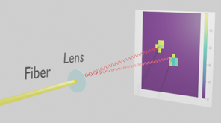

Examples of bunched HOM photons
TOT
TOA
Distance between two photons, pix

Slide 35



Hong-Ou-Mandel effect
Coincidence of photons in two fibers
Coincidence of photons in single fibers

Slide 36



HOM effect with post-selection
In collaboration with NRC (Ottawa) D.England, Y.Zhang et al
10, 5, 3 nm post-selection filters
2 nm filters at 805 nm and 817 nm.

Slide 37
More quantum imaging
other recent publications on quantum optics which used Tpx3Cam
High-speed imaging of spatiotemporal correlations in Hong-Ou-Mandel interface
Xiaoqin Gao et al. Optics Express, 30(11) 19456 (2022)
Observation of Nonclassical Photon Statistics in Single-Bubble Sonoluminescence
M. Rezaee et al. Arvix (2022)
Ray-tracing with quantum correlated photons to image a 3D scene
Y. Zhang et al. Phys. Rev. A (2022)
Tera-mode of Spatiotemporal N00N States
X. Gao et al. Optics Express, 30(11) 19456 (2022)

Slide 38



Imaging of trapped ions
Time resolved qubit manipulation (Blinov group, UWash)
Paul trap
RF 18 MHz
Ba ions
Register 493 nm photons to probe dark/bright state of ion = state of qubit register
Fast Simultaneous Detection of Trapped Ion Qubit Register with Low Crosstalk, M.Zhukas, P.Svihra, A.Nomerotski, B.Blinov, arxiv.org/abs/2006.12801

Slide 39





Time resolved ion oscillations
54 ns → 18 MHz
Emission rate oscillations due to Doppler shift of laser light wrt moving ion
Simultaneous time & position information allows to monitor ion micro-motions
Powerful technique to characterize traps
L.Zhukas, M.Millican, P.Svihra, A.Nomerotski, B.Blinov, Direct observation of ion micromotion in a linear Paul trap, https://arxiv.org/abs/2010.00159, Phys. Rev. A 103, 023105 (2021)

Slide 40

Ion micromotion
Emission rate oscillations due to Doppler shift of laser light wrt moving ion
Simultaneous time & position information allows to monitor ion micro-motions
  Period 54 ns
  Amplitude 0.4 micron
L.Zhukas, M.Millican, P.Svihra, A.Nomerotski, B.Blinov, Direct observation of ion micromotion in a linear Paul trap, https://arxiv.org/abs/2010.00159, Phys. Rev. A 103, 023105 (2021)

Slide 41


Ion micromotion in 2D
2D ion crystals, RF period 92 ns
A.Kato et al, Two-tone Doppler cooling of radial two-dimensional crystals in a radiofrequency ion trap, arxiv.org/abs/2111.05829; Phys. Rev. A 105, 023101

Slide 42
HEP applications

Slide 43




TPX3Cam on ARIADNE 1-ton dual phase Liquid argon TPC
LAr Cosmic Muons (10msec slice)
Image light from avalanches in gas phase in THGEM
hep.ph.liv.ac.uk/ariadne/index.html
Kostas Mavrokoridis et al
D. Hollywood et al, 2020 ARIADNE—A novel optical LArTPC: technical design report and initial characterisation using a secondary beam from the CERN PS and cosmic muons JINST 15 P03003
A. Roberts et al., 2019 First demonstration of 3D optical readout of a TPC using a single photon sensitive Timepix3 based camera JINST 14 P06001

Slide 44


5.5 MeV alphas in CF₄ gas
in Tpx3Cam
Color = TOA
Color = TOT
First demonstration of 3D optical readout of a TPC using a single photon sensitive Timepix3 based camera, A Roberts, P Svihra, A Al-Refaie, H Graafsma, J Küpper, K Majumdar, ... K. Mavrokoridis, A.Nomerotski … Journal of Instrumentation 14 (06), P06001 (2019)

Slide 45


More ideas
Flashes in scintillator are imaged by intensified Tpx3Cam
Alphas, hard x–rays, neutrons, …
Thin fast scintillator
Difficulty: light collection efficiency (but it’s single photon sensitive)
Advantage: outside of the beam, around the corner (with mirrors)

Slide 46




Alphas in LYSO in Tpx3Cam
TOT
TOA
Am241 5.5 MeV alphas
LYSO 0.5 mm thickness
Alpha hits in Tpx3Cam
Neutron detection paper submitted to NIM
G. D'Amen et al 2021 JINST 16 P02006

Slide 47




Neutron detection with Tpx3Cam
⁶Li-based scintillator
Neutrons produce alphas
Time resolved
Tpx3Cam neutron event display
A.Losko et al, DOI:10.21203/rs.3.rs-257513/v1
J.Yang et al, arxiv.org/abs/2102.13386
Material characterization with Bragg edges

Slide 48
Future directions

Slide 49

by Medipix4 collaboration
X. Llopart
WISH LIST:
ASIC with optimized timing for clusters and with triggering capabilities,
Readout with several 10 ps TDCs in synch with Tpx
X. Llopart et al., Timepix4, a large area pixel detector readout chip which can be tiled on 4 sides providing sub-200 ps timestamp binning, JINST 17 (2022) C01044

Slide 50


Direct MCP → Timepix detection

Slide 51
Single Photon Sensitivity without intensifier?
So far needed outside amplification (MCP) to have a detectable signal
Limitation: QE ~ 35% (for 800nm)
GaAs
Photonis photocathodes

Slide 52
Single Photon Sensitivity without intensifier?
Can the amplification be integrated into the sensor? Silicon QE can be >90%
SPADs
Currently PDE (photon detection eff) ~30-50% but there is no fundamental limit
Can we build a hybrid (SPAD + Timepix4.1) camera?

Slide 53
Summary
  Time stamping of optical photons with data-driven readout is attractive alternative to frame readout
  Works well for sparse data
  Needs intelligent pixels with complex functionality
  Timing resolution: 10 nsec → 0.1 nsec
  Photon sensitivity: 1000 photons → single photon
  New technologies for fast single photon detection → hot topic in quantum applications

Slide 54



Acknowledgements
Eden Figueroa
Paul Stankus
Tom Tsang
Justine Haupt
Mael Flament
Guodong Cui
Sonali Gera
Michael Keach
Steven Paci
Alex Parsells
Jonathan Schiff
Denis Dolzhenko
Stepan Vintskevich
Anze Slosar
Zhi Chen
Jesse Crawford
Rom Simovitch
Jingming Long
Martin van Beuzekom
Bram Bouwens
Erik Maddox
Jord Prangsma
Duncan England
Yingwen Zhang
Boris Blinov
Mila Zhukas
Maverick Millican
Alex Kato
Peter Svihra
Michal Marcisovsky
Sergei Kulkov
BNL team
SBU team

Slide 55
spares

Slide 56

Photon absorption in silicon
Blue photons are absorbed near the surface (~0.25 um for 430 nm, P47 max emission)
~1 um for 500 nm, ~10 um for 800 nm
λ, nm
d, m

Slide 57

Ion Imaging

Slide 58


Ions in TimepixCam

Slide 59

FLASH data, paper submitted to Journal of Synchrotron Radiation

Slide 60

Quantum Network
Attenuation in fibers → need quantum repeater to reproduce qubits
  Simple amplification will not conserve the quantum state
Qubit teleportation: produce entangled photons and send them to two locations
Bell State Measurement (BSM) on one photon will collapse the wave function of the other one (or swap entanglement, or teleport photon)
A.Zeilinger

Slide 61


Slide 62


Characterization of Single Photon
Down-Conversion Source
Figueroa lab
qubit: use H, V photon polarization states

Slide 63




Time difference between photons
Find coincidences, plot as function of two polarizations
Figure of merit: S-value
  If > 2: photons are entangled
  max value: 2 $\sqrt{2}=2.82$
Measurement:
S-value = 2.72$±$0.02
Time resolution: 2ns

Slide 64


Spatial characterization of entanglement
Measure S-value
for 81 combinations of subareas
Imaging enables scalability

Slide 65

Scalability
Tpx3Cam supports 10MHz single photon rate :
= 10 x 10 x 100kHz beams
Photon router:
Used acousto-optical modulators to create 8x8 grid
Arbitrary routing between spots
10 ns time resolution, 1 μs switching
laser
AOM: x & y
Time, ns

Slide 66


Scalability
Goal: storage of multiple qubits in single ⁸⁷Rb cell

Slide 67

Hanbury Brown – Twiss Interferometry

Slide 68
Possible impact on astrophysics and cosmology
offers orders of magnitude better astrometry with major impact
Parallax: improved distance ladder (DE)
Proper star motions (DM)
Microlensing, see shape changes (DM)
Black hole imaging
Gravitational waves, coherent motions of stars
Exoplanets
https://arxiv.org/abs/2010.09100

Slide 69

Qubit detection error
Fast Simultaneous Detection of Trapped Ion Qubit Register with Low Crosstalk, M.Zhukas, P.Svihra, A.Nomerotski, B.Blinov, arxiv.org/abs/2006.12801
single qubit detection error: ~ 5 ppm

Slide 70
Lifetime Imaging

Slide 71


Lifetime imaging with ns timing

Slide 72



Lifetime imaging with oxygen sensors
Sensor lifetime depends on oxygen concentration → in-vivo monitoring of oxygen in tissues
Oxygenation
De-oxygenation
Polystyrene
PVC
Polystyrene
PVC
PVDC
PVDC
48.9 µs
35.5 µs
13.4 µs
49.4 µs
44.9 µs
51.05 µs
PMMA
Hydrogel
PMMA
Hydrogel
34.8 µs
37.3 µs
56.2 µs
48.9 µs
Papkovski group, University College Cork (Ireland)
Oxygenation and Deoxygenation of PtBp Solid State sensors
New luminescence lifetime macro-imager based on a Tpx3Cam optical camera, R Sen et al, Biomedical optics express 11 (1), 77-88 (2020)

Slide 73
















Measurements with biosamples
Intraluminal application (Mice2)
Large Intestine
Small Intestine
35.5
33.9
22.8
32.2
33.6
30.2
35.3
38
35
36.3
32.8
31
43.1
23.5
30.1
32.7
38.2
44.5
Inhibitor
Inhibitor
Inhibitor
Inhibitor
Inhibitor
Inhibitor
Inhibitor
35.4
30.9
27.7
28.6
33
35
30.1
31.3
23.1
21.5
22.4
20.3
22.1
24.4
27
19.7
23.7
21.1
0 hr
1 hr
2 hr
3 hr
4 hr
Large Intestine
Time Lapse
35.3
38
35
43.6
43.6
43.65
43.1
47.3
45.1
43.2
46.6
43.9
40.3
40.99
46.8
Papkovski group, University College Cork (Ireland)
Mapping O₂ concentration in ex-vivo tissue samples on a fast PLIM macro-imager, R Sen et al, Scientific reports 10 (1), 1-11 (2020)

