Slide 1
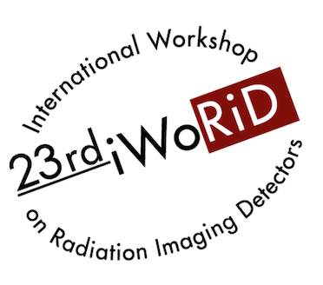
Spectral and phase-contrast imaging: from crystal-based synchrotron setups to detector-based compact systems
28/06/2022
Luca Brombal – INFN Trieste
iWoRiD 2022 – Riva Del Garda (TN), Italy – 26-30 June 2022

Slide 2
OVERVIEW
Principles
X-ray spectral imaging
  Crystal-based systems
  Detector-based systems
Phase-contrast imaging
  Analyzer-based imaging @ synchrotron
  Edge illumination in the lab
PEPILab: a compact spectral and phase-contrast imaging tool
L. Brombal |23rd iWoRiD 2022 |Riva Del Garda (TN), Italy | 26-30 June 2022

Slide 3
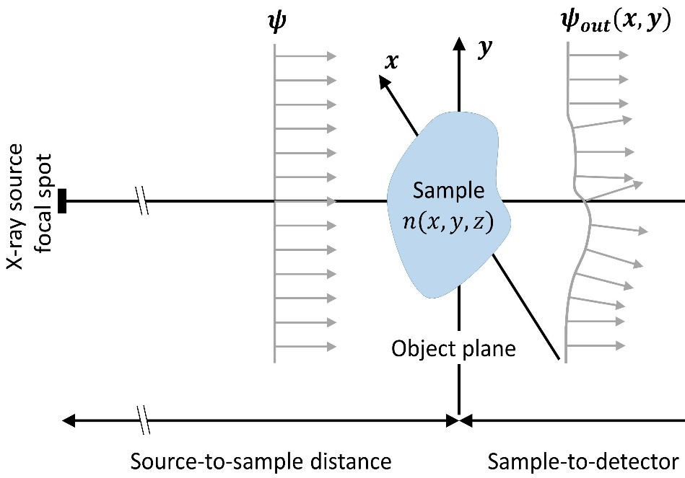


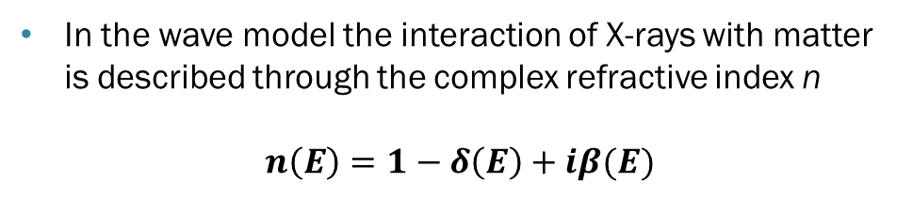

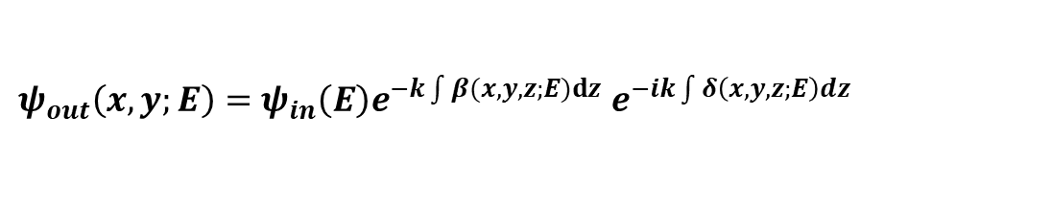
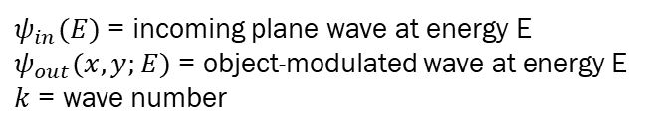
X-rays in matter
3
In the wave model the interaction of X-rays with matter is described through the complex refractive index n
$$n\left(E\right)=1−δ\left(E\right)+iβ(E)$$
$$ψ_{in}\left(E\right)$$
$$ψ_{out}\left(x,y;E\right)$$
$$β(E)=\frac{μ(E)}{2k}$$
attenuation
coefficient
$$n(x,y,z;E)$$
$ψ_{out}\left(x,y;E\right)=$ $ψ_{in}\left(E\right)e^{−k\int{β(x,y,z;E)}dz} e^{−ik\int{δ\left(x,y,z;E\right)dz}}$
$ψ_{in}(E)$ = incoming plane wave at energy E
$ψ_{out}(x,y;E)$ = object-modulated wave at energy E
$k$ = wave number
Attenuation
Phase shift
Spectral imaging
Phase-contrast imaging
L. Brombal |23rd iWoRiD 2022 |Riva Del Garda (TN), Italy | 26-30 June 2022

Slide 4
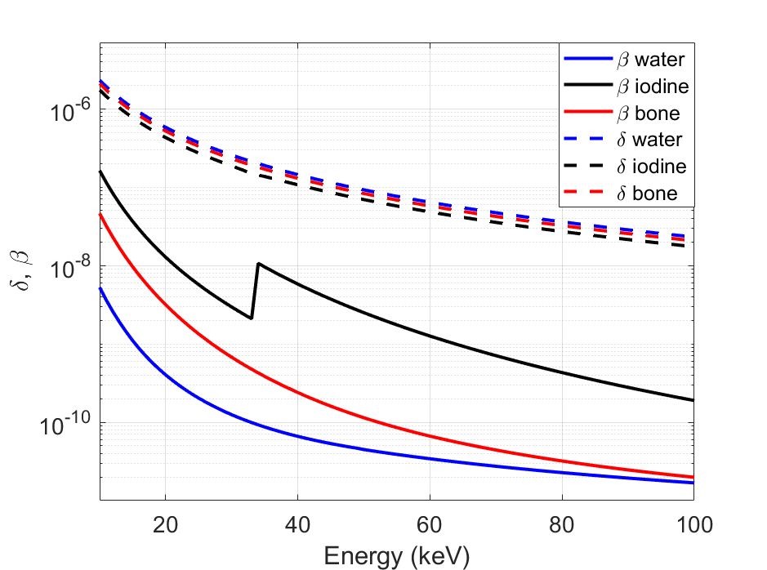
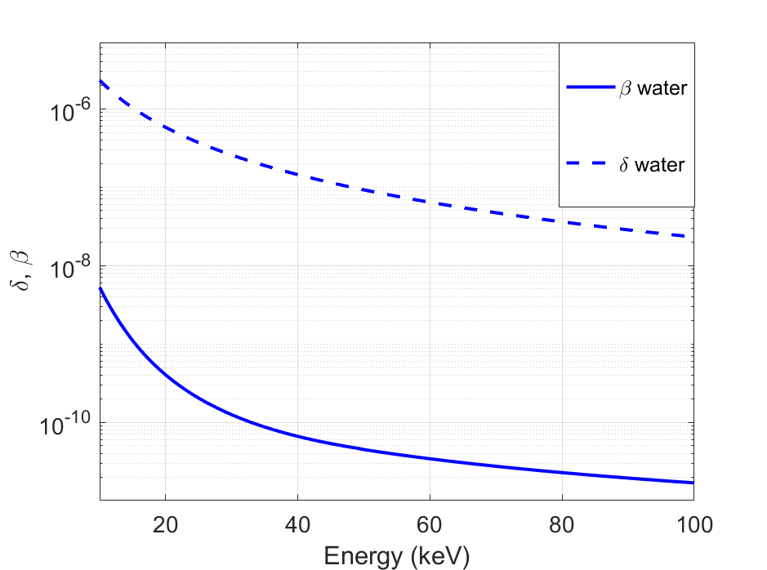


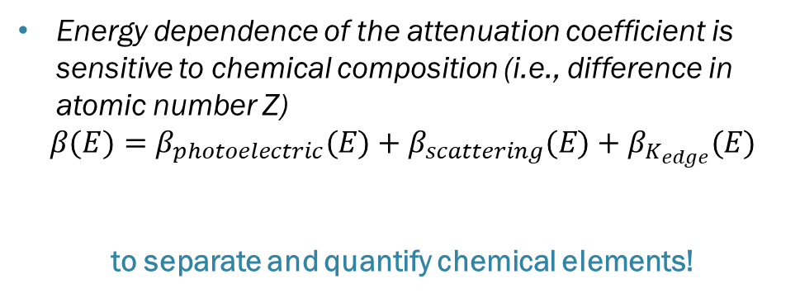
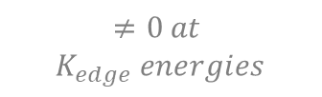

X-rays in matter
4
Why spectral imaging?
Why phase-contrast imaging?
δ ~ phase
δ ~ phase
β ~ attenuation
β ~ attenuation
β ~ attenuation
Energy dependence of the attenuation coefficient is sensitive to chemical composition (i.e., difference in atomic number Z)
$$β(E)=β_{photoelectric}(E)+β_{scattering}(E)+β_{K_{edge}}(E)$$
to separate and quantify chemical elements!
For light materials (e.g. soft tissues) and energies of radiological interest (10 – 100 keV) phase effects are much larger than attenuation
          $\frac{δ}{β}\sim 10^{3}$
to increase visibility of soft tissues!
$∝\frac{Z^{4}}{E^{4.5}}$
$∝\frac{Z}{E}$
$$≠0 at$$
$$K_{edge} energies$$
L. Brombal |23rd iWoRiD 2022 |Riva Del Garda (TN), Italy | 26-30 June 2022

Slide 5
OVERVIEW
Principles
X-ray spectral imaging
  Crystal-based systems
  Detector-based systems
Phase-contrast imaging
  Analyzer-based imaging @ synchrotron
  Edge illumination in the lab
PEPILab: a compact spectral and phase-contrast imaging tool
L. Brombal |23rd iWoRiD 2022 |Riva Del Garda (TN), Italy | 26-30 June 2022

Slide 6
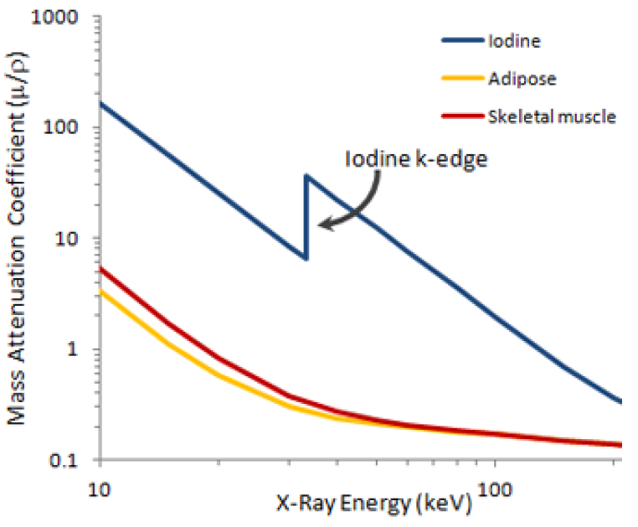






X-ray spectral imaging
6
Low
High
5 mm
Spectral imaging requires to probe the attenuation properties of the sample (at least) at 2 different energies
Images acquired at different energies are processed through matrix inversion algorithms to extract (quantitative) maps of elements of interest
$cm^{−1}$
$cm^{−1}$
Low energy
image
High energy
image
Acquired @ Elettra – bent Laue crystal
Water iodine solution
Water-iodine solution
Decomposition
algorithm
Water
Iodine
$$g/cm^{3}$$
m$g/cm^{3}$
$$\frac{g}{ml}$$
$$\frac{mg}{ml}$$
L. Brombal |23rd iWoRiD 2022 |Riva Del Garda (TN), Italy | 26-30 June 2022

Slide 7
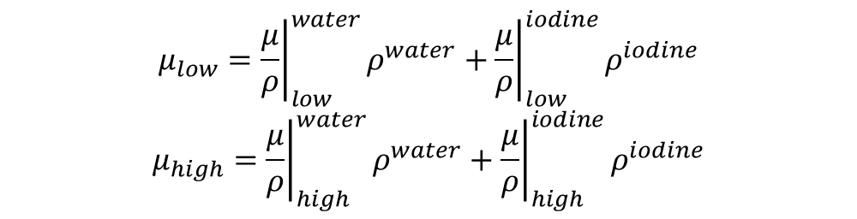

Basis material decomposition
7
Attenuation images at each energy bin are written as a linear combination of basis materials mass attenuation coefficients
By inverting the linear system, density maps of basis materials are obtained
Low energy
image
High energy
image
$$μ_{low}={\left.\frac{μ}{ρ}\right|}_{low}^{water}ρ^{water}+{\left.\frac{μ}{ρ}\right|}_{low}^{iodine}ρ^{iodine}$$
$$μ_{high}={\left.\frac{μ}{ρ}\right|}_{high}^{water}ρ^{water}+{\left.\frac{μ}{ρ}\right|}_{high}^{iodine}ρ^{iodine}$$
Decomposition matrix
$$\vec{μ}=A\vec{ρ}$$
$$\vec{ρ}=A^{−1}\vec{μ}$$
Decomposed maps
L. Brombal |23rd iWoRiD 2022 |Riva Del Garda (TN), Italy | 26-30 June 2022

Slide 8
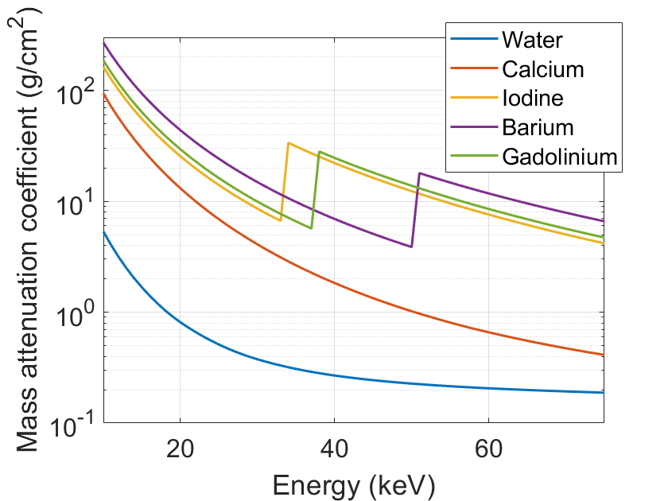
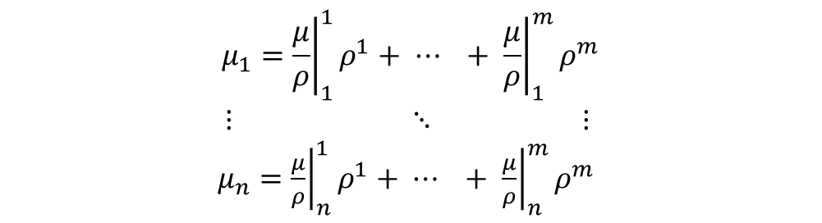



Multi-basis material decomposition
8
The algorithm can be extended to multiple energy channels and multiple decomposition materials
$$μ_{1}={\left.\frac{μ}{ρ}\right|}_{1}^{1}ρ^{1}+ ⋯ + {\left.\frac{μ}{ρ}\right|}_{1}^{m}ρ^{m}$$
$⋮ ⋱ ⋮$
$μ_{n}={\left.\frac{μ}{ρ}\right|}_{n}^{1}ρ^{1}+ ⋯ + {\left.\frac{μ}{ρ}\right|}_{n}^{m}ρ^{m}$
$n$ energy channels
$$\vec{μ}=A\vec{ρ}$$
$$\vec{ρ}=A^{−1}\vec{μ}$$
$m(≤n)$materials
Inversion performed
through least-squares
L. Brombal |23rd iWoRiD 2022 |Riva Del Garda (TN), Italy | 26-30 June 2022

Slide 9
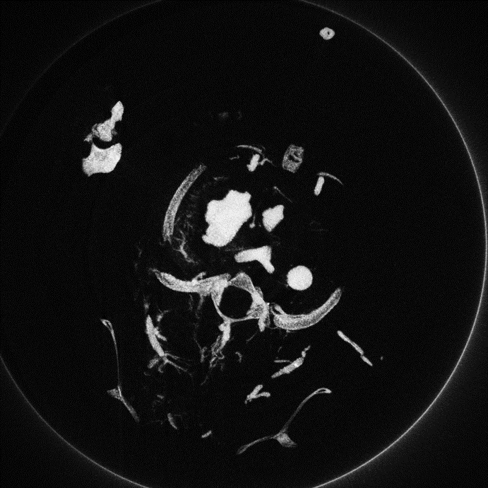
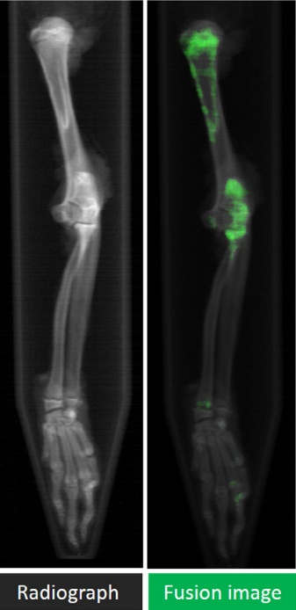
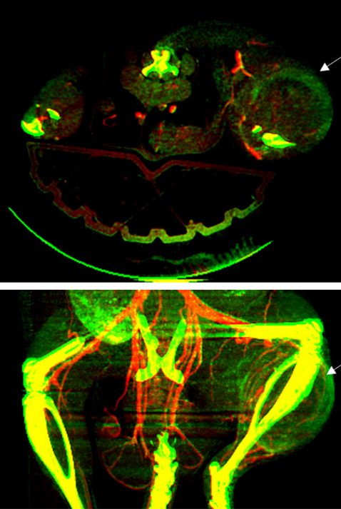
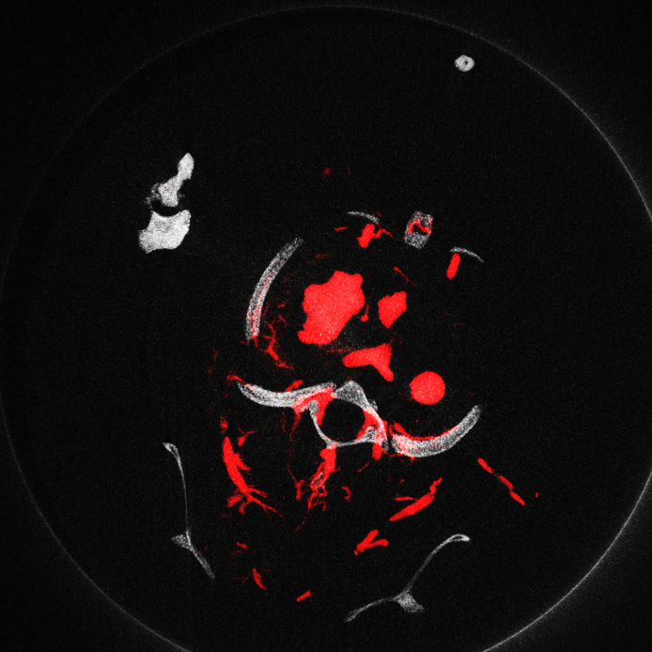
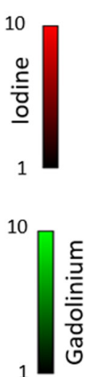
Applications: imaging with contrast medium
IODINE (33 keV)
BARIUM (37 keV)
GADOLINIUM (50 keV)
1 cm
Acquired @ PEPI Lab INFN Trieste
Panahifar, Arash, et al. Physica Medica 32.12 (2016): 1765-1770.
C T Badea et al 2019 Phys. Med. Biol. 64 065007
bone
iodine

Slide 10
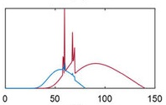
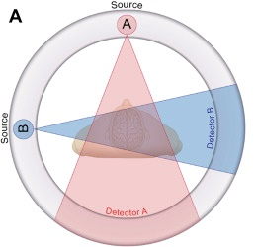
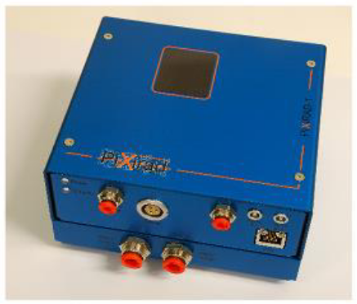
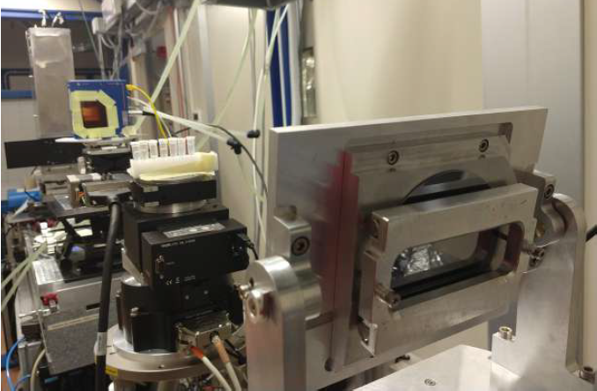
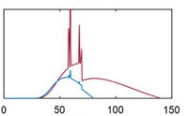
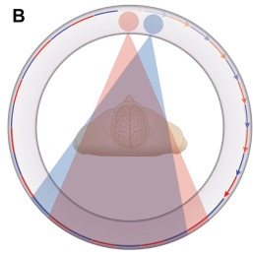
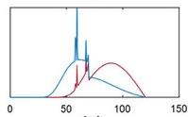
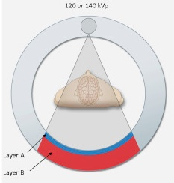
Spectral imaging systems
10
X-ray spectrum-based
  2 X-ray tubes with different voltages
  Voltage switching
  Dual layer detectors
Detector-based: energy discrimination on pixel-by-pixel basis
Crystal-based: energy dispersive systems based on bent crystals (@ synchrotrons)
Th1<E<Th2
E>Th2
Rivelatore
Detector
Campione
Sample
Fascio
Beam
L. Brombal |23rd iWoRiD 2022 |Riva Del Garda (TN), Italy | 26-30 June 2022

Slide 11
CRYSTAL-BASED SPECTRAL IMAGING
L. Brombal |23rd iWoRiD 2022 |Riva Del Garda (TN), Italy | 26-30 June 2022

Slide 12
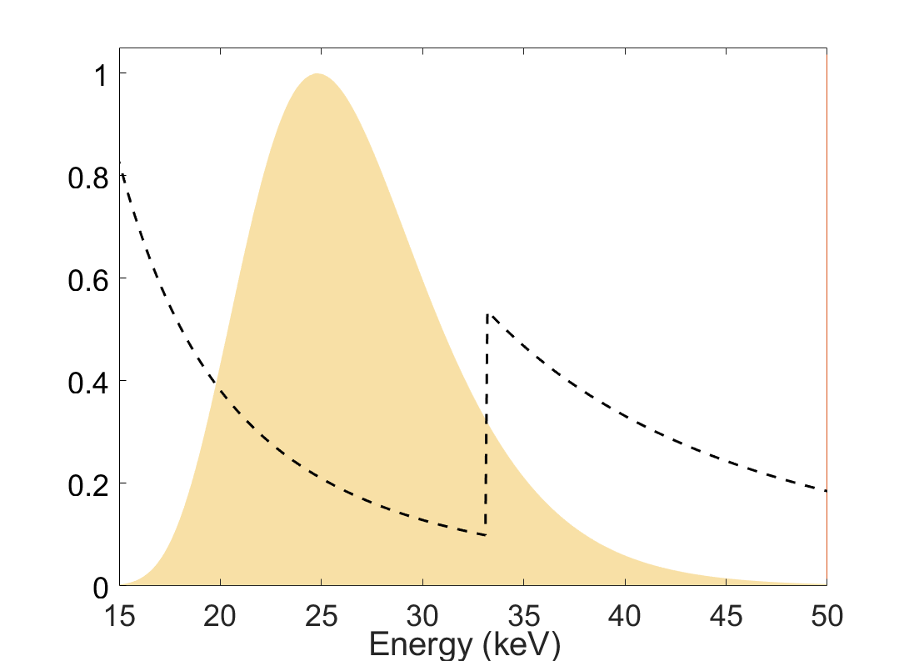
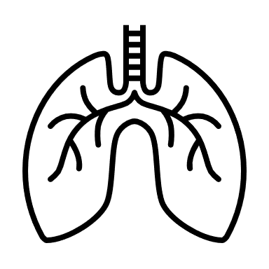
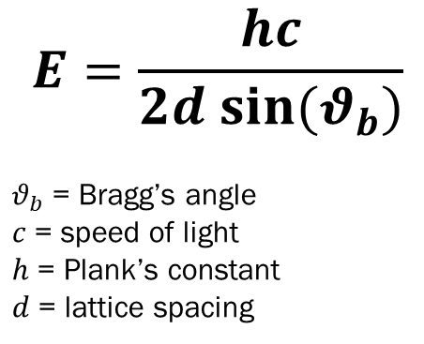

Laue diffraction
12
Detector
Iodine
Monochromatic beam
Polychromatic (white) beam
Silicon crystal
Sample
$$2θ_{b}$$
Bragg’s law
$$E=\frac{hc}{2d sin⁡(θ_{b})}$$
$θ_{b}$ = Bragg’s angle
$c$= speed of light
$h$ = Plank’s constant
$d$ = lattice spacing
L. Brombal |23rd iWoRiD 2022 |Riva Del Garda (TN), Italy | 26-30 June 2022

Slide 13
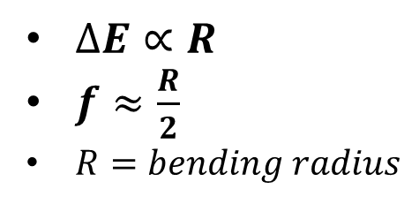

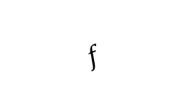
Energy dispersive bent Laue diffraction
13
Detector
Iodine
Energy dispersed beam
Polychromatic (white) beam
Bent silicon crystal
Sample
$$f$$
Focal distance
By bending the Laue crystal, the impinging beam is focused
Due to curvature Bragg’s law is satisfied at different angles
The beam is energetically dispersed in space!
Wide energy bandwidth $∆E$
$∆E∝R$
$f≈\frac{R}{2}$
$R=bending radius$
L. Brombal |23rd iWoRiD 2022 |Riva Del Garda (TN), Italy | 26-30 June 2022

Slide 14
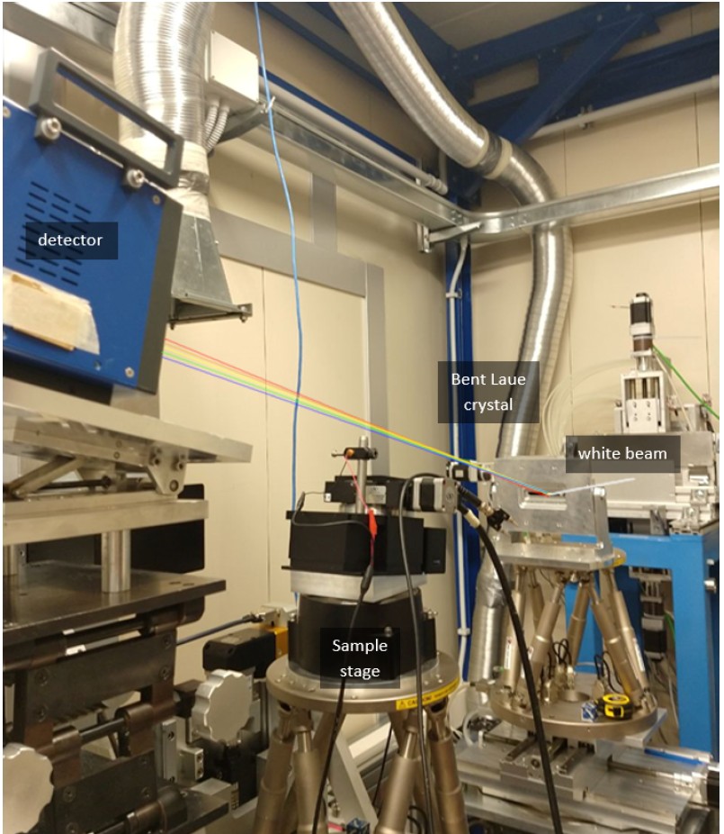
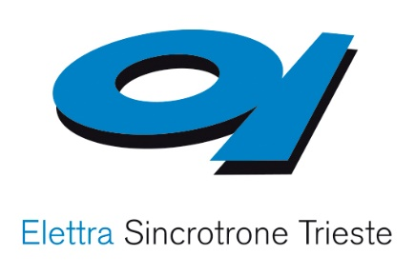
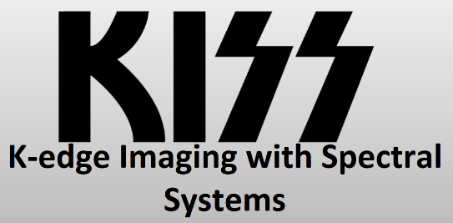
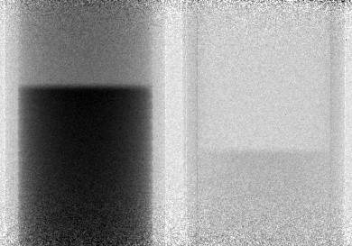

Spectral system @ SYRMEP beamline
14
SYRMEP beamline
Fixed radius frames
Radius = 0.5 m
Focus ~ 0.25 m
Pixirad 8 - detector
Bent Laue crystal
White beam
Iodine
Xenon
33.2 keV
$$\frac{∆E}{dE} ≈50$$
Energy
dE = 0.1 keV
ΔE = 5 keV
Sample stage
34.6 keV
Largest bandwidth
so far!
Horizontal position
1 cm

Slide 15
Tomographic multi-material imaging
Iodine
Xenon
Iodine
Tomographic reconstruction
Xenon
Iodine
Xenon
Iodine
Xenon
Energy
Barium
Multi-material decomposition
Barium
Barium
Barium
Multi-material
density maps
Angular position
(sample rotation)
Linear Position
iodine
Goal: simultaneous cardiovascular + respiratory + inflammatory imaging!
barium
xenon
water
1 cm

Slide 16
DETECTOR-BASED SPECTRAL IMAGING
L. Brombal |23rd iWoRiD 2022 |Riva Del Garda (TN), Italy | 26-30 June 2022

Slide 17
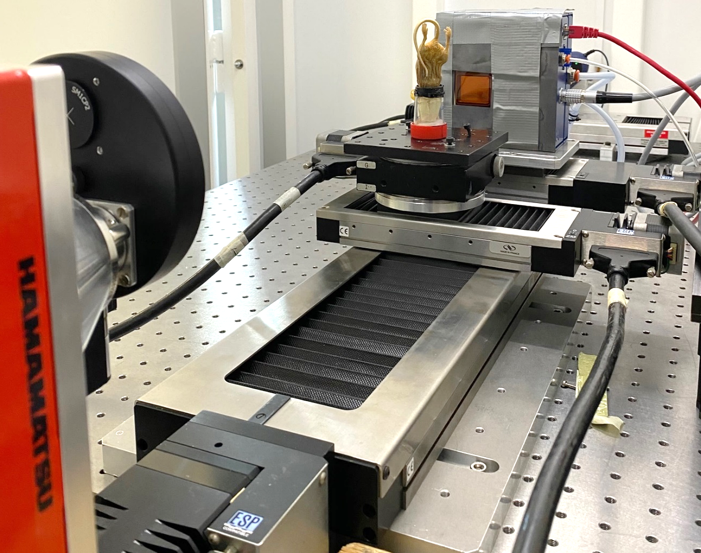
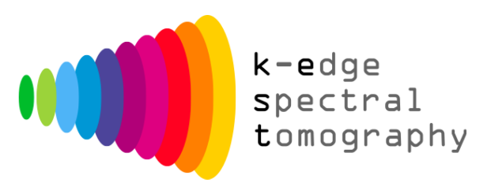
Detectors in spectral imaging
17
Pixirad - PixieIII
Spectral detectors can acquire multiple images over different energy channels in a single shot
High-Z sensors (CdTe, CZT, GaAs) are used for spectral imaging due to their high efficiency at high energies
Modern small-pixel chips feature charge sharing compensation mechanisms (← crucial for spectral imaging applications!)
Funded by INFN
Spectral µCT setup @ INFN - Trieste
Chip/Producer | Pixel size (µm) | N.o Threshold
Medipix3 | 55 | 2 (8 in 2x2 binning)
Pixirad – PixieIII | 62 | 2
Direct Conversion | 100 | 2
Dectris - Eiger 2 | 75 | 2
…
F Brun, et al. Phys. Med. & Biol. 65.5 (2020): 055016.
L. Brombal |23rd iWoRiD 2022 |Riva Del Garda (TN), Italy | 26-30 June 2022

Slide 18
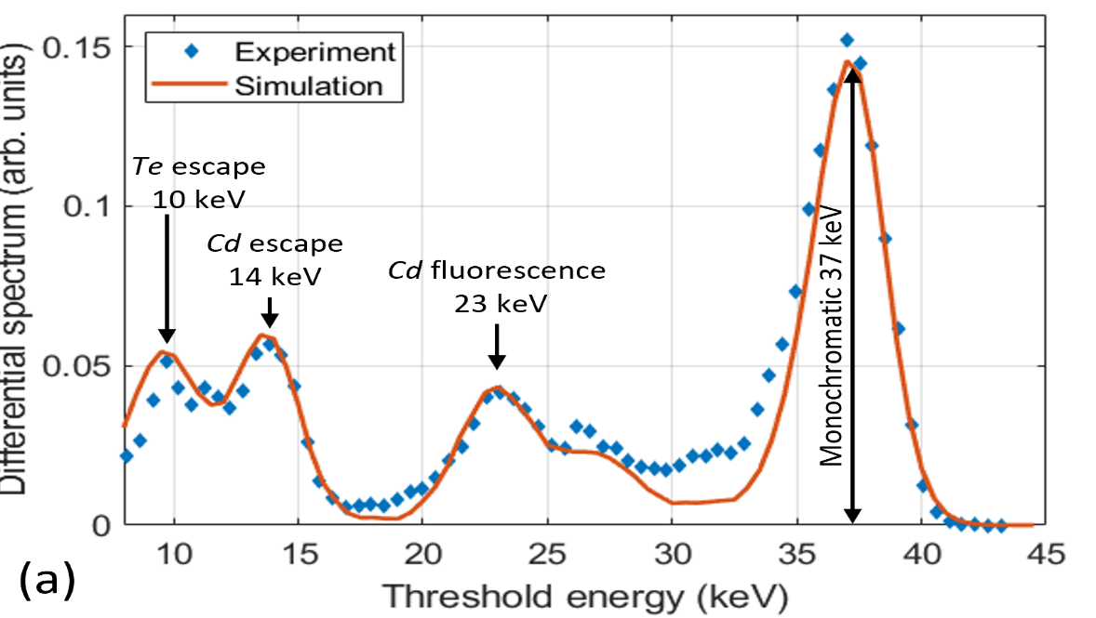
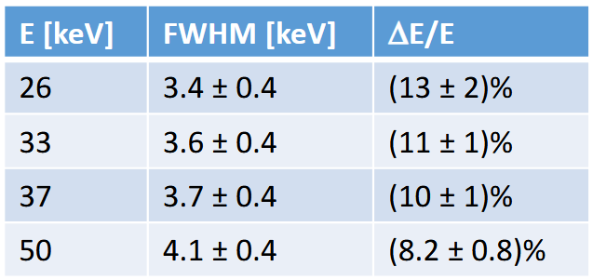
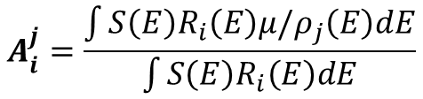



SYSTEM CHARACTERIZATION
18
Object composition
Detector response
X-ray spectrum/
Threshold selection
$$R_{low}\left(E\right)$$
$$R_{high}\left(E\right)$$
Poster
Optimization of energy threshold for fluorescence rejection in K-edge subtraction in synchrotron-based imaging with a spectral CdTe detector
Pasquale Delogu et al.
Pixirad1-PixieIII, NPISUM mode:
Differential threshold scan with 33 keV monochromatic X-ray @ SYRMEP
Brombal, L., et al. JINST 17.01 (2022): C01043.
Di Trapani, V., et al. NIM-A 955 (2020): 163220.
$$S\left(E\right)$$
Spectrum recorded in each channel
Th1<E<Th2
E>Th2
$$A_{i}^{j}=\frac{\int{S\left(E\right)R_{i}\left(E\right)μ/ρ_{j}\left(E\right)dE}}{\int{S\left(E\right)R_{i}\left(E\right)dE}}$$
$$R_{low}\left(E\right)S(E)$$
Material decomposition matrix
$$R_{high}\left(E\right)S(E)$$
Input energy spectrum, threshold selection and attenuation coefficients
L. Brombal |23rd iWoRiD 2022 |Riva Del Garda (TN), Italy | 26-30 June 2022

Slide 19
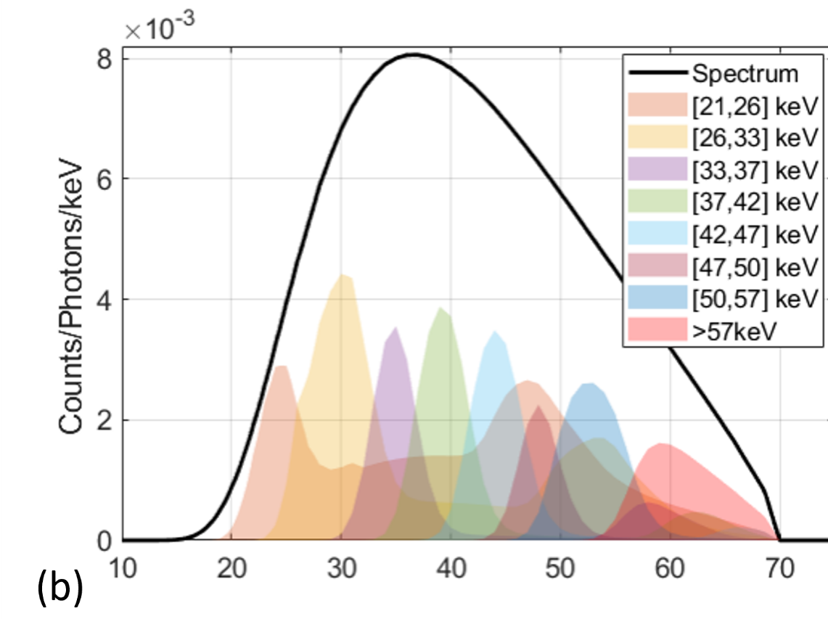
Quantitative multi-material µ-CT
19
Unpublished data – manuscript in preparation

Slide 20
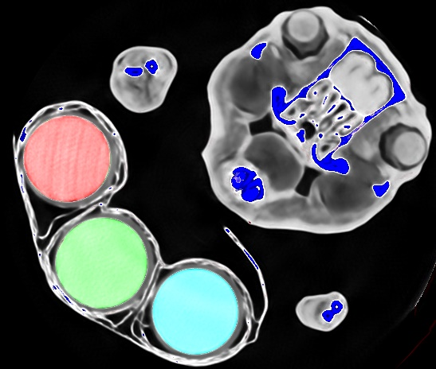
Quantitative multi-material µ-CT
Composite image
iodine
barium
gadolinum
bone
soft tissue
Unpublished data – manuscript in preparation

Slide 21
Crystal vs Detector-based spectral imaging
21
 | Crystal-based | Detector-based
Energy resolution | High (~100 eV) | Low (~3 keV)
Multi-material decomposition | Yes (nearby K-edges) | Yes (well separated K-edges)
Sensitivity | High – gold standard (<1 mg/ml) | Medium (function of detector/spectrum)
Setup complexity | High | Low
Scalability | Only in synchrotrons | Everywhere
L. Brombal |23rd iWoRiD 2022 |Riva Del Garda (TN), Italy | 26-30 June 2022

Slide 22
OVERVIEW
Principles
X-ray spectral imaging
  Crystal-based systems
  Detector-based systems
Phase-contrast imaging
  Analyzer-based imaging @ synchrotron
  Edge illumination in the lab
PEPILab: a compact spectral and phase-contrast imaging tool
L. Brombal |23rd iWoRiD 2022 |Riva Del Garda (TN), Italy | 26-30 June 2022

Slide 23

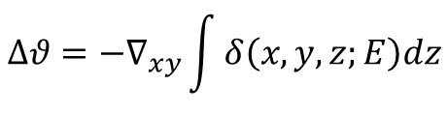
Phase effects
23
Refraction
(= differential phase contrast)
Ultra-small angle scattering
(= dark field)
y
Sample
Microstructured sample
x
×
z
$$∆θ$$
$$∆θ=−∇_{xy}\int{δ\left(x,y,z;E\right)dz}$$
Within the ray-optical approximation phase effects = refraction
Refraction is proportional to the gradient of δ → strong at the edges
Refraction angles range 1-100 µrad
In microstructured samples multiple-refraction occurs, causing a diffusion of the beam in the range 1-100 µrad
The “amount of diffusion”, i.e. scattering signal, depends on sample’s properties at a scale smaller than the system’s spatial resolution
Phase-contrast imaging = to transform phase effects into detectable intensity modulations
L. Brombal |23rd iWoRiD 2022 |Riva Del Garda (TN), Italy | 26-30 June 2022

Slide 24
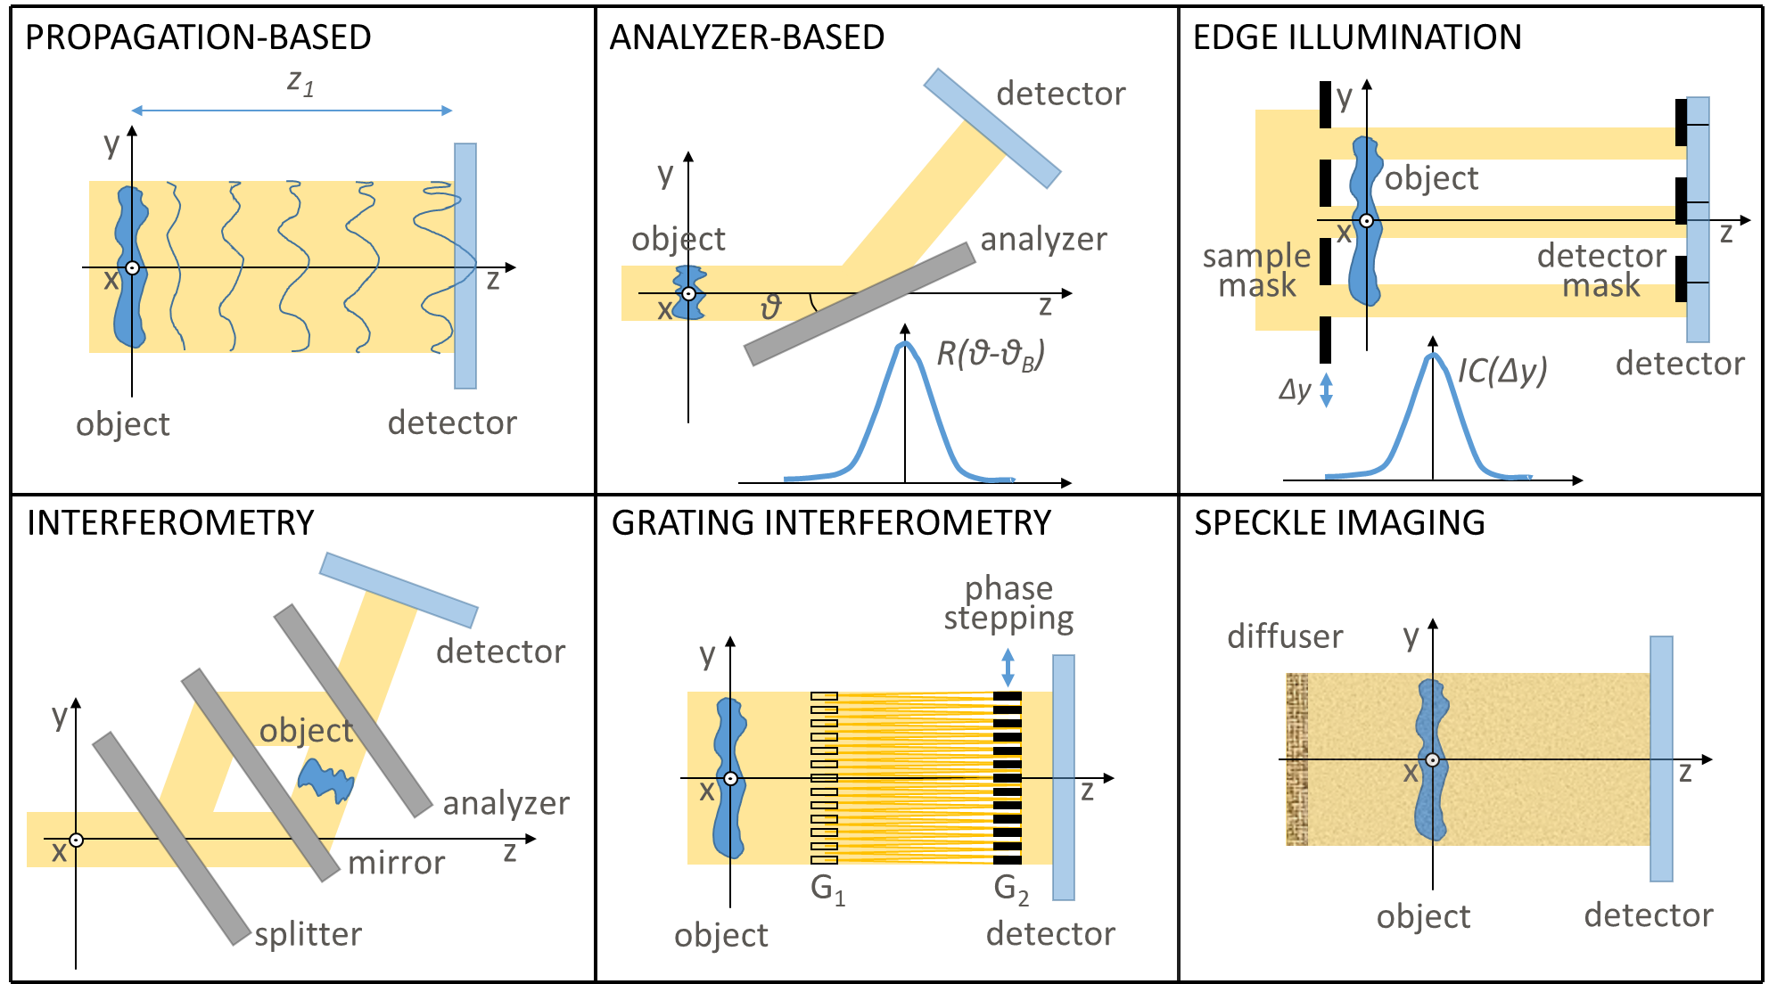

Slide 25
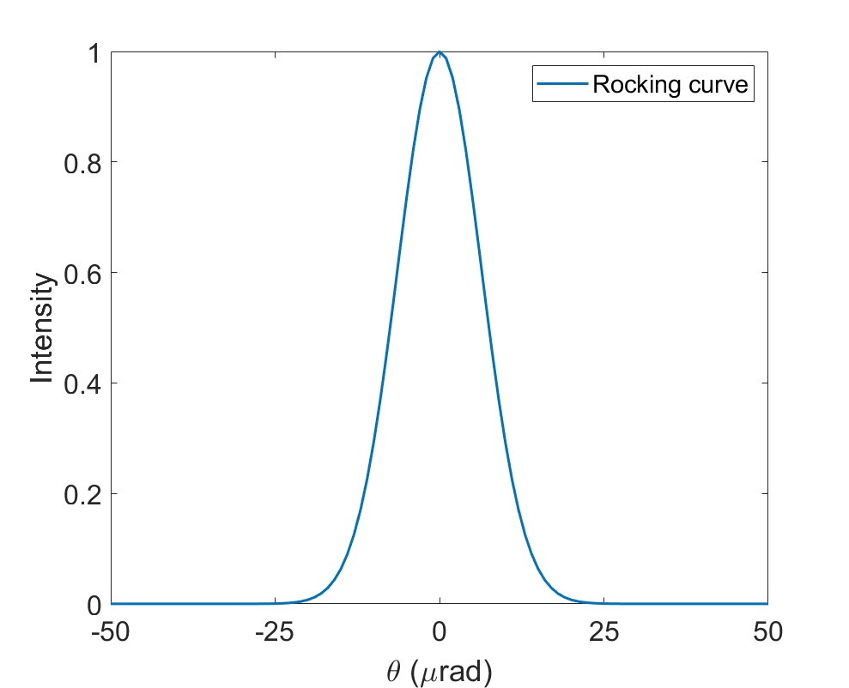
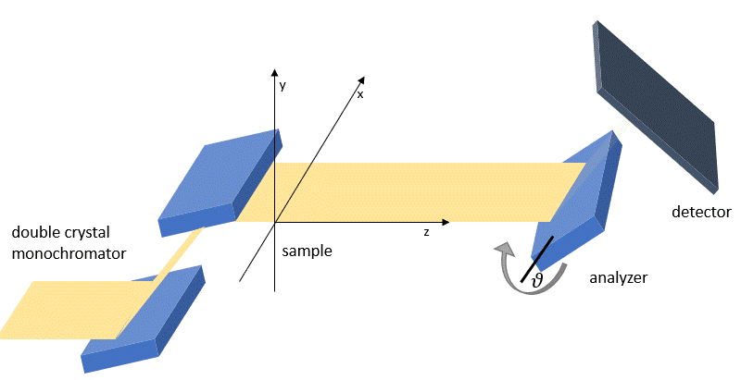
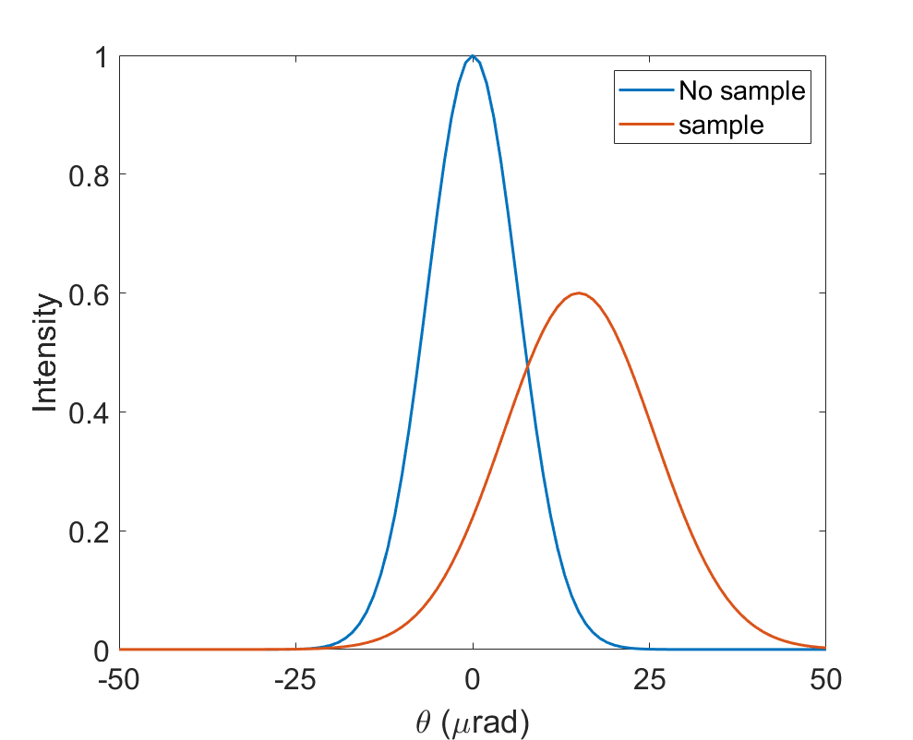
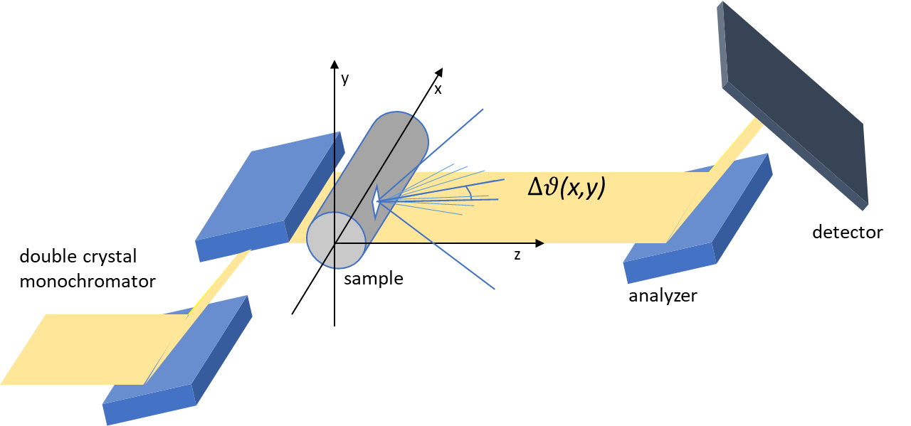

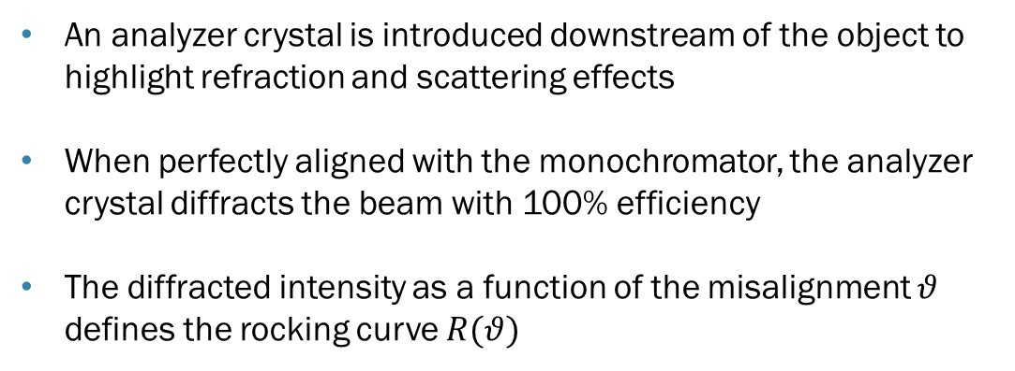

Analyzer-Based Imaging (ABI)
25
$$∆θ$$
$$θ$$
analyzer
Chapman, D. et al., Phys.Med.Biol. 42 2015 (1997)
Arfelli, F. et al., Sci. Rep. 8 362 (2018)
An analyzer crystal is introduced downstream of the object to highlight refraction and scattering effects
When perfectly aligned with the monochromator, the analyzer crystal diffracts the beam with 100% efficiency
The diffracted intensity as a function of the misalignment $θ$ defines the rocking curve $R(θ)$
The presence of the sample modifies the rocking curve
$R\left(θ\right)$ → $T×R\left(θ−∆θ\right)∗S$
Transmission
Refraction
Scattering
L. Brombal |23rd iWoRiD 2022 |Riva Del Garda (TN), Italy | 26-30 June 2022

Slide 26







Edge Illumination (EI)
26
mask displacement
$$∆x=\frac{∆θ}{z_{2}}$$
Poster
Unified Modulation Pattern Analysis algorithm (UMPA) for 1D sensitive X-Ray Phase Contrast Imaging techniques
Vittorio Di Trapani et al.
M Endrizzi et al. App. Phys. Letters 104.2 (2014): 024106.
$IC\left(x\right)$ → $T×IC\left(x−∆x\right)∗S$
  In edge illumination (EI) the X-ray beam is structured into mutually independent beamlets by a structured absorbing mask
  The beamlets are analyzed by a second mask close to the detector or by the detector itself
  The detected intensity as a function of the misalignment between the two masks is the Illumination curve $IC(x)$
DEI |  | EI
Monochromator | → | Sample mask
Analyzer crystal | → | Detector mask
Rocking curve | → | Illumination curve
L. Brombal |23rd iWoRiD 2022 |Riva Del Garda (TN), Italy | 26-30 June 2022

Slide 27
DEI & EI: pros and cons
27
DEI
Pros:
High sensitivity (gold standard)
Quantitativeness/monochromaticity
Cons:
Complex setup
Requires laminar beam
Limited to synchrotron facilities
EI
Pros:
Works with spatially incoherent sources
Compact
Cons:
Mask alignment is challenging
“photon hungry”: most photons absorbed by the masks
L. Brombal |23rd iWoRiD 2022 |Riva Del Garda (TN), Italy | 26-30 June 2022

Slide 28

DEI: Lung imaging
Transmission
Refraction/differential phase
Scattering/dark-field
Menk, R. H., et al. "A novel approach to separate absorption, refraction and scattering in analyzer based lung imaging." Journal of Instrumentation 15.05 (2020): C05069.

Slide 29



EI: soft tissue imaging and industrial inspection
Material science/industrial inspection
Virtual histology
Attenuation
Scattering
L Massimi et al. IEEE TMI 41.5 (2021): 1188-1195.
Matsunaga et al., J. Phys. D: Appl. Phys. 53 095401 (2020)

Slide 30
OVERVIEW
Principles
X-ray spectral imaging
  Crystal-based systems
  Detector-based systems
Phase-contrast imaging
  Analyzer-based imaging @ synchrotron
  Edge illumination in the lab
PEPILab: a compact spectral and phase-contrast imaging tool
L. Brombal |23rd iWoRiD 2022 |Riva Del Garda (TN), Italy | 26-30 June 2022

Slide 31





Photon-counting Edge-illumination Phase-contrast Imaging
31
PEPI is a project funded by the Young researchers grant programme (2020/22260) – National Scientific Committee 5 – INFN
AIM: to develop a new laboratory phase-contrast imaging system based on a photon counting detector and the edge-illumination technique with 2 key features:
Flexibility: multiple imaging modalities (spectral/phase-contrast) on a broad energy range (from soft tissue to material science samples)
Compactness: overall dimension < 1m
https://web.infn.it/PEPI/index.php
In collaboration with:
L. Brombal |23rd iWoRiD 2022 |Riva Del Garda (TN), Italy | 26-30 June 2022

Slide 32



Flexibility
32
Spectral
Single-Mask EI
Double-Mask EI
Detector
Detector mask
Sample mask
Sample
X-ray beam
Features
Features
Features
Attenuation imaging
Spectral imaging
Sensitivity to refraction (phase) and attenuation
Single shot imaging
Faster (2x or more) than double-mask
Sensitivity to refraction (phase), scattering and attenuation
High accuracy
L. Brombal |23rd iWoRiD 2022 |Riva Del Garda (TN), Italy | 26-30 June 2022

Slide 33


Simulation and Design
33
A Geant4 simulation platform accounting for the whole imaging chain including:
X-ray refraction
Detector’s energy response
Masks, material and geometry
…
The simulation was key in the choice of:
X-ray source (Hamamatsu L10101 – 40 – 100 kV)
Mask material/thickness (gold 250 µm)
Geometry (magnification 2)
…
Open source: https://web.infn.it/PEPI/index.php/it/#simulation
Brombal, L., et al. Journal of Physics D 55.4 (2021): 045102.
Brombal, L., et al. JINST 17.01 (2022): C01043.
L. Brombal |23rd iWoRiD 2022 |Riva Del Garda (TN), Italy | 26-30 June 2022

Slide 34



Realization
34
How it started…June 2021
How it is…June 2022
Photo by Luigi Rigon
L. Brombal |23rd iWoRiD 2022 |Riva Del Garda (TN), Italy | 26-30 June 2022

Slide 35




Setup
35
Filters for spectral tuning
LATERAL VIEW
Pixirad
Detector mask
Sample mask
X-ray source
Sample stage
50 cm
TOP VIEW
Mask alignment + slide in/out
Mask alignment + slide in/out
65 cm
L. Brombal |23rd iWoRiD 2022 |Riva Del Garda (TN), Italy | 26-30 June 2022

Slide 36







Spectral CT
Bin1 [27, 33] keV
Bin2 >33 keV
Ex-vivo murine model perfused with iodine-based contrast medium
1 cm
Bone map
Iodine map
Voxel size 38 µm
In collaboration with

Slide 37








Double mask
Single mask
Flower
low energy – 60 kVp
Smartphone camera
high energy – 100 kVp
Transmission
5 mm
Refraction
5 mm
5 mm
Preliminary results

Slide 38
THANK YOU!
Next steps
Spectral phase-contrast imaging
Applications…
Open to collaborations!
Luigi Rigon (University of Trieste & INFN)
Fulvia Arfelli (University of Trieste & INFN)
Francesco Brun (University of Trieste & INFN)
Ralf H. Menk (Elettra & INFN)
Vittorio Di Trapani (University of Trieste)
Paola Perion (University of Trieste)
Sandro Donato (University of Calabria & INFN)
Alessandro Olivo (University College London)
Marco Endrizzi (University College London)
…
Acknowledgements

