Slide 1
Prospects of Large Hydropower Development in Africa
Presented by Ing Prof Eric Ofosu Antwi
(Director of RCEES, UENR)

Slide 2
Table of Contents
Introduction
Trends in Hydropower Development
River Basins of Africa
Hydropower Potential of Africa
Challenges with Hydropower Development in Africa
Financing of Hydropower
Lesson’s Learnt: Critical success and failure factors in Hydropower Projects
Summary of key findings and recommendations

Slide 3





Introduction
Over 645 million people in Africa, approximately half the continent lack access to reliable and clean energy
The Africa Agenda 2063, seeks to build a prosperous Africa based on inclusive growth and sustainable development
The AfDB has prioritized to “Light Up and Power Africa” to accelerate Africa’s development.
Hydropower remains the main renewable resource in Africa
Hydropower constitutes 15% of Africa’s total electricity share (37 GW), projected to increase to 23% by 2040

Slide 4
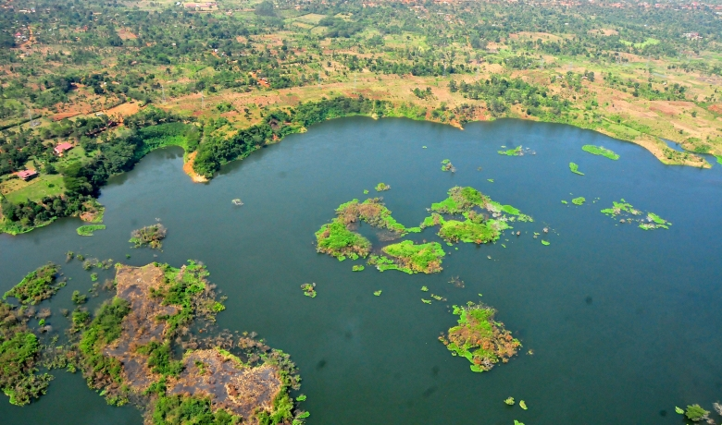
Introduction
Development of large Hydropower to support energy sustainability is key because
It can respond to variable load requirements, from short term (daily peaking) to weekly and seasonal variability.
It could feature in the mid-merit, peak merit and storage as they have low margin cost.
It can support the penetration of intermittent Renewable Energy i.e. solar and wind.
It has the flexibility to generate electricity on demand and reduces dependence on the variability of inflow.
Bujagali hydropower project
Photo credit: Aga Khan Development Network

Slide 5
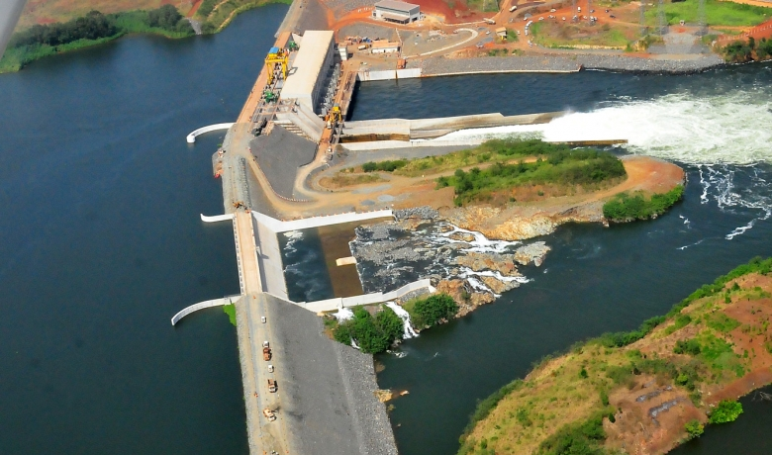
Introduction
It can play a large role in the total CO₂ emissions reduction.
It can meet baseload or peak load because it can be operated to start or shut down on short notice.
It offers a hedge against volatile energy prices and can play an important role in energy trade and regional power pools.
Multipurpose HPP systems can provide other benefits such as flood control, water supply, irrigation, navigation, and recreation.
Bujagali hydropower project
Photo credit: Aga Khan Development Network

Slide 6
Global Trends in hydropower development
The global total hydropower generation stands at 4,306 TWh as of 2019 (1308 GW) (IHA, 2020)
A series of large Hydropower projects were deployed worldwide between the 1940s and 1960s
Between 1999 and 2005 (orange arrow), hydropower development was largely halted worldwide
From 2005 onwards (green arrow) the development of hydropower has seen an upswing
Global total hydropower generation since 1980 (Source: IHA, EIA, REN21- Renewables 2014 Global status Report)

Slide 7
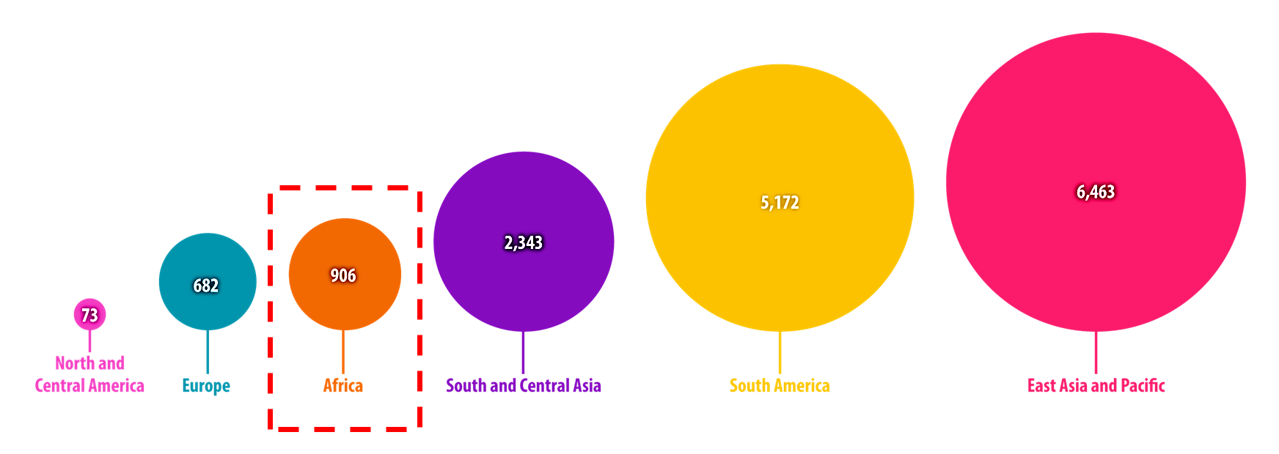
Regional Trends in Hydropower Development
New installed capacity by region (MW) in 2019
  50 countries added hydropower installed capacity. The region to add the most capacity was East Asia and the Pacific, followed by South America and then South and Central Asia.
Source: IHA, 2020

Slide 8
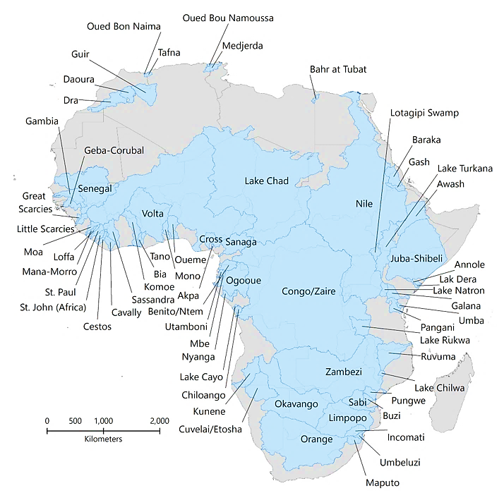
River Basins in Africa
Africa has 63 transboundary basins
The major hydro resources of the continent are located in Central Africa (40%), Eastern Africa (28%) and Southern Africa (23%) (IRENA International Renewable Energy Agency, 2015). The remaining 9% is shared between West and North Africa.
The hydro potential in Africa is mainly located in 4 hydroelectric hubs and revolves around 7 key river basins (UNEP, 2017).
  This includes the hub in West Africa located on the Niger and Senegal River,
  The Central Africa’s hub on the Congo river,
  The Eastern Africa’s hub, which involves the Nile River basin development and
  The Southern Africa’s hub, involving the Orange, Limpopo and Zambezi rivers

Slide 9
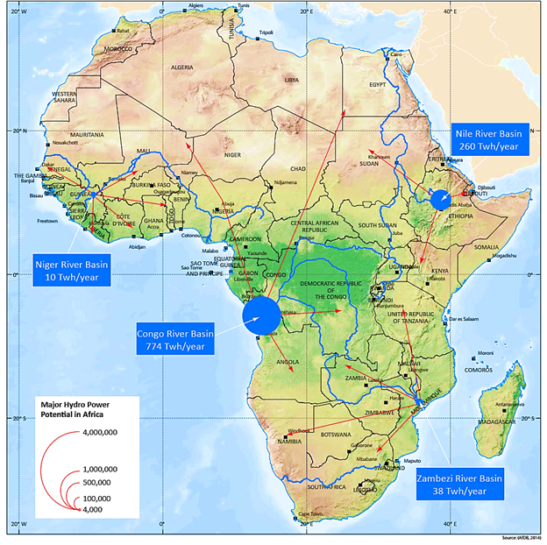
Hydropower potential of Africa
Region | Technically feasible hydro generation potential (GWh) | Total installed hydro capacity (MW) | Hydro capacity under construction (MW)
North Africa | 91,252 | 6,759 | 358
Central Africa | 492,758 | 4,014 | 698
East Africa | 549,218 | 7,065 | 7,411
West Africa | 109,371 | 4,964 | 2,602
Southern Africa | 303,715 | 10,051 | 3,921

Slide 10
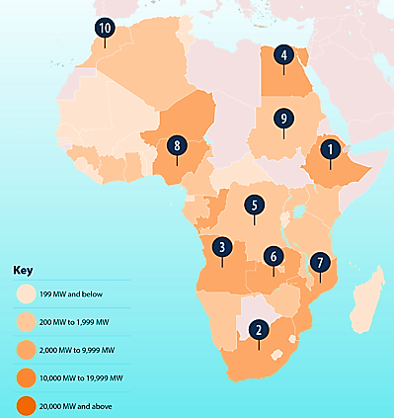
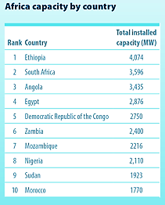
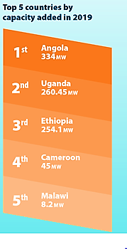
Trends in Hydropower Development in Africa
Source: IHA, 2020
Notes:
Africa installed capacity in 2019

Slide 11
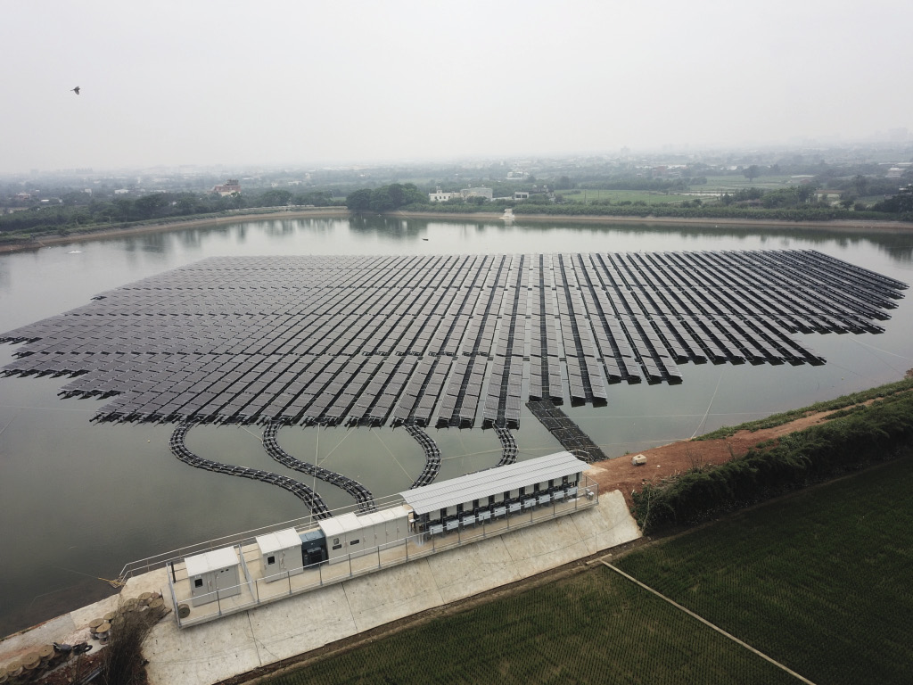
Trends in hydropower development-Technological Evolution
Single Purpose (only power generation)
Multi-purpose (power + other uses such as irrigation, flood control, water supply, recreation,aquaculture, etc.)
Hybrid systems (Hydro+solar, wind, etc)
Pumped hydro Energy Storage
Floating solar PV (FPV) solutions installed on dammed surfaces are technically feasible and make use of underutilized water surfaces to ease competition for land use. They can be combined with battery storage (BESS) for higher efficiency/productivity.
Some benefits include:
The FPV and BESS will act as an associated generation plant and offer complementary functions to the hydro power plant.
FPV reduces evaporation rate of the water body therefore conserving water
The co-location of the system means no extra transmission infrastructure is required
Bi-facial solar PV modules can be used to boost system performance by harnessing reflected irradiation from the water surface
FPV benefits from improved cooling system from the water evaporation increasing output of the PV modules.
Photo credit : PV magazine
Notes:
Benefits of a floating solar PV plant would include:
The FPV and BESS will act as an associated generation plant and offer complementary functions to the hydro power plant. During daytime peak solar PV generation, the hydro will reduce its output and smooth the variable PV output. At night the hydro can operate on peak output. Similarly, during the dry season, which also happens to be the highest irradiation period, the solar plant will generate at peak capacity allowing the hydro plant reservoir to refill for night dispatch
FPV reduces evaporation rate of the water body therefore conserving water.
The co-location of the system means no extra transmission infrastructure is required. The solar PV production during the dry season also ensures maximum utilization of the high voltage transmission line already in place.
Bi-facial solar PV modules can be used to boost system performance by harnessing reflected irradiation from the water surface.
FPV benefits from improved cooling system from the water evaporation increasing output of the PV modules.

Slide 12
Trends in hydropower development-Environmental and Social consideration
Hydropower develoment (with less environmental consideration)
Hydropower development (with Environmental and Social Consideration)
Hydropower development (with Environmental and Social Sustainability+climate change)
Climate change has the potential to impact the hydropower sector through regional changes in rainfall and water availability, protracted drought events, significant variation in temperature regimes, and more frequent and severe weather events.
It’s likely that future conditions will be more variable than current ones. But it is not being adequately considered in the design of many hydropower schemes.
Examples of the impact of Climate change on existing hydropower projects include:
  Zambia - A severe drought in 2015 led to a drop-in output at the largest hydropower plant, resulting in power blackouts.
  Cahora Bassa in Mozambique, the Kenyan Sondu-Miriu and Masinga, and Lake Malawi
  Low water level in the Akosombo dam in Ghana
Due to the challenges posed by Climate Change, developers, MDBs, government, etc. may have reduced confidence in hydropower development

Slide 13







Challenges with hydropower development in Africa
    Environmental
    Biodiversity loss, erosion, land degradation, loss of soil quality, etc.
    Political
    Political and security challenges affect hydropower project development especially in the context of regional integration.
    Reaching agreement on a hydropower scheme in a transboundary setting
    Technological
    Underdeveloped transmission networks are limiting factors of reliable supply of electricity in the energy power pools across the continent
    Institutional
    In transboundary basins, the emerging water scarcity, and pollutions issues need to be addressed through a common basic policy, legal and institutional arrangements, which often is not the case.
    Socio-economic
    Environmental and ecological impacts of the development;
    Local socio-economic impacts associated with the hydropower project;
    Public participation and consultation practices
    Financial
    Lack of long-term financing mechanism is a barrier (due to huge upfront capital)

Slide 14
Some hydropower financing models
Sovereign financing through Multilateral lenders
The Export Credit Agencies (ECA) model
The public-private partnerships (PPPs)/ Independent power producers (IPPs)model
  Example, Build-Operate-Transfer (BOT), Build-Own-Operate-Transfer (BOOT), etc.
Finance, Engineer, Lease and Transfer Model (FELT Model)

Slide 15
Lessons Learnt: Critical Success and Factors in Hydropower Projects
A resilient approach: Should adapt to the Natural Challenges and Geography of the Region.
Increase reliability: Increasing capacity of the hydropower project
A range of local benefits: Including increasing electricity access, job creation, improvement in the local economy, etc.
Government support: Favourable power Sector reform policies that creates competitive environment to attract private sector participation.

Slide 16
Lessons Learnt: Critical Success and Factors in Hydropower Projects cont’d
Expertise and knowledge: Attraction of a highly skilled workforce in the project implementation and operationalization.
Fair evaluation of social compensation: Factor of success if population concerned at both the upstream flooded areas and downstream are properly expiated.
Sound engineering design, procurement, implementation and operations.

Slide 17
Lessons Learnt: Critical Failure Factors in Hydropower Projects
Some of the failure factors that have affected hydropower development in Africa include:
Unfair evaluation of social compensation:
  compensations are usually paid to the population displaced from upstream flooded areas and does not benefit population downstream.
  (Example is the Akosombo Hydropower Dam and unaddressed downstream impact)

Slide 18
Lessons Learnt: Critical Failure Factors in Hydropower Projects Cont’d
Unregulated electricity market:
  a situation where the structure of the state-owned utility companies are still vertically and horizontally bundled, government-controlled regulators, etc., creating lack of market competition.
Risk challenges (Economic, Technical, Political, Social, Environmental, etc.)
Project schedule delays
Cash flow difficulties

Slide 19
Key Findings
The paper made the following specific observations:
  Most of the early (1960-70s) large hydropower dams were designed without the consideration of Climate Change
  Lack of adequate and requisite data (hydrological, meteorological, energy demand, future projections, etc.)
  Majority of the large hydropower dams developed in Africa are single purpose.
  The other benefits of multipurpose dams, are not developed in a majority of dams

Slide 20
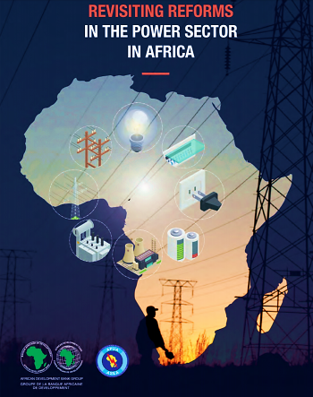
Key Findings-cont’d
  Compensation payments to upstream inhabitants leaving the downstream inhabitants.
  Small internal/domestic markets for their potential large hydropower projects are largely inadequate to meet the financing requirements for potential investors.
  Lack of power sector reforms that enable upscaled development of Hydropower.
  Lack of clear-cut policies on hydropower at the National and Regional Level.

Slide 21
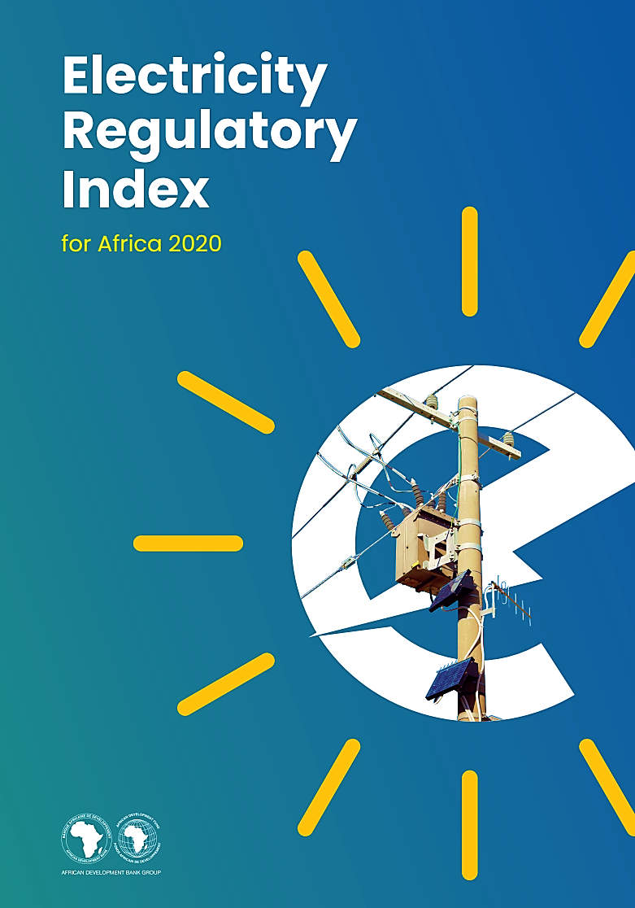
Key Findings-cont’d
A number of potential hydropower projects in Africa remain undeveloped because of transboundary conflicts and right to water (e.g., GERD in Ethiopia with related conflict with Sudan and Egypt)
There is lack of regional regulation targeted towards large hydropower development.
Main Hydropower developments in Africa has been government loans financed by MDBs and foreign countries without private sector involvement.

Slide 22
Key Findings-cont’d
The driving force behind recent increase in hydropower development in Africa has been financing of large hydropower projects from Brazil, China, India and the Gulf State
The enabling environment for Private Sector investment in Large Hydropower Development in Africa is inadequate
The AfDB has focused on providing loans and in some cases technical assistance in the hydropower development across Africa.

Slide 23

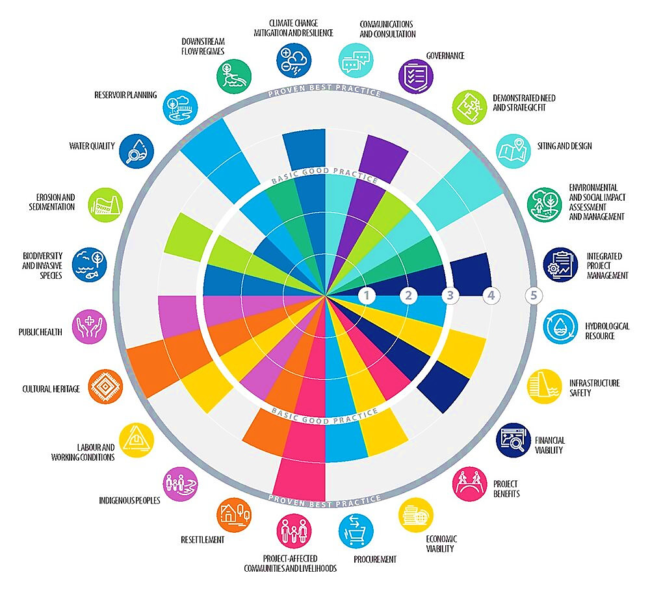
Recommendations
Factor climate change scenarios, competing water uses and future land-use changes in Hydropower Designs
Influence National and Regional policies to obtain requisite datasets needed for Hydropower development decisions and other Renewable Energy Technologies
Effective engagement of affected communities and stakeholders.
The AfDB should adopt and religiously adhere to the sustainability assessment protocol of IHA together with the Bank’s integrated safeguard policy.

Slide 24
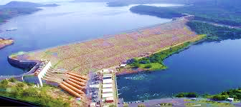
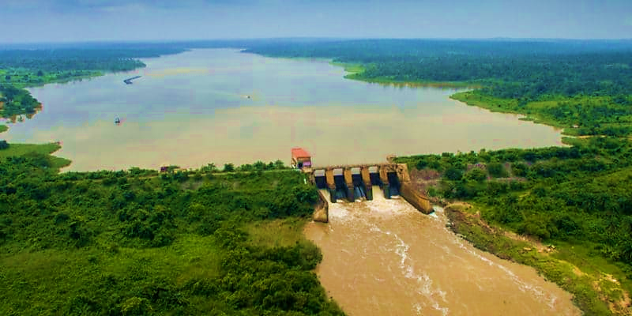
Recommendations cont’d
Target the development of multipurpose large hydropower plants instead of single purpose large hydropower
Other purposes of existing multipurpose dams should be developed to address the numerous social and environmental issues.
The Bank could provide technical assistance for the development of bankable feasibility studies through a collaborative joint development framework.
The Bank should selectively support large hydroelectric power plants designed to withstand extreme climate conditions with multipurpose regional benefits and electricity markets.

Slide 25
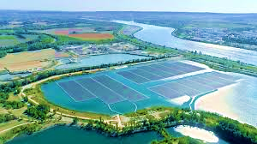
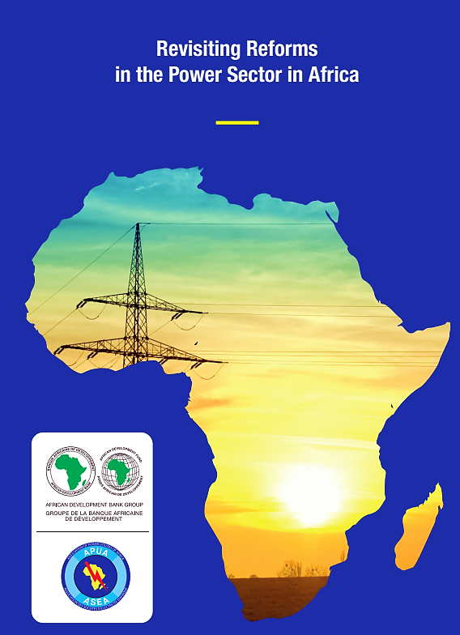
Recommendations – cont’d
Diversify investment in other renewable energy sources (e.g., Floating Photovoltaic).
Drive policies that are aimed at Country and Regional Electricity market liberalization.
Regional Member Countries should be encouraged to unbundle their electricity utilities, vertically and horizontally, to introduce competition, to create independent regulators, and to make space for private sector participation.

Slide 26
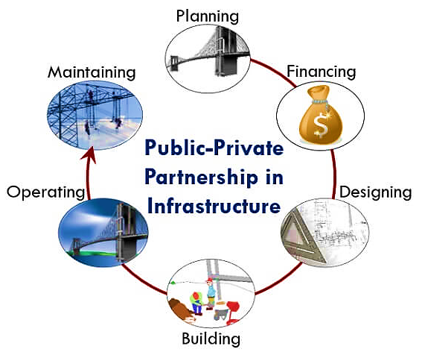
Recommendations – cont’d
Develop supporting policies aimed at building the African Continent’s capacity in the governance, engineering and electricity market of Hydropower projects.
The Bank should go beyond lending and involve technical support, knowledge sharing, capacity building, policy dialogue, economic and sector reforms and support during project preparation and implementation.
The Bank should consider the Finance, Engineer, Lease and Transfer (FELT) Model for Financing Hydropower in Africa which will rope in Private Sector investment.

