Slide 1

The HL-LHC High Order Correctors production status
Marco Statera
on behalf of the LASA team
INFN Milano - LASA
CERN – Feb 9th 2022

Slide 2
TEST 1
date | Magnets | Training and quench memory | Other results
Jul 2020 | MQSXFP1c MCDXF01 | compliant | First test on a series magnet
Nov 2020 | MCDXF02 MCOXF01 MCSXF01 MCTXF01 | compliant | Wedge movement observed (MCOXF01 MCTXF01) and feedback on assembly of batch1a First test on a long dodecapole
Jan 2021 | MCDXF03 MCOXF03 MCSXF03 MCTXF2 | compliant | MCOXF03 wedge movement – accepted (updated in Aug 2021)
Mar 2021 | MCOXF02 MCOXF04 MCSXF02 MQSXF2 | compliant | Wedge movement observed First test on a skew quadrupole

Slide 3
TEST 2
date | Magnets | Training and quench memory | Other results
Mar-Apr 2021 CERN | MCDXF02b MCDXF04 MCSXF01b MCDXF05 MCDXF06 MCSXF04 MCDXF01b MCTXF1b | compliant | Tested at CERN
Apr 2021 | MQSXF1 MCSXF05 MCTSXF1 MCTSXF2 | compliant | MQSXF1 performance ok but wedge supports not tightened after thermal cycles. Magnets is repaired and tested again First short dodecapole tested
Jun 2021 | MCOXF04b MCOXF07 MCSXF06 MQSXF3 | compliant | Added wedge supports for MCOXF04b and MCOXF07 Modified wedge supports for MQSXF3
aaa

Slide 4
TEST 3
date | Magnets | Training and quench memory | Other results
Sep 2021 CD7 | MCDXF07 MCDXF08 MCSXF07 MCTXF3 | compliant
Nov 2021 CD8 | MCOXF05 MCOXF01b MCSXF08 MCTXF4 | compliant
Dec 2021 CD9 | MCOXF08 MCOXF06 MCSXF09 MQSXF1b | compliant
Feb 2022 CD10 | MCTSXF3 MCTSXF4 MCSXF10 MQSXF5 | Test ongoing
a

Slide 5
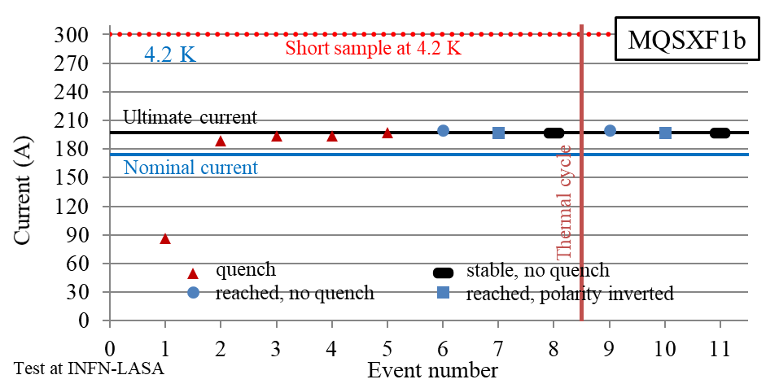
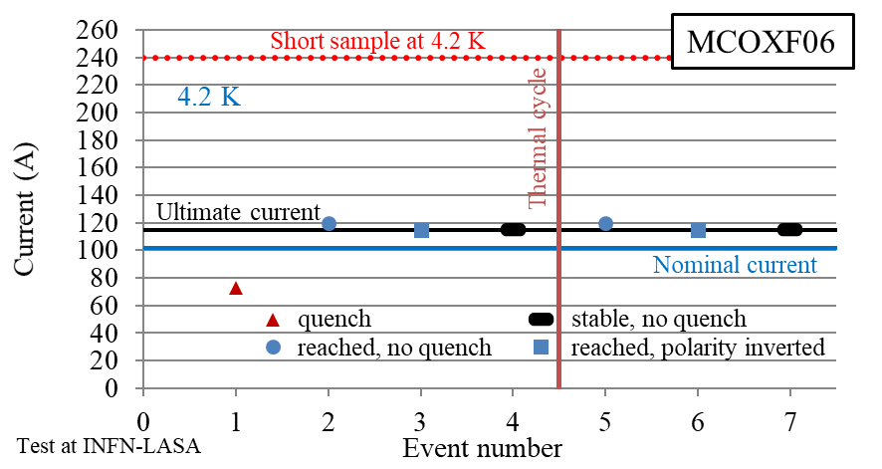
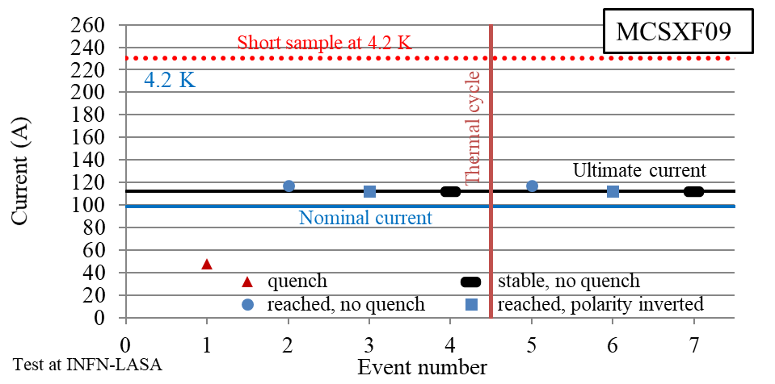
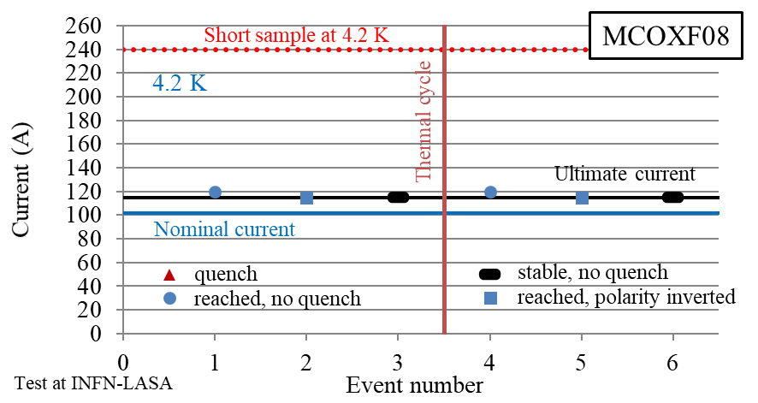
Powering test n9 HOC - training
MCOXF08 MCOXF06 MCSXF09 MQSXF1b
By M. Prioli

Slide 6
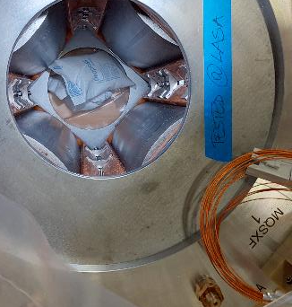
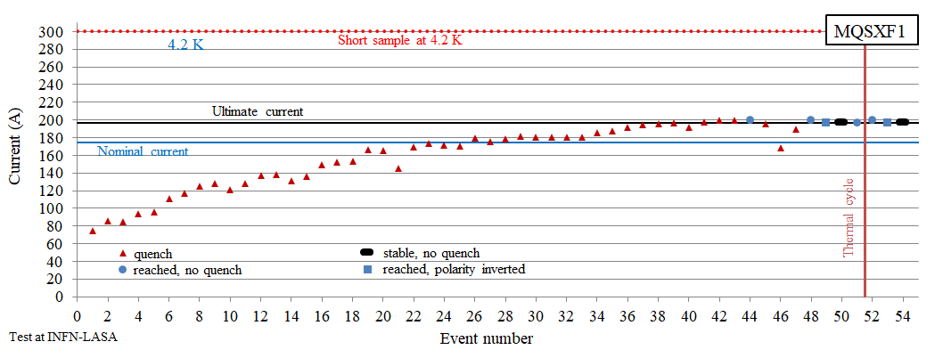
M04_1 assemblies comparison
Second assembly due to unfastened supports for wedges EDMS 2611005
The coils have good memory
Several quench with all coils quenched (by S. Mariotto)

Slide 7
Powering test n9 HOC – MM field integral
High reproducibility wrt simulations
MCOXF06 | Measured (Calculated)
Nominal current I_{nom} | 102 A
Integrated field @ I_{nom} @ 50 mm | 71.8 T mm (70.7 T mm)
Difference with calculated data @ I_{nom} | 1.6 %
MCSXF09 | Measured (Calculated)
Nominal current I_{nom} | 99 A
Integrated field @ I_{nom} @ 50 mm | 95.4 T mm (93.5 T mm)
Difference with calculated data @ I_{nom} | 2.0 %
MCOXF08 | Measured (Calculated)
Nominal current I_{nom} | 102 A
Integrated field @ I_{nom} @ 50 mm | 71.7 T mm (70.7 T mm)
Difference with calculated data @ I_{nom} | 1.4 %
MQSXF1b | Measured (Calculated)
Nominal current I_{nom} | 174 A
Integrated field @ I_{nom} @ 50 mm | 719.0 T mm (700.0 T mm)
Difference with calculated data @ I_{nom} | 2.7 %
By E. De Matteis

Slide 8
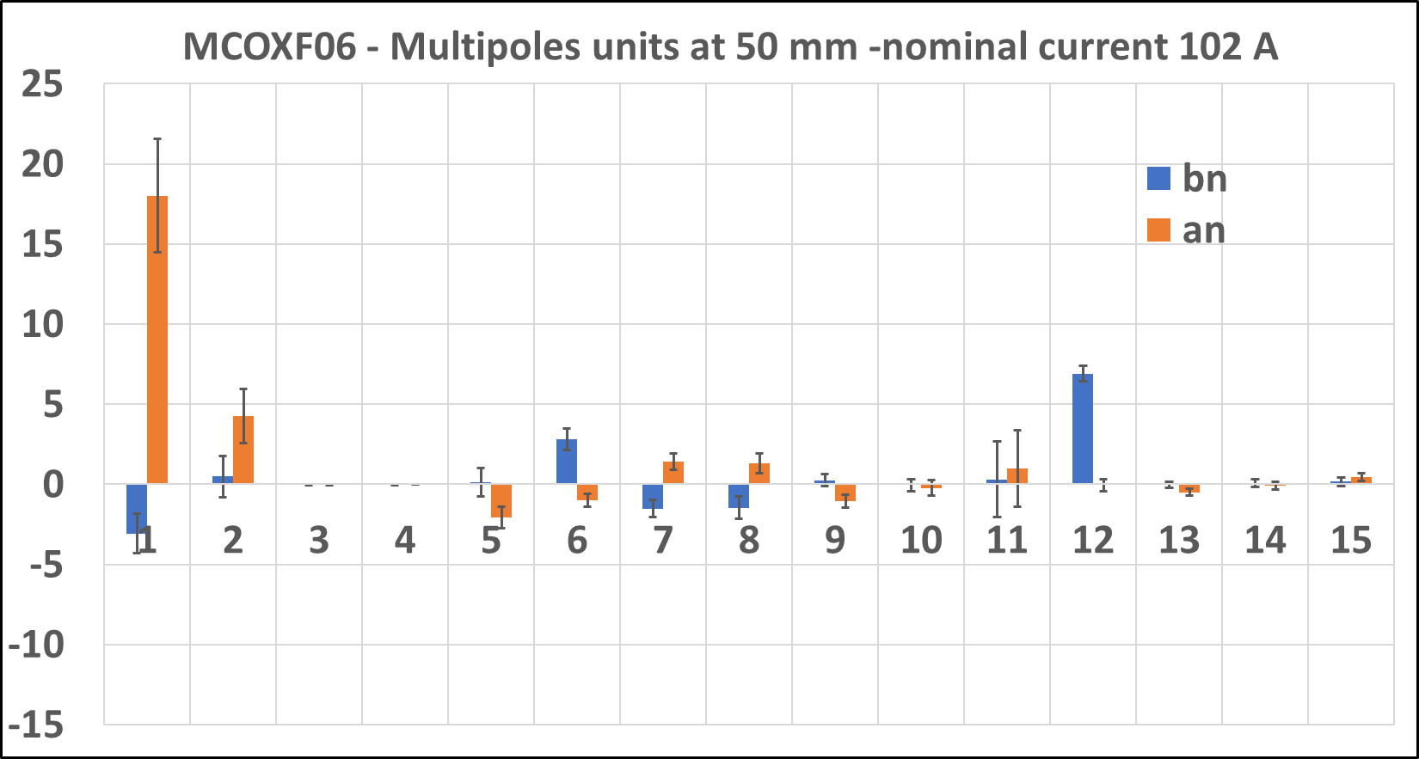
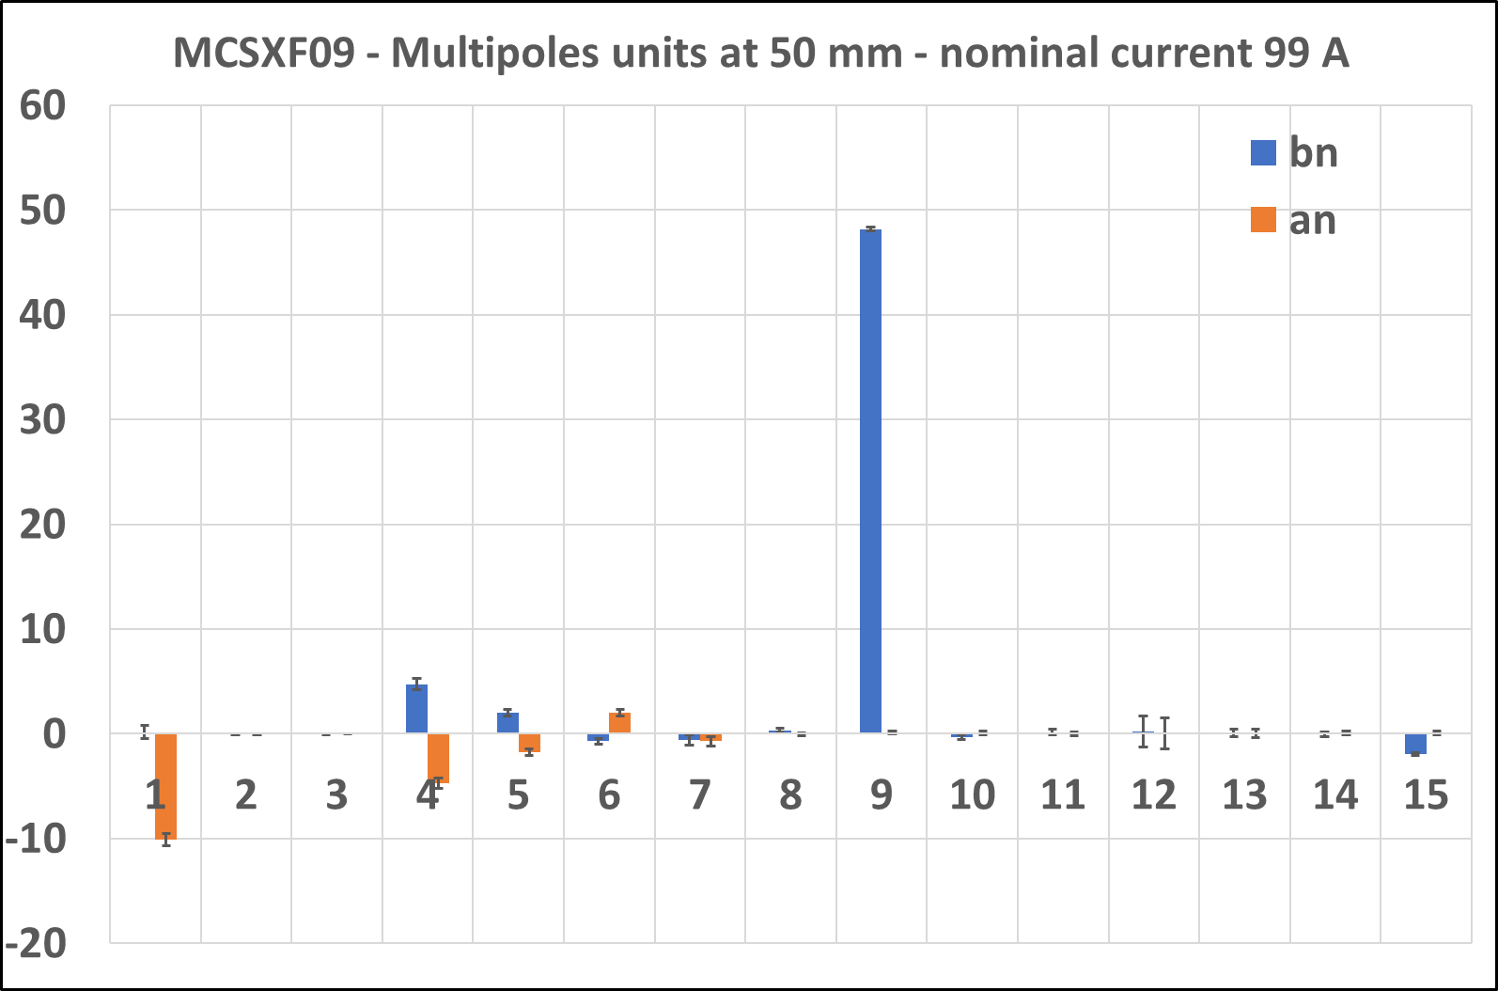
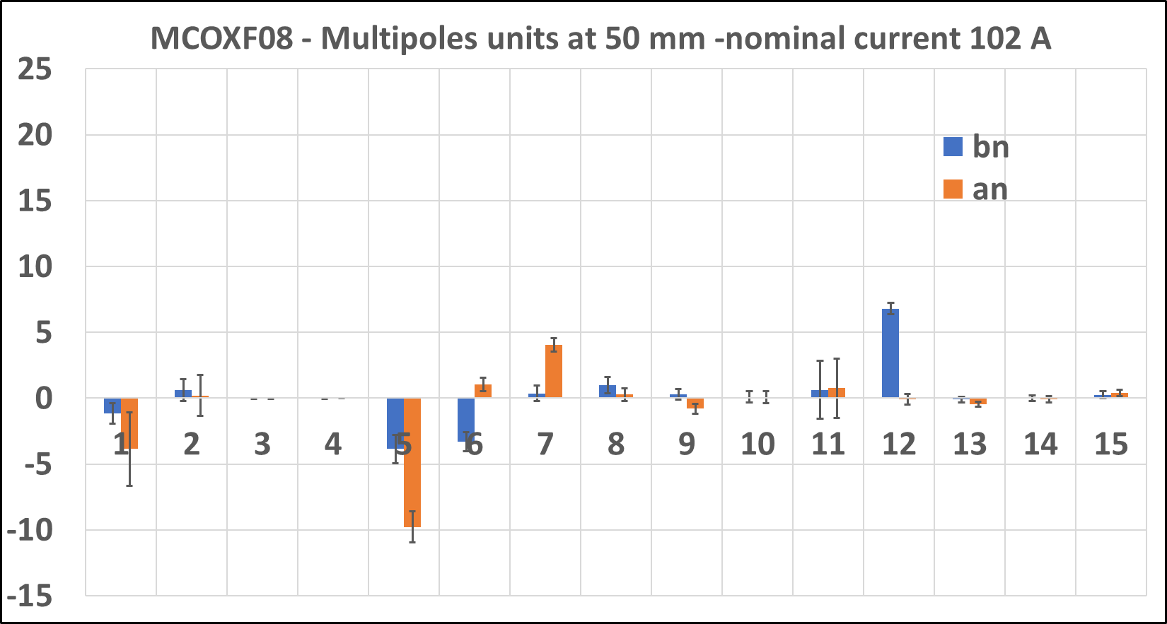
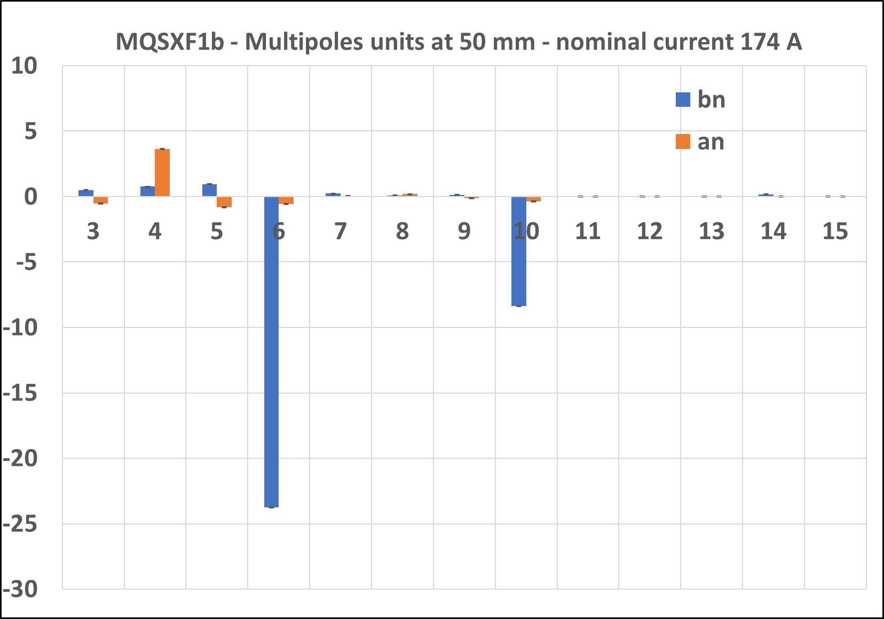
Powering test n9 HOC – MM harmonics
By E. De Matteis

Slide 9
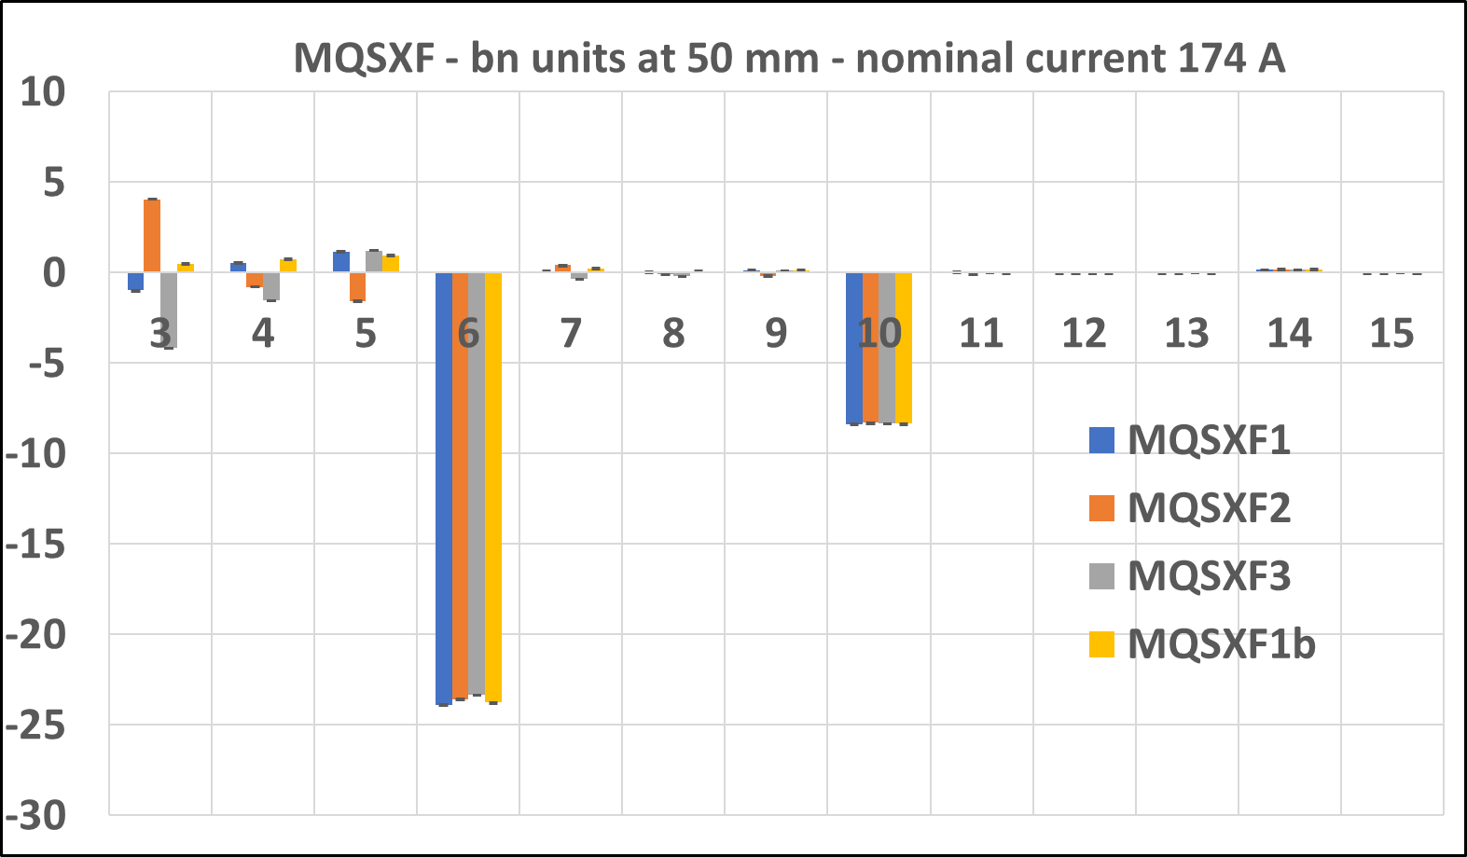
MM results – MSQXF Family
Order | Magnet |  | Specification | Calculations | Measured at LASA
 |  | Current [A] | BdL [T mm] | BdL [T mm] | BdL [T mm] | diff [%]
2 | MSQXF1 | 174 | 700 | 700.0 | 718.8 | 2.7
 | MQSXF1b |  |  |  | 719.0 | 2.7
 | MSQXF2 |  |  |  | 720.36 | 2.8
 | MSQXF3 |  |  |  | 719.6 | 2.8
Multipoles in the specs (< 100 units)

Slide 10
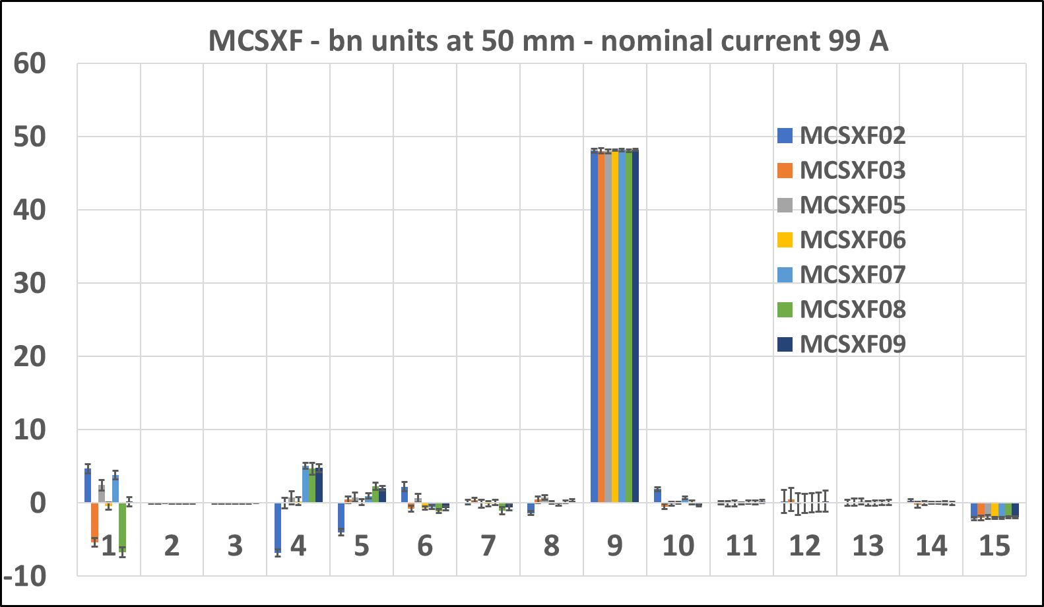
MM results – MCSXF Family
Order | Magnet |  | Specification | Calculations | Measured at LASA
 |  | Current [A] | BdL [T mm] | BdL [T mm] | BdL [T mm] | diff [%]
3 | MCSXF02 | 99 | 93.5 | 93.5 | 95.22 | 1.8
 | MCSXF03 |  |  |  | 95.22 | 1.8
 | MCSXF05 |  |  |  | 95.31 | 1.9
 | MCSXF06 |  |  |  | 95.27 | 1.9
 | MCSXF07 |  |  |  | 95.34 | 2.0
 | MCSXF08 |  |  |  | 95.29 | 1.9
 | MCSXF09 |  |  |  | 95.37 | 2.0
Multipoles in the specs (< 100 units)

Slide 11
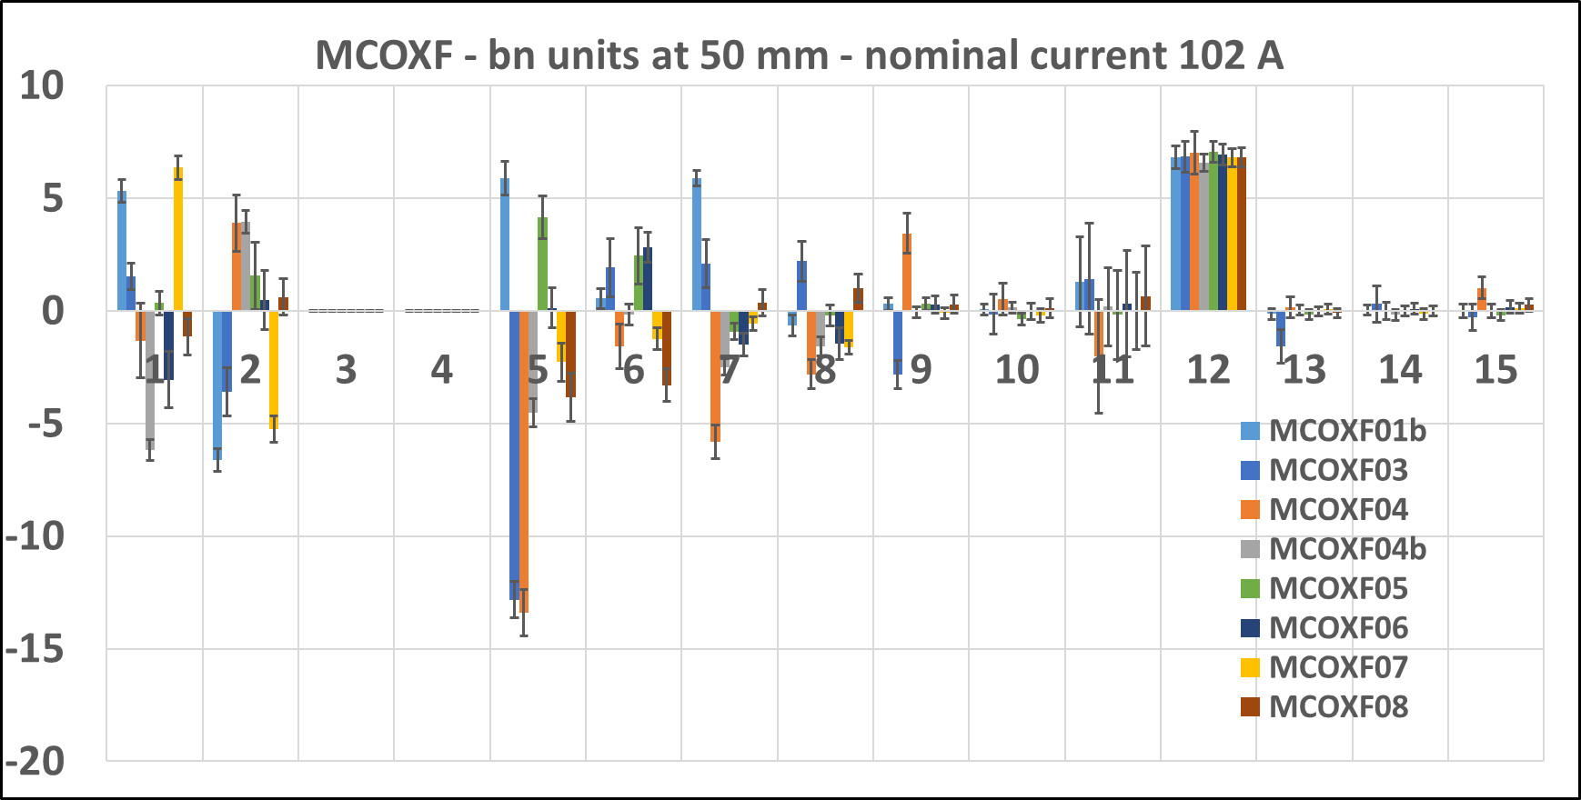
MM results – MCOXF Family
Order | Magnet |  | Specification | Calculations | Measured at LASA
 |  | Current [A] | BdL [T mm] | BdL [T mm] | BdL [T mm] | diff [%]
4 | MCOXF01b | 102 | 69 | 70.7 | 71.57 | 1.2
 | MCOXF03 |  |  |  | 71.59 | 1.3
 | MCOXF04 |  |  |  | 71.54 | 1.2
 | MCOXF04b |  |  |  | 71.48 | 1.1
 | MCOXF05 |  |  |  | 71.67 | 1.4
 | MCOXF06 |  |  |  | 71.81 | 1.6
 | MCOXF07 |  |  |  | 71.59 | 1.3
 | MCOXF08 |  |  |  | 71.70 | 1.4
Multipoles in the specs (< 100 units)

Slide 12
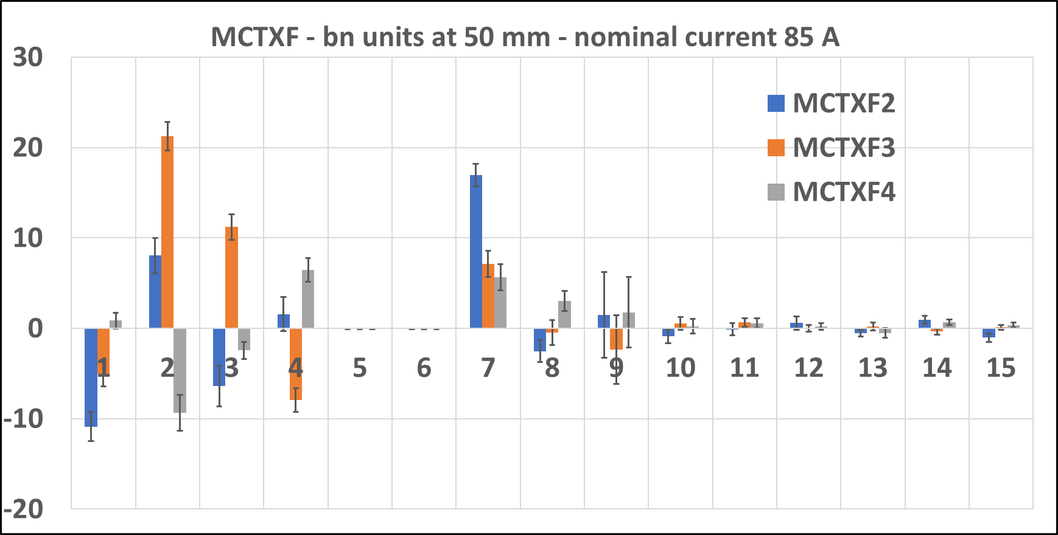
MM results – MCTXF Family
Magnet-to-magnet Magnet-to-magnet repeatability is 0.3%
Difference wrt the model of about 2.5%
repeatability is 0.3%
Difference wrt the model of about 2.5%
Order | Magnet |  | Model | Measured at LASA
 |  | Current [A] | BdL [T mm] | BdL [T mm] | diff [%]
6L | MCTXF2 | 85 | 86.1 | 88.82 | 3.1
 | MCTXF3 |  |  | 88.20 | 2.4
 | MCTXF4 |  |  | 88.41 | 2.7
Multipoles in the specs (< 100 units)

Slide 13
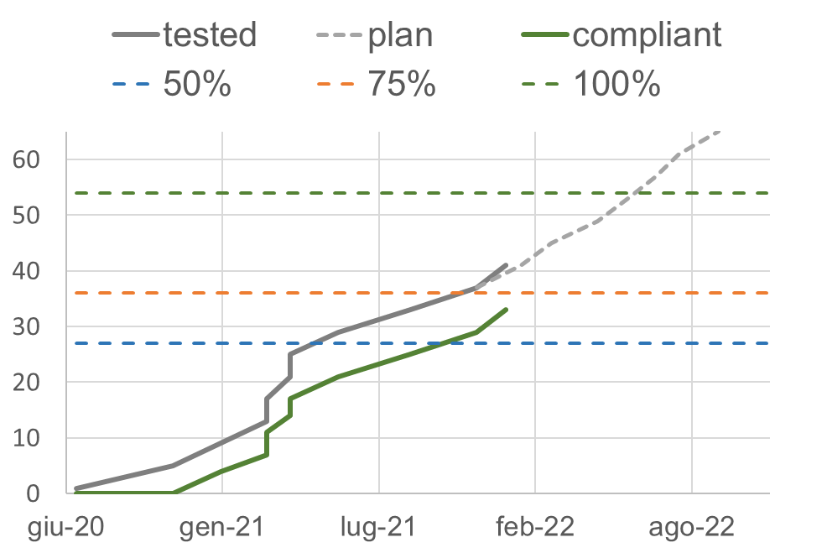
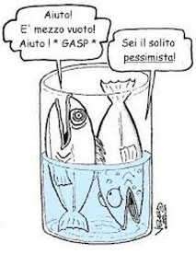
Tested Magnets
More than 50% tested magnets
End of testing Sep 2021
5 Cool Down + spares
12P_1 tested @CERN
Protection w/o dump R crosscheck
2/3
54
36
33
27

Slide 14
Tested Magnets 2
TESTED
REPAIRED TO BE RE-TESTED
NEXT TEST / ONGOING
Today shipping to CERN
M08_05 M08_06 M08_08 M06_08
M12_1c (from SRV) and M12_4

Slide 15
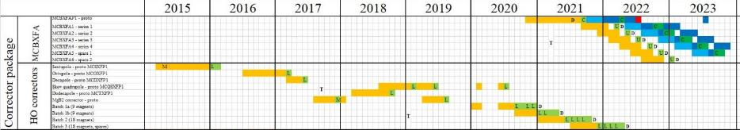
Schedule
Completion of assembly expected in Oct 2021. Done
Expected end of testing at LASA Aug 2022 / Sep 2022
Prototypes
Series production
Contract signed
Batch 2
Mar 2022
Batch 3
Sep 2022
Batch 1
Jul 2021

Slide 16
Conclusion
HO Correctors series production test ongoing
  54 HO Correctors produced by SAES Rial Vacuum
  33 magnets compliant
  Quench protection crosscheck ongoing
24 magnets at CERN
6 magnets travelling this week to CERN

Slide 17

THANK YOU
LASA team
F. Broggi, E. De Matteis, S. Mariotto, A. Paccalini, A. Palmisano, A. Pasini, D. Pedrini, A. Leone, M. Quadrio, M. Prioli, M. Sorbi, M. Statera, M. Todero, C. Uva

