Slide 1


RF separated and conventional hadron beam in CERN’s secondary M2 beam line
Fabian Metzger^{1,2}, Dipanwita Banerjee¹, Johannes Bernhard¹, Markus Brugger¹, Lau Gatignon³, Alexander Gerbershagen⁴, Bernhard Ketzer², Silvia Schuh¹
31.08.2022
¹CERN, Switzerland
²HISKP, University of Bonn, Germany
³University of Lancaster, UK
⁴PARTREC, University of Groningen, Netherlands

Slide 2
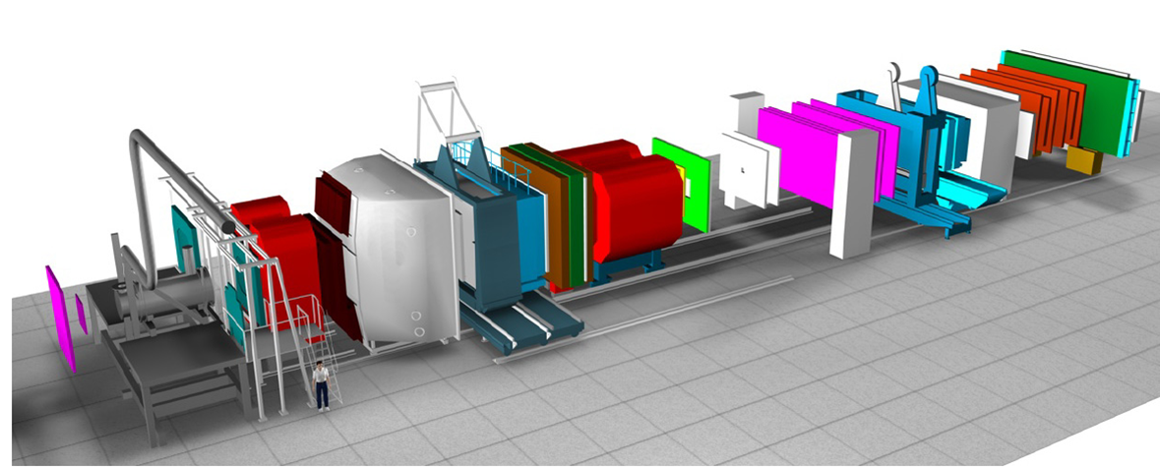
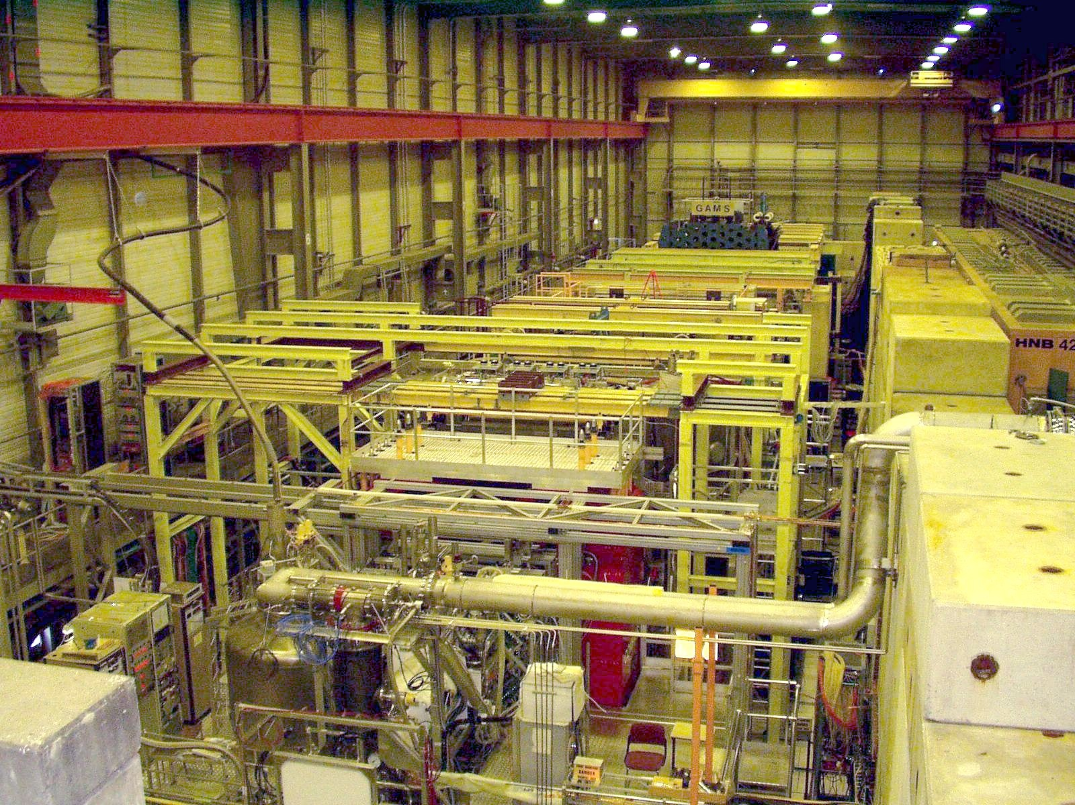
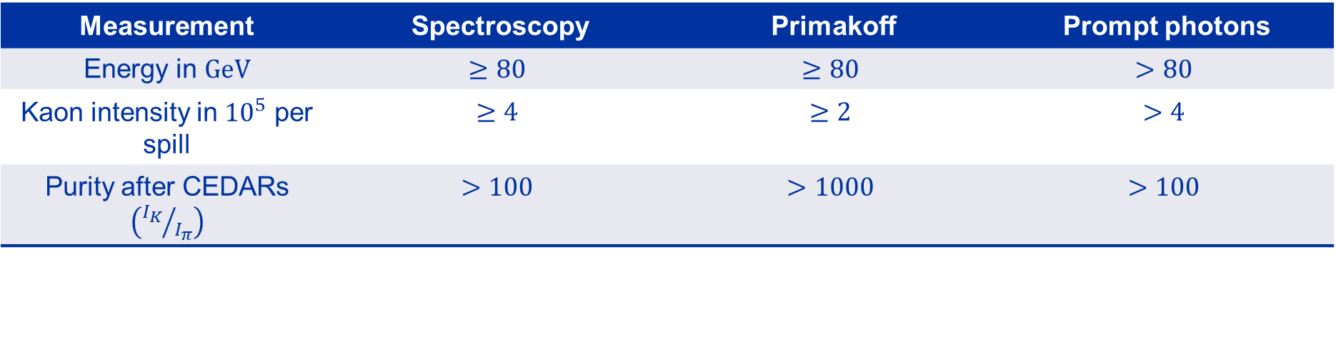
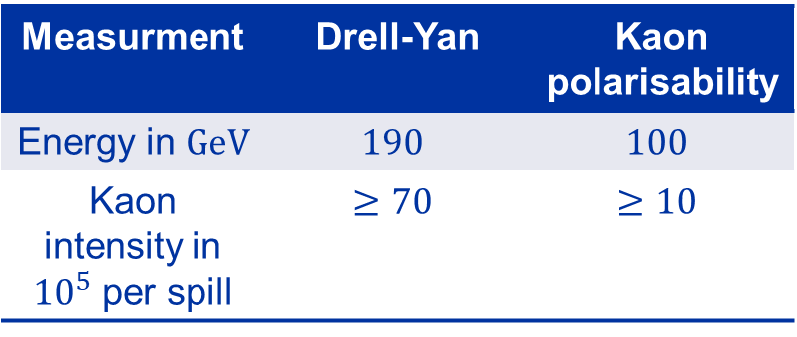
AMBER beam requirements
RF Workshop
Follow-Up Workshop
RF-Separated Beam Project for the M2 Beam Line at CERN
Measurment | Drell-Yan | Kaon polarisability
Energy in $GeV$ | $$190$$ | $$100$$
Kaon intensity in ${10}^{5}$ per spill | $$≥70$$ | $$≥10$$
Measurement | Spectroscopy | Primakoff | Prompt photons
Energy in $GeV$ | $$≥80$$ | $$≥80$$ | $$>80$$
Kaon intensity in ${10}^{5}$ per spill | $$≥4$$ | $$≥2$$ | $$>4$$
Purity after CEDARs $\left({I_{K}}/{I_{π}}\right)$ | $$>100$$ | $$>1000$$ | $$>100$$

Slide 3
RF separated beam
Principle and first results

Slide 4
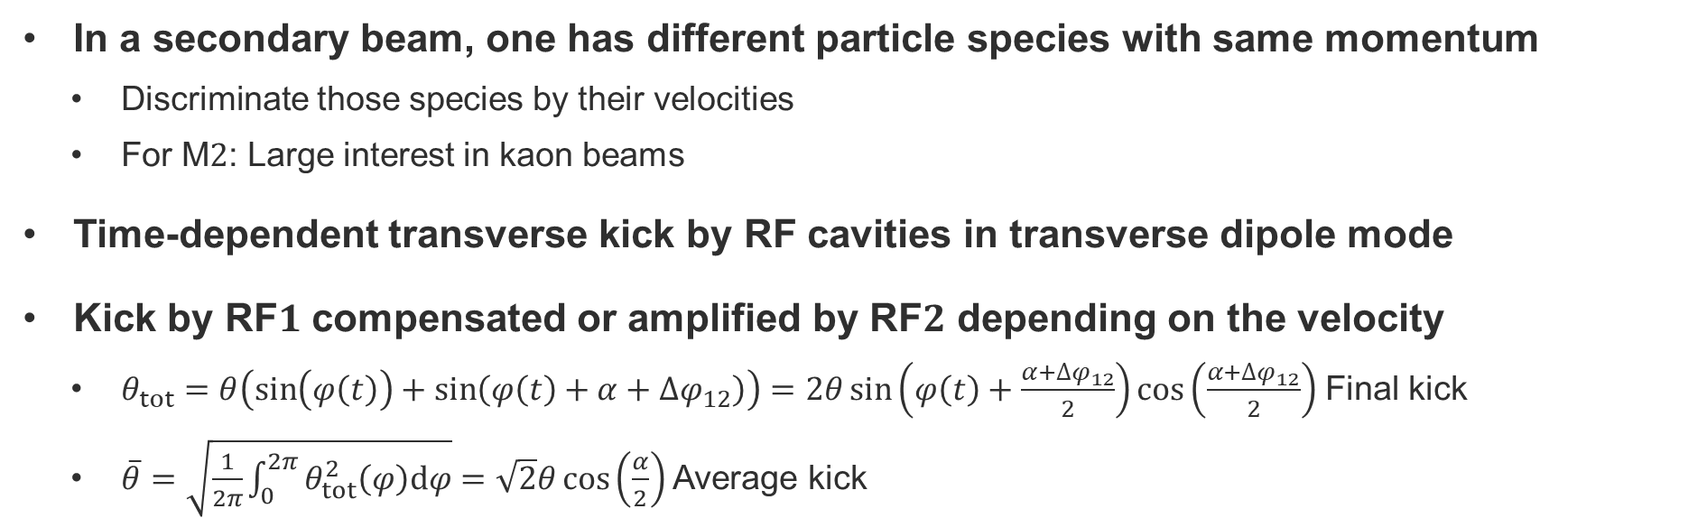
Principle of RF separation
In a secondary beam, one has different particle species with same momentum
  Discriminate those species by their velocities
  For M$2$: Large interest in kaon beams
Time-dependent transverse kick by RF cavities in transverse dipole mode
Kick by RF$1$ compensated or amplified by RF$2$ depending on the velocity
  $θ_{tot}=θ\left(\sin\left(φ\left(t\right)\right)+\sin\left(φ\left(t\right)+α+∆φ_{12}\right)\right)=2θ\sin\left(φ\left(t\right)+\frac{α+∆φ_{12}}{2}\right)\cos\left(\frac{α+∆φ_{12}}{2}\right)$ Final kick
  $\overline{θ}=\sqrt{\frac{1}{2π}\int_{0}^{2π}{θ_{tot}^{2}\left(φ\right)dφ}}=\sqrt{2}θ\cos\left(\frac{α}{2}\right)$ Average kick
C1
Experiment
RF1
RF2
w
DUMP
Momentum
selection
Quadrupole
L_{RF}

Slide 5
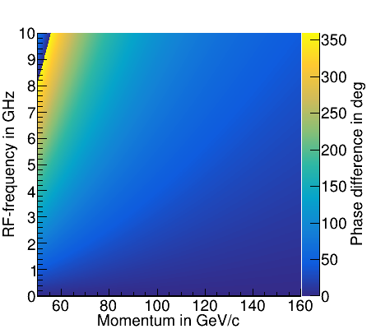
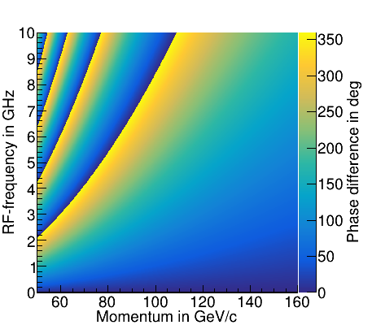
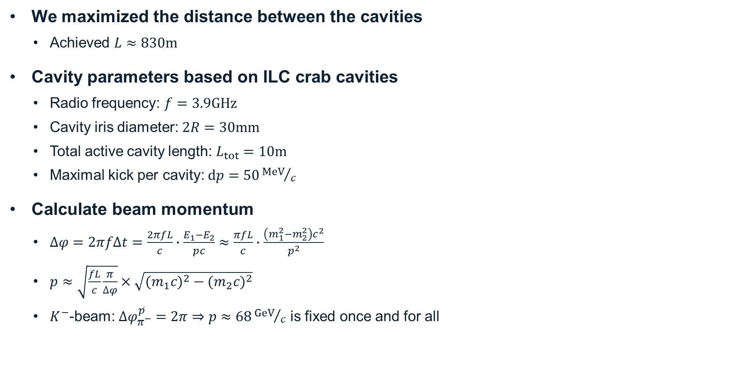


Cavity parameters
We maximized the distance between the cavities
  Achieved $L≈830m$
Cavity parameters based on ILC crab cavities
  Radio frequency: $f=3.9GHz$
  Cavity iris diameter: $2R=30mm$
  Total active cavity length: $L_{tot}=10m$
  Maximal kick per cavity: $dp=50{MeV}/c$
Calculate beam momentum
  $∆φ=2πf∆t=\frac{2πfL}{c}∙\frac{E_{1}−E_{2}}{pc}≈\frac{πfL}{c}∙\frac{\left(m_{1}^{2}−m_{2}^{2}\right)c^{2}}{p^{2}}$
  $p≈\sqrt{\frac{fL}{c}\frac{π}{∆φ}}×\sqrt{{{(m}_{1}c)}^{2}−{{(m}_{2}c)}^{2}}$
  $K^{−}$-beam: $∆φ_{π^{−}}^{\overline{p}}=2π⇒p≈68{GeV}/c$ is fixed once and for all
$${∆φ}_{pion}^{kaon}$$
$${∆φ}_{pion}^{antiproton}$$

Slide 6
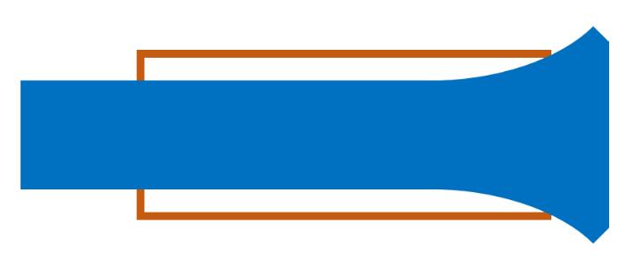
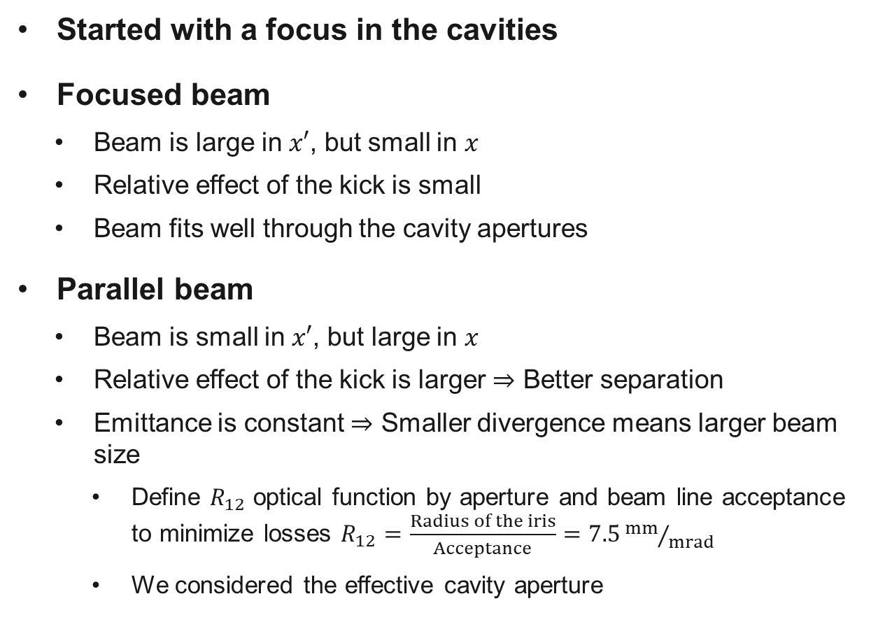
Focused vs. parallel beam in the cavities
X’
Started with a focus in the cavities
Focused beam
  Beam is large in $x′$, but small in $x$
  Relative effect of the kick is small
  Beam fits well through the cavity apertures
Parallel beam
  Beam is small in $x′$, but large in $x$
  Relative effect of the kick is larger $⇒$ Better separation
  Emittance is constant $⇒$ Smaller divergence means larger beam size
    Define $R_{12}$ optical function by aperture and beam line acceptance to minimize losses $R_{12}=\frac{Radius of the iris}{Acceptance}=7.5{mm}/{mrad}$
    We considered the effective cavity aperture
Effect of a kick
X
X’
Effect of a kick
X

Slide 7
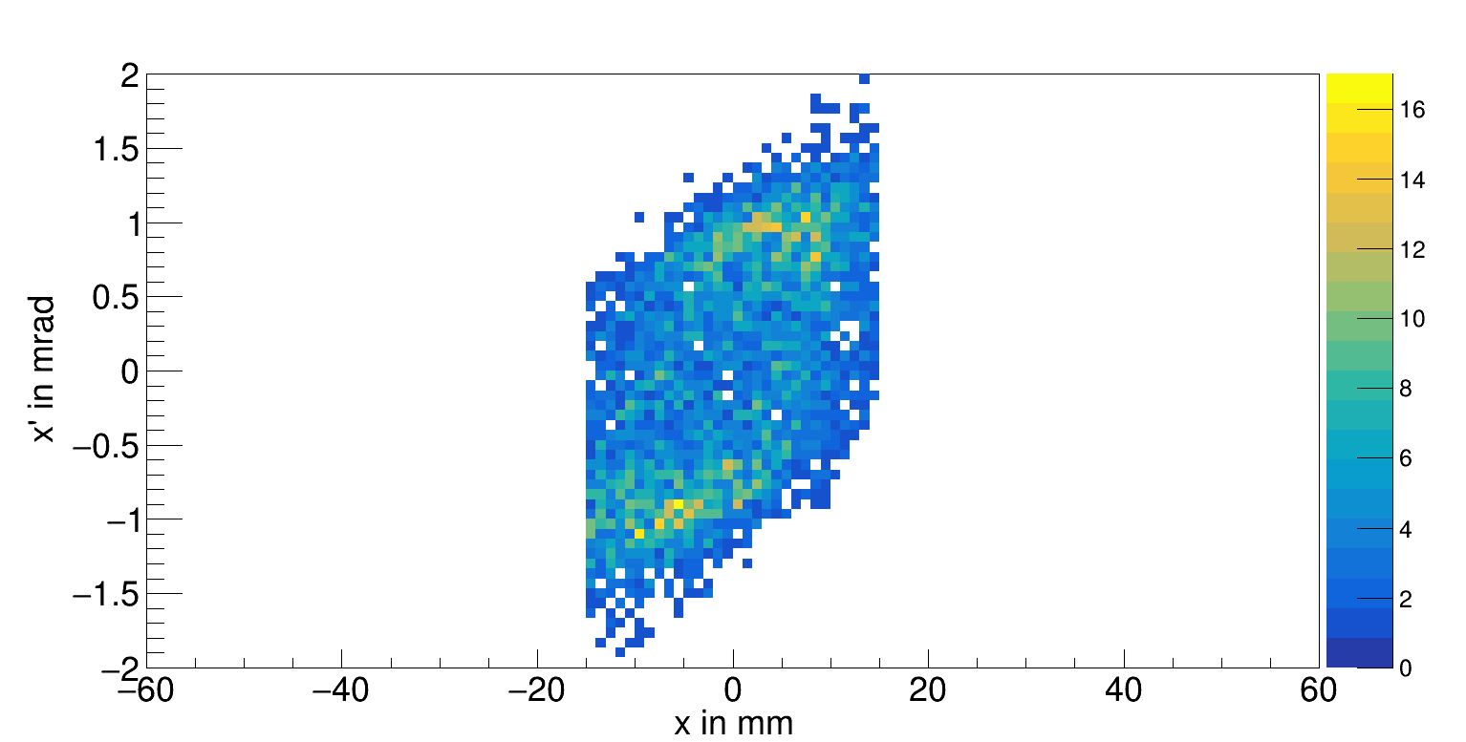
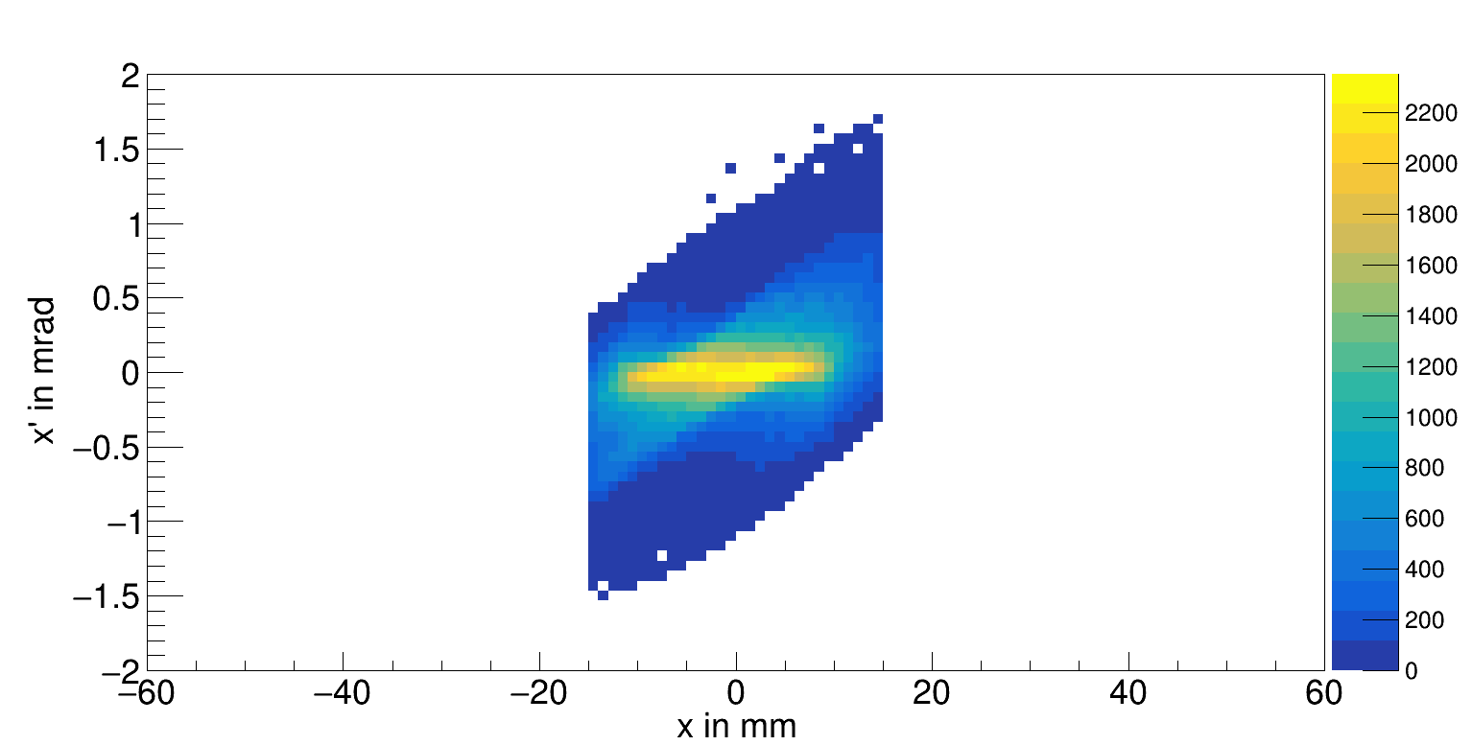

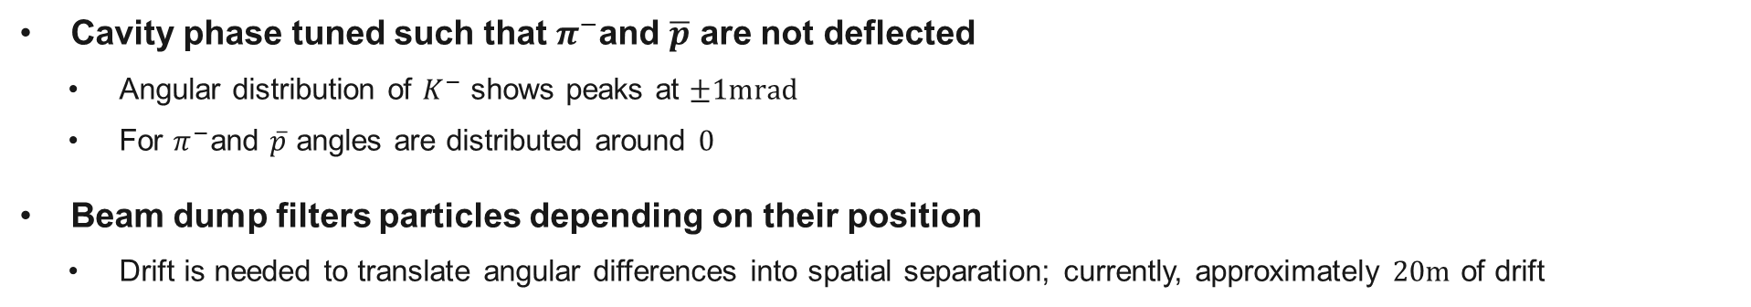

Phase space distribution after RF$2$
$K^{−}$ phase space
$π^{−}$ phase space
Cavity phase tuned such that $π^{−}$and $\overline{p}$ are not deflected
  Angular distribution of $K^{−}$ shows peaks at $±1mrad$
  For $π^{−}$and $\overline{p}$ angles are distributed around $0$
Beam dump filters particles depending on their position
  Drift is needed to translate angular differences into spatial separation; currently, approximately $20m$ of drift

Slide 8
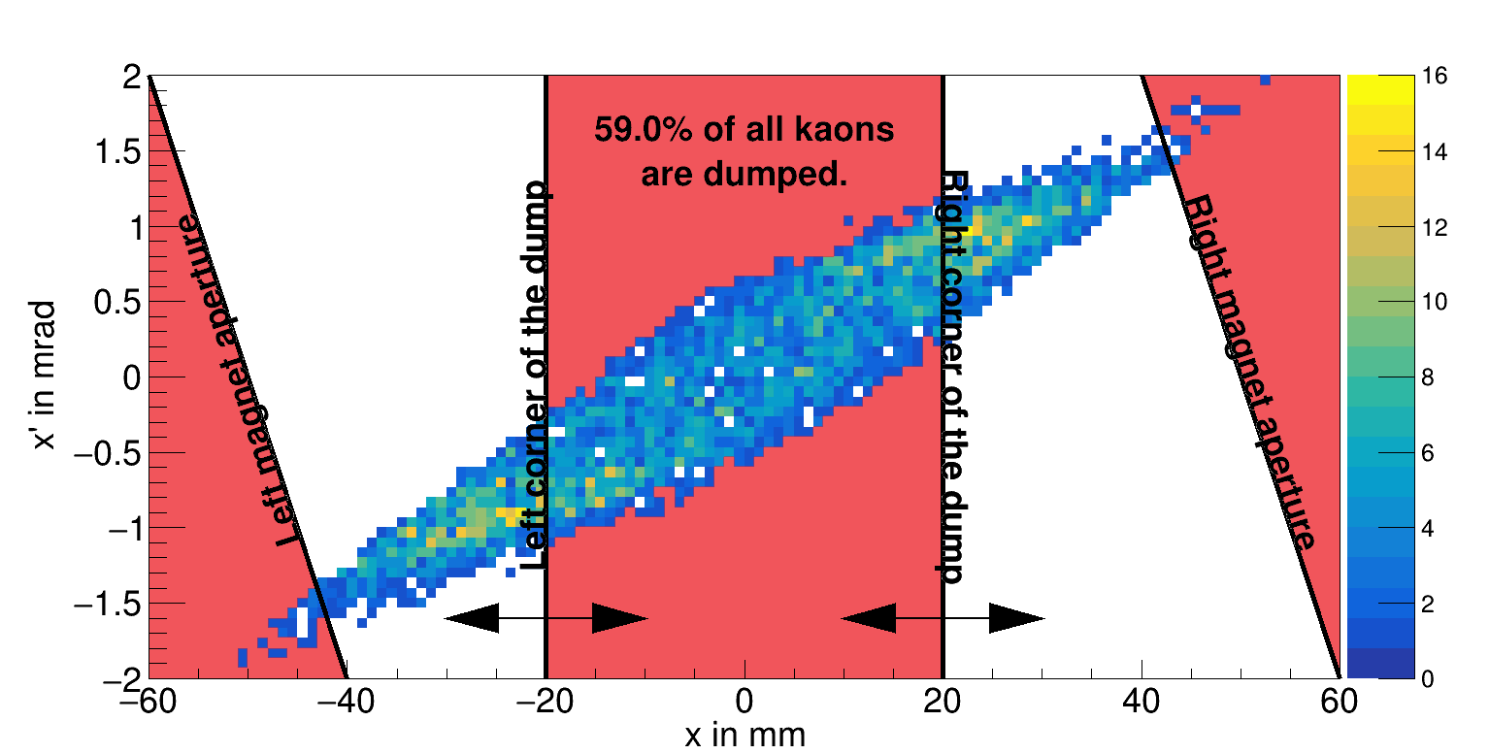
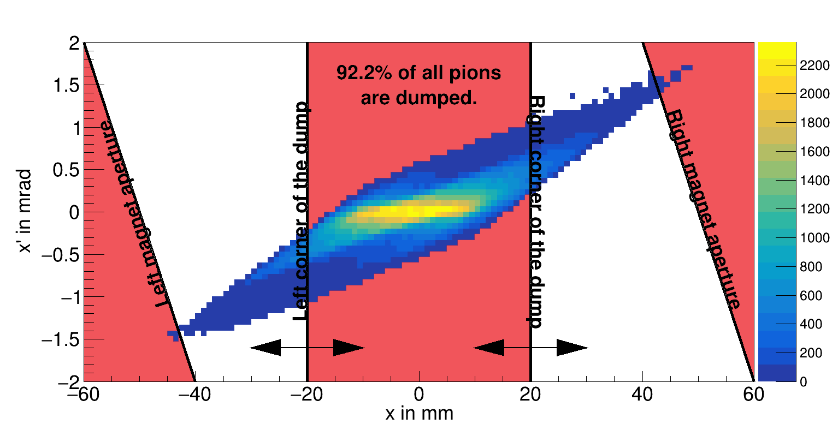
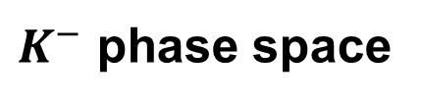
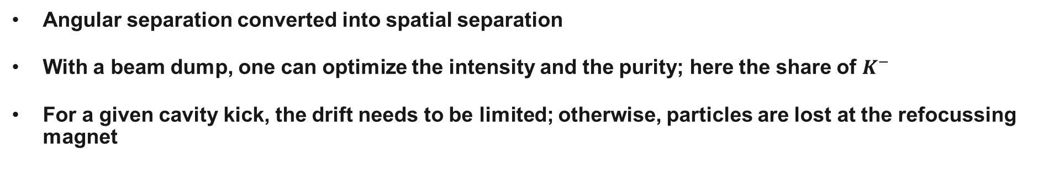
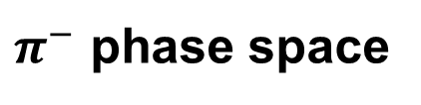
Phase space distribution $20m$ after RF$2$ (dump)
$K^{−}$ phase space
$π^{−}$ phase space
Angular separation converted into spatial separation
With a beam dump, one can optimize the intensity and the purity; here the share of $K^{−}$
For a given cavity kick, the drift needs to be limited; otherwise, particles are lost at the refocussing magnet

Slide 9
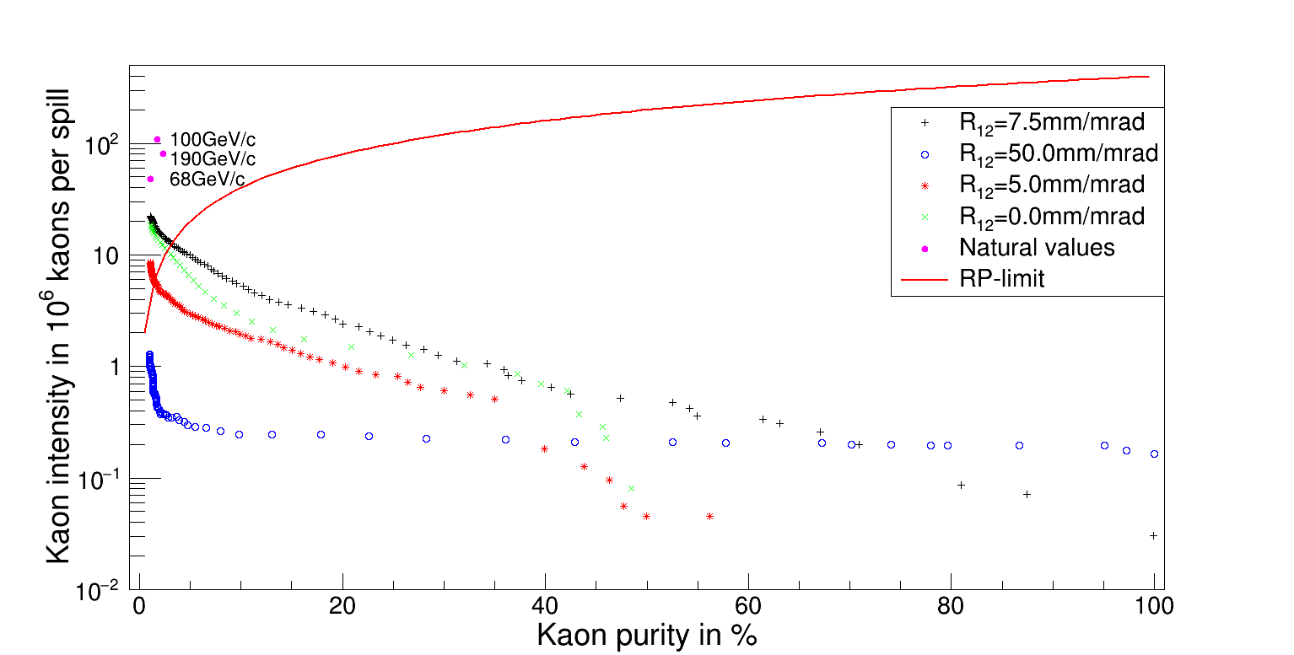
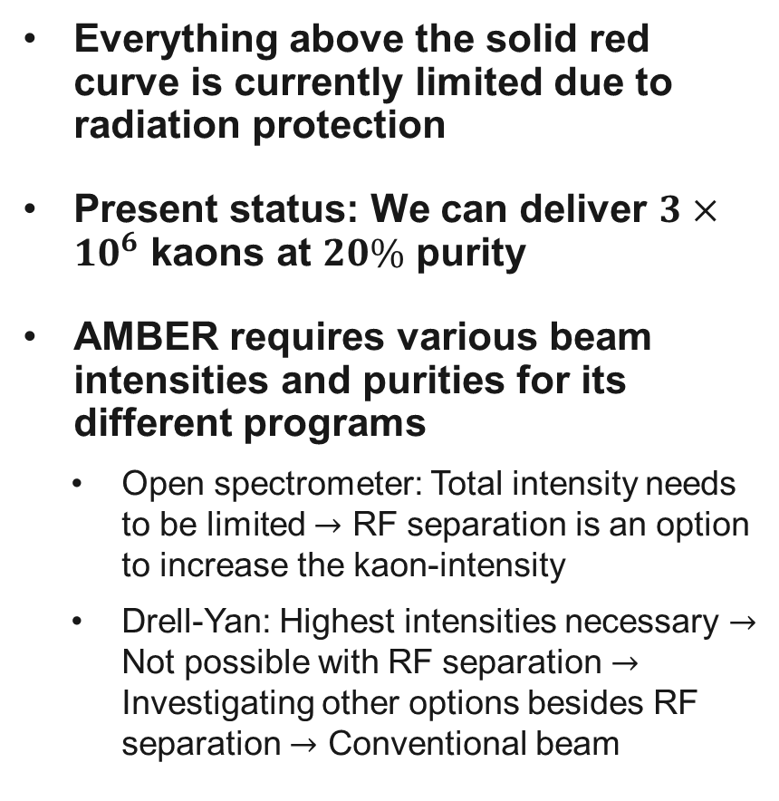
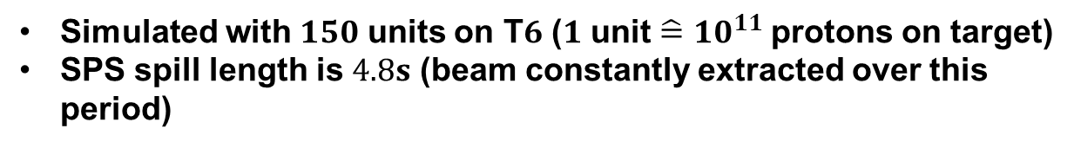
Separation power
Everything above the solid red curve is currently limited due to radiation protection
Present status: We can deliver $3×{10}^{6}$ kaons at $20\%$ purity
AMBER requires various beam intensities and purities for its different programs
  Open spectrometer: Total intensity needs to be limited $→$ RF separation is an option to increase the kaon-intensity
  Drell-Yan: Highest intensities necessary $→$ Not possible with RF separation $→$ Investigating other options besides RF separation $→$ Conventional beam
Simulated with $150$ units on T$6$ ($1$ unit $\hat{=}$ ${10}^{11}$ protons on target)
SPS spill length is $4.8s$ (beam constantly extracted over this period)

Slide 10
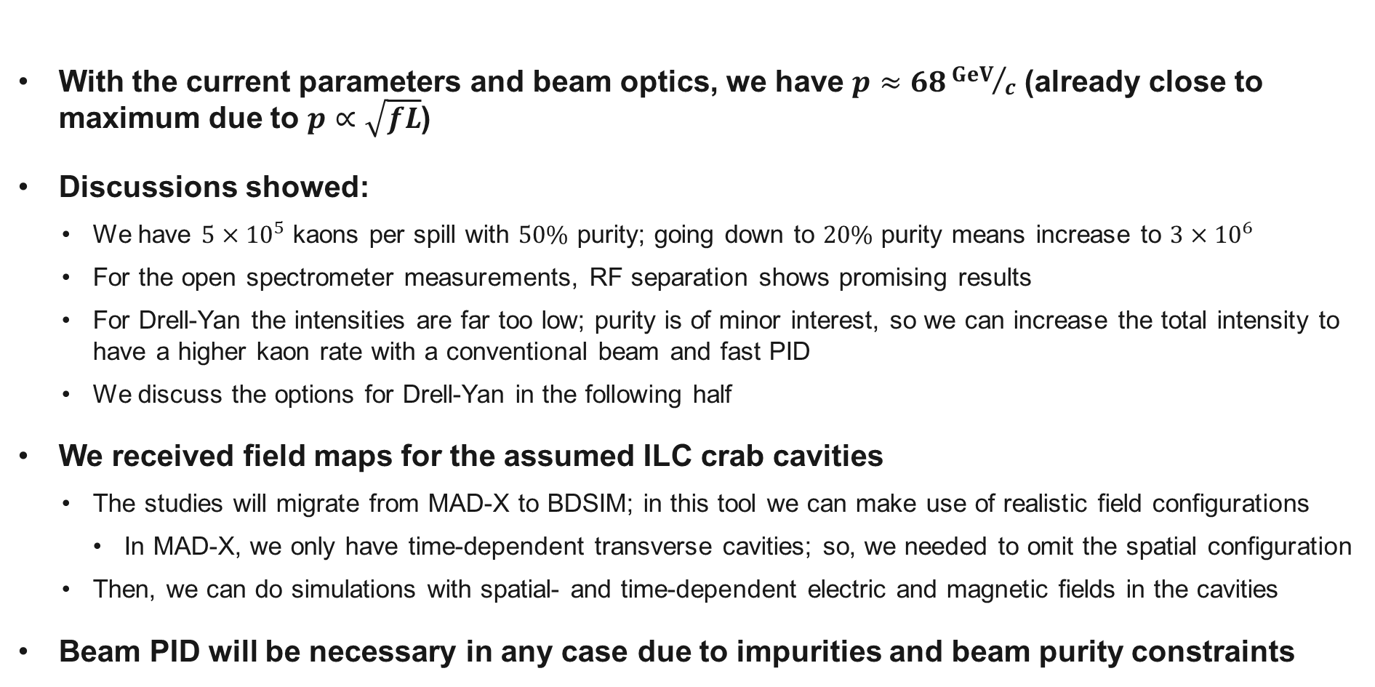
Summary
With the current parameters and beam optics, we have $p≈68{GeV}/c$ (already close to maximum due to $p∝\sqrt{fL}$)
Discussions showed:
  We have $5×{10}^{5}$ kaons per spill with $50\%$ purity; going down to $20\%$ purity means increase to $3×{10}^{6}$
  For the open spectrometer measurements, RF separation shows promising results
  For Drell-Yan the intensities are far too low; purity is of minor interest, so we can increase the total intensity to have a higher kaon rate with a conventional beam and fast PID
  We discuss the options for Drell-Yan in the following half
We received field maps for the assumed ILC crab cavities
  The studies will migrate from MAD-X to BDSIM; in this tool we can make use of realistic field configurations
    In MAD-X, we only have time-dependent transverse cavities; so, we needed to omit the spatial configuration
  Then, we can do simulations with spatial- and time-dependent electric and magnetic fields in the cavities
Beam PID will be necessary in any case due to impurities and beam purity constraints

Slide 11
Conventional hadron beam
Optimization for Drell-Yan

Slide 12
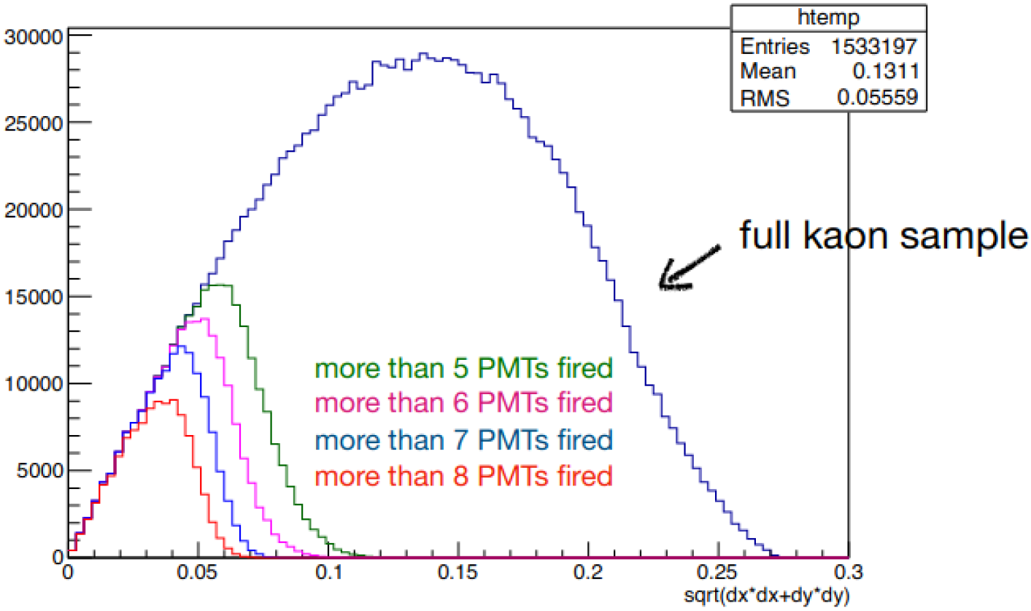
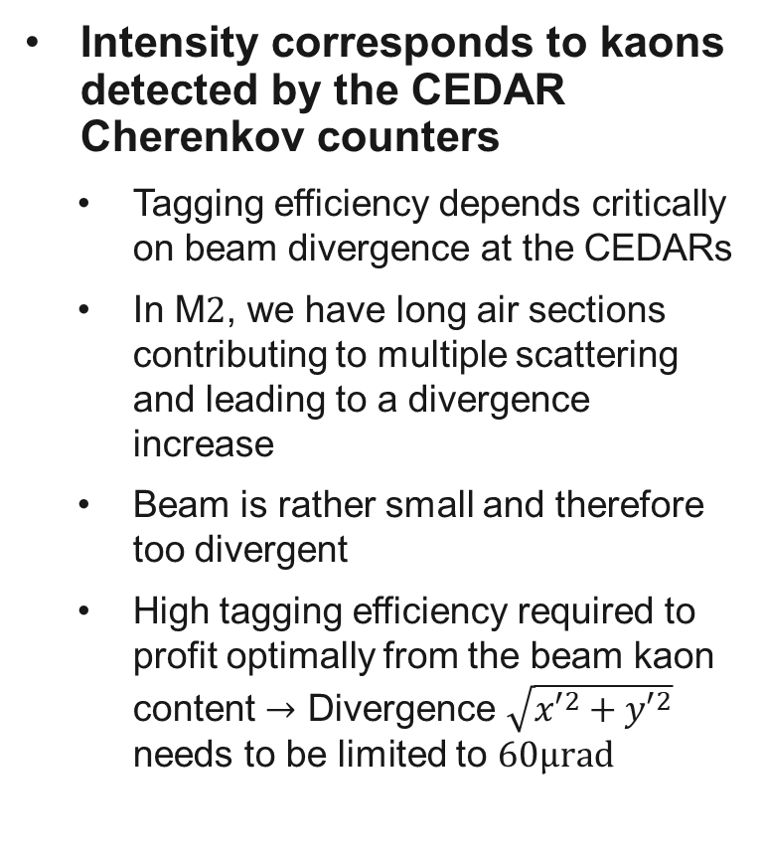
Current hadron beam
Intensity corresponds to kaons detected by the CEDAR Cherenkov counters
  Tagging efficiency depends critically on beam divergence at the CEDARs
  In M$2$, we have long air sections contributing to multiple scattering and leading to a divergence increase
  Beam is rather small and therefore too divergent
  High tagging efficiency required to profit optimally from the beam kaon content $→$ Divergence $\sqrt{{x′}^{2}+{y′}^{2}}$ needs to be limited to $60μrad$
Plot by C. Quintans
AMBER DY-Meeting 30.11.2021

Slide 13
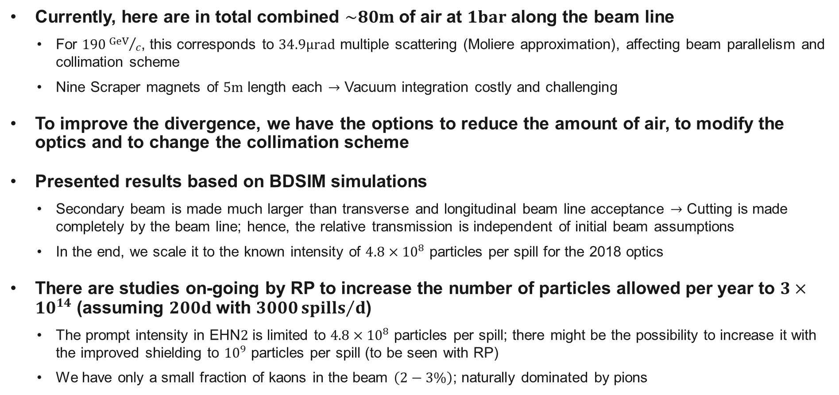
M$2$ hadron beam
Currently, here are in total combined $\sim 80m$ of air at $1bar$ along the beam line
  For $190{GeV}/c$, this corresponds to $34.9μrad$ multiple scattering (Moliere approximation), affecting beam parallelism and collimation scheme
  Nine Scraper magnets of $5m$ length each $→$ Vacuum integration costly and challenging
To improve the divergence, we have the options to reduce the amount of air, to modify the optics and to change the collimation scheme
Presented results based on BDSIM simulations
  Secondary beam is made much larger than transverse and longitudinal beam line acceptance $→$ Cutting is made completely by the beam line; hence, the relative transmission is independent of initial beam assumptions
  In the end, we scale it to the known intensity of $4.8×{10}^{8}$ particles per spill for the 2018 optics
There are studies on-going by RP to increase the number of particles allowed per year to $3×{10}^{14}$ (assuming $200d$ with $3000{spills}/d$)
  The prompt intensity in EHN$2$ is limited to $4.8×{10}^{8}$ particles per spill; there might be the possibility to increase it with the improved shielding to ${10}^{9}$ particles per spill (to be seen with RP)
  We have only a small fraction of kaons in the beam $\left(2−3\%\right)$; naturally dominated by pions

Slide 14
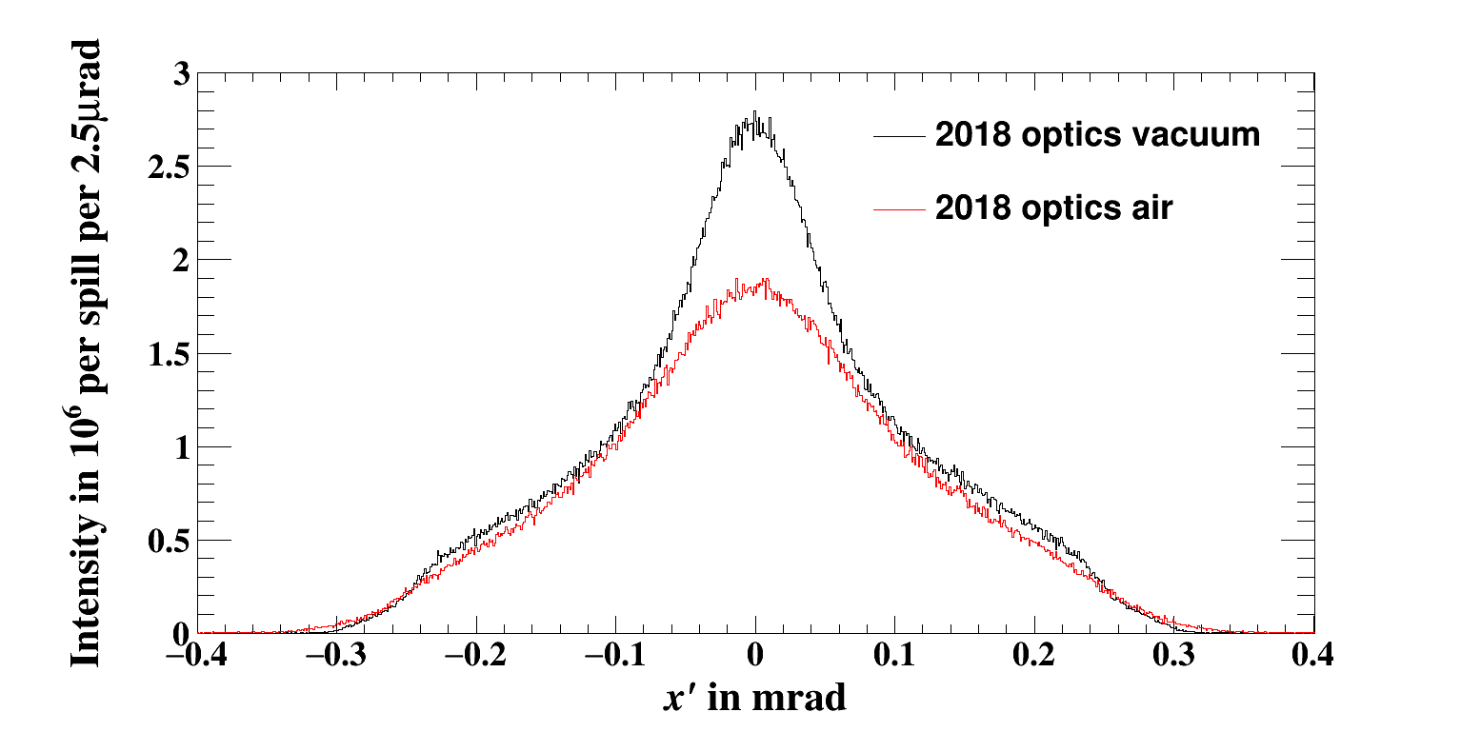
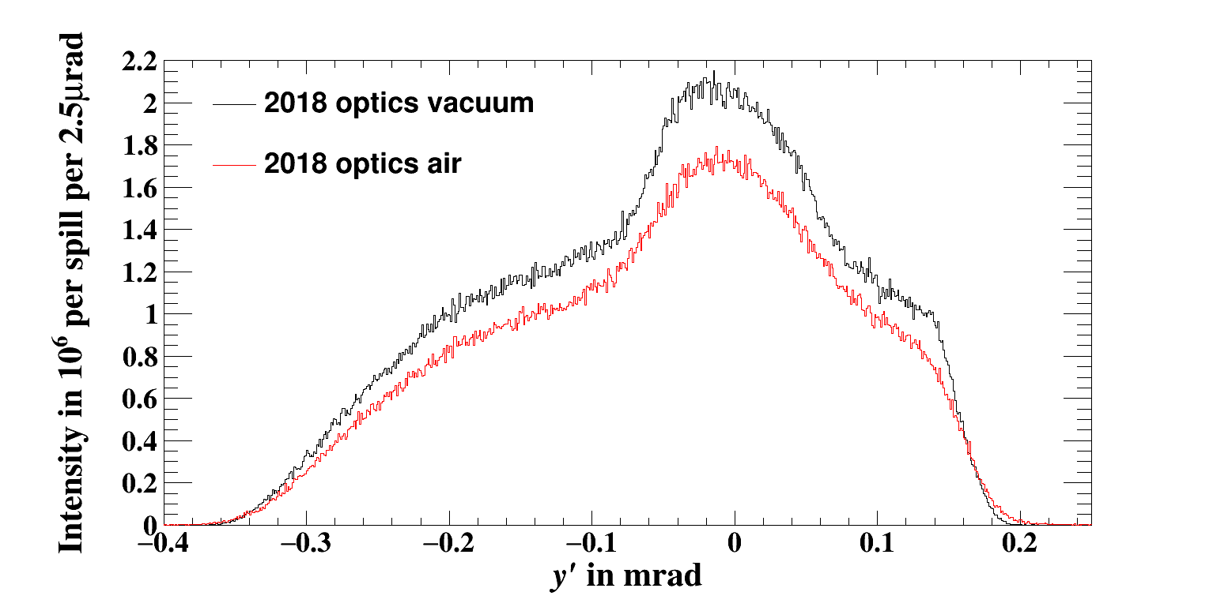
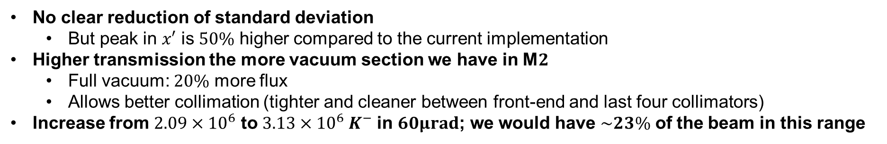
Beam divergence at the CEDARs in 2018
$$σ_{x^{′}}=117.3μrad,110.6μrad$$
$$σ_{y^{′}}=117.4μrad,117.0μrad$$
No clear reduction of standard deviation
  But peak in $x′$ is $50\%$ higher compared to the current implementation
Higher transmission the more vacuum section we have in M$2$
  Full vacuum: $20\%$ more flux
  Allows better collimation (tighter and cleaner between front-end and last four collimators)
Increase from $2.09×{10}^{6}$ to $3.13×{10}^{6} K^{−}$ in $60μrad$; we would have $\sim 23\%$ of the beam in this range

Slide 15
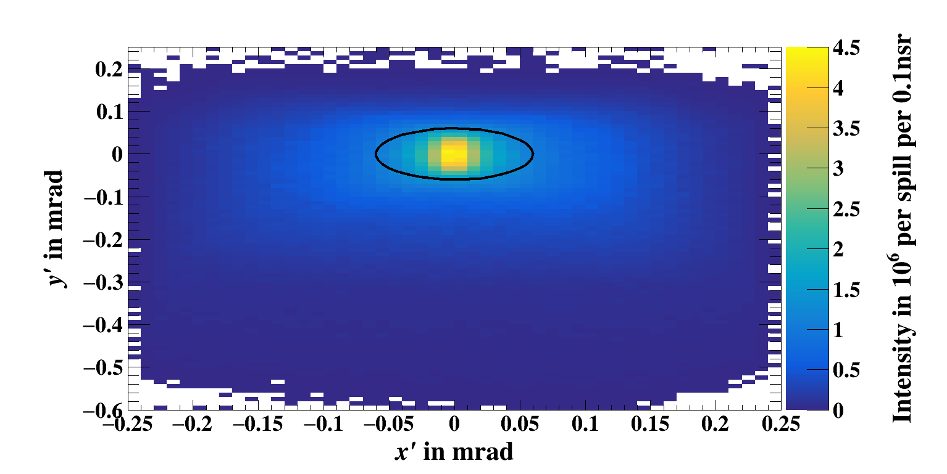
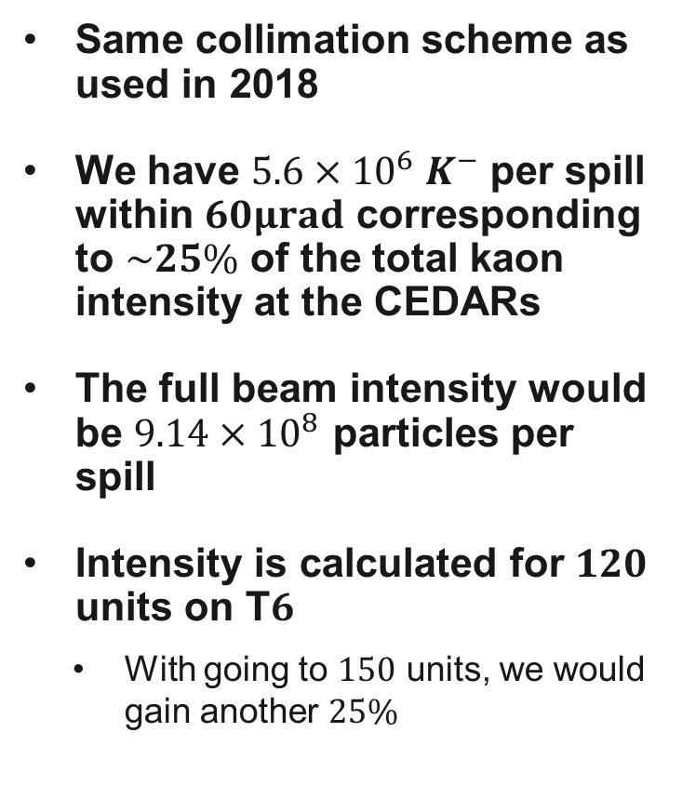
Beam divergence at the CEDARs with new optics
Same collimation scheme as used in 2018
We have $5.6×{10}^{6} K^{−}$ per spill within $60μrad$ corresponding to $\sim 25\%$ of the total kaon intensity at the CEDARs
The full beam intensity would be $9.14×{10}^{8}$ particles per spill
Intensity is calculated for $120$ units on T$6$
  With going to $150$ units, we would gain another $25\%$
We assume full vacuum implementation
In these optics the beam is made larger at the CEDAR location

Slide 16
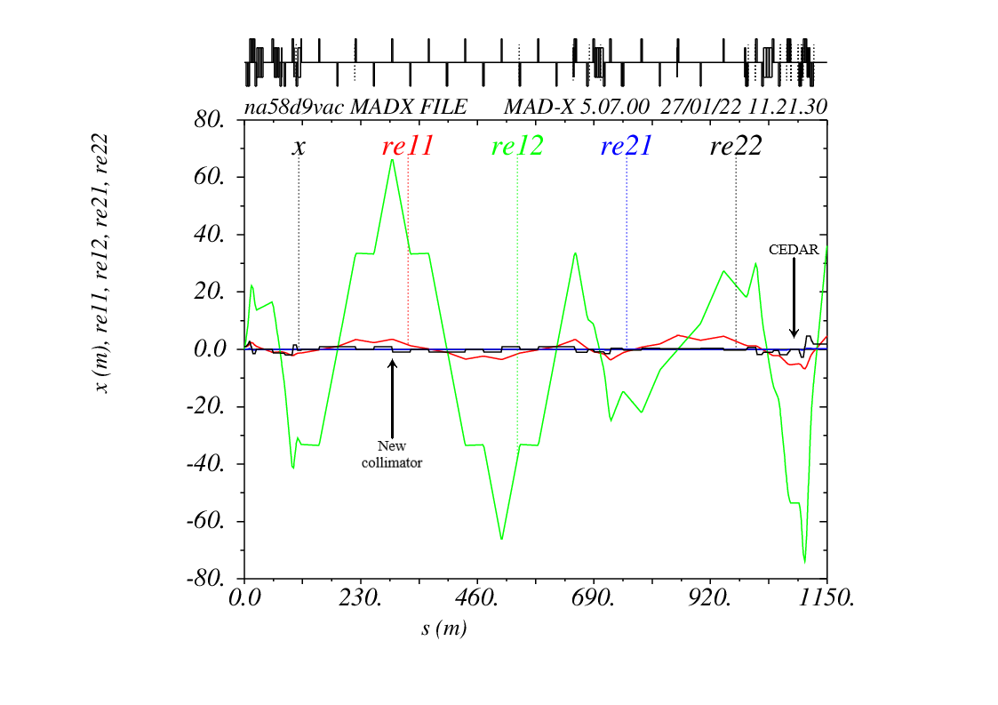
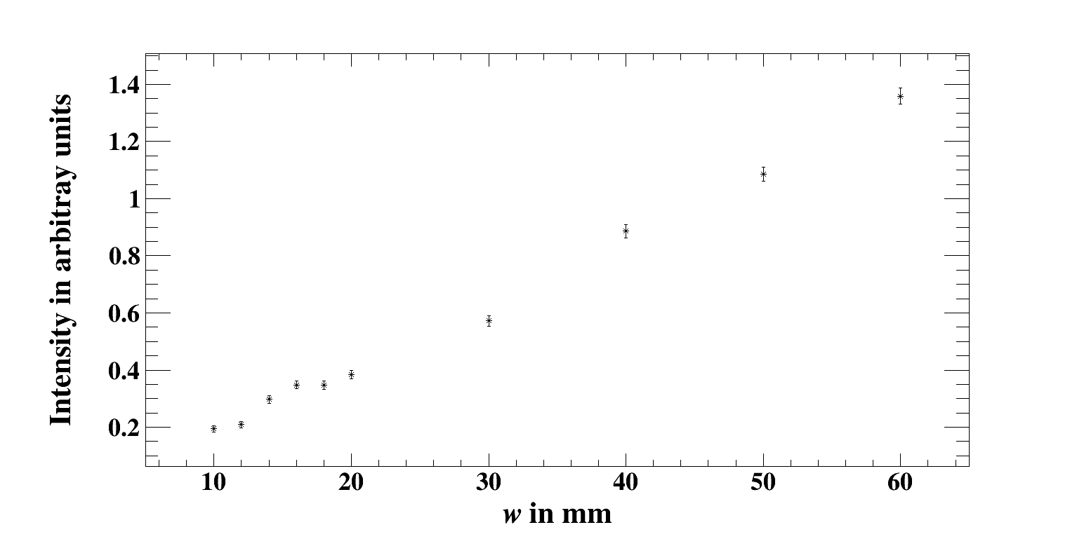
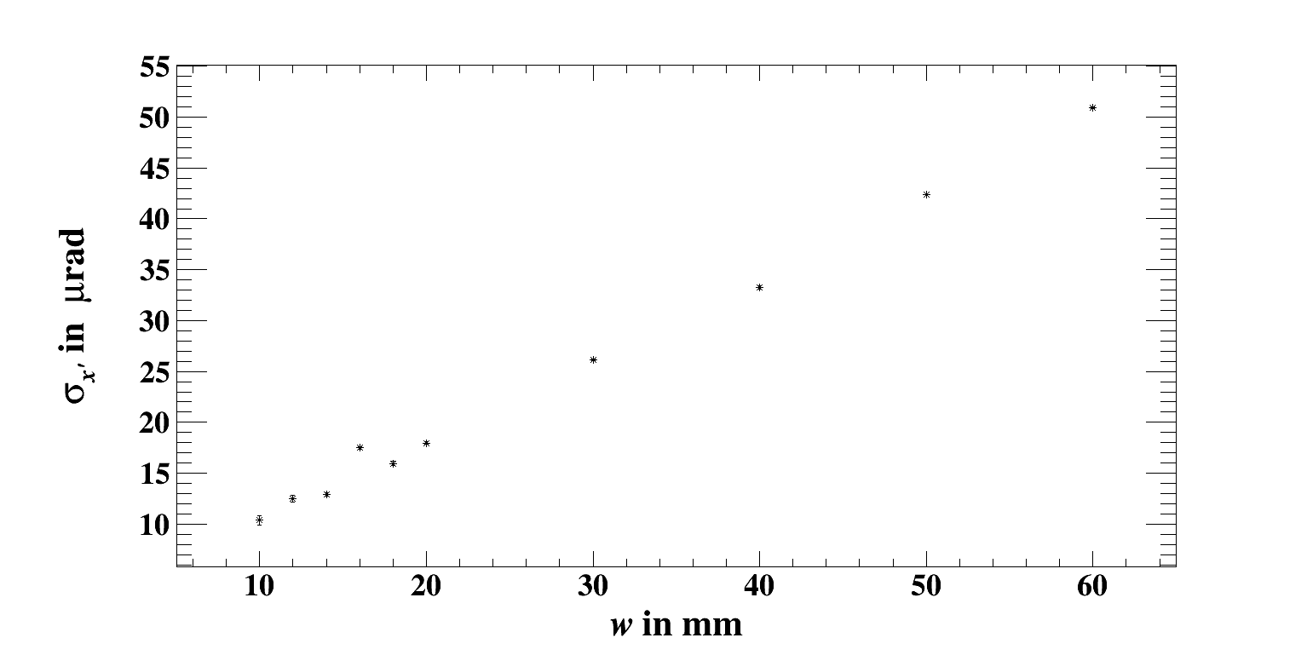
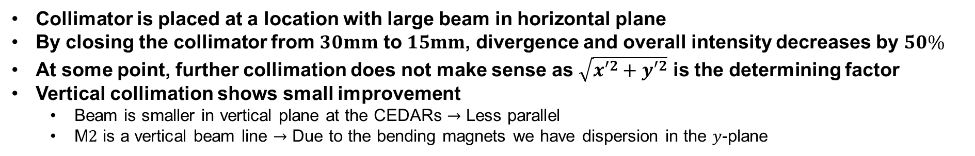
Horizontal collimation
Collimator is placed at a location with large beam in horizontal plane
By closing the collimator from $30mm$ to $15mm$, divergence and overall intensity decreases by $50\%$
At some point, further collimation does not make sense as $\sqrt{{x′}^{2}+{y′}^{2}}$ is the determining factor
Vertical collimation shows small improvement
  Beam is smaller in vertical plane at the CEDARs $→$ Less parallel
  M$2$ is a vertical beam line $→$ Due to the bending magnets we have dispersion in the $y$-plane

Slide 17
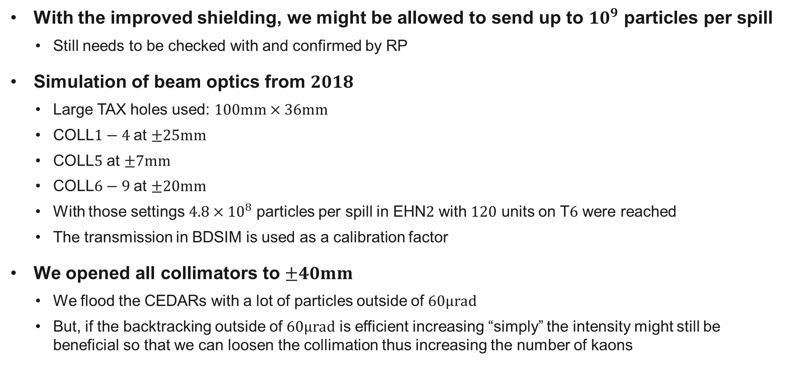
Going to higher intensities
With the improved shielding, we might be allowed to send up to ${10}^{9}$ particles per spill
  Still needs to be checked with and confirmed by RP
Simulation of beam optics from $2018$
  Large TAX holes used: $100mm×36mm$
  COLL$1−4$ at $±25mm$
  COLL$5$ at $±7mm$
  COLL$6−9$ at $±20mm$
  With those settings $4.8×{10}^{8}$ particles per spill in EHN$2$ with $120$ units on T$6$ were reached
  The transmission in BDSIM is used as a calibration factor
We opened all collimators to $±40mm$
  We flood the CEDARs with a lot of particles outside of $60μrad$
  But, if the backtracking outside of $60μrad$ is efficient increasing “simply” the intensity might still be beneficial so that we can loosen the collimation thus increasing the number of kaons

Slide 18
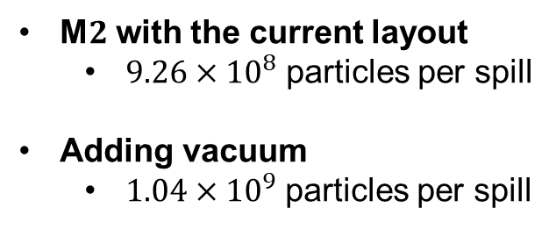
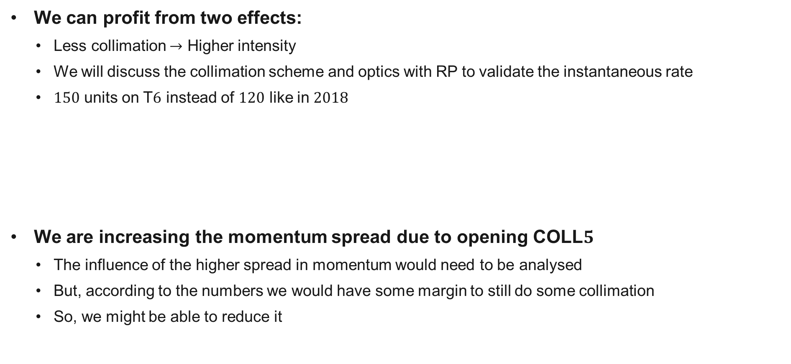

High intensity runs
We can profit from two effects:
  Less collimation $→$ Higher intensity
  We will discuss the collimation scheme and optics with RP to validate the instantaneous rate
  $150$ units on T$6$ instead of $120$ like in $2018$
We are increasing the momentum spread due to opening COLL$5$
  The influence of the higher spread in momentum would need to be analysed
  But, according to the numbers we would have some margin to still do some collimation
  So, we might be able to reduce it
M$2$ with the current layout
  $9.26×{10}^{8}$ particles per spill
Adding vacuum
  $1.04×{10}^{9}$ particles per spill
New proposed optics with air
  $1.11×{10}^{9}$ particles per spill
New proposed optics with vacuum
  $1.23×{10}^{9}$ particles per spill

Slide 19
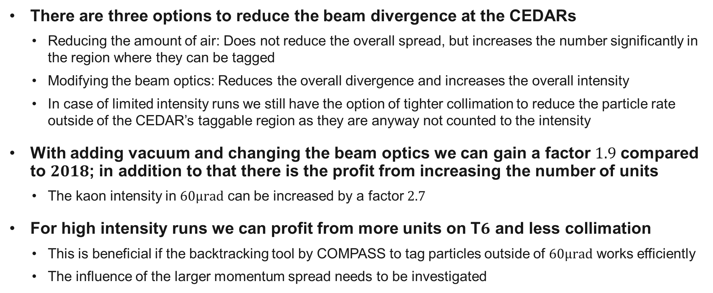
Summary
There are three options to reduce the beam divergence at the CEDARs
  Reducing the amount of air: Does not reduce the overall spread, but increases the number significantly in the region where they can be tagged
  Modifying the beam optics: Reduces the overall divergence and increases the overall intensity
  In case of limited intensity runs we still have the option of tighter collimation to reduce the particle rate outside of the CEDAR’s taggable region as they are anyway not counted to the intensity
With adding vacuum and changing the beam optics we can gain a factor $1.9$ compared to $2018$; in addition to that there is the profit from increasing the number of units
  The kaon intensity in $60μrad$ can be increased by a factor $2.7$
For high intensity runs we can profit from more units on T$6$ and less collimation
  This is beneficial if the backtracking tool by COMPASS to tag particles outside of $60μrad$ works efficiently
  The influence of the larger momentum spread needs to be investigated

Slide 20
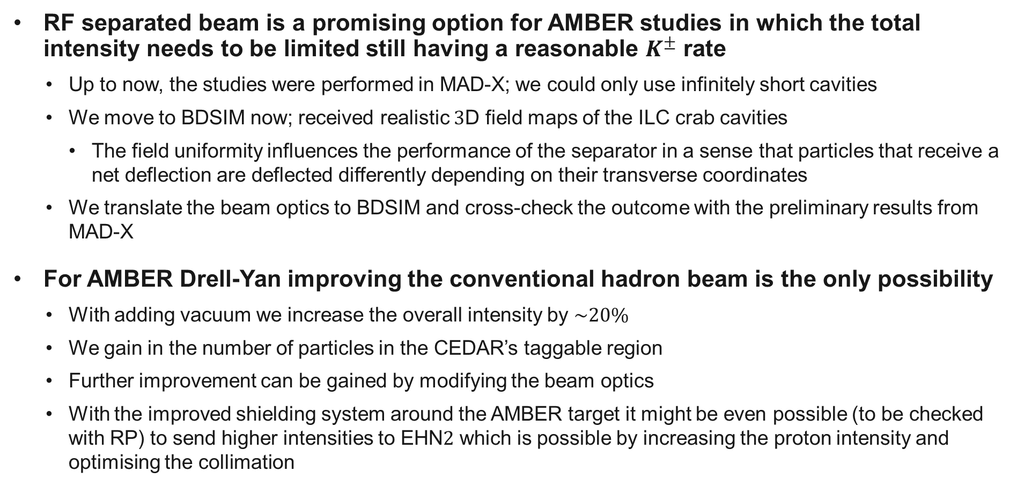
Conclusion
RF separated beam is a promising option for AMBER studies in which the total intensity needs to be limited still having a reasonable $K^{±}$ rate
  Up to now, the studies were performed in MAD-X; we could only use infinitely short cavities
  We move to BDSIM now; received realistic $3$D field maps of the ILC crab cavities
    The field uniformity influences the performance of the separator in a sense that particles that receive a net deflection are deflected differently depending on their transverse coordinates
  We translate the beam optics to BDSIM and cross-check the outcome with the preliminary results from MAD-X
For AMBER Drell-Yan improving the conventional hadron beam is the only possibility
  With adding vacuum we increase the overall intensity by $\sim 20\%$
  We gain in the number of particles in the CEDAR’s taggable region
  Further improvement can be gained by modifying the beam optics
  With the improved shielding system around the AMBER target it might be even possible (to be checked with RP) to send higher intensities to EHN$2$ which is possible by increasing the proton intensity and optimising the collimation

Slide 21
Thank you for your
attention!

Slide 22
Backup

Slide 23
Contents
Beam requirements
RF separated beams
  Principle of RF separation
  Cavity parameters
  Influence of the beam optics
  First results
Conventional hadron beam
  Current limitations
  Influence of multiple scattering
  High intensity runs
Conclusion

Slide 24
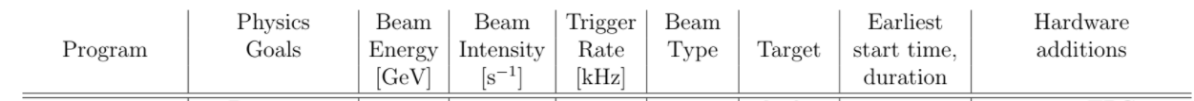
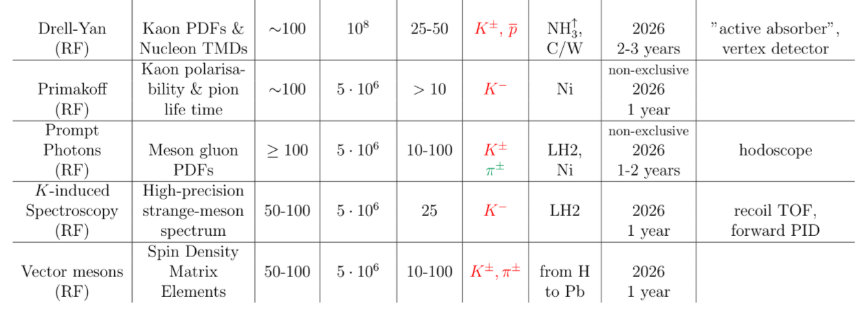
AMBER at CERN’s M$2$ beam line
AMBER’s phase 2 measurements
Very optimistic.
Current estimates: LHC Run 4

Slide 25
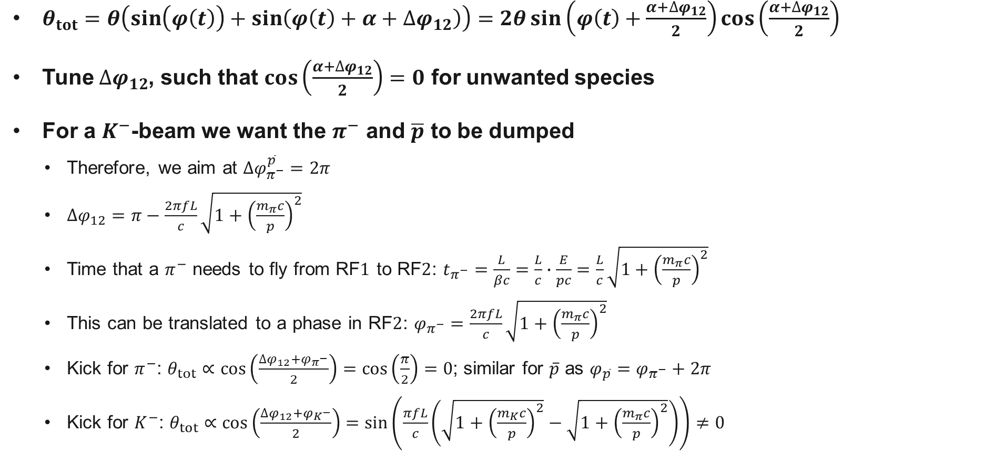
How to tune the phases
$θ_{tot}=θ\left(\sin\left(φ\left(t\right)\right)+\sin\left(φ\left(t\right)+α+∆φ_{12}\right)\right)=2θ\sin\left(φ\left(t\right)+\frac{α+∆φ_{12}}{2}\right)\cos\left(\frac{α+∆φ_{12}}{2}\right)$
Tune $∆φ_{12}$, such that $\cos\left(\frac{α+∆φ_{12}}{2}\right)=0$ for unwanted species
For a $K^{−}$-beam we want the $π^{−}$ and $\overline{p}$ to be dumped
  Therefore, we aim at $∆φ_{π^{−}}^{\overline{p}}=2π$
  $∆φ_{12}=π−\frac{2πfL}{c}\sqrt{1+{\left(\frac{m_{π}c}{p}\right)}^{2}}$
  Time that a $π^{−}$ needs to fly from RF$1$ to RF$2$: $t_{π^{−}}=\frac{L}{βc}=\frac{L}{c}∙\frac{E}{pc}=\frac{L}{c}\sqrt{1+{\left(\frac{m_{π}c}{p}\right)}^{2}}$
  This can be translated to a phase in RF$2$: $φ_{π^{−}}=\frac{2πfL}{c}\sqrt{1+{\left(\frac{m_{π}c}{p}\right)}^{2}}$
  Kick for $π^{−}$: $θ_{tot}∝\cos\left(\frac{∆φ_{12}+φ_{π^{−}}}{2}\right)=\cos\left(\frac{π}{2}\right)=0$; similar for $\overline{p}$ as ${φ_{\overline{p}}=φ}_{π^{−}}+2π$
  Kick for $K^{−}$: $θ_{tot}∝\cos\left(\frac{∆φ_{12}+φ_{K^{−}}}{2}\right)=\sin\left(\frac{πfL}{c}\left(\sqrt{1+{\left(\frac{m_{K}c}{p}\right)}^{2}}−\sqrt{1+{\left(\frac{m_{π}c}{p}\right)}^{2}}\right)\right)≠0$

Slide 26
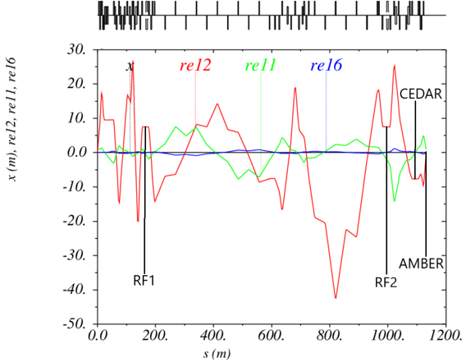
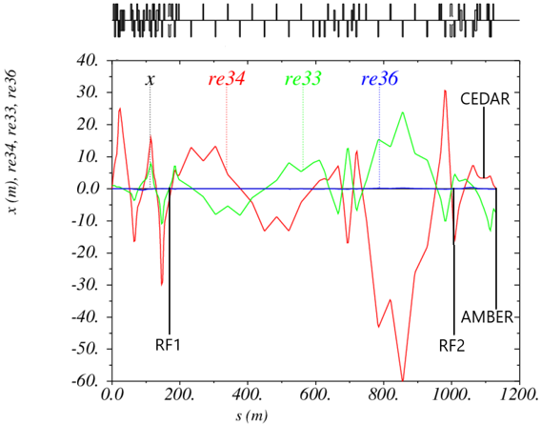

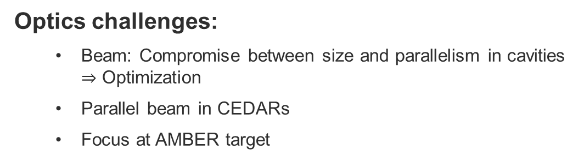

Optics development
Optics challenges:
  Beam: Compromise between size and parallelism in cavities $⇒$ Optimization
  Parallel beam in CEDARs
  Focus at AMBER target
$x$-plane
$y$-plane

Slide 27
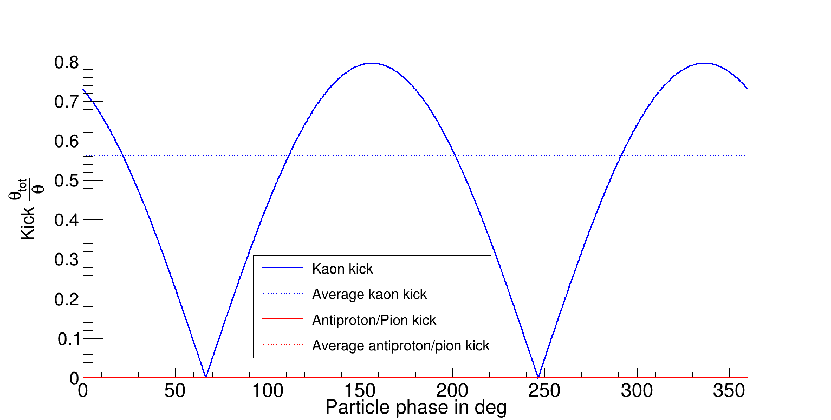
Kick of the cavities

Slide 28
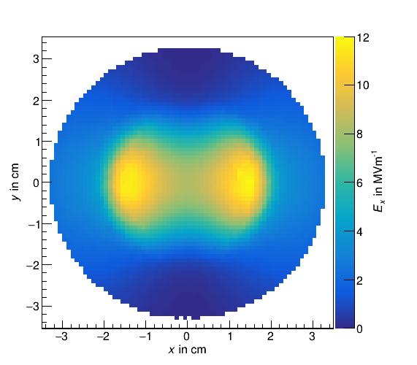
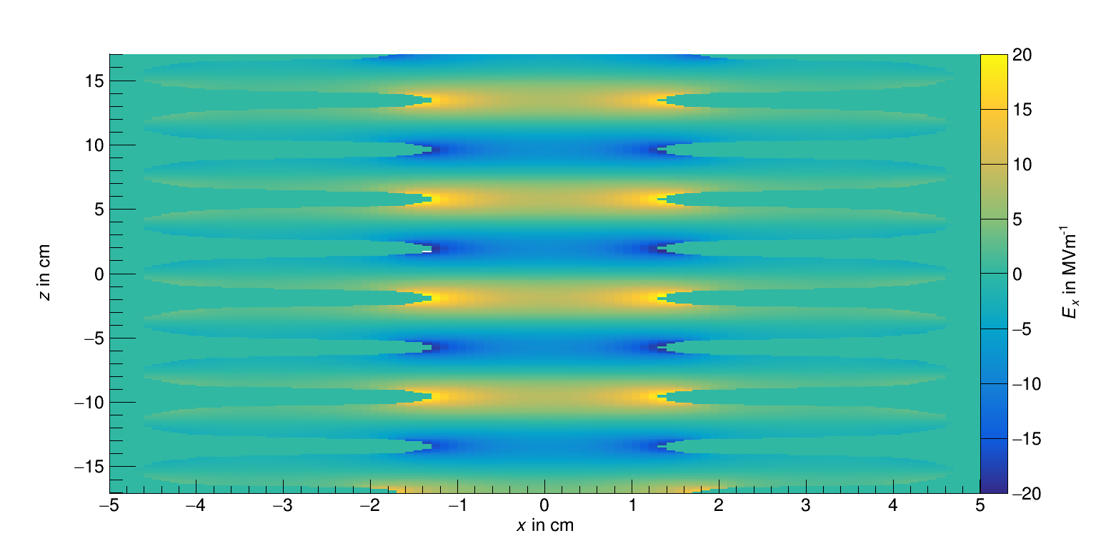


Field of the ILC crab cavities
At $z=4.6cm$
At $y=−0.05cm$
Received field maps from Graeme Burt

Slide 29
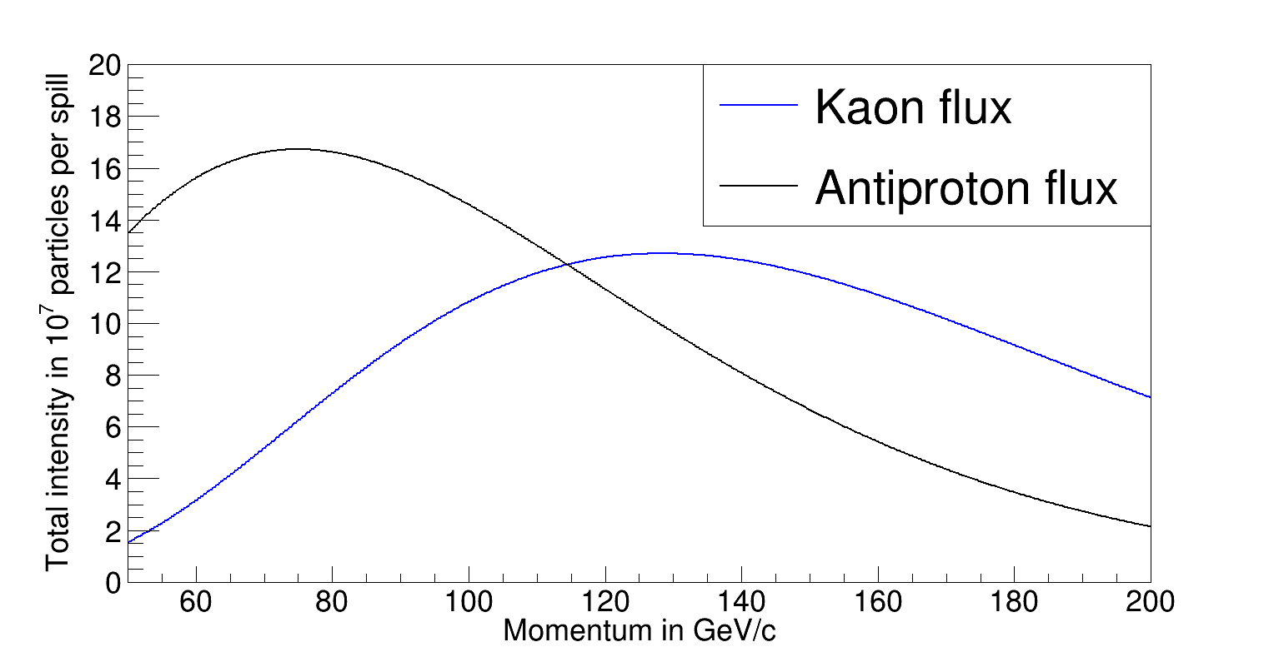


$K^{−}$ and $\overline{p}$: intensities and fractions
¹H.W.Atherton et al., Precise measurements of particle production by 400 GeV/c protons on
beryllium targets, CERN 80-07, 1980
Atherton parametrization¹ to calculate number of particles
  Parametrization of particle production measured by NA20
  With $\frac{∆p}{p}=1\%$
  Angular acceptance of $17.6μsterad$
  $1.5×{10}^{13}$ ppp on T6
  $500mm$ Be-target
  Distance between T6 and AMBER target of $1138m$
  Electrons are not considered
$4×{10}^{8}$ particles per spill allowed by RP

Slide 30

Beam momentum

Slide 31


Kick in the first cavity
SPS beam is extracted over a given time period
Particles arrive at RF$1$ with all possible phases
Angular distributions after RF$1$ look the same for all species
Simulated with a maximal kick of $50{MeV}/c$ ($\hat{=}1.5mrad$) per cavity

Slide 32

Effect of the cavity kick
In the cavity the angle increases linearly with $z$: $x′\left(z\right)=\frac{\frac{dp}{dz}}{p}∙z$
Therefore, the offset increases quadratically with $z$: $x\left(z\right)=\frac{1}{2}\frac{\frac{dp}{dz}}{p}∙z^{2}+x_{0}$
At the end of the cavity, i.e. $L_{tot}$, the offset should be the cavity radius $R$ at maximum:
$$x_{0}=\frac{1}{2}\left(2R−\frac{\frac{dp}{dz}}{p}∙L_{tot}^{2}\right)$$
Effectively usable aperture radius decreases to
$$\frac{1}{2}\left(30mm−\frac{5{MeV}/c/m}{70{GeV}/c}∙100m^{2}\right)≈11.4mm$$

Slide 33


RF separated beam
Angular distribution after RF$2$
Cavity phase tuned such that $π^{−}$ and $\overline{p}$ are not deflected
  Angular distribution of $K^{−}$ peaks at $±1mrad$
  For $π^{−}$and $\overline{p}$ angles are distributed around $0$
Beam dump filters particles depending on their position
Drift is needed to translate angular differences into positional offsets
  Currently, we have ca. $20m$

Slide 34


Absorption
Before the dump
After the dump

Slide 35



CEDAR
10.5170/CERN-1982-013
$\cos{θ=\frac{1}{nβ}}$ $∆θ≈\frac{1}{θ}\frac{∆β}{β}$
$\frac{∆β}{β}≈\frac{m_{2}^{2}−m_{1}^{2}}{2p^{2}}$ $∆R=f∆θ$

Slide 36




2018 hadron optics
$x$-plane
$y$-plane

Slide 37


Influence of the vacuum windows
In the simulations the vacuum windows have been omitted
Typically, we have $200μm$ of mylar as windows
  Some exceptions with even thinner windows
  Accounts to some $mm$ over the whole $1.1km$ of beam line
Taking these results, it is justified to not use the windows in the simulations as their effect on the beam distributions is negligible

Slide 38

Beam divergence in 2018

Slide 39




Divergence in the new optics set
$$σ_{x′}=95.8μrad$$
$$σ_{y′}=125.8μrad$$

Slide 40


New optics tighter collimated
$2.65×{10}^{8}$ particles per spill total intensity
$1.21×{10}^{8}$ particles per spill in $60μrad$
Kaon intensity in $60μrad$ of $2.9×{10}^{6}$ per spill

Slide 41




New optics tighter collimated
$$σ_{x′}=47.3μrad$$
$$σ_{y′}=66.4μrad$$

Slide 42

Courtesy by A. Devienne

Slide 43

Courtesy by A. Devienne

Slide 44

Momentum resolution

Slide 45


Beams from SPS

