Slide 1
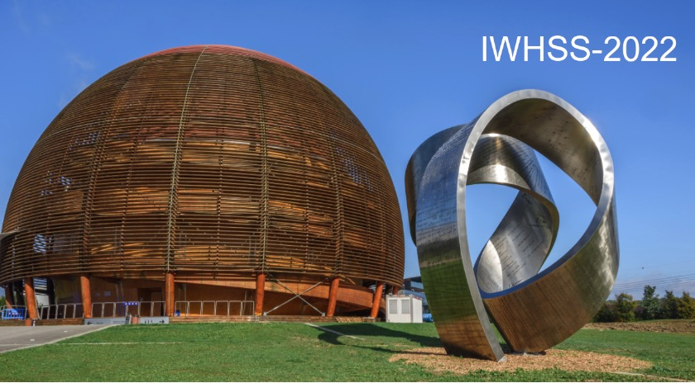
JLAB physics program: Overview
S. Stepanyan
Jefferson Lab
Notes:
----- Meeting Notes (9/27/11 07:19) ---
Many thanks to organizers for invitation to participate in the conference and give this talk on GPD program at JLAB.

Slide 2
Outline
Jefferson Lab CEBAF
Overview of physics program
  Elastic FF and polarized and unpolarized structure functions
  3-D structure, GPDs and TMDs
  Hadron spectroscopy
  QCD and nuclei
  Physics beyond the Standard model
Physics opportunities with positron beams
Future energy upgrade
Conclusion

Slide 3
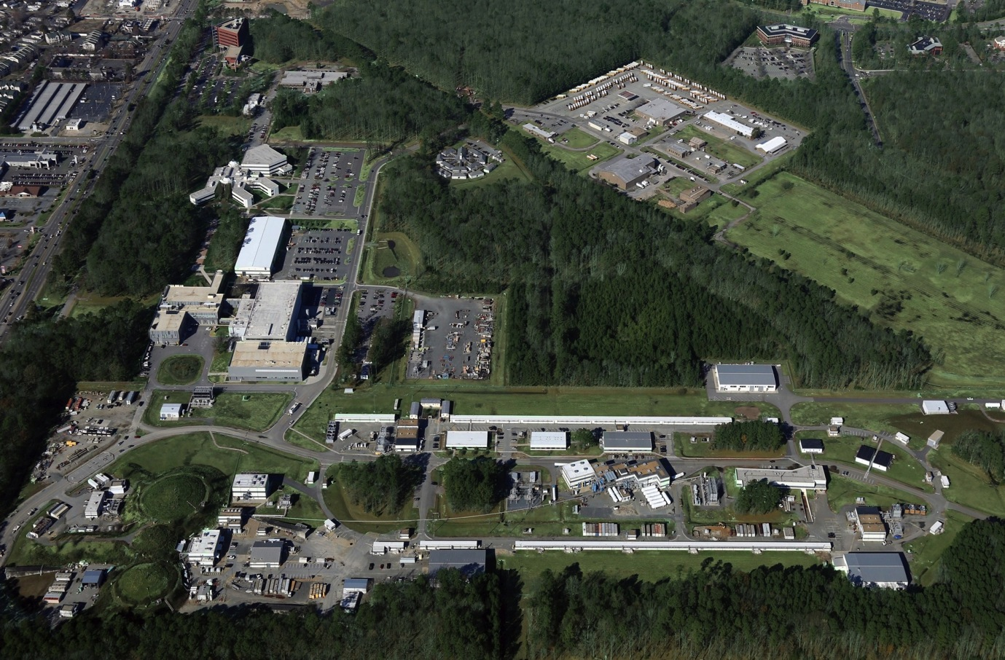
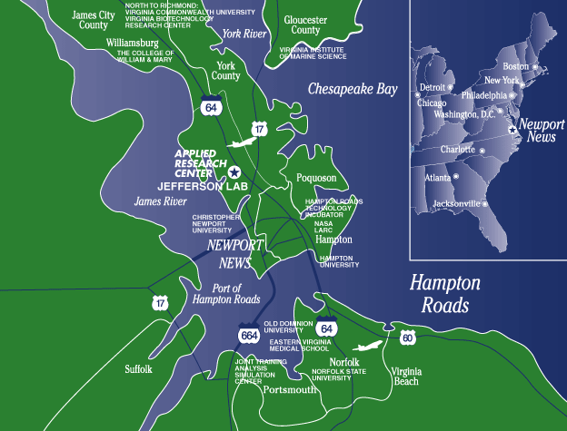
Jefferson Lab
Experimental Halls
Hall D
A
B
LERF
C
Continuous Electron Beam Accelerator Facility
Notes:
Jefferson LAB is located in eastern US, ~200 km south of W.DC
You can see here birds view of the whole complex. Our machine is e- accelerator with two linacs the CEBAF complex includes 4 experimental halls, the original hals A, B, and C, and the Hall-D added after 12 GeV upgrade of the machine

Slide 4
Experimental Setups
Hall-A: SBS & BB
Hall-B: CLAS12
Hall-C: HMS & SHMS
Hall-D: GlueX

Slide 5



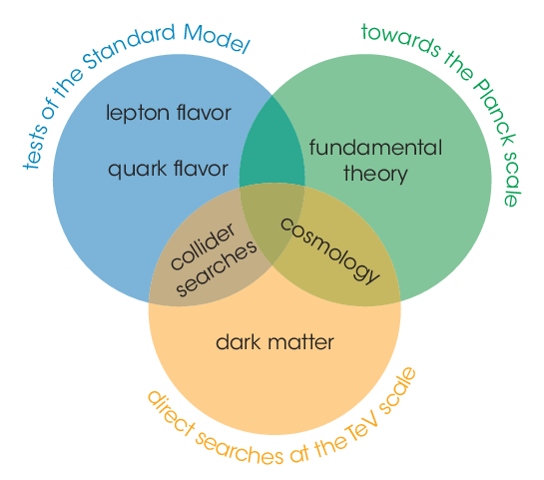
JLAB Physics program
Nucleon and nuclear structure studies, spatial and momentum tomography, form-factors …
Cold nuclear matter, NN correlations, hadronization, color transparency…
Exploring origin of confinement – meson and baryon spectroscopy, exotics …
Low-energy test of the Standard Model and fundamental symmetries.
Total of 86 approved experiments, 33 completed to date.
Notes:
Covers all aspects of nuclear physics, from meson spectroscopy, nucleon and nuclear structure
Program of electroweak physics existed since early 2000s, it has been only 10 years since first proposals for new experiments looking for physics beyond standard model, search for DM/dark photons emerged (APEX and HPS)

Slide 6
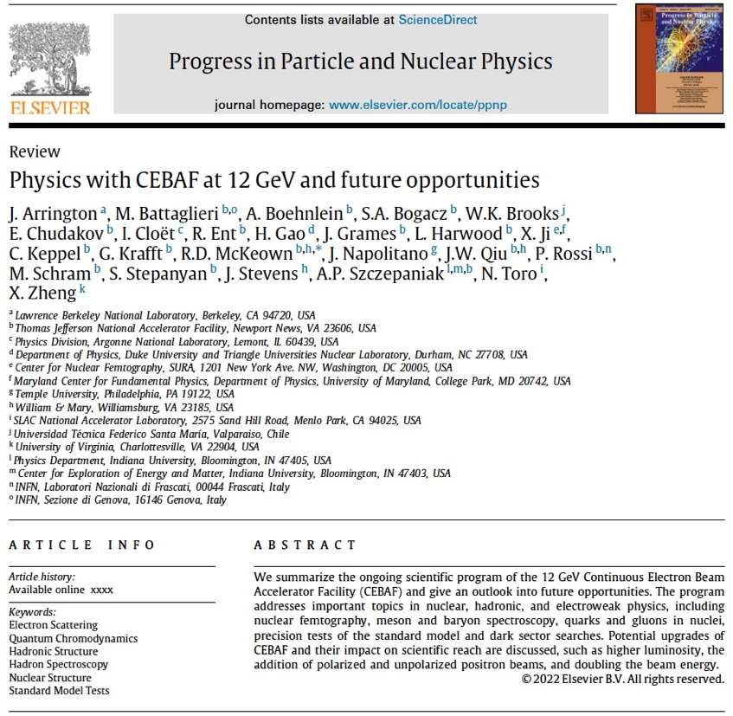
Recent overview and plans for future
https://arxiv.org/abs/2112.00060
The 12 GeV Experimental Program is now in full swing.
The overview includes recent results, updated projections, and plans for the future.
It emphasizes the need for high-luminosity facilities (SoLID and CLAS12).
Discusses the program with positron beams, and the possible energy upgrade to 20+ GeV.

Slide 7

EM form factors
Electron scattering has been a tool of choice for many decades for studies of the structure of the nucleon.
However, at each new stage of experimental investigation, new challenges and inconsistencies arose.
New experiments at Jefferson Lab address most of discrepancies, but some issues still remain:
  the ‘‘proton radius puzzle’’, discrepancy between muonic-hydrogen and electron scattering;
  the high $Q^{2}$ behavior of the proton elastic form factors $G_{E}\left(Q^{2}\right)$ and $G_{M}\left(Q^{2}\right)$has also been a puzzle.
The SBS (Hall-A) form factor experiments.

Slide 8
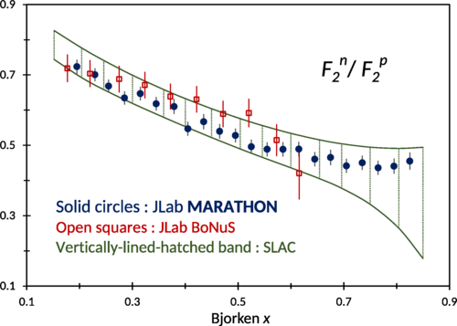
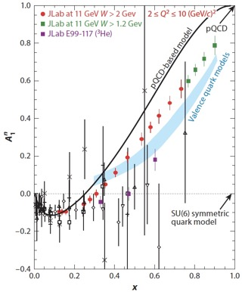
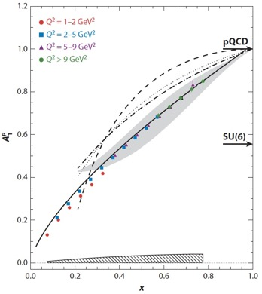
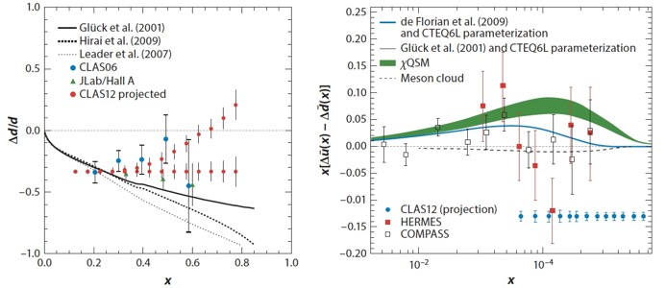
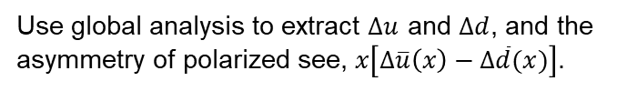
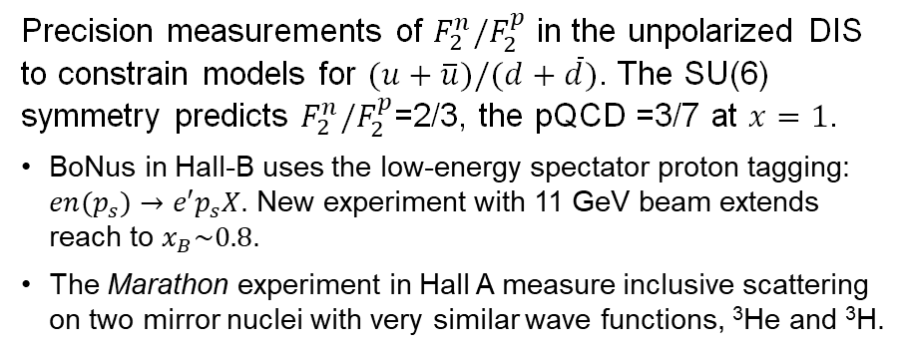
Structure of the valence quark distributions
Precision measurements of $F_{2}^{n}/F_{2}^{p}$ in the unpolarized DIS to constrain models for $(u+\overline{u})/(d+\overline{d})$. The SU(6) symmetry predicts $F_{2}^{n}/F_{2}^{p}$=2/3, the pQCD =3/7 at $x=1$.
BoNus in Hall-B uses the low-energy spectator proton tagging: $en(p_{s})→e′p_{s}X$. New experiment with 11 GeV beam extends reach to $x_{B}\sim 0.8$.
The Marathon experiment in Hall A measure inclusive scattering on two mirror nuclei with very similar wave functions, ³He and ³H.
Study polarized parton distributions with high precision measurements of $A_{1}^{p}$, $A_{1}^{d}$, and $A_{1}^{3He}$ (Hall-A, B and C) for $x_{B}≈0.8$ and $Q^{2}\sim 10$ GeV².
Use global analysis to extract $Δu$ and $∆d$, and the asymmetry of polarized see, $x\left[∆\overline{u}\left(x\right)−∆\overline{d}(x)\right]$.

Slide 9
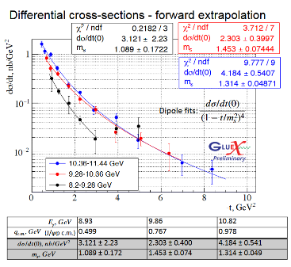
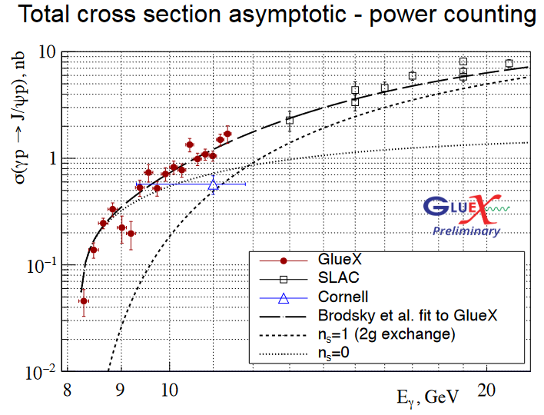
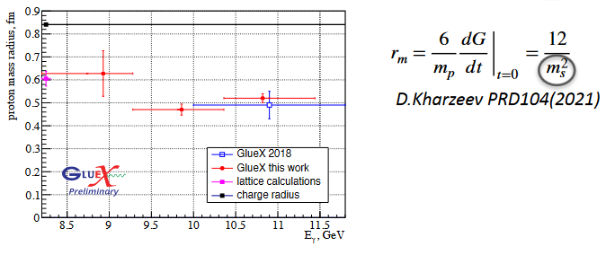
Protons gluonic FF – near threshold J/ψ production
Directly probe nucleon’s gluonic field, access to the matter distribution, mass radius, and the trace anomaly of the EMT.
Experiments in Hall C, and D (GlueX) already published results, the Hall-B CLAS12 (p, n) will follow.

Slide 10

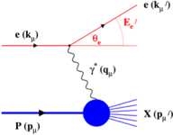
3-D Structure of the Nucleon: TMDs and GPDs
DIS Parton Distribution Functions
Elastic Form Factors
No information on the spatial location of the constituents
No information about the underlying dynamics of the system
Transverse Momentum Distributions & Generalized Parton Distributions
3-D imaging of the nucleon, the correlation of quark/antiquark transverse spatial and longitudinal momentum distributions, and on the quark angular momentum distribution
Notes:
----- Meeting Notes (9/27/11 07:19) -----
we already heard about elastic form factors that characterize charge and magnetization distribution in hadrons
parton distribution functions that have been studied extensively in DIS reveal quark-gluon substructure of the nucleon
but these two are as 2-D projection of a complex, 3-D object
3-D imaging of the nucleon, that became now reality using formaism of generalized parton distributions and deeply exclusive reactions

Slide 11

Nucleon tomography: GPDs
A major thrust of the JLab 12 GeV facility.
GPDs → PDFs (in the limit $t→0$)
Four leading-twist chiral-even GPDs:
GPDs → FFs (first moments of GPDs)
Nucleon tomography
Link to the energy-momentum tensor
Burkardt, Int.J.Mod.Phys.A, 2002
Decomposition of the nucleon spin
the D-term characterizes the distribution of forces inside the nucleon
Polyakov, Physics Letters B, 2003
Ji, Phys. Rev. Lett, 1997

Slide 12
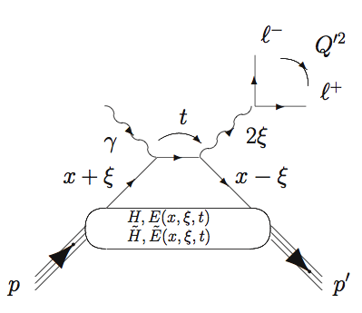
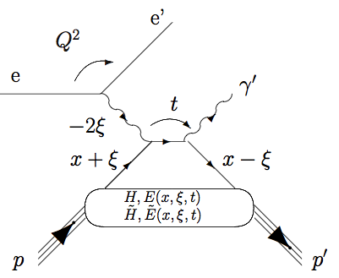
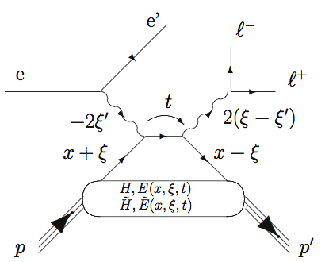

Compton Scattering and GPDs
First experimental measurement with CALS12 PRL 127, 262501 (2021)
Started in 2001, PRL 87, 182002
Is the large part of the CLAS12 physics program
Hard scale is defined by time-like photons
Hard scale is defined by space-like photon
DVCS
TCS
CLAS12 GPD studies
Access to the Re-part of the Compton amplitude
DDVCS
μCLAS12, one of two proposed facilities capable of measuring
Both space-like and time-like photons can set the hard scale
σ-DDVCS is three orders of magnitude smaller than σ-DVCS
The main driver of the high luminosity upgrade

Slide 13
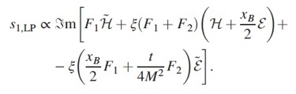
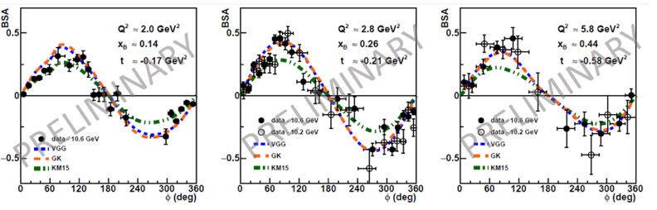





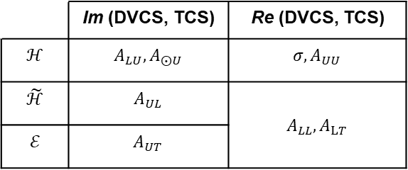

DVCS program
Program covers measurements of beam helicity, longitudinal and transverse polarized target asymmetries using detectors in Halls A, B, and C.
$$γ^{∗}(γ)$$
$$γ\left(γ^{∗}\right)$$
First BSA results from CLAS12
$$A_{LU}=\frac{a\sin{φ}}{1+c\cos{φ}+d\cos{2φ}}$$
Fit with ANNs, constrained on 6 GeV data.
$$A_{LU}∝F_{1}Imℋ$$
$$A_{UL}∝F_{1}Im\tilde{ℋ}$$
$$A_{LL}∝F_{1}Re\tilde{ℋ}$$
$$A_{UT}∝F_{1}Imℰ$$
Comparisons with KM15 and VGG/GK models.
 | Im (DVCS, TCS) | Re (DVCS, TCS)
$$ℋ$$ | $$A_{LU}, A_{⨀U}$$ | $${σ, A}_{UU}$$
$$\tilde{ℋ}$$ | $$A_{UL}$$ | $$A_{LL}, A_{LT}$$
$$ℰ$$ | $$A_{UT}$$

Slide 14
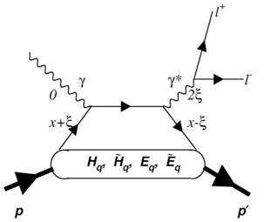
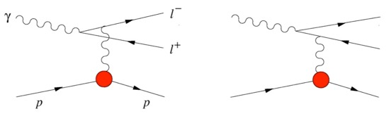
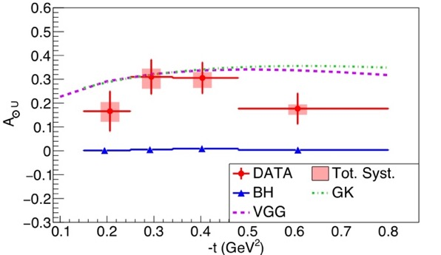
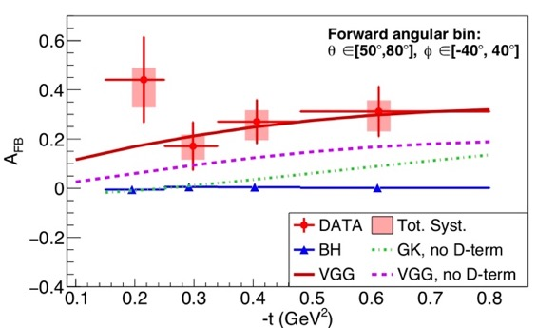
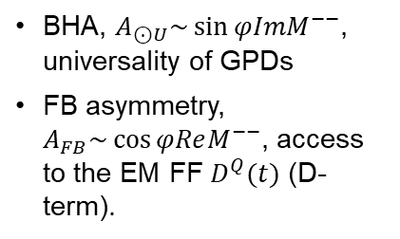
First measurements of TCS with CLAS12
TCS
Bethe-Heitler (BH)
BHA, $A_{⊙U}\sim \sin{φImM^{−−}}$, universality of GPDs
FB asymmetry, $A_{FB}\sim \cos{φReM^{−−}}$, access to the EM FF $D^{Q}(t)$ (D-term).
+
P. Chatagnon, et al. (CLAS Collaboration),"Phys. Rev. Lett. 127, 262501 (2021).

Slide 15
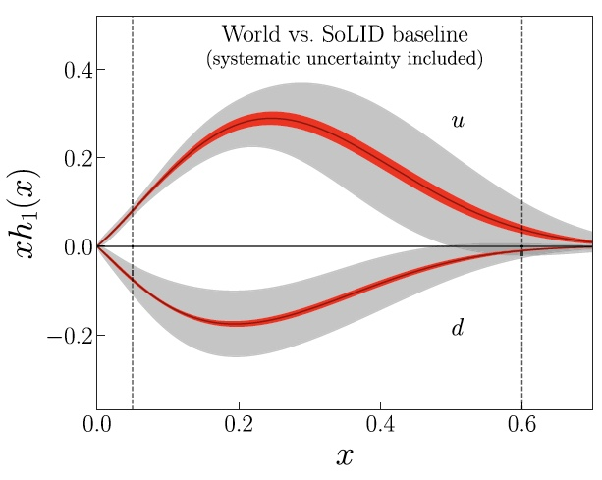
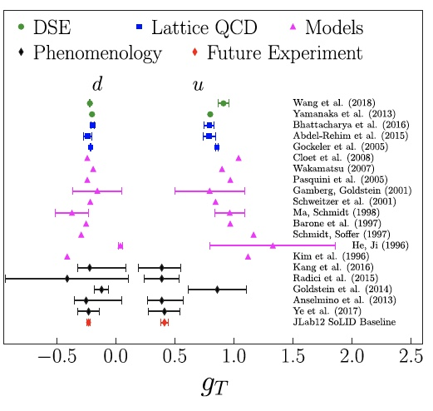
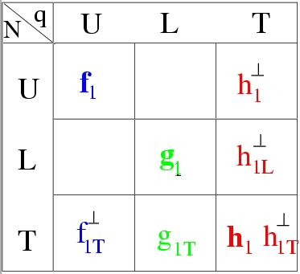
3D imaging in momentum space – SIDIS
Experiments in a wide kinematical region, with polarized beam and targets, variety of final states.
Will study hadronization in both the target and current fragmentation regions
Projected precision of extracted tensor charge for u and d quark from SoLID experiments with transversely polarized proton and ³He targets.

Slide 16


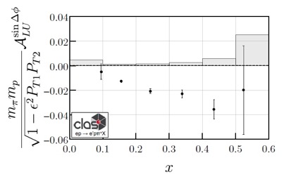
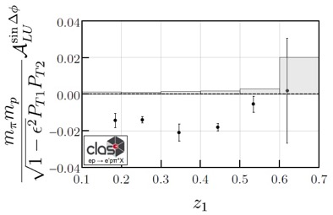
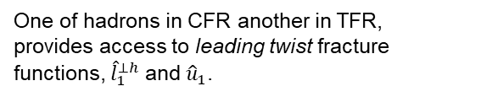
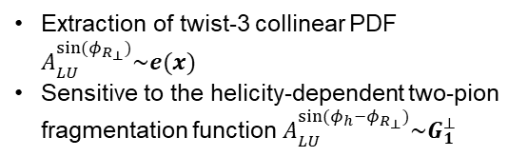
Di-hadron production in SIDS
BSA in the Process $ep→eπ^{+}π^{−}X$ with CLAS12
Extraction of twist-3 collinear PDF $A_{LU}^{\sin{(φ_{R_{⊥}})}}\sim e(x)$
Sensitive to the helicity-dependent two-pion fragmentation function ${A_{LU}^{\sin{(φ_{h}−φ_{R_{⊥}})}}\sim G}_{1}^{⊥}$
BSA in back-to-back di-hadron production in the reaction $ep→e{pπ}^{+}X$
One of hadrons in CFR another in TFR, provides access to leading twist fracture functions, ${\hat{l}}_{1}^{⊥h}$ and ${\hat{u}}_{1}$.

Slide 17
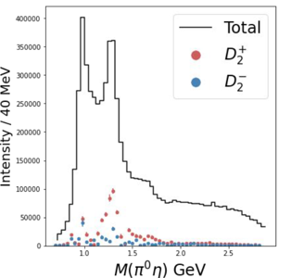
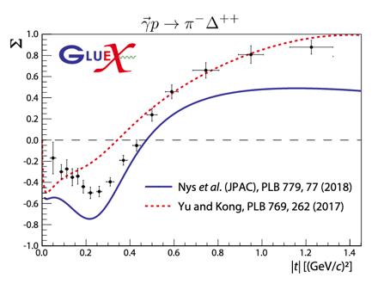
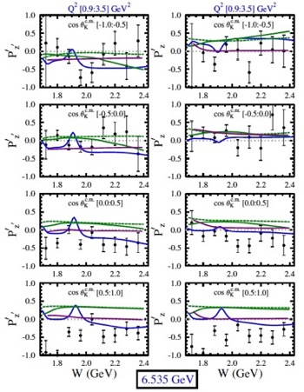
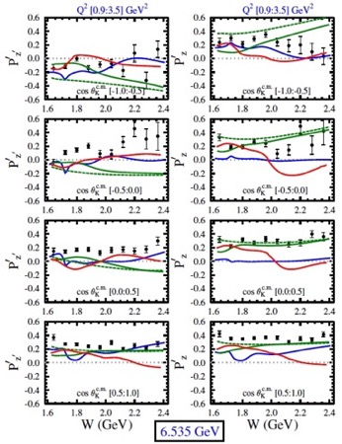
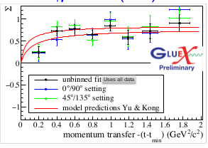


Hadron spectroscopy
Role of gluonic excitations, gluonic degrees of freedom – search for exotic states.
Spectrum of excited nucleon states, transition FF.
Strangeness production, polarization transfer
PRC 103, L02201 (2021) asymmetry
$$\frac{dN}{d\cos{θ_{p}}}=N_{0}\left[1+αP_{b}P_{Y}^{′}\cos{θ_{p}}\right]$$
$$A=\frac{N^{+}−N^{−}}{N^{+}+N^{−}}=ν_{Y}αP_{b}P_{Y}^{′}\cos{θ_{p}}$$
unnatural
natural
Σ⁰
Λ
γp→π⁻Δ⁺⁺
PRC 105, 035201 (2022) SDME, asymm.
γp→K⁺Λ(1520⁾

Slide 18
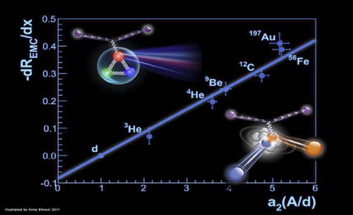
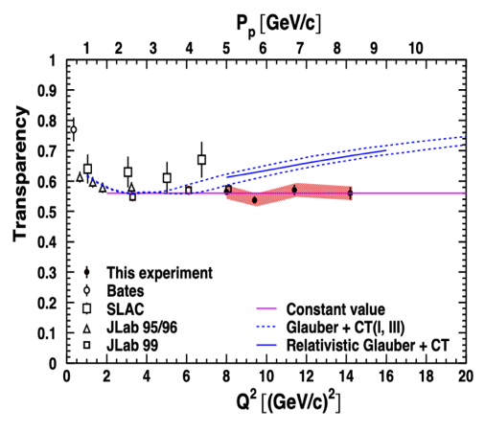
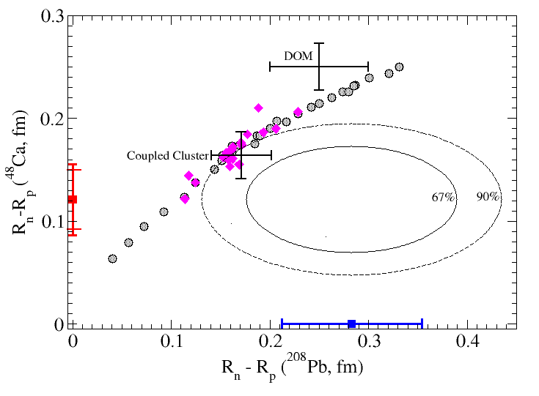
QCD and nuclei
EMC-SRC correlation
Nucleon modification, tagged EMC.
Short range NN correlations.
Quark/hadron propagation and CT.
Nuclear DVCS
PREX and CREX experiments: electroweak asymmetry in elastic eA scattering
Prediction with Color Transparency
Ruling out color transparency in quasi-elastic 12C(e,ep) up to Q² of 14.2 (GeV/c)2
Data has flat dependence
No Color Transparency !
⁴⁸Ca : thin skin
²⁰⁸Pb : thick skin
Implications for the EOS of neutron matter

Slide 19
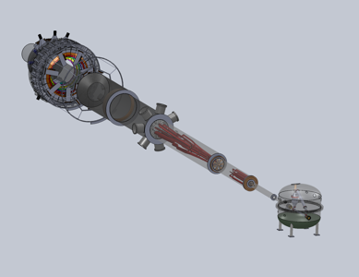
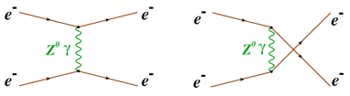
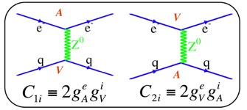





Precision test of the SM electroweak interactions
PV Moller scattering: Purely leptonic probe – test of $sin2{θ_{W}}.$
E_{b} = 11 GeV
75 μA 80% polarized
Luminosity: 3x10³⁹ cm⁻² sec⁻¹
$$A_{PV}=\frac{σ_{R}−σ_{L}}{σ_{R}+σ_{L}}=mE\frac{G_{F}}{\sqrt{2}πα}\frac{2y(1−y)}{1+y^{4}+{(1−y)}^{4}}Q_{W}^{e}$$
$$Q_{W}^{e}=−4g_{e}^{V}g_{e}^{A}=−(1−4 sin2{θ_{W})}$$
APV = 35.6 ppb
δ(APV) = 0.73 parts per billion
δ($Q_{W}^{e}$) = ± 2.1 % (stat.) ± 1.0 % (syst.)
The most precise measurement of weak mixing angle at low Q²
PV deep inelastic scattering: precision test of the SM prediction for hadronic axial-vector currents
$$A_{PV}=\frac{σ_{R}−σ_{L}}{σ_{R}+σ_{L}}=\frac{G_{F}Q^{2}}{4\sqrt{2}πα}\left(a_{1}\left(x,Q^{2}\right)Y_{1}\left(x,y,Q^{2}\right)+a_{3}\left(x,Q^{2}\right)Y_{3}\left(x,y,Q^{2}\right)\right)$$
$$a_{1}=\frac{6}{5}\left(2C_{1u}−C_{1d}\right)$$
$$a_{3}=\frac{6}{5}\left(2C_{2u}−C_{2d}\right)$$
A Large Acceptance Detector, can handle high luminosity, 10³⁹ cm⁻² sec⁻¹
BSM physics search - sensitive to contact interaction of high mass particles (~20 TeV – 40 TeV).
Will help to disentangle dimension-6 from dimension-8 SM Effective Field Theory couplings.

Slide 20
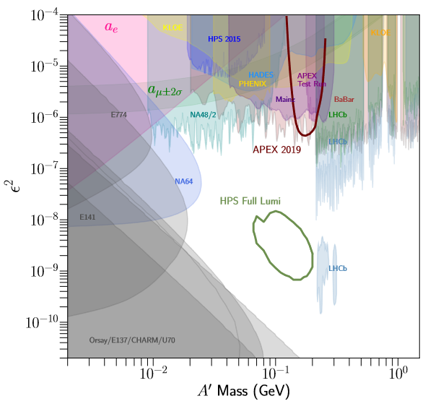



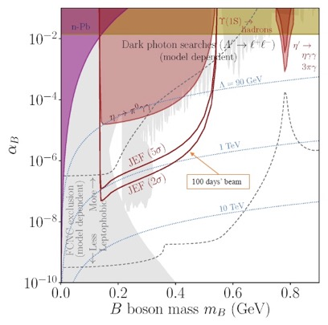
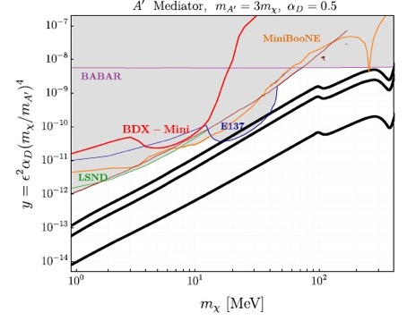


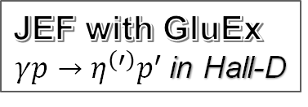

Search for dark sectors
Hall-A
Hall-B
APEX
Direct Detection Search for X17
PRAD in Hall-B
Beyond Hall A beam dump
JEF with GluEx
$γp→η^{(′)}p^{′}$in Hall-D
Leptophobic
Leptophilic
Hadrophilic
$2.56×{10}^{21}$EOT
Axion-like:

Slide 21
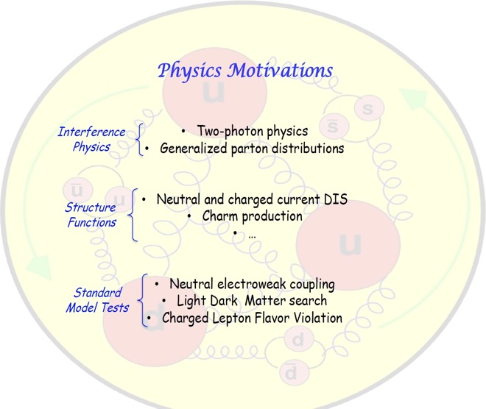
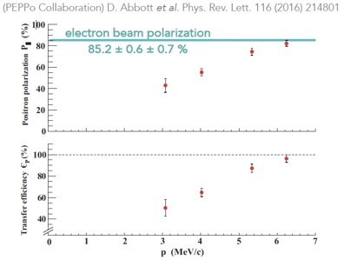





Physics with polarized positrons beams
A rich and exiting experimental program, will account for about five years of CEBAF running.
Two-photon contribution
$$R_{2γ}=\frac{σ_{e+}}{σ_{e−}}≈1+δ_{2γ}$$
Weak neutral-current coupling
$$e^{±}+N→μ^{±}+X$$
$$L≈{10}^{39}{cm}^{−2}\sec^{−1}$$

Slide 22







CEBAF energy upgrade
HIGH ENERGY WORKSHOP SERIES 2022
    3 passes with the current CEBAF (Arcs 1-6)
    8 passes through a pair non-scaling FFAs (4 + 4)
With the goal to probe the science that would be opened up by a higher energy electron beam (~20-24 GeV) at Jefferson Lab.
FFA Arcs
TOF
TOF
FFA Arcs
$$E≈20 GeV −24 GeV$$

Slide 23

Complementarity with facilities worldwide
Jefferson Lab stays very relevant and complementary to other facilities with the high luminosity ($\sim {10}^{39}{cm}^{−2}\sec^{−1}$), high x reach of fixed target experiments.
Precision measurements in the valence quark region requiring high luminosity are clearly the purview of CEBAF.
The 20+ GeV energy upgrade will provide important overlap into the sea quark region where the EIC is designed to probe at low 𝑥.
Kinematic regions of Deep Inelastic Scattering and the comparative reach of different facilities.

Slide 24
To conclude
Jefferson lab is the home of high luminosity experiments and will remain the prime facility for fixed target electron scattering for decades to come.
JLAB started the execution of a vibrant physics program with up to 12 GeV electron beams and will continue for the next 10 years or so.
New experiments yielded ground-breaking Nuclear Physics results in 3-D imaging of the nucleon, isospin decomposition of nucleon structure functions, near-threshold J/ψ production, proton charge radius measurement, and new information on neutron matter.
There are exciting physics opportunities with positron beams, and machine upgrade is now under study.
Looking forward to a new round of upgrades, building a case for high energy, ~24 GeV, machine.

