Slide 1
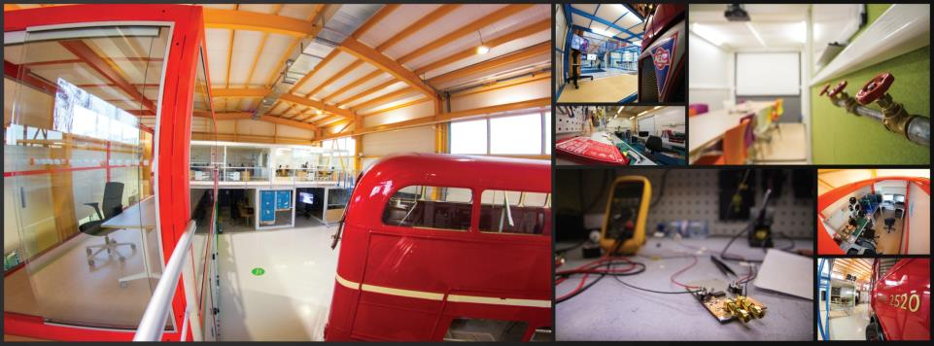
ISAB-G Annual Meeting February 11, 2022
UPDATE STRATEGY PLAN 2022 - 2025
Markus Nordberg

Slide 2
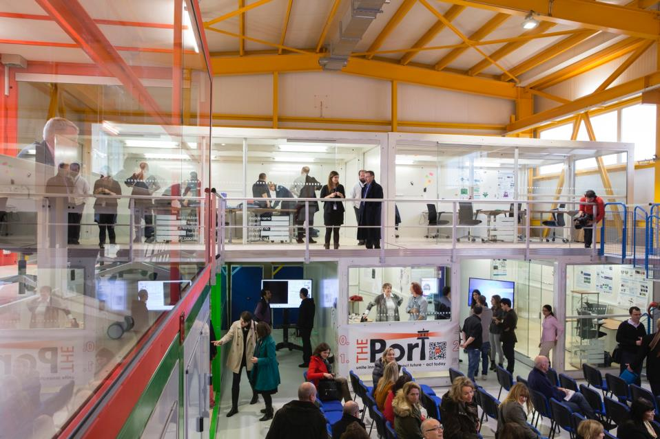
STRATEGY PLAN 2022 - 2025
Key activity drivers: ATTRACT (incl. CBI), Crowd4SDG, CERN-offerings (new GRADE initiatives; tech courses/WSs and support to CERN people; Science Gateway; SPARKS)
Key goals: More visible role in CERN activities/goals; developing ATTRACT; re-inventing CBI by 2025 (“Terraforming”)
Key resources: ATTRACT, budget from CERN (2021 and 2022 assured), additional income still needed by 2024 (exec mgmt. courses; investors?)

Slide 3
POSITIONING IDEASQUARE (FIG. 9)

Slide 4
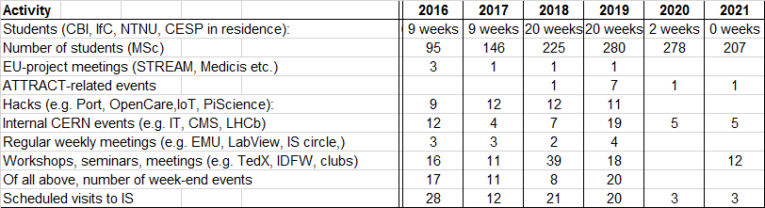
EVOLUTION OF ID2 ACTIVITIES

Slide 5
ID2 UPDATED BUDGET PLAN, kCHF in FIG. 11)
ID2 Team: O. Lillelokken, L. Mabiala, C. Marcelloni, R. Muller, J. Sarnikorpi, P. Tello, L. Veyrat, L. Wirtavuori; Strong support from: V. Brancolini, O. Darwich, L. Leveratto, S. Makinen, T. Utriainen

Slide 6
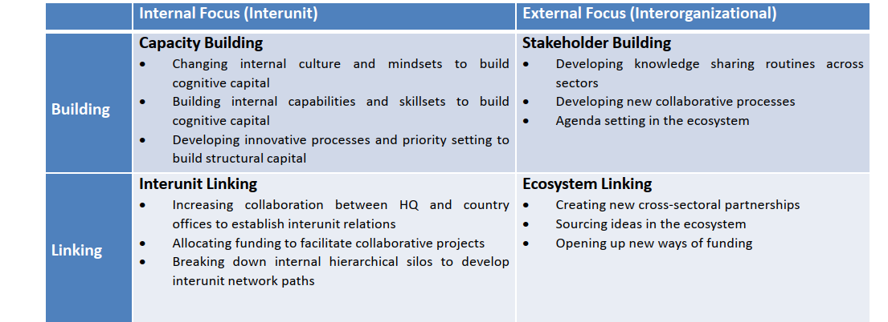
MEASURING IMPACT IN TERMS OF RELATIONAL VALUE?
Katherine Tatarinov, Tina Ambos, Julian Birkinshaw

Slide 7
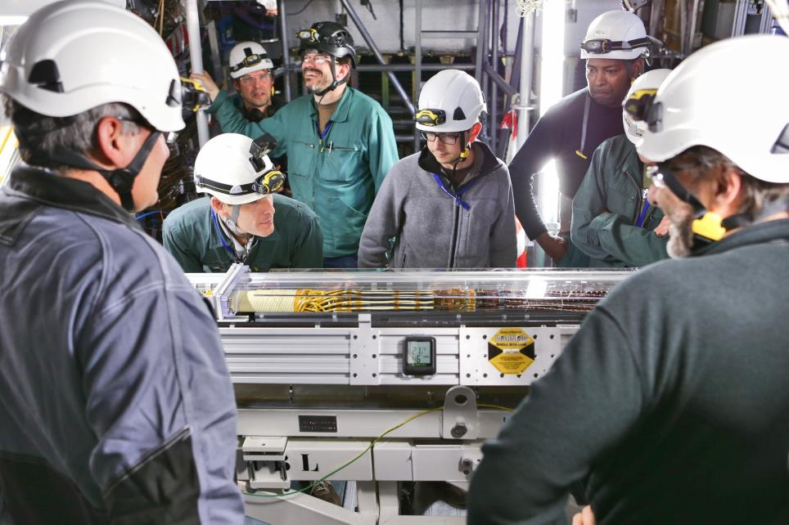
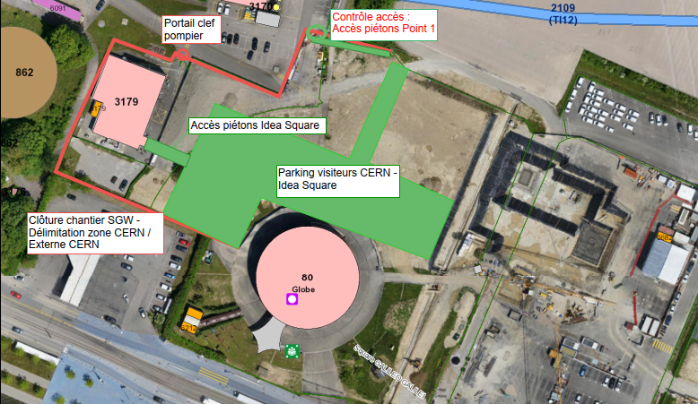
KEY CHALLENGES FOR 2022 - 2023
On-going COVID-restrictions: Can we host in 2022 our student projects as planned? Use of rental space outside (e.g. Hive)
Budget: Can we execute 2023 programs as planned (including ATTRACT-CBIs)?
Adapting to be on the public side of the CERN fences as part of the Science Gateway Campus
  What rules to follow (EP/IPT/other?)
    Operation; access; security; safety procedures
New barrier (in red) is now in place moving ID2 outside the CERN perimeters
www.attract-eu.com

Slide 8
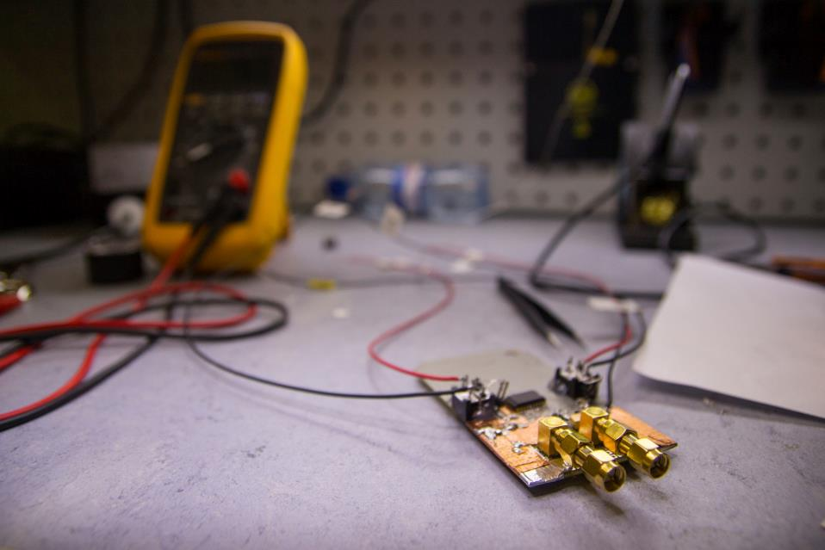
CONCLUSIONS
Similar to 2020, ID2 activities in 2021 were strongly affected by COVID-restrictions. ID2 was basically closed up all year – but we managed to run 10 of the 15 scheduled CBI-like courses online, engaging 200+ students …
As of 2021, primary focus has been supporting ATTRACT Phase 2, which now incorporates CBI. CERN-connection is stronger, but …
… more needs to be done, and 2023-2025 budgets need to be secured
Easing up of current COVID-restrictions? Which rules ID2 is to follow, (now included on the public side of the CERN fence)

Slide 9
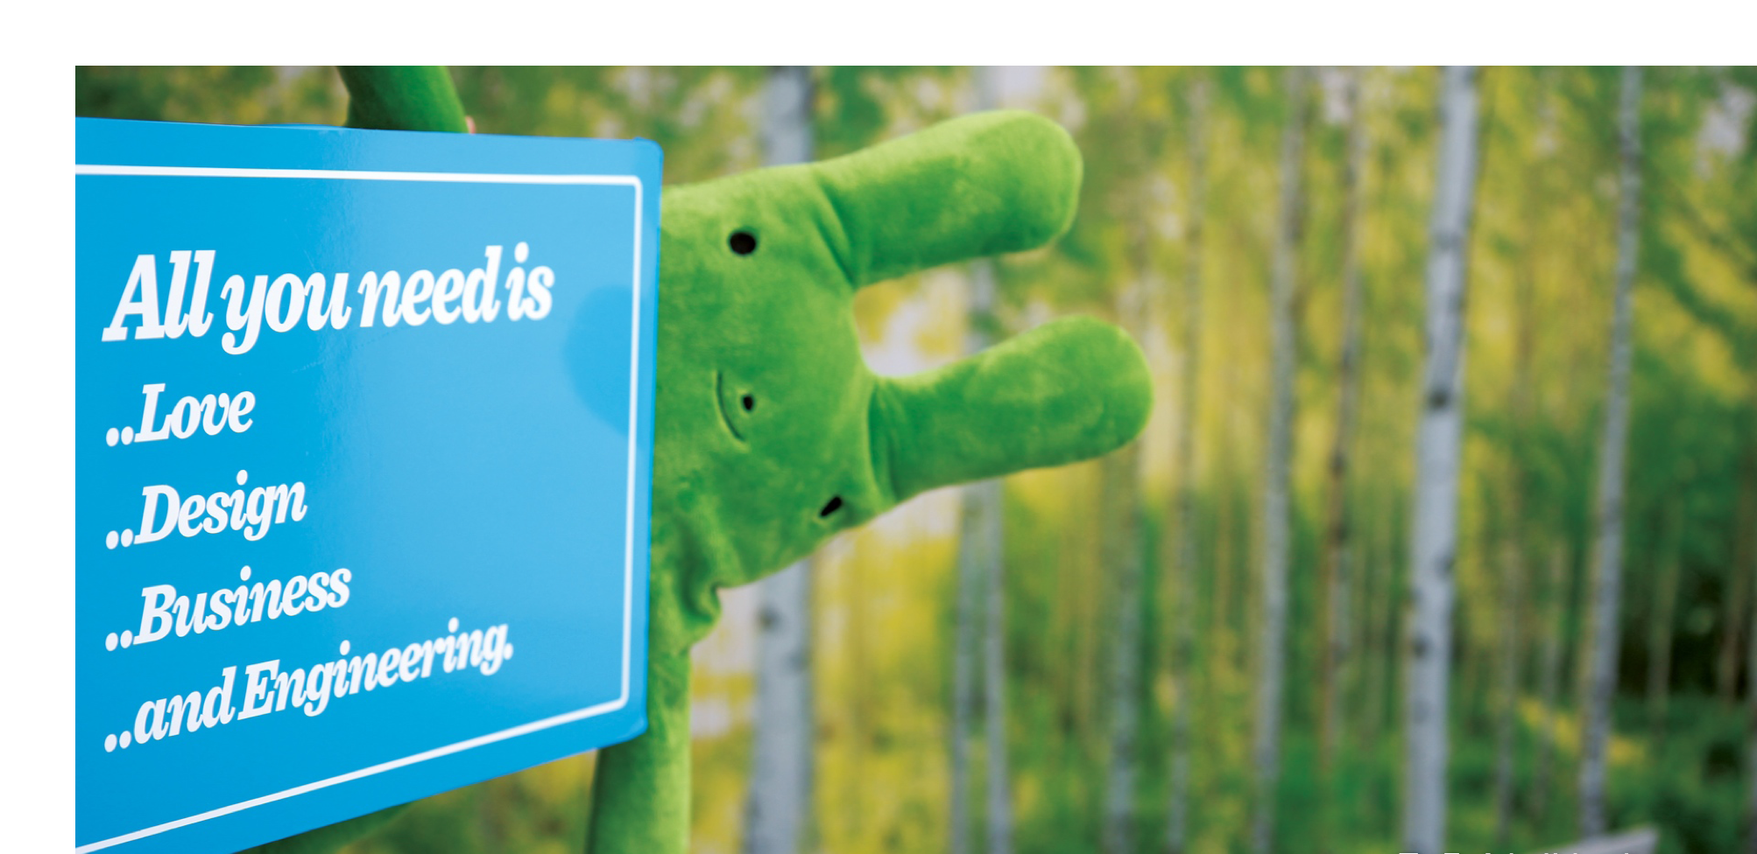

Questions? Comments?
Contact information:
Email
Skype
Let’s have a cup of coffee and make it happen!

