Slide 1
Comms
#CERNIdeaSquare
26 January 2022
By Claudia.Marcelloni@cern.ch

Slide 2
Items
Communication Strategy Plan Goals
Branding and Graphic Charter application
Channels and audiences
Report
Open Doors Event for the CERN community
Link to Science Gateway

Slide 3
Communication Strategy - Goals
The key goal of the communications plan is to complement and support the implementation of the IdeaSquare strategy for the next four years (spring 2021-spring2025):
Establish clear and consistent communication of ID2 identity, establishing it as the innovation space at CERN
Clarifying ID2 current offers and activities to its audiences,
Revamp all its communications channels
Show the added value as a testbed to European-funded projects, specifically through ATTRACT and Crowd4SDG.
Support the development of innovative educational programmes
Strengthen the link and communicate the value proposition of ID2 to CERN internal stakeholders through prototypes and events
Develop platforms and projects to harvest knowledge in innovation
Explore links with Science Gateway complementing the offer of the CERN's ECO group to the general public

Slide 4
Identity

Slide 5
Activities
IdeaSquare is the innovation space at CERN, that uses collaborative methodologies, access to CERN expertise and cross-connectivity to ideate solutions for the future of humankind. A place where people have the licence to dream.
Notes:
Alignment with the Strategy Document

Slide 6
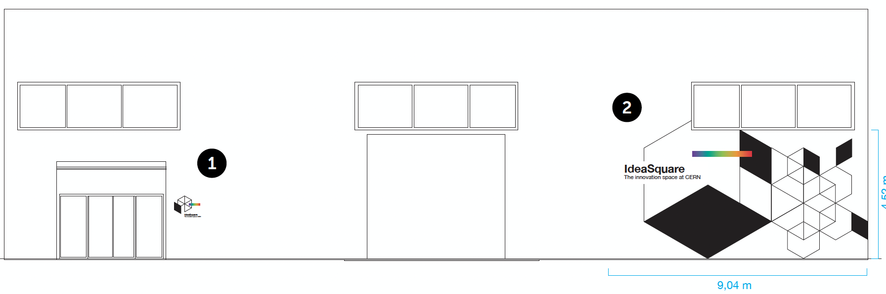
Space

Slide 7
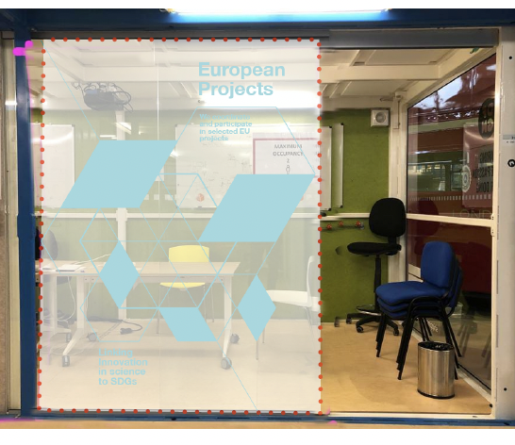
Space

Slide 8
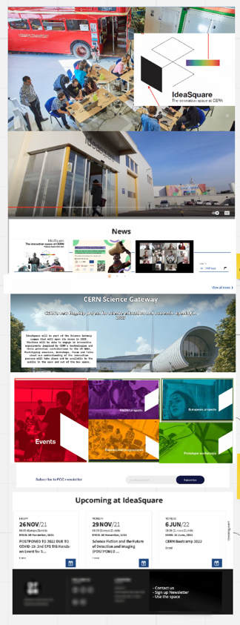
Website
Audience: all
Innovation Space at CERN
News on all 5 activities
The link to Science Gateway

Slide 9
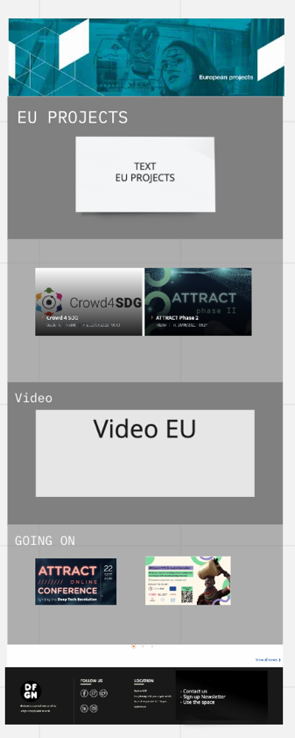
EU Projects
Overall description
Links to external websites: Ex: ATTRACT and Crowd4SDG
Featured video about the activity
Latest news updates or blogs

Slide 10
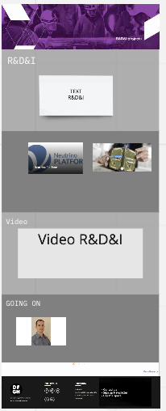
R&D
Focus on Neutrino
Link to KT

Slide 11
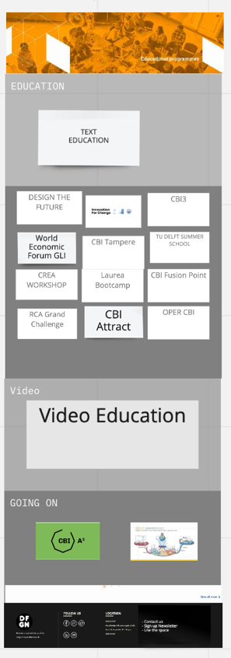
Educational Programmes
Merge the CBI website to ID2
Feature all the different Educational Programmes under one umbrella.

Slide 12
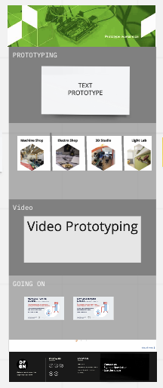
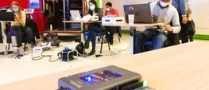
Prototype
Opportunity to feature the prototyping of the CERN internal audience
Feature workshops such as the FPGA

Slide 13
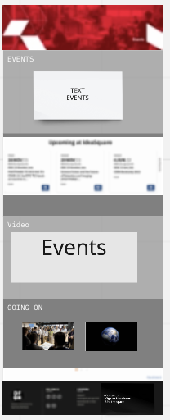
Events
Feature agenda
Will also feature workshops for Science Gateway

Slide 14
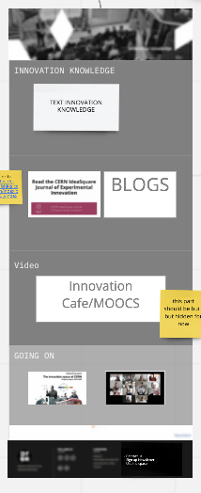
Innovation Knowledge
Feature CIJ
Blogs – invitation to partners
Potential new formats

Slide 15
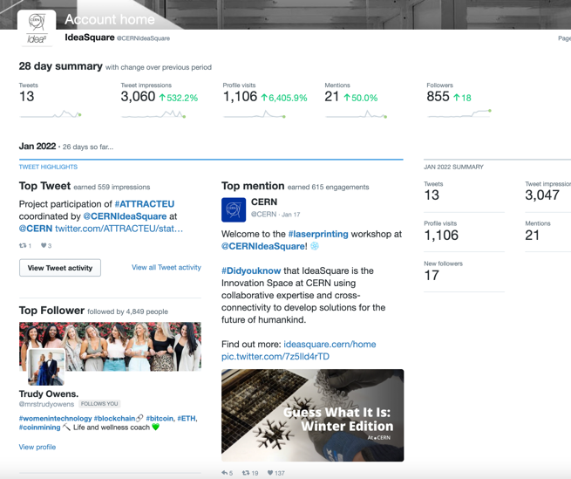
3) Social Media – Twitter
Audience: Partners and organizations. Ex: EU partners and CERN
Type: punctual with tweet-ups of events
Followers: 855
Impressions: around 1-2K/post
Top activity: 13K impressions
Full Stats

Slide 16
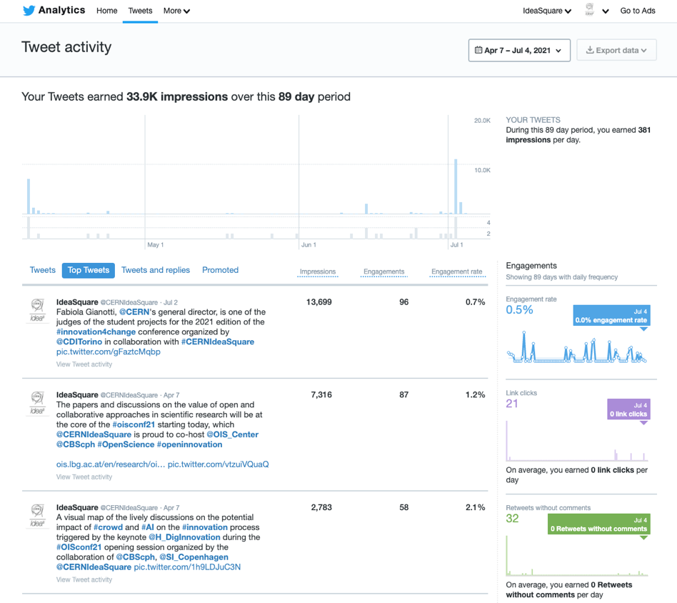

Slide 17
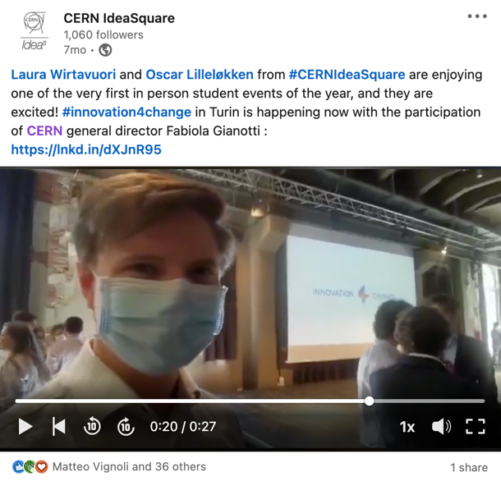
Social Media – LinkedIn
Audience: Partners, organizations and external users. Ex: universities
Type: focus on the initiative and outcomes
Followers: 1006
Impressions: around 500/post
Top activity: 14K impressions
Full stats

Slide 18
Top posts LinkedIn
We are back into business – 2K
College des ingenieurs workshop – 1.2K
VIP visit to IdeaSQuare – 3.8K
Innovation 4 change Torino – 2.4K
Design the Future – 1.3K
FDGA workshop at ID2 - 2.4K

Slide 19
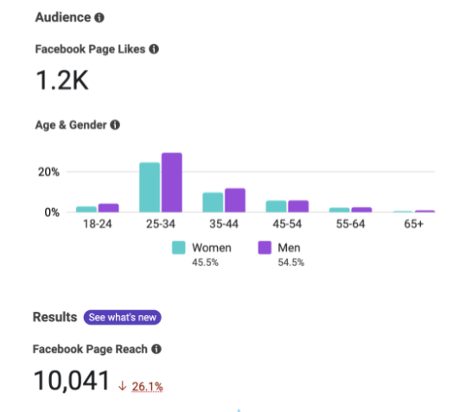
Social Media – Facebook
Audience: Partners and internal users Type: focus on groups and individual accomplishments
Followers: 1.2K
Impressions: 100/post
Top activity: 668 impressions
Full stats

Slide 20
Top Posts Facebook

Slide 21

Newsletter (with KT)
Audience: internal, management and key stakeholders

Slide 22
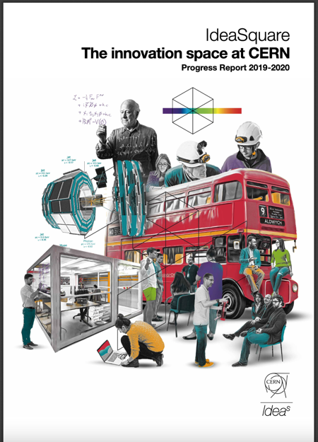
Report
Audience: CERN Management, current and future partners

Slide 23
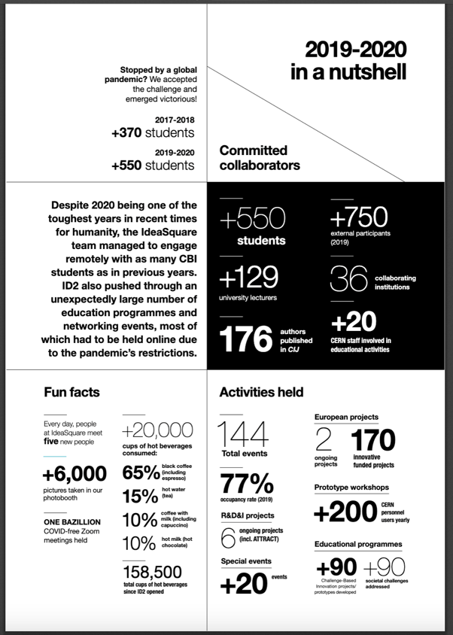
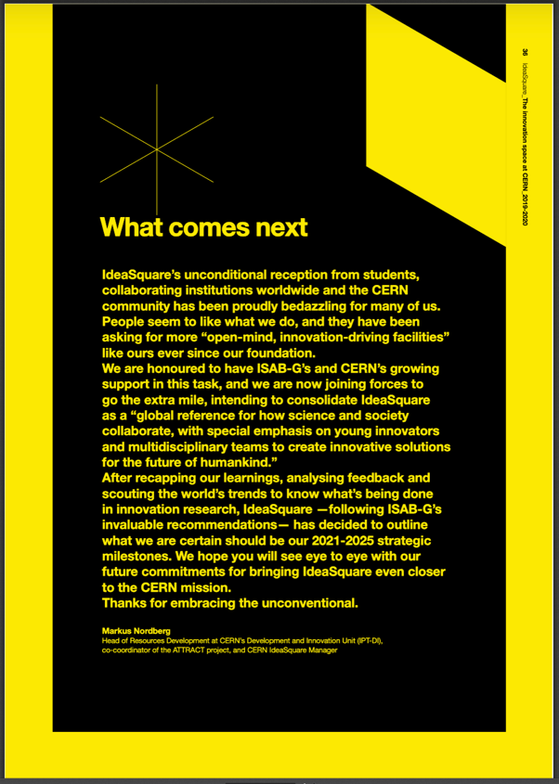

Slide 24
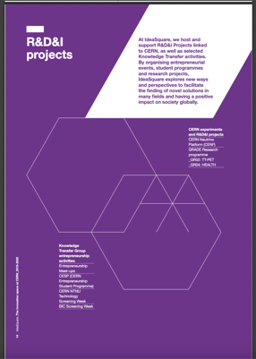
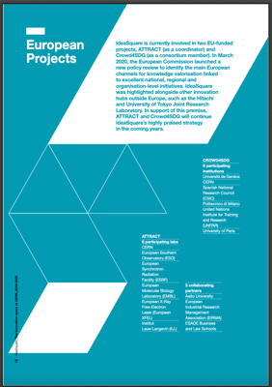
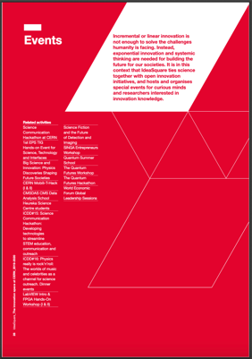
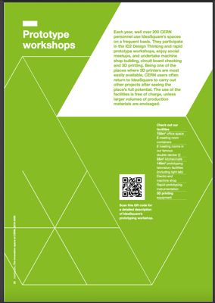
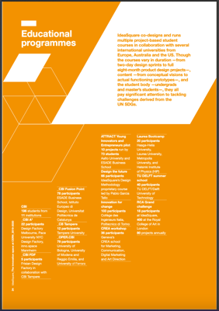
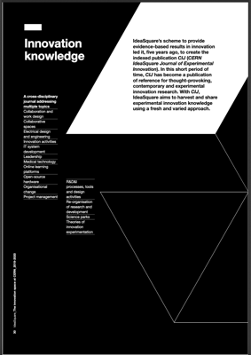

Slide 25
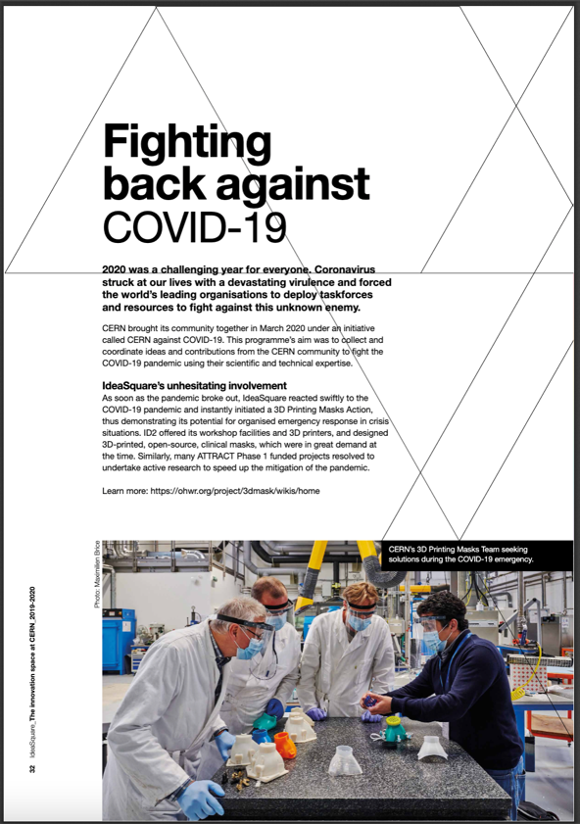

Slide 26
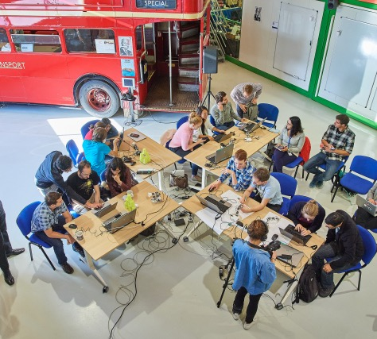
Open Doors Event
Stakeholder interviews to identify potential use of the space
Offer of workshops form ID2 team
One week of events to promote and invite people to the space
IF COVID ALLOW US ☺
IdeaSquare Open Doors event 2018

Slide 27
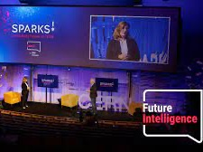
Link to Science Gateway
Sparks! Forum and Public Event – annual flagship event
Workshops for Science Gateway visitors – Wednesdays and Saturdays
Window of the Science Gateway campus of innovation at CERN (ID2 and KT)
Sparks! Forum 1st edition

