Slide 1

Prototyping activities at IdeaSquare

Slide 2
Collaboration with
CERN projects

Slide 3

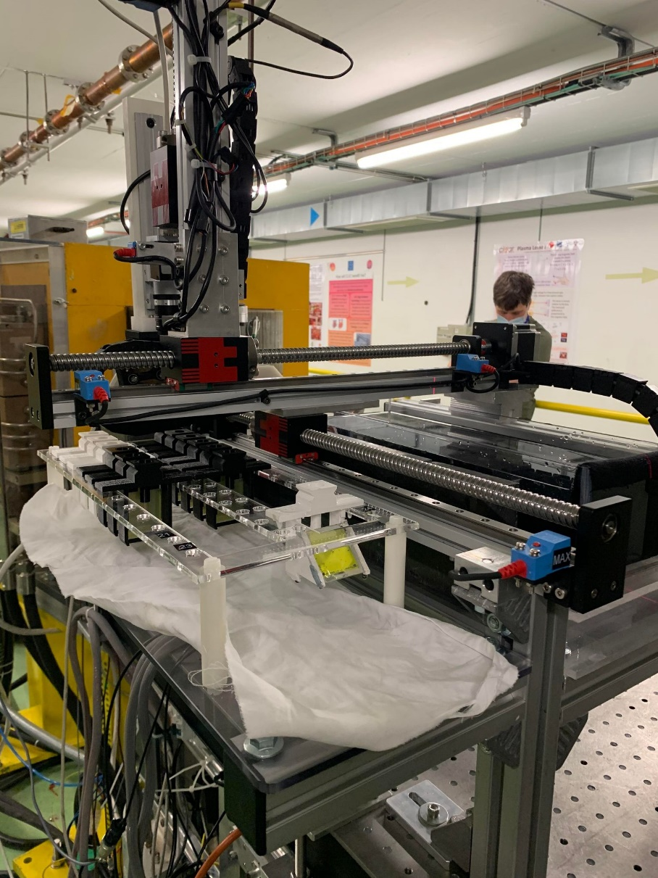
CERN Linear Electron Accelerator for Research
Medical research in radio therapy
Developed a robot for handling samples while the beam is running

Slide 4
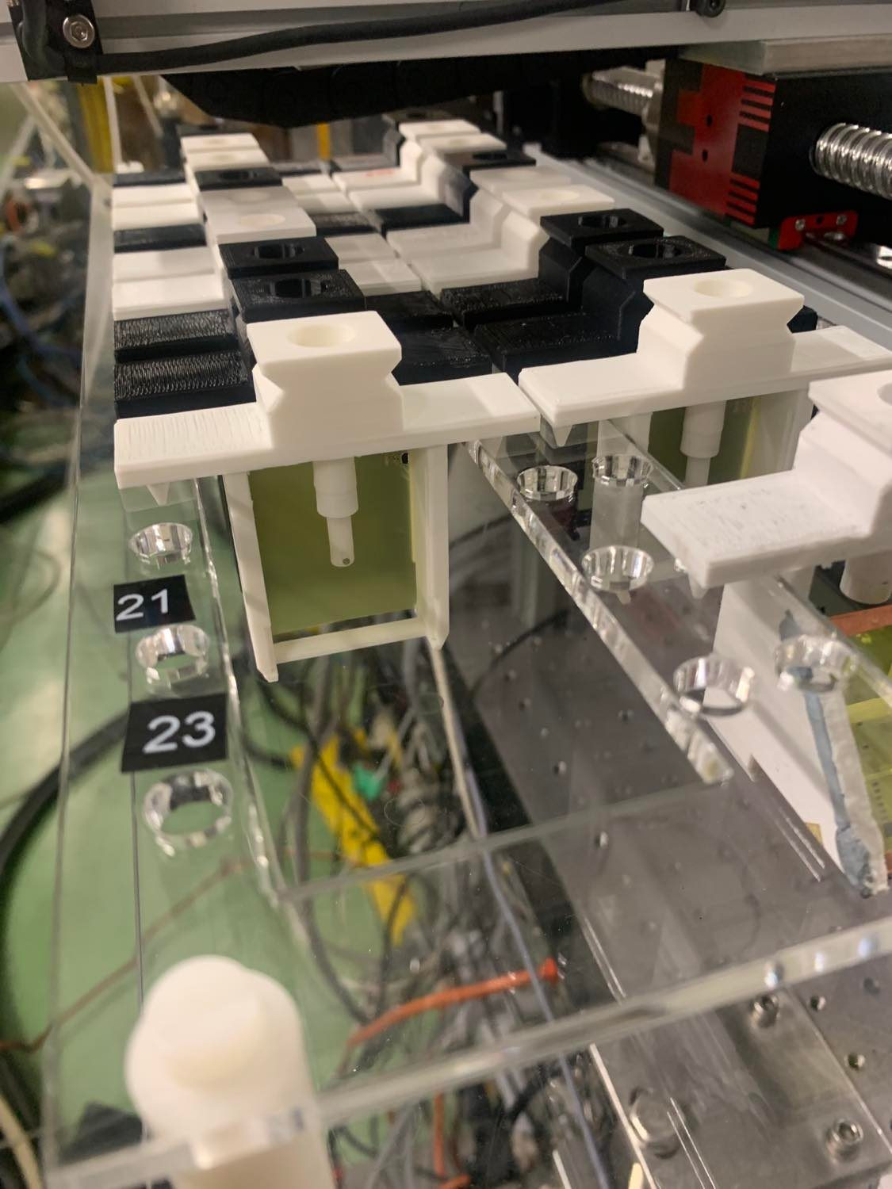
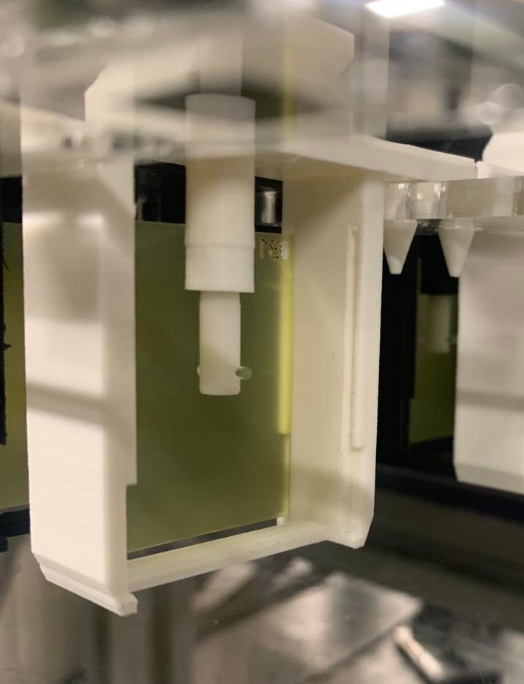
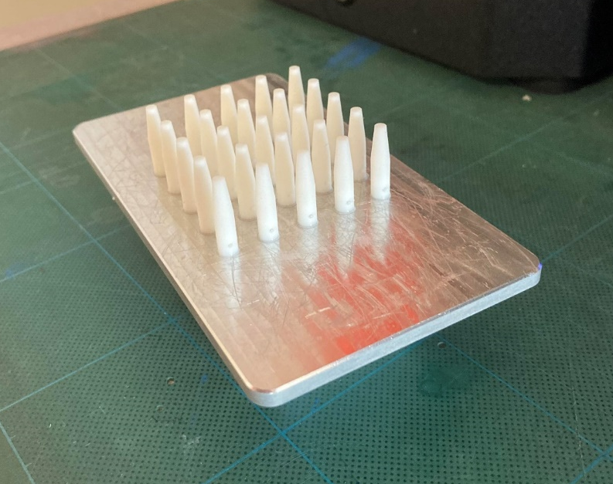
3D printing
Laser cutting

Slide 5

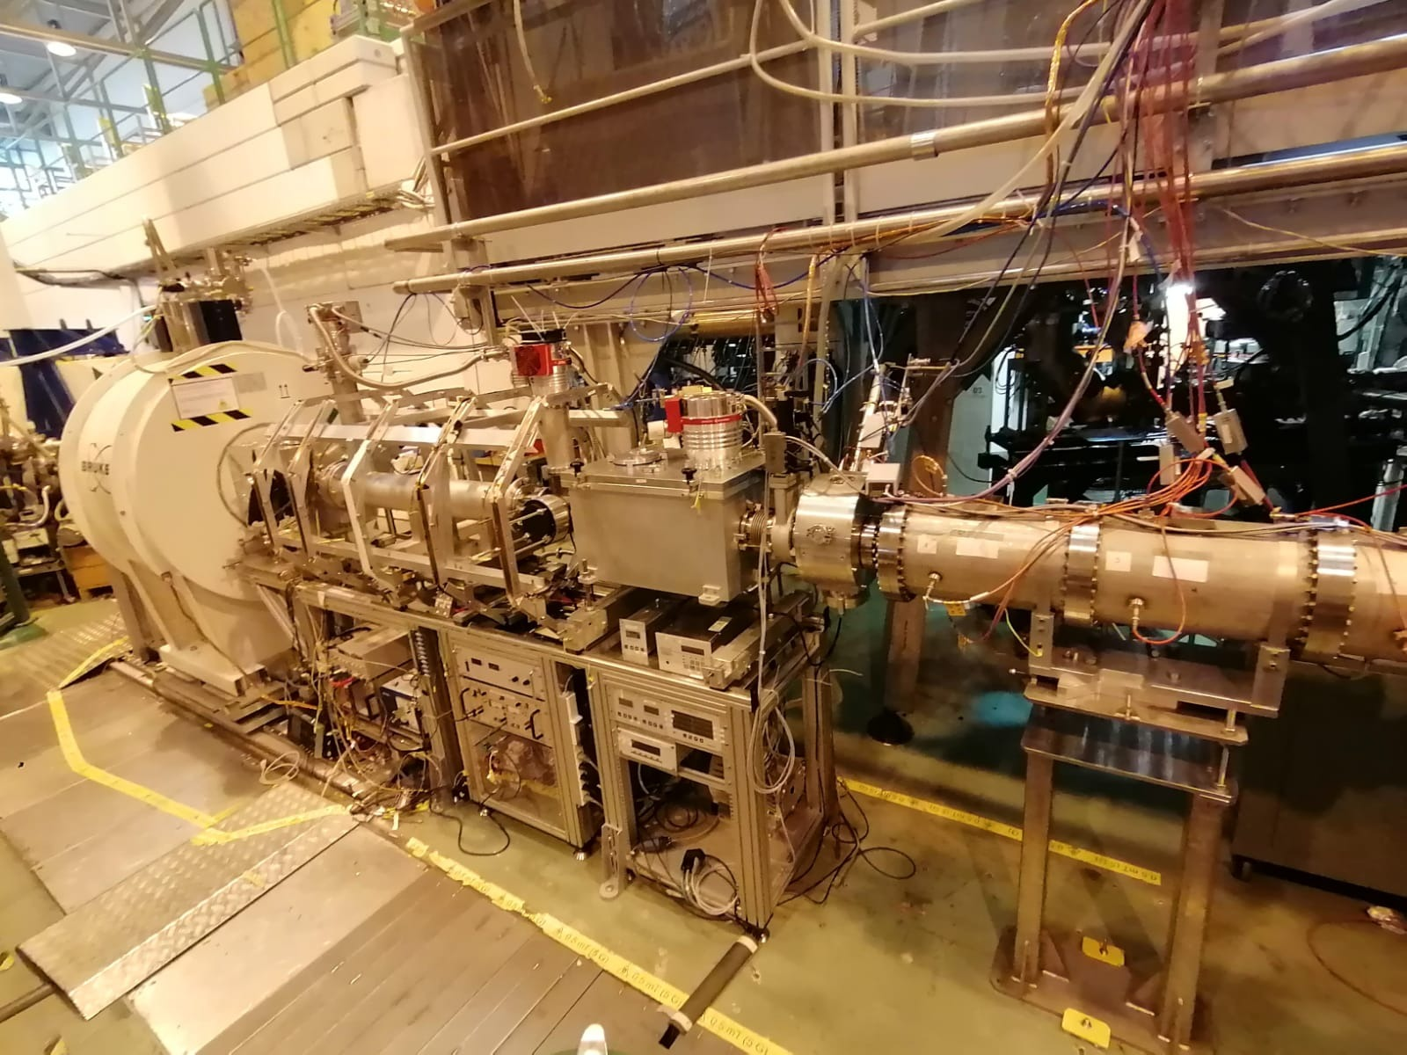
Isotope Separator On Line Device
VITO beam line
Studies weak force and
short-lived unstable nuclei
Notes:
VITO (Versatile Ion polarisation Technique Online) is a permanent beamline at the ISOLDE facility devoted to versatile studies with laser-polarised radioactive beams

Slide 6
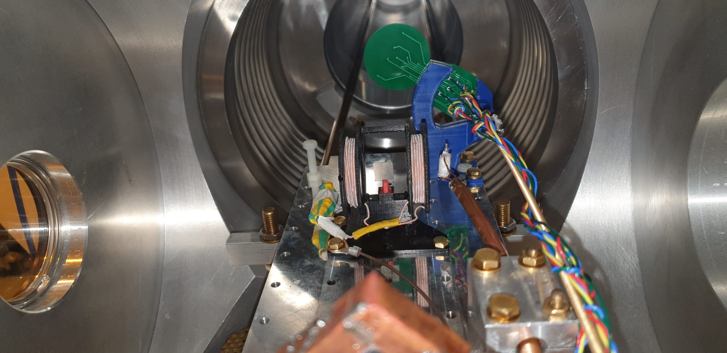
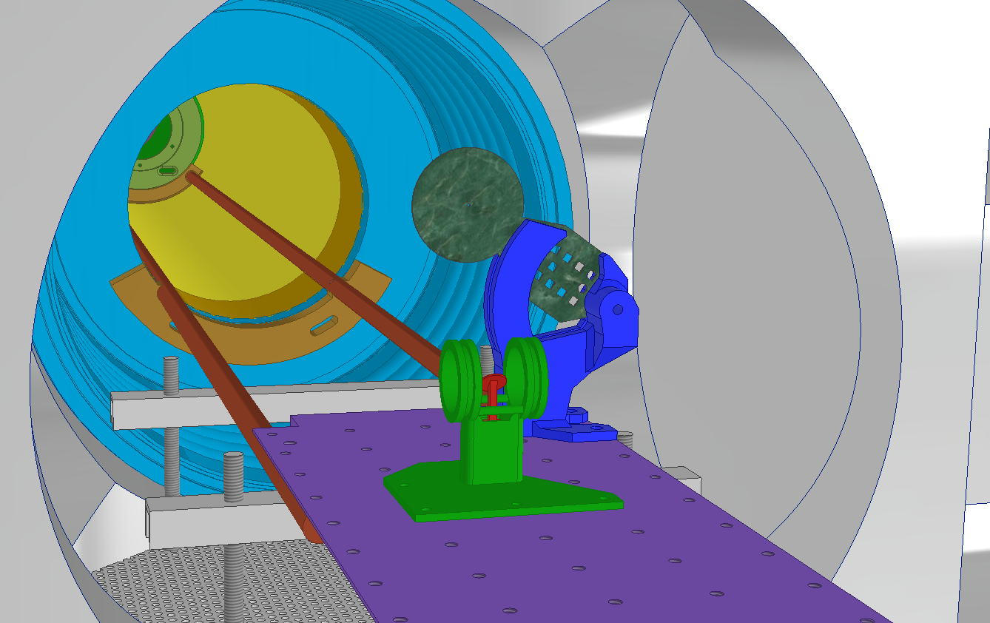
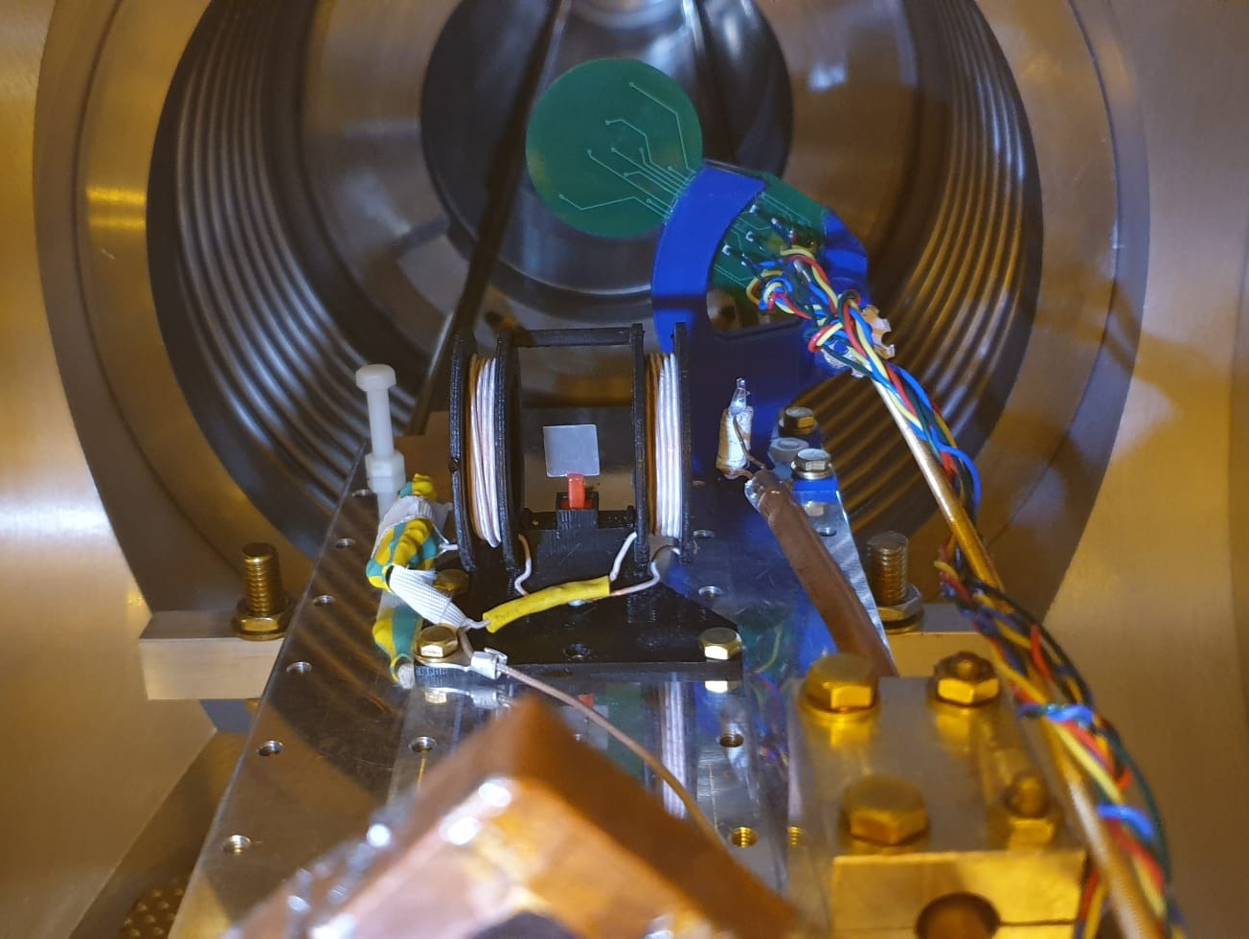
3D-printing in Idea Square for VITO
Faraday Cup Holder (blue)
RF-coil Frame (green)
Sample Carrier (red)

Slide 7
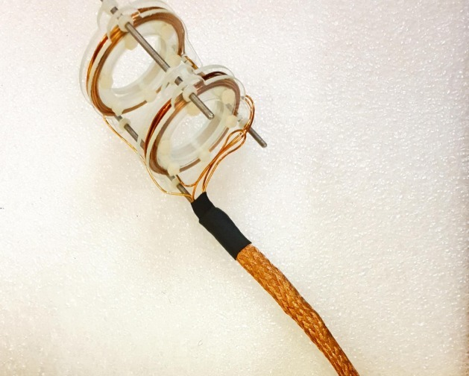
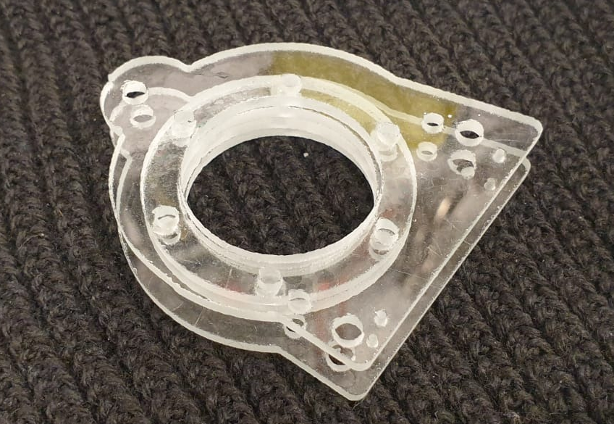
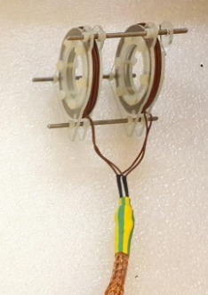
Waterjet Cutting in Idea Square for VITO - glass
As RF-coil frame printed of PLA-plastic were melted by RF-currents the frame has been re-designed to built it of glass slices made on Wazer machine in IdeaSquare

Slide 8
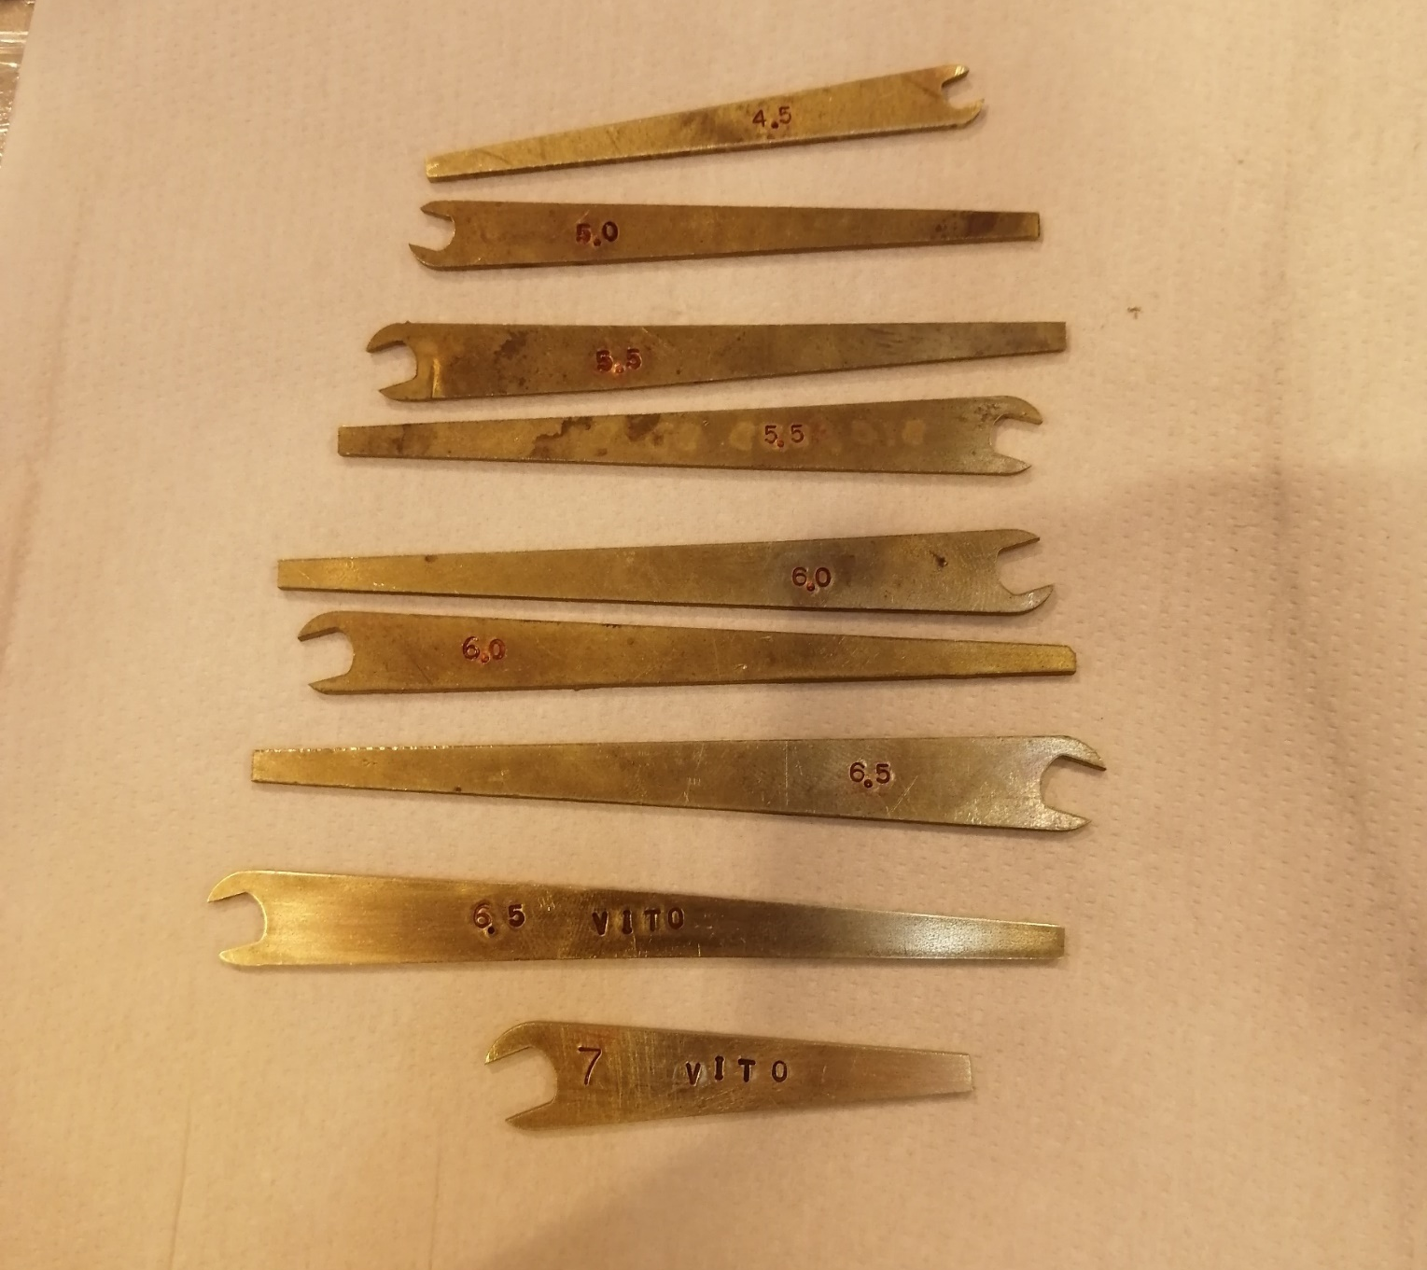
Waterjet Cutting in Idea Square for VITO - brass
Strong magnetic field of few Tesla in around the NMR magnet didn’t allow us to use a standard tools made of magnetic steel.
A set of custom brass wrenches to work on experimental carriage has been done by a cutting of brass sheet on a Wazer machine in IdeaSquare

Slide 9

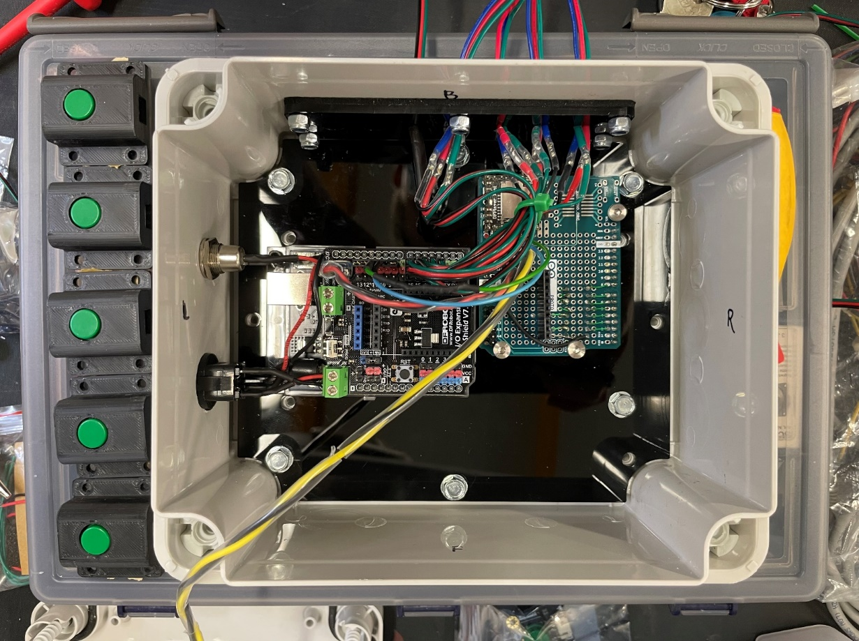
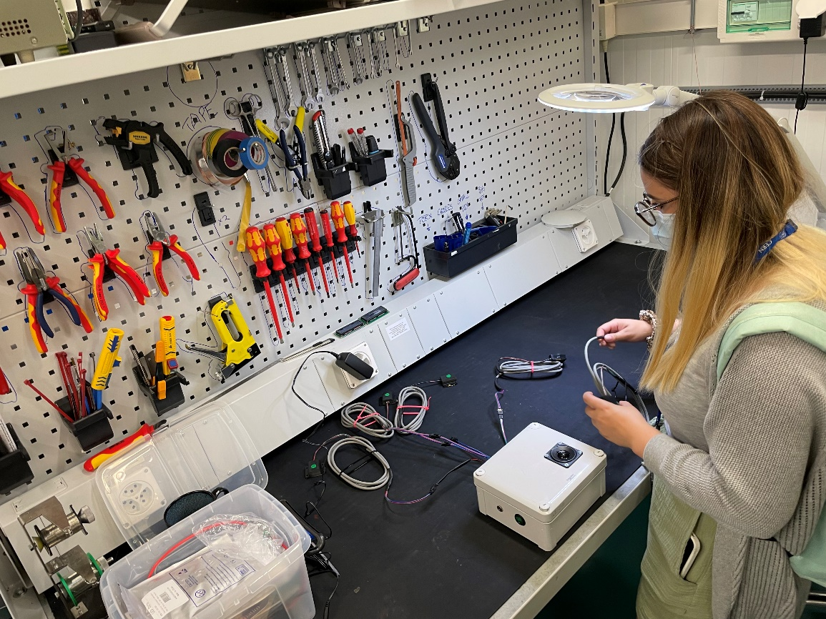

Slide 10
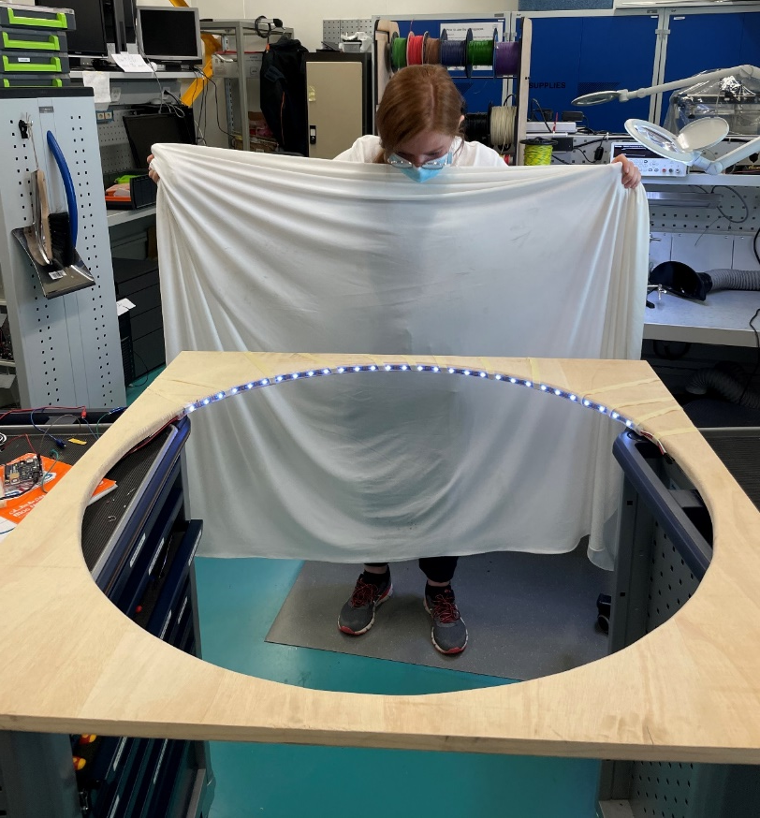
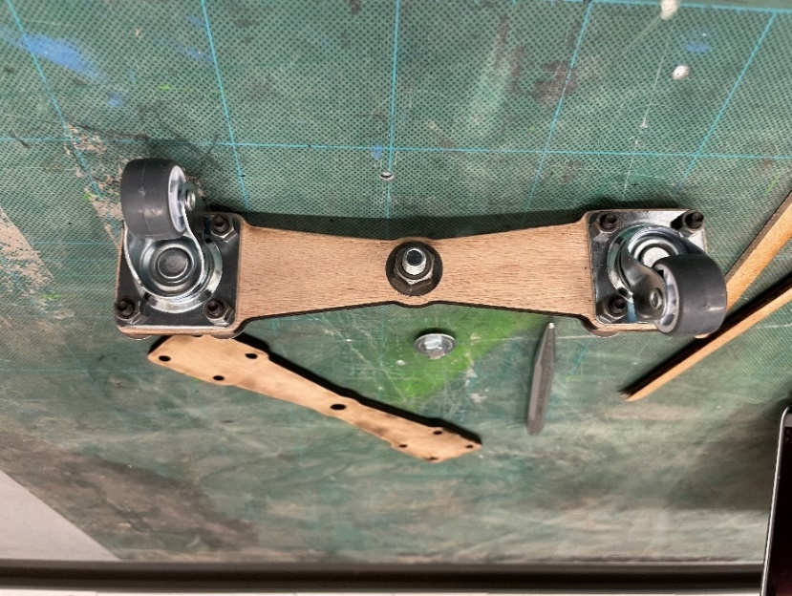
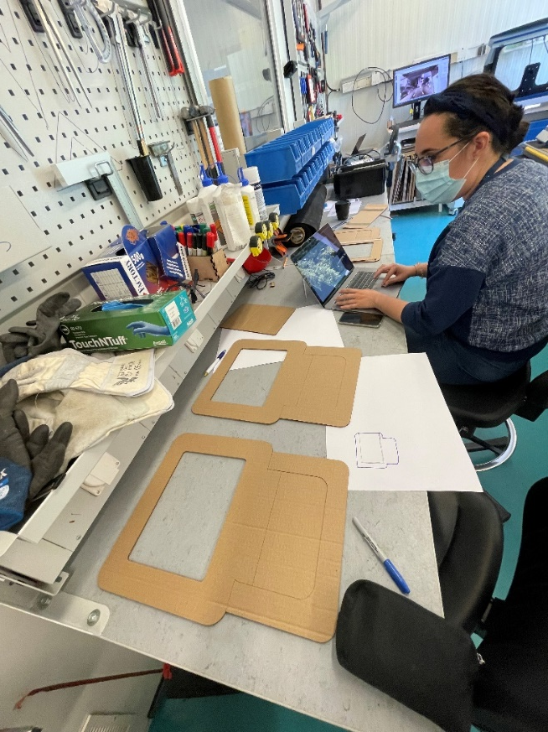

Slide 11
Workshops at IdeaSquare
Notes:
Limitation of 2 people in the workshops
~ 15 people have been trained in using the 3D studio machines

Slide 12
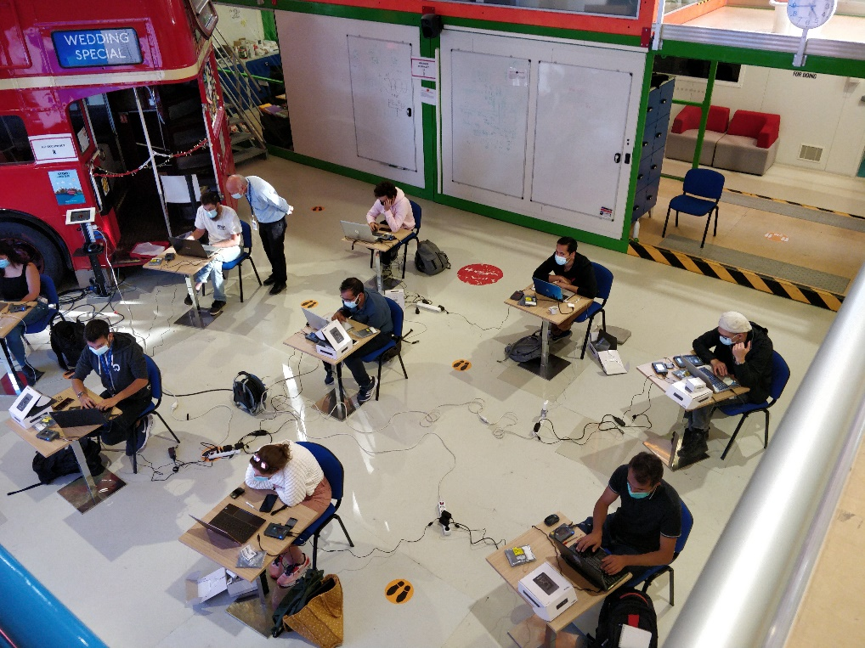
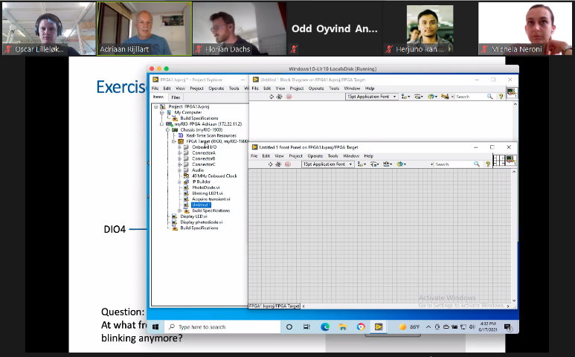
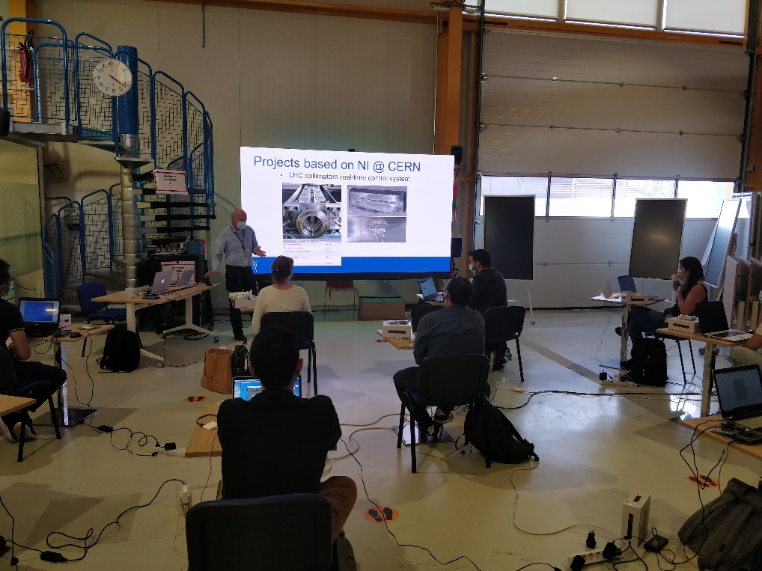
FPGA Programming Using LabVIEW hands-on workshop
With the help of Adriaan Rijllart
2x 2hrs, open to all CERN personnel
June (digital)
October
November
30+ attendees in total

Slide 13
Student programs
Notes:
Limitation of 2 people in the workshops
~ 15 people have been trained in using the 3D studio machines

Slide 14

Student programs
January 2021
December 2021
Prototyping workshop
Following up teams in their prototyping work
Prepared a system for shipping prototype materials to students abroad

Slide 15

Student programs
Prototyping workshop
Following up teams in their prototyping work
Participating in Demo Day
Planning of next year’s course

Slide 16


Student programs
Notes:
OPER CBI and the Delft Honorus Program Summer School

Slide 17

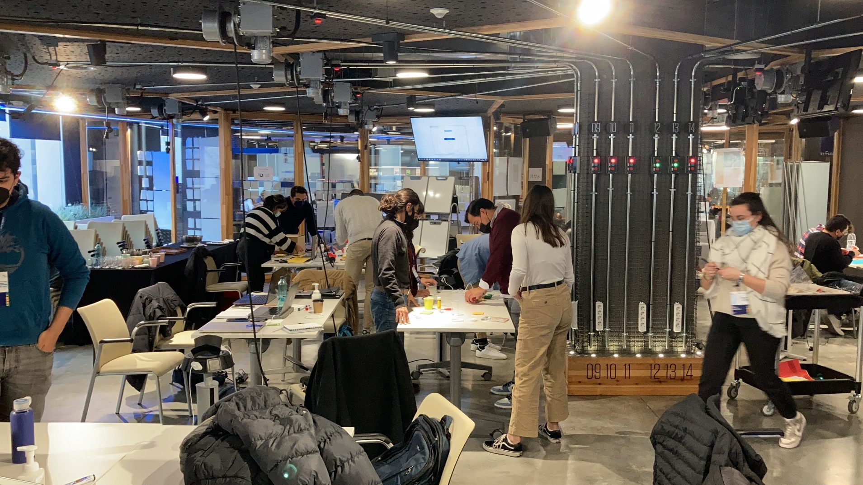
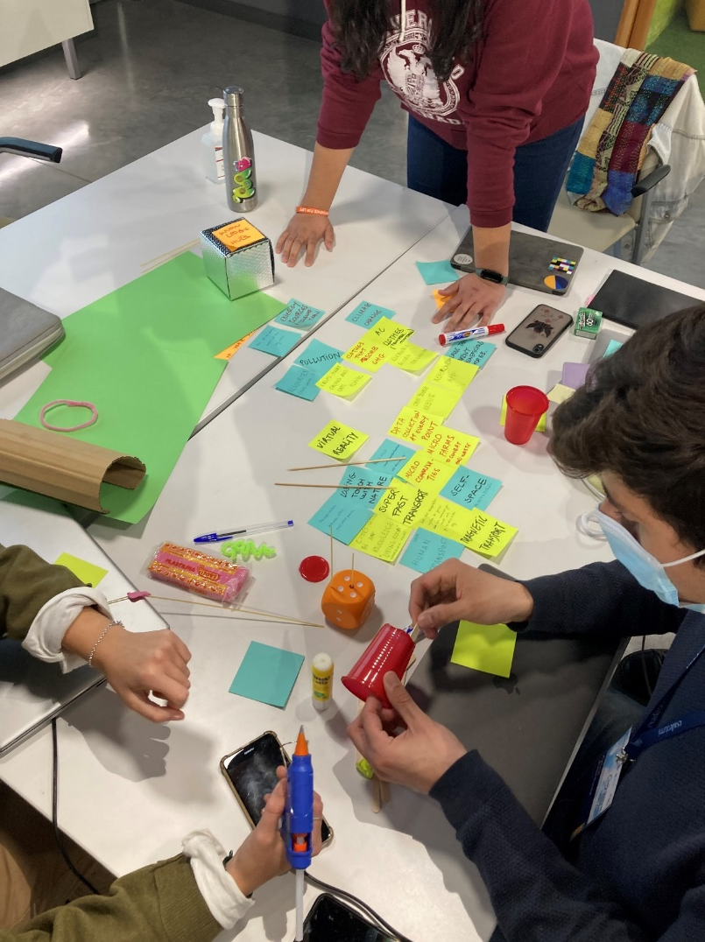
Student programs

Slide 18
New and updated equipment
Notes:
Limitation of 2 people in the workshops
~ 15 people have been trained in using the 3D studio machines

Slide 19
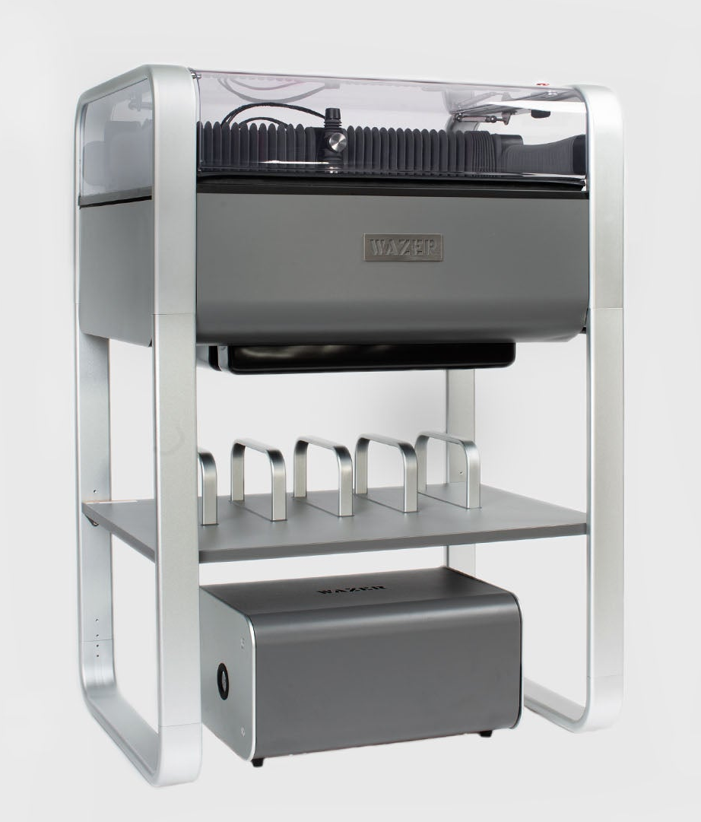
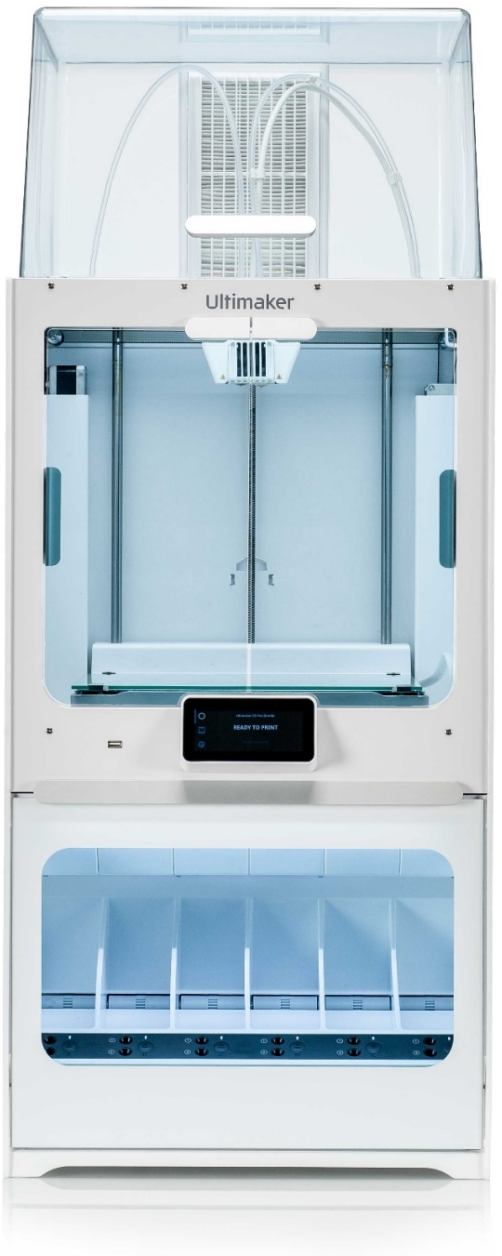
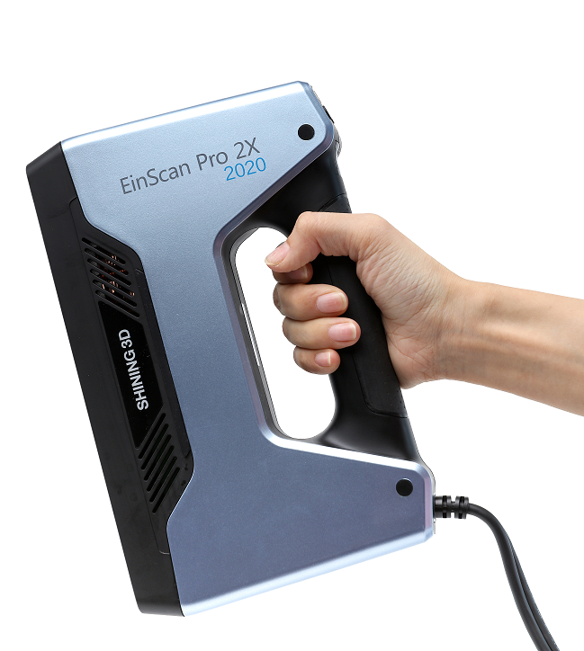
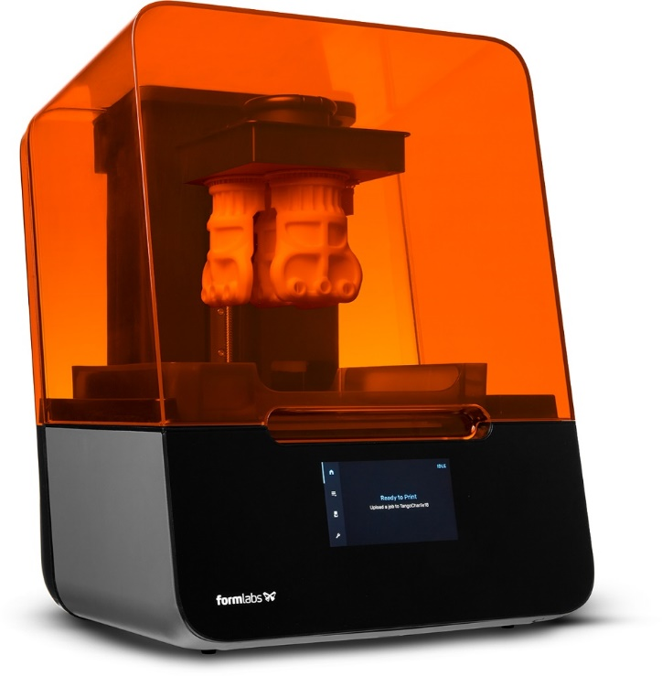
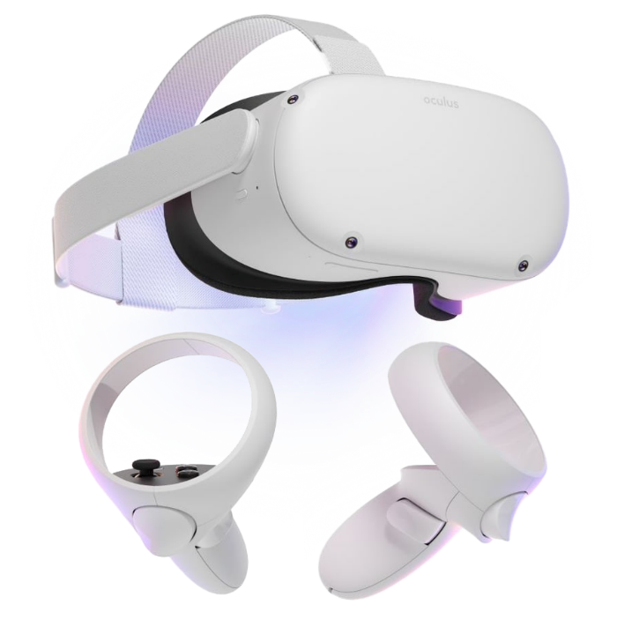
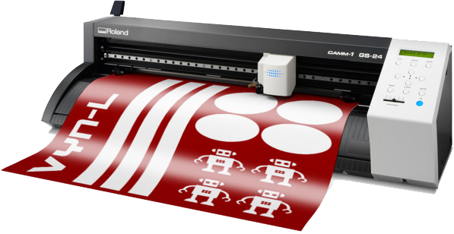
New and updated equipment
WAZER
EinScan Pro 2X 2020
Formlabs Form 3
Ultimaker S5
Pro Bundle
Oculus Quest 2
Roland GS-24
Notes:
New material:
WAZER water jet cutter
Roland GS-24 vinyl cutter
Formlabs Form 3 SLA 3D printer
Ultimaker S5 3D printer pro bundle
EinScan 2X 2020 3D scanner
Oculust Quest 2 VR headset with controllers

Slide 20

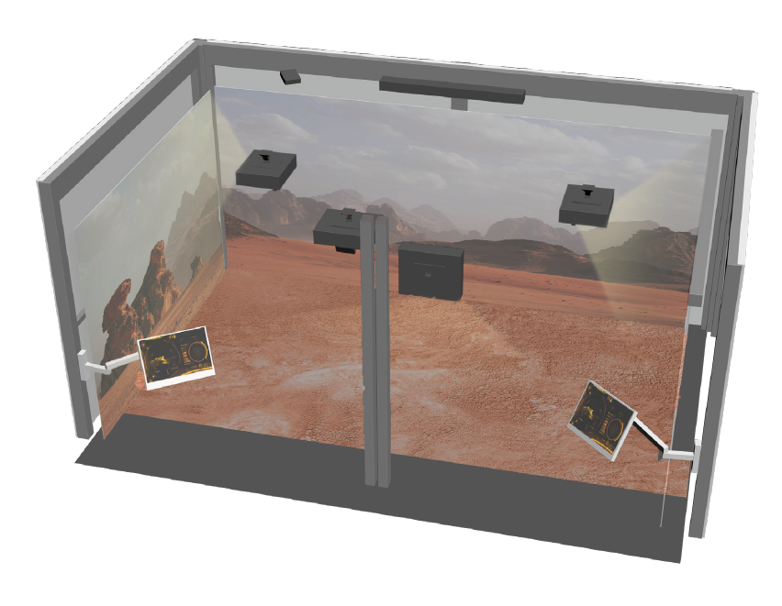
An Interactive & Immersive Space for IdeaSquare
Purposely-built virtual experiences relevant for IdeaSquare's activities
Notes:
The purpose of this installation is to provide an immersive and engaging
experience for visiting students and the public for a range of
purposely-built virtual experiences, relevant to the key objectives of
IdeaSquare. These include, among many, helping to visualize complex
design of systems such as simulated environments; visualizing futuristic
concepts including Terraforming; virtual visits to the LHC while physical
access is not possible; etc.

Slide 21
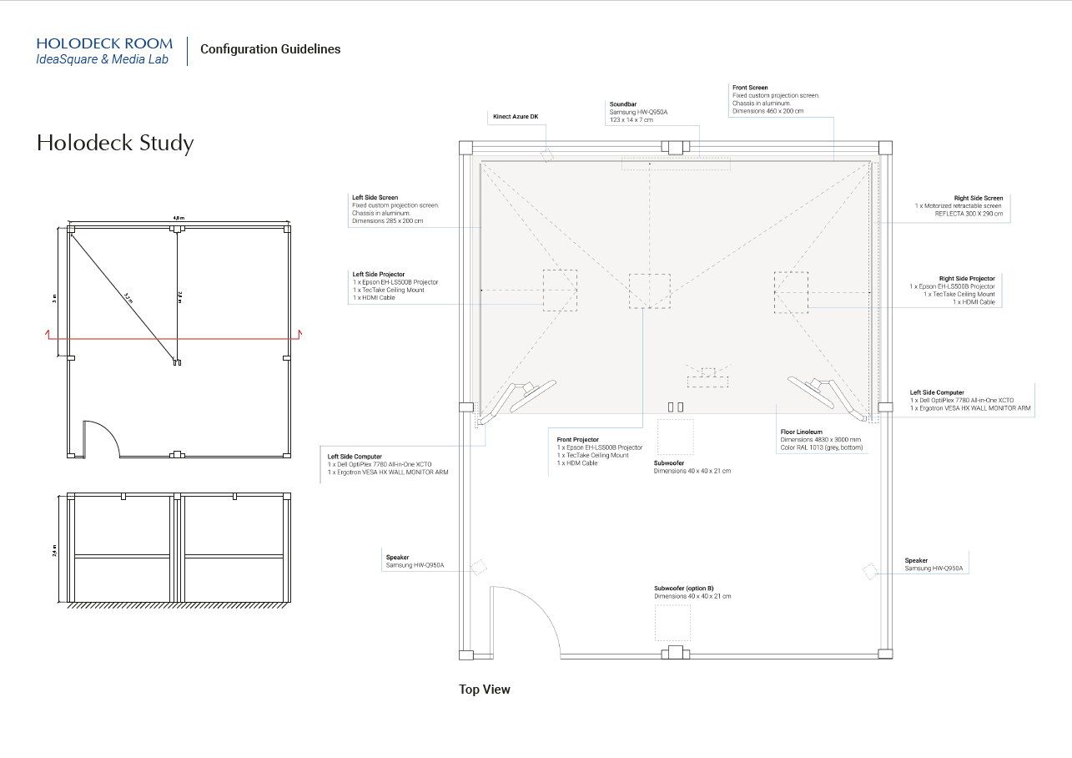

Slide 22
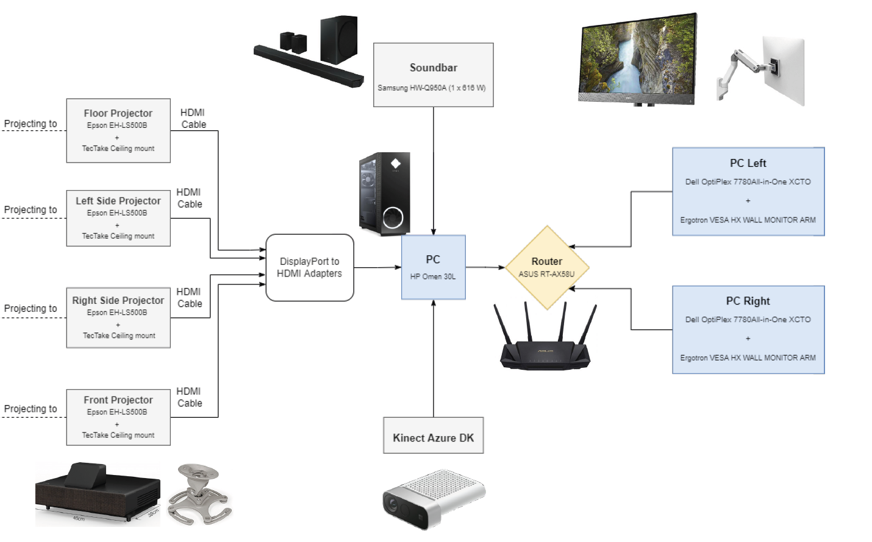
Notes:
Holodeck Room configuration Guidelines will be made available

Slide 23


