Slide 1
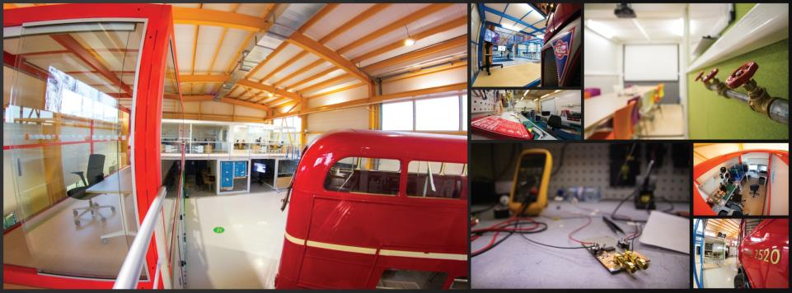
ISAB-G Annual Meeting February 11, 2022
BUDGET PLAN PLAN 2022 - 2025
Markus Nordberg

Slide 2
ID2 UPDATED BUDGET PLAN, kCHF in FIG. 11)
ID2 Team: O. Lillelokken, C. Marcelloni, R. Muller, P. Tello, L. Veyrat, L. Wirtavuori; Strong support from: O. Darwich, L. Leveratto, S. Makinen, T. Utriainen

Slide 3


Questions? Comments?
Contact information:
Email
Skype
Let’s have a cup of coffee and make it happen!

