Slide 1
Instrumentation for
High Intensity Proton Machines
Uli Raich
CERN BE/BI

Slide 2

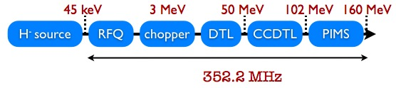
Typical high intensity accelerator front end
Ion source
Radio Frequency Quadrupole
Chopper
Different linear accelerator structures
Transfer line to circular accelerators

Slide 3
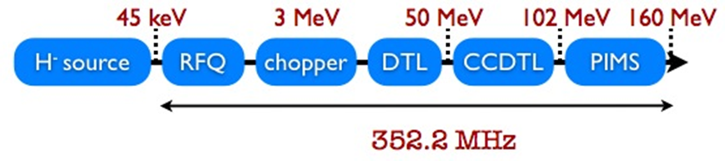
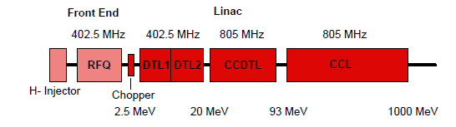

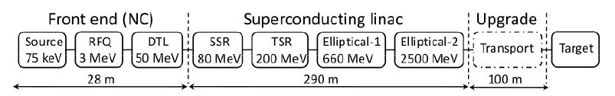

Comparison of Machines
CERN Linac-4
Spallation
Neutron
Source
Oakridge

Slide 4
Comparison of Beam Parameters
 | CERN Linac-4 | Oakridge SNS | ESS Scandinavia
Particle Type | H⁻ | H⁻ | P
Energy | 160 MeV | 1 GeV | 2.5 GeV
Average Beam Power | 2.8 kW | 1.4 MW | 5 MW
Pulse Frequency | 0.8 Hz | 30 Hz | 20 Hz
Beam Loss | < 1W/m | <1W/m | <1W/m
Ion Source current | 80 mA | 48 mA | 50 mA
Pulse Length | 400 μs – 1 ms | 1ms | 2ms
RF Frequencies | 350 MHz | 402.5 MHz | 352.2 & 704.4 MHz

Slide 5
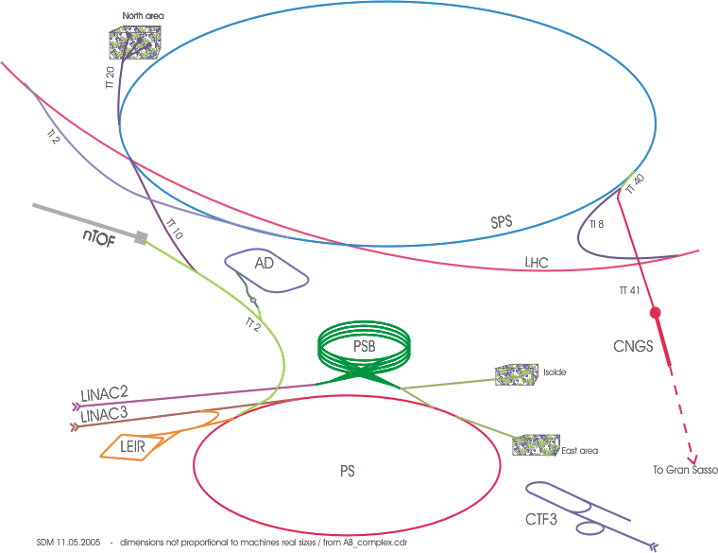
Linac-4 in the CERN complex
Linac-4 will inject into the
PS Booster (PSB)
Purpose:
Improve brightnes of beams
for LHC
Replace aging Linac2
Linac4

Slide 6
Beam Parameters to be measured
Beam intensity
Beam position
Beam profile
Beam phase & energy
Energy spread
Transverse Emittance
Longitudinal bunch shape
Effectiveness of chopper

Slide 7
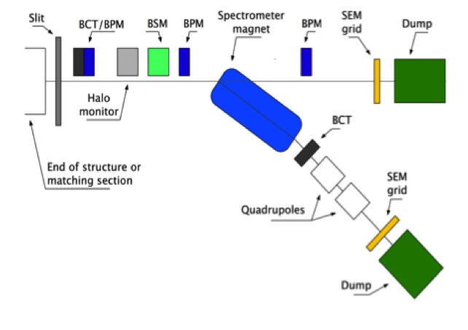
Measurement Bench

Slide 8
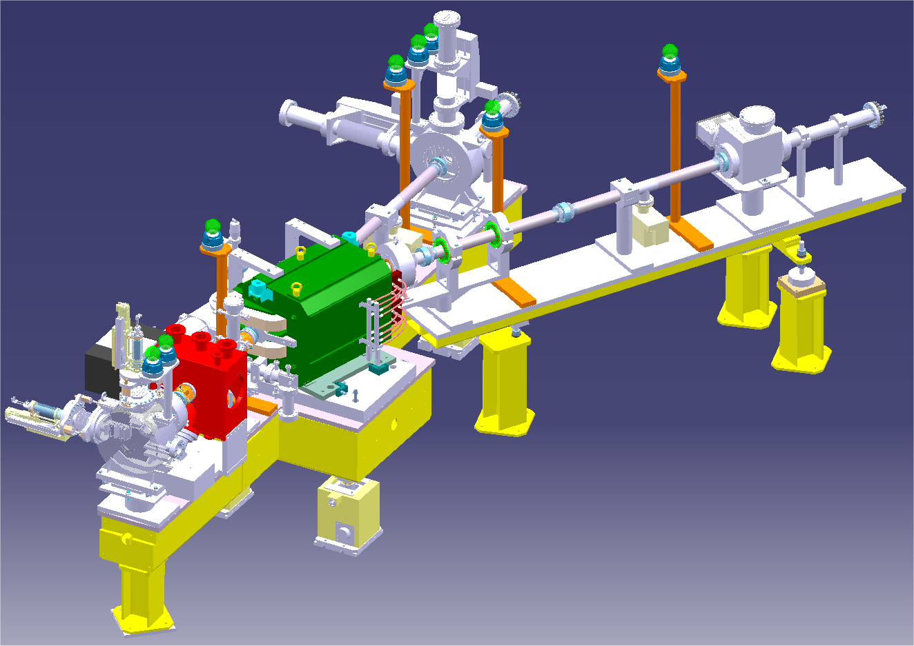
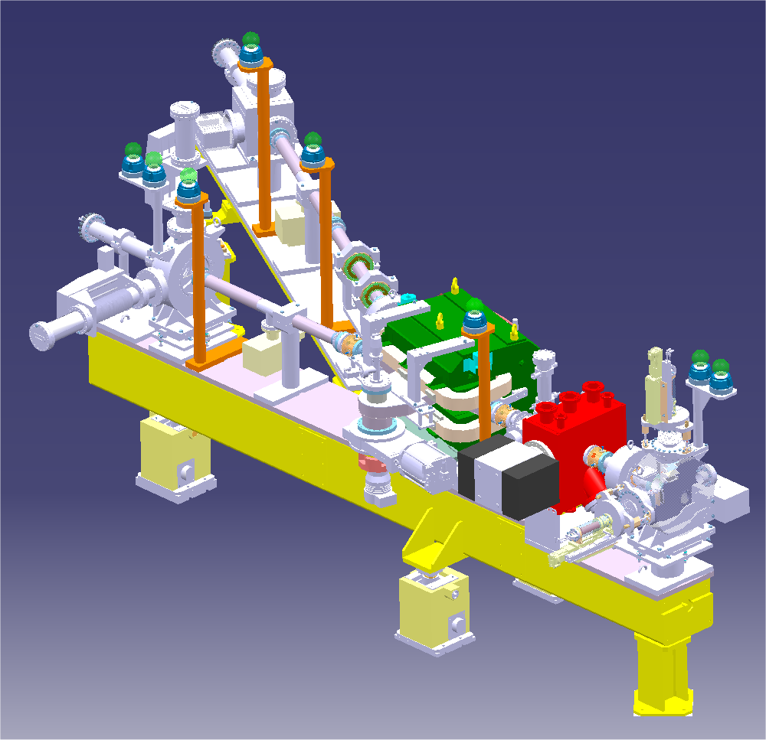
Measurement Bench
Position measurement using BPMs
Intensity measurement using Transformers
Energy spread measurement, Spectrometer
Emittance meter
Bunch shape monitor
Halo monitor

Slide 9
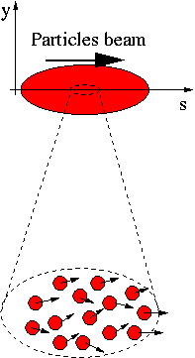
Emittance measurements
A beam is made of many many particles,
each one of these particles is moving with
a given velocity. Most of the velocity
vector of a single particle is parallel to the
direction of the beam as a whole (s).
There is however a smaller component of
the particles velocity which is
perpendicular to it (x or y).

Slide 10
Emittance measurements
If for each beam particle we plot its position and its transverse angle we get a particle distribution who’s boundary is an usually ellipse.
The projection onto the x axis is the beam size
x’
Beam size
x

Slide 11
The slit method
x’
If we place a slit into the beam we cut out a small vertical slice of phase space
Converting the angles into position through a drift space allows to reconstruct the angular distribution at the position defined by the slit
x
slit

Slide 12
Transforming angular distribution to profile
x’
Influence of a drift space
When moving through a drift space the angles don’t change (horizontal move in phase space)
When moving through a quadrupole the position does not change but the angle does (vertical move in phase space)
x’
x
x
slit
slit
Influence of a quadrupole
x’
x
slit

Slide 13
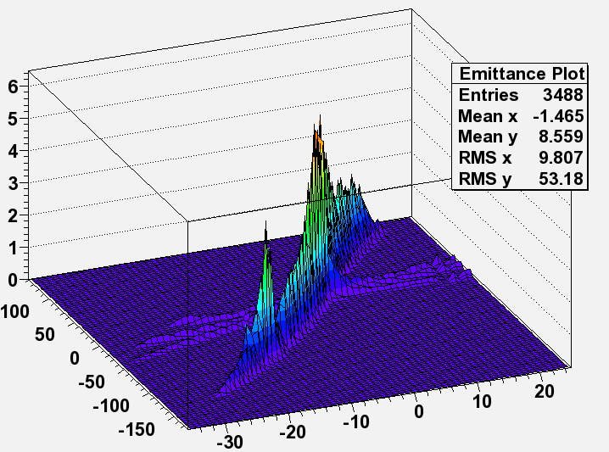
The Slit Method

Slide 14
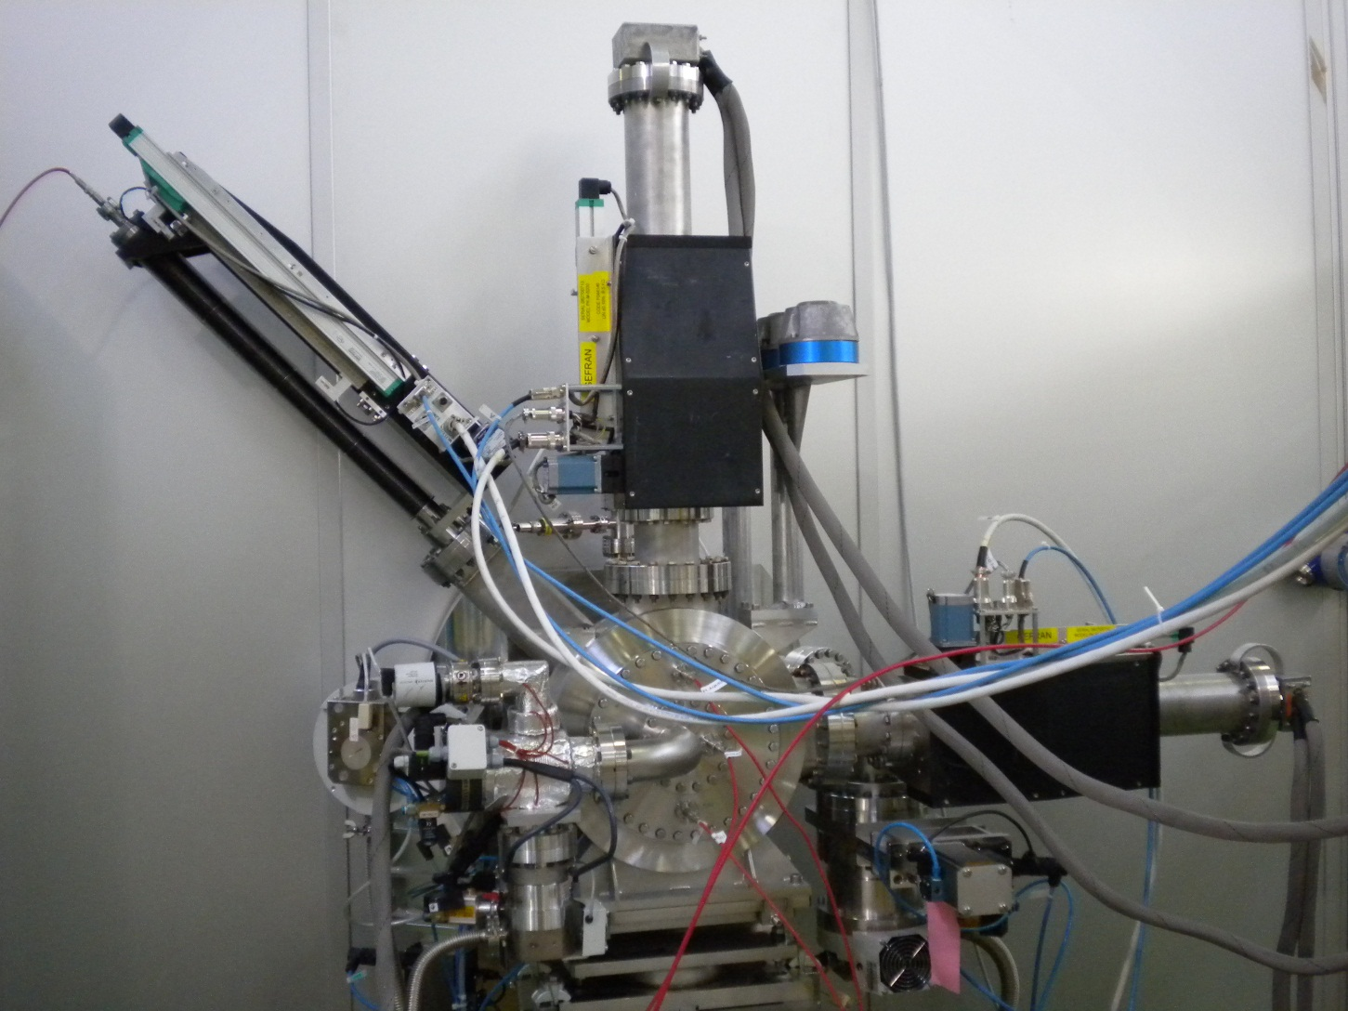
Transverse Emittance
hor and vert
wire grid
L-shaped slit

Slide 15
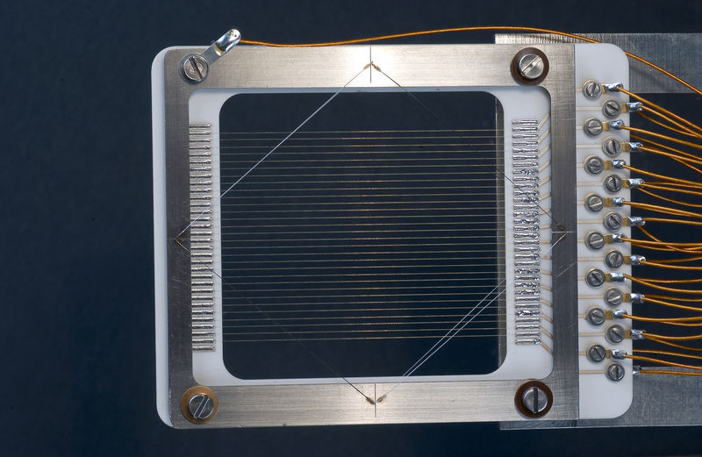
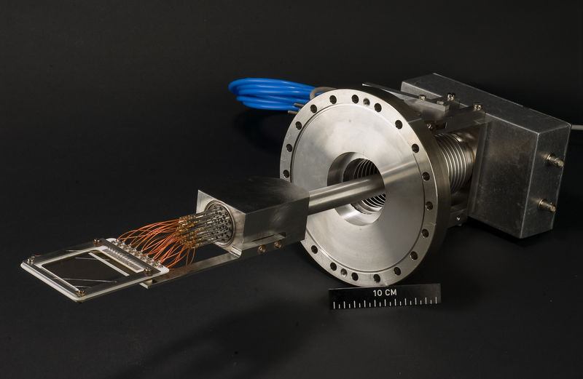
SEMGrid
Need different materials for the wire:
Tungsten at higher energies
Carbon at lower energies
Signal generation:
secondary emission
charge collection
depends on
target material
particle energy

Slide 16
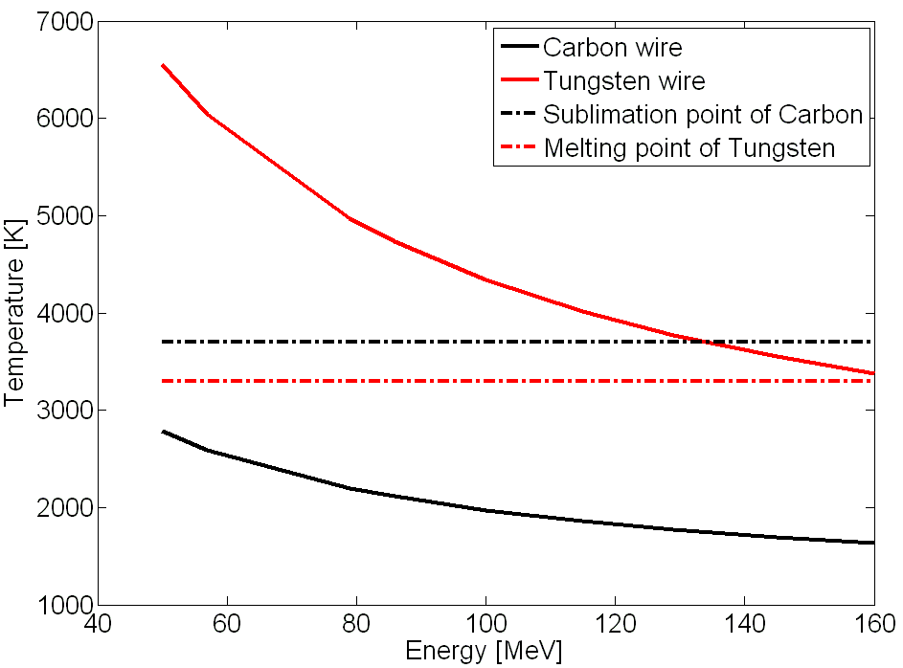
SEMGrids
Simulations of energy deposition
Simulation of signal levels to be expected
time resolved electronics (200 kHz
Fabrication of grids with carbon wires
40 mA, 400 µs, σ_{x}=1mm, σ_{y}=2mm

Slide 17
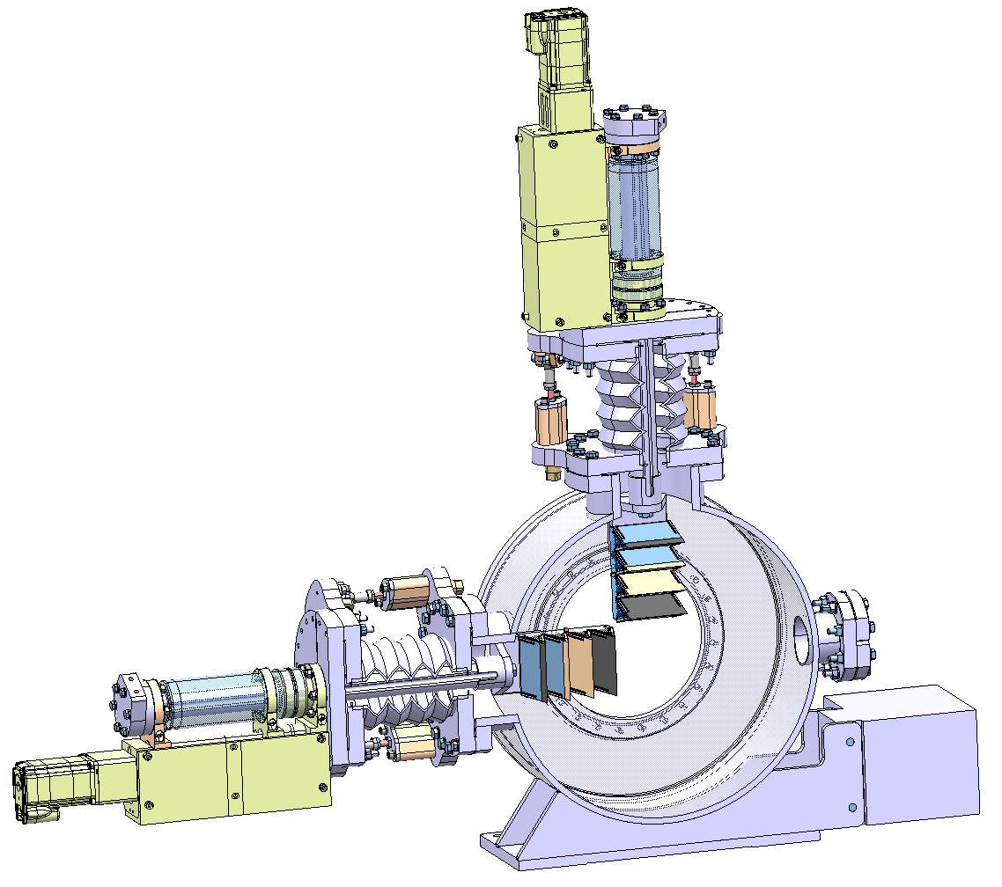
Slit at 12 MeV
At higher particle energy the thermal energy deposition becomes critical:
shorten pulse length4
cooled slit design

Slide 18
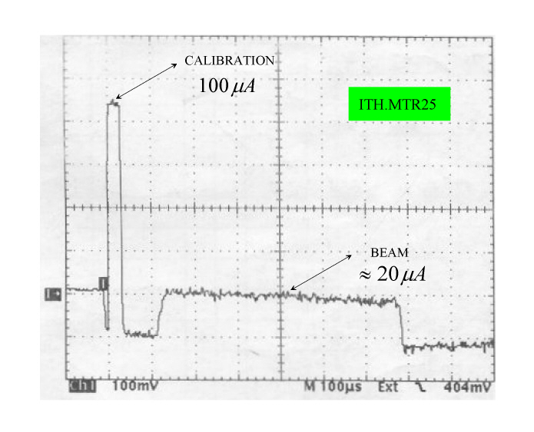
Bunch shape measurements
After the first accelerating cavity (RFQ):
2.8 ns
zoom with much higher
bandwidth

Slide 19
Measuring the Bunch Shape
A very crude estimation:
RF at 352 MHz -> RF-cycle: ~ 2.7 ns
Bunch width ~ 20%: 540 ps
want at least 20 points: resolution in the order of some ten ps

Slide 20
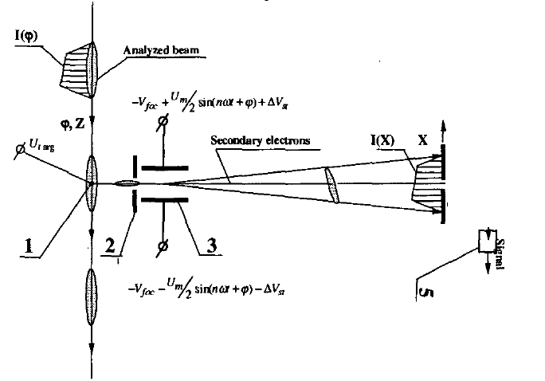
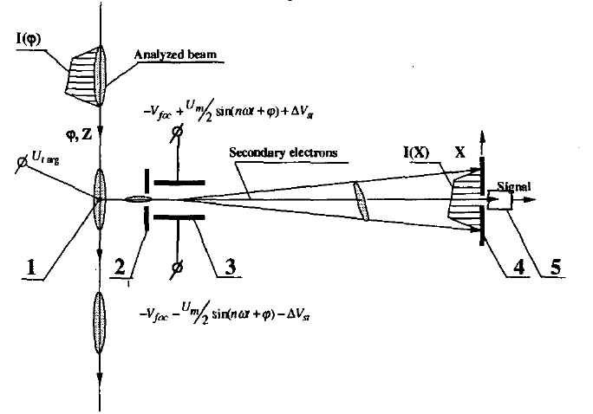
Principle of the BSM
Put a target wire into the beam (100 μm Tungsten wire).
Secondary electrons are created and accelerated due to HV on the target wire
The electrons pass through a slit followed by an RF deflector synchronous to the accelerator RF
An electron detector detects particles with a defined phase
The deflector RF is shifted with a phase shifter

Slide 21
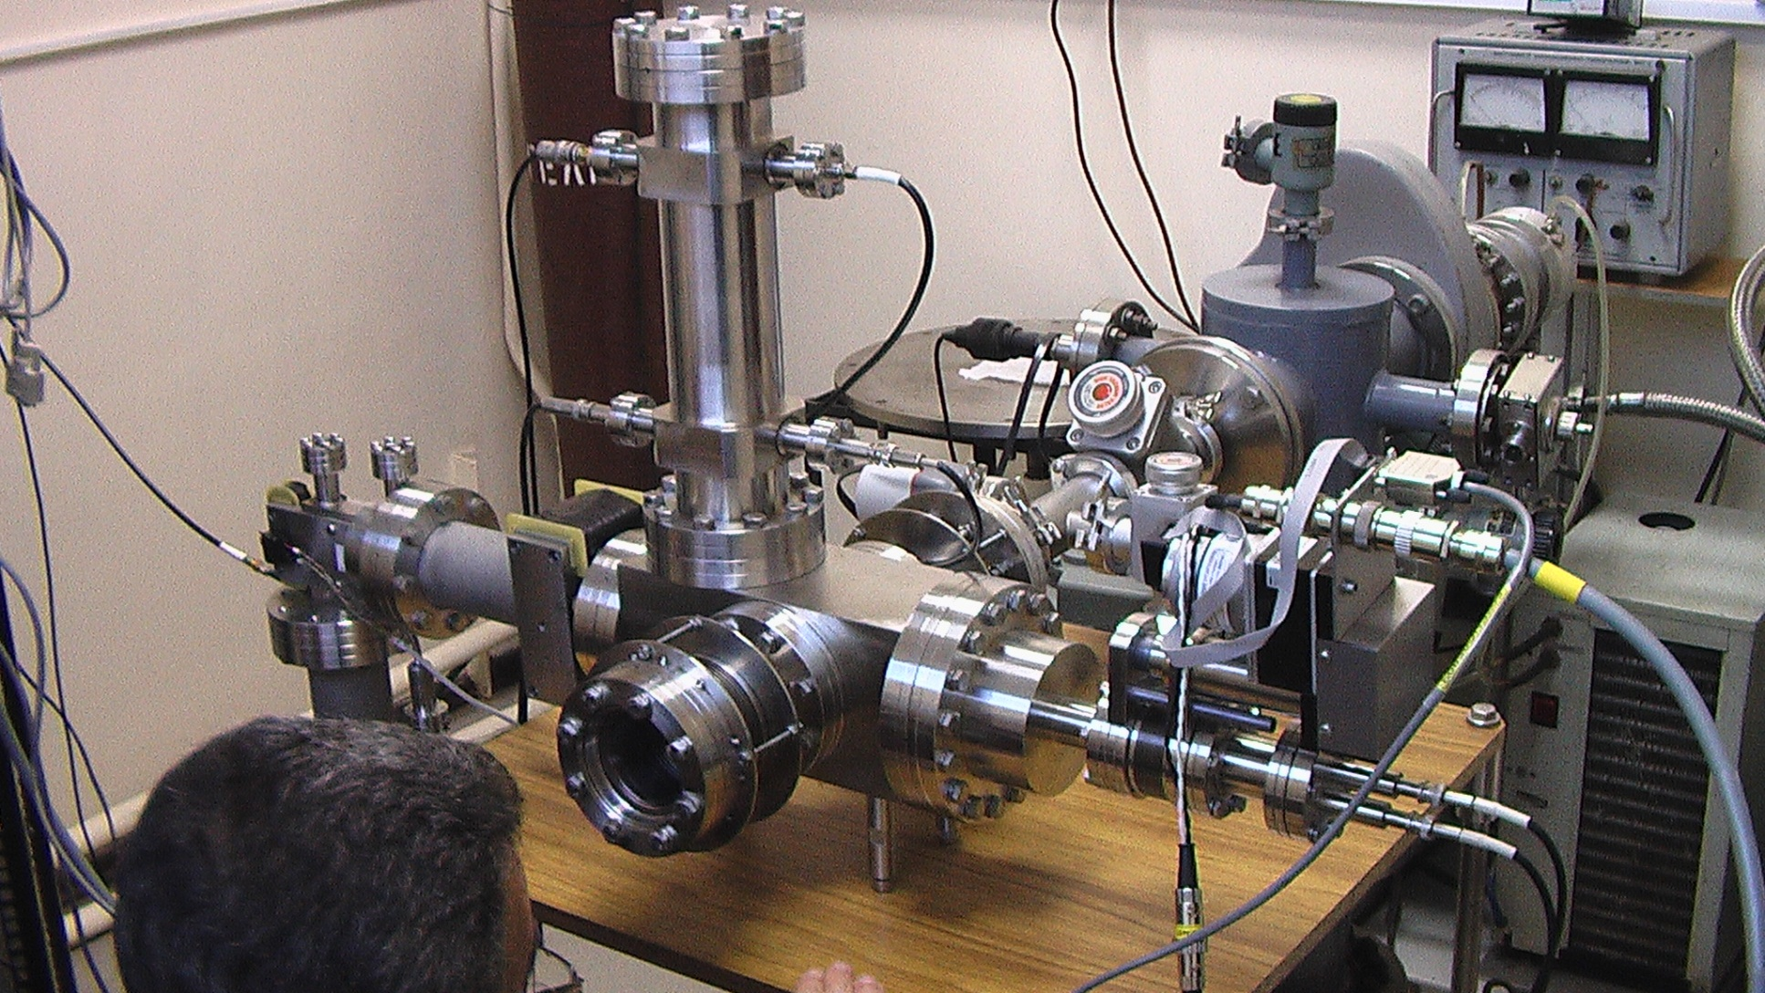
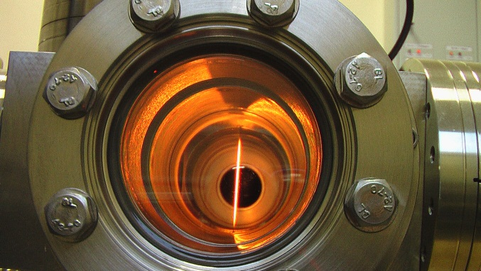
Photo of Linac-4 BSM

Slide 22
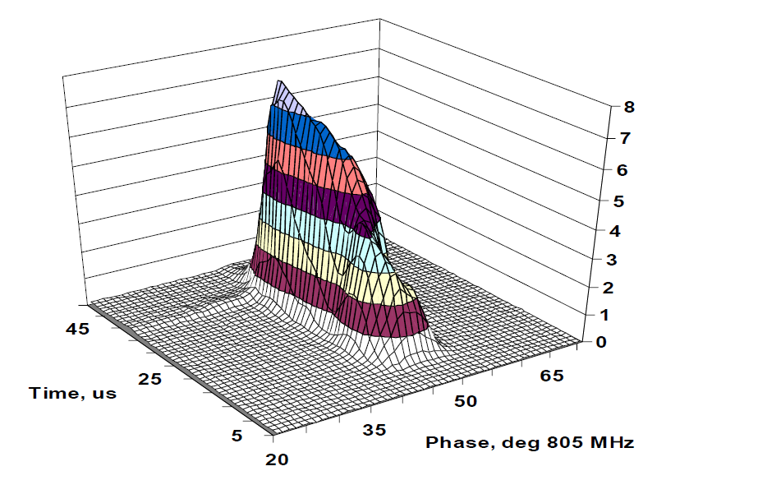
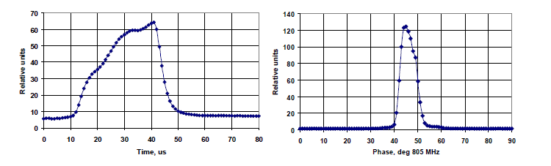
Typical BSM results
Typical BSM plot
Pulse shape
Longitidinal profile

Slide 23
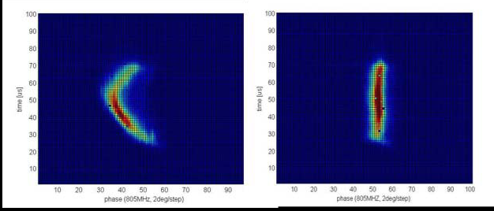
BSM results from SNS
Bad beam loading compensation

Slide 24
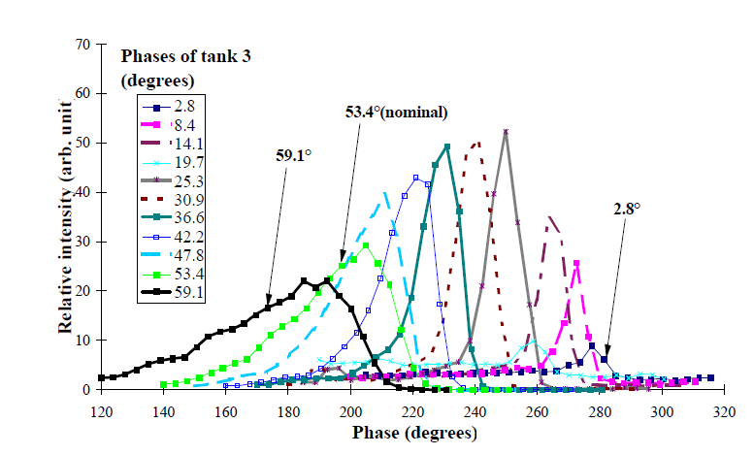
Adjusting RF phase

Slide 25
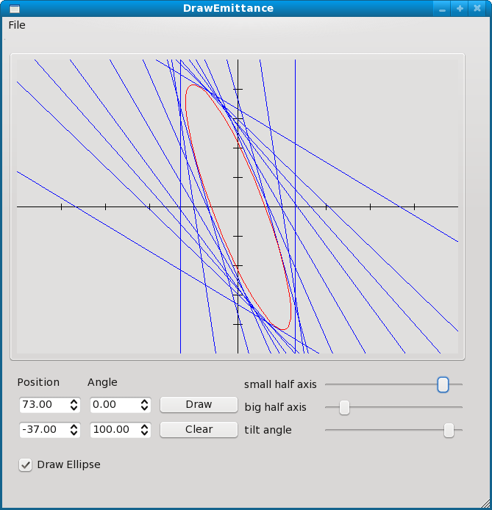
Multiple transverse Profile Measurements
Beam size
Measure beam size at several
(min 3) locations
Using linear beasm optics
Transform all beam sizes to a single
location

Slide 26
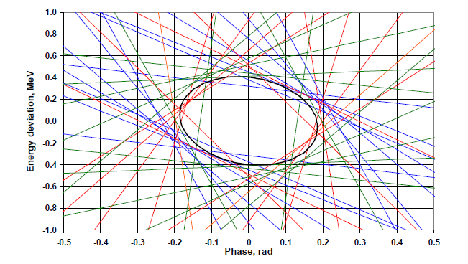
Longitudial emittance
Bunch shape measured at 3 locations
RF amplitude was modified with corresponding phase correction

Slide 27
The chopper line
“Longitudinal matching” from the LINAC (352 MHZ) to the booster frequency (1 MHZ) to avoid capture losses.
Eliminate 133/352 linac micro-bunches at the lowest possible energy (3MeV)
Combination of fast rise-time and high voltage is difficult and therefore the chopper is a LONG object compared to the characteristic FODO length at 3 MeV and 352 MHZ (~ 7 cm)
Design which includes quadrupoles to amplify the chopper kick and it’s as close as possible to FODO to minimze emitance growth

Slide 28
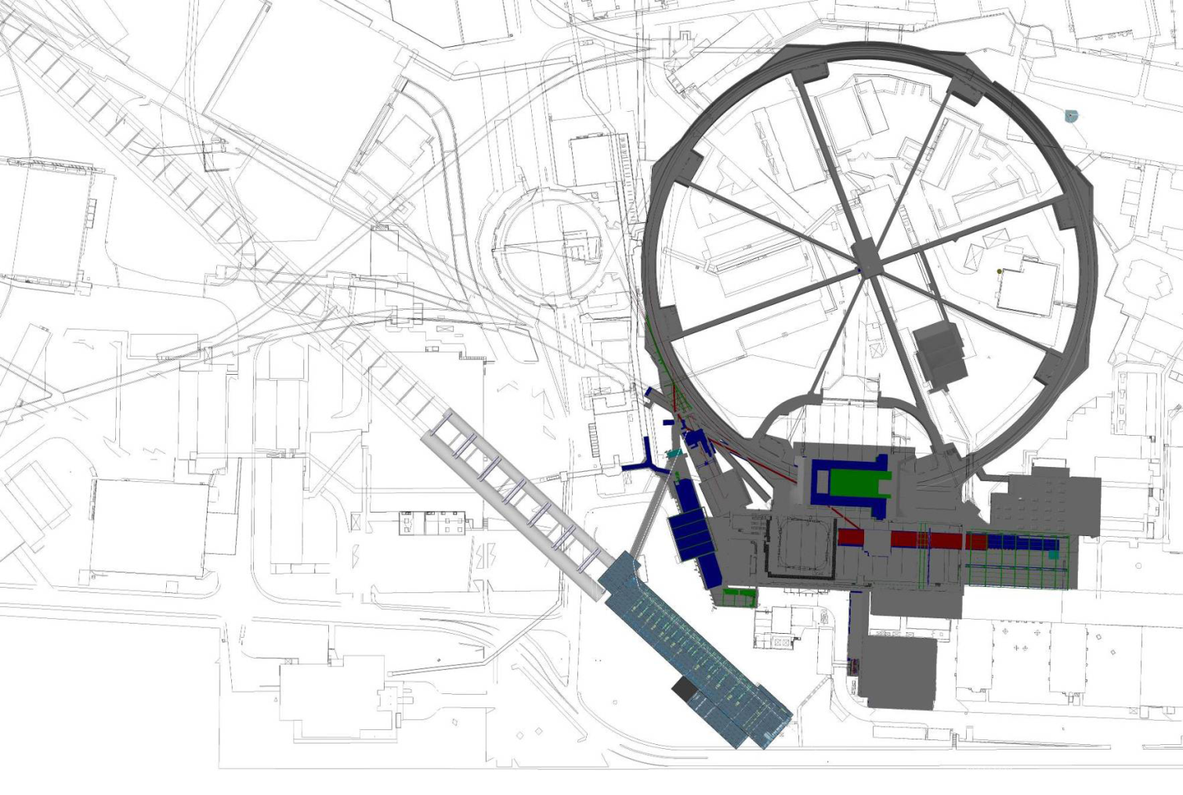
Transfer of beam into the Booster
352 MHz Linac RF
1 MHz Booster RF

Slide 29
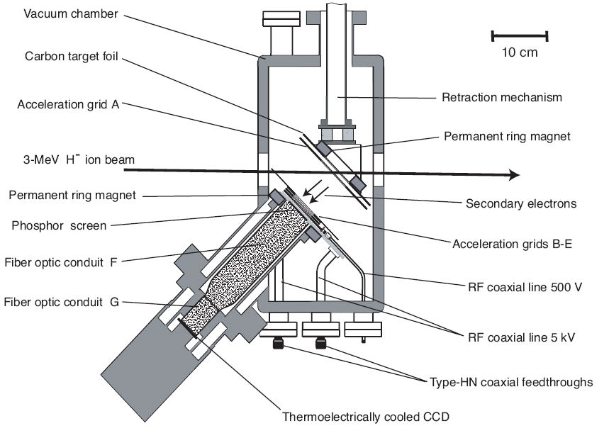
Halo Monitor

Slide 30
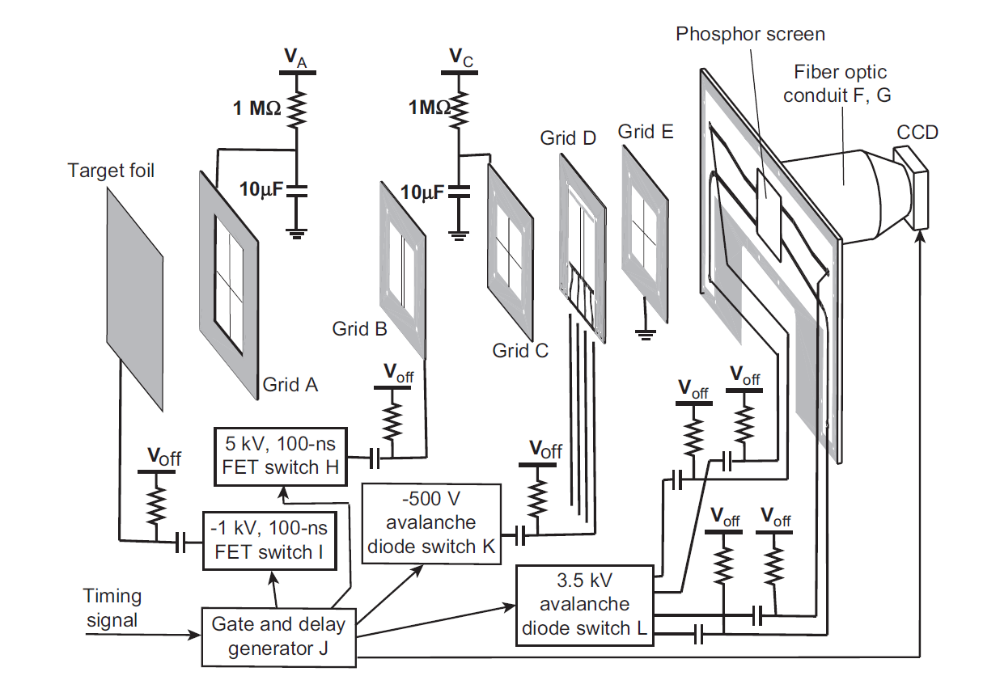
Generating very short gates
Gated off:
0.8 kV on foil, -0.3kV on GB
Accelerate but don‘t penetrate
the phosphor
-0.2 kV on foil (100 ns pulse)
Flourescence on:
3.5 kV pulse 200 ps rise time
reflection doubles the pulse to
~ 6 kV
Flourescence off:
-500V pulse again doubled to

Slide 31
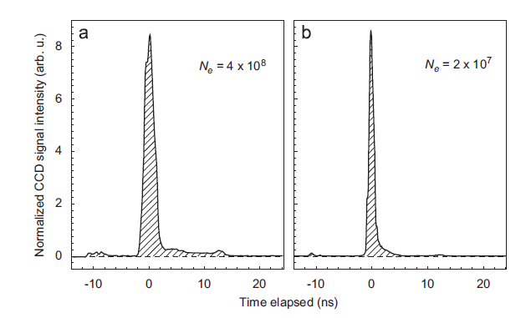
Test Results from Halo Monitor

Slide 32
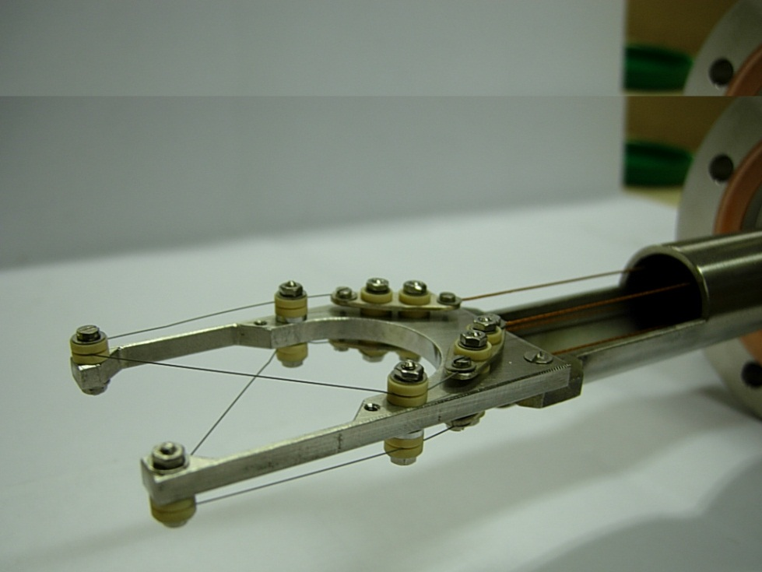
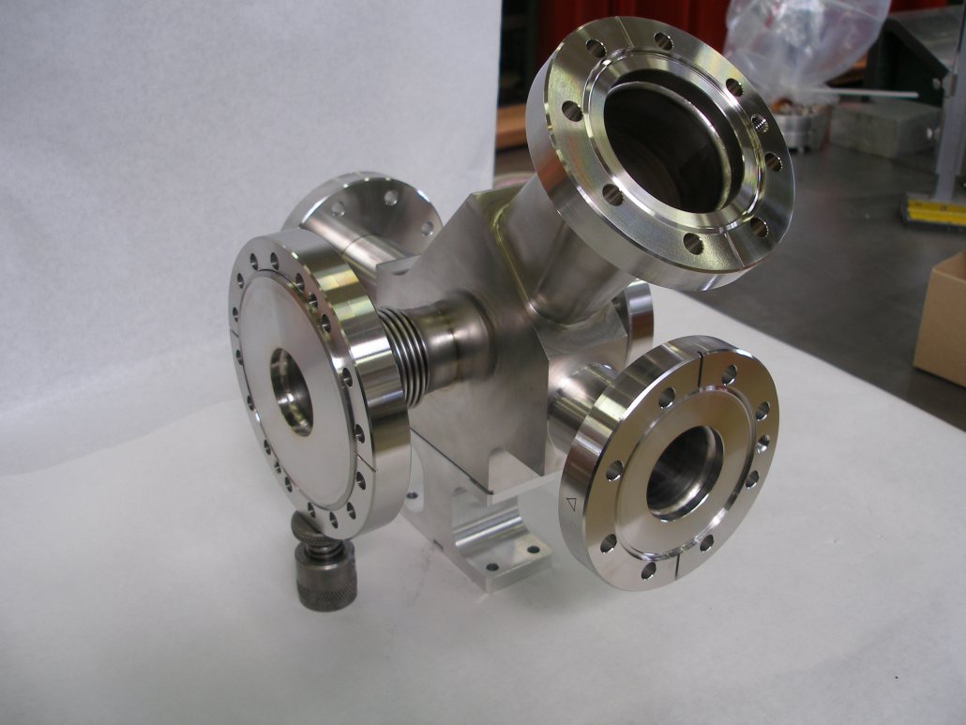
Wire Scanner
Problems:
Interceptive, causes losses
Cannot stand full pulse length

Slide 33
On H⁻ beams: photo detachment
A thin laser beam traverses the beam
The supplementary electron is detached leaving H⁰
Detection of detached electrons allows to measure profile
May act like a slit
Usings a bending magnet a slit / grid emittance measurement may be possible

Slide 34
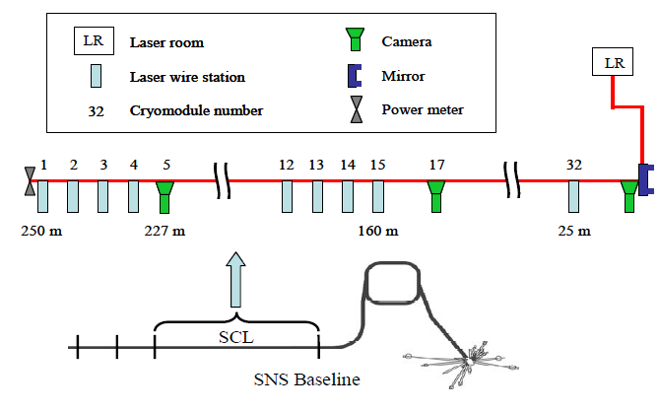
Laser Wire System at SNS

Slide 35
Laser beam pick-offs
The beam is diverted from the main line by a pneumatically driven stage.
OFF
ON

Slide 36
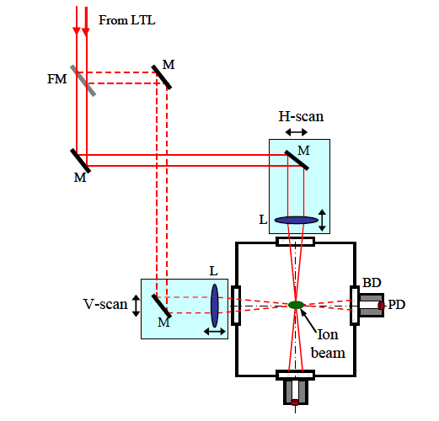
Layout of SNS Laser Station
Advantages of Laser Wire:
No intercepting material
especially important for supra
conducting cavities
Not disturbing the beam
10 ns laser pulse out of ~1 ms

Slide 37
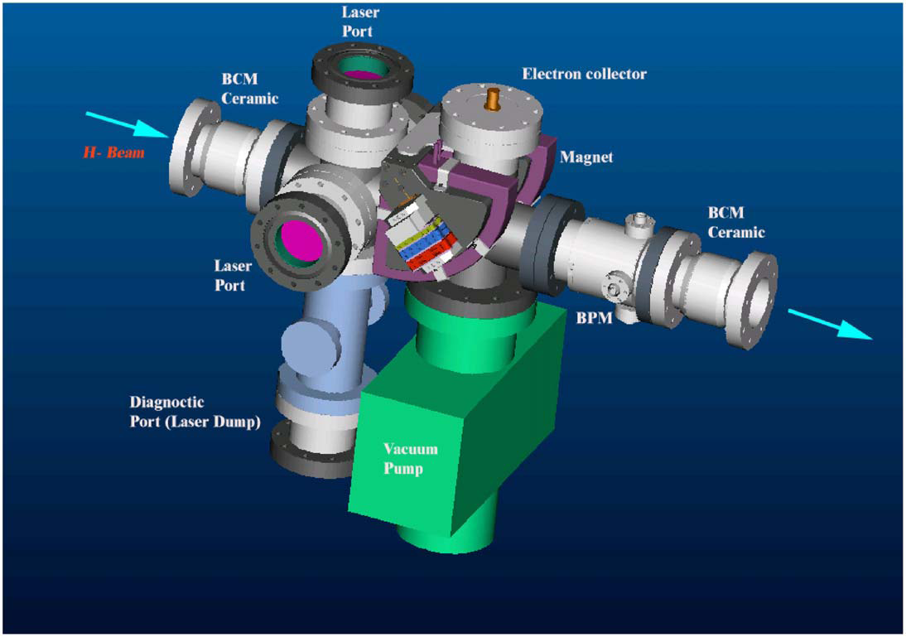
SNS Laser Station

Slide 38
Precision of Laser Wire
400 μs
2.8 ns
Precise synchronization between
micro bunches and laser pulse
Determination of laser position
Laser pulse

Slide 39
Emittance Measurement with
Laser Wire
During the acceleration along the linac and the travel between the end of the linac and the PS booster, the second electron can be stripped from black body radiation, magnetic field and residual gas.
A part of this neutral beam can reach the H0 detector and perturb the measurement.
Simulations has been done to estimate the background
Layout of the system

Slide 40
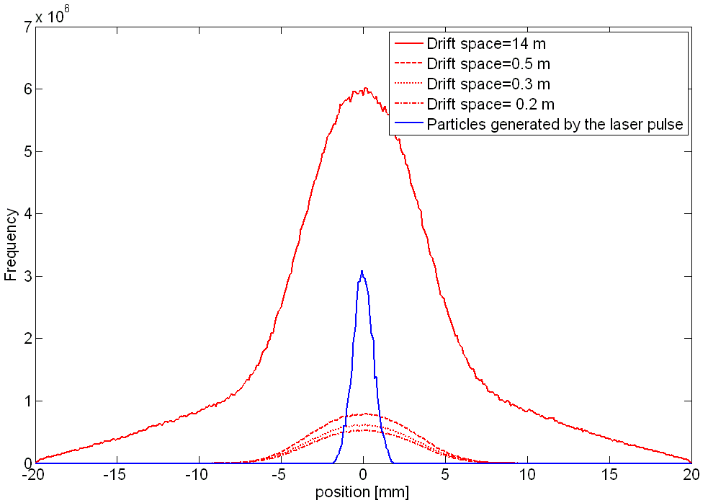
Background issues
With a laser system similar to SNS and laser beam size of 100 μm and assuming a full stripping the number of stripped particles is around 10⁷
Drift length [m] | Nunber of particles
14 | 6.87E+08
0.5 | 5.80E+07
0.3 | 4.59E+07
0.2 | 3.94E+07
Number of background particles reaching the detector
If the signal is integrated over the linac pulse, the number of the background particles is in the order of magnitude of the signal in the better case.
Particles reaching a detector positioned 2 m downstream the dipole.

Slide 41
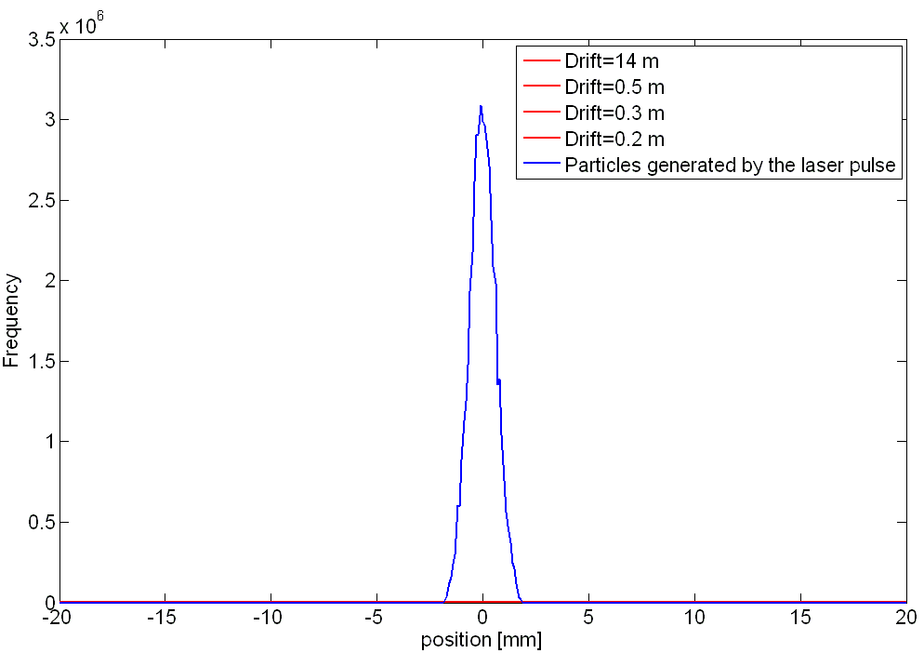
Background issues
If we assume that the probability of stripping by residual gas interaction or magnetic field stripping is independent of time, the background particles are generated over a pulse, i.e 400 μs. For the signal, the particles are generated over a laser pulse, i.e. 10 ns.
By gating the signal with a short time window, the background effect can be reduced. Assuming a window of 20 ns, the number of background particles can be reduce by a factor 20000
Drift length [m] | Nunber of particles
14 | 3.44E+04
0.5 | 2.90E+03
0.3 | 2.30E+03
0.2 | 1.97E+03

Slide 42
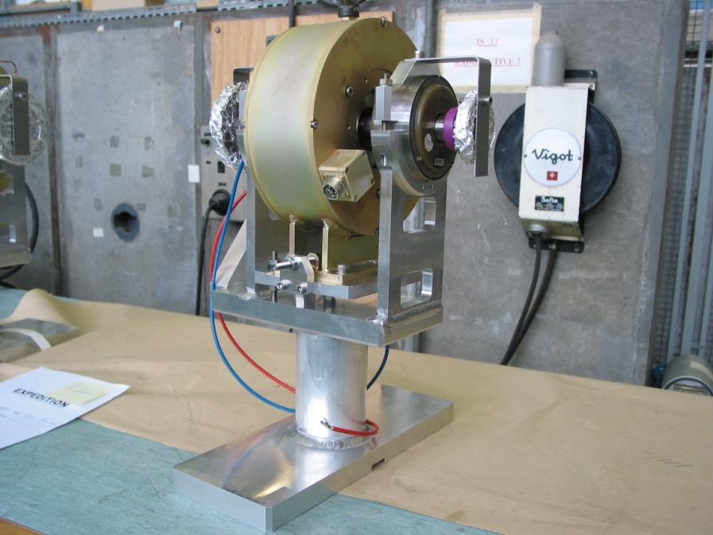
Beam Losses
Beam losses must be kept lower than 1W/m
Loss of not more than a single beam pulse is allowed
Use (hardware)
comparison of
transformer readings

Slide 43
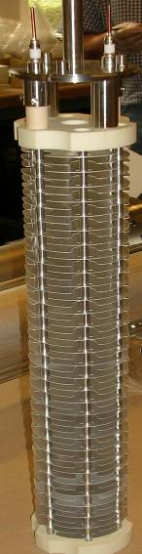
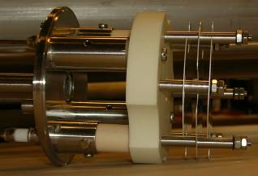
Beam Loss Monitor Types
Design criteria: Signal speed and robustness
Dynamic range (> 10⁹) limited by leakage current through insulator ceramics (lower) and saturation due to space charge (upper limit).
Secondary Emission Monitor (SEM):
  Length 10 cm
  P < 10⁻⁷ bar
  ~ 30000 times smaller gain
Ionization chamber:
  N₂ gas filling at 100 mbar over-pressure
  Length 50 cm
  Sensitive volume 1.5 l
  Ion collection time 85 μs
Both monitors:
  Parallel electrodes (Al, SEM: Ti) separated by 0.5 cm
  Low pass filter at the HV input
  Voltage 1.5 kV
Notes:
Chamber design considerations: Signal speed and robustness against ageing (and loss of chamber gas)
BLMB: Planned to use standard ACEM detectors (or photo-multipliers), and acquisition systems of LHC BCT. Not part of baseline scenario, for refined beam observation.

Slide 44
Acknowledgements
Transparencies from
M. Hori & K. Hanke (Halo Monitor)
Laser Wire SNS team
Emittance user Laser Wire: B. Cheymol
BSM: A Feshenko + INR team
Linac-4 team

