Slide 1
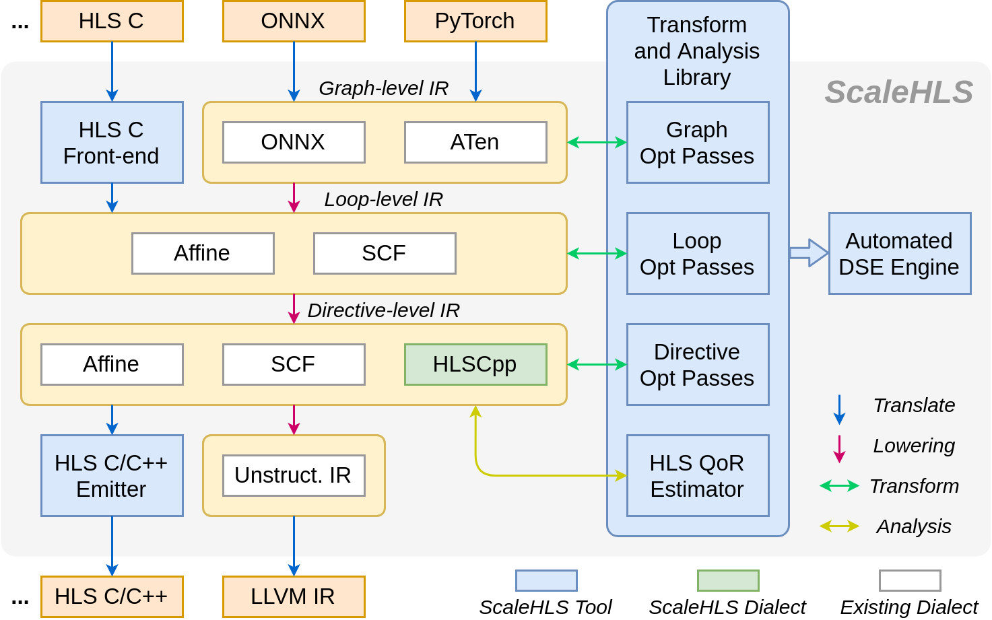
ScaleHLS (1): Overview
Our Team at UIUC: Hanchen Ye, Greg Jun, Paul Jeong
Represent It!
Graph-level IR: ONNX [1] and ATen [2] dialect.
Loop-level IR: Affine [3] and SCF (structured control flow) [3] dialect. Can leverage the transformation and analysis libraries applicable in MLIR.
Directive-level IR: HLSCpp, Affine, and SCF dialect.
Optimize It!
Optimization Passes: Cover the graph, loop, and directive levels. Solve optimization problems at the ‘correct’ abstraction level. 💪
QoR Estimator: Estimate the latency and resource utilization through IR analysis.
Explore It!
Transform and Analysis Library: Parameterized interfaces of all optimization passes and the QoR estimator. A playground of DSE. 🚀
Automated DSE Engine: Find the Pareto-frontier of the throughput-area trade-off design space.
[4]
Enable End-to-end Flow!
HLS C Front-end: Parse C programs into MLIR.
HLS C/C++ Emitter: Generate synthesizable HLS designs for downstream tools, such as Vivado HLS.
[1] ONNX-MLIR: Compiling ONNX Neural Network Models Using MLIR. https://github.com/onnx/onnx-mlir
[2] Torch-MLIR: Compiler support from PyTorch to MLIR. https://github.com/llvm/torch-mlir
[3] MLIR: Multi-Level Intermediate Representation. https://github.com/llvm/llvm-project/tree/main/mlir
[4] Vitis HLS Front-end: https://github.com/Xilinx/HLS

Slide 2
ScaleHLS (2): IP Integration
Can apply multiple optimizations to different level of abstraction
  Graph-level optimization
  Loop and HLS C++ directive optimization
After graph-level optimizations, find graph nodes that can be implemented with existing IPs through pattern matching
For graph nodes that are not substituted with existing IPs, new IPs can be generated after the loop and directive optimization
ScaleHLS
Graph-level
Front-end
(ONNX-MLIR)
Back-end
(Synthesizable C++ Emitter)
Graph-level Optimizations
Pattern Matching
IP Substitution
Loop & Directive Optimizations
IP Library

Slide 3
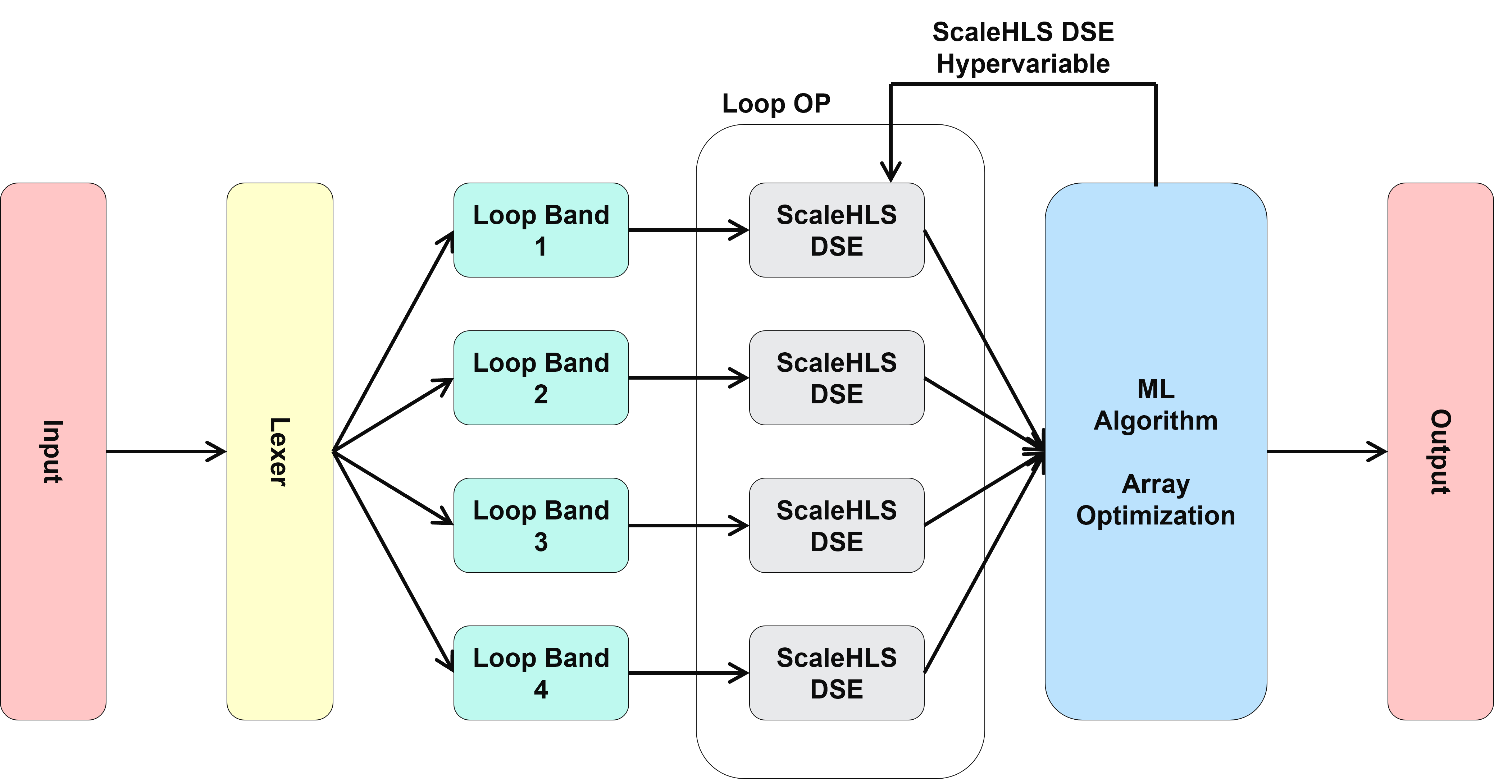
ScaleHLS (3): Design Space Exploration (DSE)
Lexer – Analyze input design
Identify Critical Loop bands
Identify dependencies between loop bands
Partition loops into digestible chunks, suitable for the ScaleHLS DSE
ScaleHLS DSE – Loop optimization
Poly-bench | 2mm small dataset |  |  | 3mm small dataset
 | Base | ScaleHLS DSE | NewFlow | Base | ScaleHLS DSE | NewFlow
Clock Cycles | 3,146,526 | 50,854 | 16,468 | 4,876,863 | 113,750 | 43,041
Clock Period(ns) | 8.286 | 15.434 | 8.726 | 8.286 | 15.434 | 9.621
Latency (μs) | 26,072 | 784 | 143 | 40,409 | 1,755 | 414
DSP48E | 2% | 78% | 58% | 2% | 27% | 41%
FF | 1% | 45% | 42% | 1% | 22% | 54%
LUT | 2% | 65% | 78% | 3% | 67% | 87%
Apply suitable ScaleHLS optimization passes
Find optimal loop tiling strategy
ML Algorithm – Array partitioning
Takes advantage of Random Forest Network, Evolutionary Algorithm, Gradient descent
Finds optimal array partitioning scheme within the allocated resource environment

Slide 4
ScaleHLS (4): Upcoming Plan
Continuous development on IP integration and DSE
More benchmarks and back-ends support
PolyBench [1]
Xilinx FPGA
Rosetta [2]
ScaleHLS
Intel FPGA
CHStone [3]
Xilinx ACAP
Upcoming events on ScaleHLS:
  Tutorial at FPGA’22 (Feb. 27): Open-Source Source-to-Source Transformation for HLS
  Presentation at HPCA’22 (April 2–6, TBD)
[1] https://web.cse.ohio-state.edu/~pouchet.2/software/polybench/
[2] Zhou, Yuan, et al. "Rosetta: A realistic high-level synthesis benchmark suite for software programmable fpgas.“
[3] Hara, Yuko, et al. "Chstone: A benchmark program suite for practical c-based high-level synthesis."

