Slide 1
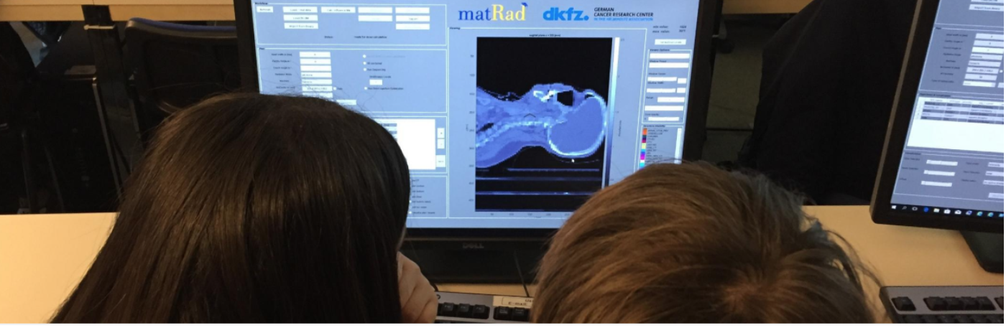



Particle Therapy MasterClass
https://indico.cern.ch/event/840212/
Yiota Foka (GSI/CERN)
on behalf of
IPPOG and IMC Steering Group

Slide 2
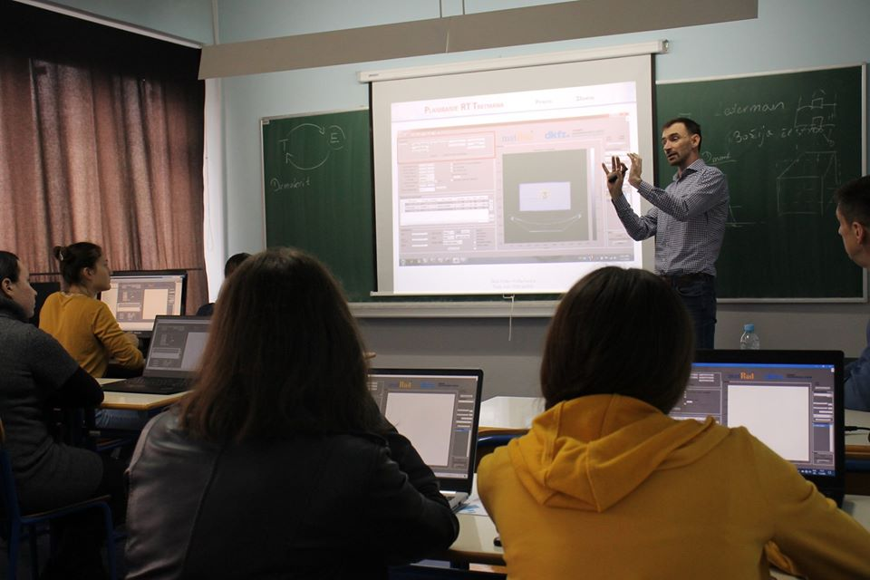
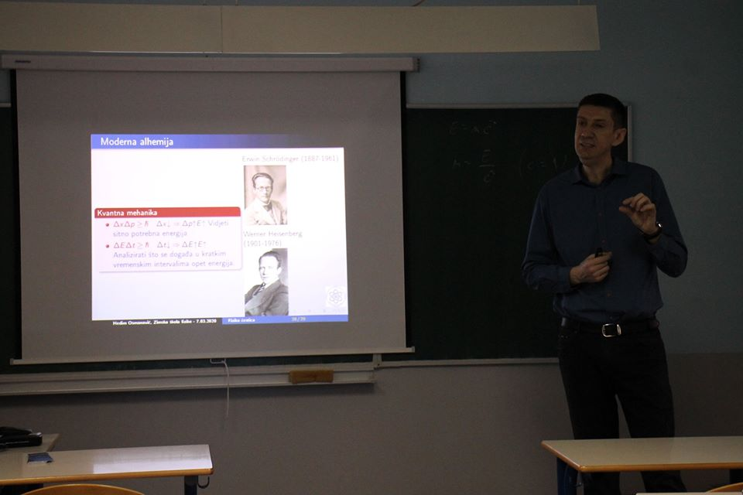
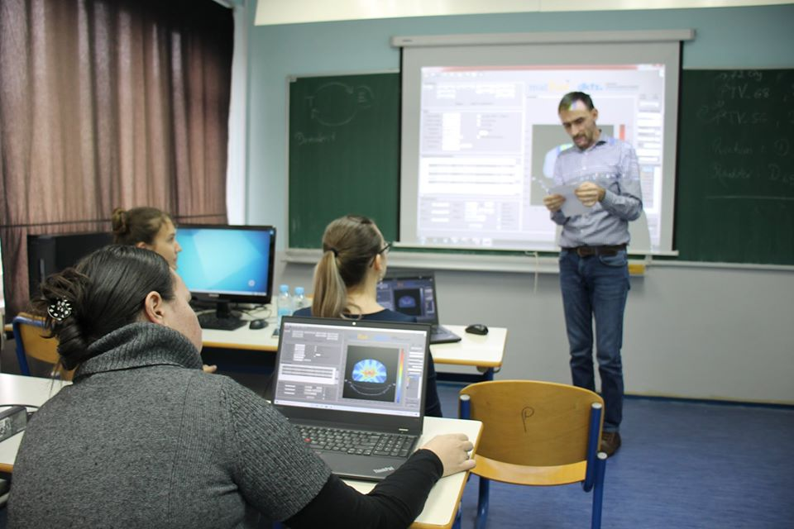
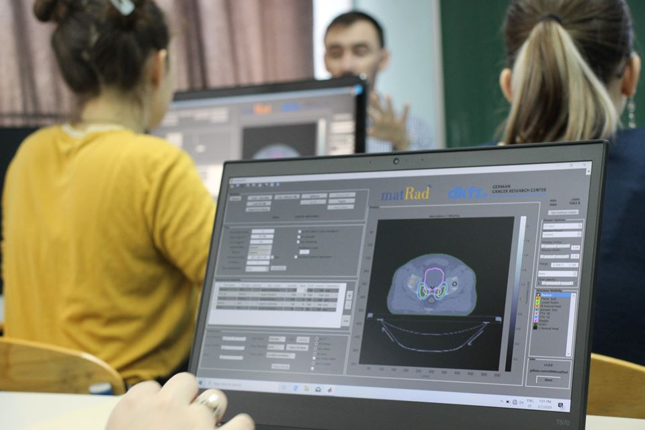

Local PTMC in Tuzla

Slide 3

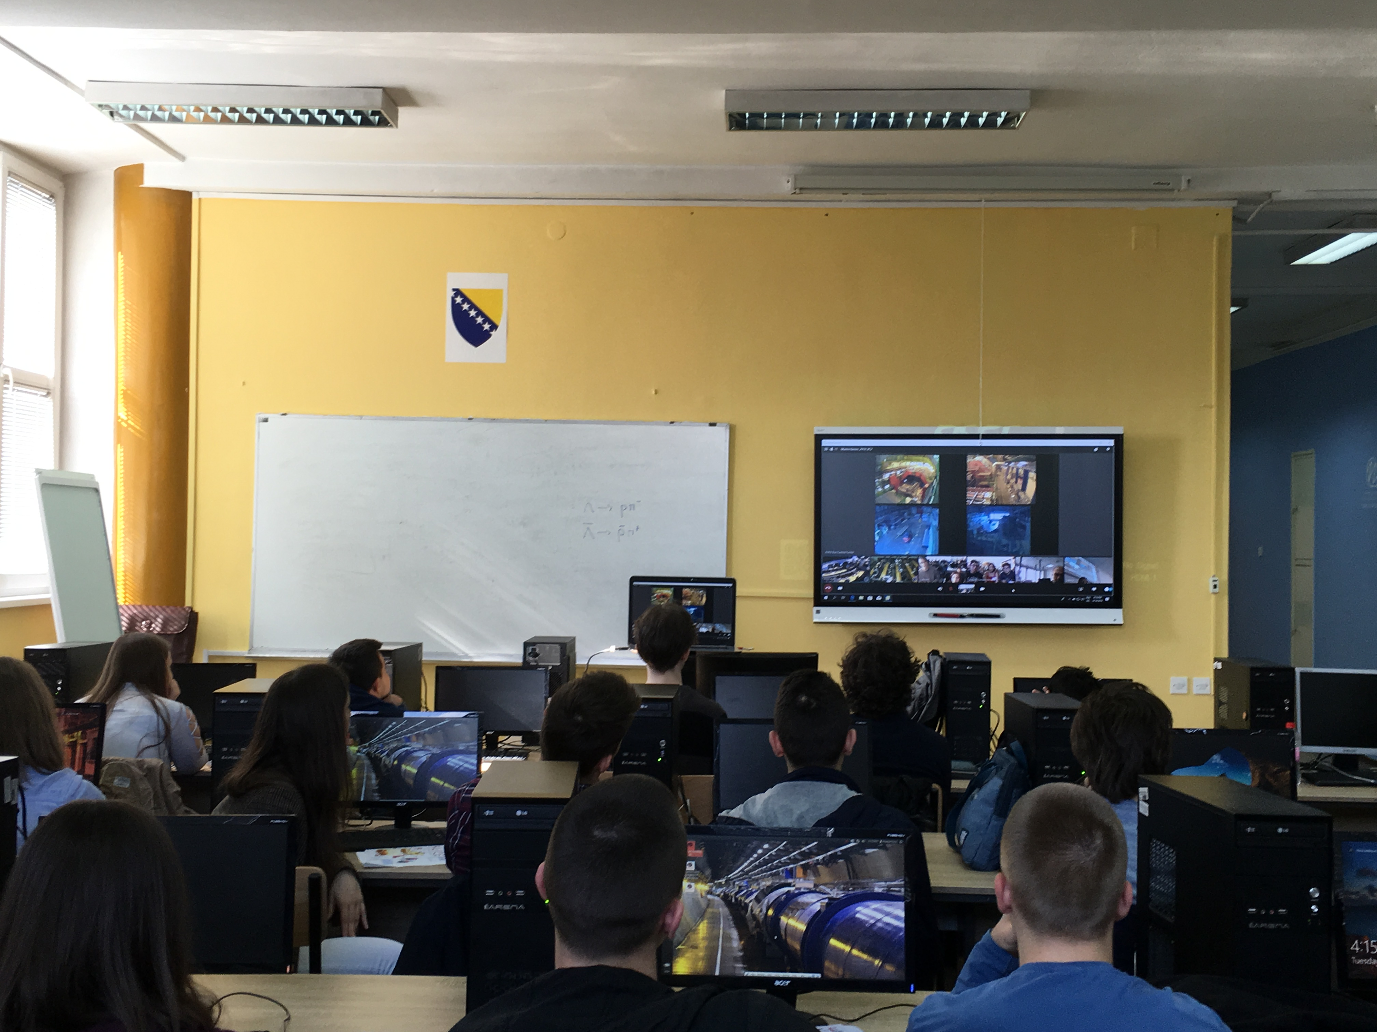
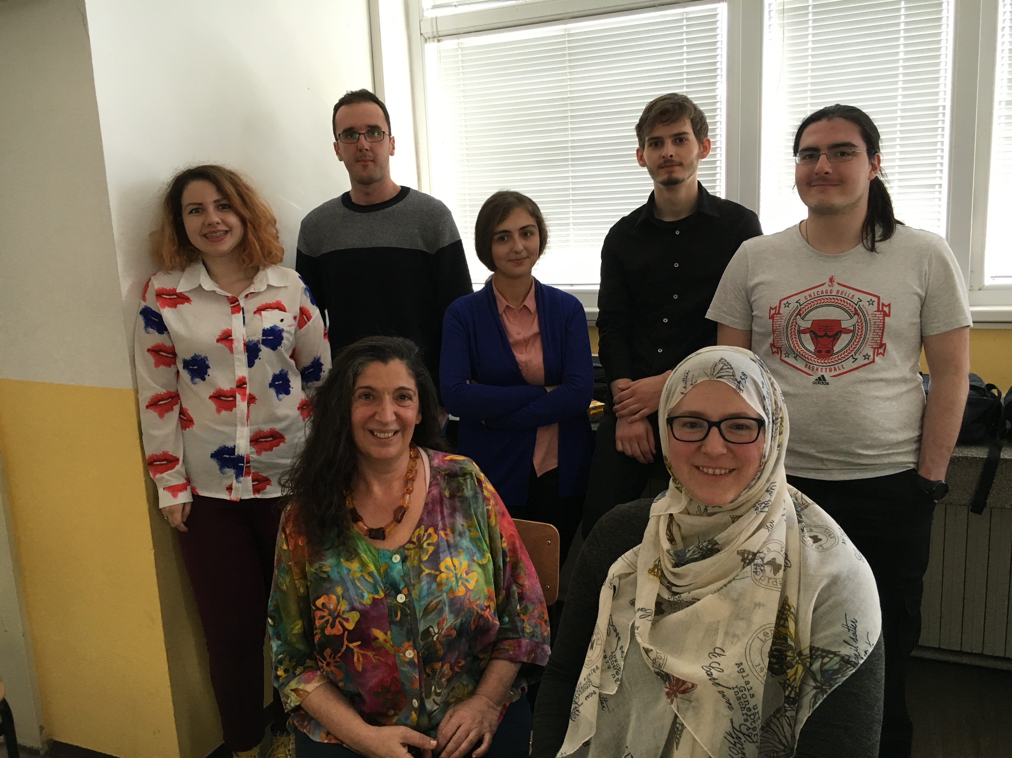
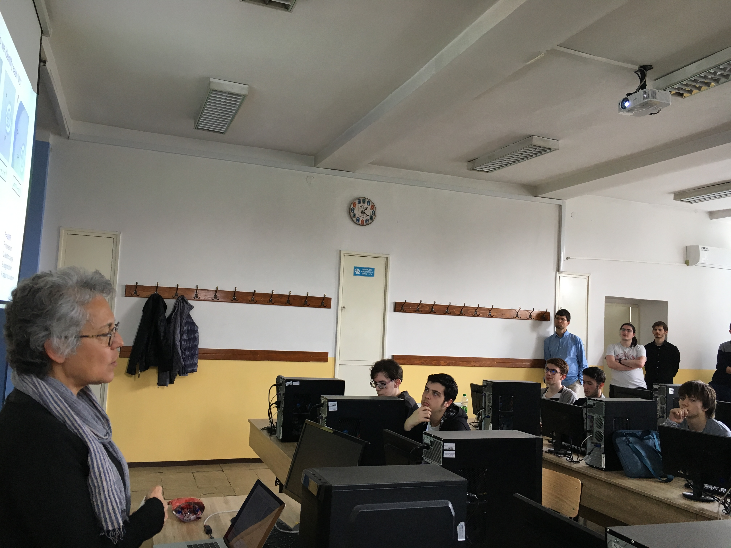
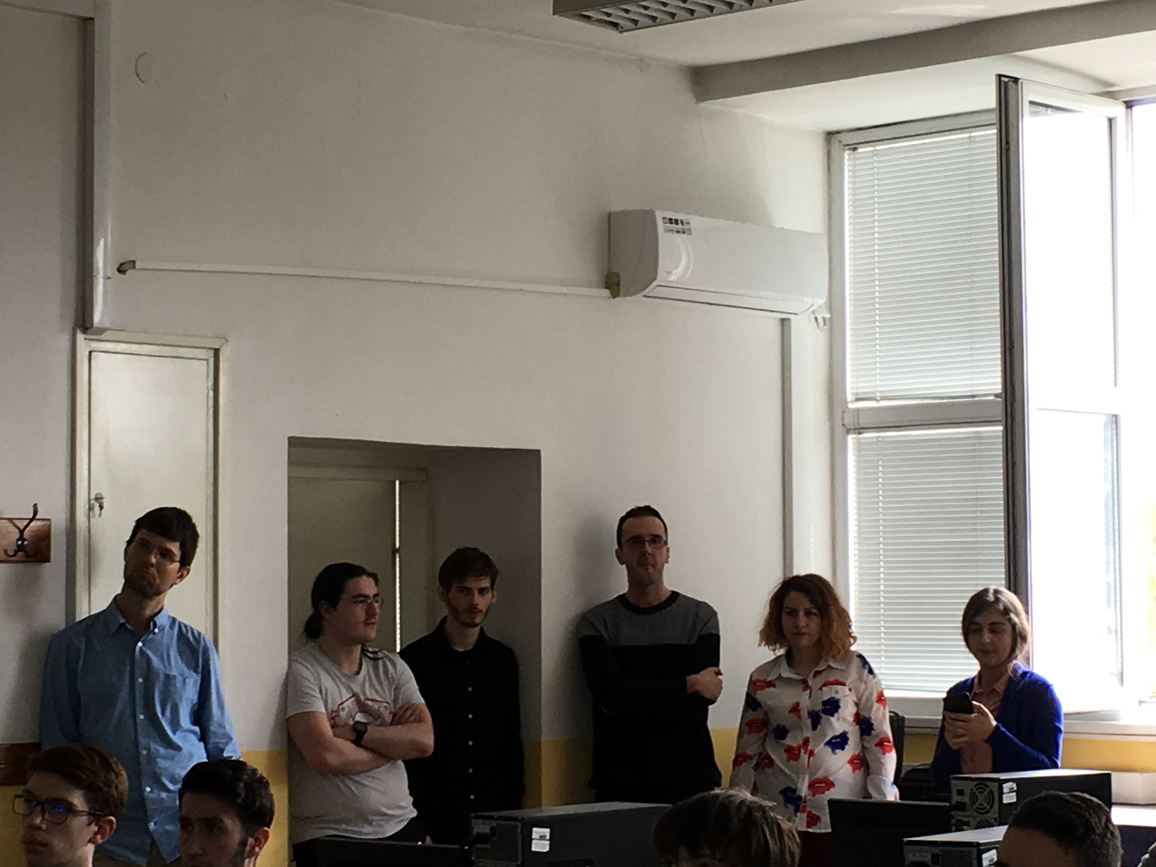

From first ALICE MC in Sarajevo in 2019 to hundreds of students !!

Slide 4
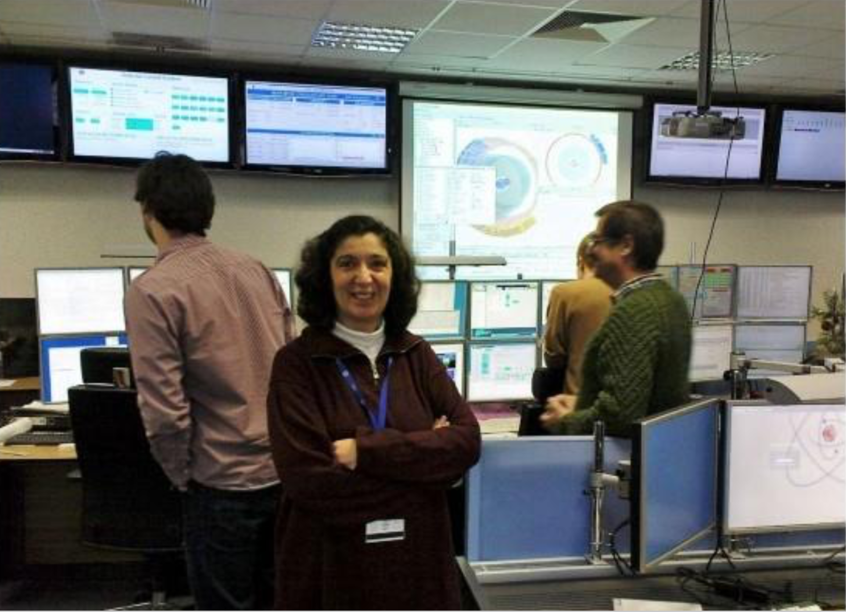
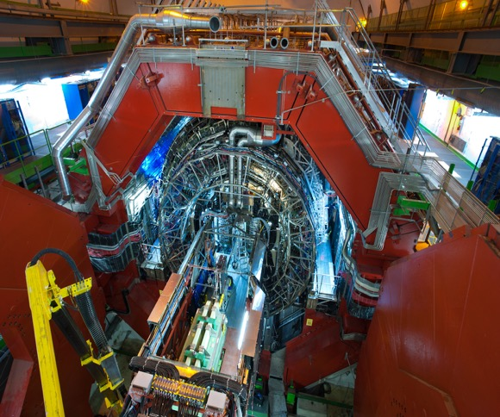
Heavy-ion research and heavy-ion therapy
Heavy-ion Physicist, involved with medical applications of heavy-ions for cancer therapy
Virtual visit: ALICE heavy-ion experiment at CERN.

Slide 5
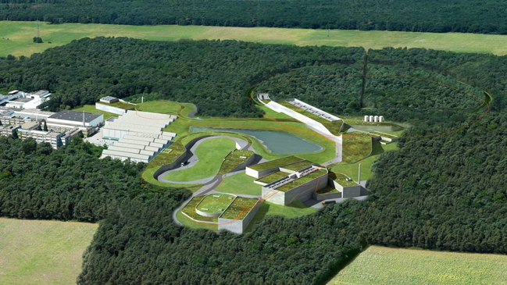
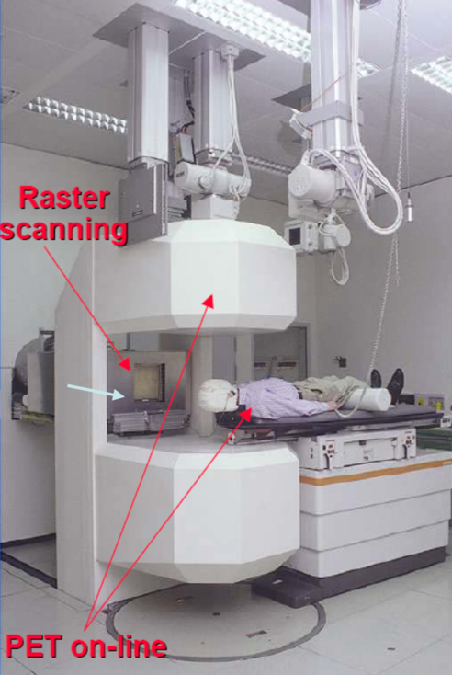
Heavy-ion research and heavy-ion therapy at GSI
Pioneered heavy-ion (carbon) therapy for cancer tumours in Europe (90s).

Slide 6
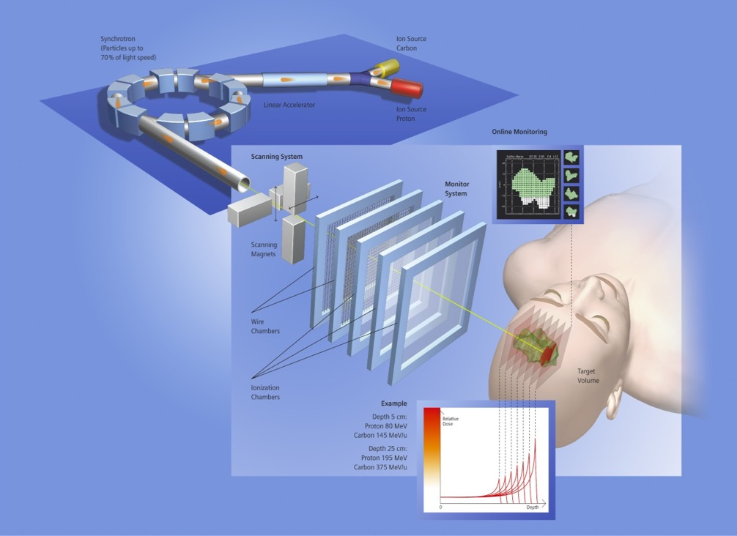
Heavy-ion research and heavy-ion therapy at GSI
Rasterscan Method
Haberer et al., NIM A , 1993
  Implemented in the Heidelberg and Marburg Ion Treatment centers
  (HIT and MIT) in Germany
Haberer et al., NIM A , 1993
Notes:
6

Slide 7
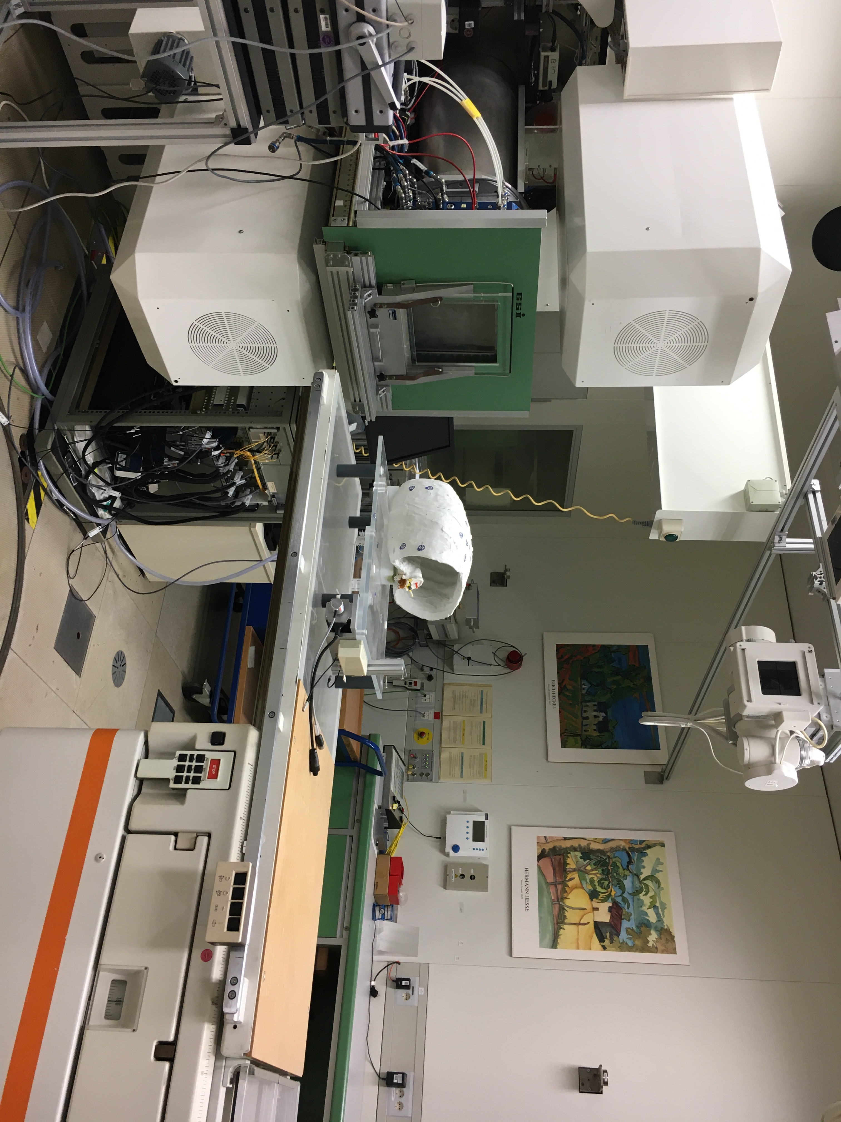
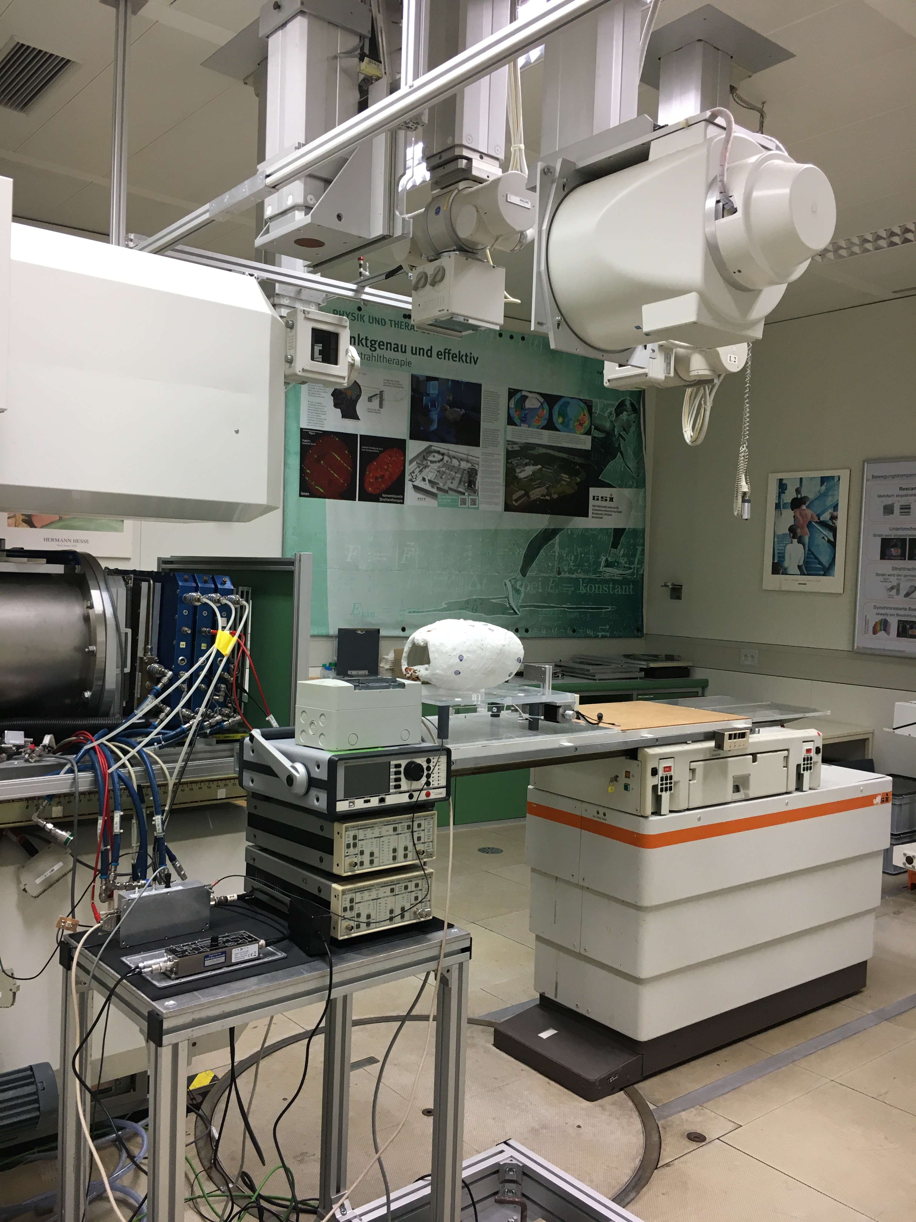
The heavy-ion therapy room at GSI today
Rasterscan Method
Haberer et al., NIM A , 1993
  Implemented in the Heidelberg and Marburg Ion Treatment centers
  (HIT and MIT) in Germany
Haberer et al., NIM A , 1993
Notes:
7

Slide 8
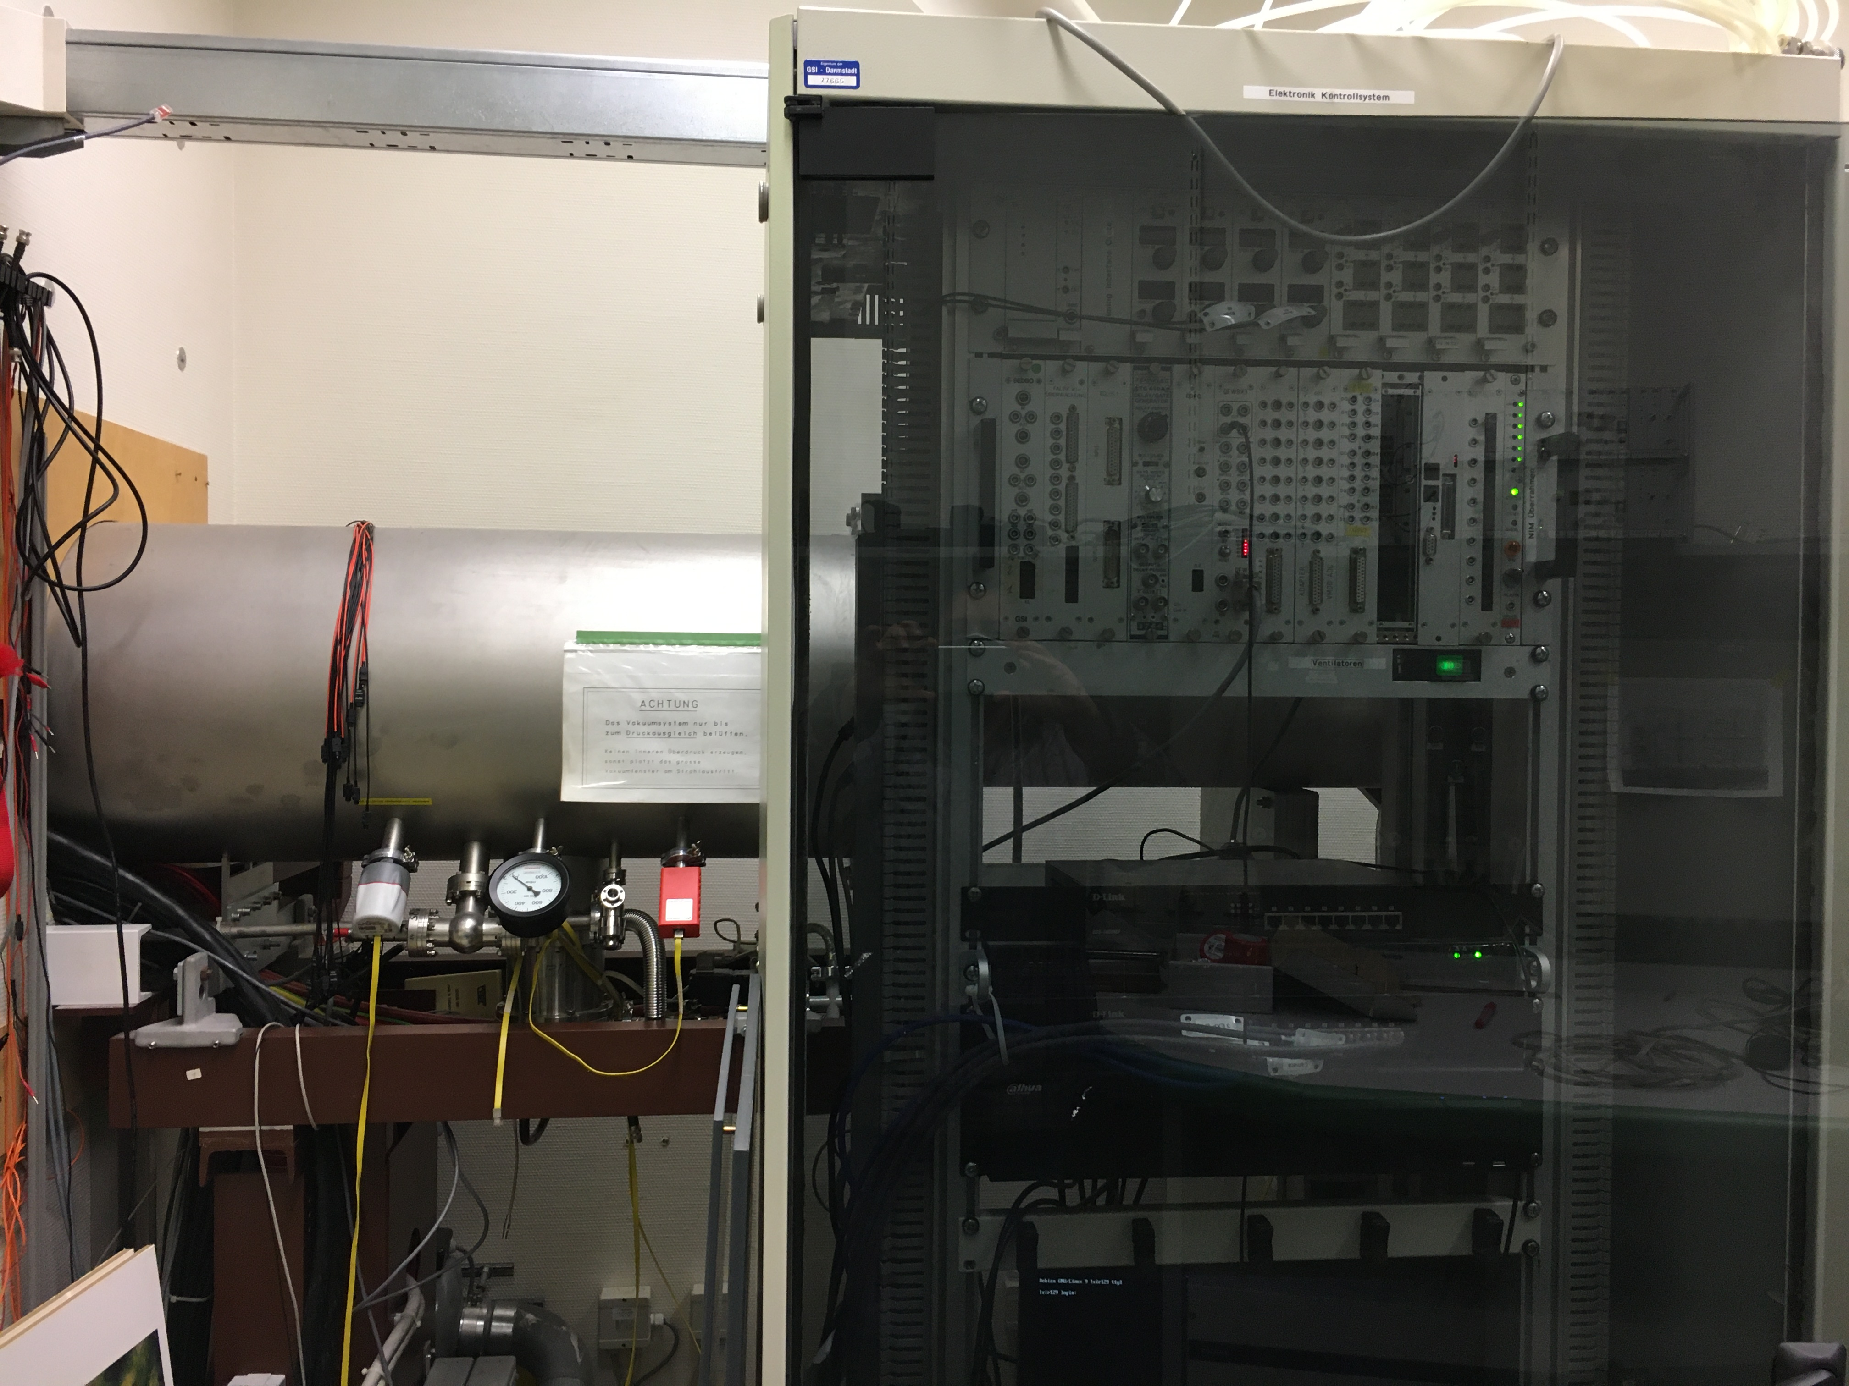
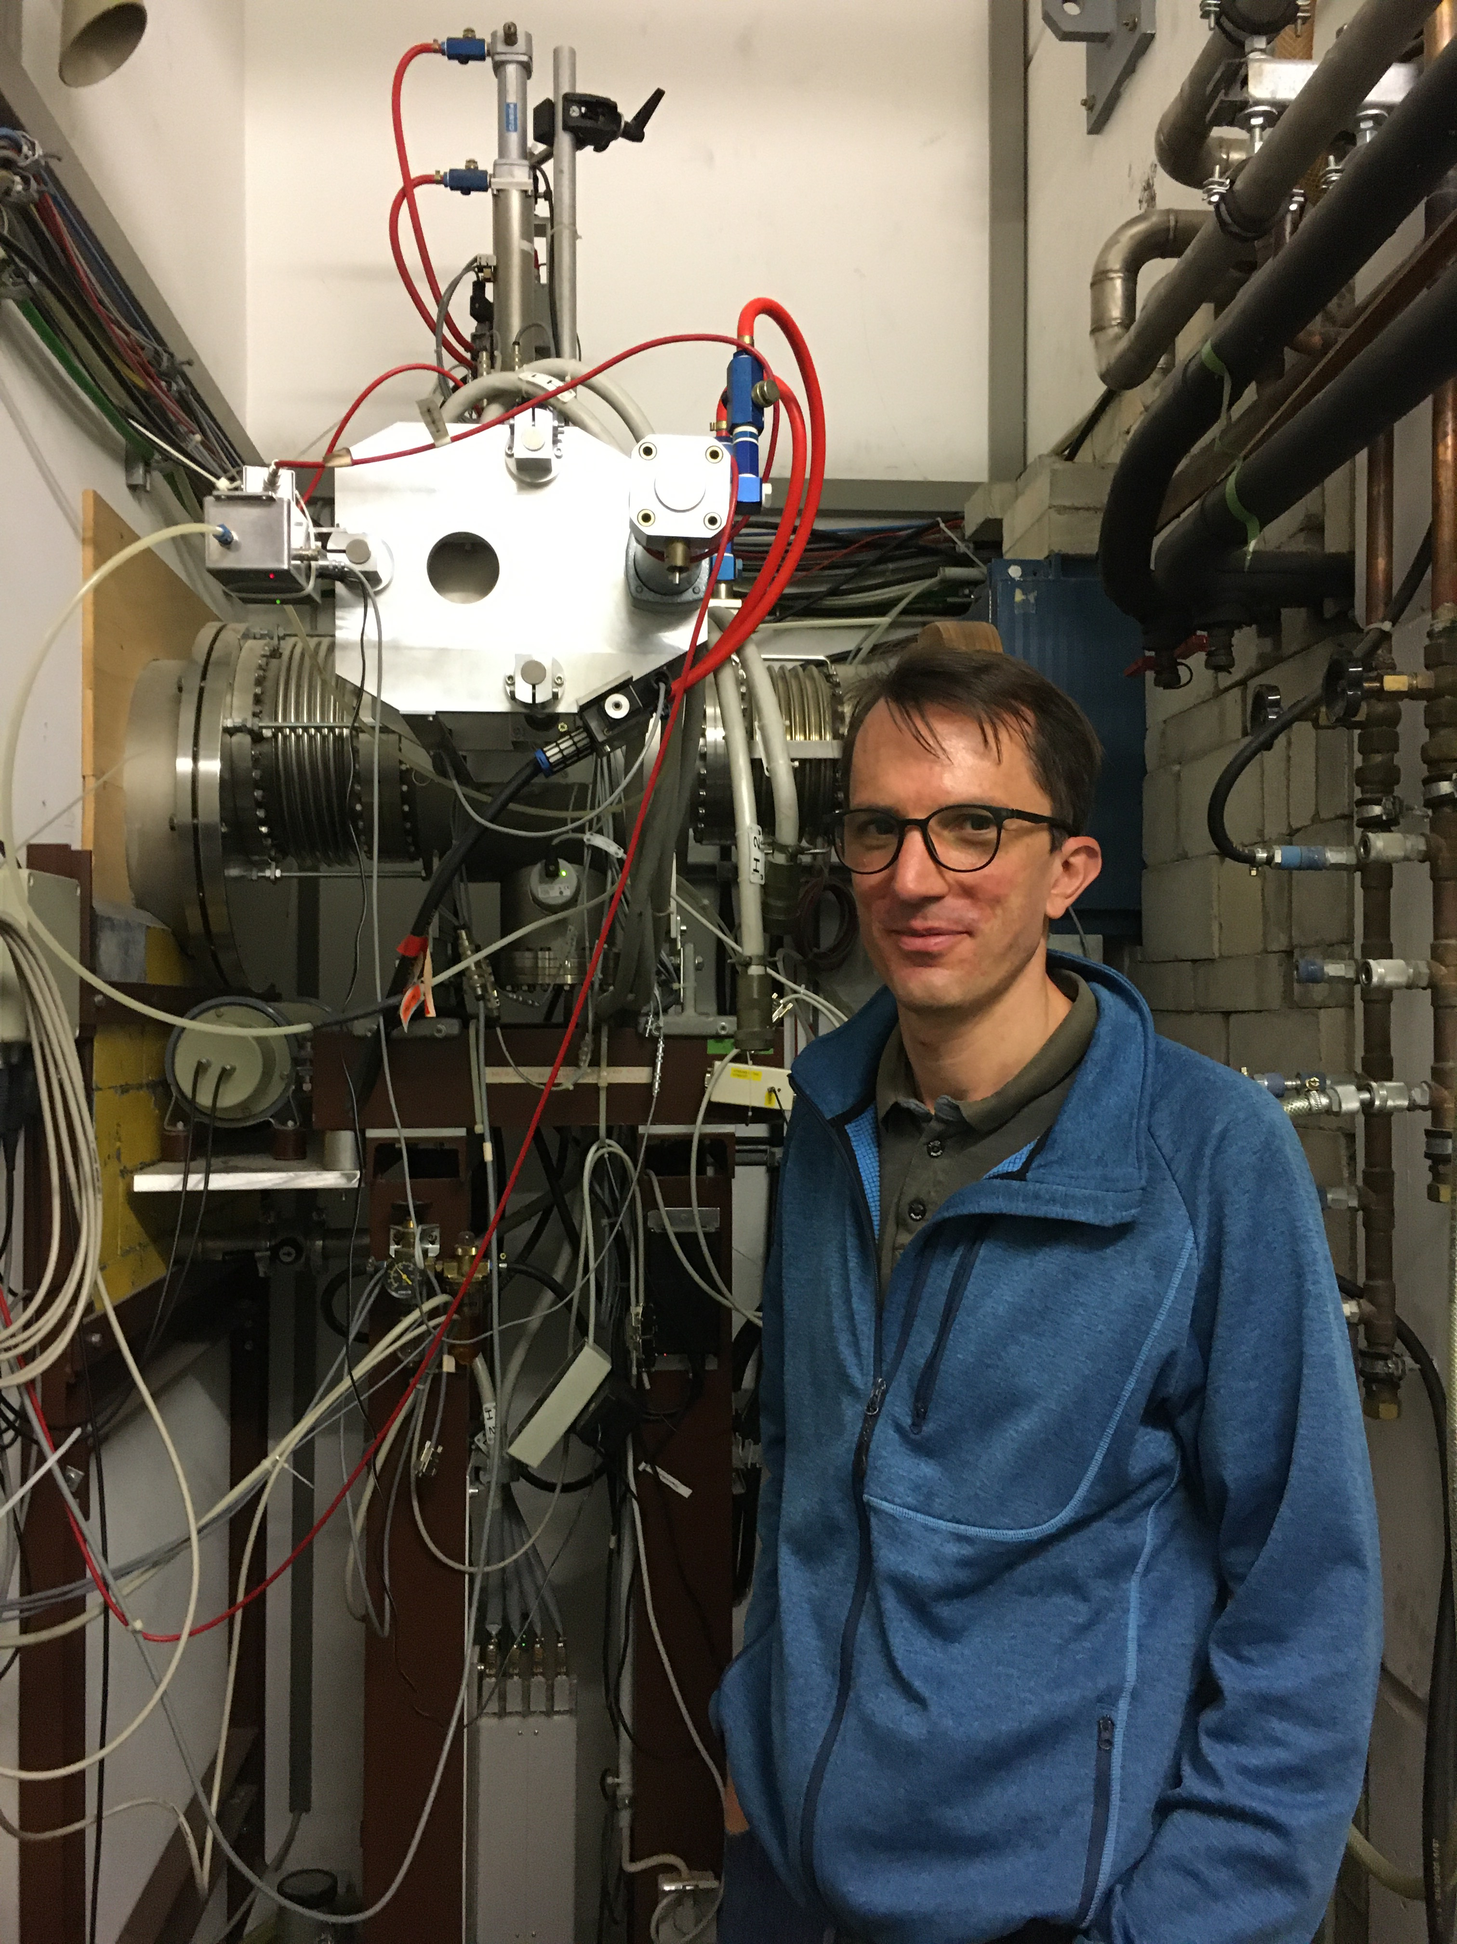
What is behind the wall?

Slide 9
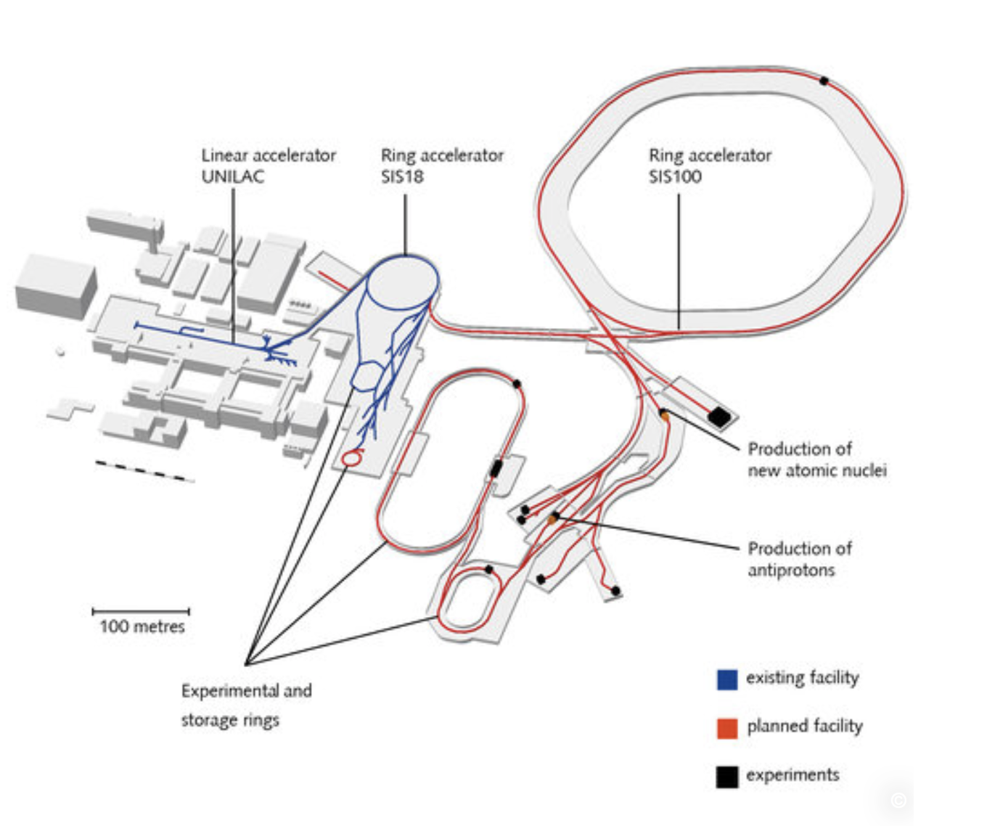
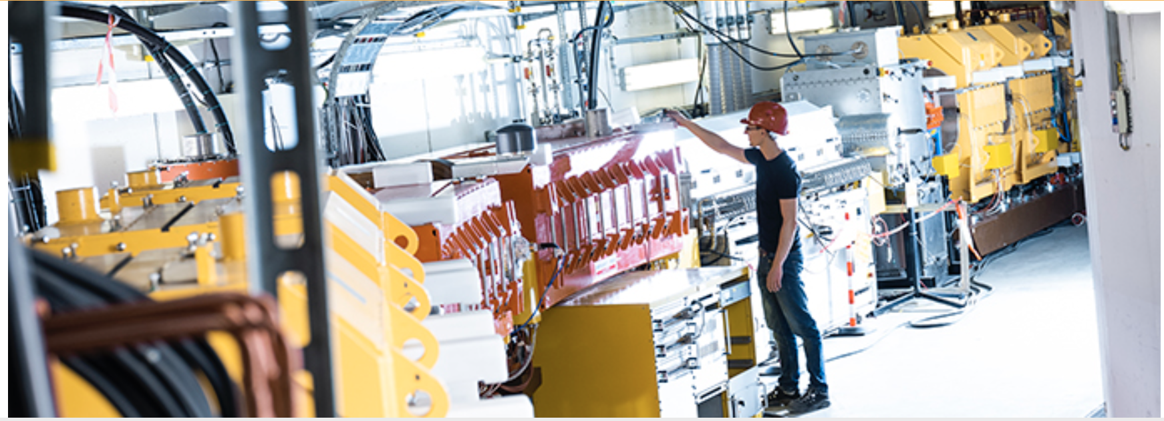
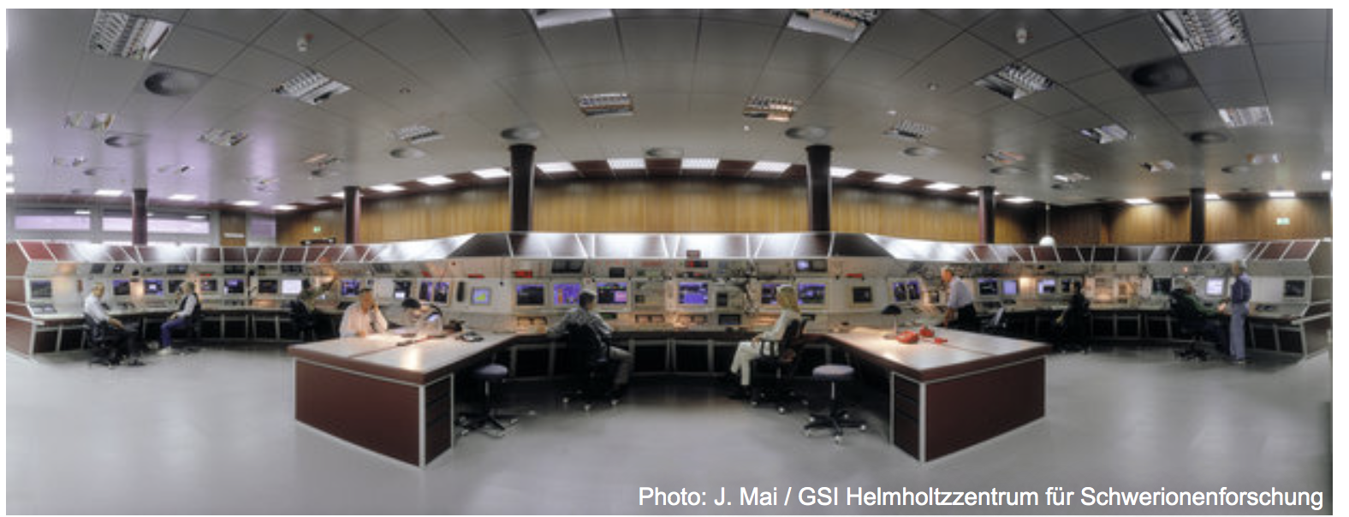
What is behind the wall?

Slide 10
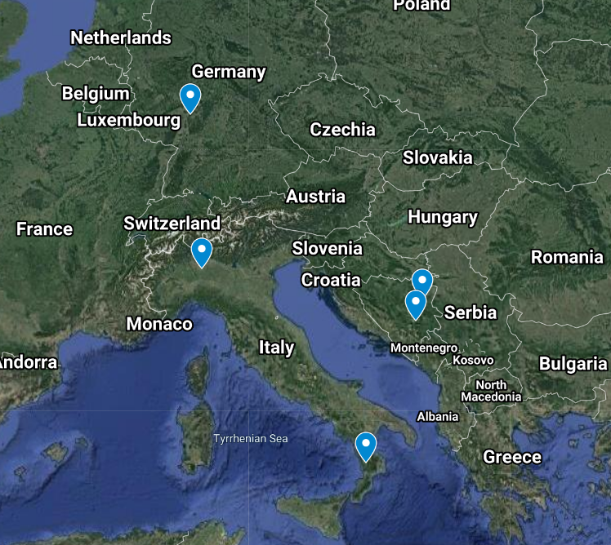
PTMC Participants, 18 March 2022
PTMC: https://indico.cern.ch/event/1122782/
International MasterClasses https://physicsmasterclasses.org/

Slide 11
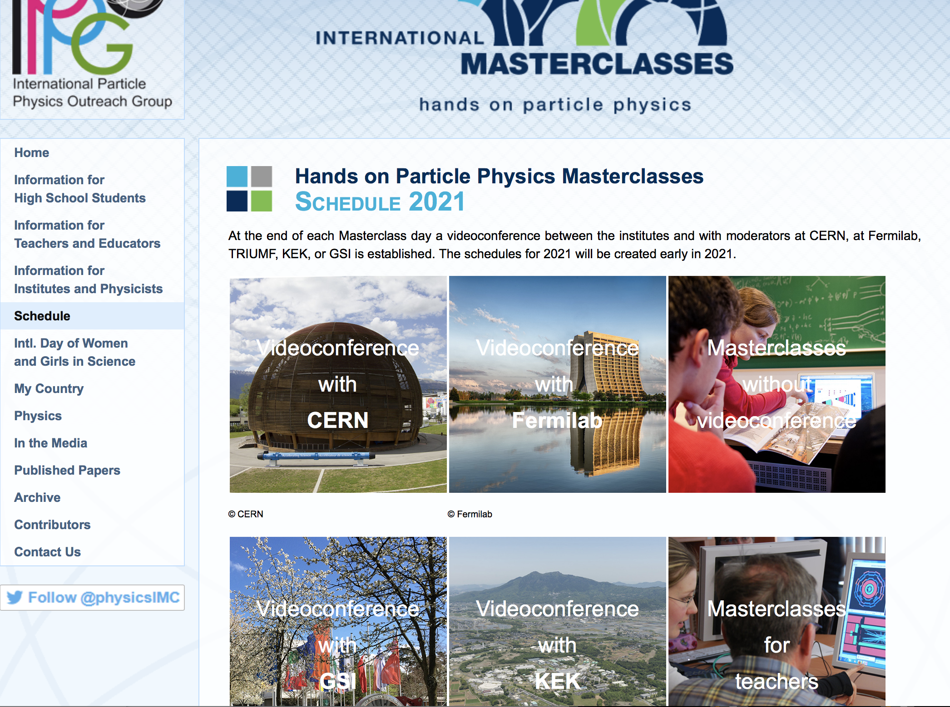
https://physicsmasterclasses.org/
https://indico.cern.ch/event/840212/

Slide 12
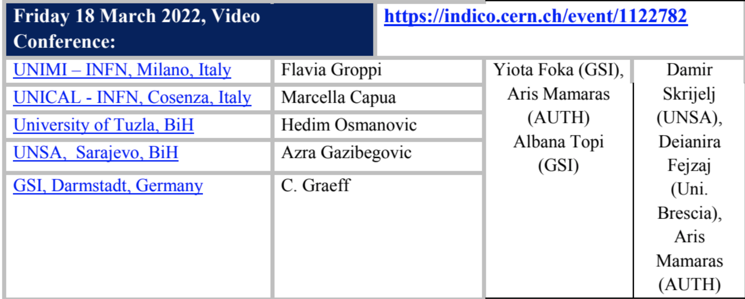
New PTMC 2022 BiH Schedule

Slide 13
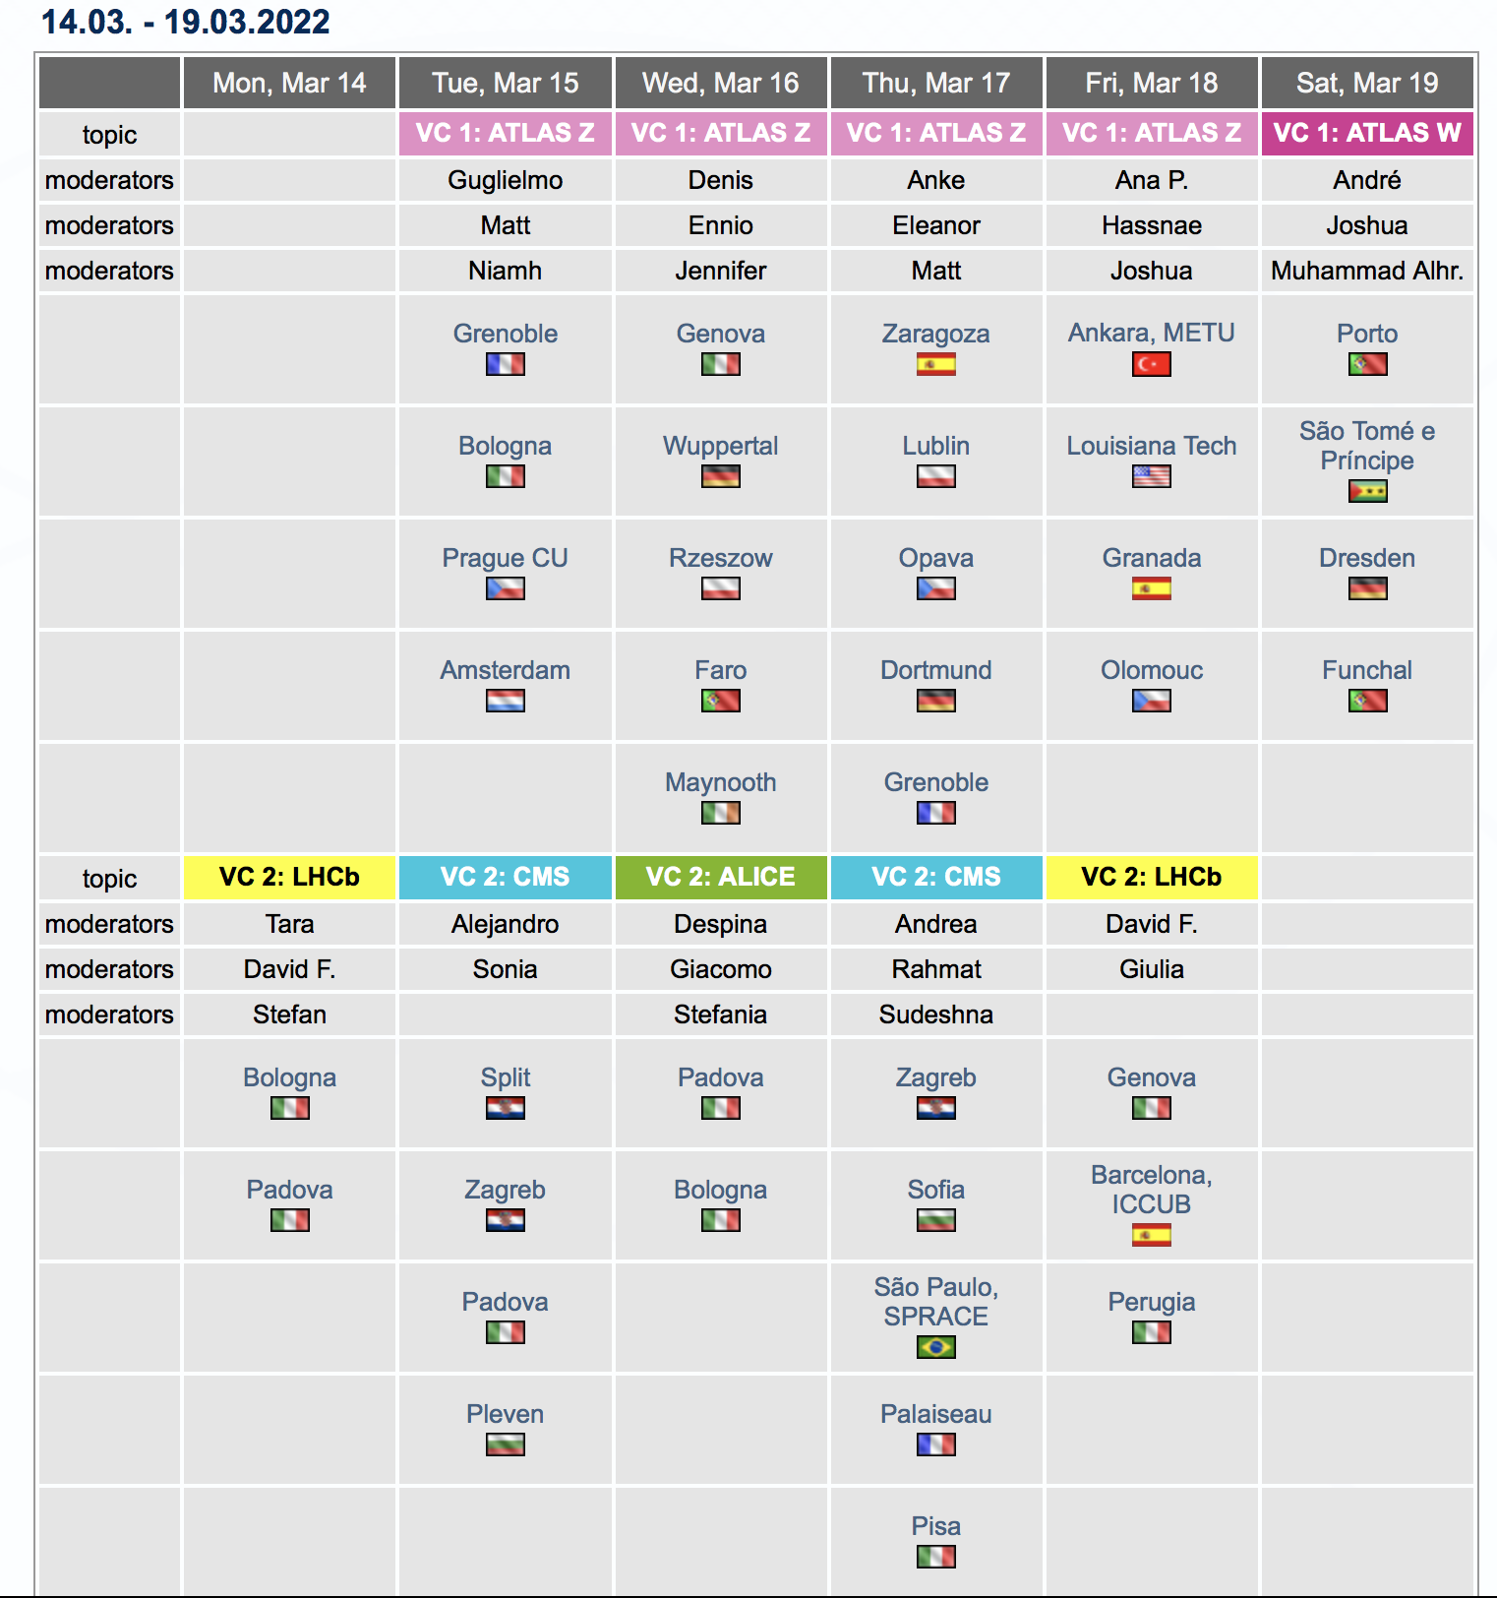
PTMC IMC Schedule

Slide 14
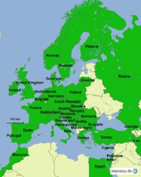
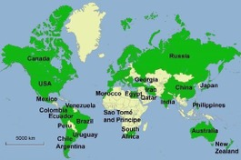

IMC Statistics 2019
Motivate the next generations of scientists !
54 countries
255 institutes
15 000 students
5 weeks in 2019
IMC 2021 :
11.2.2021 – 27.3.2021
Brings scientific methods and real data to schools!
Coordination QuarkNet / TU Dresden
188 institutes (177)
266 LHC Masterclasses (257)
  30 ATLAS W (35)
  101 ATLAS Z (104)
  64 CMS (58)
  41 LHCb (39)
  27 ALICE SP (18)
  3 ALICE R_AA (3)
51 institutes (48)
54 LHC Masterclasses (50)
  22 ATLAS (19)
  32 CMS (31)
(Incl. TRIUMF program)
12 MINERvA Masterclasses
Flagship project of IPPOG, the International Particle Physics Outreach Group

Slide 15

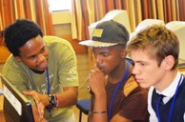
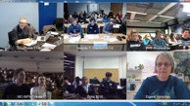
Concept and programme of an IMC day
Scientists for a day !!
Every year, during the months of
February-March
school-children (15-19 year old)
are invited to an institute of their area.
2-5 institutes per day performing the same programme
LOCAL TIME: ACTIVITY
8:30 - 9:00 Registration and Welcome
9:00 - 10:00 Introductory lectures
10:30 - 11:30 Visit of a lab or experiment
12:00 - 13:00 Lunch
13:00 - 15:00 Hands-on session
15:00 - 16:00 Discuss results locally
16:00 - 17:00 Video conference
The aim is to get insight into topics and methods of research

Slide 16

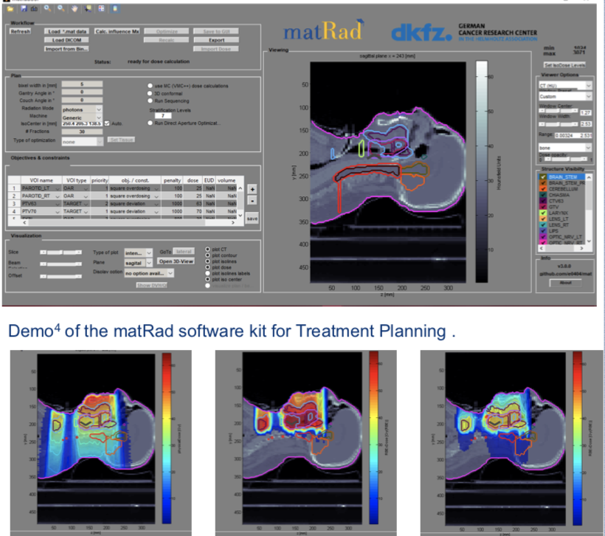
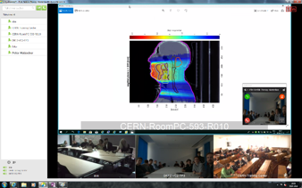
New PTMC and Treatment Planning
Based on professional open source treatment planning: matRad
developed by Heidelberg DKFZ www.matrad.org
Simplified version for PTMC
Using photons, protons and carbon ions

Slide 17
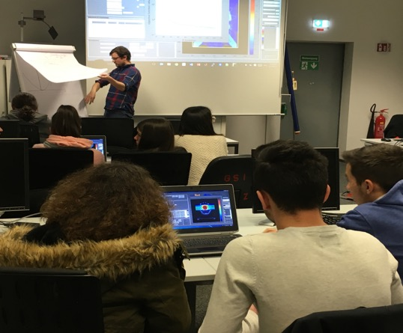
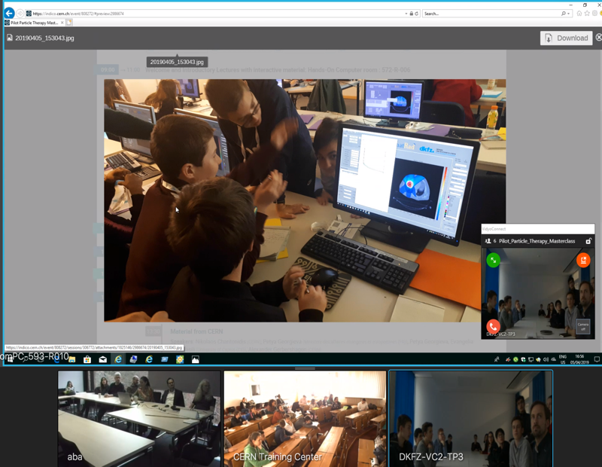
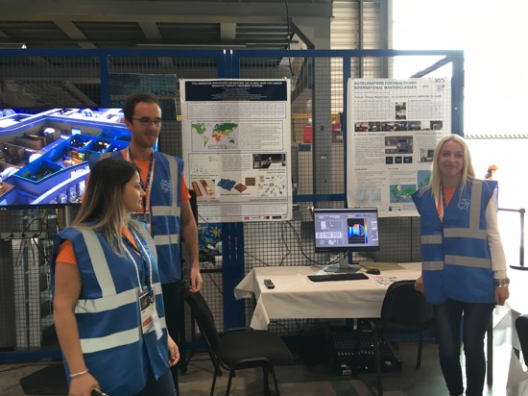
New PTMC and Treatment Planning
First Local Test: GSI Feb 2019
International Pilot: CERN, GSI, DKFZ April 2019
Web page: UNSA students
at CERN, Aug 2019
First local test: GSI Feb 2019
First International Pilot: GSI, Heidelberg DKFZ, CERN Apr 2019
IMC Steering Group Approval: GSI May 2019
Web pages: Sarajevo Uni students Aug 2019 at CERN
CERN Open days: Sarajevo Uni students Sep 2019

Slide 18
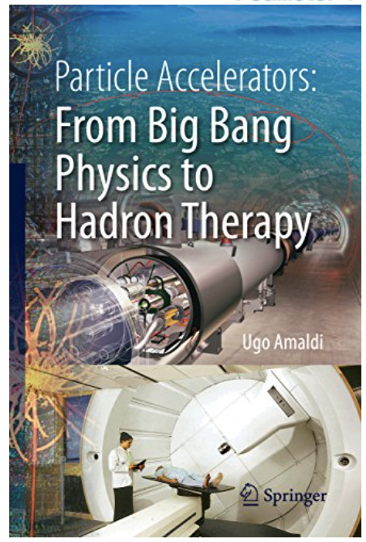
How is physics related to medicine?
What is particle therapy?
How one can use particles for
cancer treatment?
Accelerators for research
and accelerators for
cancer treatment
One of the aims of PTMC:
address such questions

Slide 19
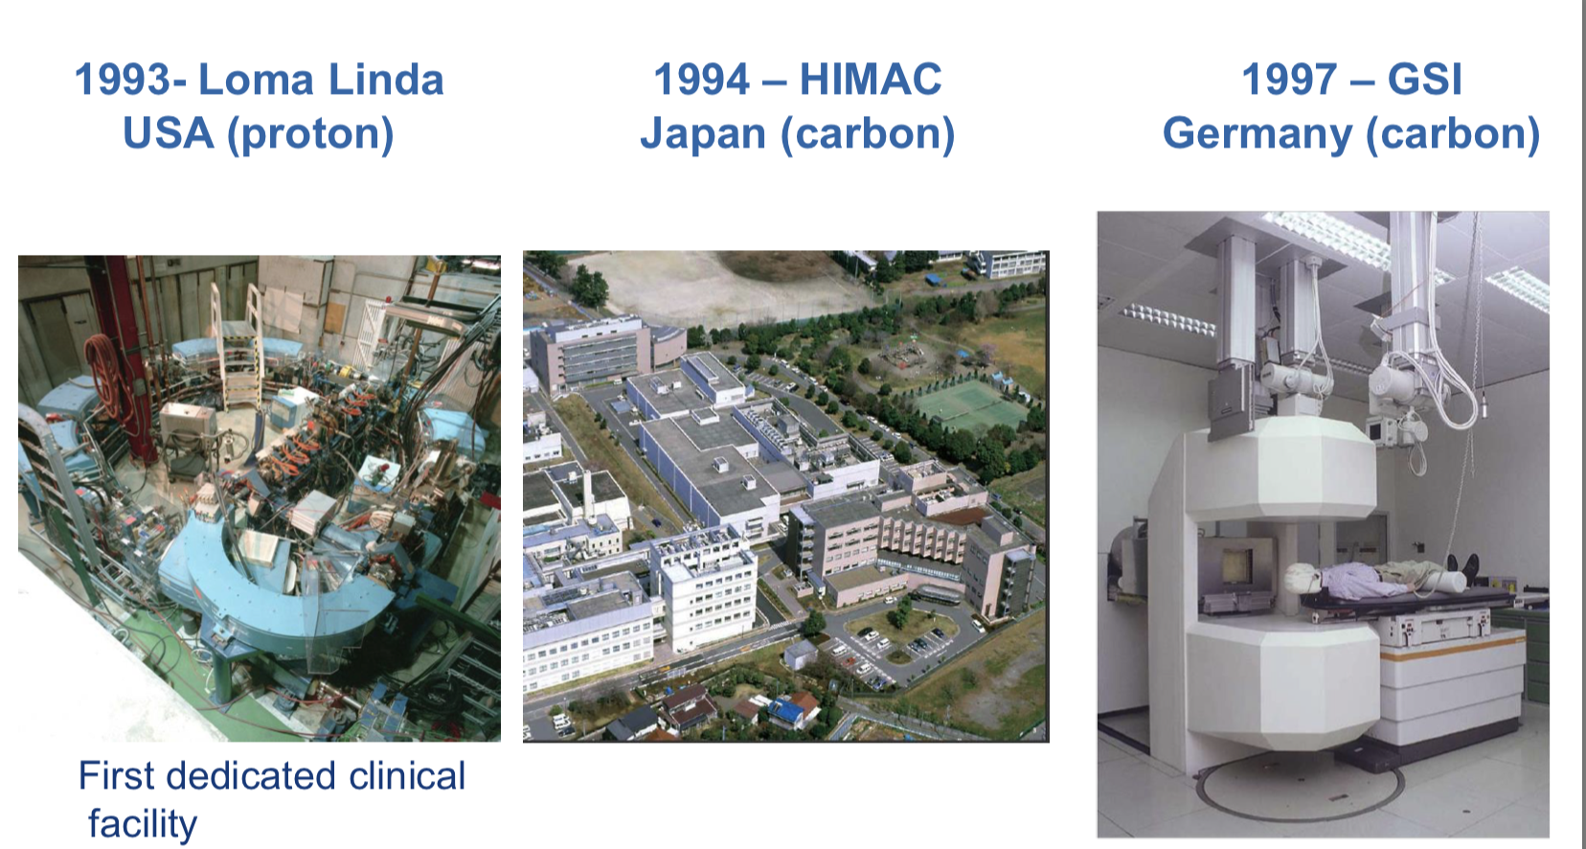
From Physics to Clinics

Slide 20
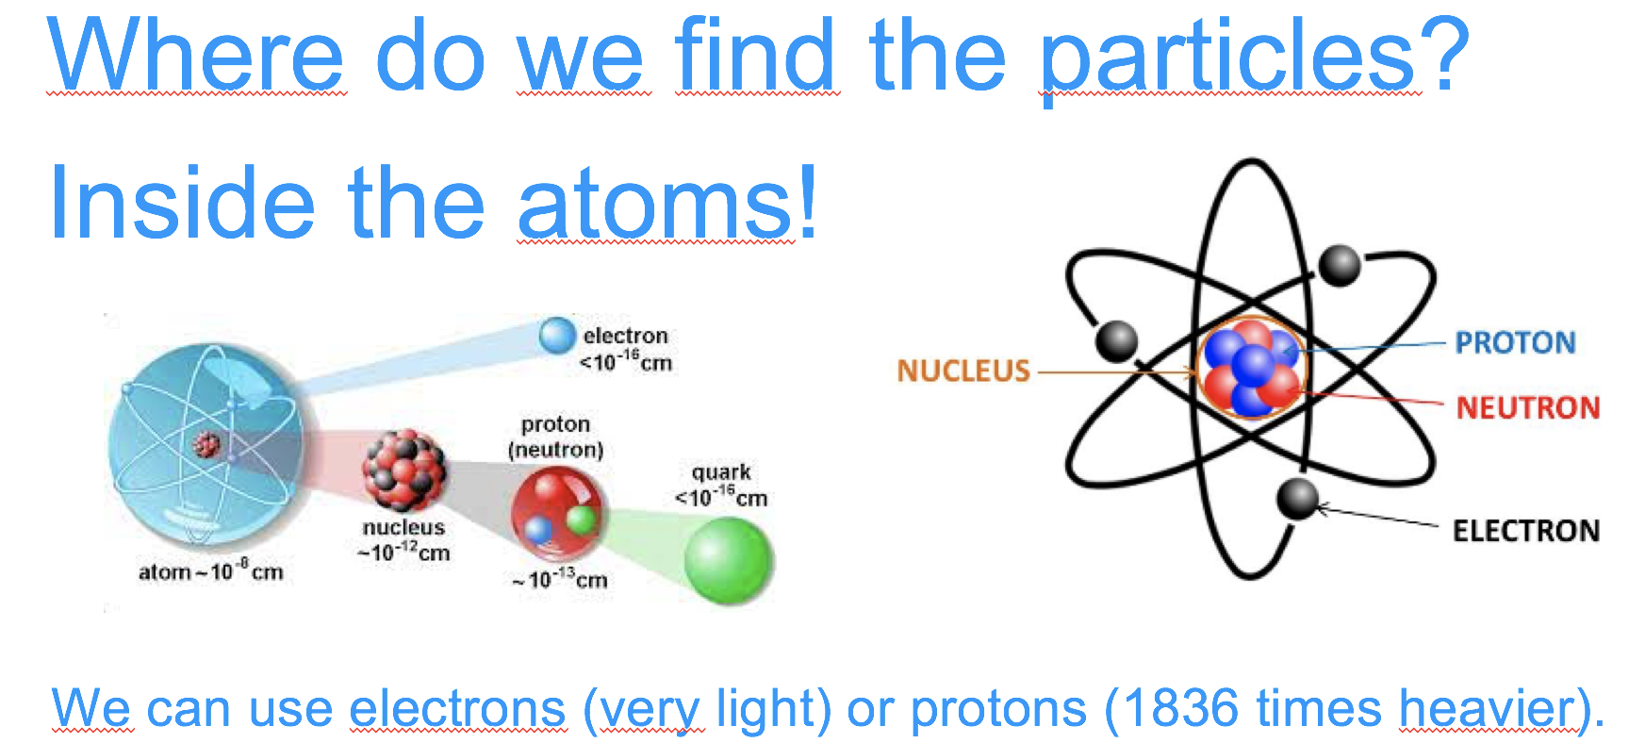
Accelerators: our key to the subatomic world
Particle accelerators are our door to access the subatomic dimension… and exploit the atom and its components

Slide 21
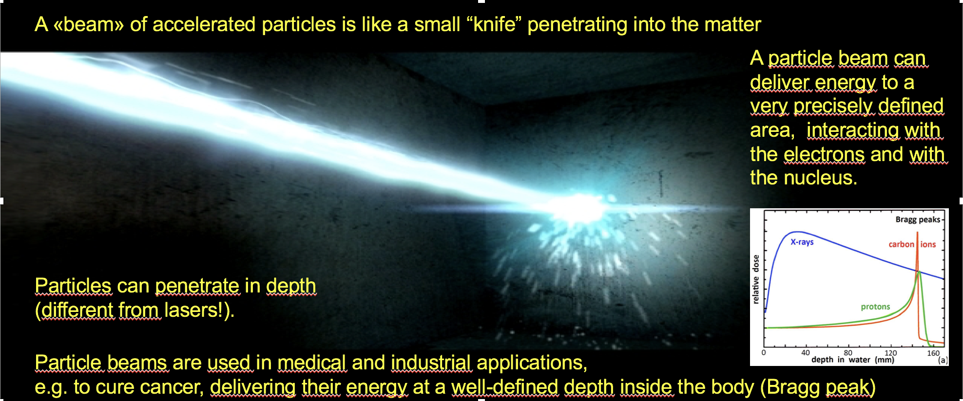
Accelerators: can precisely deliver energy

Slide 22
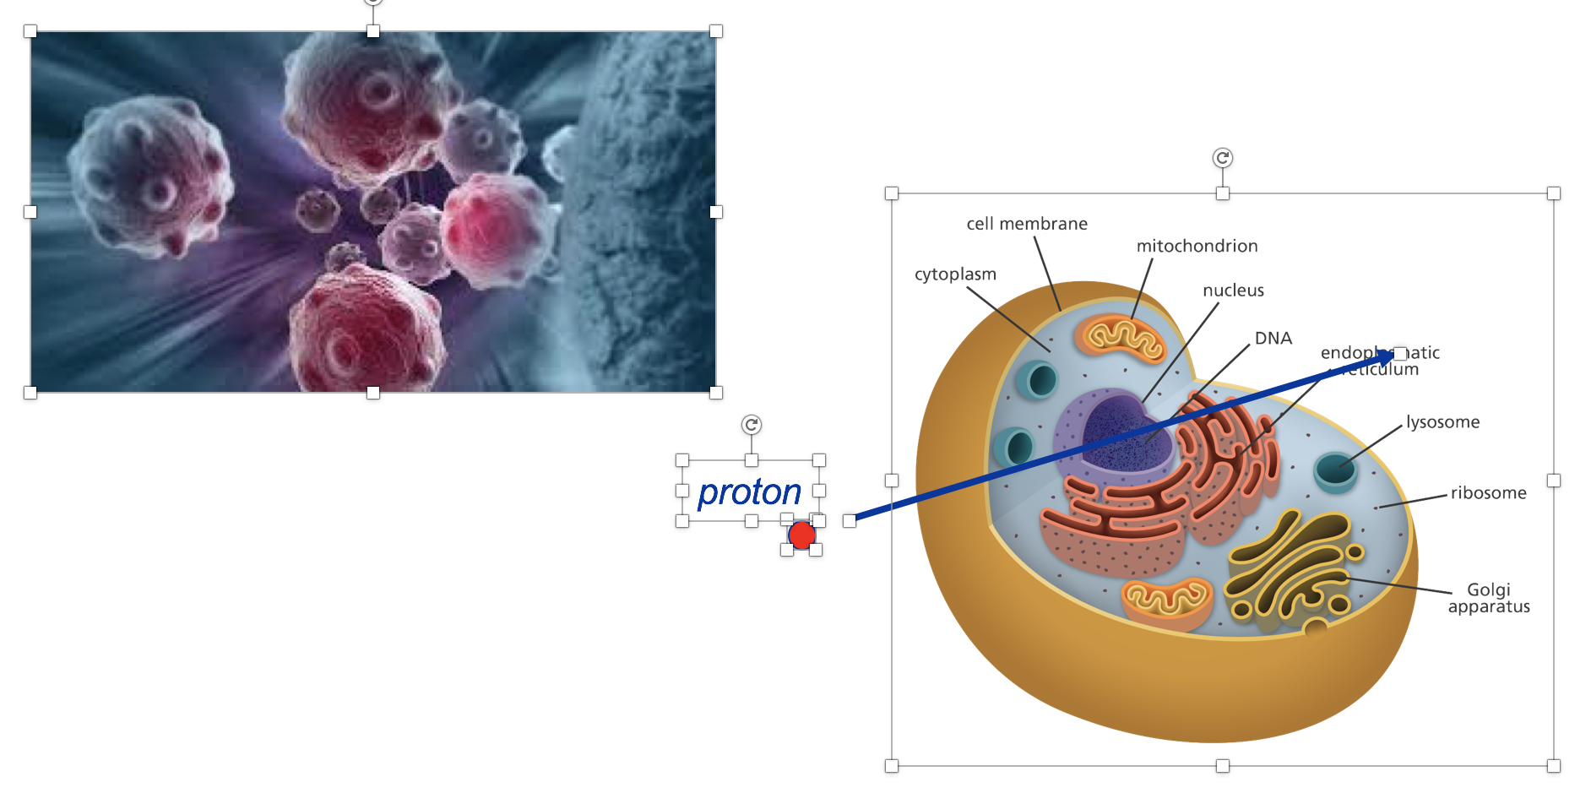
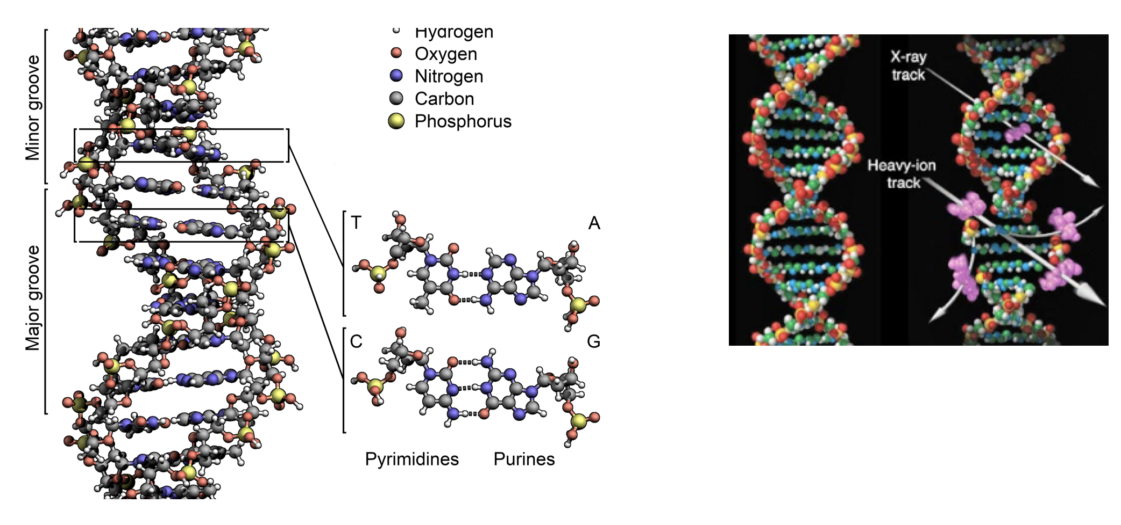
A particle beam can break the DNA and kill a cell

Slide 23
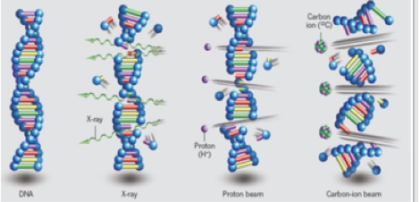
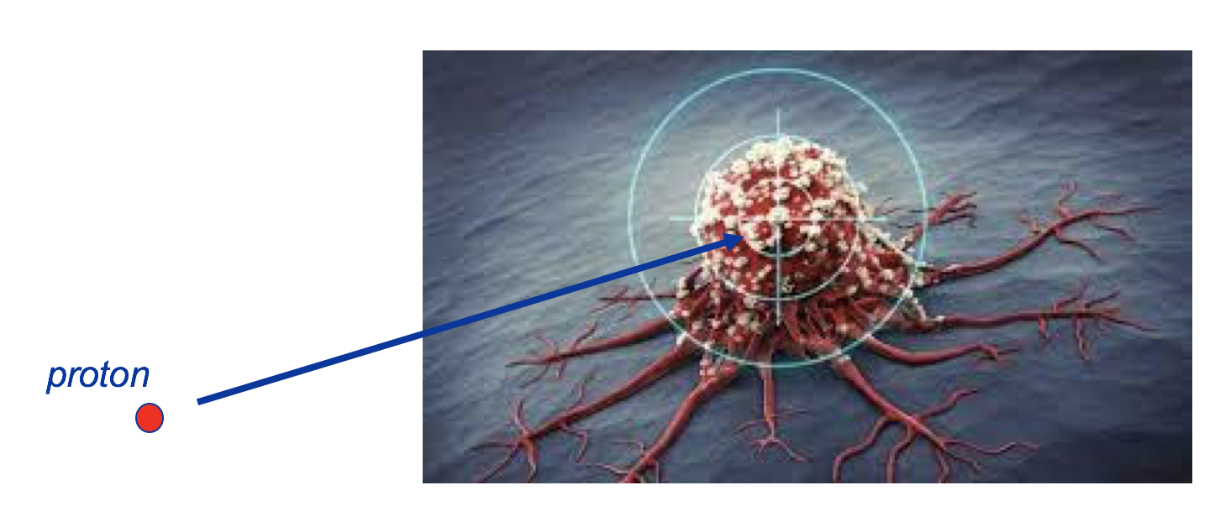
And if the cells has the cancer?
Killed !
A particle beam can break the DNA and kill a cell

Slide 24
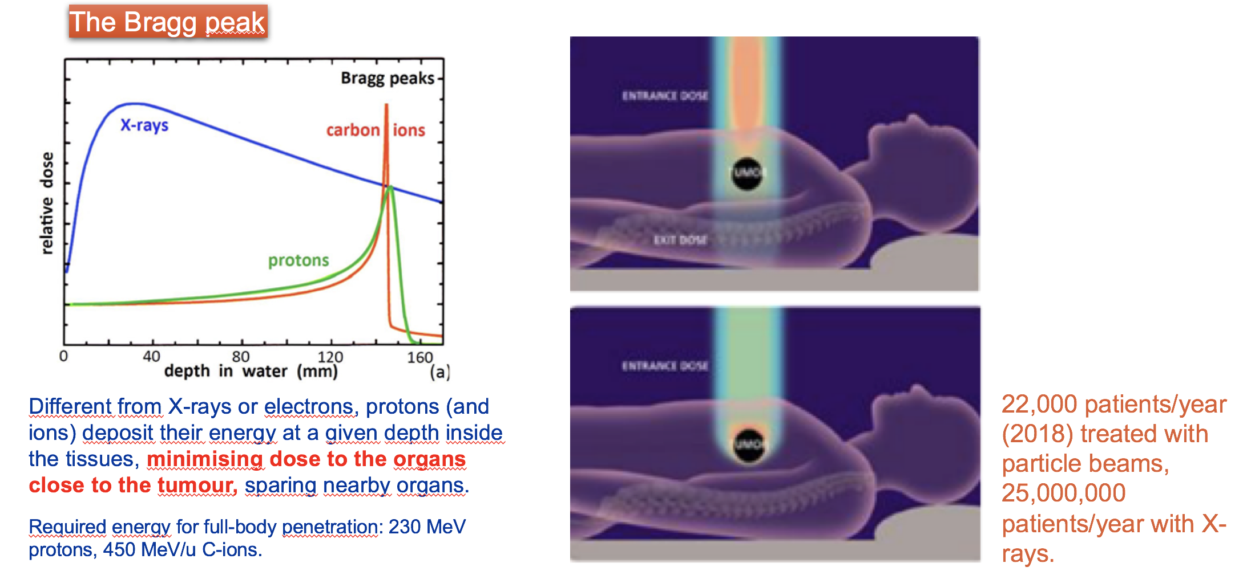
Hadron therapy with protons or ions

Slide 25
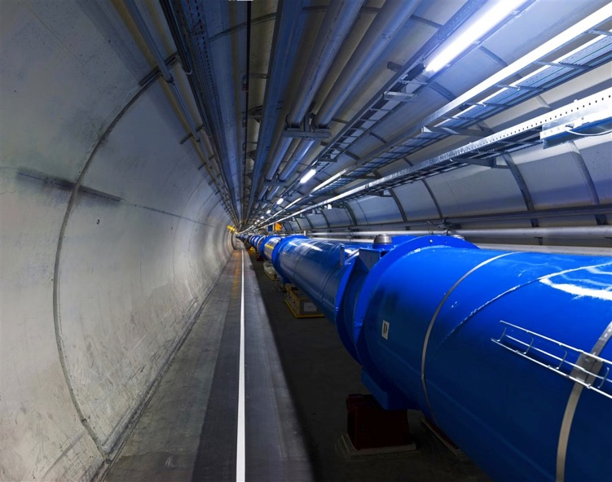
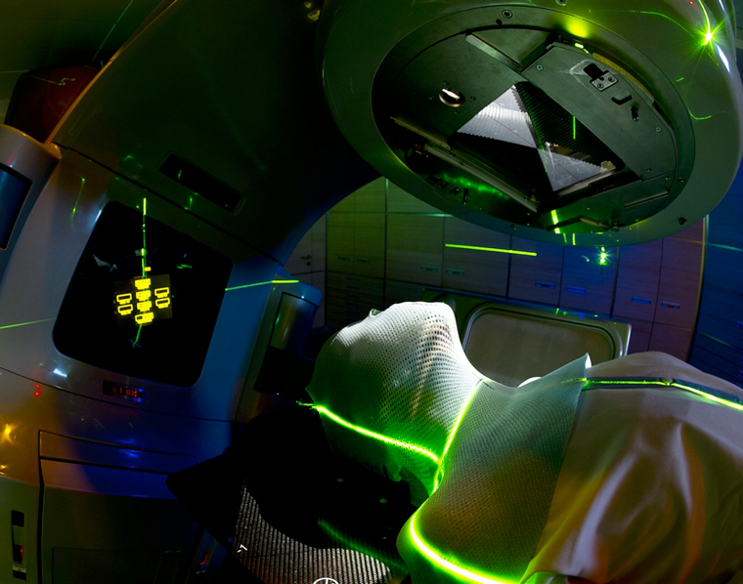
Accelerators for health
From fundamental research…
……to medical applications

Slide 26
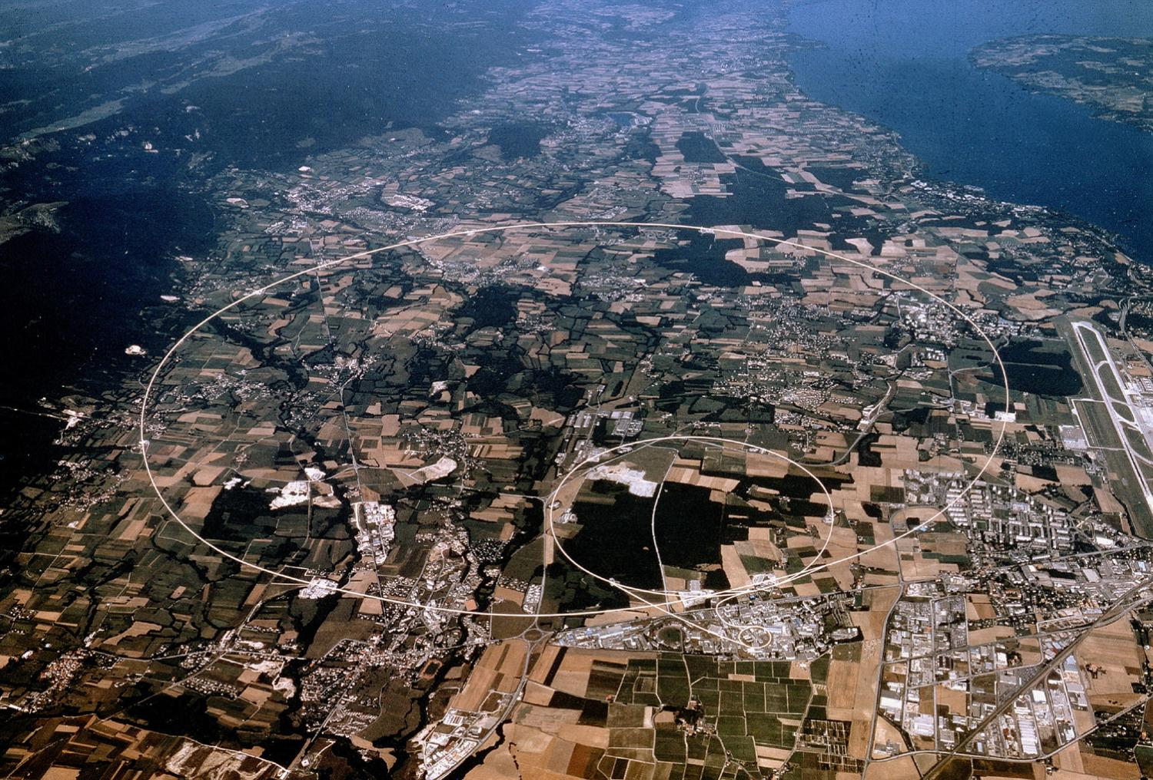
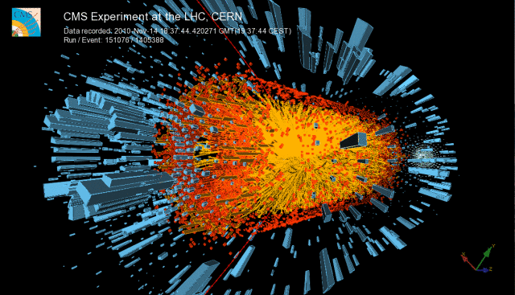
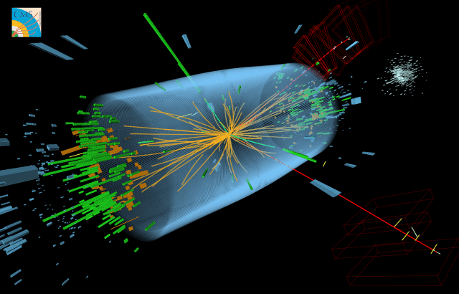
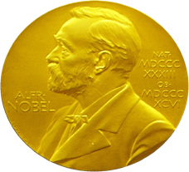
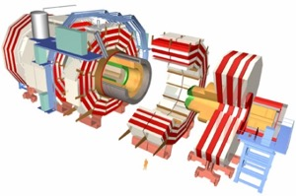



Large 'Hadron Collider'
Collider of 'Large Hadrons'
Design Energy:
14 TeV (pp)
1150 TeV (PbPb)
Lake Geneva
CMS
p + p
Pb + Pb
LHCb
Nobel for physics 2013
ALICE
ATLAS

Slide 27



Applications for society
Even if fundamental research does not aim at developing “useful products” the fact is that many applications for the benefit of the broader society are based on developments for physics fundamental research.
Touchscreen
World Wide Web (WWW)
PET scan
Tim Berners-Lee
The aim and mandate of research institutes is fundamental research and knowledge

Slide 28




Colour radiographies
From the first x-ray radiography to the first colour radiography
Rontgen 1895, to CERN technology 2018
Notes:
28

Slide 29



From tracing particles with silicon pixel detectors to colour radiographies (Medipix)
Colour radiographies
Based on detector technology
Credits: Simon Procz,
University of Freiburg

Slide 30


Modecular imaging
Cardiovascular diseases: cause of 37% of deaths in EU.
Steven Gieseg, Uni. Canterbury
Notes:
30

Slide 31


Proton CT scanner based on ALPIDE ALICE
ALPIDE:
A new Monolithic Active Pixel Sensor

Slide 32


Slide 33



Accelerators for health
Conventional x-ray
Radiotherapy
Particle/Hadron Therapy with protons
Hadron Therapy centers in Europe (2018)

Slide 34





Four carbon-ion cancer therapy centers in Europe
MedAustron, Αustria
CNAO, Ιtaly
Video-visit@CNAO
HIT, Germany
MIT, Germany

Slide 35


Virtual Hadron Therapy Center

Slide 36


Next generation facility for cancer tumour therapy
and research with heavy-ion beams
Δ. Καπρινης
Proposal for a facility in South East Europe: SEEIIST

Slide 37



Accelerator and Beam Delivery
600 tons
40 tons
Gantry at HIT
Gantry at SEEIIST
SEEIIST
facility

Slide 38


Particle Therapy MasterClass
https://indico.cern.ch/event/840212/
Material in different languages
Animations

Slide 39

Heavy-ion research and heavy-ion therapy
Pb-Pb at 5.5 TeV
pp at 14 TeV
88-430 MeV/u carbon
50-221 MeV/u protons

Slide 40

https://videos.cern.ch/record/2002120

