Slide 1
Benha University (CERN training).
Rawda Zayed
Mohamed Nasser
Mohamed Fawzi
Mohamed Sobhy
Mohamed wahba

Slide 2
MatLab and Matrab

Slide 3
photons

Slide 4
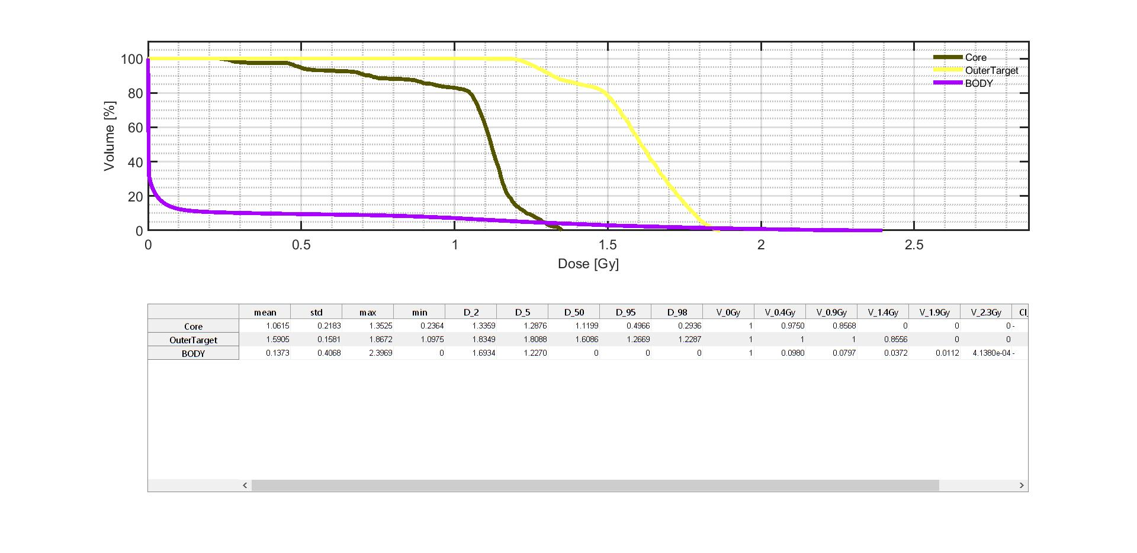

Slide 6
protons

Slide 7
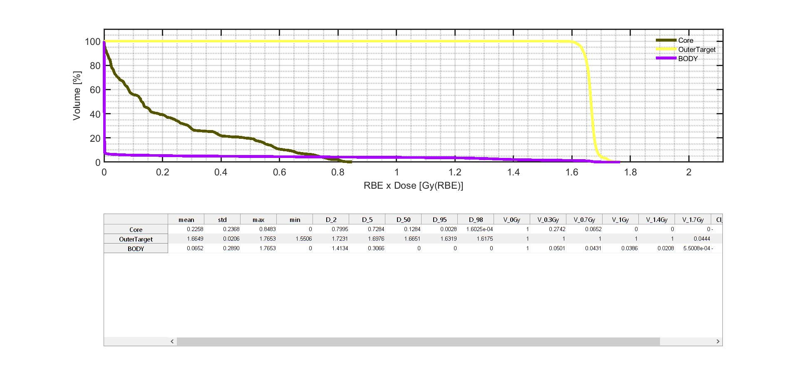

Slide 8
carbon

Slide 9
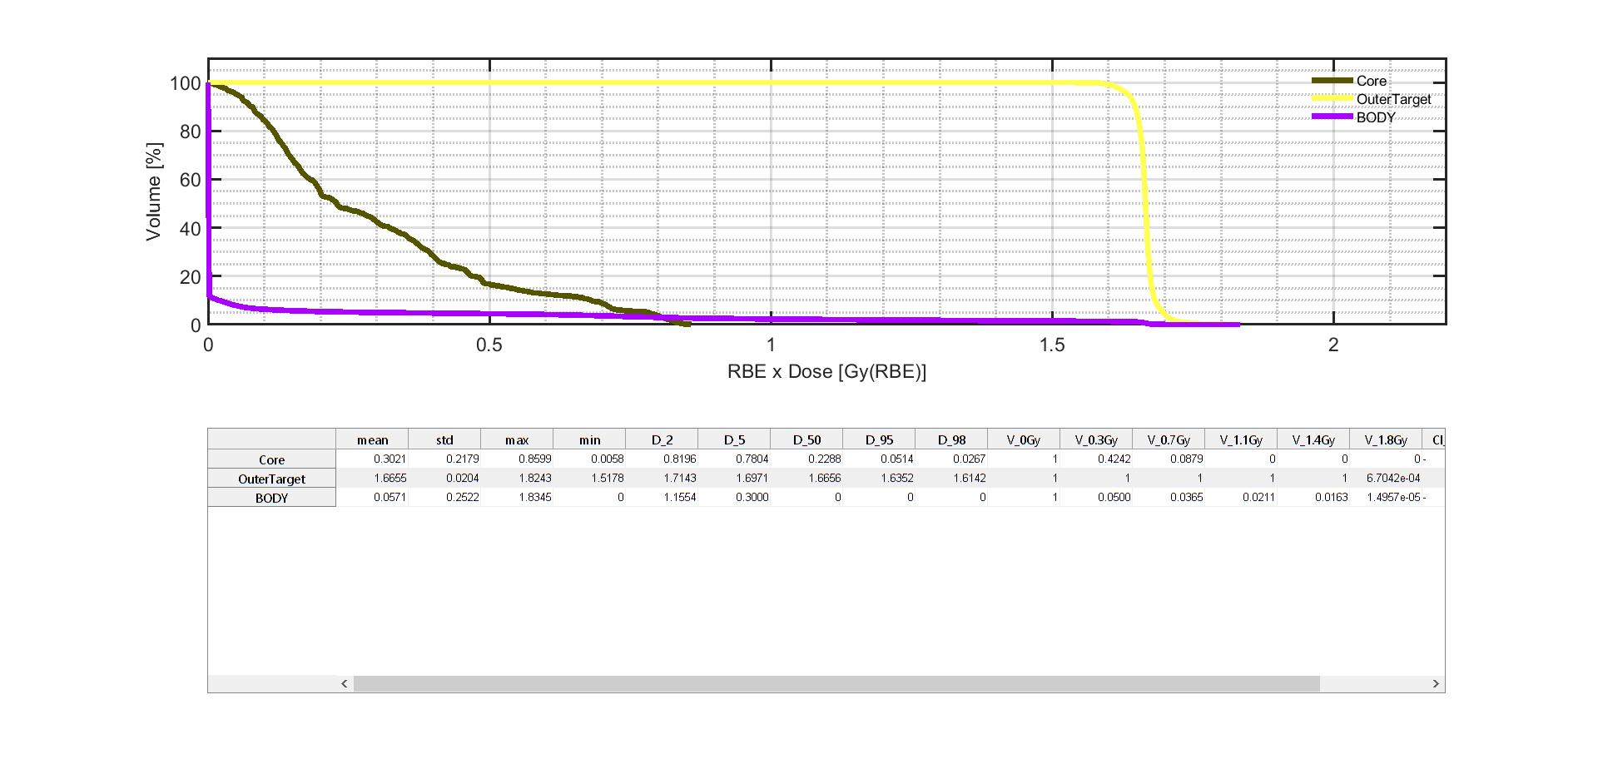

Slide 10
Thank you

