Slide 1


Ahmed lofty Ibrahim
Kholod moawad abo-hegazy
Sarah ali el-kady

Slide 2
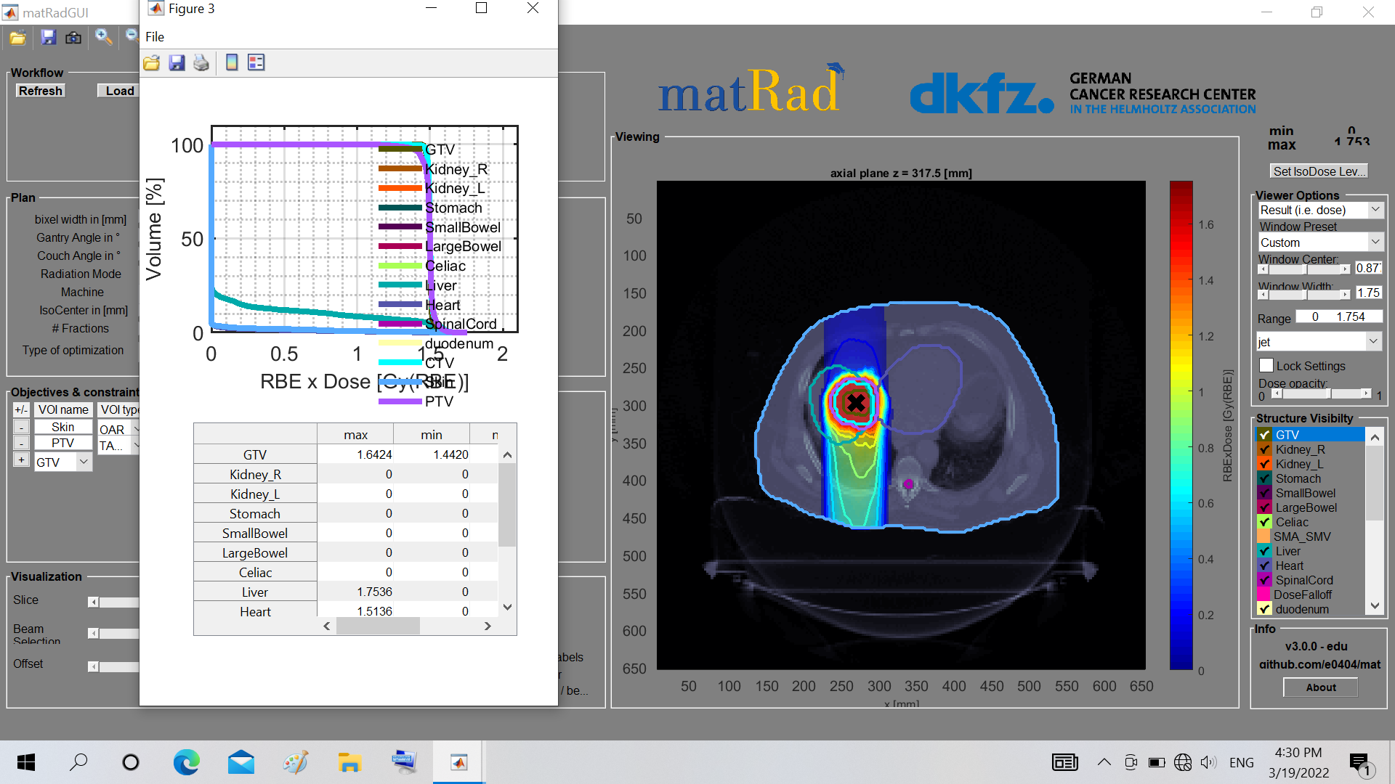
Carbon with 180

Slide 3
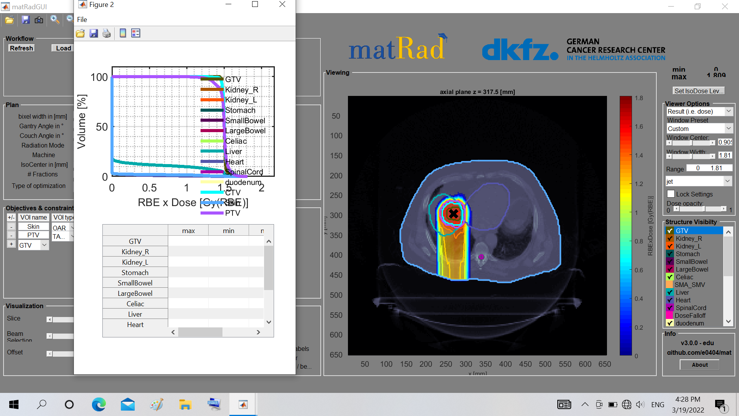
Proton with 180

Slide 4
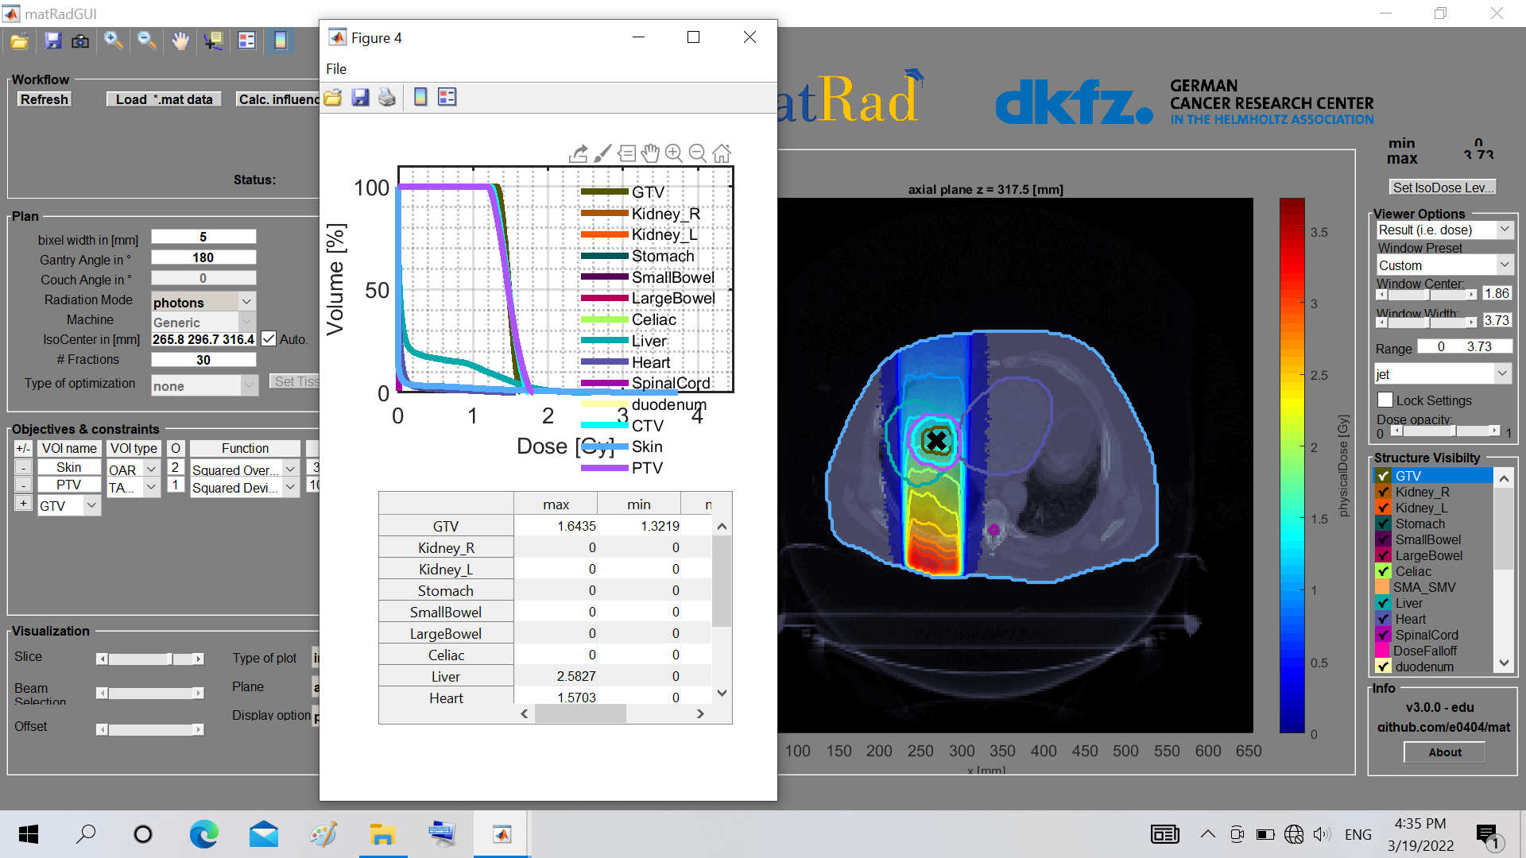
Photon with 180

