Slide 1
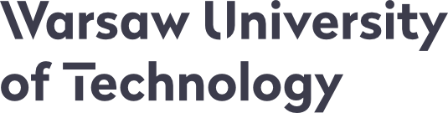

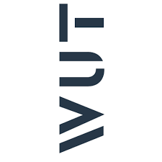
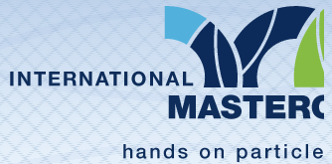
Particle therapy masterclass
Therapy planing
Warsaw university of technology
Students from warsaw

Slide 2
Table of content
ABSTRACT
C PHANTOM
LIVER
COMPARISON FOR PHOTON AND PROTON THERAPY FOR LIVER
COMPARISON FOR PROTON AND CARBON ION THERAPY FOR LIVER
HEAD AND NECK – ERROR IN PATIENT‘S POSITIONING
CONCLUSION

Slide 3
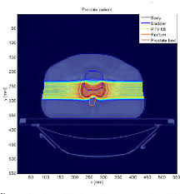
abstract
Firstly we used a phantom to understand how ionizing radiation is absorbed in the body. We compared what happens when you use one beam or a few photon beams, a proton beam or carbon ions.
Then we created various radiotherapy plans for liver patient. We used protons, carbon ions and multiple photon beams.
Our analisis was based on dose distriution in patient‘s body, dose volume histograms and dose statistics.
We also simulated error in patient‘s positioning, changing the isocenter position.

Slide 4
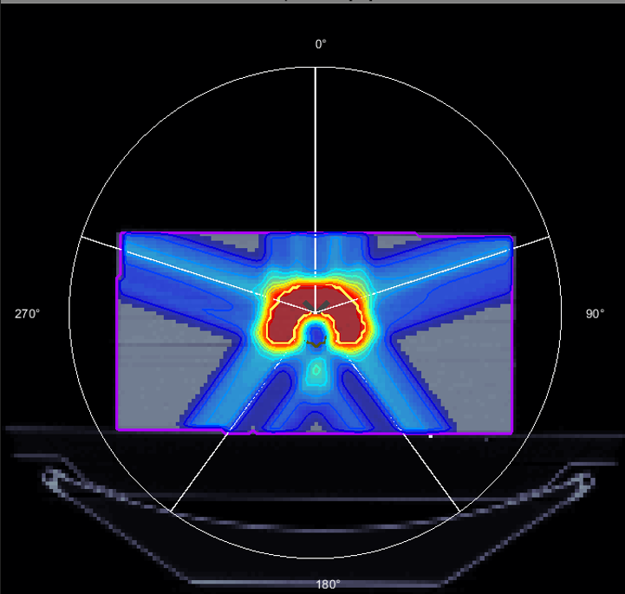
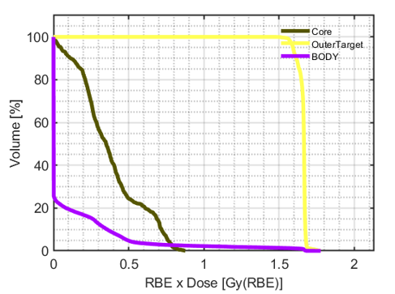
C phantom
Here we compared the use of photons and protons in our phantom.
Conclusions:
Multiple photon fields create better dose distribution than single photon beam.
Protons enable us to spare healthy tisses better than photons.
Photons
gantry angles: 0 72 144 216 288

Slide 5
LIVER
Regions of interest
heart | OAR
spinal cord | OAR
liver | OAR
small bowell | OAR
large bowell | OAR
PTV | PTV
We selected just a few necessary organs at risk to make our images more clear and simple

Slide 6
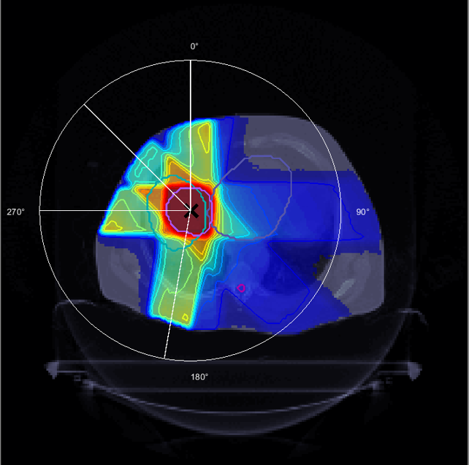
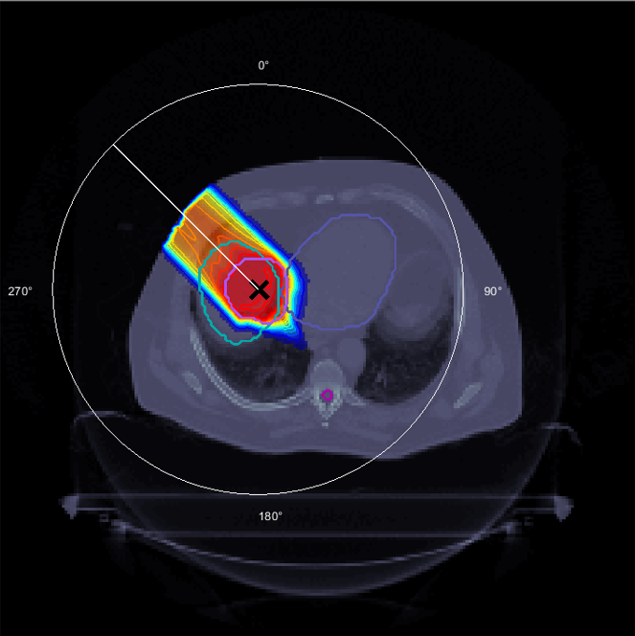
Comparison for photon and proton therapy for LIVER
Photon therapy
Proton therapy
Even if we can have a good dose distribution in PTV region, there are many low dose regions in i=the whole patient‘s body.
Thanks to Bragg‘s peak, the healthy tissues under the tumor are completely spared.

Slide 7
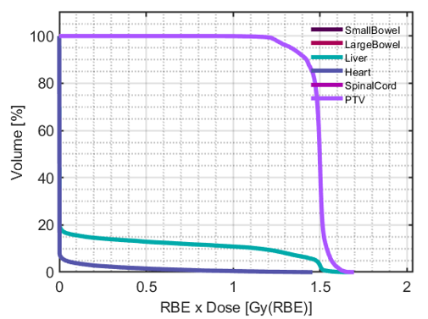
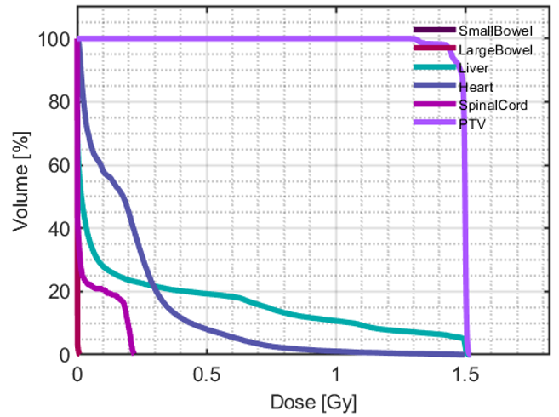
Comparison for photon and proton therapy for LIVER
Photon therapy
Proton therapy
DVH for photons looks better than for proton therapy. Unfortunately organs at risk receive lots of lower doses.
Organs at risk are much better spared than when we use multiple photon fields.

Slide 8
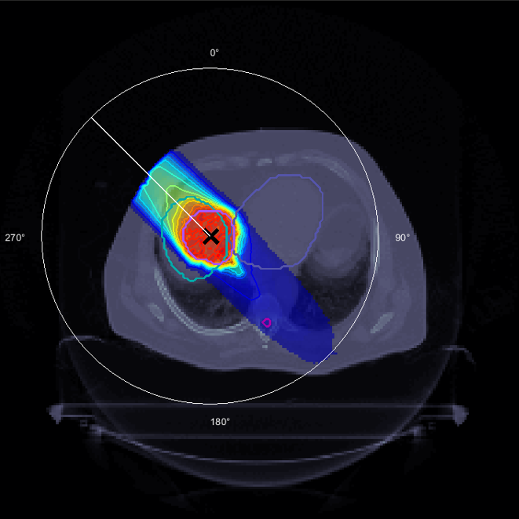
Comparison for proton and carbon ion therapy for LIVER
Proton therapy
Carbon ion therapy
Healthy tissues and organs at risk under the PTV are really well or completely spared.
Doses under patient‘s skin above PTV are lower than when we use protons.
Bad thing is that under the tumor there are lots of low doses in healthy tissues.

Slide 9
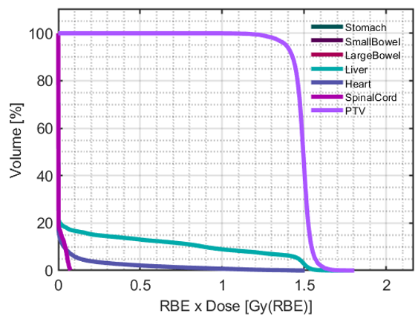
Comparison for proton and carbon ion therapy for LIVER
Proton therapy
carbon ion therapy
There is no dose absorbed in spinal cord – it‘s fully spared thanks to the fact than under the PTV there is no dose (Bragg peak)
DVH looks similar to the one on the left. Unfortunately spinal cord gets low doses because carbon‘s Bragg peak is more expressed.

Slide 10
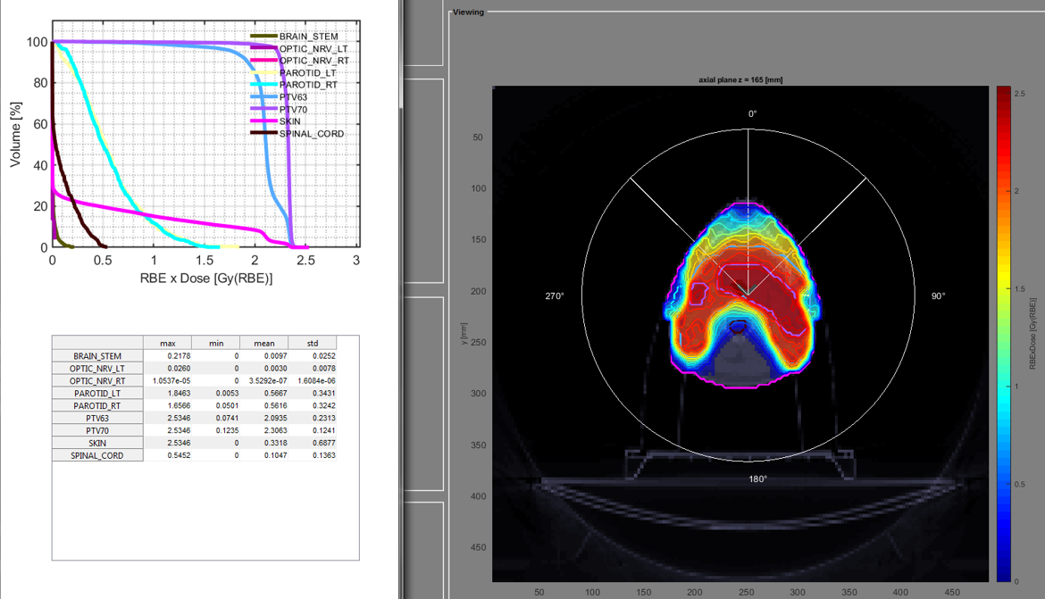
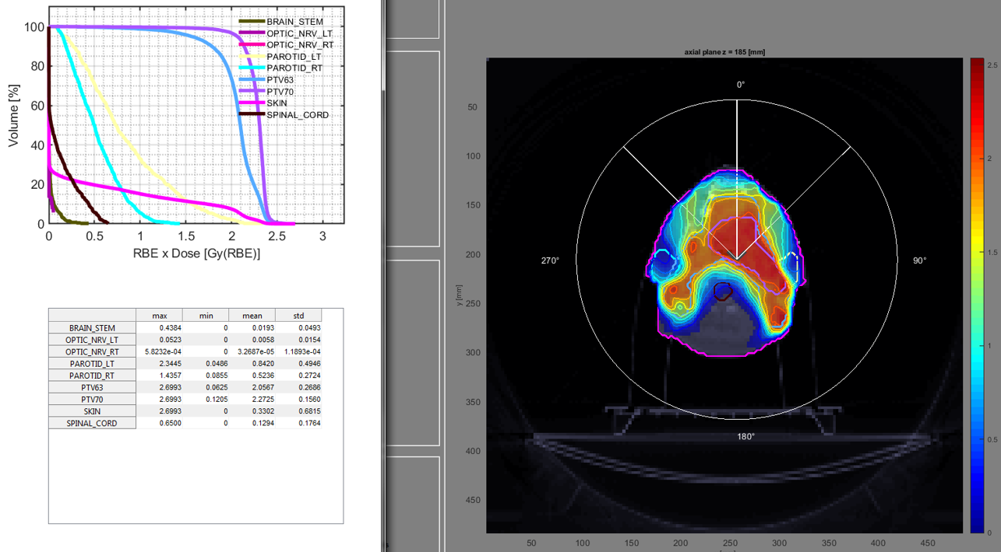
Houston, we have a problem – error in patient‘s positioning
PROPER positioning
An error – isocenter changed
We have the best achievable dose distribution.
Dose distribution worse for PTV, higher mean doses in organs at risk.
We cannot achieve the goal of the therapy.

Slide 11
conclusion
When we use a few photon fields we get better dose distribution than when using a single beam.
Proton and carbon therapy thanks to the Bragg peak can spare organs at risk and other healthy tissues while still creating a good dose distribution in PTV region.
The difference between carbon and proton is that below PTV there is almost no dose when we use protons. When we use carbon, there are some elow dose regions under PTV. But when using carbon we have lower doses under patient‘s skin than when using proton therapy.

Slide 12
Thank you for your attention

