Slide 1
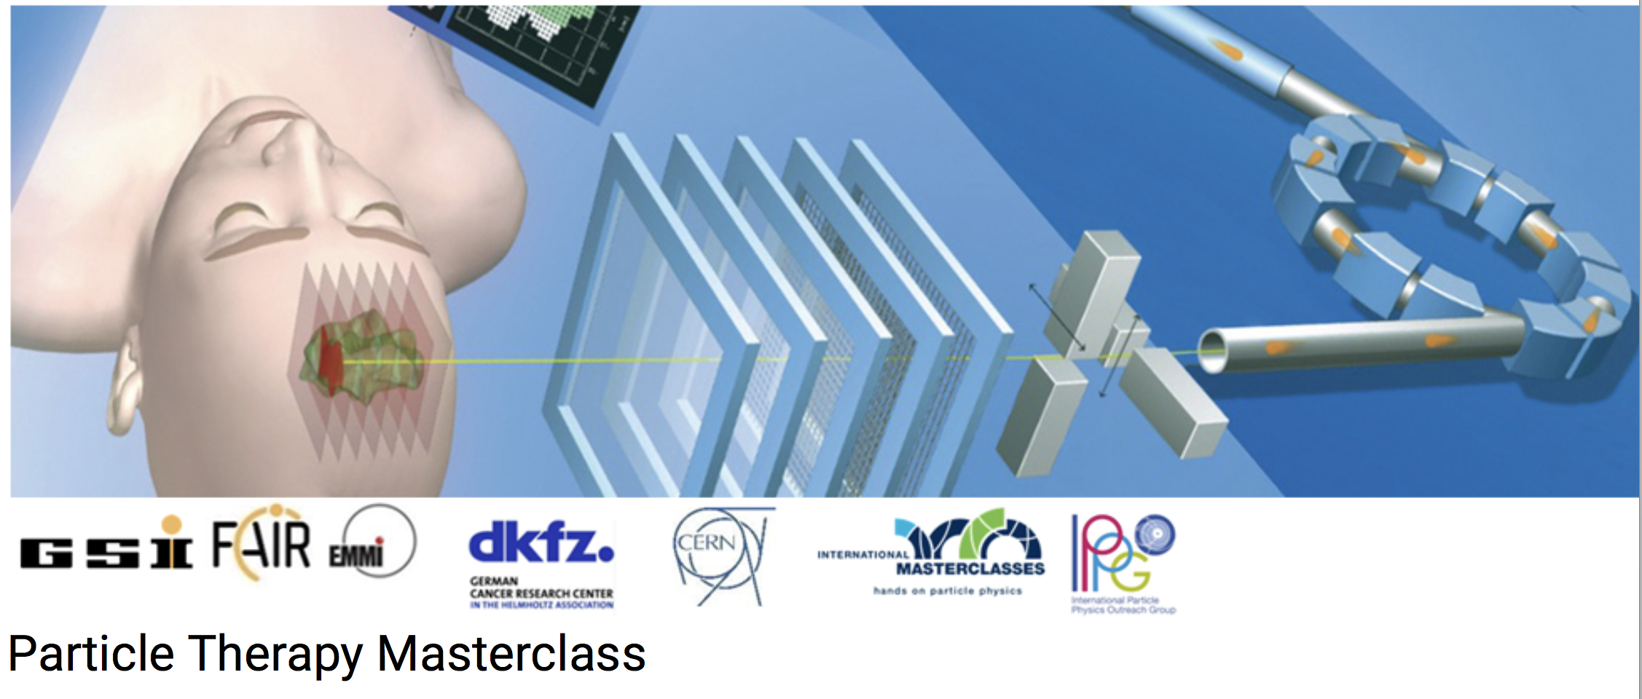
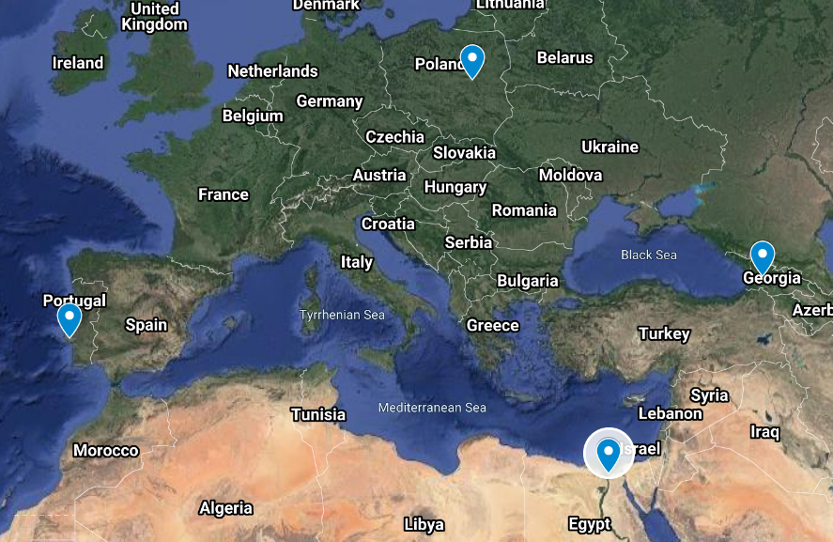
PTMC Video Conference 19 March 2022

Slide 2
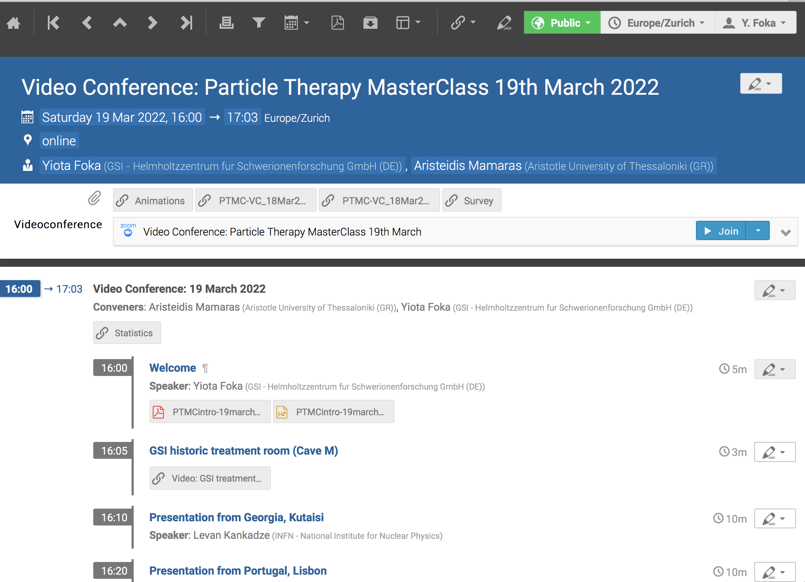
PTMC Video Conference 19 March 2022
https://indico.cern.ch/event/1122934/

Slide 3
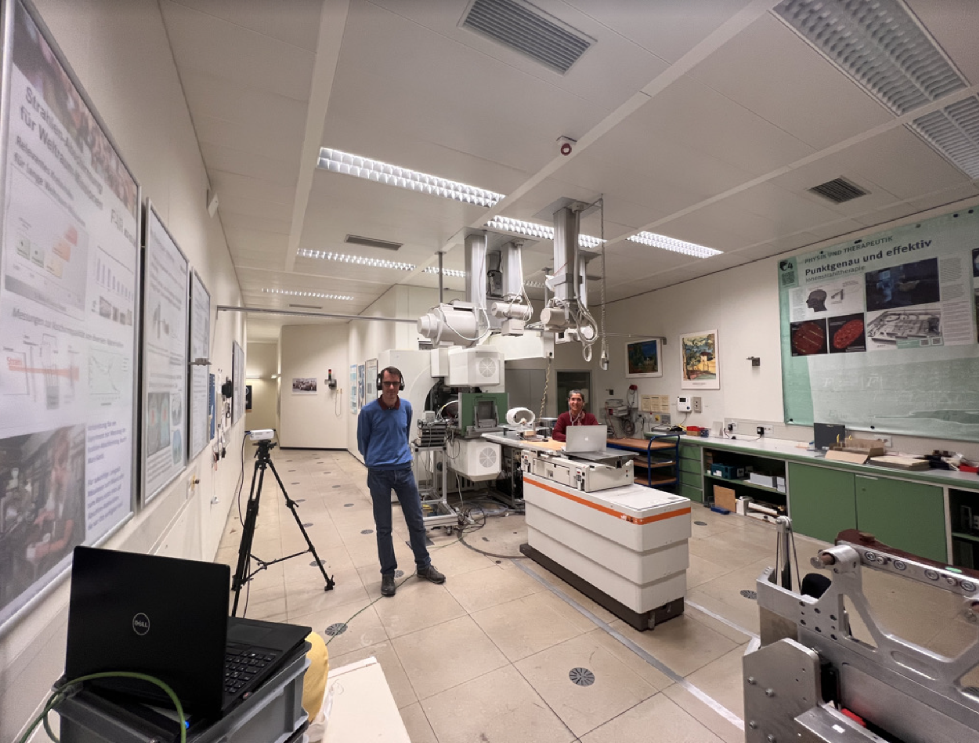
From the historic GSI therapy room Cave M
https://www.dropbox.com/scl/fo/y32povwa5jdj7gwrdmmu2/h?dl=0&preview=05-20210609_virtual-visit_therapie_en.mp4&rlkey=cqplic473dlrjy1dyi95mfoje

Slide 4
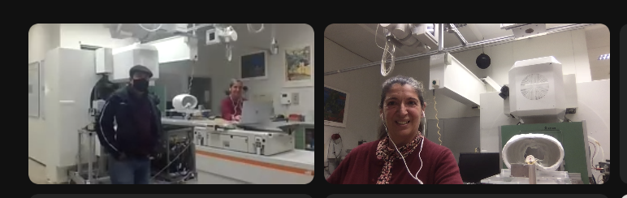
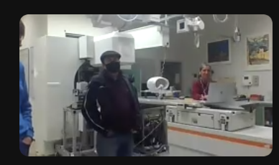
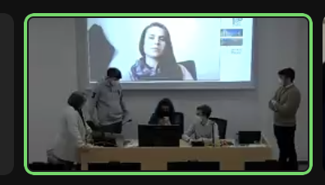

Slide 5

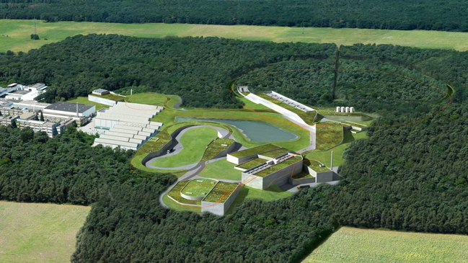
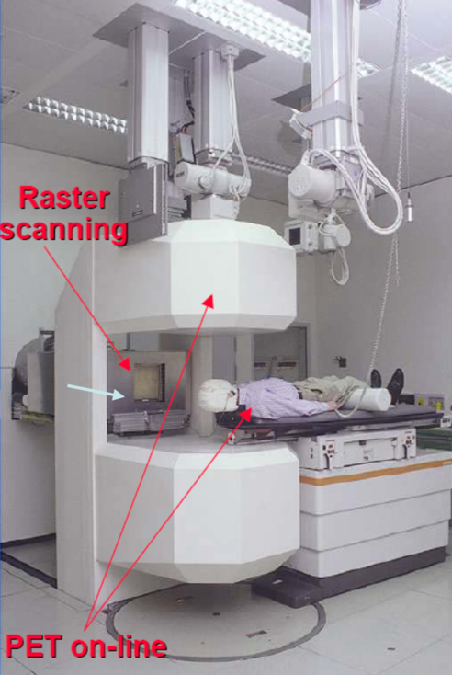

Heavy-ion research and heavy-ion therapy at GSI
Pioneered heavy-ion (carbon) therapy for cancer tumours in Europe (90s).

Slide 6
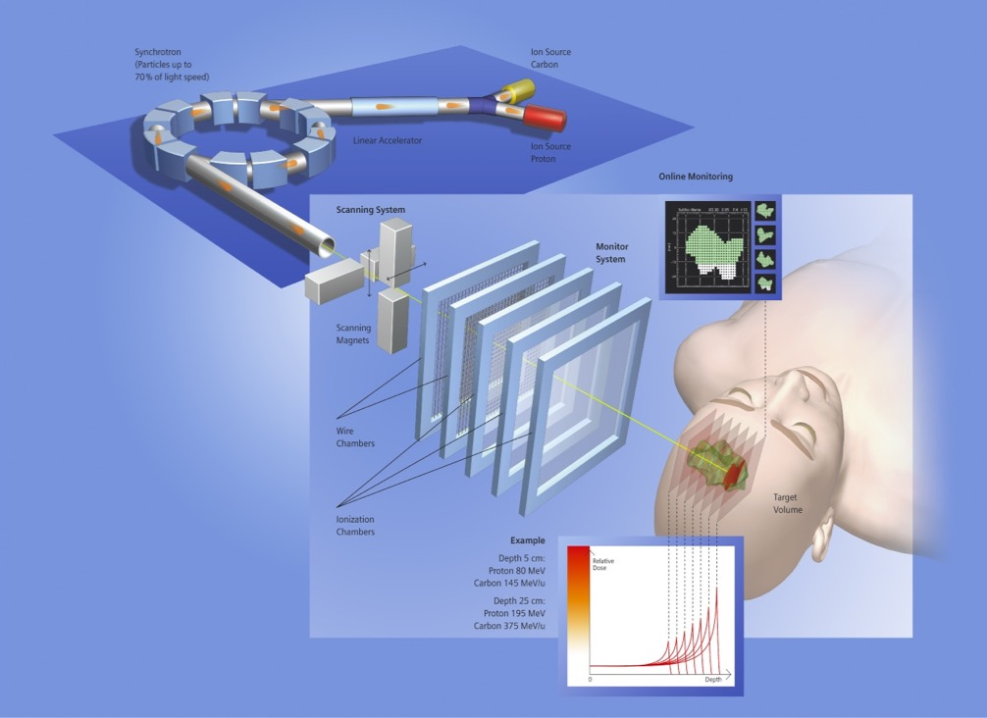
Heavy-ion research and heavy-ion therapy at GSI
Rasterscan Method
Haberer et al., NIM A , 1993
  Implemented in the Heidelberg and Marburg Ion Treatment centers
  (HIT and MIT) in Germany
Haberer et al., NIM A , 1993
Notes:
6

Slide 7
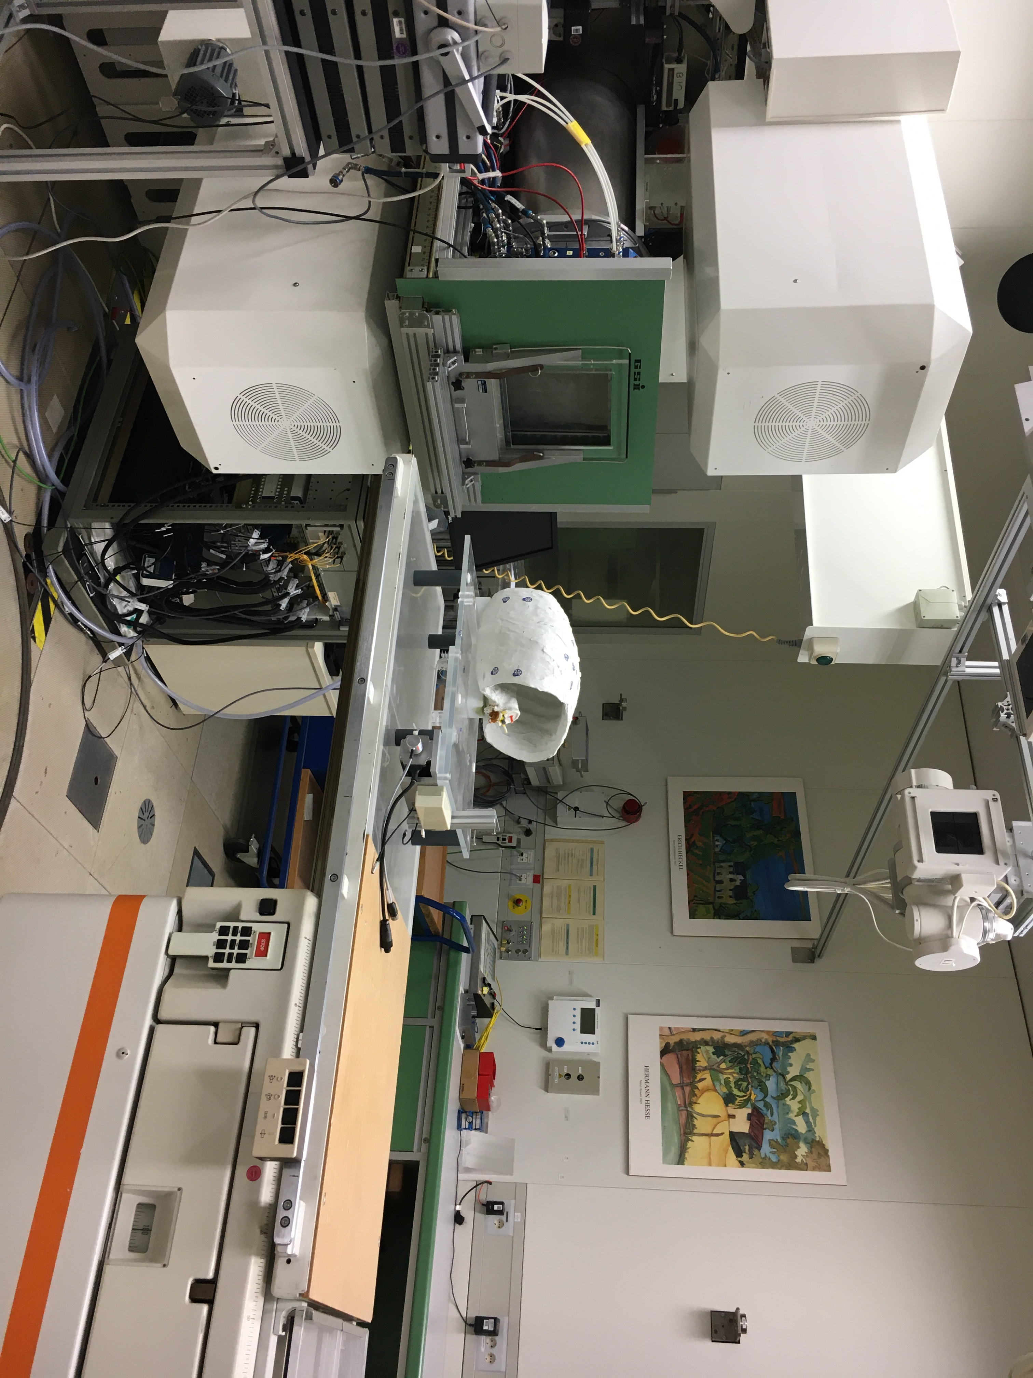
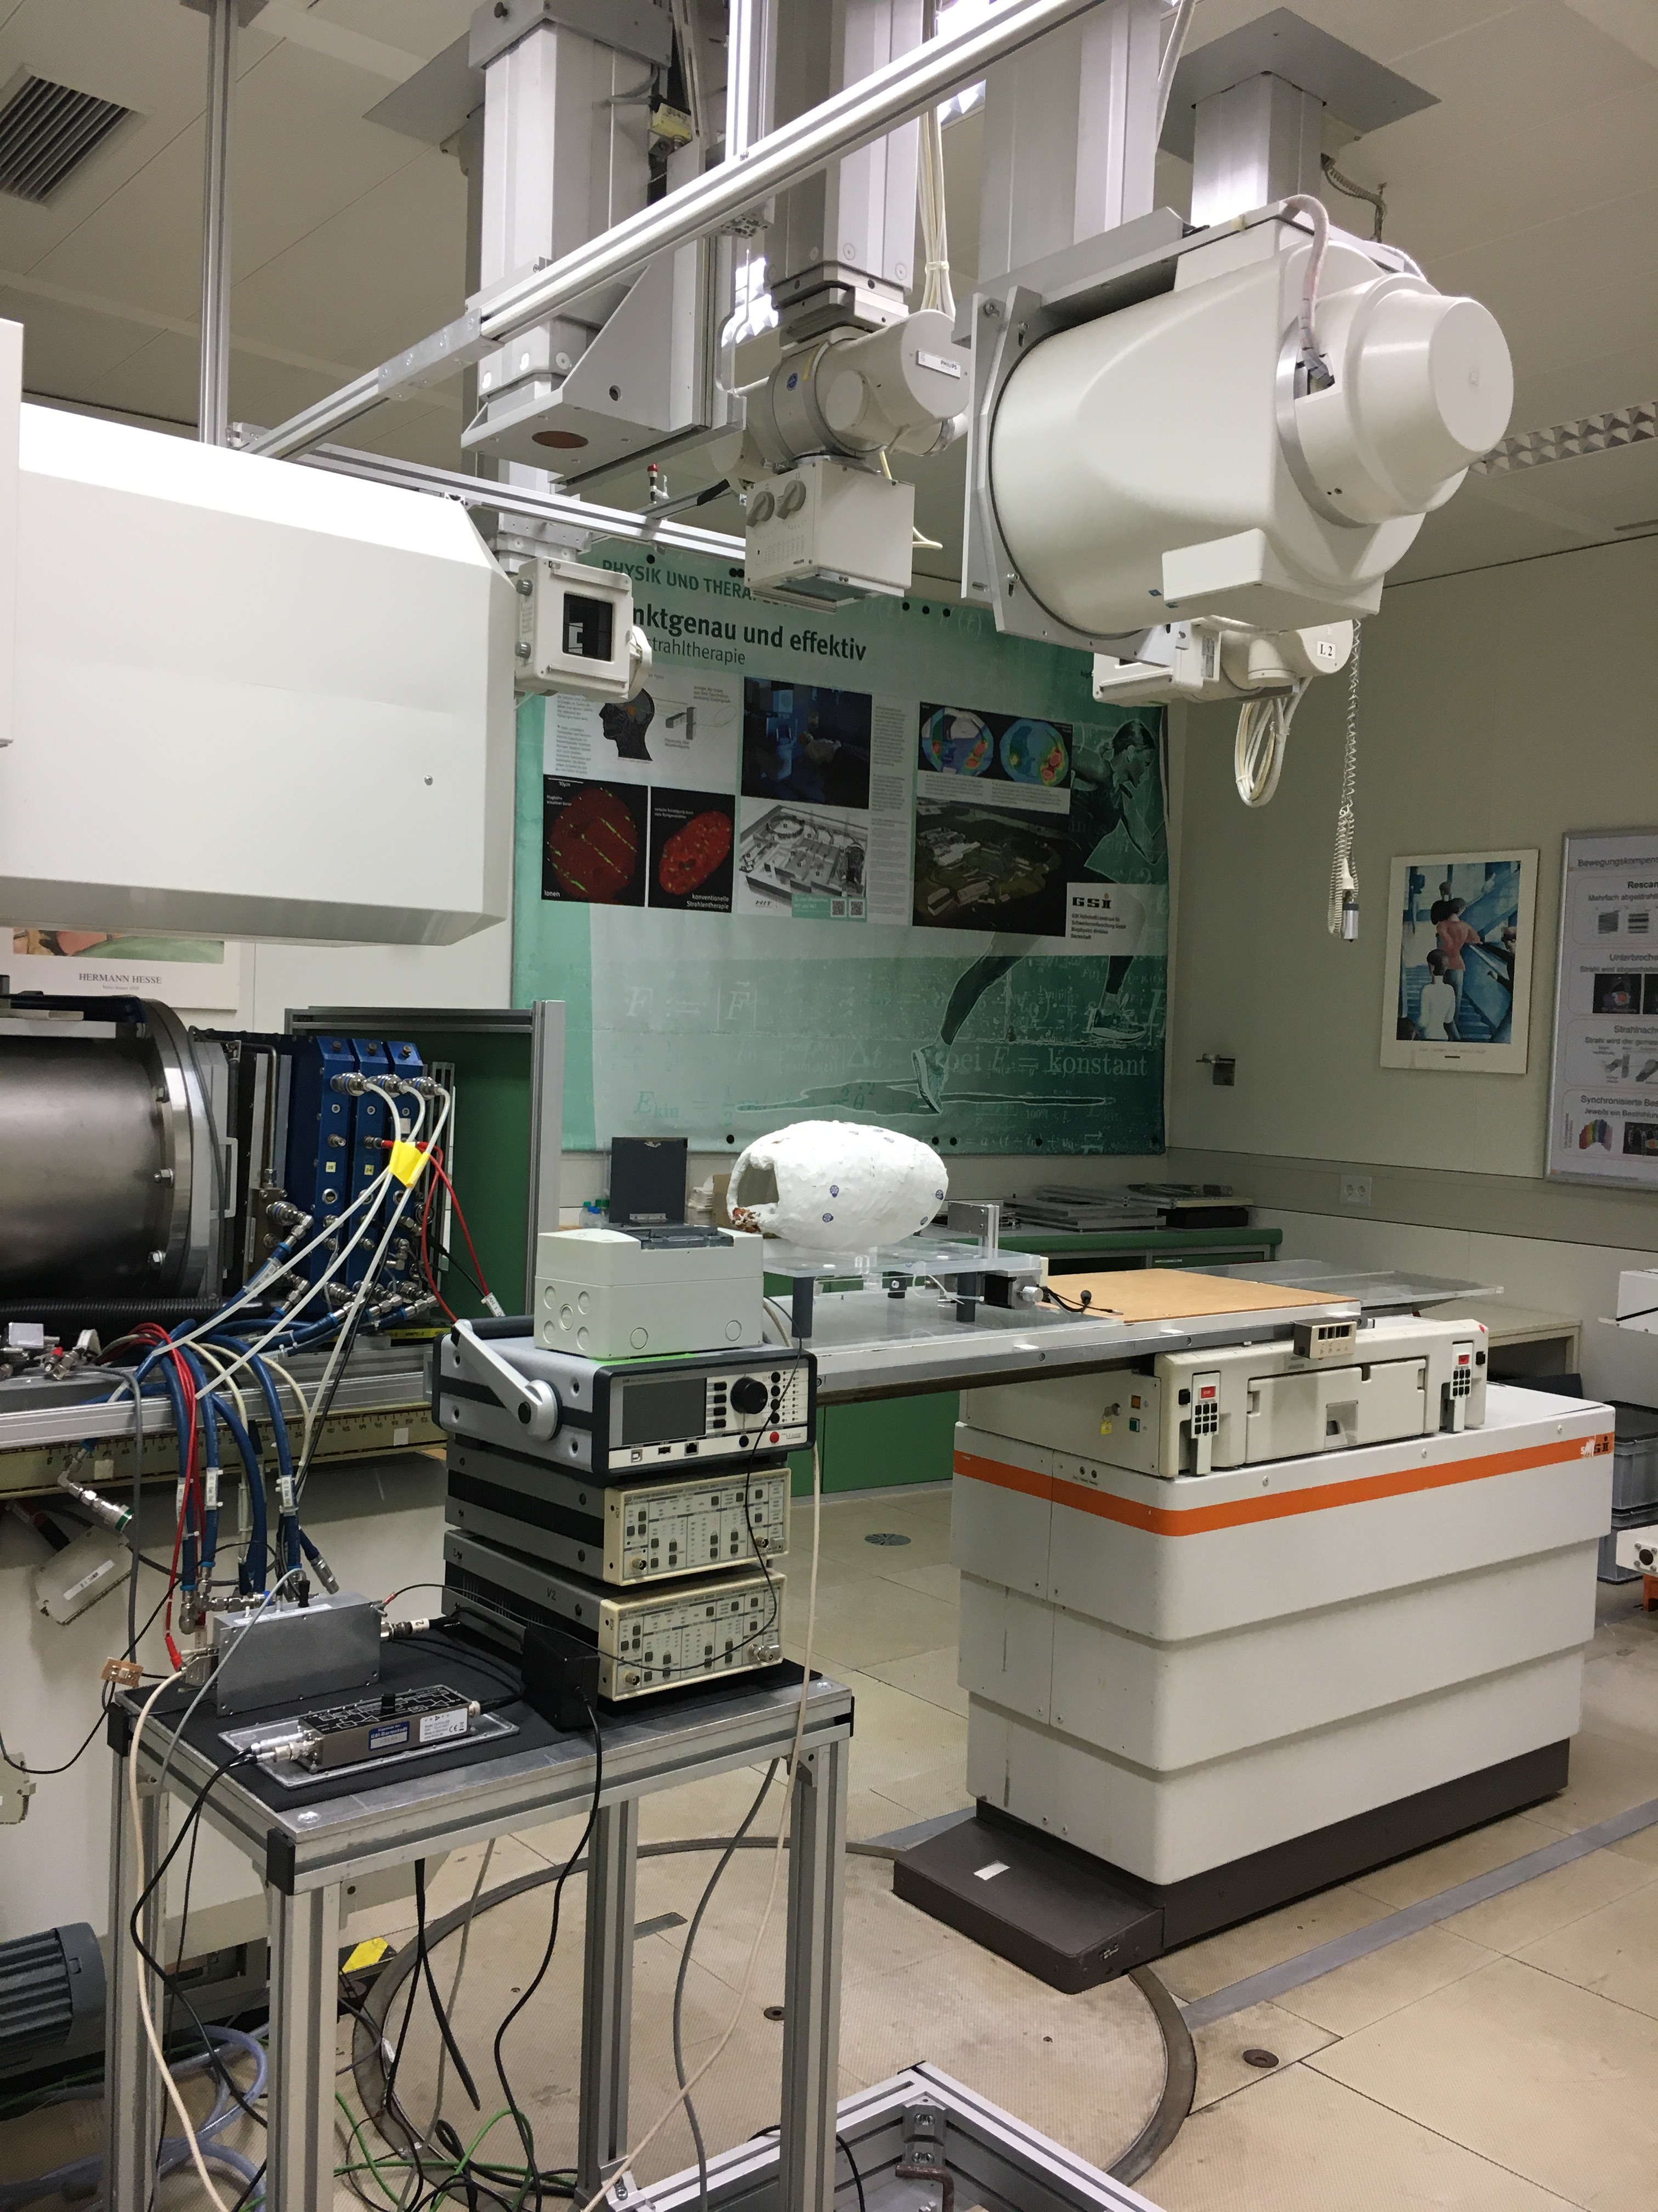
The heavy-ion therapy room at GSI today
Rasterscan Method
Haberer et al., NIM A , 1993
  Implemented in the Heidelberg and Marburg Ion Treatment centers
  (HIT and MIT) in Germany
Haberer et al., NIM A , 1993
Notes:
7

Slide 8
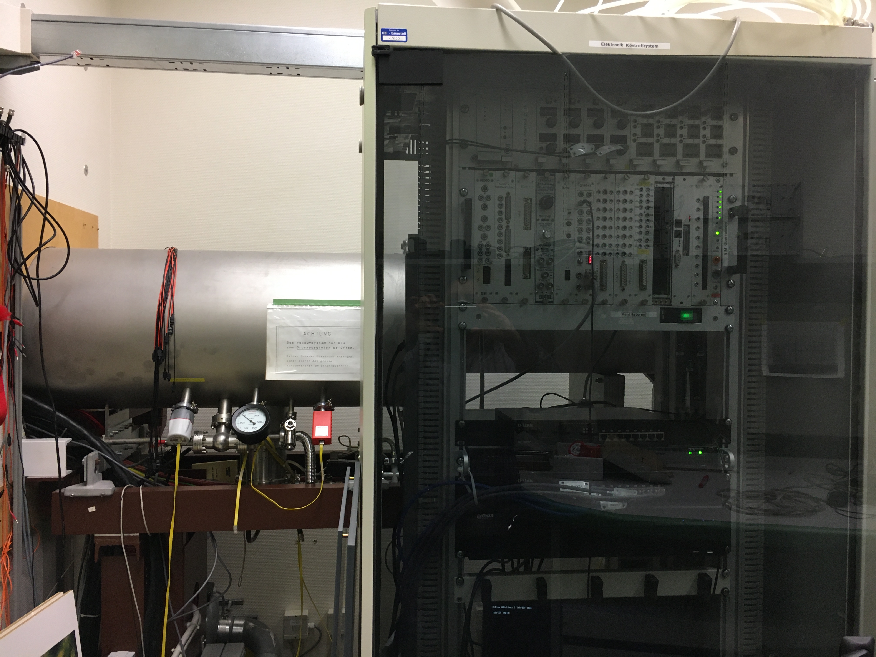
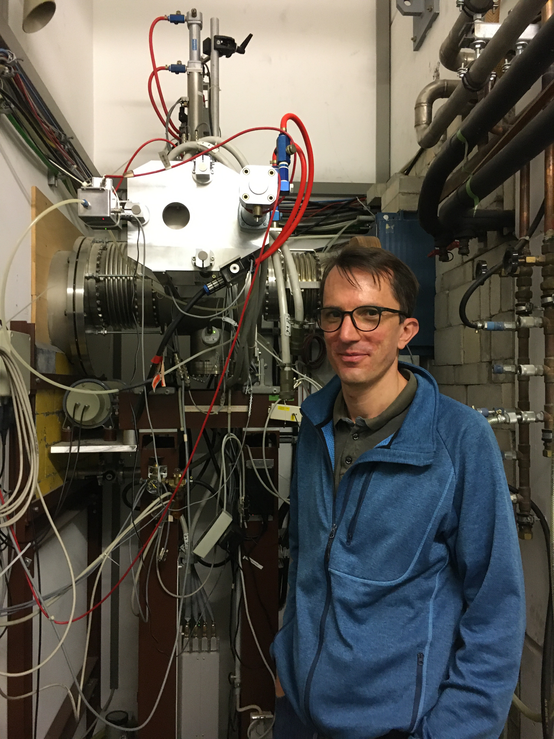
What is behind the wall?

Slide 9
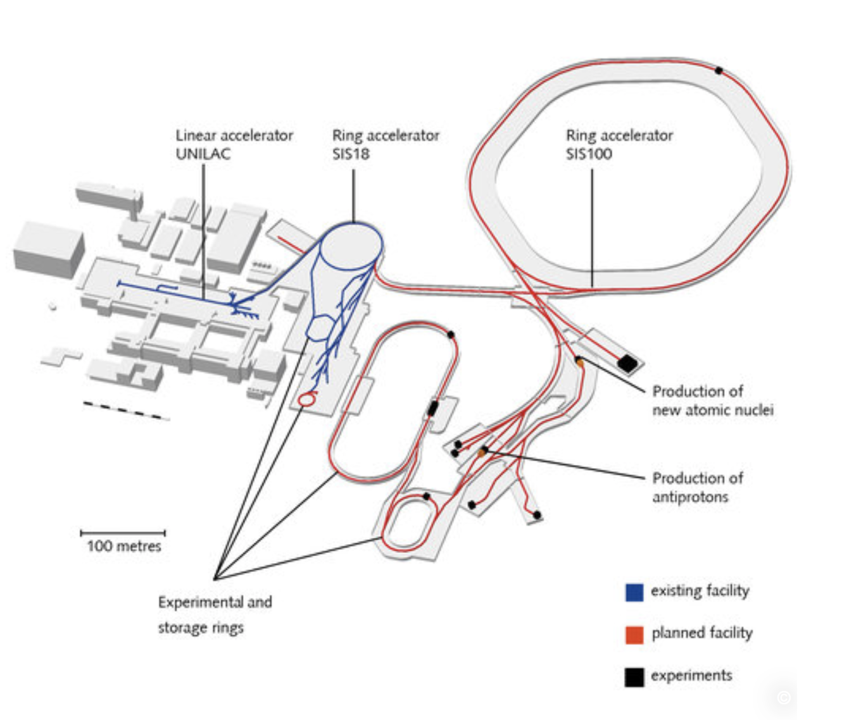
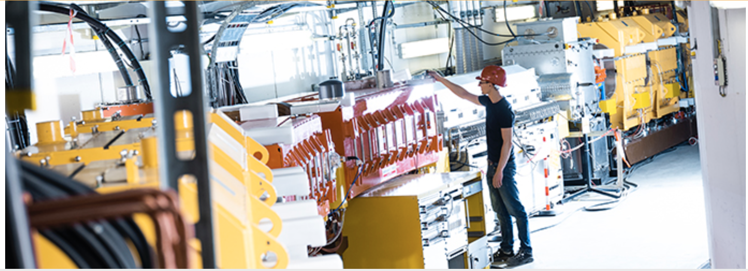
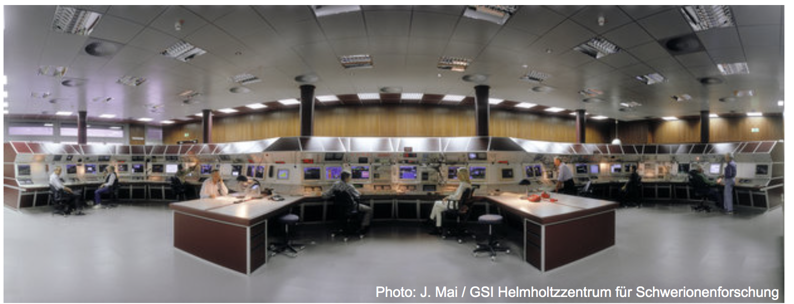
What is behind the wall?

Slide 10

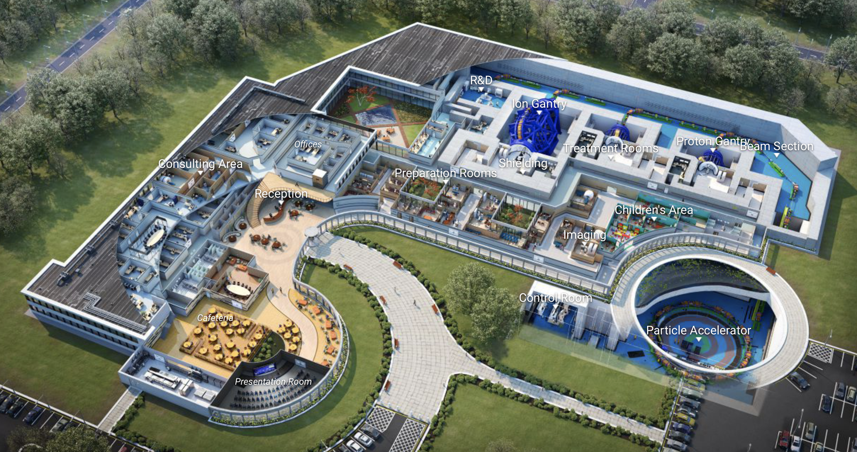
Virtual Hadron Therapy Center

Slide 11
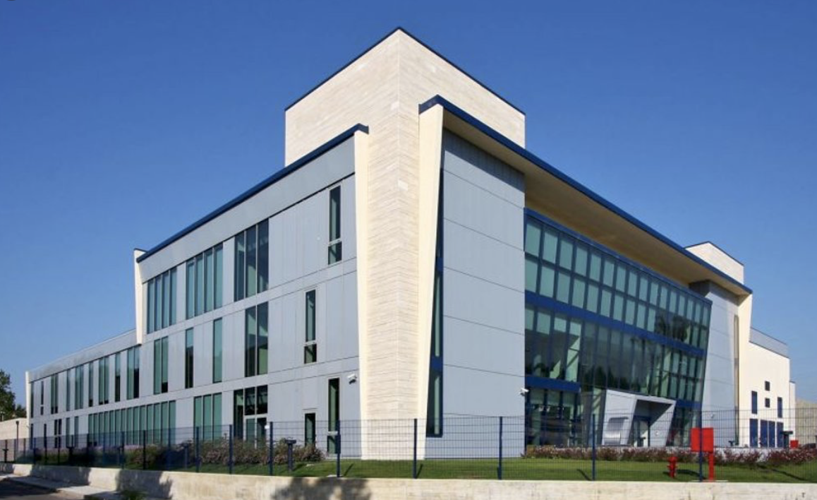
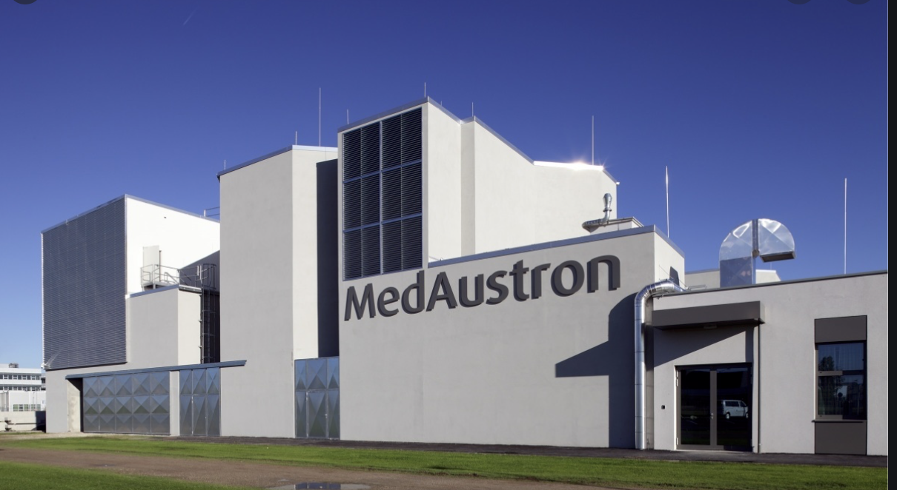
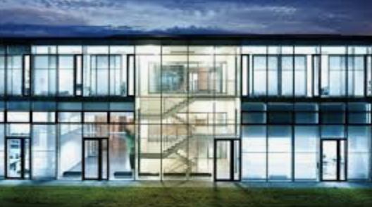
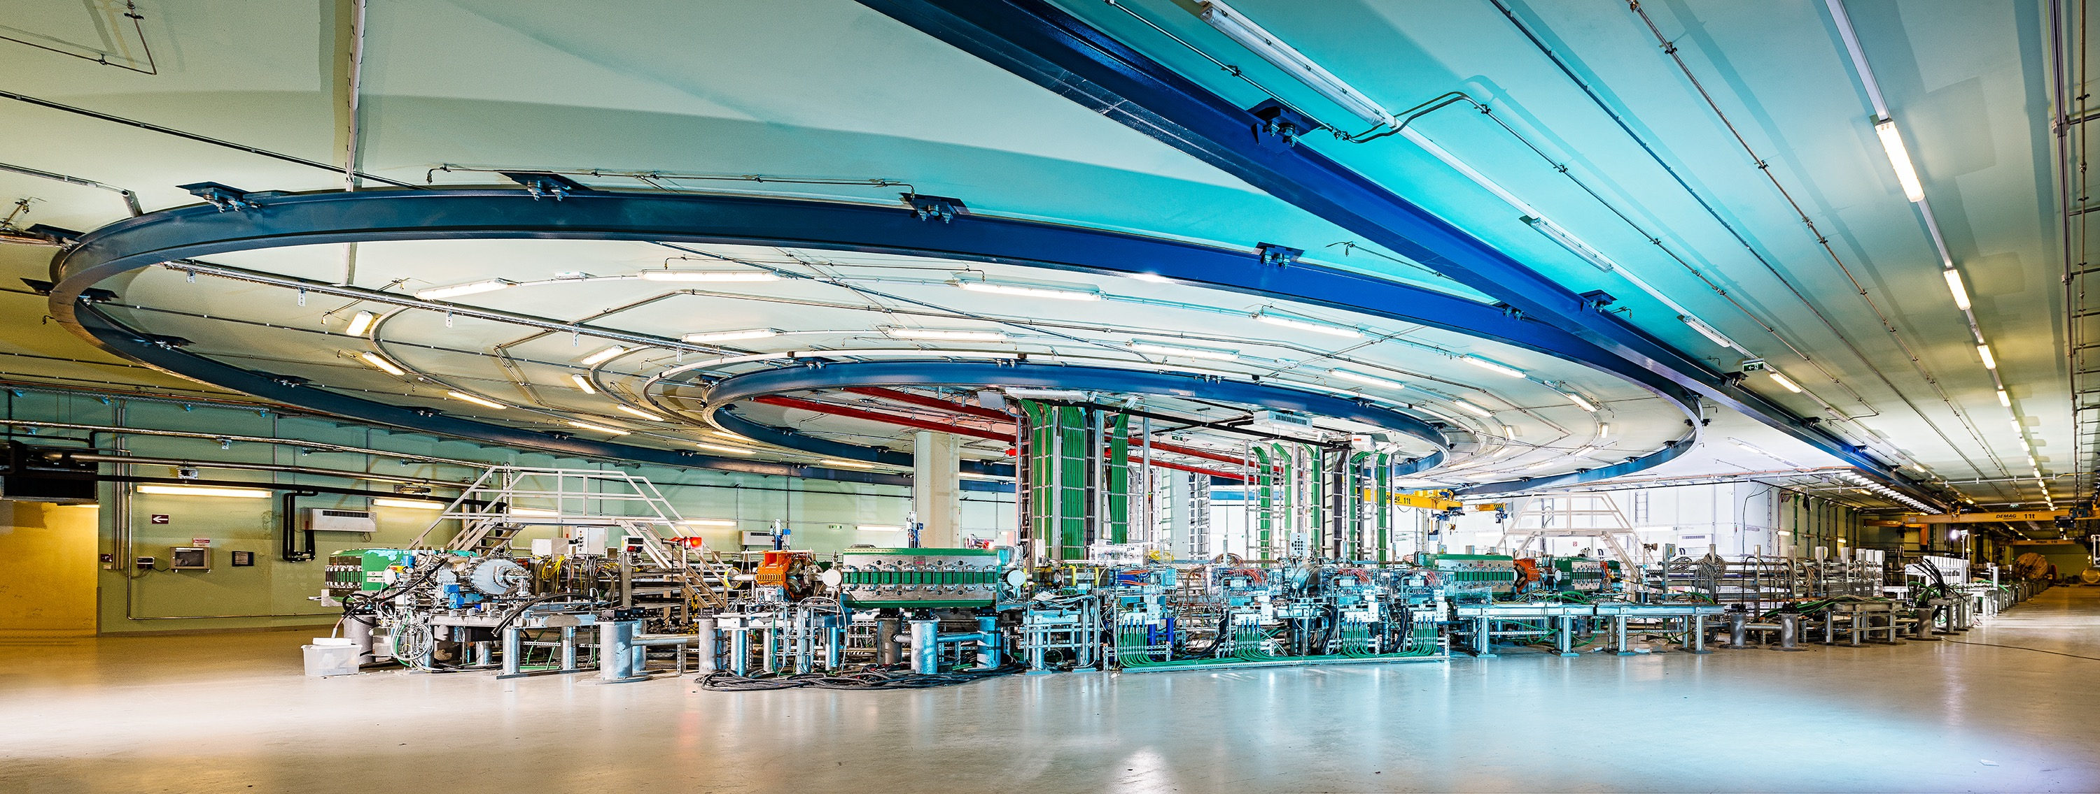
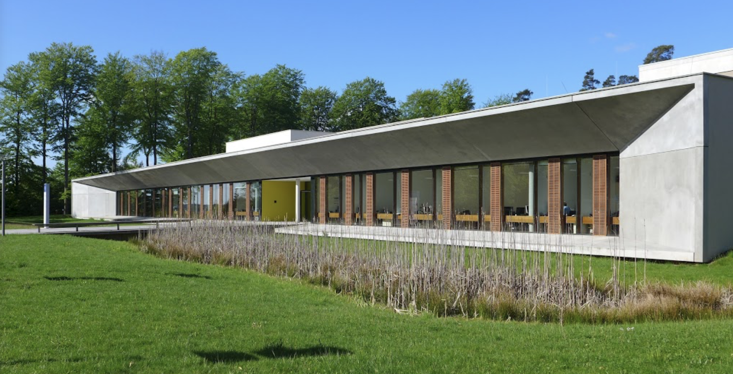
Four carbon-ion cancer therapy centers in Europe
MedAustron, Αustria
CNAO, Ιtaly
HIT, Germany
MIT, Germany

Slide 12
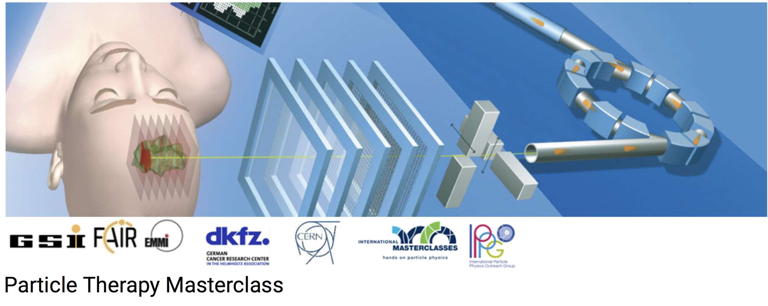
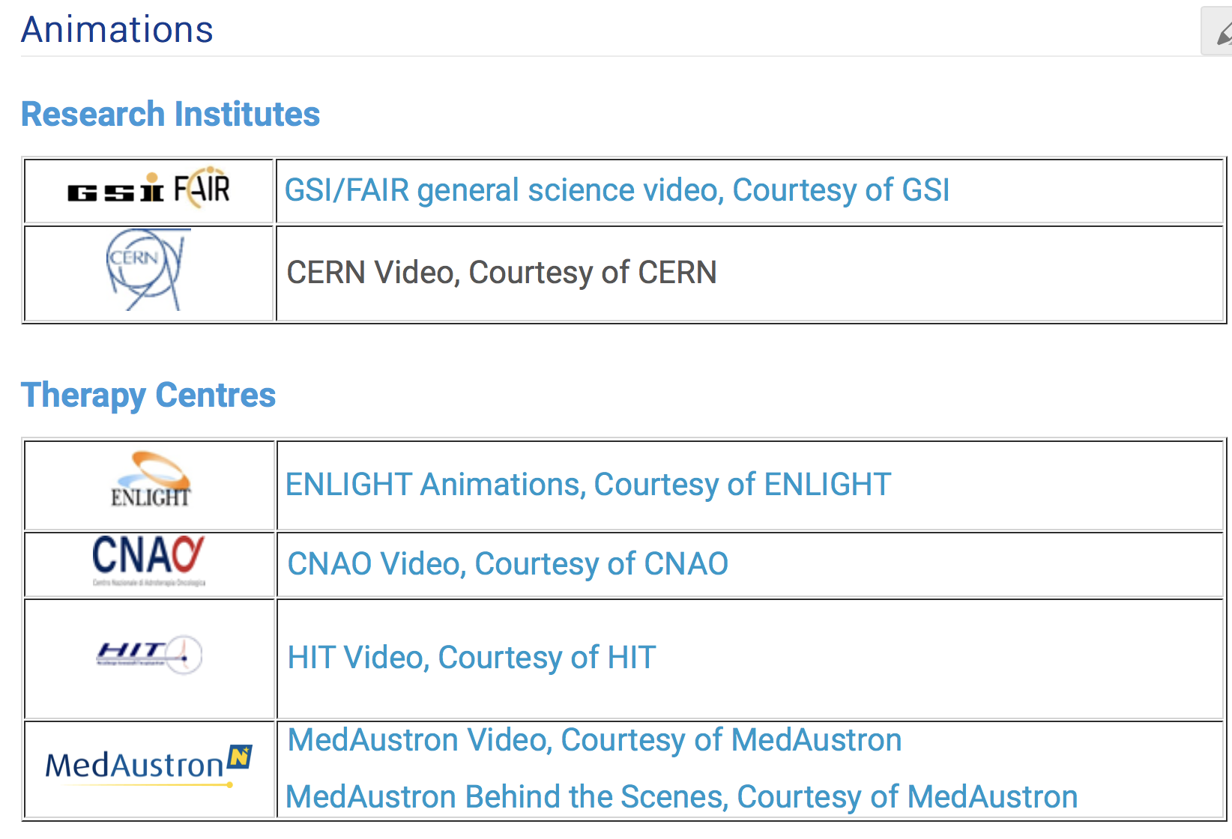
https://indico.cern.ch/event/840212/page/18000-animations

