Slide 1

OUTLOOK AND MEETINGS 2022
HEPTech Board –10 June 2022

Slide 2
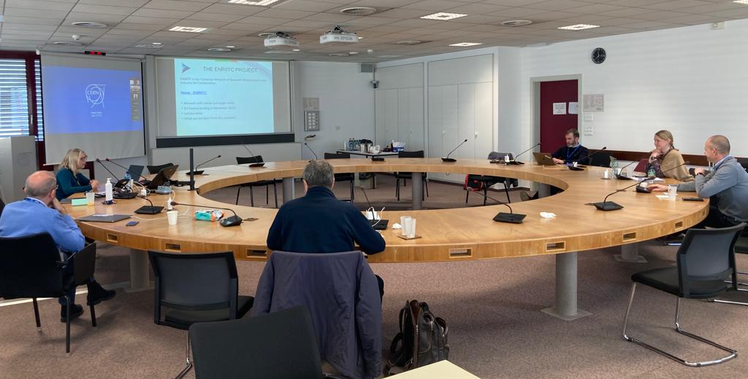
HEPTech activities
05 April: Internal Workshop for discussion on HEPTech’s future, CERN, Geneva.
9-10 June: Best Practice & Board meeting
Location: ELI Beamlines, Prague
TBD: AIME 2022
1-2 December: Best practice & Board meeting
Possible location: CERN, Geneva
HEPTech’s future meeting at CERN, photo V. Venturi

Slide 3

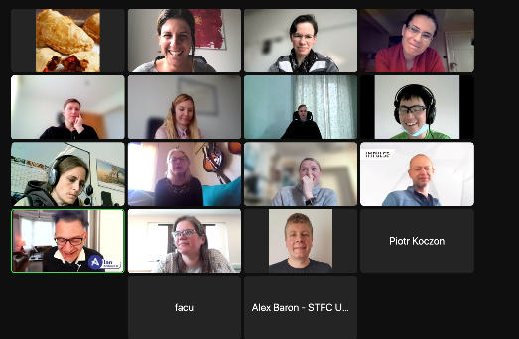
HEPTrepreneurs
HEPTrepreneurs episodes are organized by HEPTech and GSI.
Calendar:
06.04.2022, Episode 6: Presentation on a technical topic
The power of, and how to Network
24.05.2022, Episode 7: Keynote
Entrepreneurship
05.07.2022, Episode 8: Round Table
Entrepreneurs in HEP
13.09.2022, Episode 9: Presentation on a technical topic
How to write a proposal
08.11.2022, Episode 10: Presentation on a technical topic
How to write a business plan

Slide 4
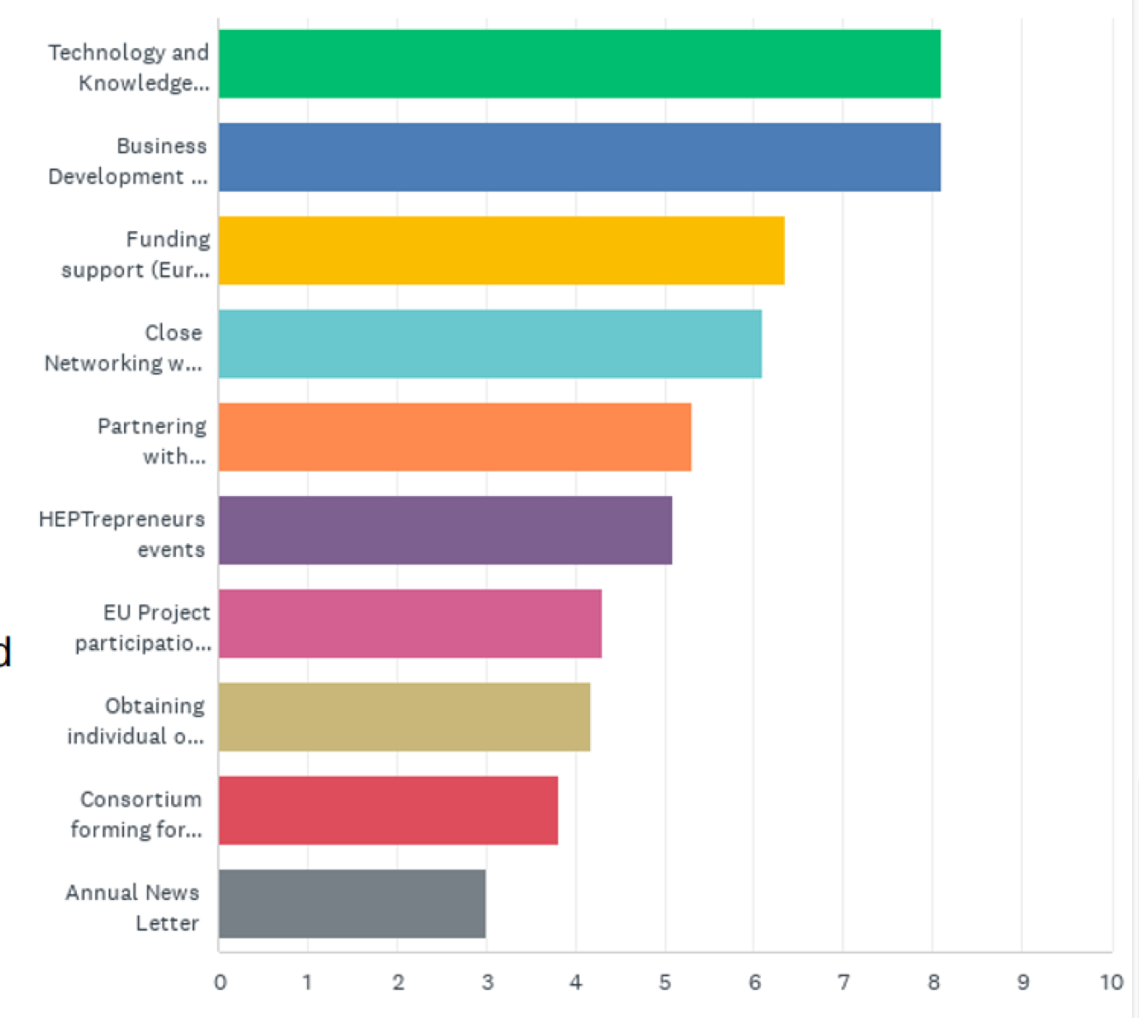
HEPTech’s Future
Review and Discussion of 2019 Mission Statement
Objective, mission statement for the future.
Review current offering and identify gaps
Discuss ENRIITC and joining any future network

Slide 5
Thank you!

