Slide 1
Aperture checks in Point 8
R. De Maria

Slide 2
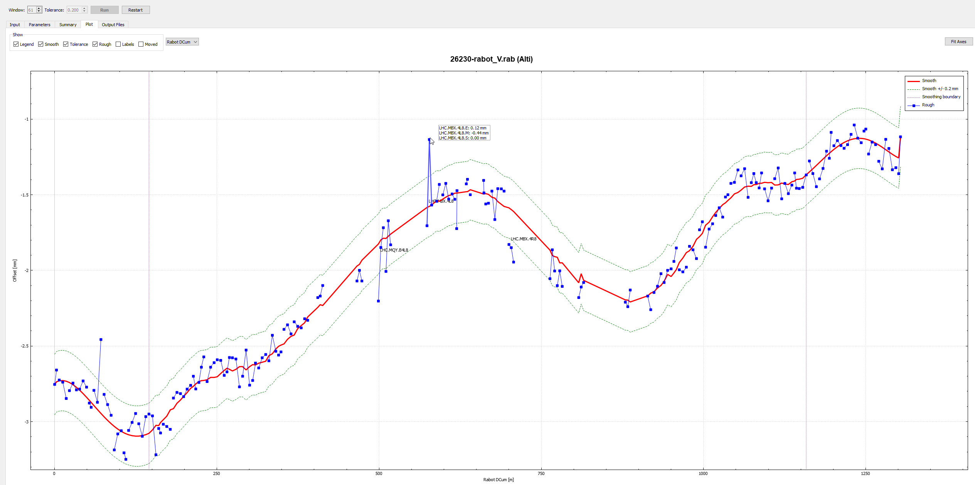
Misalignment report
LHC.MB.C14L8.S -0.49mm : lissage en cours dans le secteur 78
LHC.MQY.B4L8.E 0.38mm : A aligner ?
LHC.MBRC.4L8.E 0.22mm : je préconise de ne pas le toucher
LHC.MBX.4L8.M -0.44mm : Ce point de bouge pas (jack pas au contact, aimant en banane vers le haut)
LHC.MBXWS.1L8.E 0.24m : je préconise de ne pas le toucher
LHC.MBX.4R8.E 0.24mm : A aligner ?
LHC.MBX.4R8.M 0.25mm : A aligner ?
LHC.MBX.4R8.S 0.33mm : A aligner ?

Slide 3
HL-LHC Protected Apertures
Parameters | 7 TeV | 0.45 TeV
Emittance normalized | 2.5µm
Radial CO [mm] | 2
Mom offset | 2 10⁻⁴ | 8.6 10⁻⁴
Dispersion | 0.1 | 0.14
Beam size | 1.1 | 1.05
Min Ap. no TCT [σ] | 19.4* | 12.6
Min H. Ap. with TCT [σ] | table | 12.6
Min V. Ap. with TCT [σ] | 11.2 | 12.6
Δµ_{x} MKD-TCT [°] | H. Ap. W [σ@2.5µm] | H. Ap. CuCD [σ@2.5µm]
0-20 | 11.2 | 11.2
30 | 11.9 | 11.2
40 | 12.9 | 11.9
50 | 13.8 | 12.8
60 | 14.5 | 13.6
70 | 14.6 | 14
80-90 | 14.6 | 14.3
R. Bruce et al. CERN-ACC-2017-0051 and proposal of differentiating H/V collimators (R. Bruce).

Slide 4
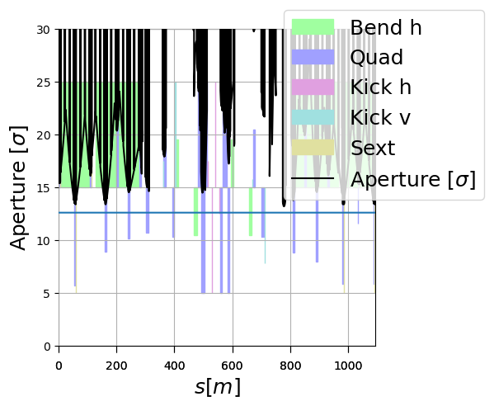
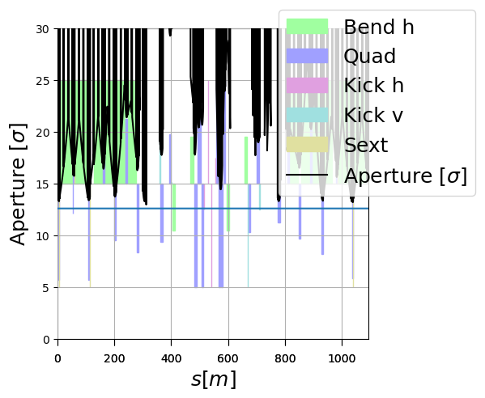
Injection aperture injection
Beam 1
Beam 2

Slide 5
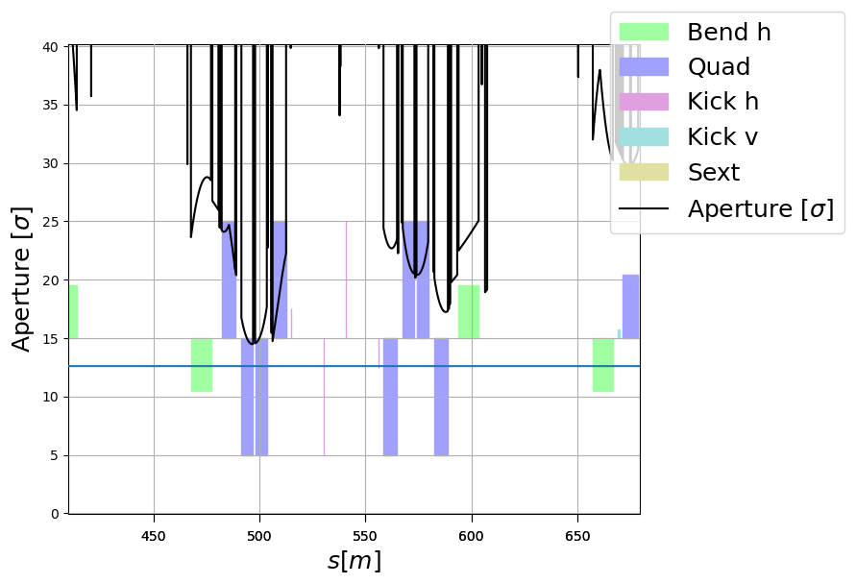
Injection aperture injection (detail)
Beam 1
Aperture restriction dominated by H gap.

Slide 6
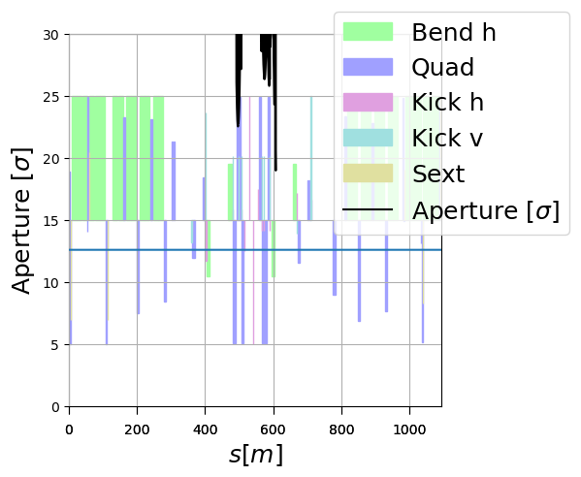
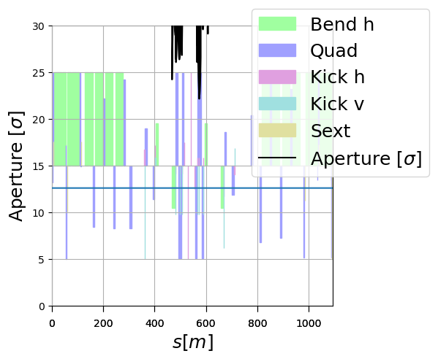
2m protons H crossing
Beam 1
Beam 2

Slide 7
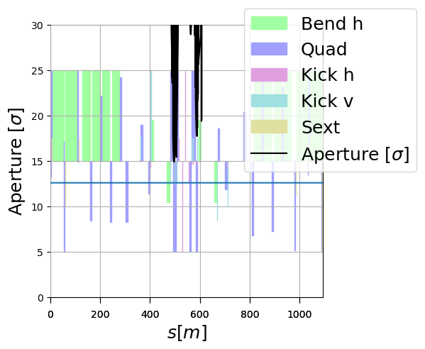
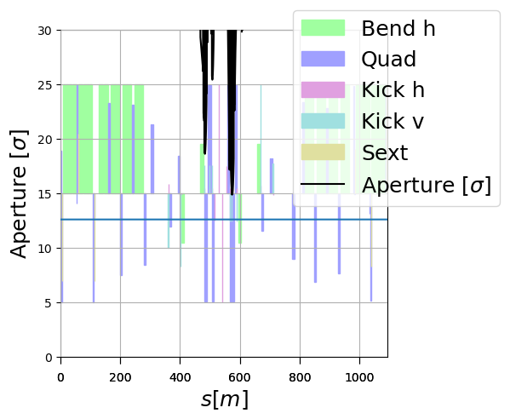
2m proton V crossing (-200 murad)
Beam 1
Beam 2

Slide 8
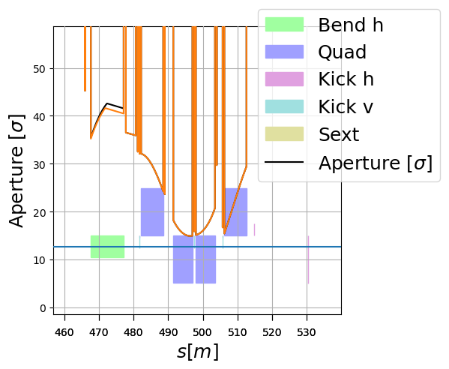
2m proton V crossing (-200 murad) detail
Impact of 0.5 misalignment small.

Slide 9
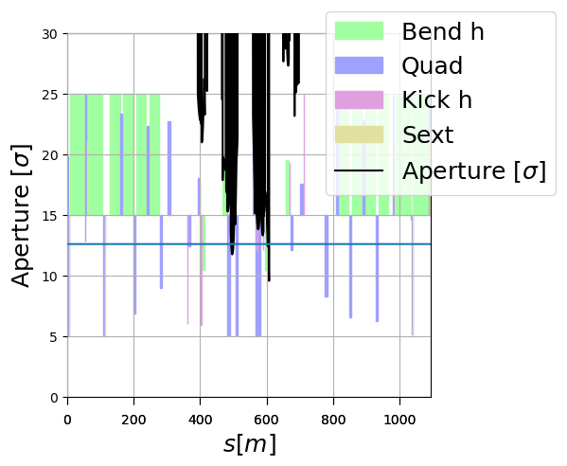
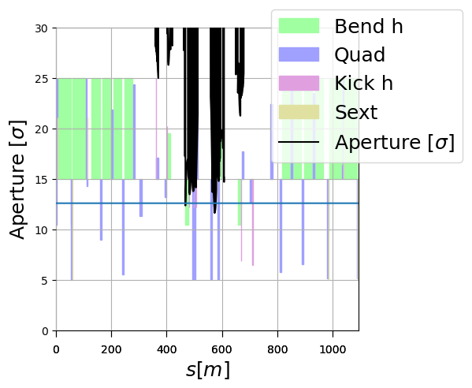
0.5m (tentative) for ions for H crossing (170 murad)
Beam 1
Beam 2
Optics parameters are tentative (realistic beta* around 0.7m for the TCDDM in Beam 2).
MBX still in the shadow of the triplet, bottleneck in the H plane.

