Slide 1


Slide 2

Hepix 2022
CERN Cloud Infrastructure - operations and service update
Jayaditya Gupta
CERN, 28th April 2022
Notes:
This talk will cover update of the evolution of the cloud service over the past year, and the plans for the upcoming year.
and also our challenges and approach to high availability , VMs live migrations and monitoring live migration executions.

Slide 3
Since the last HEPiX
Brief overview
Ironic upgrades
Anomaly detection upgrades
Glance upgrade
Migration cycle tool (VM migration tool)
Notes:
This is the outline we will follow for this talk. These are the topics in glance that I will try to cover. Let’s start with the overview of the cern cloud.

Slide 4
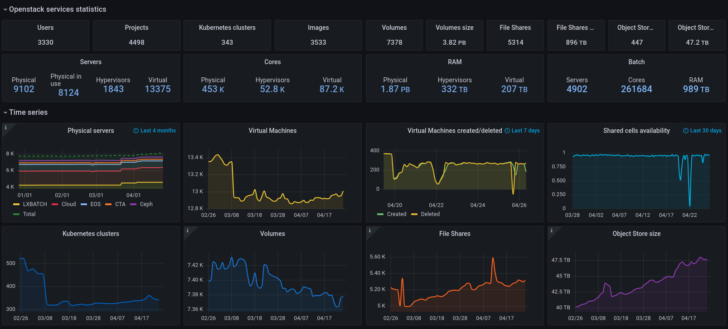
Openstack Overview
Notes:
CERN's private OpenStack cloud offers more than 300,000 cores to over 3000 users with services for compute, multiple storage types, baremetal, container clusters, and more.
Here we can see an Overview of the Cloud service statistics and some graphs with numbers that represent evolution of our services over the time. We can highlight that we have more than 9k physical servers in the ironic service and 13k virtual machines in nova. Among our resources we have 453k cores and almost 2pb of ram.
In the past we converted batch to virtual machines but now Ironic provides the same virtualization api functionality without the performance issues of virtualization.

Slide 5

Openstack baremetal (Ironic) service upgrades
What is ironic ?
Ironic is an openstack program that aims to provide bare metal instead of virtual machines.
Use of ironic?
Ironic allows physical servers to be managed as though they were virtual machines.
API driven Installation of physical machines to support cloud infrastructure or tenant workloads.
Notes:
It is best thought of as a bare metal hypervisor API and a set of plugins which interact with the bare metal hypervisors.

Slide 6
Openstack baremetal (Ironic) service upgrades
Physical machines uses Ironic for whole onboarding process.
Auto Registration
Inventory
Verification
Burn-in
Benchmarking
Provisioning of the machines was already done with Ironic before.
To Learn more : https://indico.cern.ch/event/1096851/
Notes:
on the Ironic side, the whole onboarding of physical machines is moved to it (auto-registration, inventory verification, burn-in, benchmarking, ... (provisioning was done with Ironic already before))

Slide 7
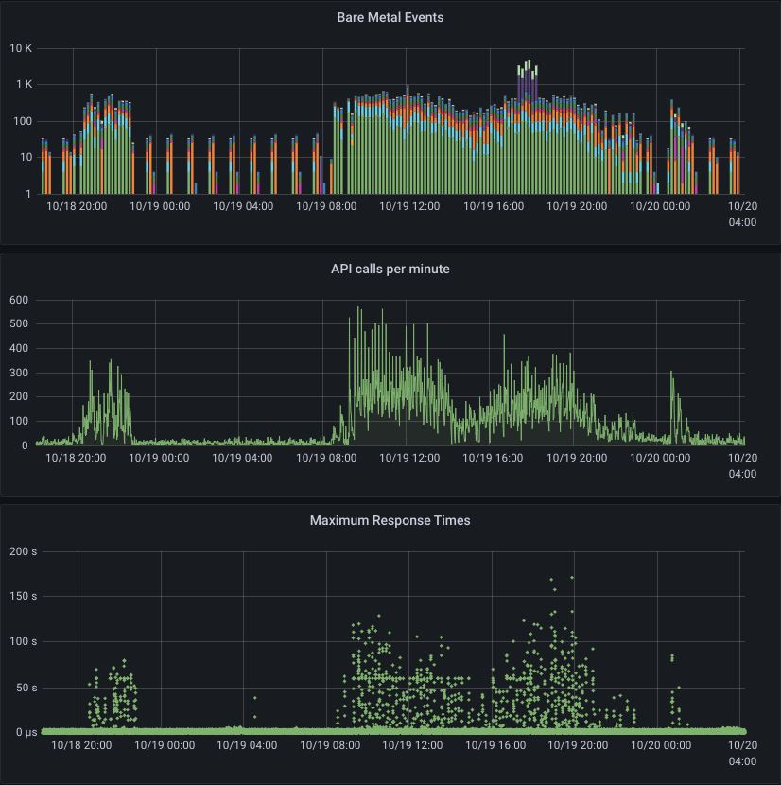


instance deletion
instance creation
RPC timeout
change
Physical Batch
automatic testing
Conversion of virtual to physical batch
  with the availability of a bare metal API,
  we revisited the virtualisation tax
3’775 hypervisors recreated as physical
batch instances
  done in multiple chunks over several months
Terraform as the ‘Infrastructure-as-Code’
tool to interface with OpenStack/Ironic
API requests from Nova instantiating
(and Terraform checking instance status)
nodes are in few “understaffed” conductor groups, so RPC times go up
new RPC timeout
default RPC timeout
Bonus: 16’000 VMs less than one year ago … 10k+ IPv4 addresses free’d up.
A. Wiebalck & N. Papakyprianou: Server Life-Cycle and Bare Metal Fleet Management in the CERN IT Data Centre (ITTF, 21 Jan 2022)
Notes:
Advantage of converting virtual to physical batch is that there is no virtualization, hypervisor overhead. A bare metal server enables the user to rely on the entire hardware setup.

Slide 8
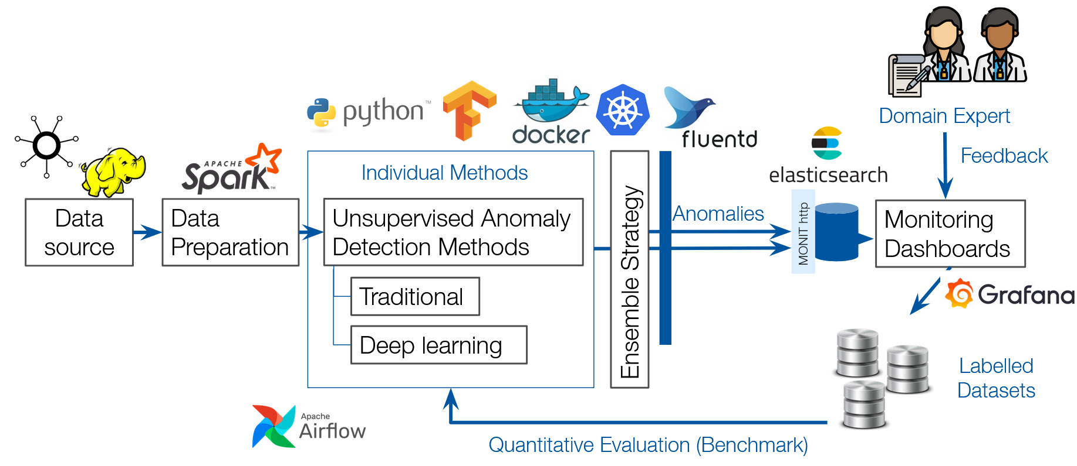
Anomaly Detection
Fully automated Anomaly Detection Pipeline extending the previous work
Implementation of new Unsupervised Machine Learning algorithms
Combination of the algorithms in an Ensemble
Work in progress to include in Daily Operations
https://indico.cern.ch/event/1123214/contributions/4809938/
Notes:
As cloud service managers, one of our tasks is to make sure that the desired computational power is delivered to all users. This task is accomplished by monitoring the utilization metrics of each hypervisor and reacting to alarms in case of server saturation to mitigate the interference between VMs.
In order to maximize the efficiency of our cloud infrastructure and to reduce the monitoring effort for service managers, we have developed an Anomaly Detection System that leverages unsupervised machine learning methods for time series metrics. To learn more about anomaly detection attend the next talk by Antonin Dvorak right after this.

Slide 9

Openstack image “glance” service upgrades
What is glance?
The Image service (glance) project provides a service where users can upload and discover data assets that are meant to be used with other services. This currently includes images and metadata definitions.
Use of glance?
Allows users to discover, register, and retrieve virtual machine images.
Allow VMs to be created in batches, reducing deployment time.
Notes:
Glance is the OpenStack image service. With upgrade to xena glance now has Support for unified quotas using keystone limits. At CERN we have linux, windows images. Users can upload their own image for their specific work. We also encourage users to create snapshots of their machines, however this also leads to a problem. Users tends to forget to delete their images/snapshots. We reach out to users to delete their snapshots.

Slide 10
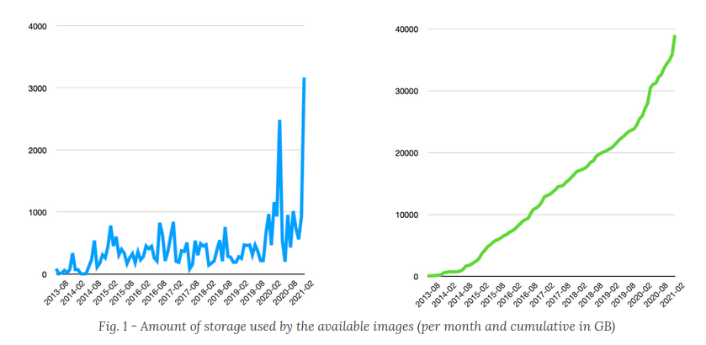
Openstack image “glance” service upgrades
Upgraded to Xena version.
Support for glance quotas
Why quotas are important
50 TB of Cloud Images blog
Notes:
Glance is the OpenStack image service. With upgrade to xena glance now has Support for unified quotas using keystone limits. At CERN we have linux, windows images. Users can upload their own image for their specific work. We also encourage users to create snapshots of their machines, however this also leads to a problem. Users tends to forget to delete their images/snapshots. We reach out to users to delete their snapshots.

Slide 11
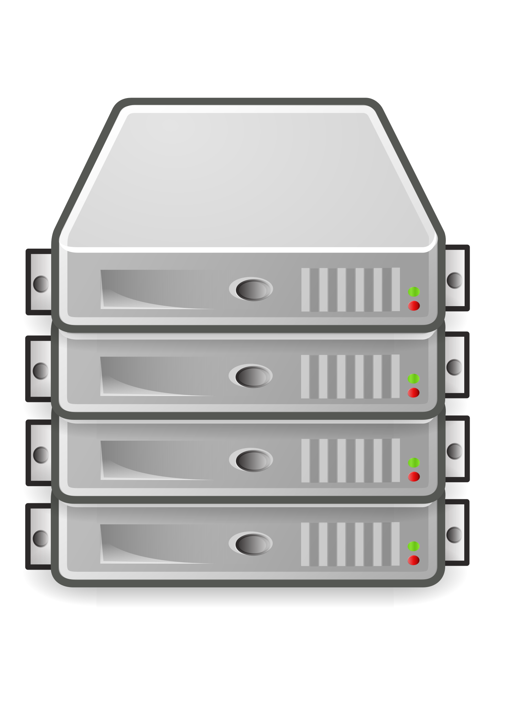
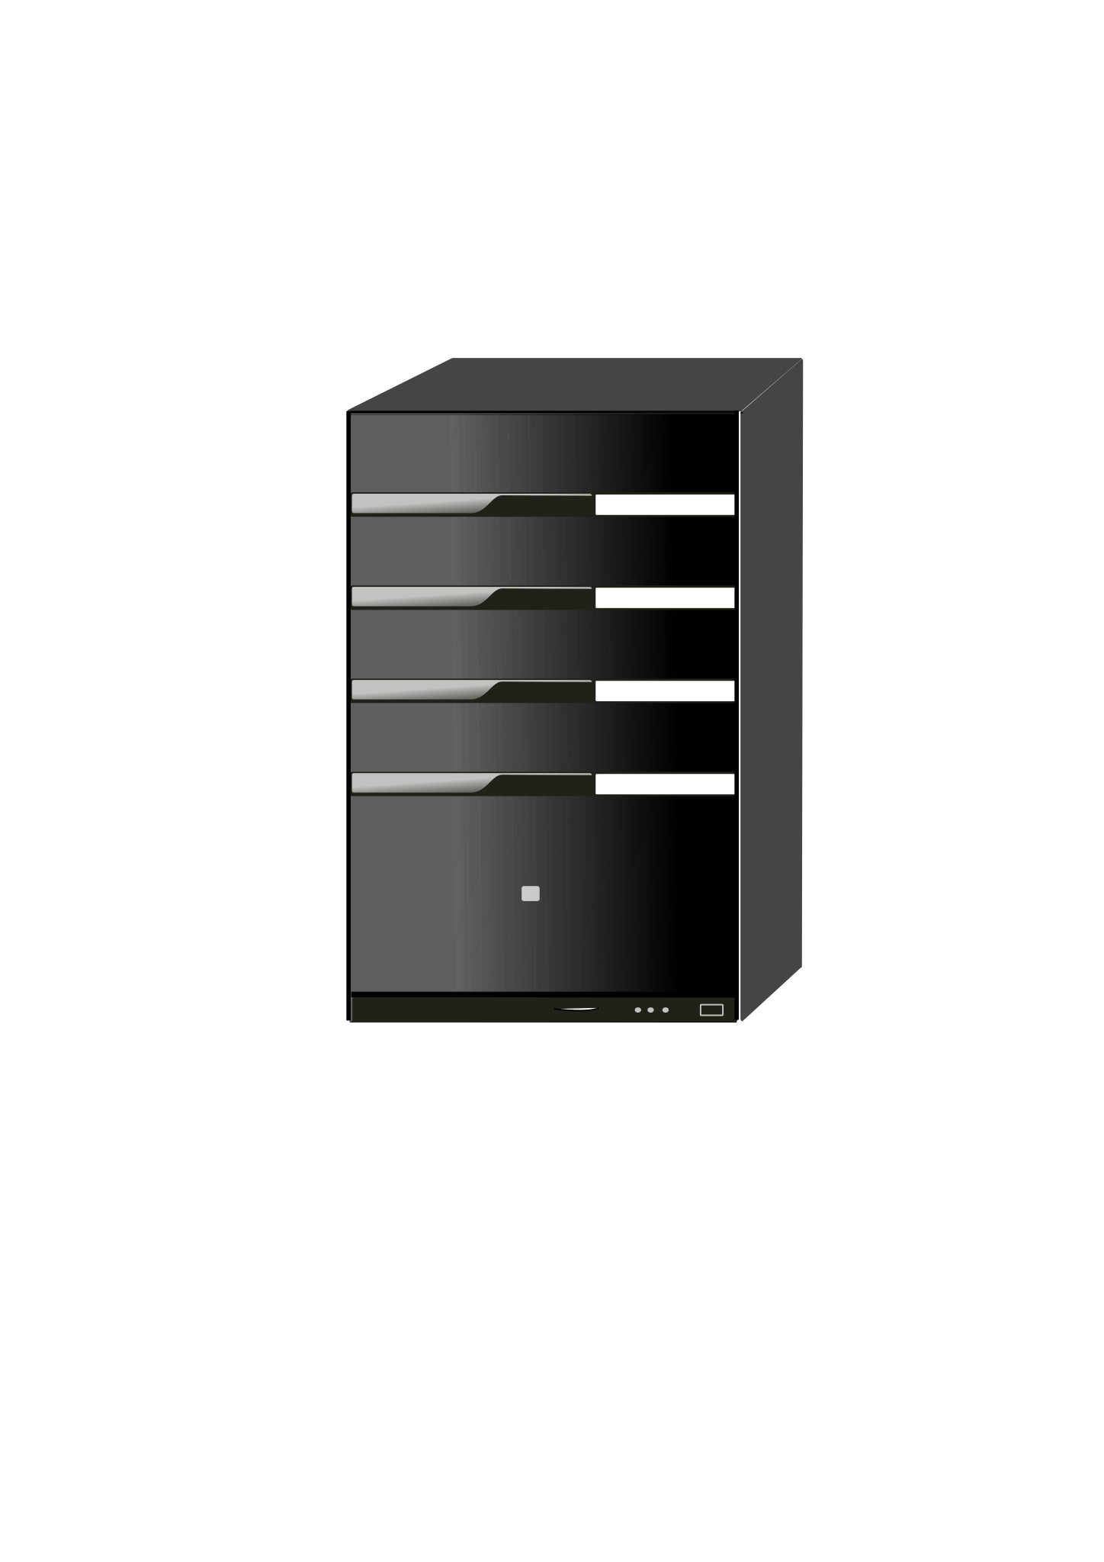
Virtual machines migration 101
What is virtual machine migrations?
In simplest terms migration is the task of moving a virtual machine from one physical hardware environment to another.

Slide 12
Virtual machines migration 101
What is virtual machine migrations?
In simplest terms migration is the task of moving a virtual machine from one physical hardware environment to another.
Types of virtual machine migrations
Cold migrations : cold migration is a virtual machine that is powered off in the entire duration of migration.
Live migrations : live migration means that the workload and application will remain available during the migration.

Slide 13
Migration cycle tool
Why it was created? What’s the use case?
  To increase user’s VM availability
  Eliminate/Reduce VM downtime due to hardware interventions
  Kernel security upgrades
  Trigger and monitoring live migration execution
Where is it deployed?
  Automation tool(rundeck) jobs
  Dedicated node to run and manage vm migrations
Notes:
Migration cycle is a tool to improve virtual machines uptime and ensuring their maintenance while reducing the intervention/downtime. Now i will focus only migration cycle tool that I worked on and details around it.

Slide 14
How migration cycle works ?
Disable VM creation
Disable alarm
Find vms in the hypervisor
Perform migration operation on vms and show progress
Enable VM creation
Enable alarm
Reboot hypervisor
Notes:
This is simplest way/scenario . things can be skipped. Show potential of tool

Slide 15
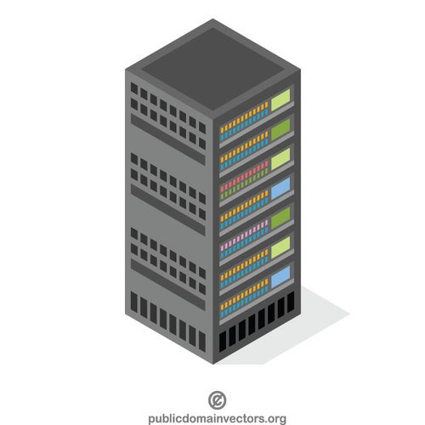
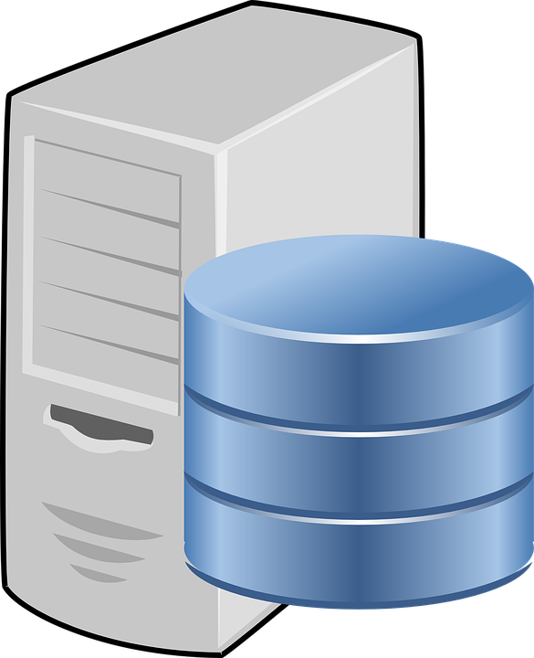

How migration cycle works

Slide 16

Scenario 1
Eliminate/Reduce VM downtime due to hardware interventions
Hardware is failing or need repairs/upgrades.
Example: Memory replacement on a compute node.
Notes:
Tell story that repair team interact with openstack api via Rundeck and they have set of 2 jobs minor and simple reboot.
Repair team is external team that manages the hardware in data center and if they want to perform intervention/repair upgrades they use these rundeck jobs.

Slide 17
Problem with Previous Solution
Current procedures causes interruption to users as the maintenance procedure has to be scheduled.
The hosted virtual machines will be unavailable for the time of the operation.
The current procedure send email to users stating that “your vm will be down from this time to that time”.
This procedure disrupts the service and users might not always comply.
Repair team needs to wait for the schedule date to intervene in the compute node.

Slide 18
New/Improved solution
Combining previous solution with live and cold migration operations.
Scheduling server intervention job + migration cycle tool.
Hardware intervention procedure
Step 1 : try migrating virtual machines
Migrations
If step 1 fails
Do intervention
Step 2 : Schedule intervention

Slide 19
How new solution tackles the problem
New procedures avoid causing downtime by first trying to migrate the instances from the host.
Essentially the job becomes 2 step process.
Step 1 : first the job will perform instances migrations on the hosts that require the intervention. If successful the intervention can be performed immediately. Thus not impacting the user.
Step 2 : if step1 fails the existing procedure will be executed i.e. scheduling intervention.
Notes:
Why job becomes 2 step process ? Because we wanted to slowly bring change to repair team procedures.
Live migration does not always succeed.
Keep things simple as possible. Not changing repair procedure too much
The jobs might have similarities but they have some different parameters like, duration, schedule date etc which is not needed by new job.

Slide 20
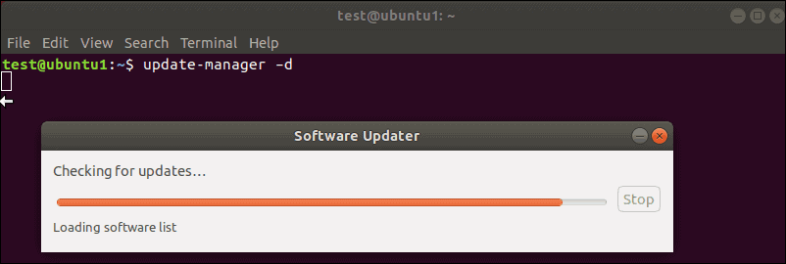
Scenario 2
Kernel security upgrades
All compute nodes need to be rebooted for kernel upgrades.
Example: Security issues, new kernel features...
Notes:
Manually applying security patches will take forever. Why we need migration cycle ? because the job will run for weeks or months and rundeck jobs cannot run for that long duration

Slide 21
Scenario 3
Trigger and monitor live migrations ….
Decommission a hardware/ end of life.
Need to free up a set of compute nodes.
https://techblog.web.cern.ch/techblog/post/beyond-live-migrating-virtual-machines/
Notes:
We discovered another use case. Jan/cloud-team started migration campaign decommissioning of cell and we didn’t had the tool to easily live migrate the instances , so we thought can we reuse the migration_cycle tool for this . Migration cycle was not designed for this at all. So we needed to rethink how the tools work to adapt it to new use case . and to trigger live migrations per node. So this new use case came up and we decided to make a CLI interface with more new features.

Slide 22
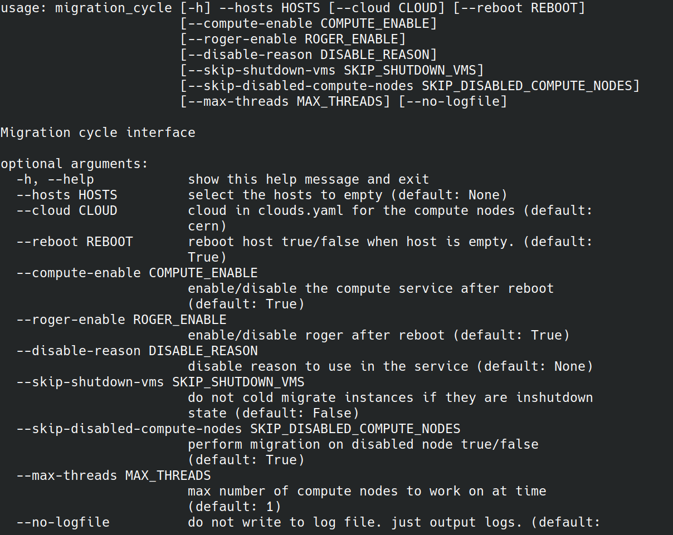
Migration cycle CLI
Notes:
Also we added support for all this in rundeck. You can also now run migration cycle CLI on rundeck and preserve logs.

Slide 23
Future use cases/plans
Targeting specific virtual machines: currently we can only specify cell or hosts
Operating system upgrades (major releases)
Applying security patches at large scale.
Deploy it on K8s

Slide 24
Conclusion
In last years we have invested in support for improving service level of virtual machines by investing in virtual machine migrations.
Upgraded hardware
  Decommissioned 6 year old hardware with better machines
  They had 128GB of RAM, an Intel Xeon CPU E5-2630 v3 @ 2.40GHz and 2 SSDs of 900GB each that we configured in RAID 1. They are now replaced by 120 compute nodes with 192GB of RAM, an Intel Xeon Silver 4216 CPU @ 2.10GHz and 2 SSDs of 1.8TB each, again configured in RAID 1.
  Hardware refresh campaign
Migration cycle tool
  Execution via automated tool (rundeck) : 175+
  Migrated virtual machines : ~1600
  OSS release : https://gitlab.cern.ch/cloud-infrastructure/migration_cycle/
Notes:
Migration operation used to be very error prone. Belmiro invested time to harden the migration operations and now the operations are quite smooth, less error prone.

