Slide 1
EOS and XCache data access performance for LHC analysis at CERN
Dirk Duellmann, Bernd Panzer-Steindel, Markus Schulz, Andrea Sciabà, David Smith (CERN IT-SC)
HEPiX Spring online Workshop, 25-29 April 2022

Slide 2
Introduction
LHC analysis at CERN
  Hundreds of physicists using a variety of methods, tools and resources
    Batch and interactive
    Machine Learning and columnar data formats increasingly popular
Support in IT for analysis
  Are the hardware and the services adequate to current (and future) needs?
  Does anything special need to be done about analysis (e.g., having a dedicated analysis facility)?
Data access performance for analysis
  A working group was created to give an answer to these questions
  Experts from the experiments on software and computing and from IT
  The scope was only CERN and Run 3: no attempt at providing answers for WLCG or other sites or for longer time scales!

Slide 3
Structure of the talk
Overview of analysis resources at CERN
EOS usage for analysis
Data access performance studies with XCache
Final report
  https://zenodo.org/record/6337728
  A document summarizing the report was prepared, will be published in the next days
Contact
  it-dep-cern-lhc-analysis-studies@cern.ch

Slide 4
Analysis resources overview
Three main classes of resources locally available at CERN
  Grid (CERN is also a Tier-2)
  Batch (direct submission to LXBATCH)
  Interactive (LXPLUS, Spark/HADOOP, SWAN, …)
Heterogeneous resources are increasing
  GPUs available since long, ARM will be soon
The first step is to understand how much they are used

Slide 5
Measuring utilization for analysis
Experiment | Completed jobs | Running jobs | CPU time | Wallclock time
ATLAS | 100K | 2500 | 70 years | 80 years
CMS | 600K | 8000 | 140 years | 170 years
First question is: what is analysis?
  Easy to answer for Grid jobs (from experiments’ job monitoring)
  In other cases, it is less clear cut, can only calculate upper bounds
Grid and batch analysis are by far the largest contributions
  Peaks sometimes 3-4 times the average
Interactive analysis still at low scale
  Usually, cores allocated to users are mostly idle
    Example: SWAN cores used for about 5% of their time
CERN Grid analysis in a 7-day period in October
 | LXBATCH | LXPLUS
ATLAS | 4400 cores | 100 cores
CMS | 8800 cores | 70 cores
Average number of busy cores in a 7-day period
 | SWAN | Spark/YARN
ATLAS | 8.5K hours ∙ cores | 18.5K hours ∙ cores
CMS | 16K hours ∙ cores | 22K hours ∙ cores
Wallclock time in a 10-day period

Slide 6
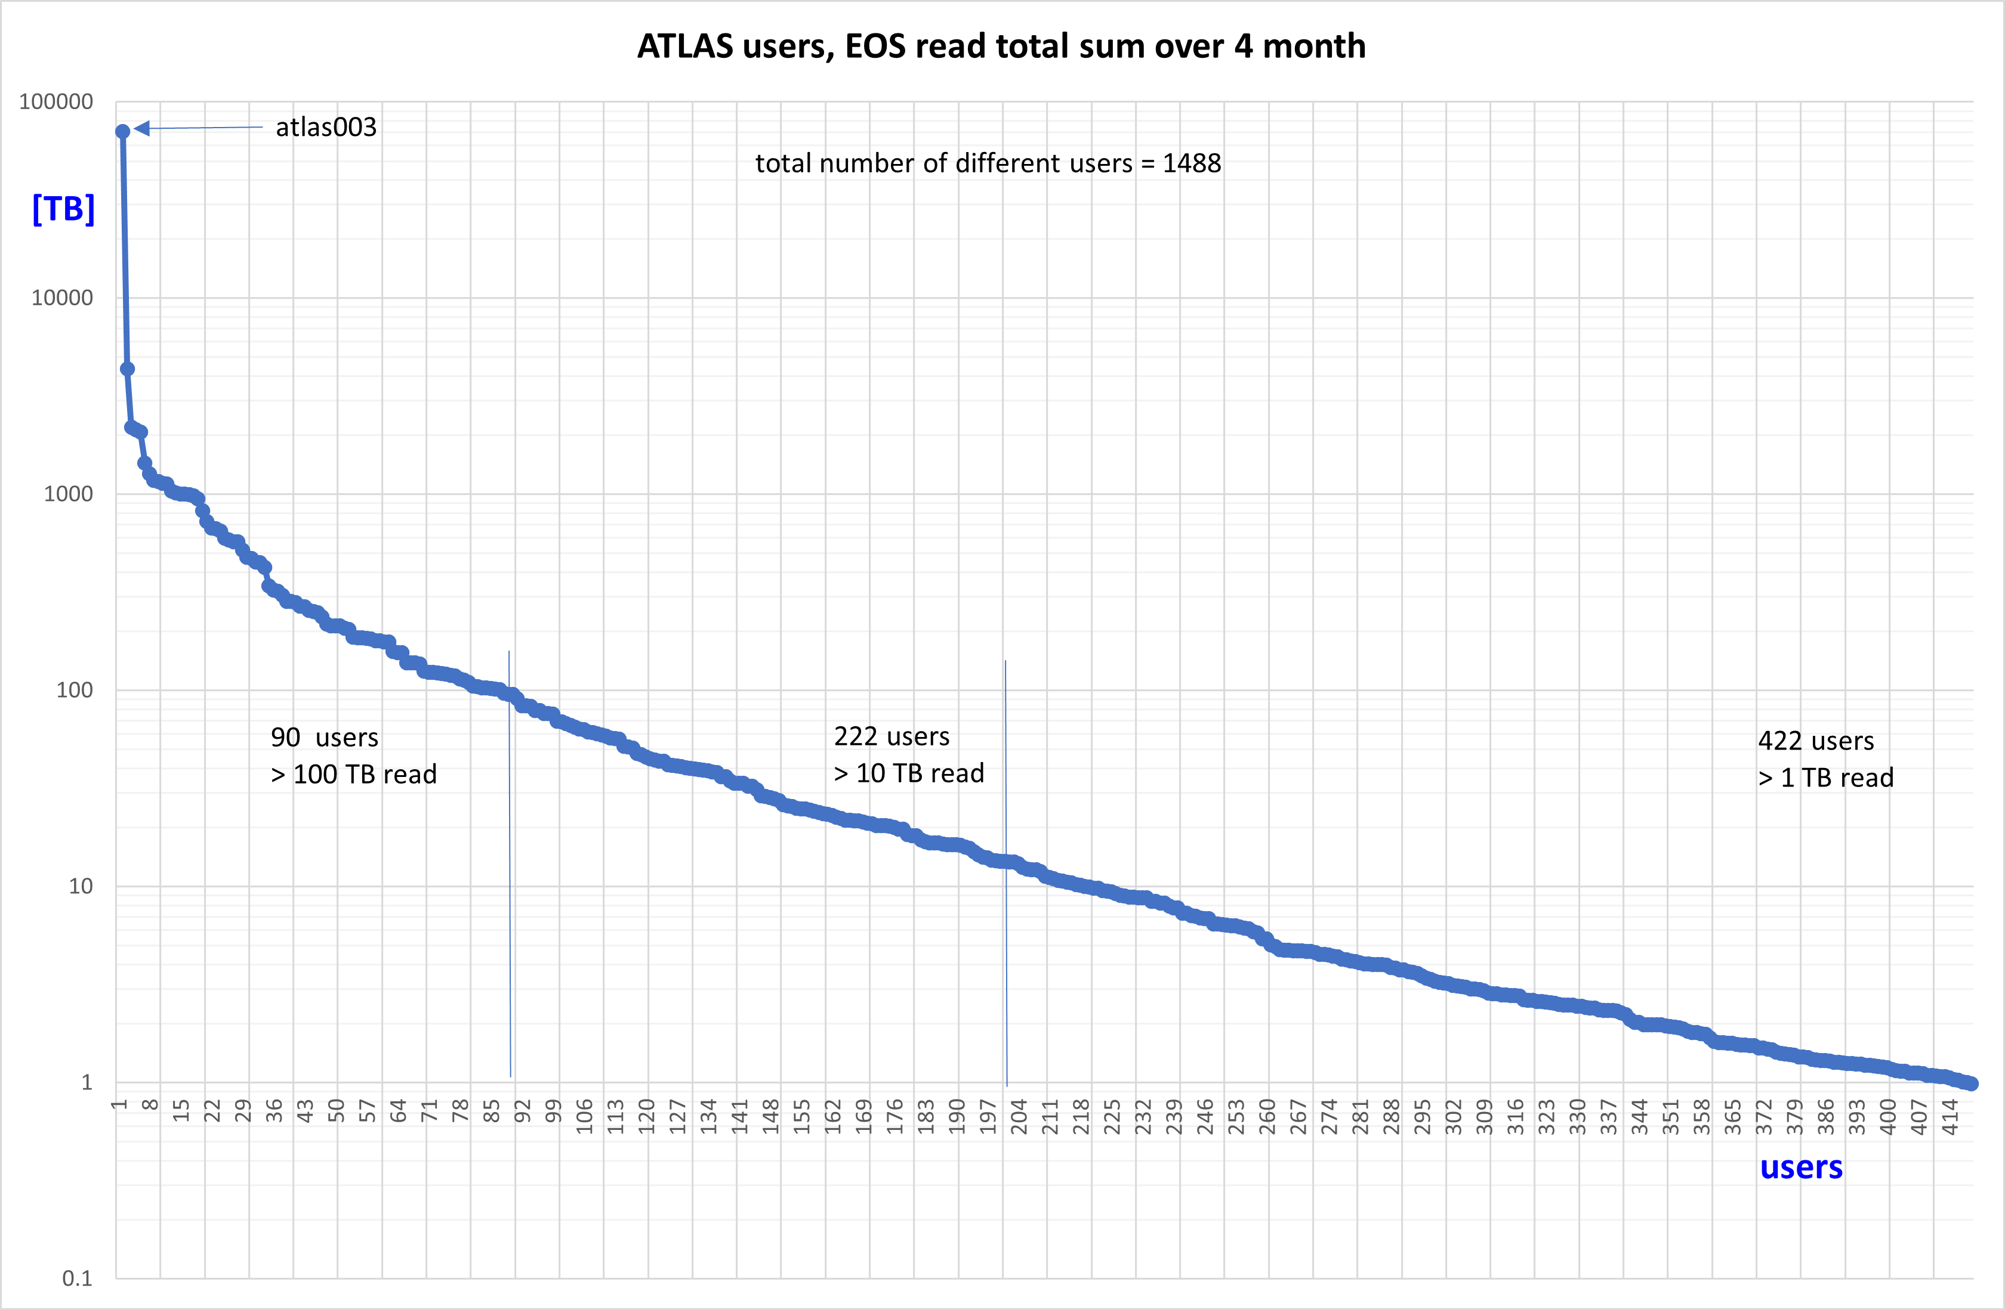
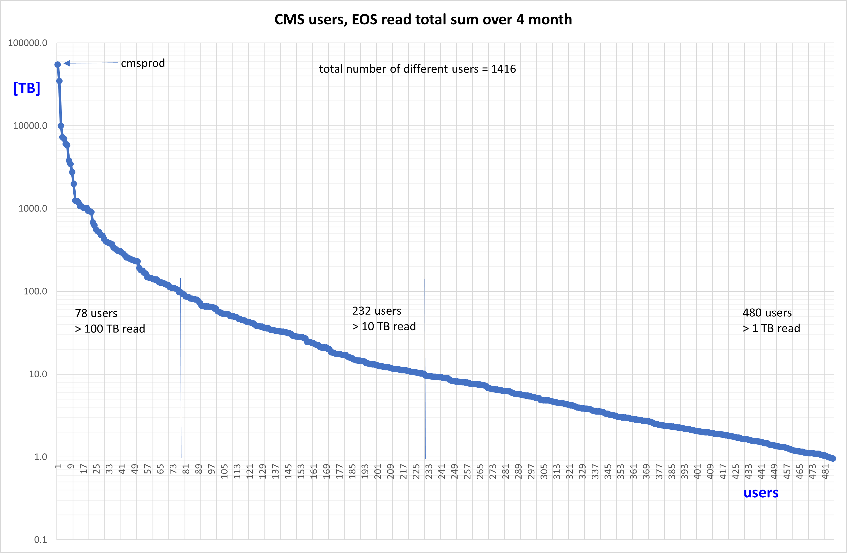
Data access performance and EOS
Goal: study data access patterns on EOS and determine if there are bottlenecks in the system
  Used EOS log files between February and May 2021
  Internal EOS activities (rebalance, etc.) and production accounts filtered out
Selected only “regular” users who read more than 100 TB (“heavy analysis users”)
  Only O(100) users for ATLAS and CMS remaining
Selection cut
 | ATLAS | CMS
Distinct users | 1488 | 1416
Total data read | 117 PB | 169 PB
from LXPLUS | 7% | 2%
from batch | 74% | 61%
from eosftp | 15% | 33%
from external IPs | 4% | 4%
Selection cut

Slide 7
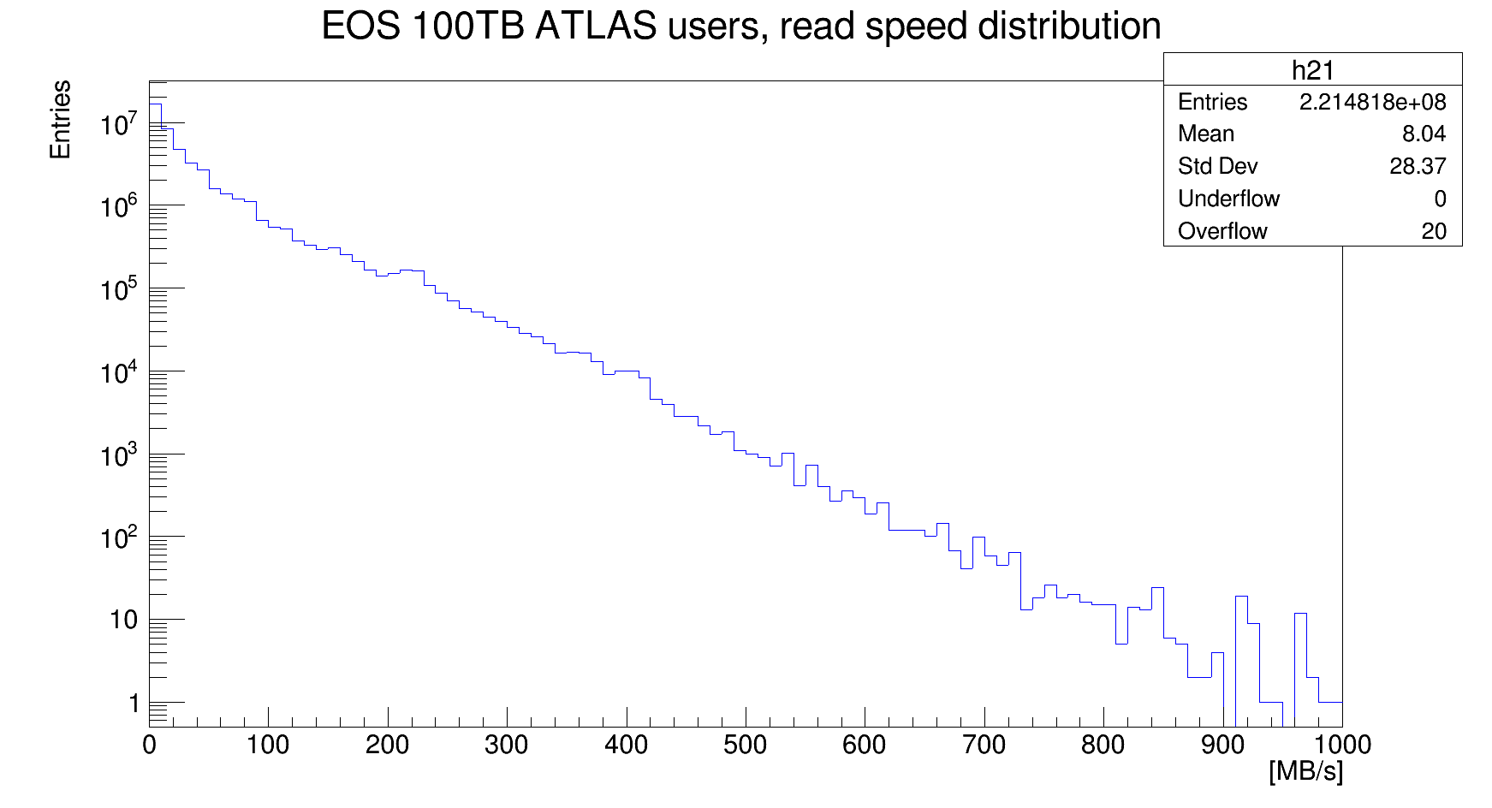
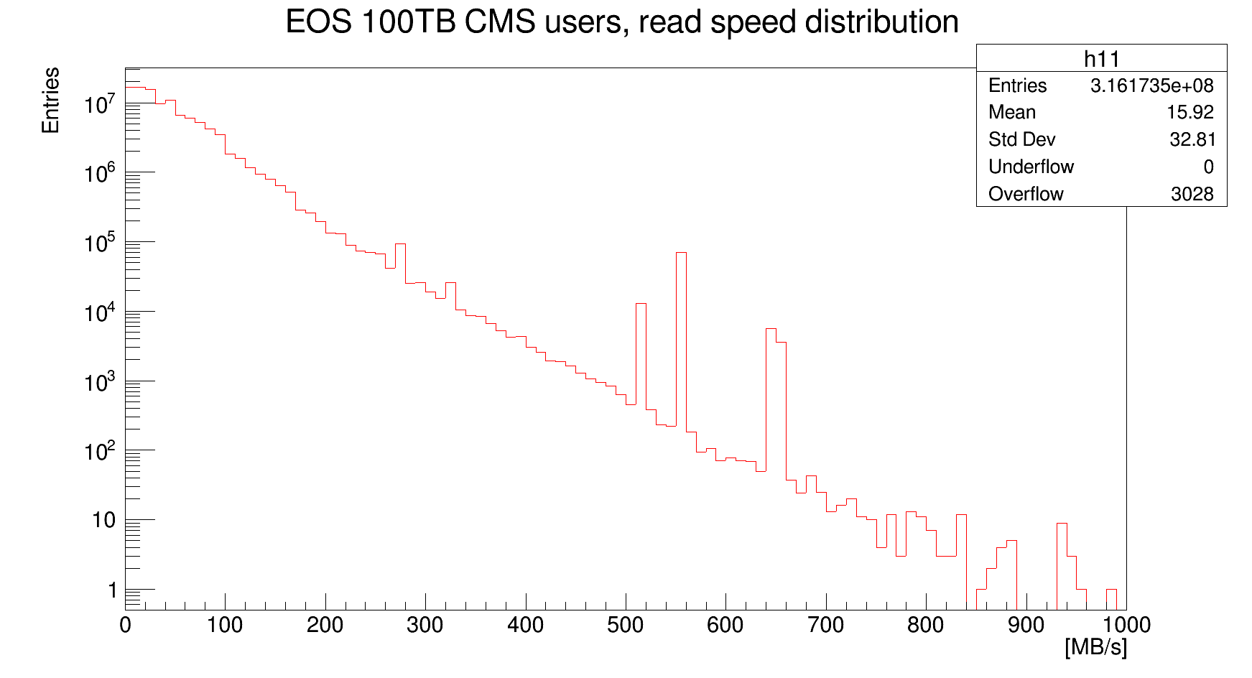
Read distributions
Average read rates are rather low and dominated by small reads
    ATLAS: 8 MB/s (52 MB/s excluding reads < 10 MB/s)
    CMS: 16 MB/s (24 MB/s excluding reads < 10 MB/s)
High transfer rates (> 250 MB/s) can be explained as accessed through memory caches
  Estimating 15-20 TB of memory cache installed for 30 PB of EOS disk space
  Less than 1% of accesses uses the cache
HDD max speed
 | ATLAS | CMS
Number of “heavy analysis users” | 87 | 74
Total data read | 40 PB | 108 PB
Total size of unique files read | 0.5 PB | 11 PB
Number of unique files read | 0.7M | 5.3M
Number of files read (any number of times) | 155M | 38M
HDD max speed

Slide 8
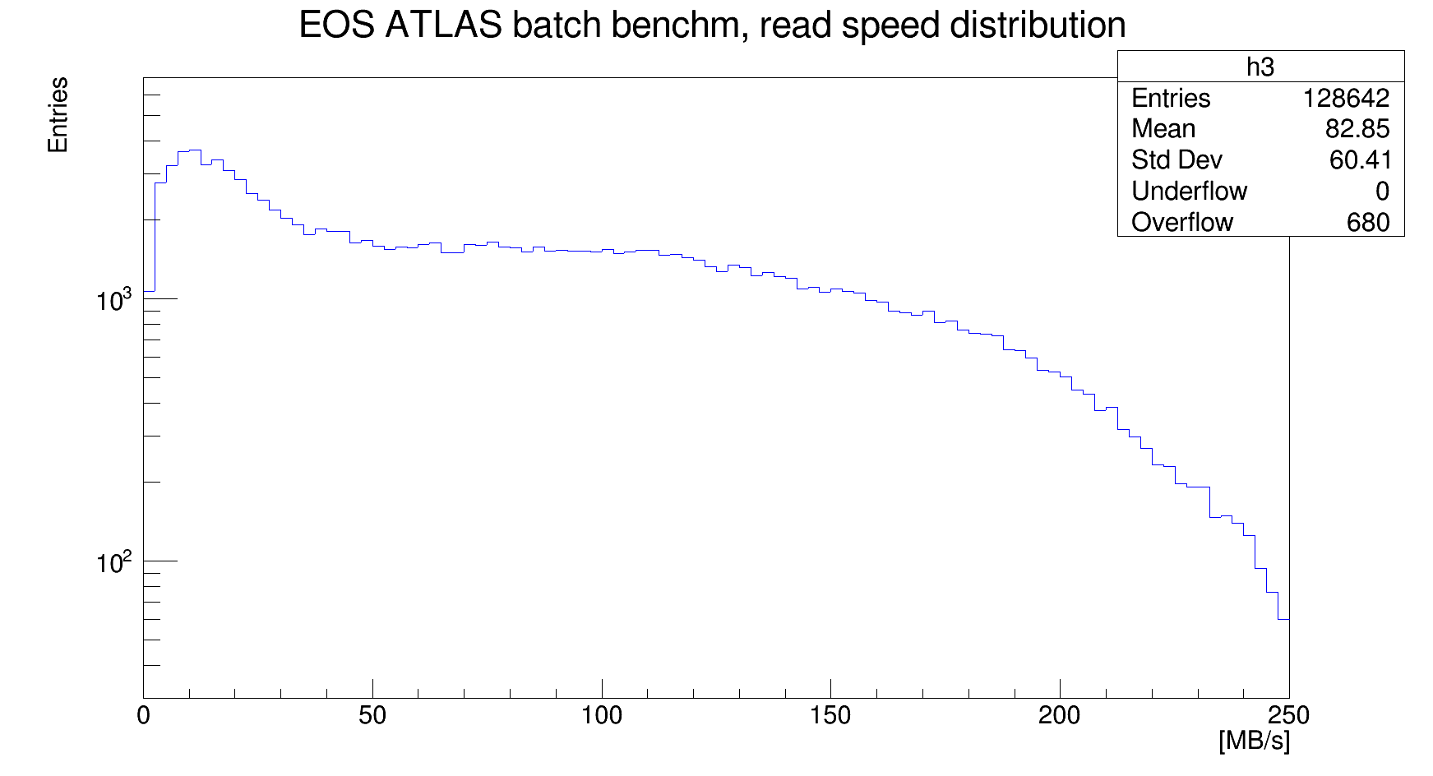
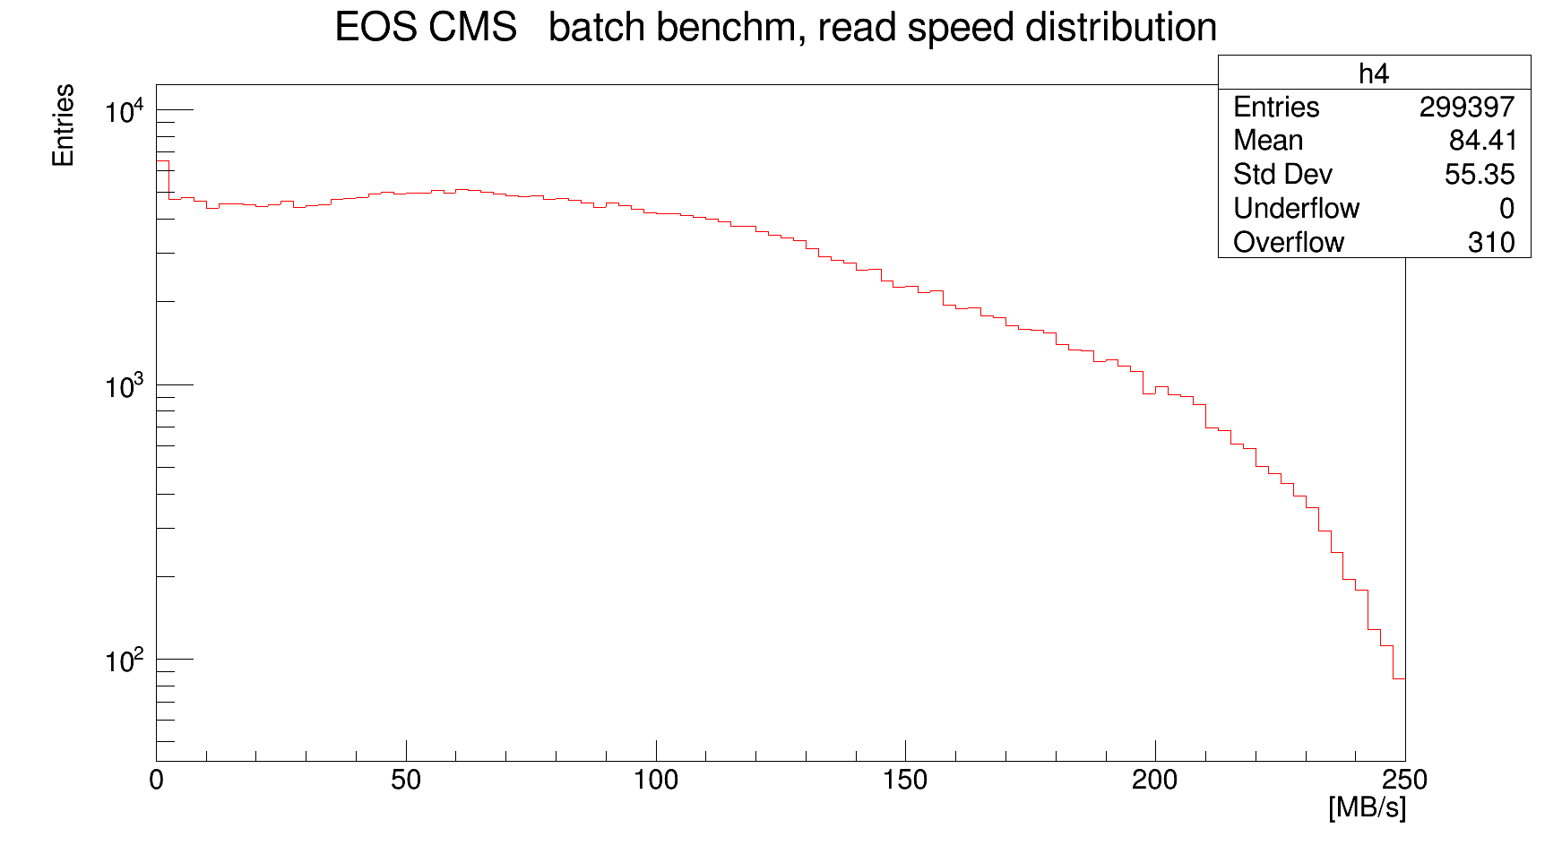
“Synthetic” benchmarks
A simple check to measure “achievable” data read rates
  Thousands of trivial jobs randomly reading files accessed by analysis jobs, via EOS FUSE
  Rates about 80 MB/s
  Even higher rates (~100 MB/s) achieved using xrdcp
Other file statistics
  Open files per second:
    ATLAS: 70% of entries, less than 20 file opens/sec
    CMS: 85% of entries, less than 20 file opens/sec
    Reaching into the thousands, no bottlenecks
  Seeks per file:
    ATLAS: 94% less than 10 seeks per file
      Using local copies?
    CMS: 60% less than 10 seeks per file

Slide 9
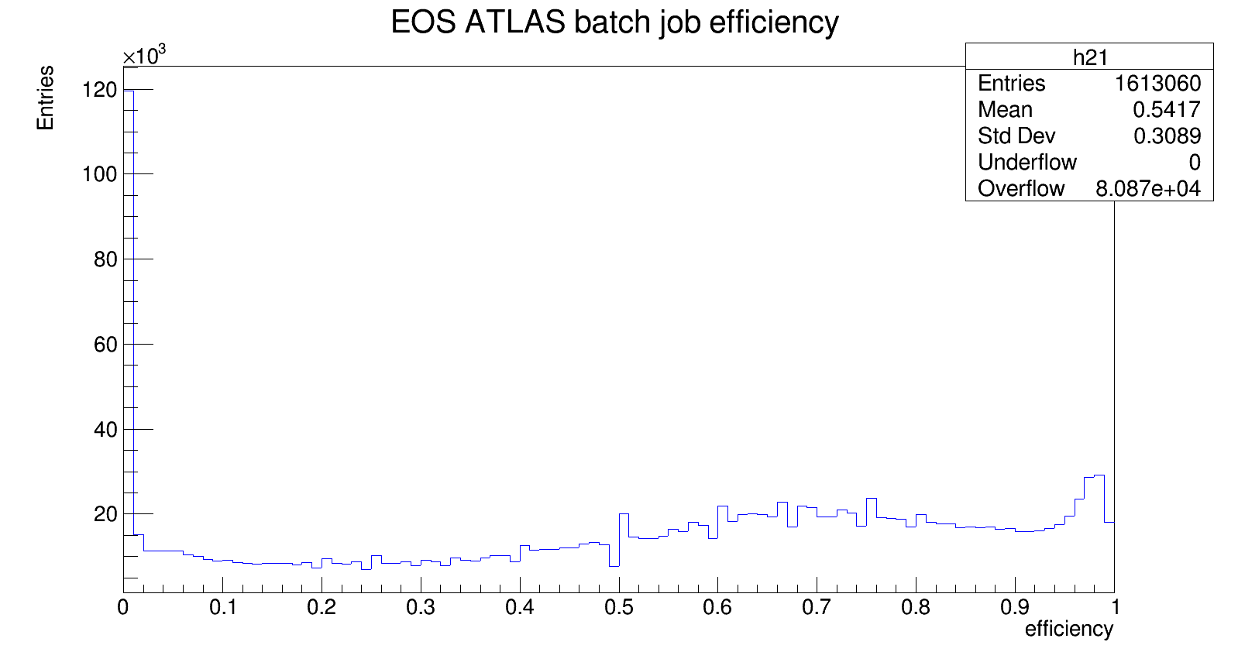
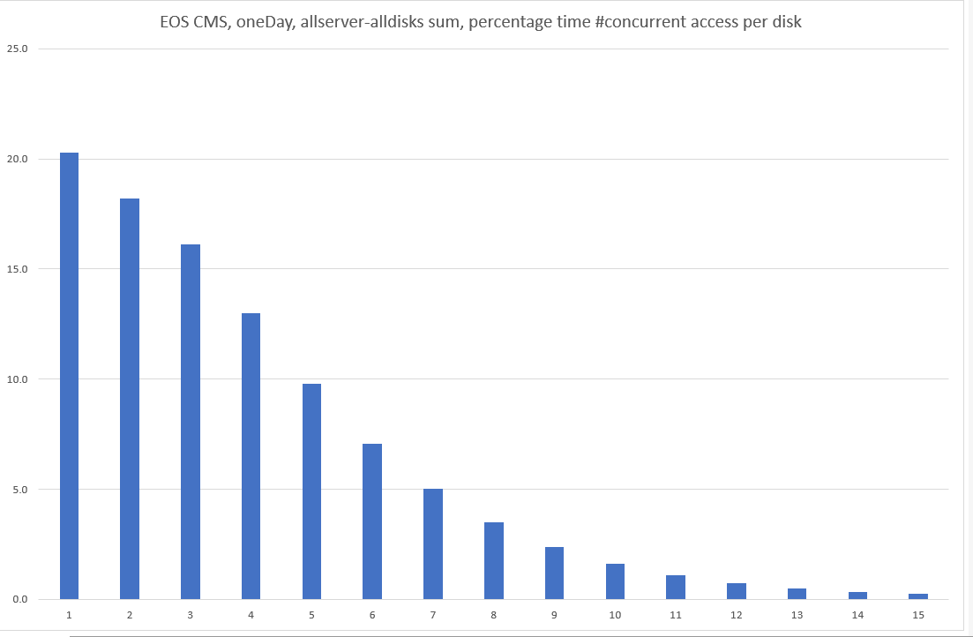
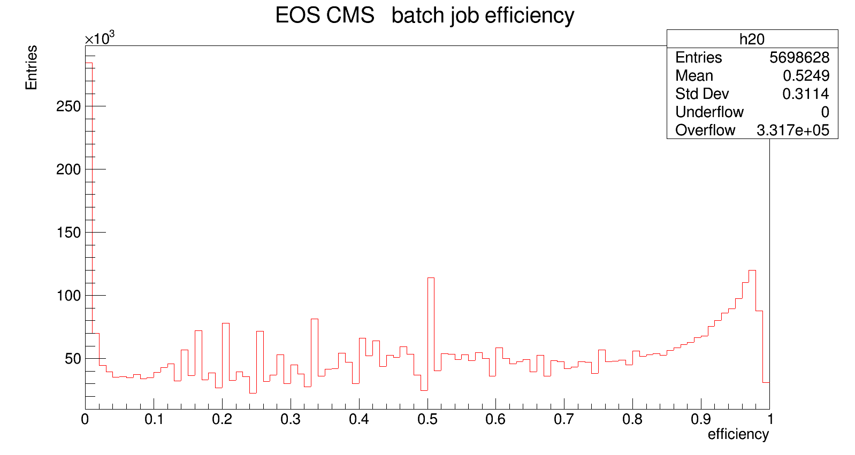
Job efficiencies and disk contention
CPU efficiencies (from batch log files) relatively low
A quick look at disk contention shows that concurrent accesses to the same disks are the norm
  Which explains the spread in data read rates
One HDD from EOSCMS
Fraction of time
Number of concurrent accesses

Slide 10
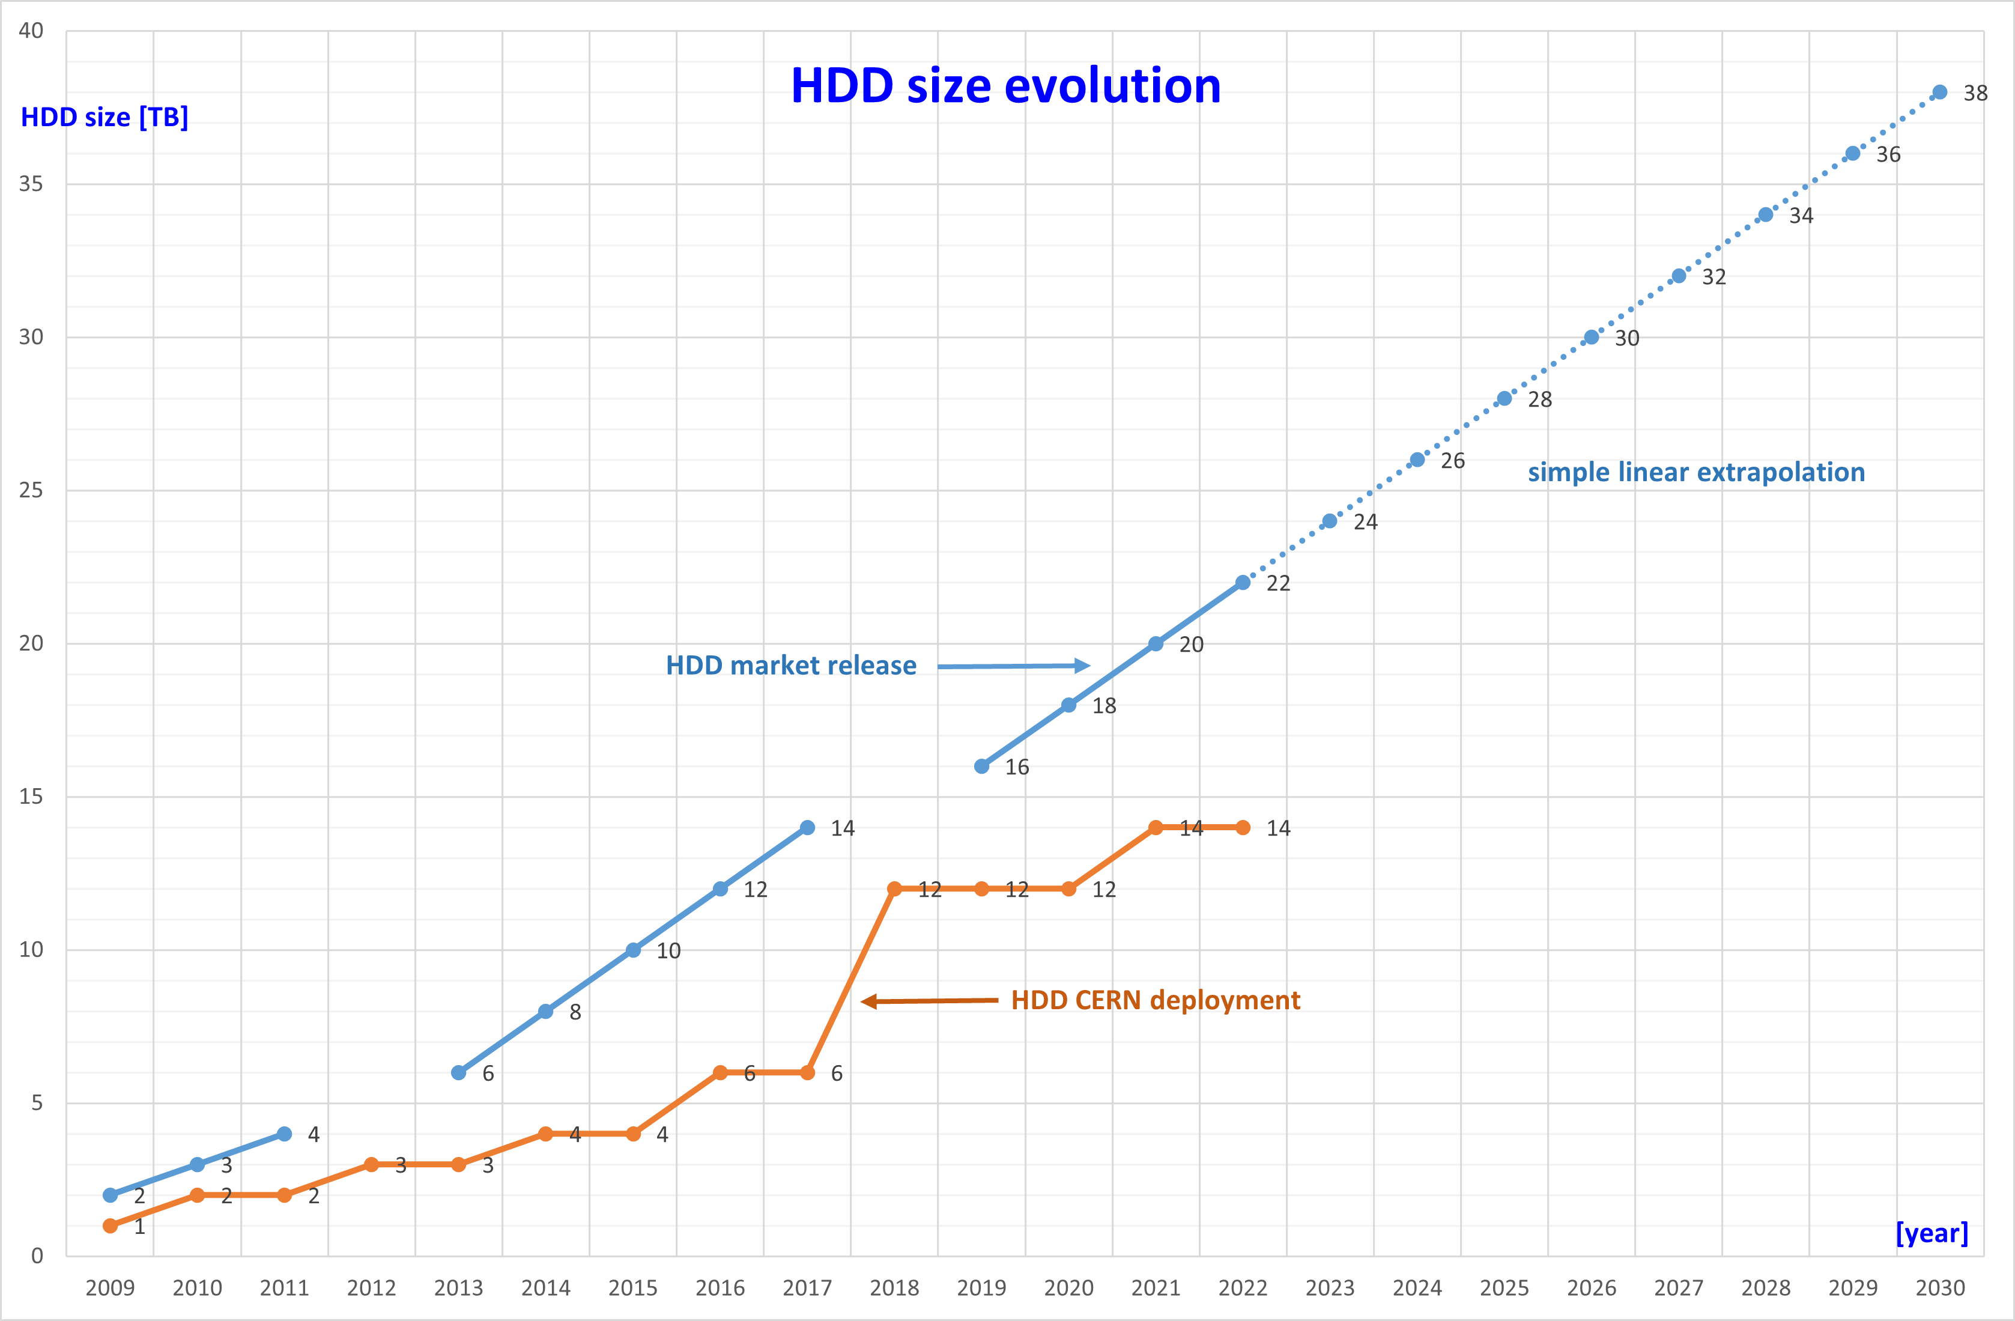
HL-LHC lookout and wrap-up
Extrapolations to 2028
  Resource request of 500 PB of HDD storage per ATLAS and CMS each
  HDD size of 40 TB, 100 disks per server, server memory 512 GB, 500 MB/s per disk
  Mix of erasure coding and two copies
  → twice as many spindles as today, total throughput 1 TB/s
EOS measurements wrap-up
  Currently, no performance bottlenecks observed on EOS infrastructure for the bulk of analysis workloads
    Still considerable headroom in I/O and network
  No apparent need for caching layers

Slide 11
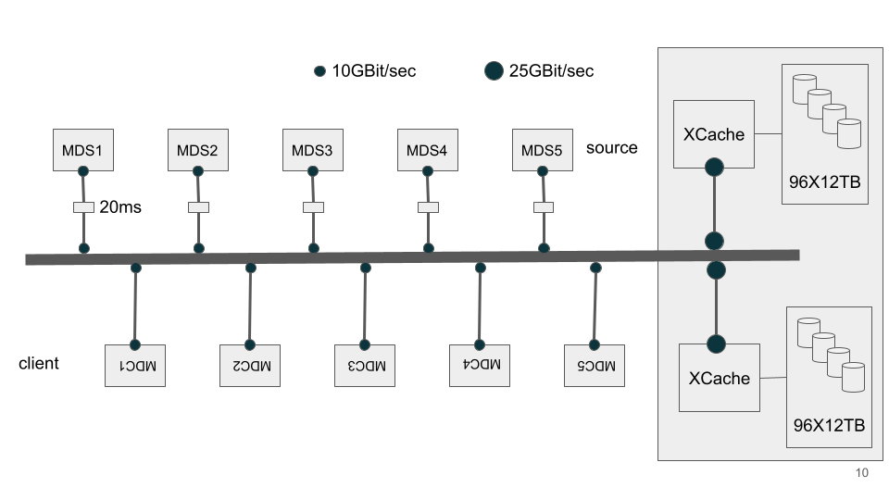
XCache data access performance
The goal is to measure performance and scalability of both SSD and HDD based XCache instances with respect to analysis workloads. For example:
  When do SSDs give an advantage?
  How many clients can an XCache instance support?
Three types of tests
  Synthetic tests using fio and dd
  “Baseline” tests simulating real access patterns (MockData)
  Tests using “real” analysis applications from ATLAS and CMS
Testbed consisting of
  2 nodes with 96 12TB HDD each
  2 nodes with 16 2TB SSD each
  Both pairs used for Xcache and with 25 Gb/s connections, 64 logical cores each node
  Several client nodes (mostly VMs)

Slide 12
Synthetic tests
Single HDD performance
  fio with 32 KB blocks for random access: max IOP ~ 220
  dd with 10 MB blocks for sequential access: average rate ~ 200 MB/s
Single SSD performance
  IOP ~ 4500 using MockData high seek job (see next slide)
HDD-based XCache node performance
  Aggregate data rate of 6.67 GB/s reading locally with dd from all disks (theoretical maximum 7.88 GB/s)
SDD-based XCache node performance
  Aggregate data rate of 6.99 GB/s (theoretical maximum 7.88 GB/s)

Slide 13
“Baseline” tests using MockData
Storage type | Access pattern | Rate (overruns) GB/s | Rate (net monitoring) GB/s
HDD | Sequential | 5.5 | 6.0
HDD | High seek | 1.2 | 1.7
SSD | Sequential |  | ~6
SSD | High seek |  | ~6
MockData is a custom tool to test data access performances by replaying a recorded history of data accesses by multiple jobs
  Presented at CHEP 2019
Sequential tests
  randomreader: ran 5 clients against the HDD-based instance and reached 5 GB/s (to be compared with the 6.25 GB/s of network bandwidth)
“High seek” access tests
  A coordinator process dispatches transfer job definitions to several loadgenerator processes to mimic real data access patterns
    Used the actual file names, file sizes and open times from a 6-month period of ATLAS jobs at Prague in 2018. The files are “fake” and generated on the fly
    File accesses via XrdCl
    Can tune the transfer jobs to aim at a given target transfer rate
Achievable rates on SSD- and HDD-based XCaches measured in two ways
  Rate when the transfer jobs start to be cancelled for exceeding their targeted time
  Maximum rate measured at the network interface level
As expected, SSDs cope well even with random access

Slide 14
Tests with “realistic” analysis workloads
Example workloads received from ATLAS and CMS
The XCache nodes are also used as clients due to memory requirements
  SSD nodes clients for the HDD XCache and vice versa
  Also local access tested
  Tests use all available cores
Aggregate gradients
  ROOT script allocating 90 GB of RAM, processing 189 root files (1.5 TB in total), writes results
  Multithreaded (one copy with 64 threads)
  Used XRD_PARALLELEVTLOOP=16 to improve performance (env)
  Forced the client to establish multiple TCP connections to the servers instead of multiplexing (to improve performance) (multi conn)
Name | Experiment | Data | Events
top-xaod | ATLAS | 1 DAOD_PHYS file | 35000
cms-skimmer | CMS | 640 NANOAODSIM files | 670M
Aggregate gradients | CMS | 189 root files
cms-skimmer
  Uses CMSSW
  Builds the executable, processes a single file
  Run in 64 copies, each reading one file at random
top-xaod
  Reads an input file and writes an output file
  The only input file (1.16 GB) was copied 256 times
  Run in 64 copies, each processing a random number of events from a random input file

Slide 15
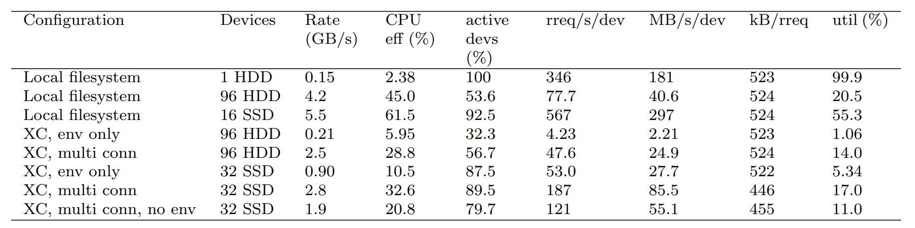
Results from aggregate gradients
Very I/O intensive workload
Local access data rates 60-70% of maximum from synthetic tests
The impact of the env and multi conn settings is huge: XCache rates approach the network limit
SSD-based XCache only marginally better in rate than HDD-based

Slide 16
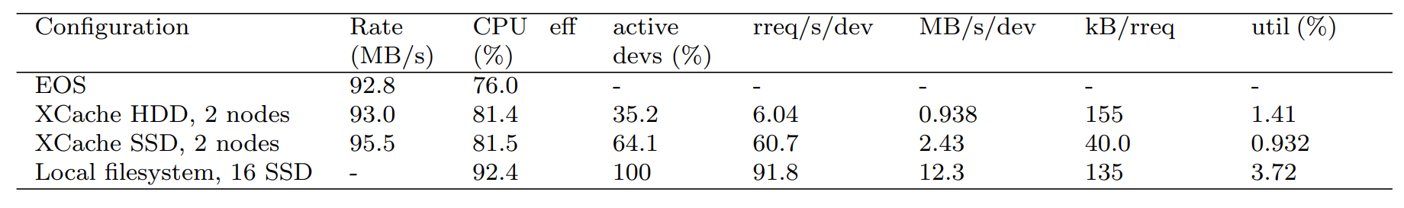
Results for cms-skimmer
Relatively low I/O: low rates, low device utilization and good CPU efficiency
No advantage with respect to reading directly from EOS

Slide 17
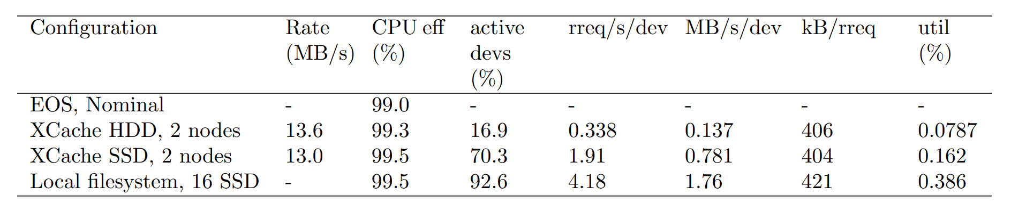
Results for top-xaod
Extremely low I/O: very low rates and almost 100% CPU efficiency
The storage is de facto irrelevant

Slide 18
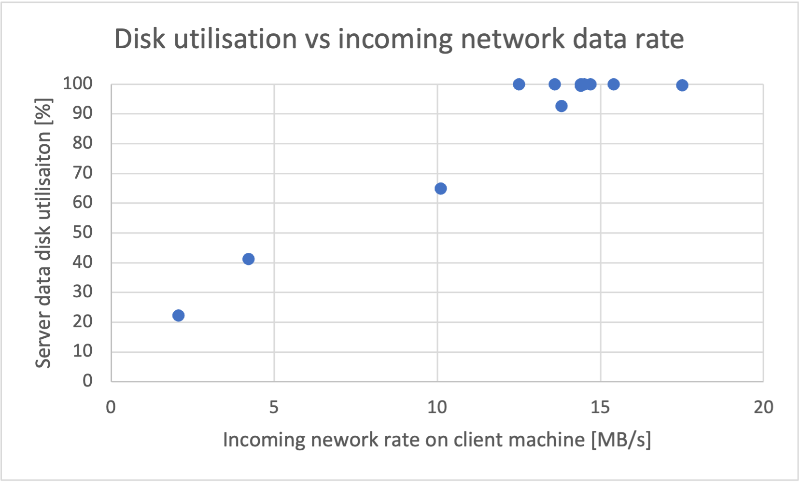
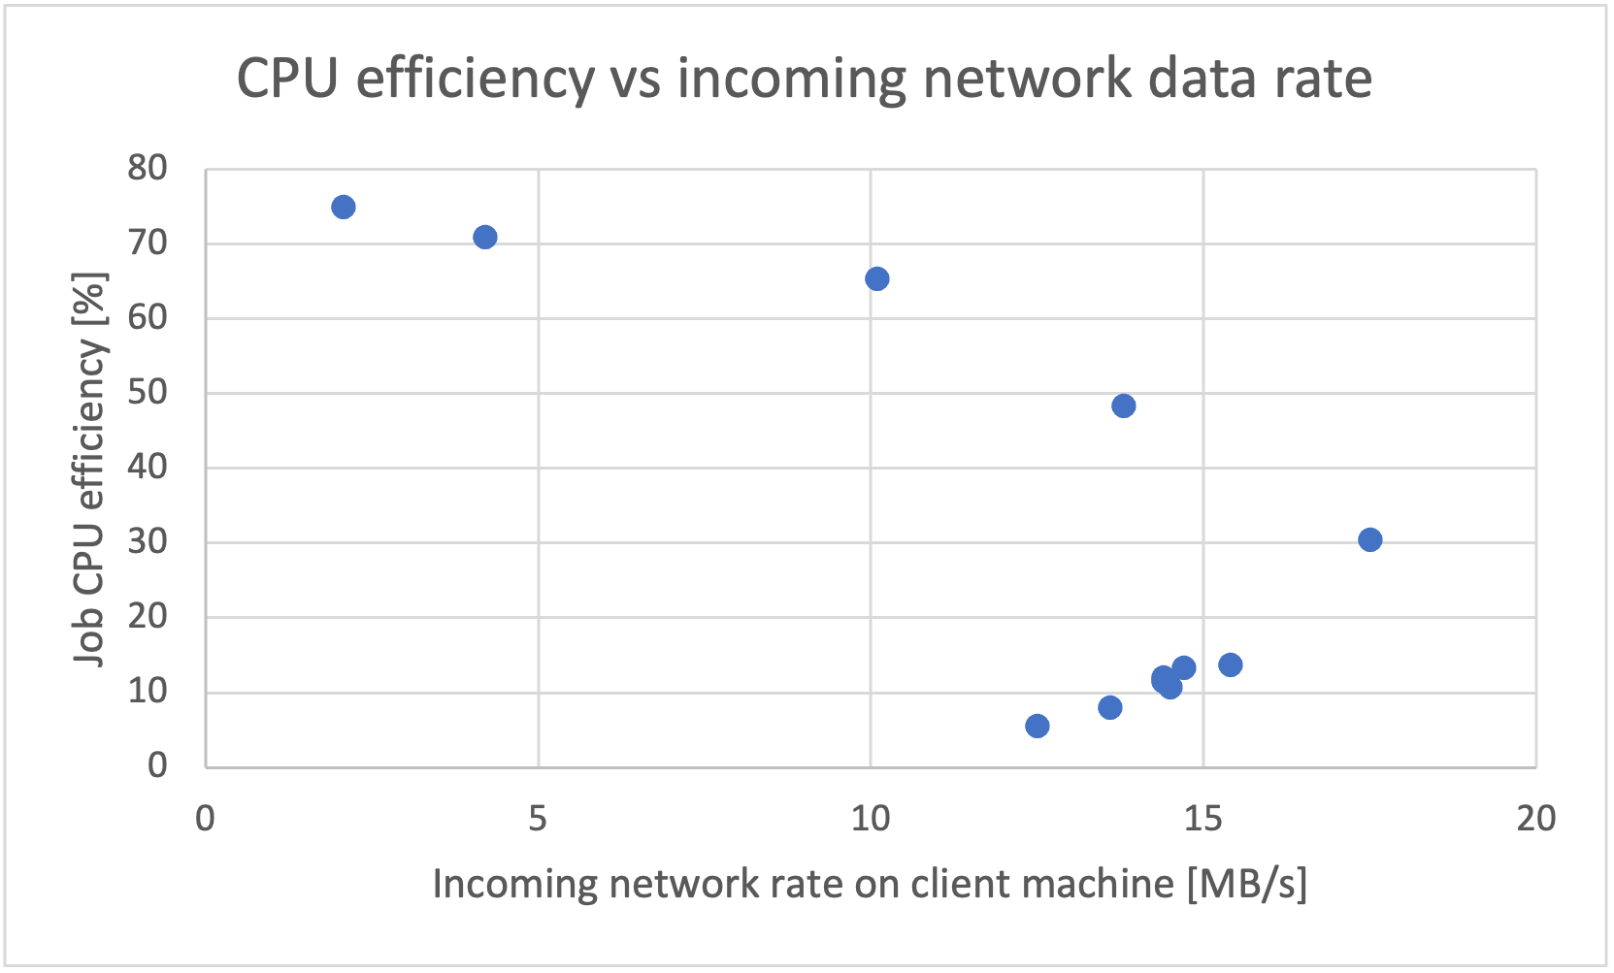
Disk utilization and job performance: an example
Used cms-skimmer and varied the number of concurrent jobs from 1 to 64
  Each accessing a different data file via xrootd from a plain xrootd server
  All files on a single HDD
Measured total data rate vs. disk utilization vs. CPU efficiency
  Increasing number of jobs increases disk utilization and total rate until the former saturates and the rate eventually falls
  CPU efficiency decreases with increasing number of jobs and does so dramatically once 100% disk utilization is achieved
Storage scalability is completely dependent on the access patterns and the application

Slide 19
XCache scalability estimates
Estimate the number of client threads that would saturate the XCache instance
  Network limit: saturation of the network interface bandwidth (2800 MB/s)
  Disk utilization limit: saturation of the storage devices
  Results are rescaled to assume a 100% CPU efficiency, so they are a lower limit
Workload | Network limit | Disk limit (96 HDD) | Disk limit (16 SSD)
top-xaod | 14000 | 40000 | 20000
cms-skimmer | 1500 | 1800 | 2800
aggregate gradients | 20 | 130 | 60
Planning hardware-friendly hardware requires to first study the relevant workloads!
  Match the disk performance and the network
  The optimal storage architecture depends (strongly) on the application

Slide 20
Data access performance wrap-up
Observations generally match the expectations
  Higher rates with sequential patterns (difference less important for SSDs)
  High throughput jobs have lower CPU efficiencies
  Access to locally attached storage is fastest (no network bottlenecks)
  On a single HDD, data rate approximately proportional to disk utilization until near saturation
  The scalability of an XCache instance is critically dependent on the workload

Slide 21
Conclusions
The scope of these investigations is physics analysis, the goal is to determine if new resources had to be invested on for Run 3
  Find out if there are bottlenecks in EOS for LXPLUS/LXBATCH analysis
  Study data access performance of (interactive) analysis on high performance nodes for different storage configurations
Results
  The existing hardware in the IT CC is generally able to handle current analysis activities
    High performance/throughput servers can be requested by physics groups
  The EOS disk servers operate well below saturation with the current hardware and software
Focus on analysis is rapidly increasing in many communities
  CERN IT, SFT, experiments, HSF, WLCG, …
  Continue performing performance studies to improve our understanding of analysis use cases
  Encourage interaction with analysis users to discuss together their needs

Slide 22
Acknowledgements
Many thanks to all members of the working group
  Josh Bendavid, Alessandro Di Girolamo, Enrico Giraud, Lukas Heinrich, Michael Holzbock, Ben Jones,Oliver Keeble, Matt Leblanc, James Letts, Zach Marshall, Helge Meinhard, Tadej Novak, Andreas Peters, Danilo Piparo
And to
  Riccardo Castellotti, Andrey Kiryanov, the SWAN team, the Spark/HADOOP team

Slide 23
Backup slides

Slide 24
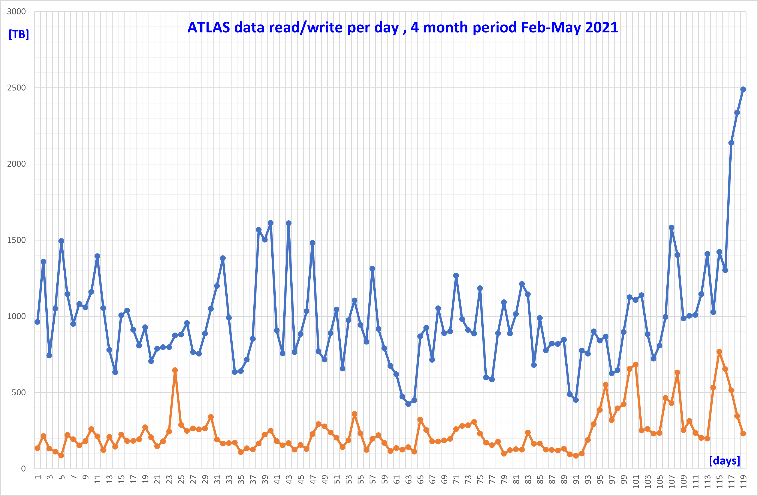
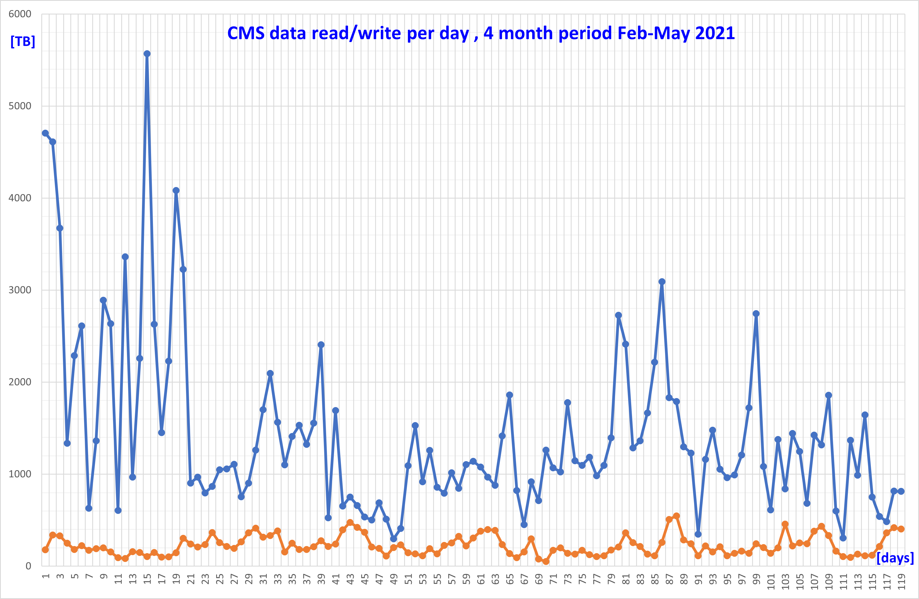
EOS daily amounts of data read/written

Slide 25
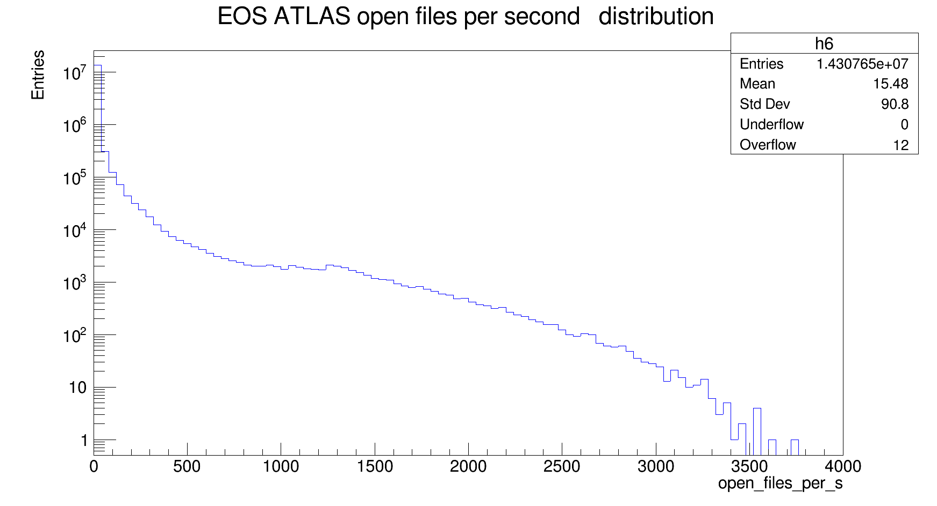
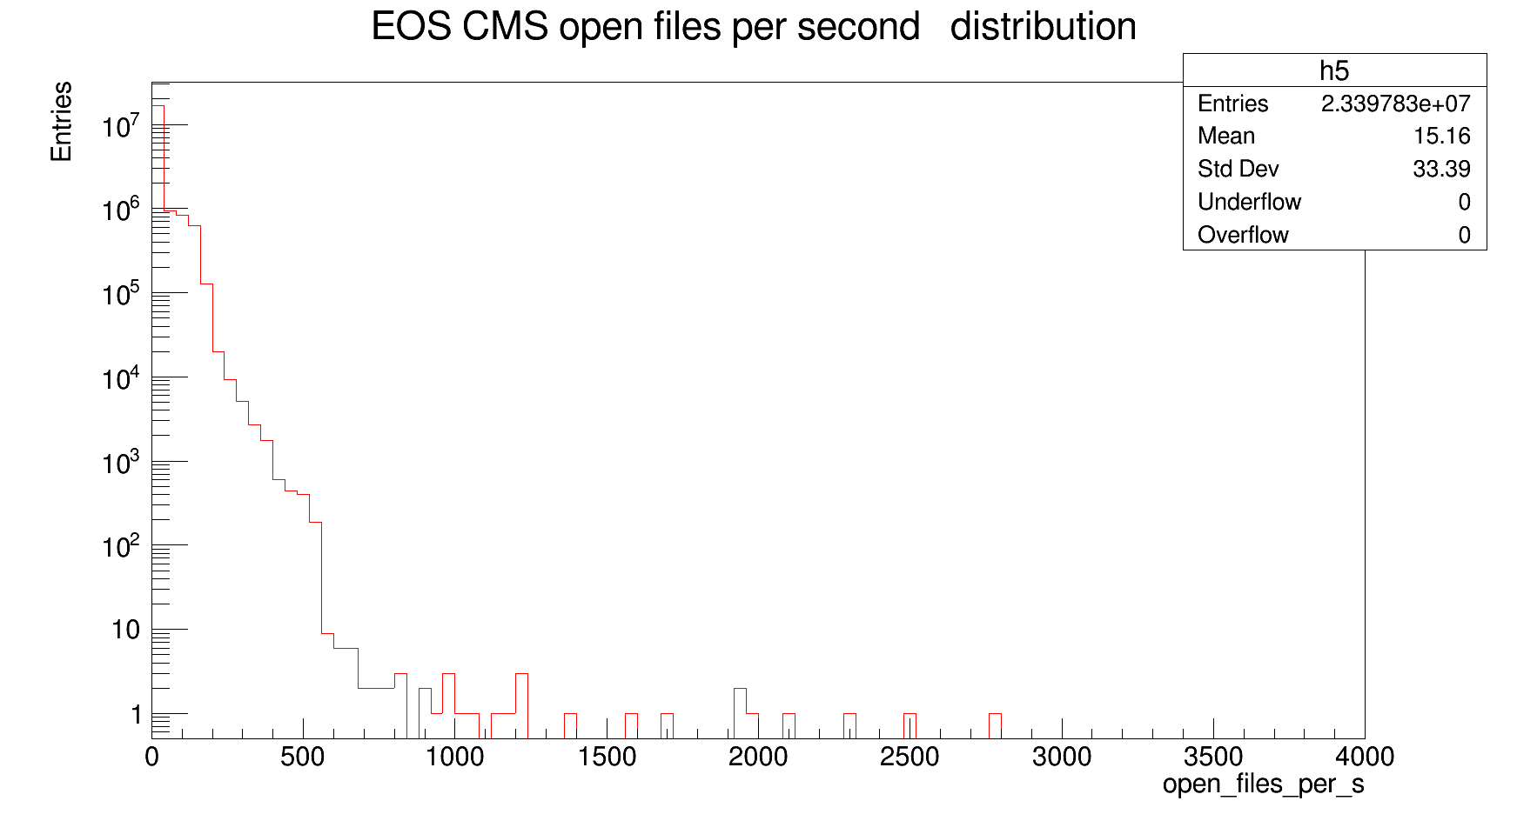
File opens per second

Slide 26
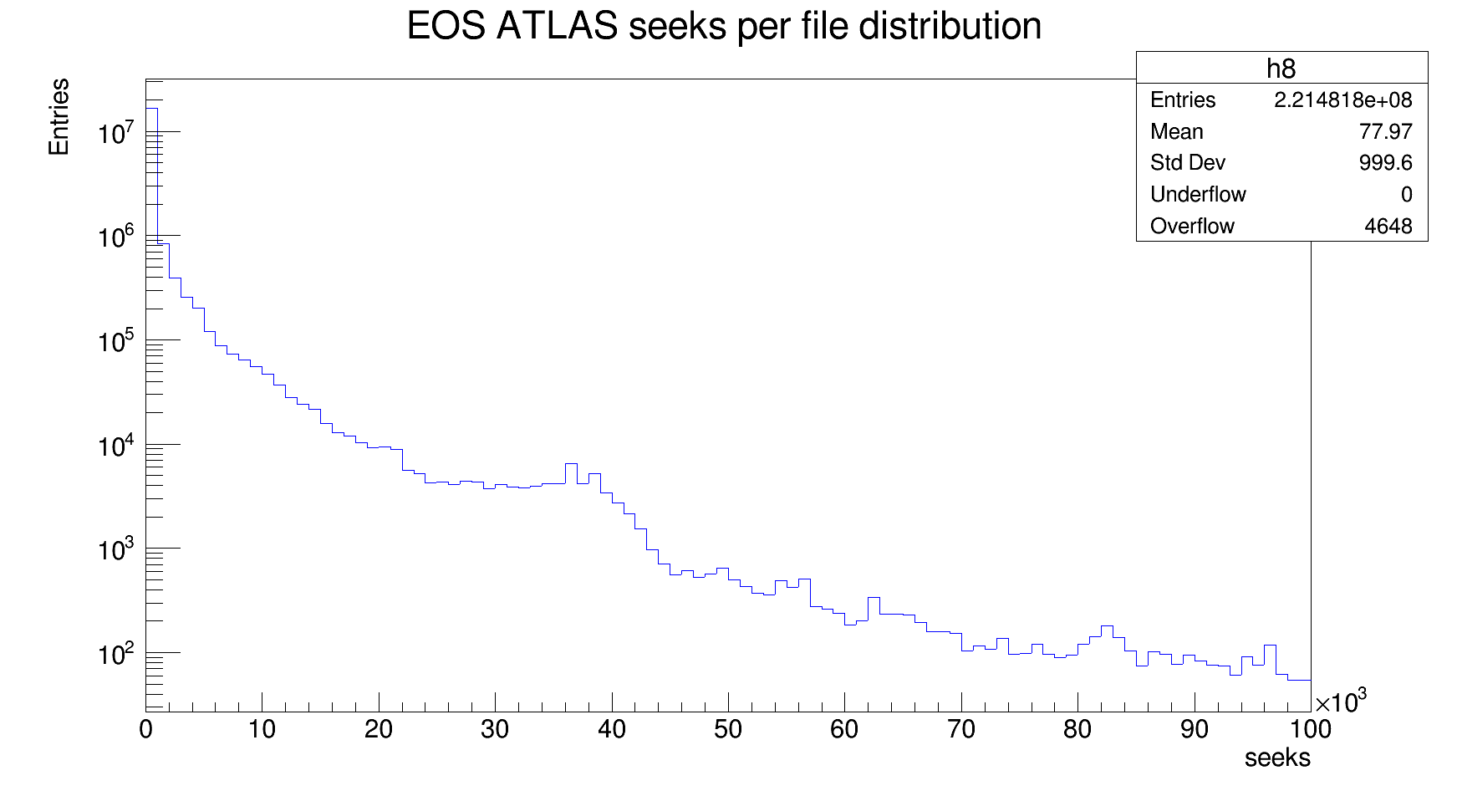
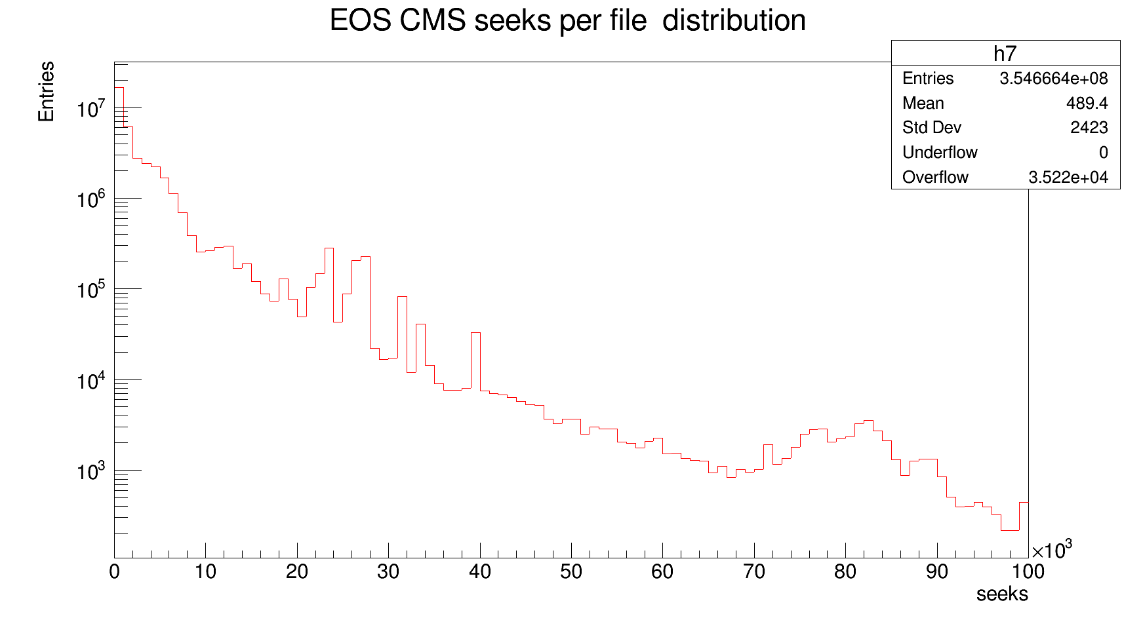
Seeks per file

Slide 27
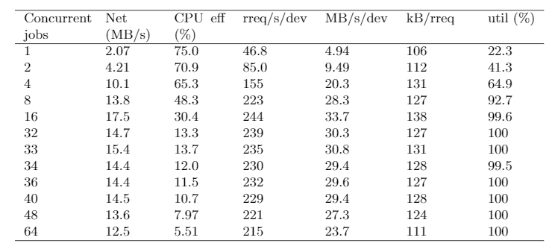
Cms-skimmer jobs against a single HDD: all metrics

