Slide 1



A new Ceph deployment using Cephadm at RAL
HEPiX Spring 2022
Kyle Pidgeon
Scientific Computing Department,
STFC UKRI

Slide 2
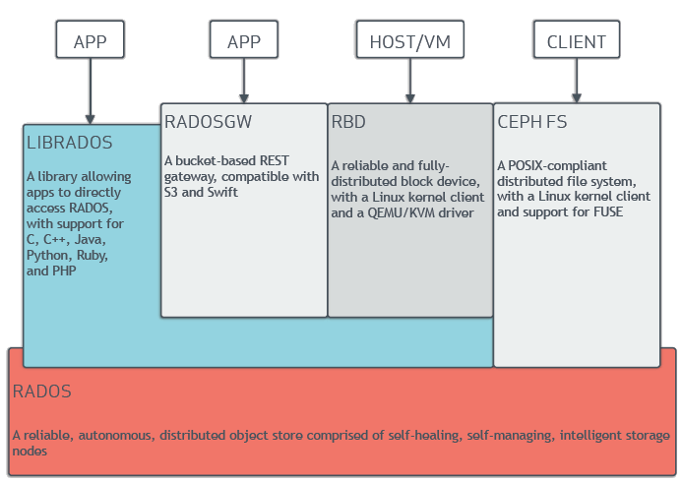
Ceph
“Ceph is an open-source software storage platform, implements object storage on a single distributed computer cluster, and provides 3-in-1 interfaces for object-, block- and file-level storage.” – Wikipedia
Scalable and reliable
  Dynamic rebalancing and recovery
Many plugins and drivers for
integration with other technologies

Slide 3
Ceph at RAL
ECHO – Tier-1 storage
  ~50PiB raw storage capacity
  S3, XRootD, GridFTP
Sirius
  Block device storage for Cloud VMs
Deneb
  CephFS, used by several STFC Facilities e.g. ISIS and CLF

Slide 4
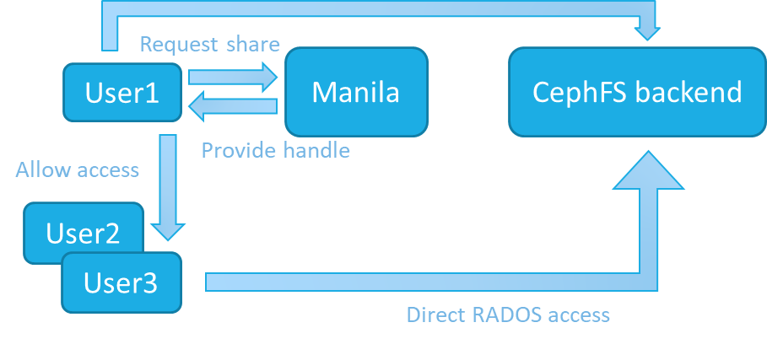
A new cluster: Arided
Backend for an OpenStack Manila service
  ‘Shared Filesystem Service’
Motivated by:
  High demand for FS storage
  Potential disruption if using e.g. Deneb
  Ability to use faster SSD storage
Opportunity to try out new (to us) deployment methods
  And a newer version of Ceph than is used on the current clusters (Octopus)

Slide 5
Cephadm
Container orchestration for Ceph daemons
  Can automate deployment, scaling, management of cluster
Fully-featured
  Implements all of Ceph’s generic ‘Orchestrator’ features
  Seems to be a primary focus of Ceph developers
Minimal requirements
  Python3, Docker, systemd, LVM

Slide 6
Ceph Orchestrator interface
API
ssh
Host 1
Host 2
Host 3
Container 1
Container 1
Container 1
Ceph Mon
Ceph Mon
Ceph OSD 1
Container 2
Container 2
Container 2
Ceph Mgr
Ceph Mgr
Ceph OSD 2
mgr/cephadm
mgr/cephadm
ceph orch CLI
ceph orch CLI

Slide 7
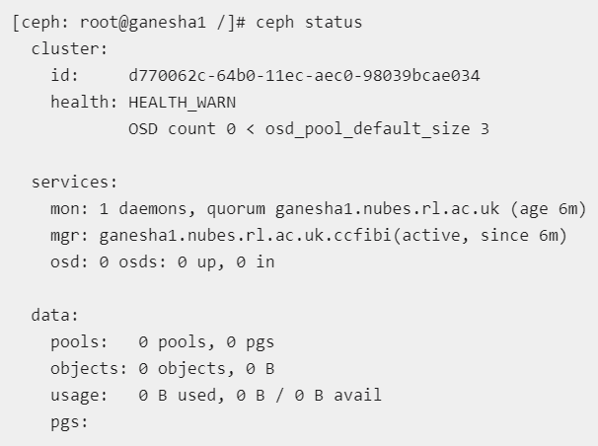
Cluster creation
(a test instance for now)
[root@ganesha1 ~]# cephadm check-host
podman|docker (/usr/bin/docker) is present
systemctl is present
lvcreate is present
Unit ntpd.service is enabled and running
Host looks OK
cephadm bootstrap
(Ceph version: Ceph Octopus 15.2.15)

Slide 8
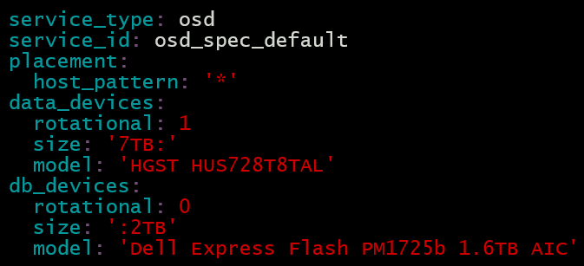
‘Day 2’ procedures
Addition of hosts to cluster
  Copy Ceph’s pub key and ceph orch host add <host>
Service placement specs
  Example uses HDDs for primary data storage and SSDs for metadata DBs

Slide 9
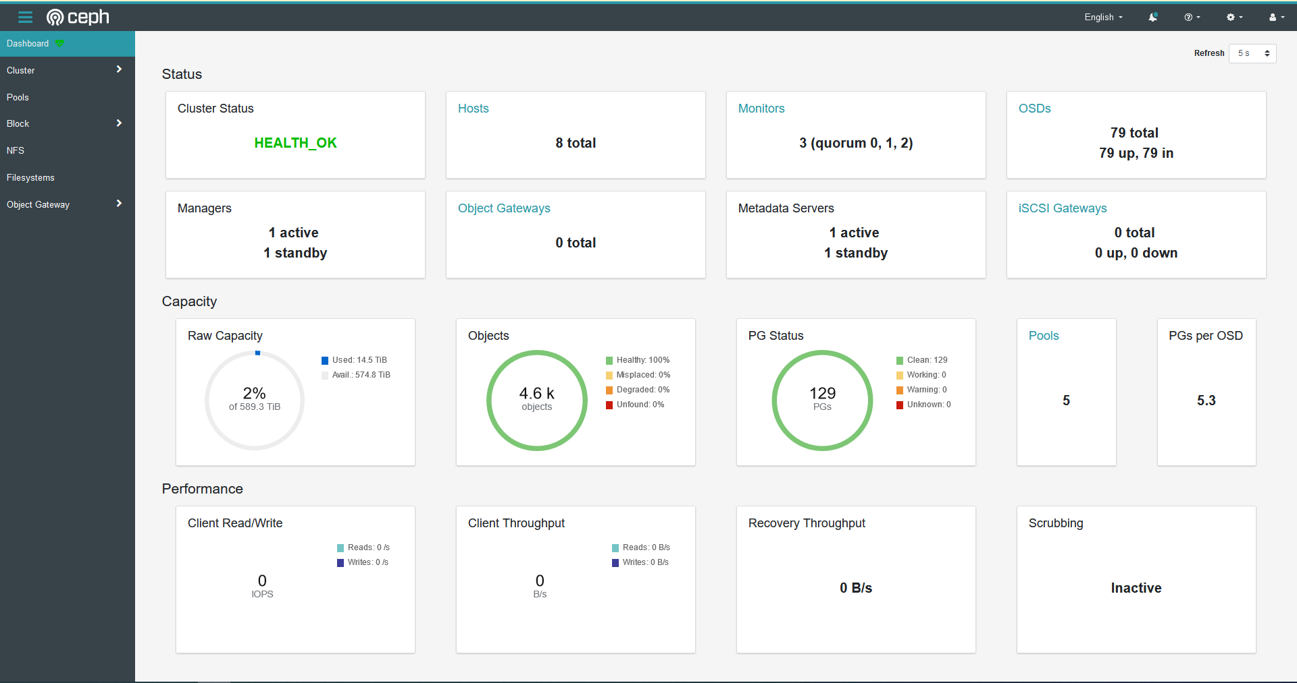
Monitoring
Full monitoring stack deployed by default
Can perform ops via Dashboard (interacts via Orchestrator)

Slide 10
Cluster admin
Orchestrator API centralises a lot of routine ops
  Daemon management from a single admin node
Creating a CephFS: ceph fs volume create <fs name>
  Automatically deploys metadata servers (MDS)
Cephadm automates some time-consuming procedures
  Cluster upgrades
  Example: storage additions/replacements

Slide 11
Disk replacements
Remove Ceph OSD from cluster
Replace physical drive
Re-create OSD & add to cluster
Admin
Admin
Admin Cephadm
Ceph OSD = a daemon that interfaces with an Object Storage Device

Slide 12
Potential downsides
Performance (but probably not)
  If degraded, probably compensated for by SSDs
Scalability
  Questions surrounding cephadm’s scalability
  Seems to have developer attention

Slide 13
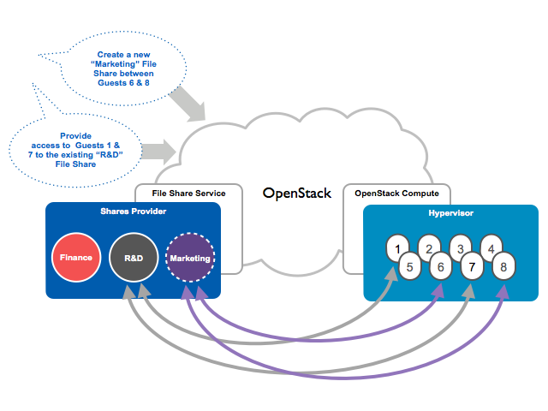
Integration with Manila
Manila will run on the STFC Cloud OpenStack
  Brings file shares into the same ecosystem as compute etc.
Specialised driver interfaces with CephFS
  Creates CephFS ‘subvolumes’ for shares etc.
Shares are mountable via Ceph FUSE

Slide 14
Summary
Developed test instance of a file shares service
  Made use of Cephadm for the Ceph backend
Cephadm…
  …allowed rapid deployment of a Ceph cluster
  …can simplify cluster admin procedures
Intending to use for production instance
  (If anyone has experience running a cephadm deployed/managed cluster in production, it’d be great to hear about it)

Slide 15
Questions?

