Slide 1
High-Gradient Acceleration and Applications
Part 1

Slide 2
Overall objectives
The main objective of these two hours of lectures are to give you an taste of high-gradient accelerators. Some of the points we will address include:
The CLIC project - features, performance demands
High-gradient acceleration – introduction, vacuum arcing
Compact applications – Technology spin-out to fields beyond high-energy physics, in particular compact facilities, with a focus on FLASH therapy
Part of the lectures are seminar-like but I’ve tried to put in theory appetizers.
Please feel free to interrupt with questions!

Slide 3
Introduction to CLIC
Physics requirements drive accelerator technology development

Slide 4
Linear colliders
Among the possible paths forward for accelerator-based high-energy physics are e⁺e⁻ linear colliders.
High-energy physics has historically advanced through the complementarity of lepton and hadron machines.
An intrinsic advantage of a linear e⁺e⁻ collider is that the collision energy is not limited by synchrotron radiation as in a ring. Synchrotron radiation power α E⁴.
Technology challenge different from hadron collider – rf (radio frequency) systems rather than magnets.
Based on these considerations, e⁺e⁻ linear collider designs and technology have been developed worldwide since the late 1980s.
Two main linear collider projects have emerged and survived:
ILC – Based on superconducting rf (radio frequency) cavity acceleration. 250 GeV center of mass. International project with Japan as host. Long-standing effort to obtain approval. https://linearcollider.org/
CLIC – Based on normal conducting high-gradient rf. 380 GeV first stage, extendable up to 3 TeV. International collaboration led by CERN. Now so-called plan B for CERN… http://clic.cern/

Slide 5
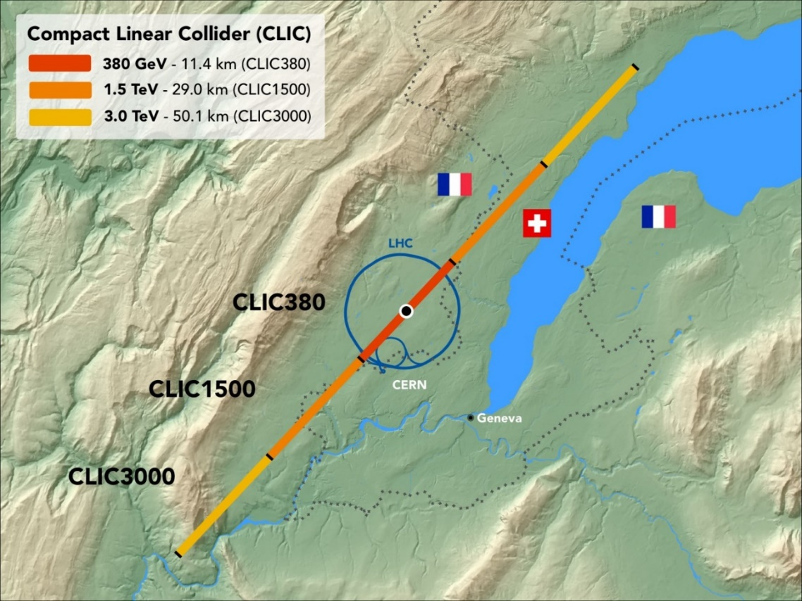
CLIC
Initial energy of 380 GeV to cover Higgs and top physics.
The highest energy stage is 3 TeV in order to complement the physics reach of the LHC, for example directly producing new particles discovered there (!). Roughly 14 TeV/6.
The higher energy stages also provide a strong probe for beyond standard model physics.

Slide 6
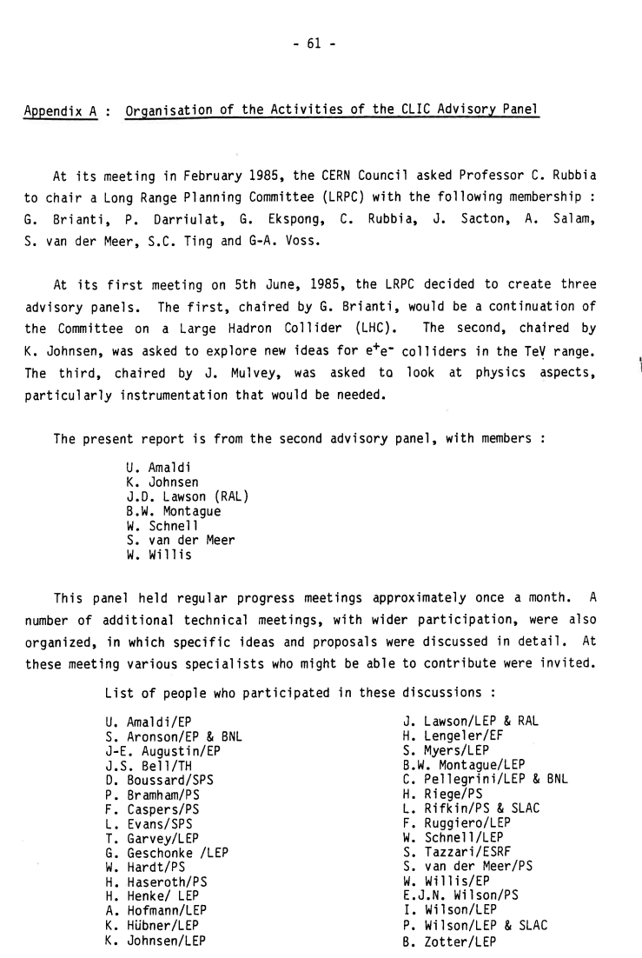
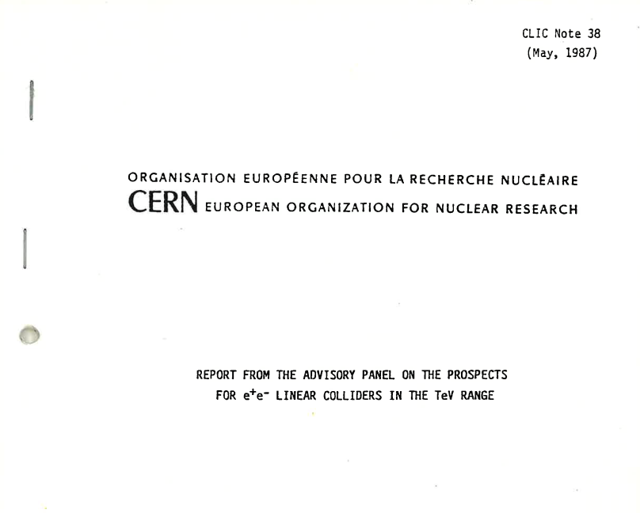
A bit of history

Slide 7
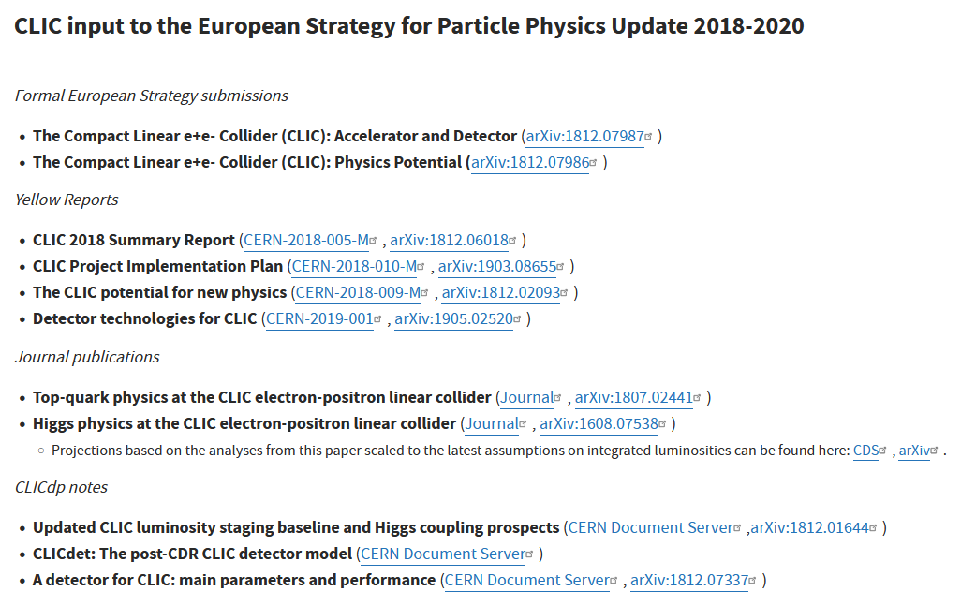
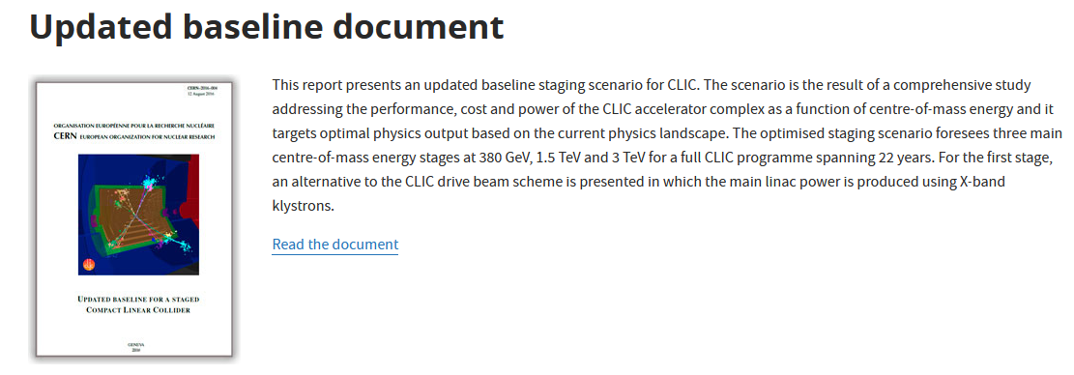
Back to the Future
https://clic-study.web.cern.ch/content/updated-baseline-document
https://clic.cern/european-strategy

Slide 8
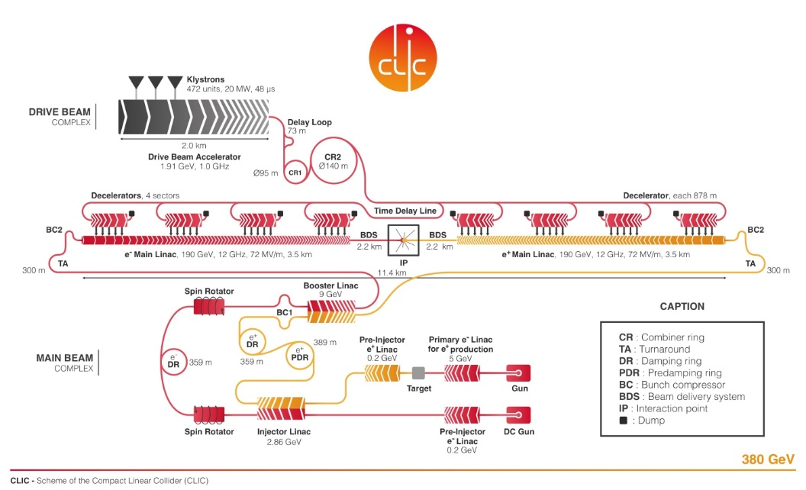
Linear collider features
Beam energy:
Beams take single pass through machine, so collision energy is length times gradient.
High-gradient becomes a key performance parameter.
CLIC uses 72 MV/m for 380 GeV stage and 100 MV/m for 3 TeV stage.
Normal conducting rf
These gradients used to be beyond state-of-the-art consequently CLIC invested significant resources in finding ways to increase gradient.
Plasma enthusiast aim to go even higher.
No upper limit on energy due to synchrotron radiation energy loss – but –rf system must proved full energy in one pass.

Slide 9
Linear collider features
Luminosity:
Beams collide only once.
Aim for high current and very small beam at interaction region.
CLIC beam current is approximately 1 A during pulse, 7.3 µA average per beam so a total of 5.5 MW average beam power – developed extremely efficient acceleration with strong beam loading.
The beam size at the interaction region 150 x 3 nm – damping rings to produce very low emittance beams plus very precise alignment to maintain low emittance in linac.

Slide 10
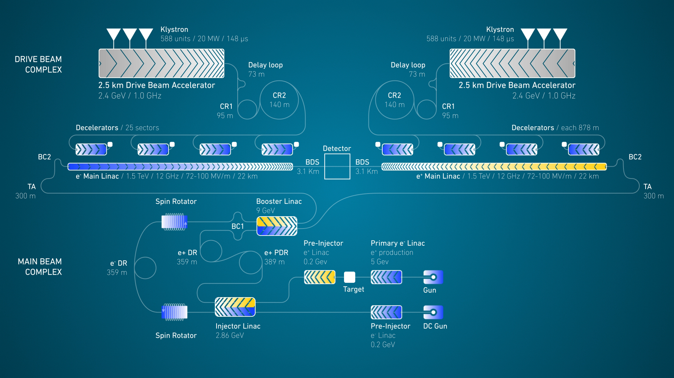

Slide 11
A very brief introduction to radio frequency acceleration

Slide 12
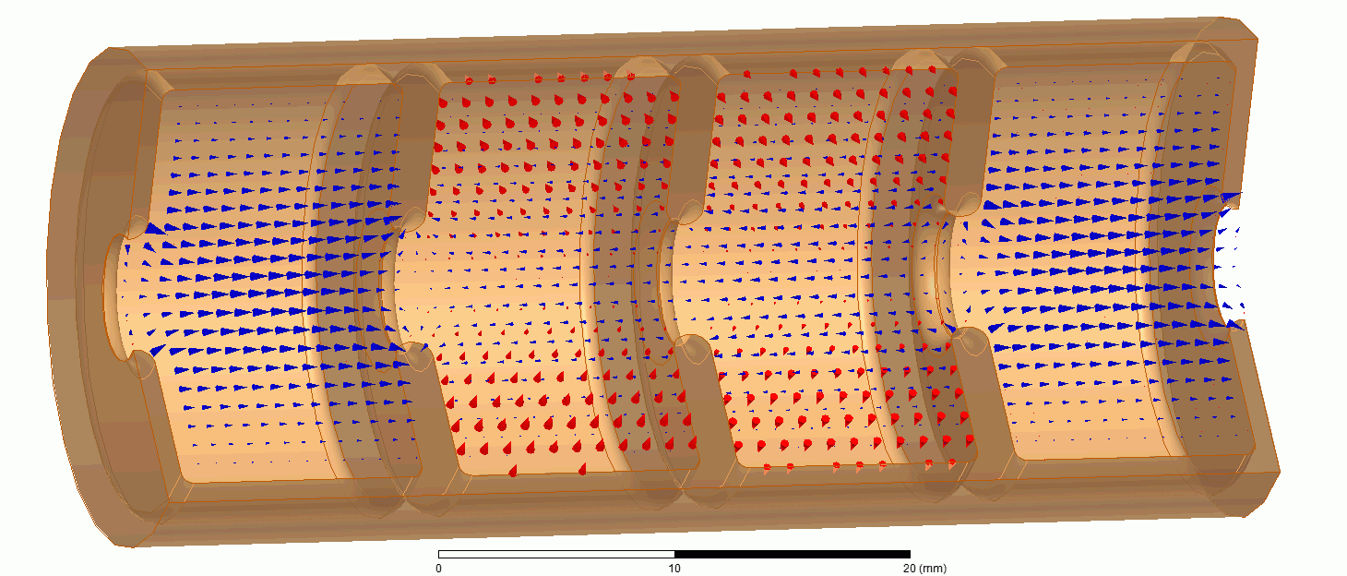

Electric field
Magnetic field
Beam propagation direction. Beam and phase velocity must be the same – synchronism.
How can this be arranged?

Slide 13
Uniform (rectangular) waveguide
Field solution
The lines are electric field
y
x
Width a
Gives cutoff frequency

Slide 14


The dispersion curve
$$v_{phase}=\frac{ω}{k}$$
case 1
Speed of light line
case 2
$$e^{i\left(ωt−kz\right)}$$
Horizontal green line: waveguide k is 0.75 of free space k at 11.994 GHz

Slide 15
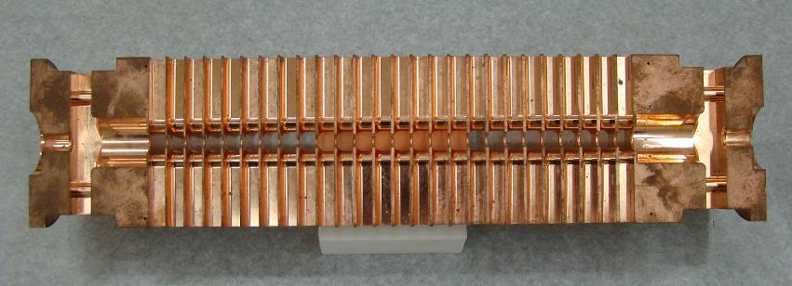
How do we slow down phase velocity to c?
Uniform waveguide
Periodic loading

Slide 16
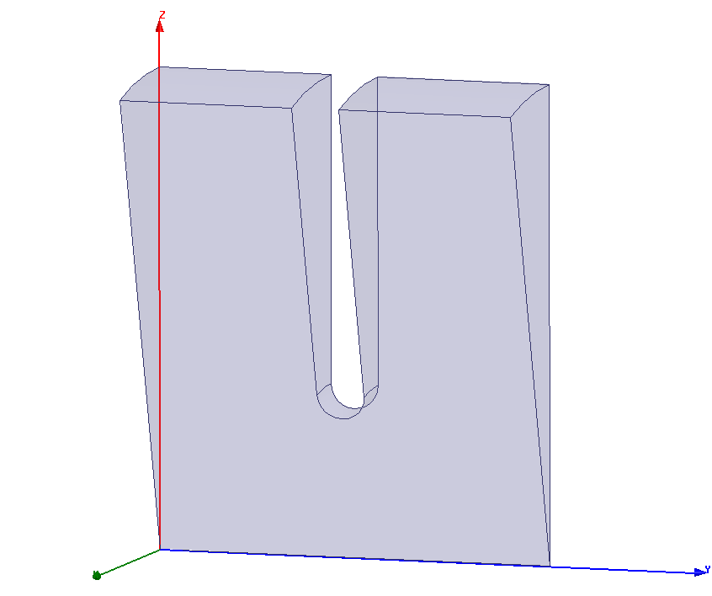
Solve the problem that phase velocity is too high (wavelength is too long) with periodic loading by putting “irises” in the uniform waveguide
speed of light
Floquet’s theorem states, translated to rf language, that periodic boundary conditions give solution with same field in every cell, just differing by a complex phase advance.
L
kL
periodic loading

Slide 17
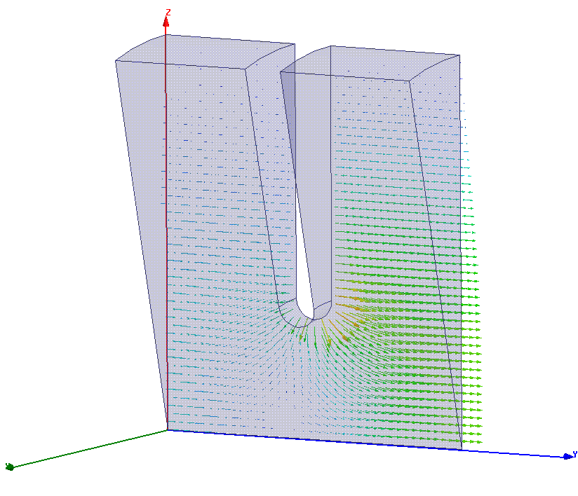
Single cell electric field pattern 2π/3 phase advance
Phase synchronism means time for beam to get across cell is the same as accelerating phase to get across cell.

Slide 18
The Brillouin diagram. Frequency vs phase advance per period, which is kL.
2π
π
stop band
pass band
synchronism
0
0
kL
π

Slide 19
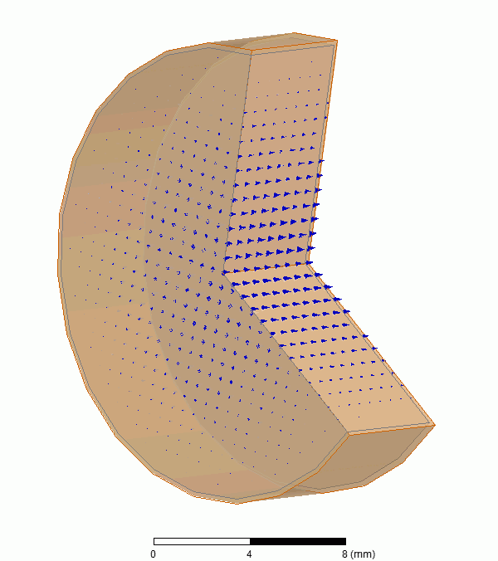
Quantities people use
Quality factor
Shunt impedance [MΩ]
Often the quantity used to optimize cavity design
Ratio of acceleration to stored energy

Slide 20
rf power in, approximately 50 MW, fed into the structure symmetrically.
Beam accelerated by 100 MV/m

Slide 21

Group velocity
We now go from stored energy to power via group velocity:

Slide 22
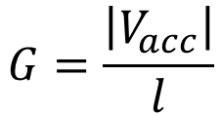
Quantities people use with group velocity mixed in
Ratio of acceleration to stored energy
Quality factor
Shunt impedance [MΩ]
Often the quantity used to optimize cavity design
We now go from stored energy to power via group velocity:
$$G=\frac{\left|V_{acc}\right|}{l}$$

Slide 23
CLIC structure (approximate values):
R’=100 MΩ/m, Q=5500, v_{g}/c=1%

Slide 24
The layout of a linac radio frequency unit

Slide 25
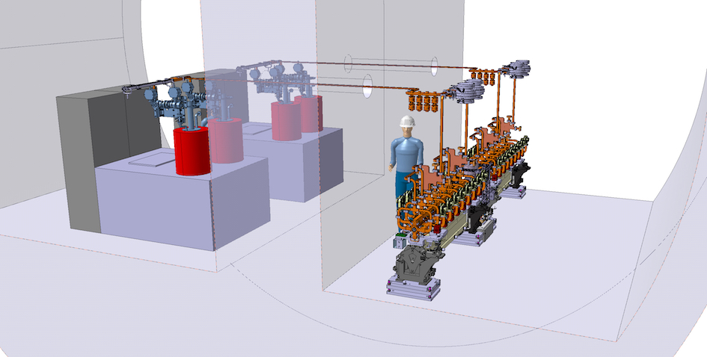
Linear accelerator, linac, overview
Pulse compressor
Modulator
Accelerating structures
Klystron

Slide 26
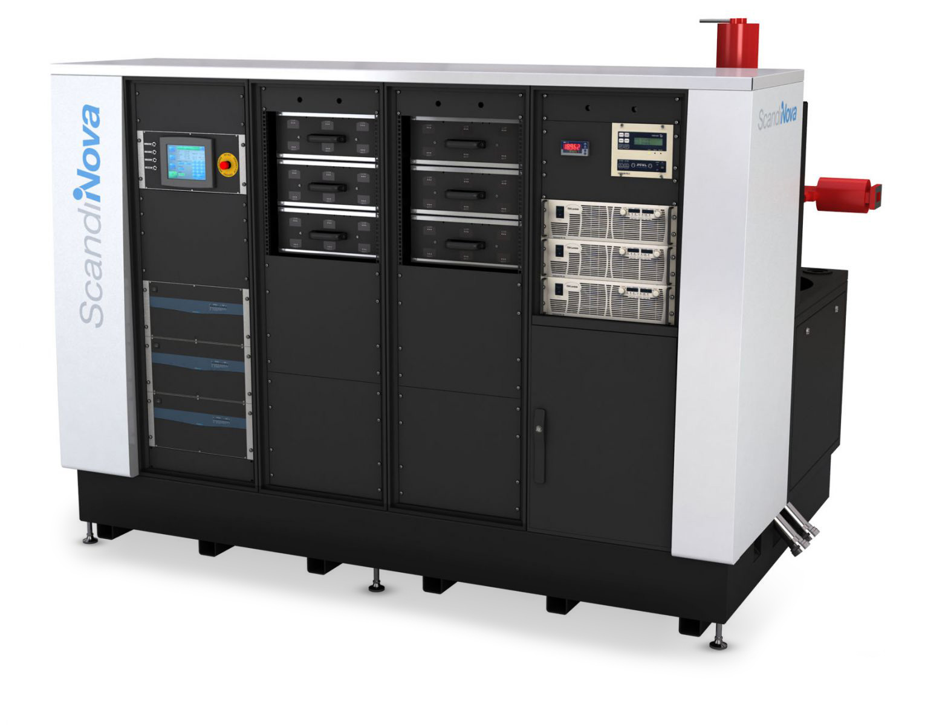
Solid-state modulator
Converts mains to 1.5 kV and stores energy in capacitors.
Switches IGBTs which feed split core transformer
Secondary on transformer produces (approximate numbers) 400 kV, 200 A pulse, which is 80 MW. Pulse duration is 1.5 µs.
Note pulse is longer than we need for accelerator.
Prototype modulator used in high-gradient test stands.

Slide 27
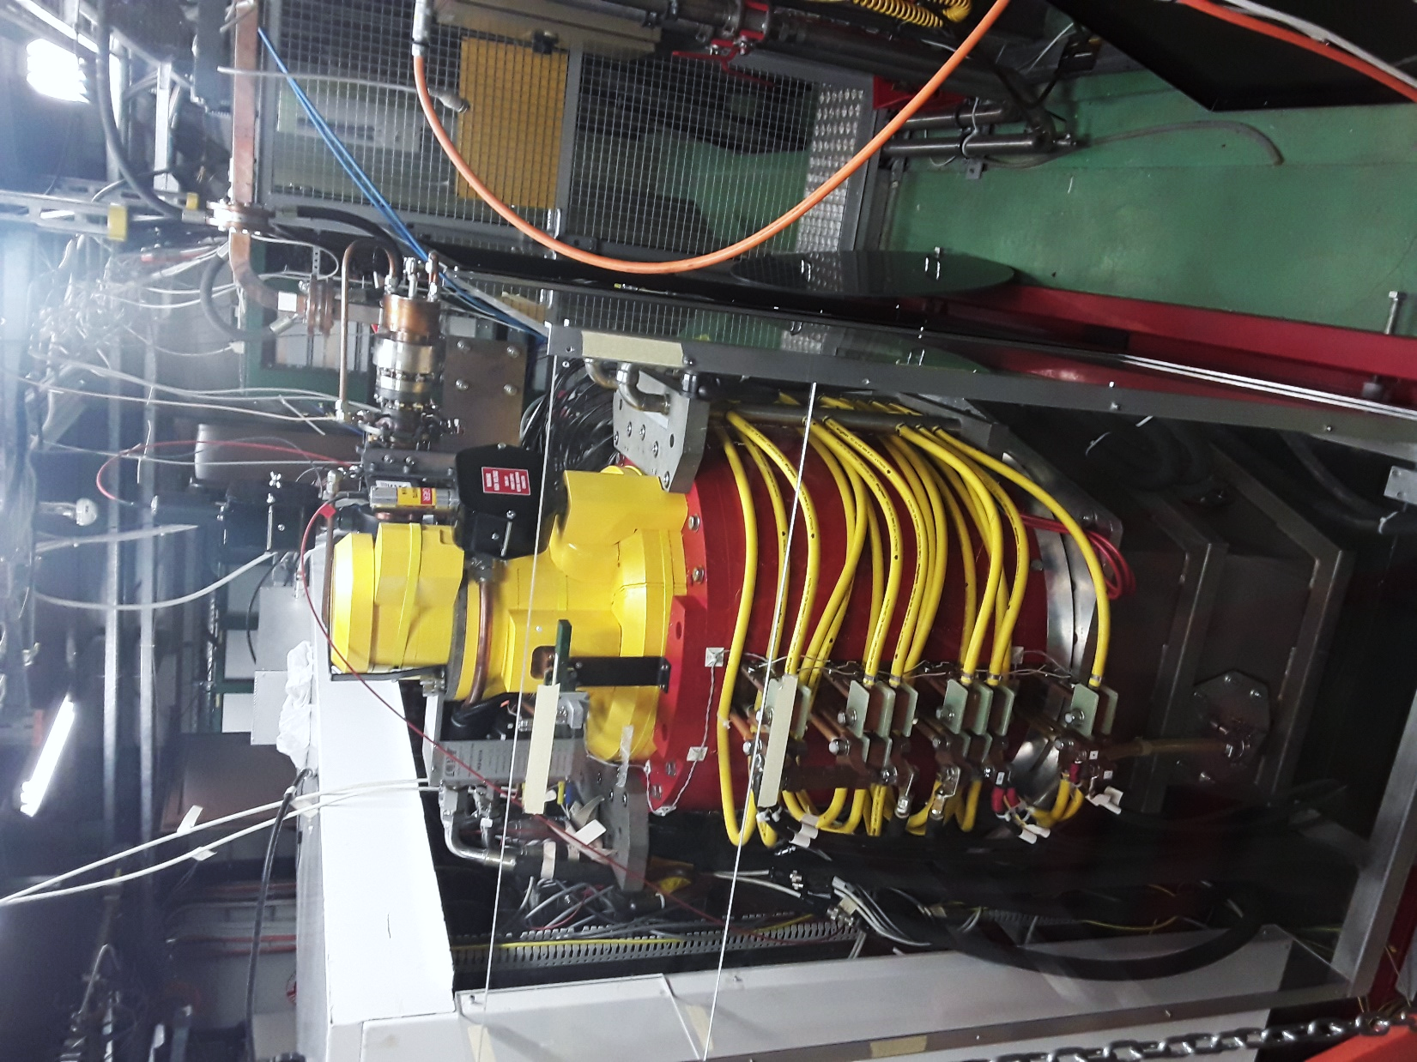
Klystron
Pulse from modulator is converted to a current in vacuum inside the klystron, approximately 400 keV and 200 A.
This is done by emitting electrons from a cathode, making a vacuum diode.
400 keV is sub-relativistic. This allows the beam to be bunched through a velocity modulation.
Power is extracted by cavity which decelerates the bunched beam.

Slide 28
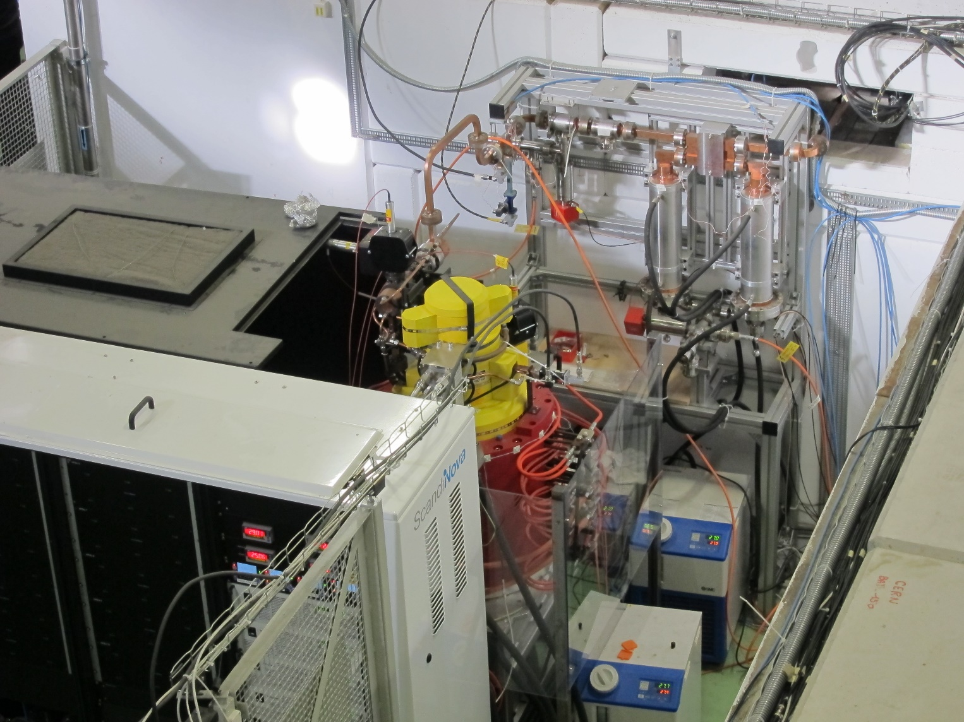
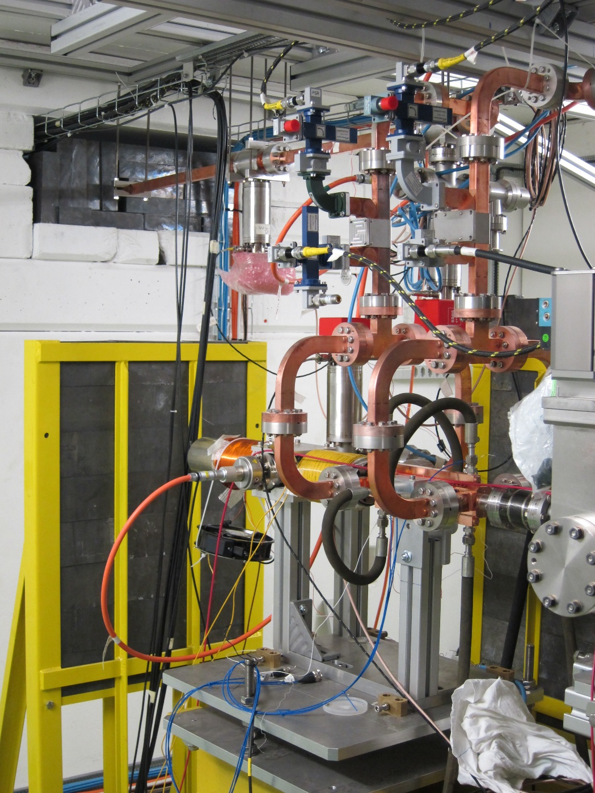
This klystron modulator unit feeds…
this accelerating structure.

Slide 29
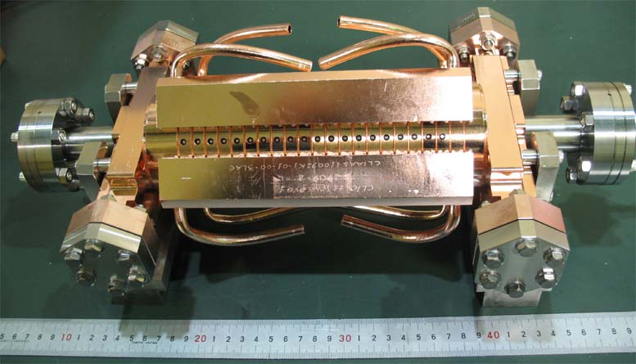
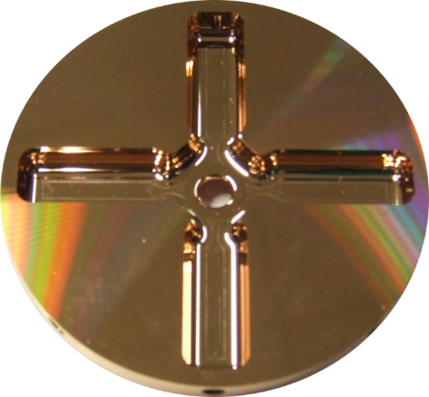
A CLIC prototype accelerating structure.
11.994 GHz X-band
100 MV/m acceleration
Input power ≈50 MW
Pulse length ≈200 ns
Repetition rate 50 Hz
outside
inside

Slide 30
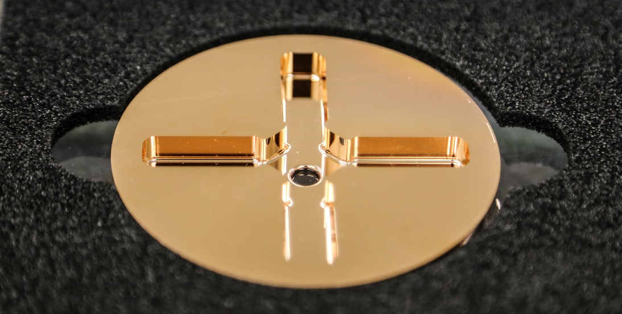
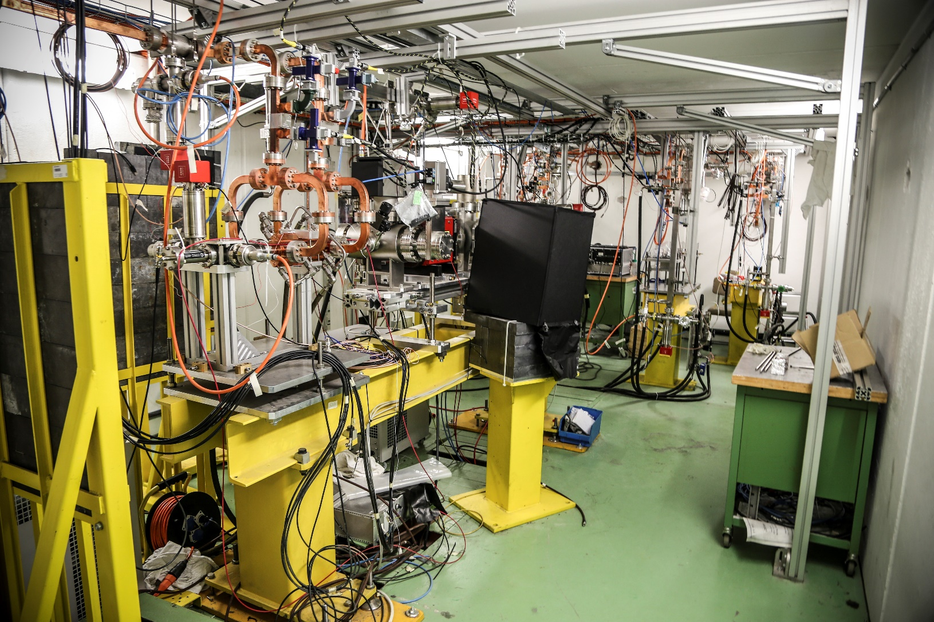
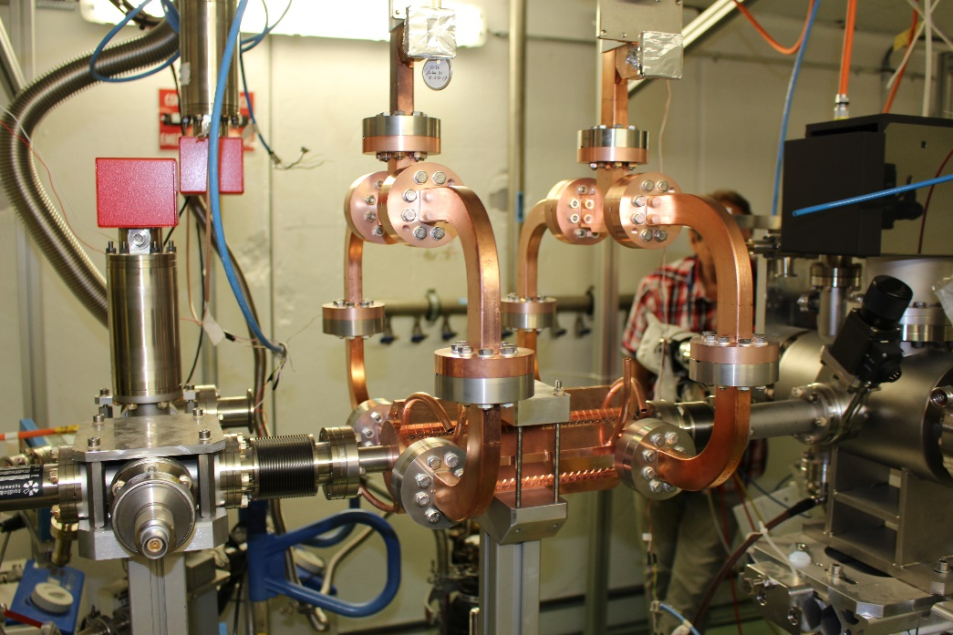
Introduction to CLIC linac technology
Very strong involvement of University of Tartu and University of Helsinki in understanding high-gradient phenomena!

Slide 31
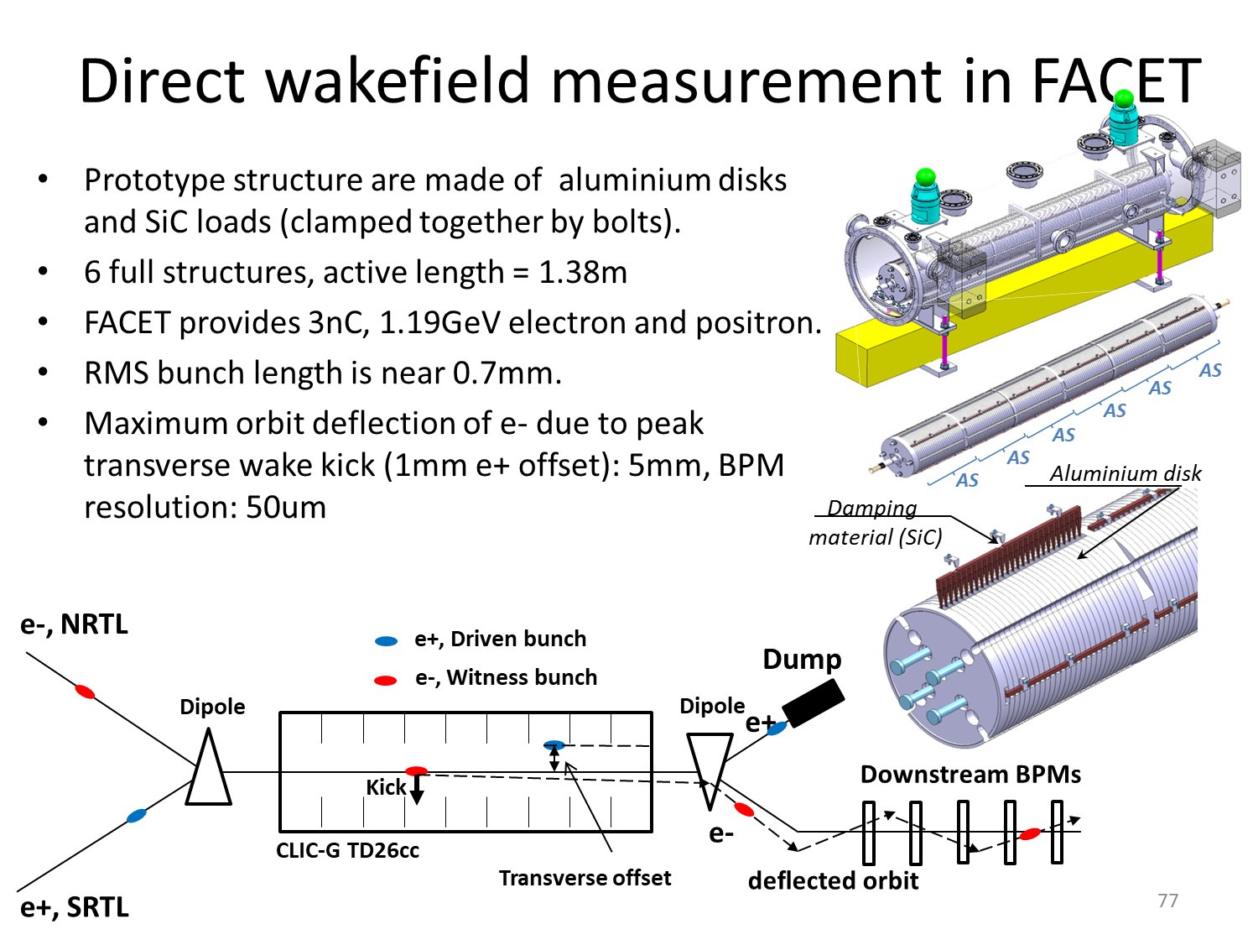
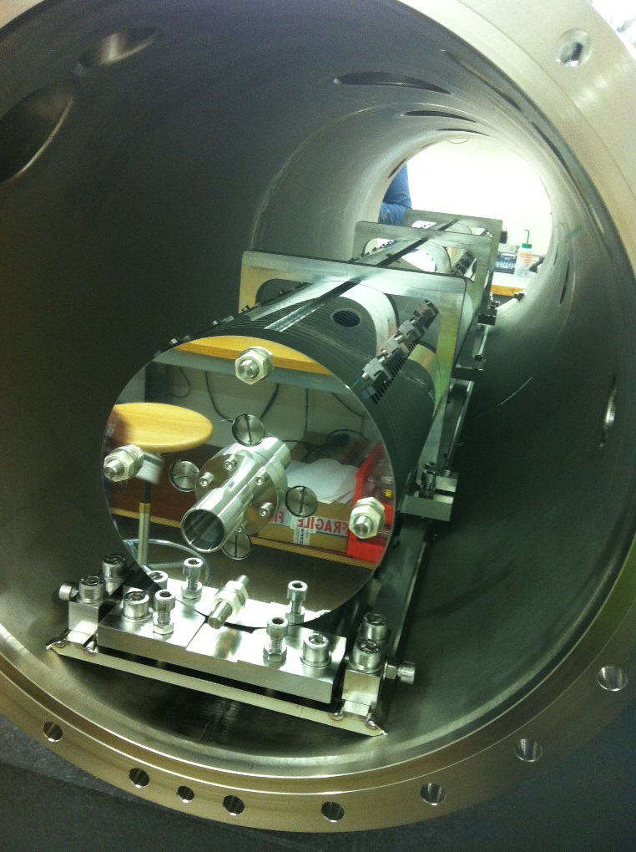
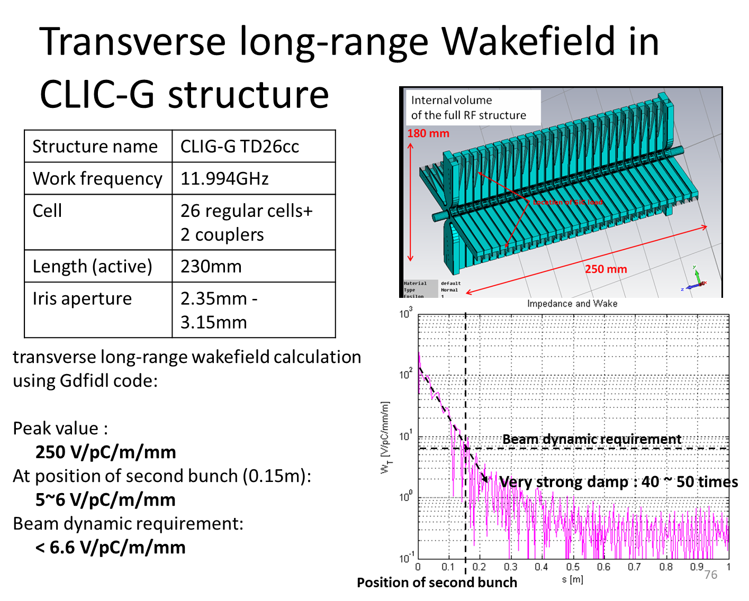
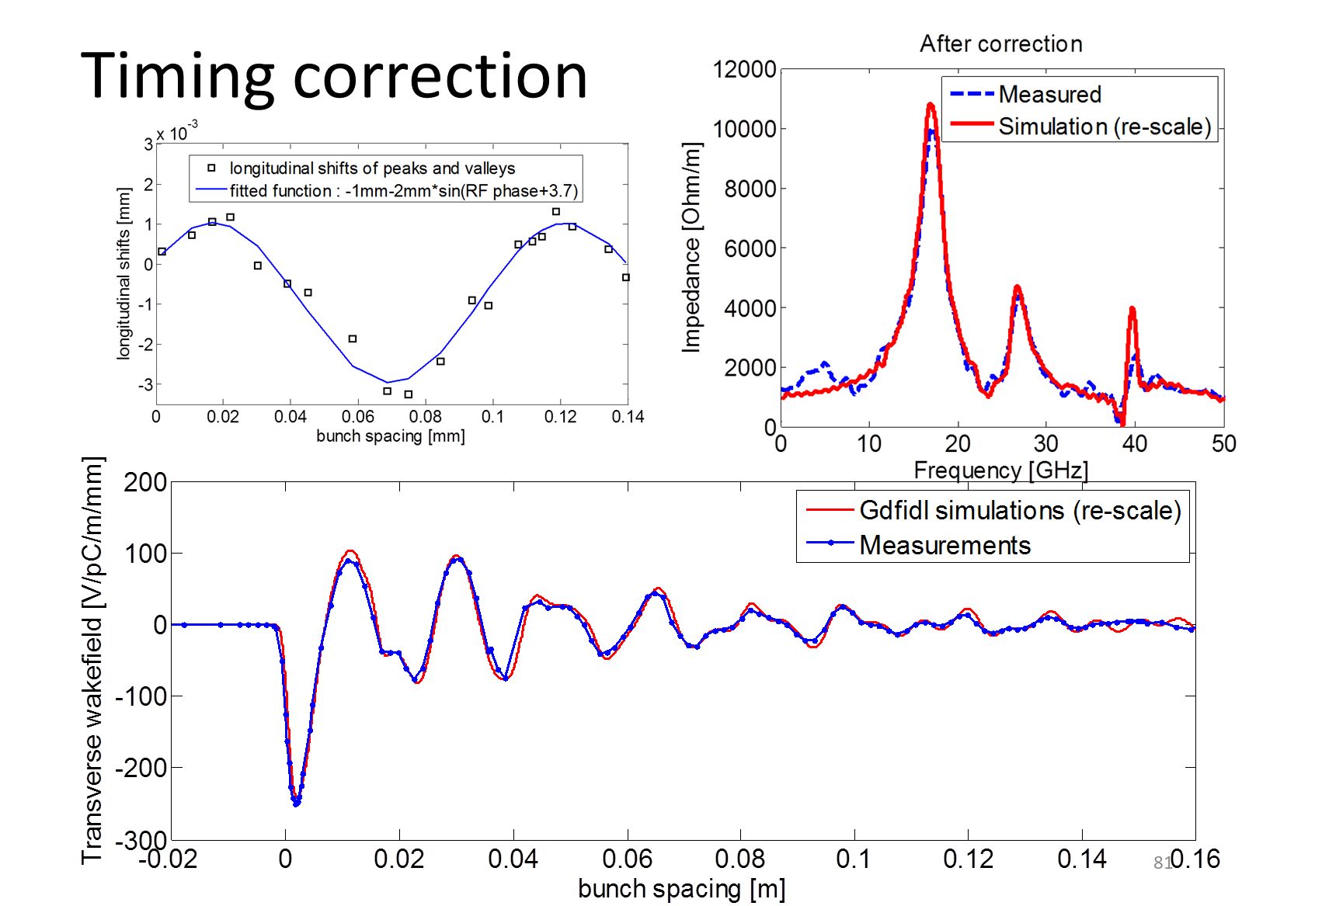
High current beam stability
High-current beam requires Higher-Order-Mode suppression for beam stability, just like CLIC
https://doi.org/10.1103/PhysRevAccelBeams.19.011001

Slide 32

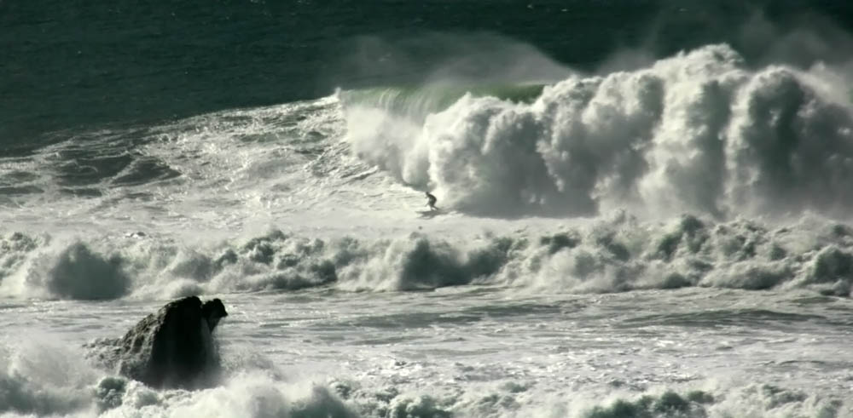
Now – The thrilling world of high gradients!
"Mavericks and surfer" by Brocken Inaglory. Licensed under CC BY-SA 3.0 via Commons - https://commons.wikimedia.org/wiki/File:Mavericks_and_surfer.jpg#/media/File:Mavericks_and_surfer.jpg

Slide 33
Motivation
We have seen that CLIC (and tomorrow see other applications) requires a high collision energy. This makes a high accelerating gradient an extremely important parameter to reduce the length and cost of the facility.
But going to high gradient requires:
High peak rf power
Facing high field phenomena, especially vacuum breakdown (sparking)
Vacuum breakdown has been known about for a long time, but with limited quantitative understanding. The CLIC project has invested significant resources in extending the quantitative understanding of vacuum arcing in order to improve the performance of CLIC structures and so reducing the cost of CLIC and extending its energy reach.
Also vacuum arcing is a fascinating and extremely challenging problem of applied physics!
Connection point - You’ve already had an extensive introduction to breakdown in Flyura’s lectures.

Slide 34
Complexity
The underlying equations for the acceleration equations we have seen are Maxwell’s equations and the Lorentz force – linear equations!
When we raise the power we put in a structure, increasing the surface fields, we encounter a whole range of new phenomena.
These phenomena include field emission and vacuum arcing and pulsed surface heating which, in various combinations, affect the beam and can damage a structure.
We need to consider:
  Electromagnetism
  Material science
  Plasma physics
  Quantum mechanics - field and photo emission

Slide 35
Vacuum arc, a.k.a. breakdown
Some (round) numbers to keep in mind:
Average accelerating gradient - 100 MV/m
Peak surface electric field – 220 MV/m
Input power - 50 MW
Pulse length - 180 ns
Pulse energy of 12 J.
Vacuum inside where beam and fields are
Usually copper walls

Slide 36
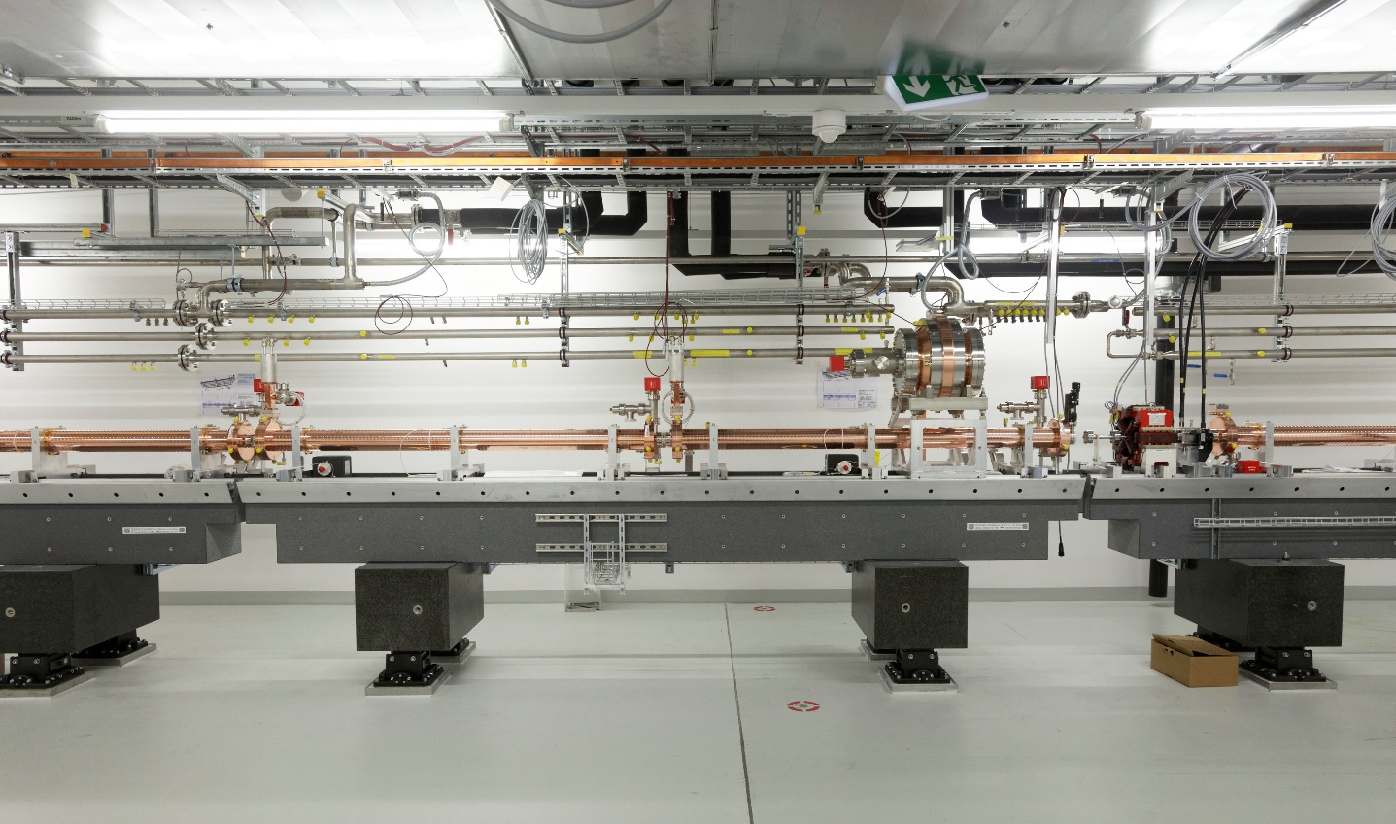
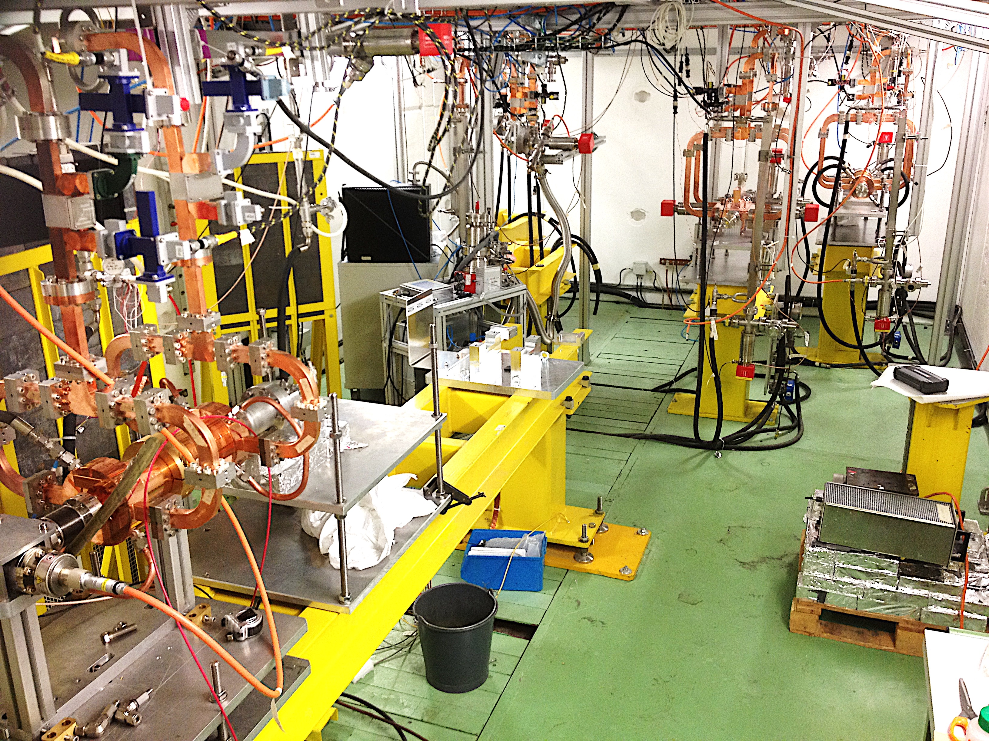
Operational and state-of-the-art
SwissFEL C-band linac:
Just under 30 MV/m
CLIC prototypes:
Over 100 MV/m

