Slide 1
High-Gradient Accelerator Development and Applications
Part 2

Slide 2
Vacuum breakdown
You saw in Flyura’s lectures an in-depth introduction to vacuum breakdown. Narrative recap:
On the microscopic scale:
High surface electric fields cause field emission of electrons from a cathode surface and transfer of electrode atoms to vacuum. The electrons ionize some of the (copper) atoms, now positively charged, which are accelerated back to the electrode surface. On impact, they eject more copper, that gets ionized, a plasma forms, with it a plasma sheath, more electrons are emitted – avalanche! This all occurs on small surface, something of the order of a few tens of microns across, and it happens quickly, in a few nanoseconds.
On the macroscopic scale:
A high voltage, or high field in the case of rf, system starts with a lot of electromagnetic energy stored in the fields and power supply of the system. It stays where it is because the vacuum is insulating. A breakdown generates a conducting zone in the vacuum, the high currents that drain the stored energy of the system and cause a sudden and substantial modification of the electromagnetic fields in the system.
Accelerator scale:
The currents and collapsing fields mean that our accelerating structures don’t. The collapsed fields give less acceleration and transverse breakdown currents distort and kick the beam.

Slide 3
Microscopic scale

Slide 4
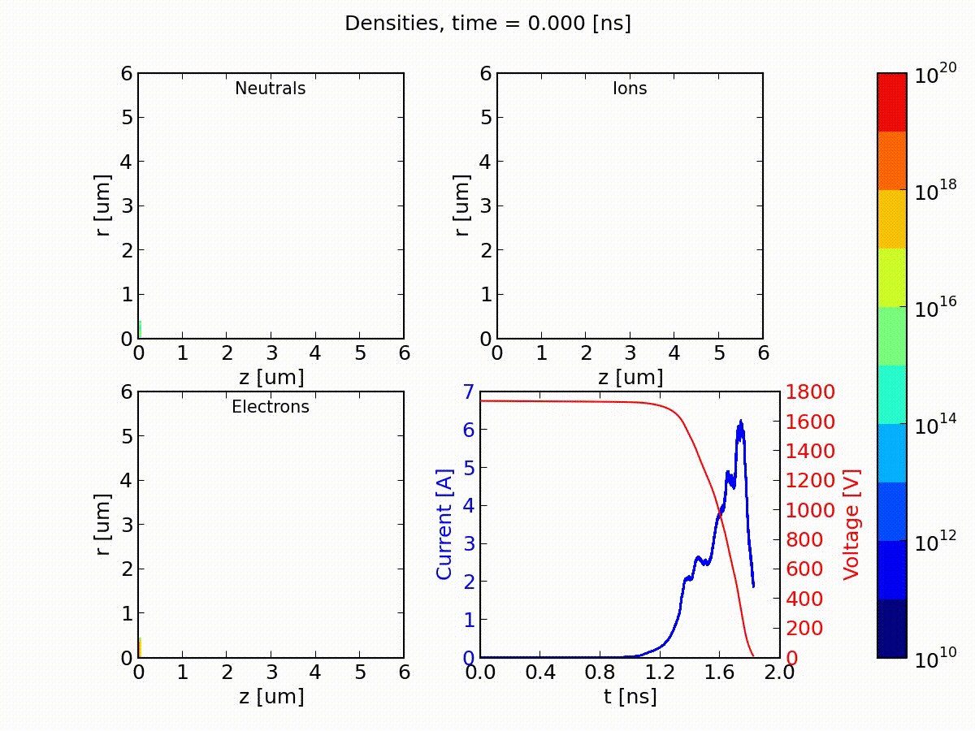

Slide 5
What’s going on inside.
ArcPIC simulation of the onset of breakdown, starting from field emission and going through the formation of a plasma, a plasma sheath and dramatically rising emitted current.
The code is ArcPIC and simulates a 20 micron wide dc gap.
https://doi.org/10.1002/ctpp.201400069

Slide 6
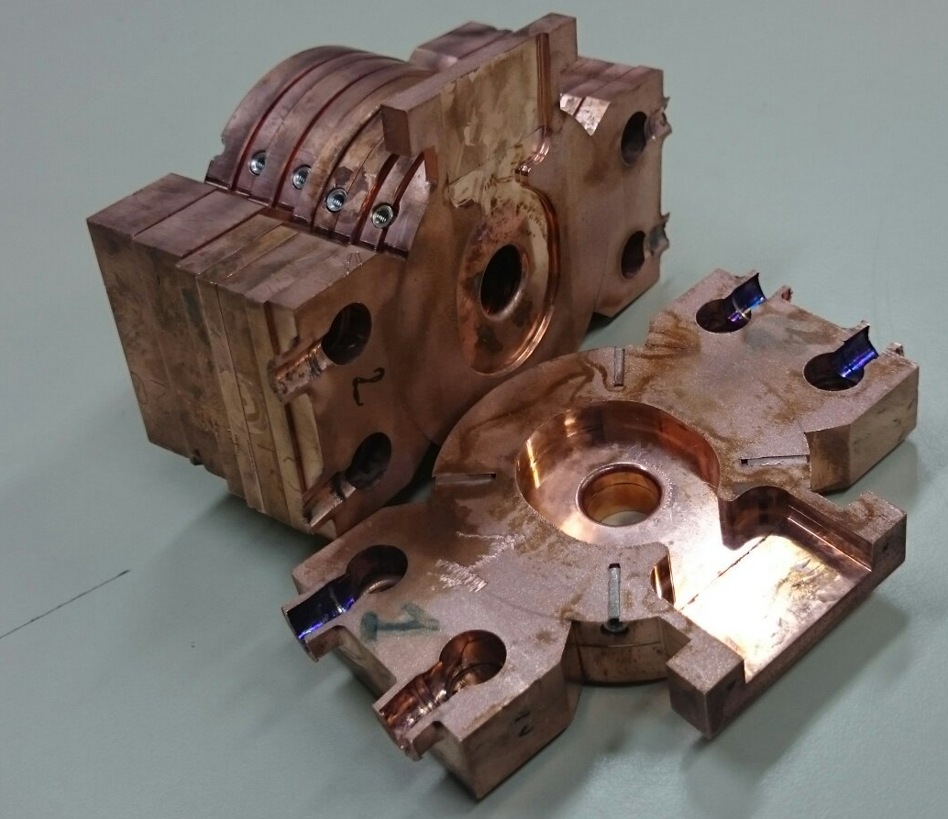
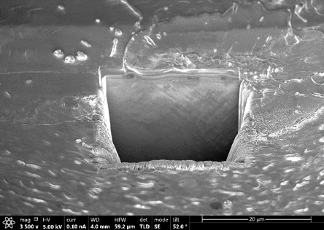
Looking afterwards with an electron microscope

Slide 7
Macroscopic and rf system scale

Slide 8
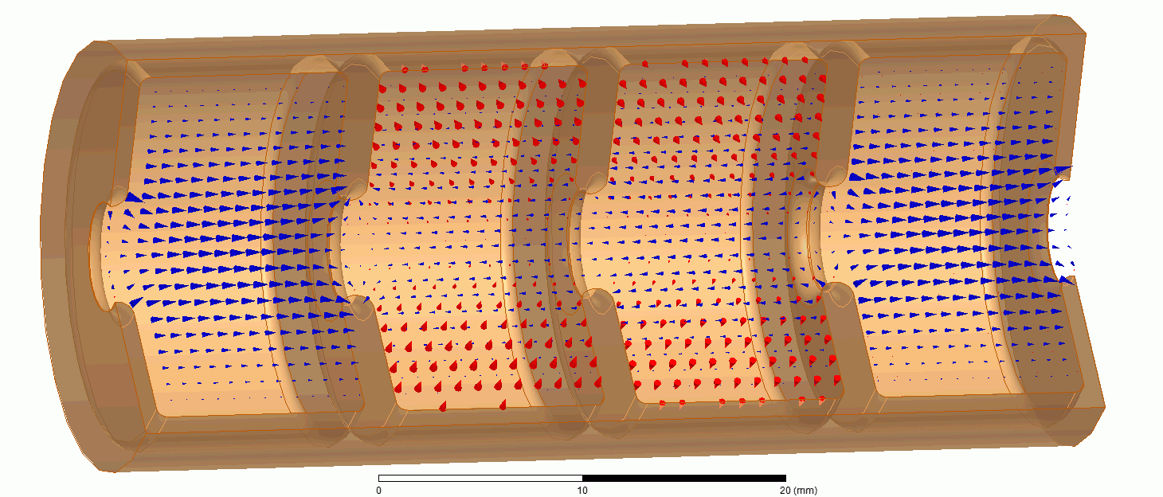

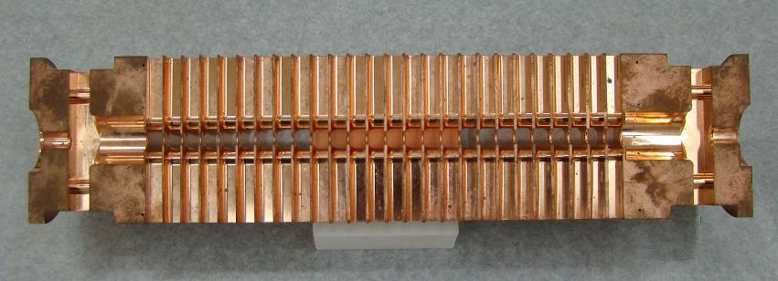
Vacuum arc in an accelerating structure

Slide 9
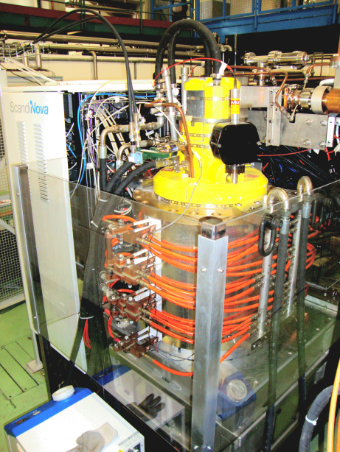
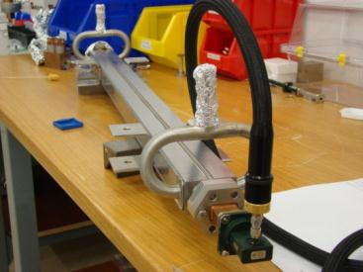
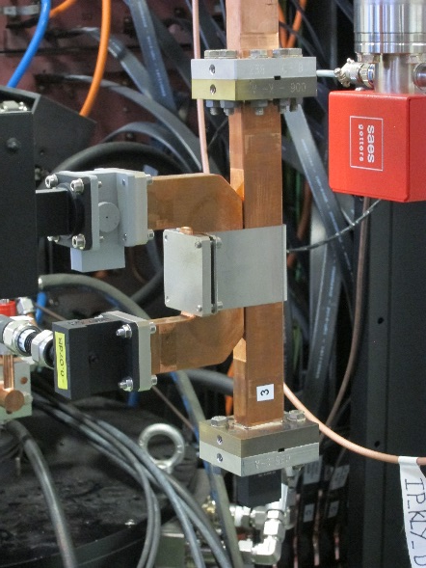
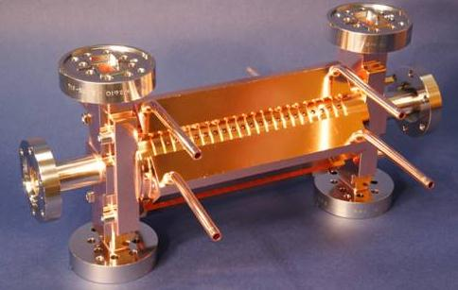
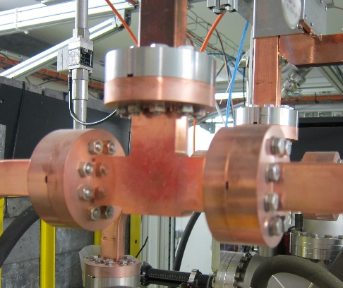
klystron
directional coupler
load
Transmitted
Reflected
Incident
splitter
accelerating structure
The basic layout of an rf system

Slide 10
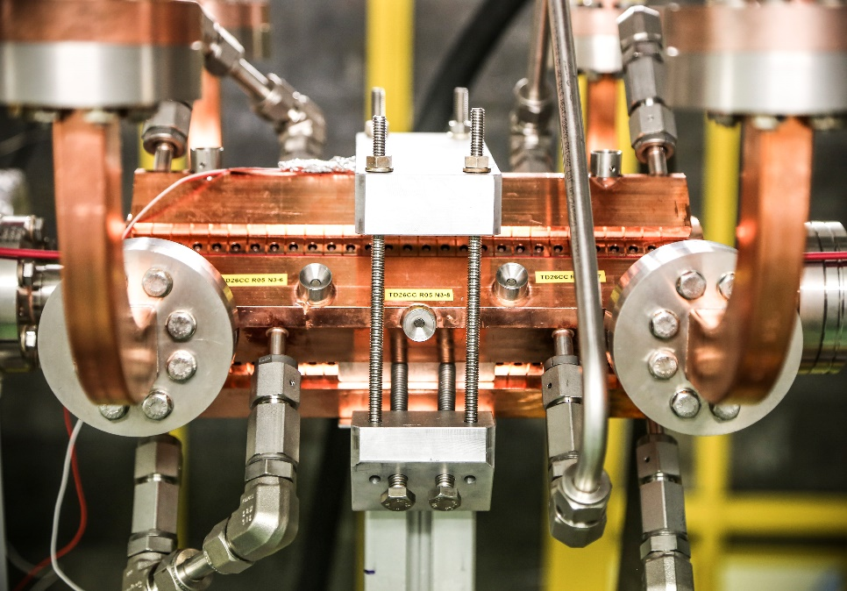
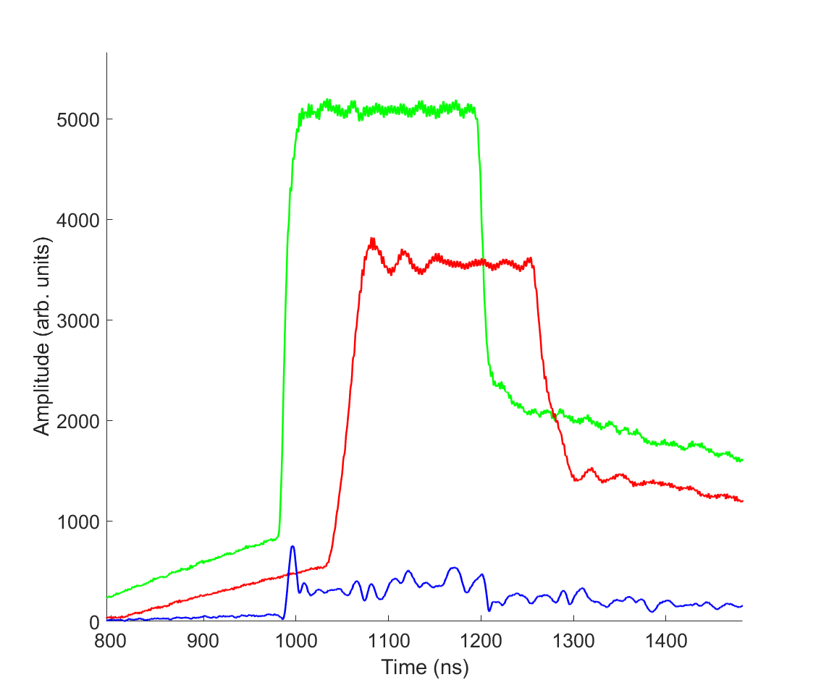
incident power
rf signals
transmitted
power
reflected power
From CLIC XBoxes
incident
transmitted
Envelope of rf pulse
reflected

Slide 11
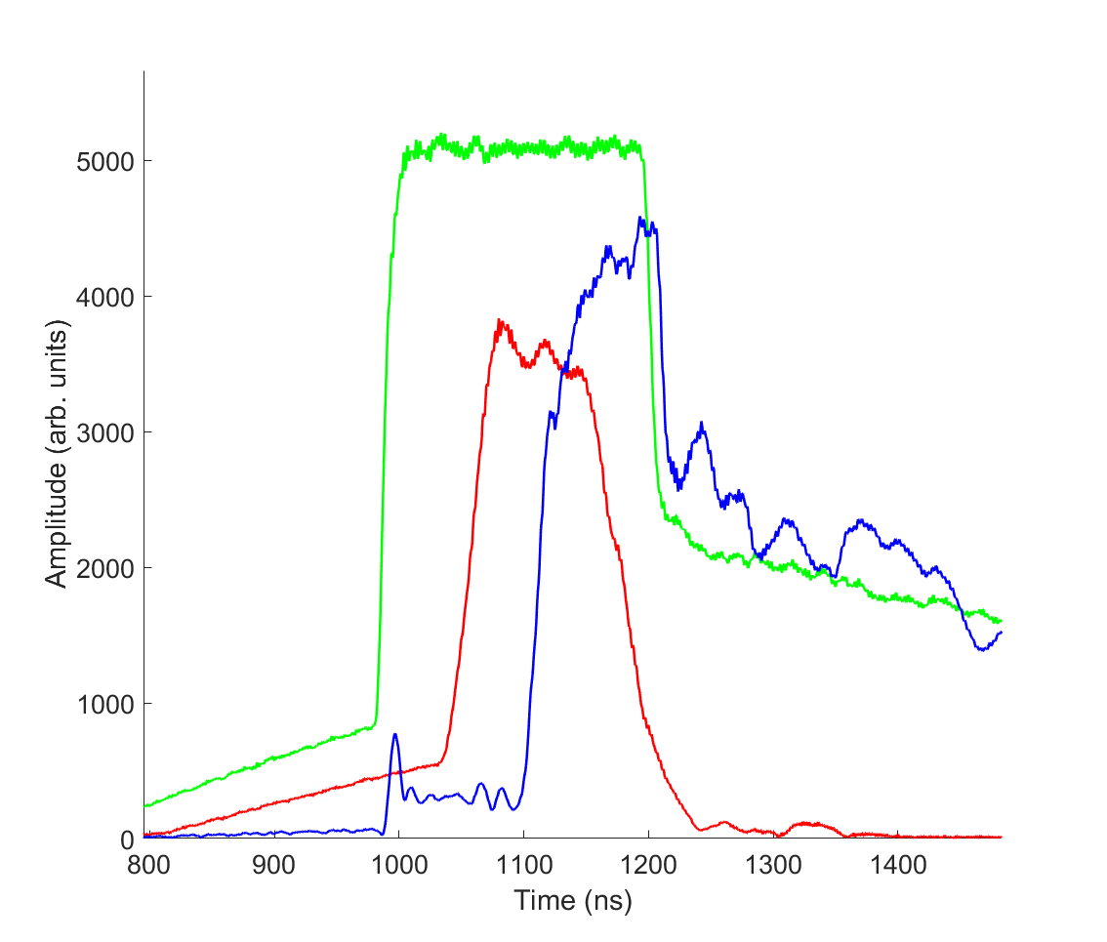
incident power
rf signals
transmitted
power
reflected power
Suppression of transmission and reflection due to breakdown
incident
transmitted
reflected

Slide 12
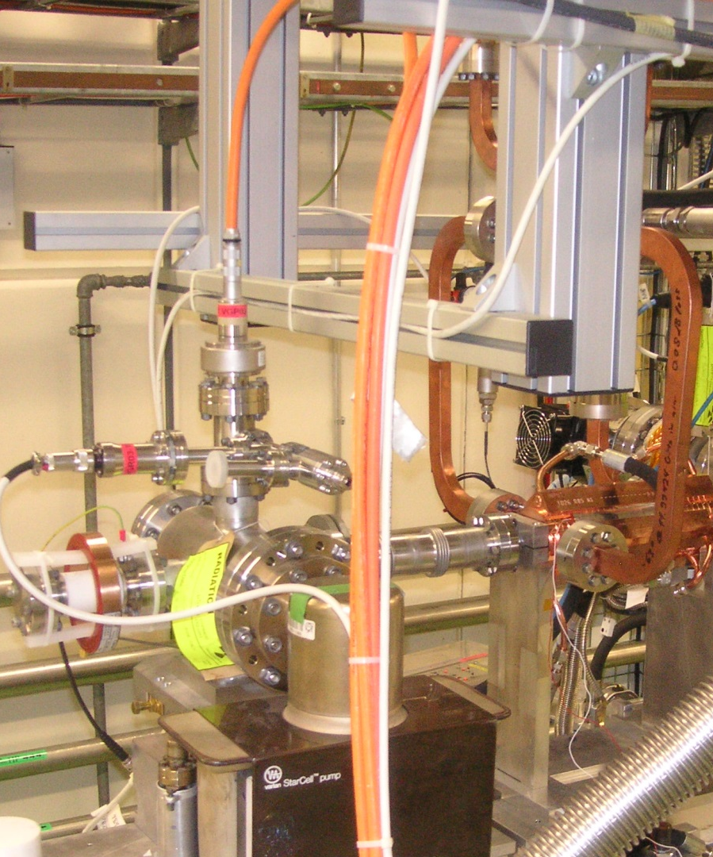
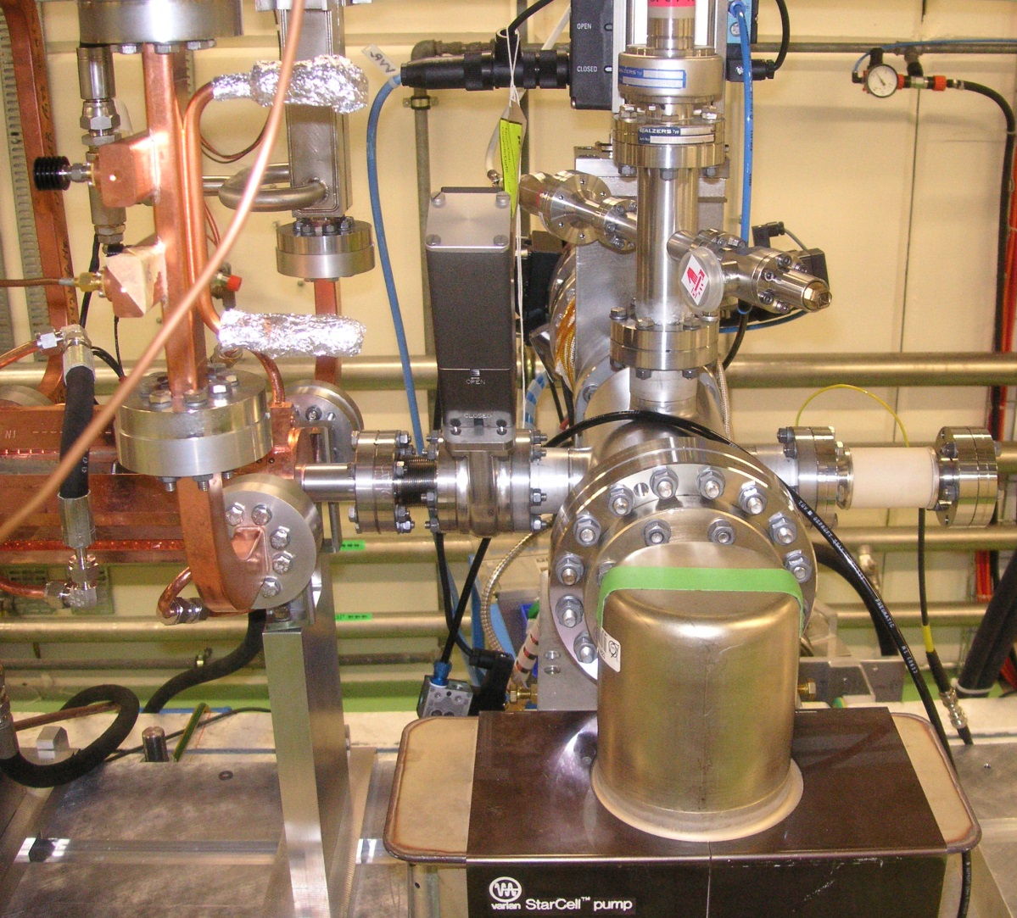
Accelerating Structure Diagnostics
RF hybrid splitter
(behind metal support)
Directional coupler
Vacuum valve
Ion Gauge
Faraday Cup
Ion Gauge
RF Load
Structure input couplers
Temperature probe
Structure output couplers
Ion Pump

Slide 13
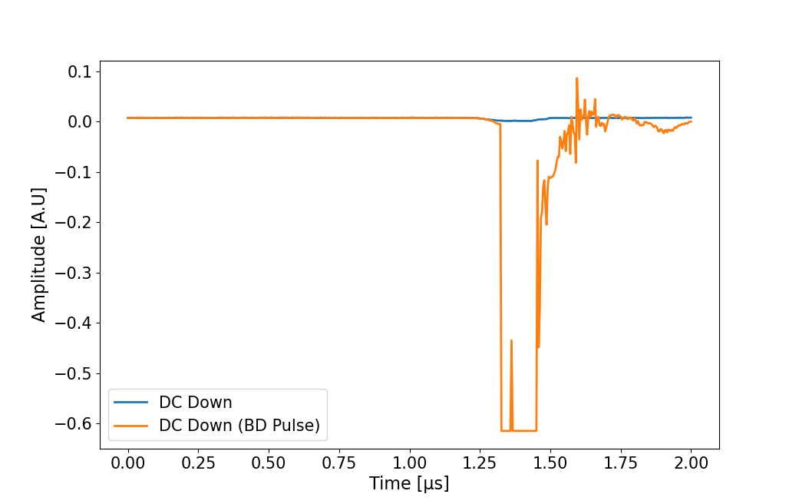
Current in Faraday cup
Current of the level of amps

Slide 14
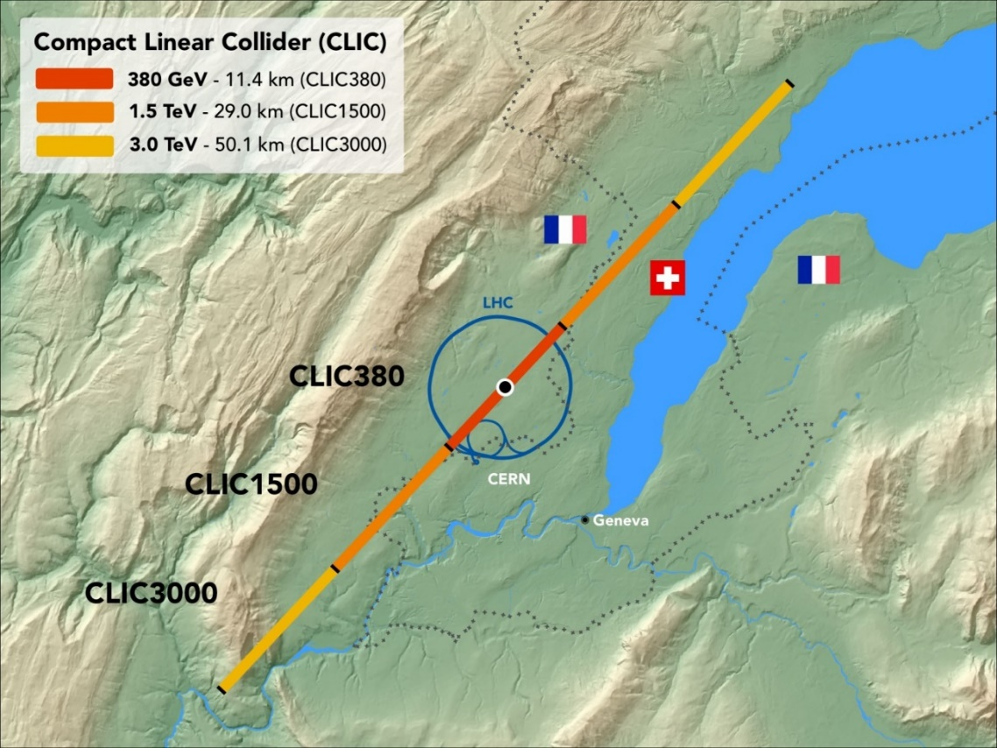
Back to CLIC
BDR (BreakDown Rate) is the fraction of pulses which have a vacuum arc. Arc currents and lost acceleration result in lost luminosity on that pulse.
CLIC specification:
3x10⁻⁷ 1/pulse/m
At 50 Hz, per structure:
1 BD every 3 days
Per 380 GeV facility:
1 BD someplace every 12 seconds

Slide 15
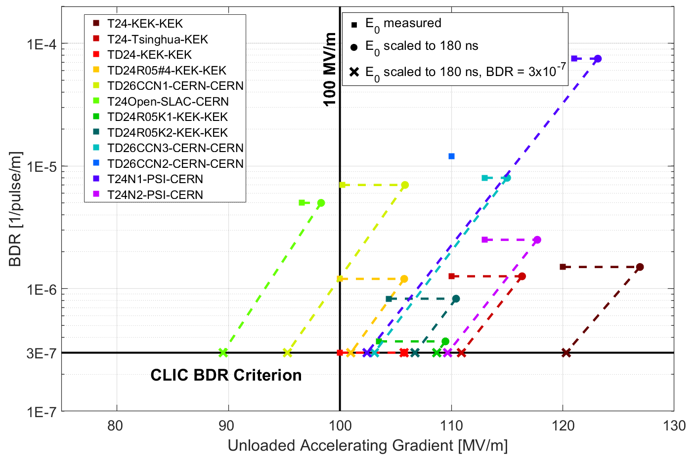
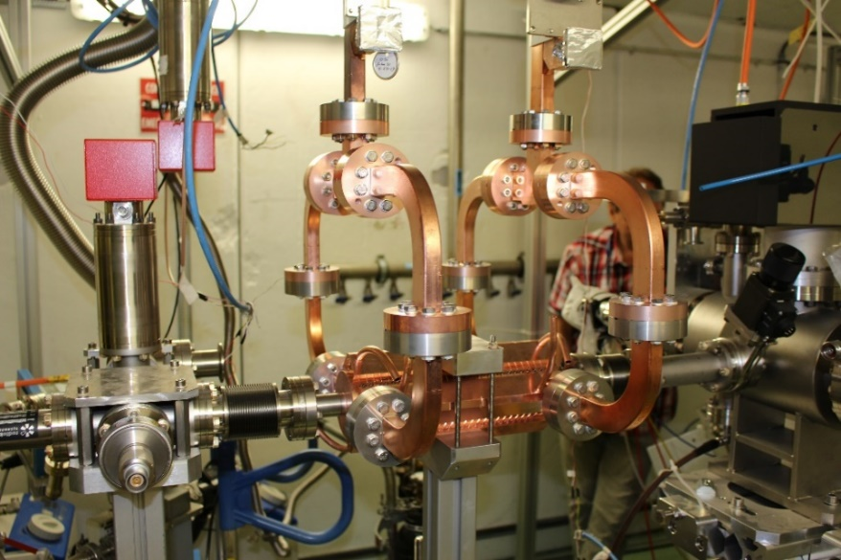
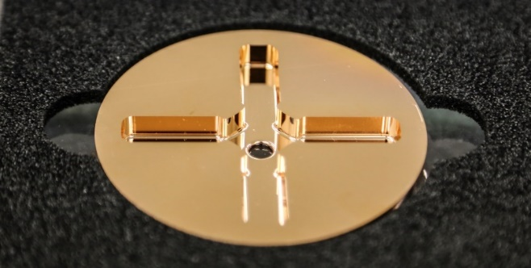
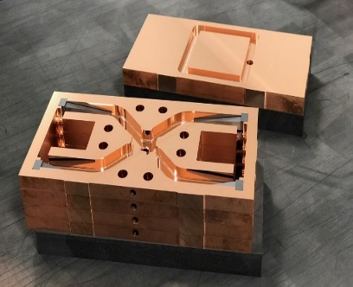
CLIC 12 GHz prototypes – what is possible
Peak surface electric fields about x 2.5 higher
https://doi.org/10.1103/PhysRevAccelBeams.21.061001,
https://doi.org/10.1103/PhysRevAccelBeams.20.052001 etc.
Much of the progress has been in quantifying dependence of gradient on RF design.

Slide 16
A very brief look at some accelerator-specific critical questions in breakdown theory

Slide 17
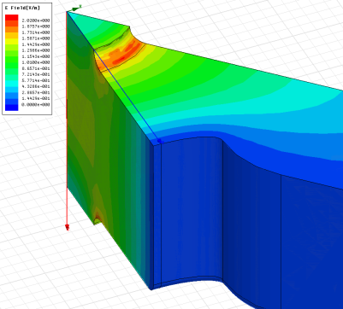
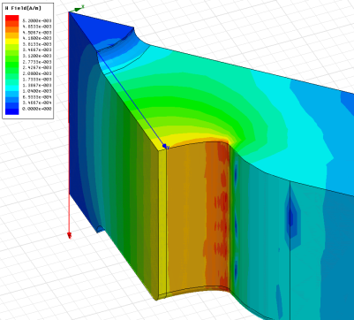
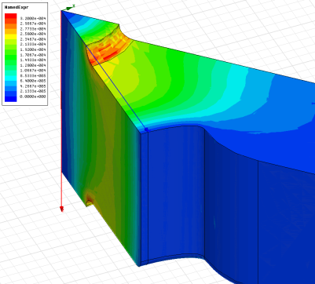
How does structure geometry affect achievable gradient?
E_{s}/E_{a}
global power flow
H_{s}/E_{a}
S_{c} is typically the quantity which dominates the design of high-gradient travelling wave structures.
local complex power flow
S_{c}/E_{a}²
A. Grudiev, S. Calatroni, and W. Wuensch,
New local field quantity describing the high gradient limit of accelerating structures,
Phys. Rev. ST Accel. Beams 12, 102001 (2009)
https://doi.org/10.1103/PhysRevSTAB.12.102001

Slide 18
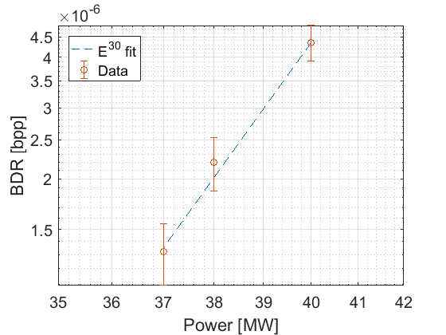
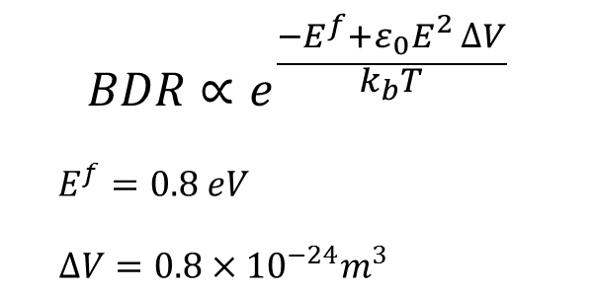

What drives the statistics of breakdown?
Describing mobile dislocation population evolution:
$$BDR∝E^{30}τ^{5}$$
Leads to an exponential decay:
Physical model based on defect formation
K. Nordlund, F. Djurabekova, Defect model for the dependence of breakdown rate on external electric fields, Phys. Rev. ST Accel. Beams 15, 071002 (2012) https://doi.org/10.1103/PhysRevSTAB.15.071002
Eliyahu Zvi Engelberg, Yinon Ashkenazy, and Michael Assaf Phys. Rev. Lett. 120, 124801 (2018) https://doi.org/10.1103/PhysRevLett.120.124801

Slide 19

Applications of high gradient accelerators
Having made a significant step in practical accelerating gradient for CLIC, we looked more broadly to see if there are applications that could benefit, or become realistic, due to this step in performance.

Slide 20
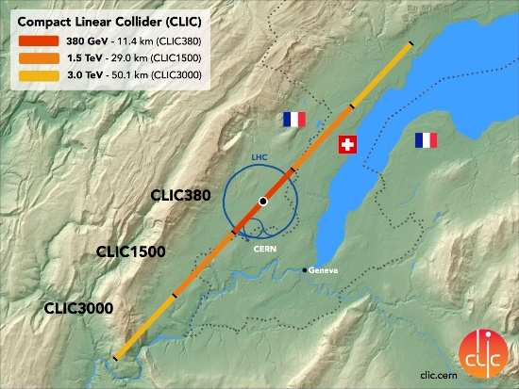
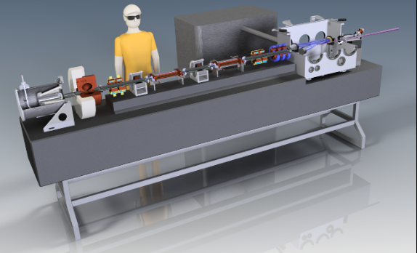
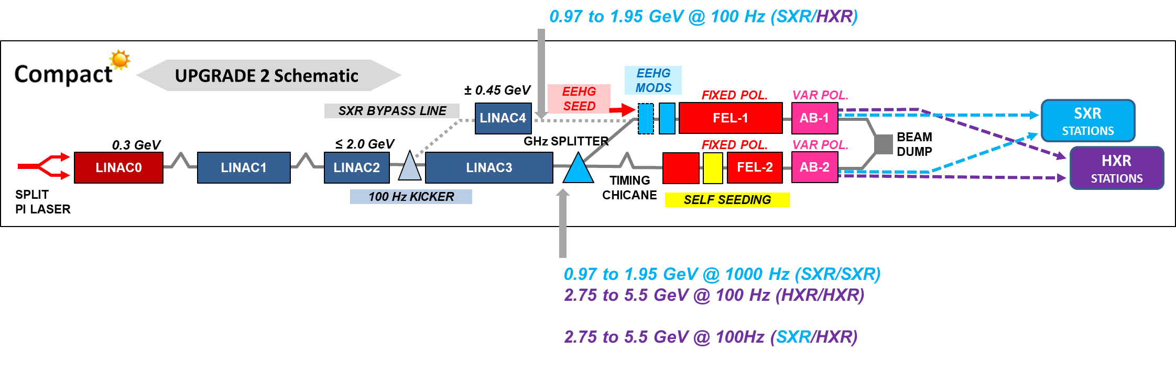
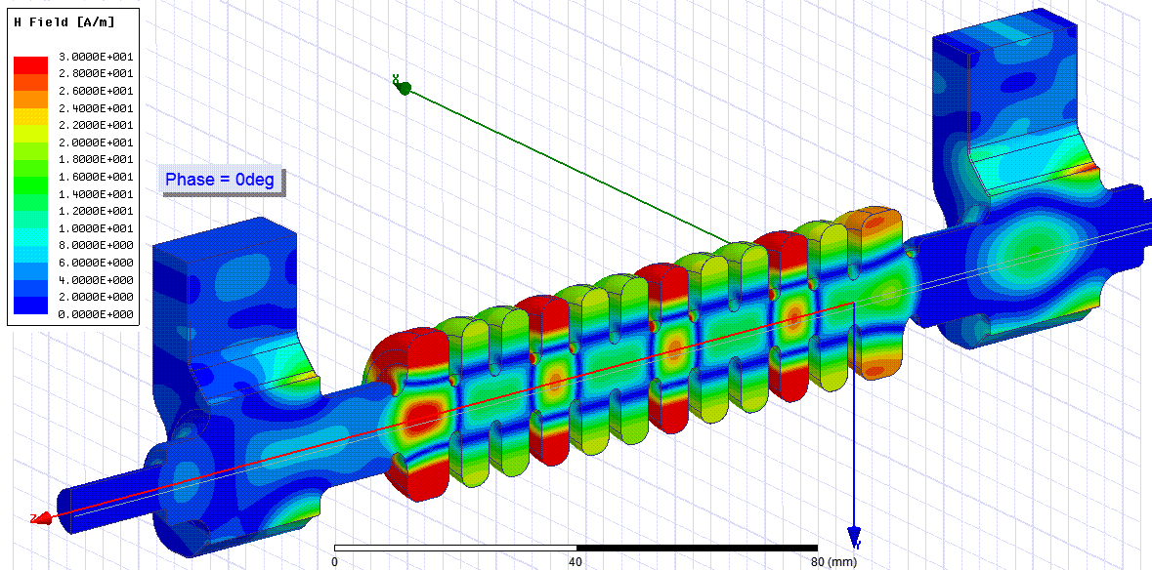
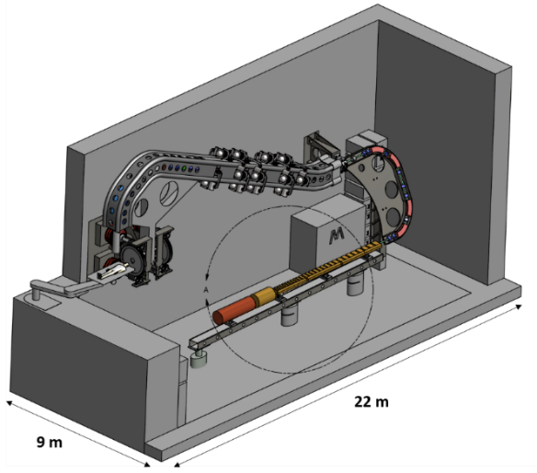
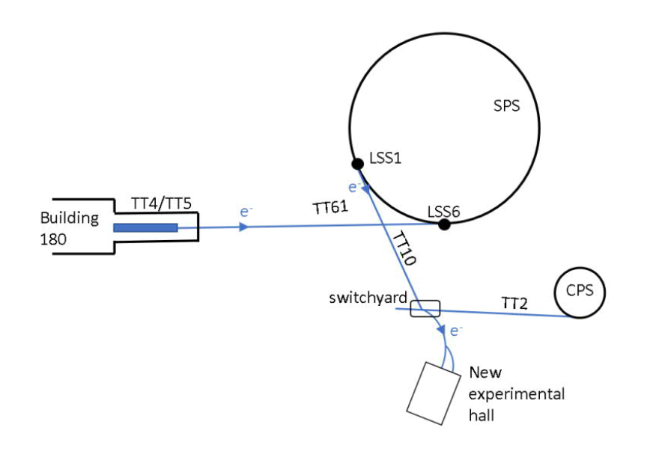
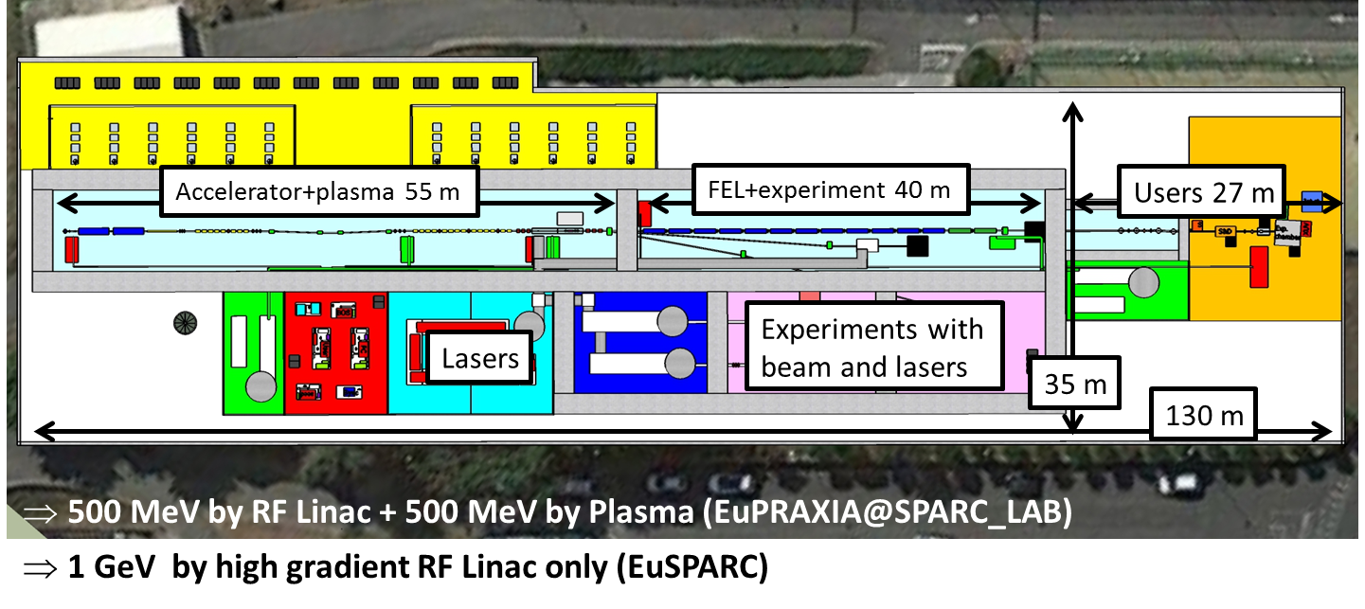
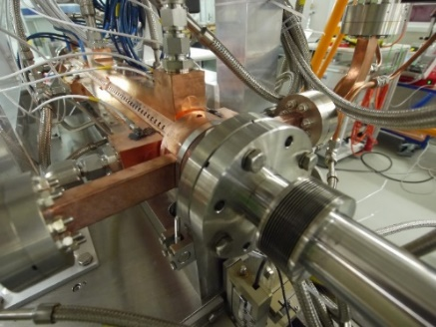
X-band and high-gradient applications overview
Linear collider
Light source - Inverse Compton Scattering Source
Light source - XFEL
eSPS
Medical applications
GeV-range research linacs
Beam manipulation

Slide 21
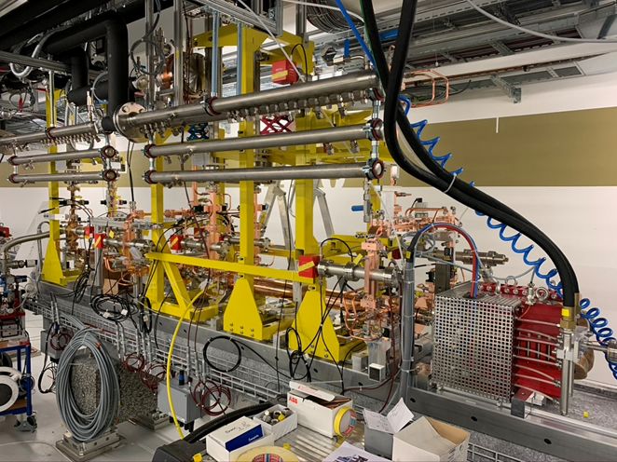
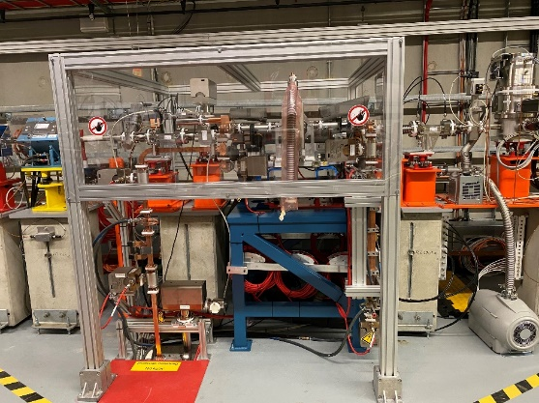
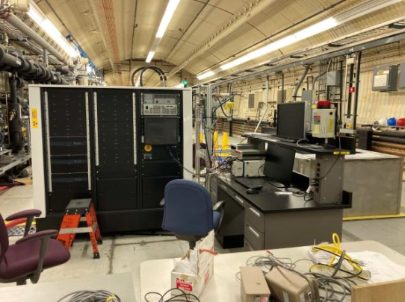
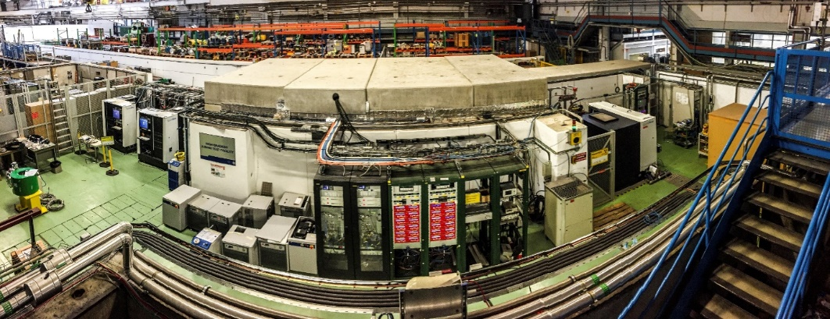
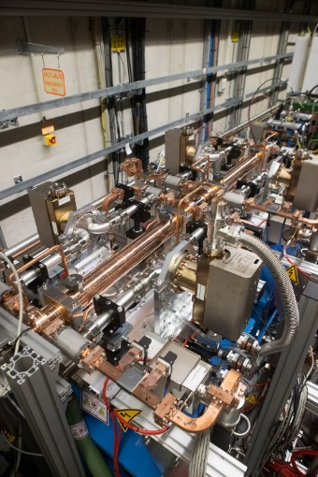
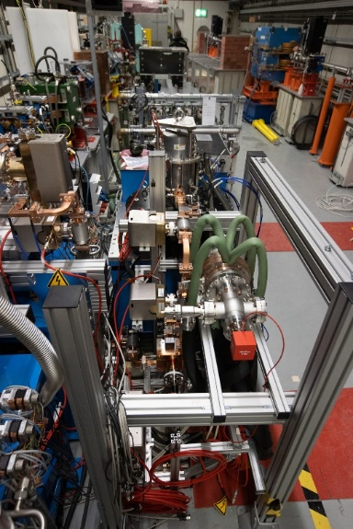
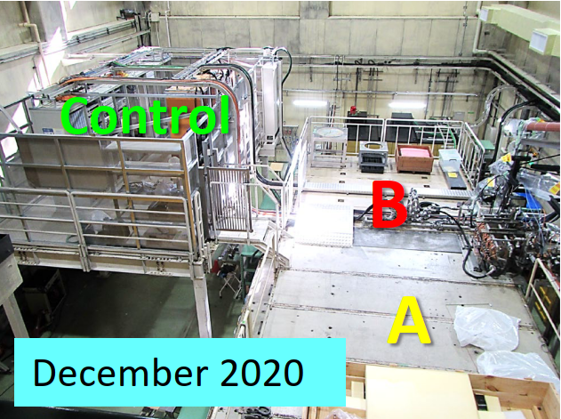
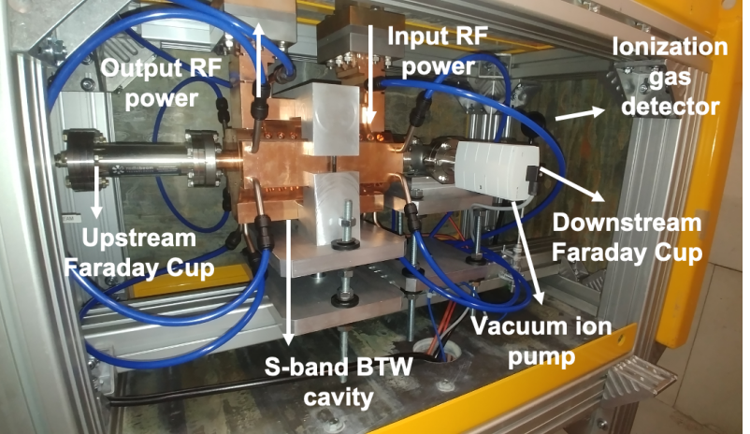
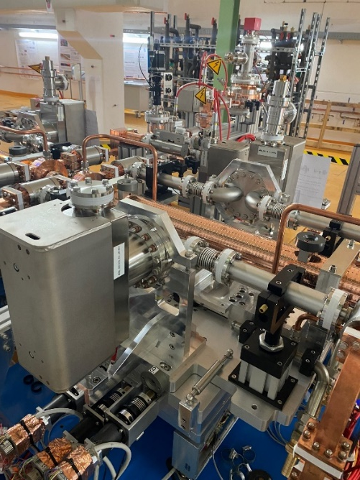
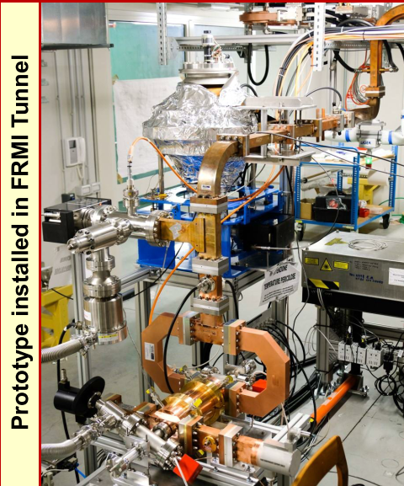
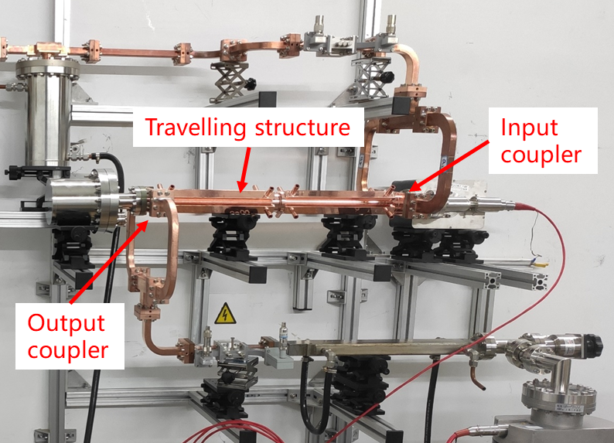
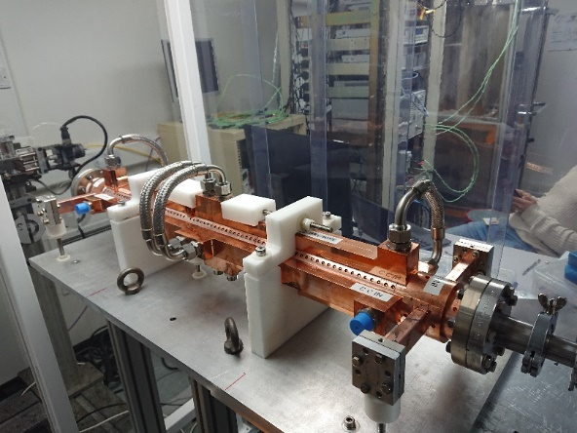
X-band and high-gradient infrastructure worldwide

Slide 22
Focusing on one application – FLASH radiation therapy

Slide 23
Introduction
A very hot topic in radiation oncology is so-called FLASH therapy which involves delivering an entire radiation treatment in a few hundred ms or less, as opposed to minutes, and in one or few fractions.
This fast delivery can reduce toxicity to healthy tissue while maintaining tumor control expanding the parameter space for treatment – more in a moment.
Another trend in radiation oncology is a renewed interest in VHEE (Very High Energy Electron) therapy.
In a parallel universe, major developments in accelerator technology have occurred in linear collider projects, relevant for this story, CLIC…

Slide 24
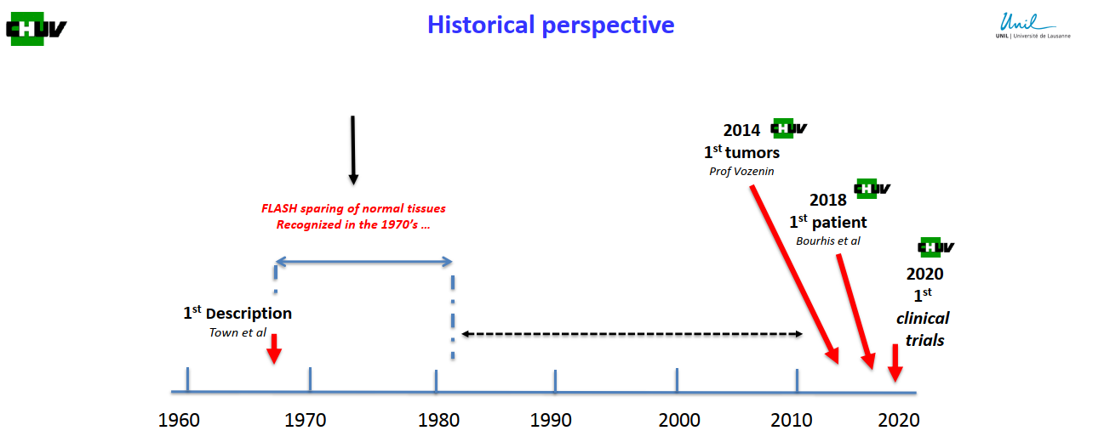
FLASH goes way back

Slide 25
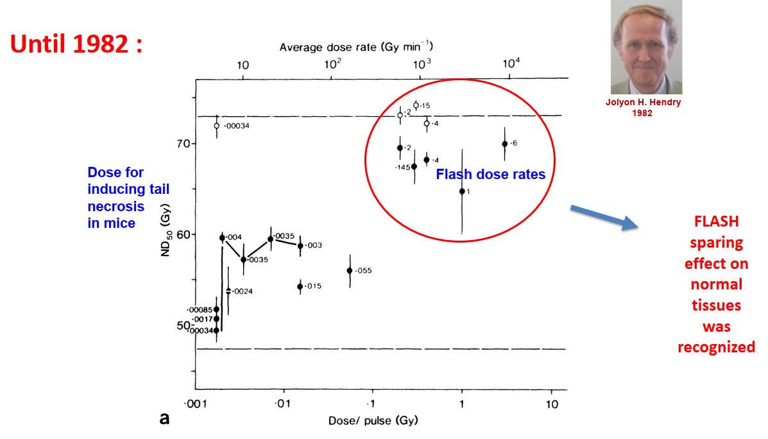
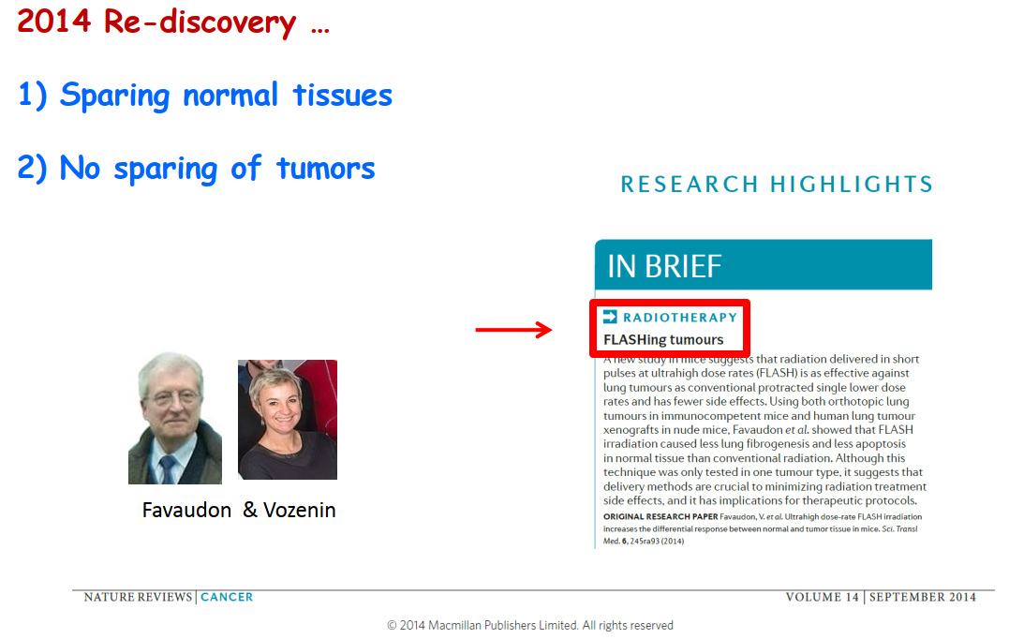
What oncology data can look like

Slide 26
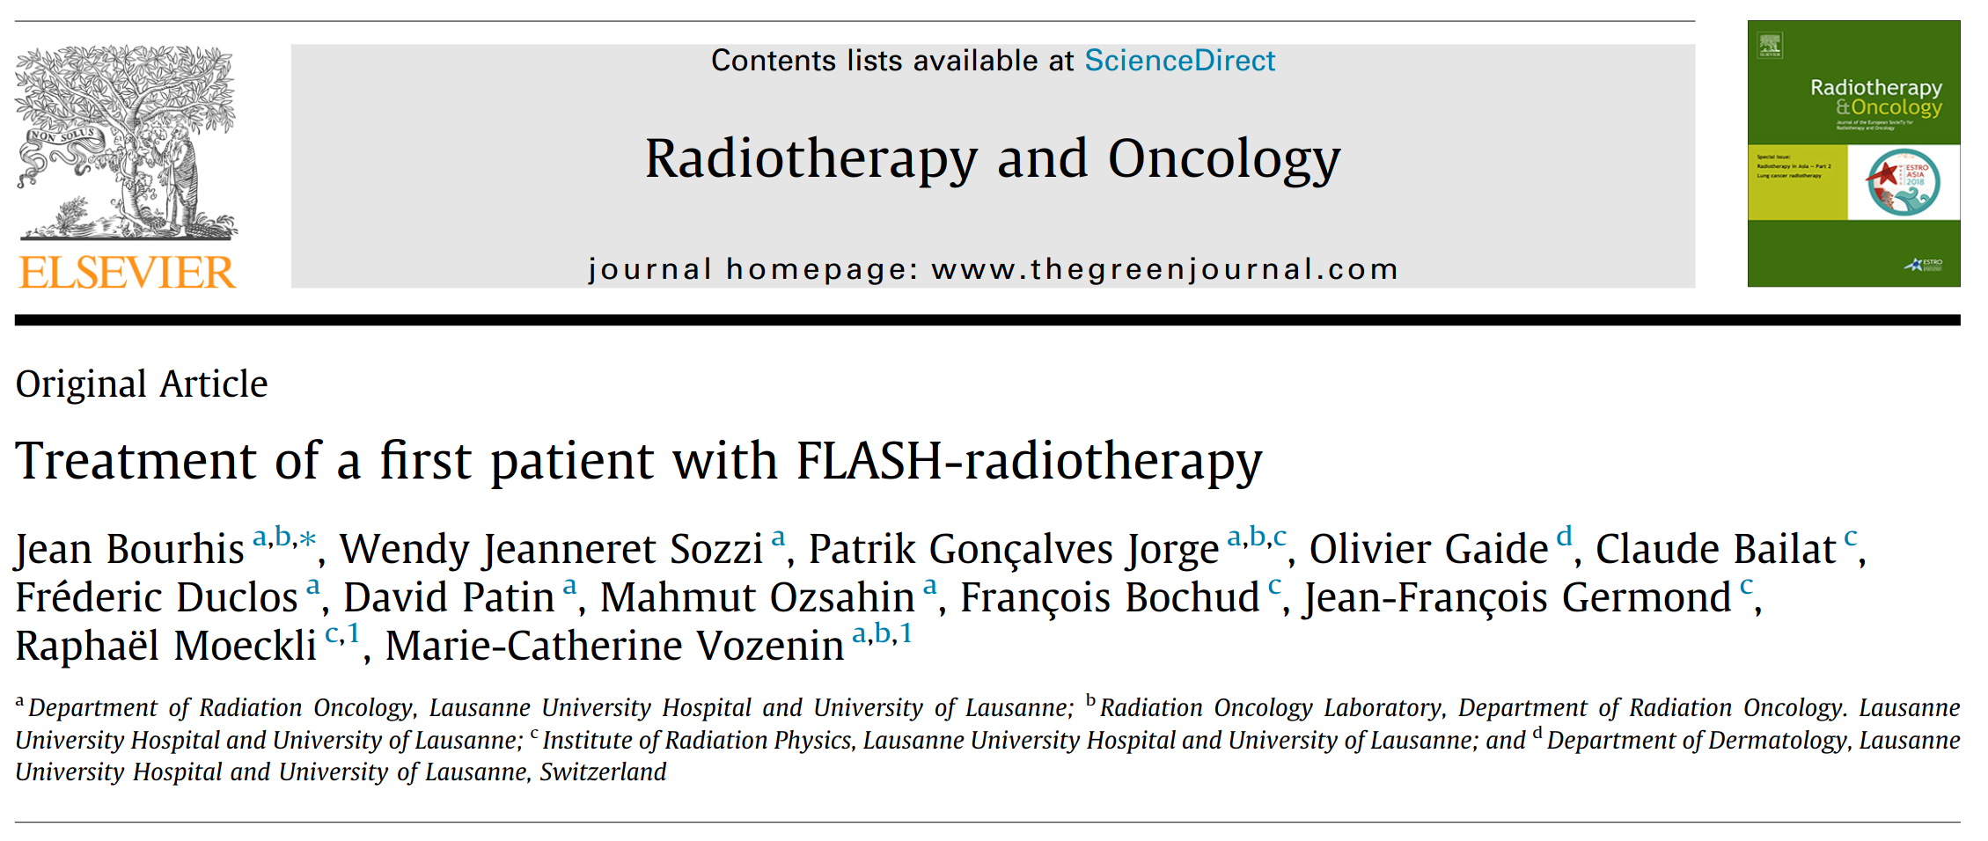


Visually
Illustration of the Flash-RT effect in pig :
A major decrease of radiation side effects
Vozenin et al
Clin Cancer Res
2018
First human patient – skin cancer treated with 10 MeV-range electrons

Slide 27


First clinical translation with low energy electrons

Slide 28


Slide 29

What a high-energy electron beam can do
200 MeV electrons in water
2.5 Gycm²/nC
cm
cm
Estelle Brierre

Slide 30
The CHUV-CERN collaboration
From a few coincidences then follow up discussions (a story for another day) CHUV and CERN realized that electron linac technology developed for CLIC could be the basis for a facility for treating large, deep-seated tumors in FLASH timescales – extending CHUV’s clinical translation program.
An extremely dynamic collaboration started in early 2019 to make a conceptual design of such a facility. This design is now done, feasibility OK and we have a good idea of the critical areas.
CHUV succeeded in finding a donor to fund the construction of the facility.
The project officially started on 1 September 2022, and ramp-up – as a collaboration, at CHUV and at CERN – is now underway.
Participation of an industrial partner is planned and investigation and discussions are underway.

Slide 31
Layout
X-band linac
Beam delivery system
S-band laser driven photoinjector
S-band is 3 GHz
X-band is 12 GHz
Electron beam
Patient
≈ 10 m

Slide 32
Basic parameters
X-band linac
Beam delivery system
S-band laser driven photoinjector
Maximum energy of beam > 100 MeV – Depth of tumor
Treatment time < 500 ms – FLASH effect
Largest field > 10 cm – Clinical scope
Current average over treatment > 100 µA – Field size over time capability
Electron beam
Patient

Slide 33
Starting in the middle – the X-band linac
X-band linac
Beam delivery system
S-band laser driven photoinjector
Critical issues:
Give energy to the beam of > 100 MeV in a short distance – X-band technology
High current beam – High beam loading and challenging beam stability
Electron beam
Patient

Slide 34



X-band linac hardware
Based on CLIC accelerating structures and XBox test stands.
CPI 50 MW klystron
Prototype CLIC accelerating structure
Scandinova solid state modulator

Slide 35
The S-band photoinjector
X-band linac
Beam delivery system
S-band laser driven photoinjector
Critical issues:
Generate a high-current beam
Stability
Precise beam characteristics
Electron beam
Patient

Slide 36


Laser-driven RF photoinjectors
Laser-driven RF photoinjectors are a commonly used device to provide well controlled electron bunches in a wide variety of linacs including XFELS, Inverse Compton Sources, ERLs, linear collider related test facilities etc.
From J.E. Clendenin, LINAC96
2021 - New CLEAR gun from INFN Frascati

Slide 37

The beam delivery system
X-band linac
Beam delivery system
Patient
XRay therapy system
from https://www.varian.com/en-ch
(not same scale)

Slide 38
The beam delivery system
X-band linac
Beam delivery system
S-band laser driven photoinjector
Critical issues:
Provide multiple irradiation angles in FLASH sub-100 ms – no time for mechanical gantry movement so use energy switching and spectrometer magnet
Expand beam to target cross section >10 cm
Specially designed combined function separator magnet.
Electron beam
Patient

Slide 39


Pulsing and energy modulation
LINAC2
XBox-3 high-gradient test stand. Klystrons operate at 400 Hz, alternatively powering two test slots at 200 Hz.

Slide 40
Energy E₁
Spectrometer magnet
Pulsed linac
Isocenter

Slide 41
Energy E₂
Spectrometer magnet
Pulsed linac
Isocenter

Slide 42





The overview again
X-band linac
Beam delivery system
S-band laser driven photoinjector
Electron beam
Patient
≈ 10 m

Slide 43
More information

Slide 44

Fundamental processes of high-fields
Dynamic and growing community of university, laboratory and industrial groups.
Fields include accelerators, fusion devices, satellites, vacuum interrupters, electron sources, photo-switching nano-devices, high-voltage systems etc.
Next meeting https://indico.cern.ch/event/1099613/ in person hosted by the University of Tartu!

Slide 45


The High-Gradient RF Workshop Series
Our last in-person meeting, Chamonix, summer 2019
Last meeting, remote, hosted by Tsinghua University.
https://indico.cern.ch/event/1080222/

Slide 46




More on FLASH therapy
https://indico.cern.ch/event/1131207/

Slide 47
Animation
https://www.youtube.com/watch?v=87JLhcsuIao

