Slide 1
EGI User Support

Slide 2
Scaling the Human Network
Across an NGI Research Community
Across an International Research Community
Across different disciplines & skill levels
From an Individual to a Community
Services that enable the human network
Services that support building your
Virtual Research Community

Slide 3
An Evolving Relationship
User Community Support Team
(EGI.eu)
Defined by MoU

Slide 4
A Virtuous User Cycle
Aka: “the chicken and egg conundrum...
Design
Deliver
Discover
Feedback through VRCs in the User Community Board
User Services Advisory Group to drive detailed design
Where is the community?
How can I contribute?
- VRCs
Mailing lists
Workshops
Forums
Blogs
Projects
Sharing stories
Collaborating
Applications
Data collections
Requirements
Proposals
Projects
Success stories
How do I use these resources?
Integrated Services
Human
Technical
Infrastructure
Attend training courses
Utilise training material
Access data
Run applications on the grid

Slide 5
Provided Services
Human Services
  UCST at EGI.eu
  Support teams in NGIs
Technical Services
  Provided centrally through EGI.eu & partners
  From the Heavy User Community
Infrastructure Services
  EGI Helpdesk (GGUS)
  Operations

Slide 6
Current Technical Services
Training Events
  Calendar of training events available to all infrastructure providers and technologies.
Training Repository
  Central point for the training material from EGI community
Applications Database
  A catalogue of all applications that have been ported or are being ported within the infrastructure
VO Services
  To help build the collaborations within your community
    VOMS
    VO database & registration services
    Basic portals
    VO Dashboards

Slide 7
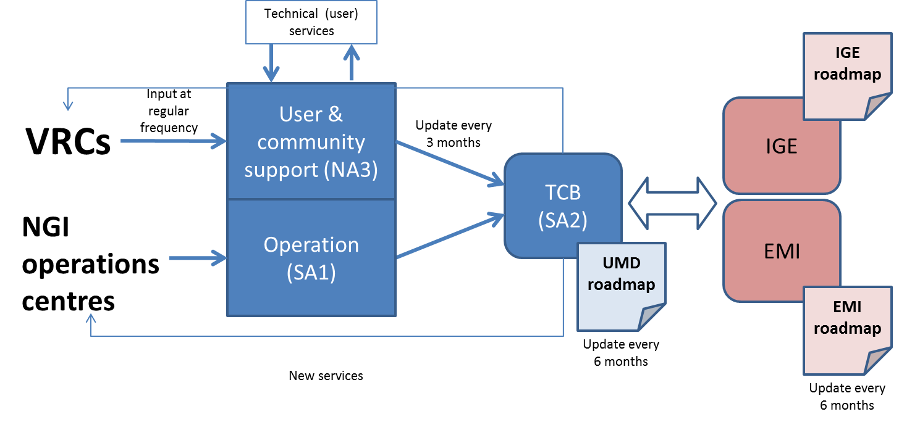
Requirements input
Feedback and recommendations gathering process

Slide 8
Requirements process
Collecting and processing requirements and recommendations from users

Slide 9
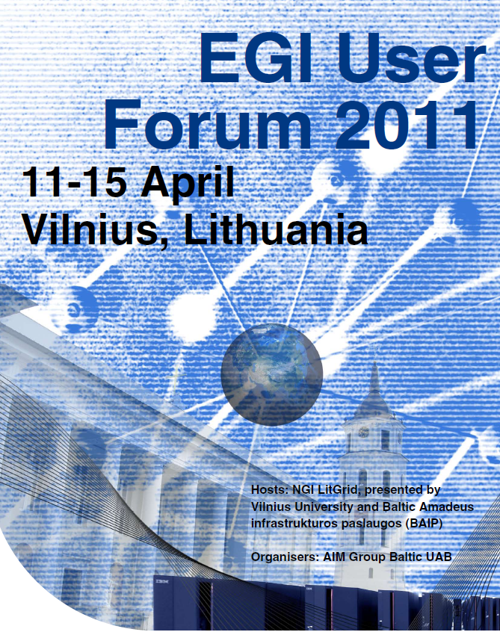

Questions?
Call for papers opens October 2010
See www.egi.eu/EGIUF2011 for more details
Contact:
  Steven Newhouse
    director@egi.eu

