Slide 1
PSI Positron Production (P³)
Paolo Craievich, Riccardo Zennaro, Matta Schaer :: Paul Scherrer Institute
FCC-ee Injector Study Collaboration, 10.03.2022

Slide 2
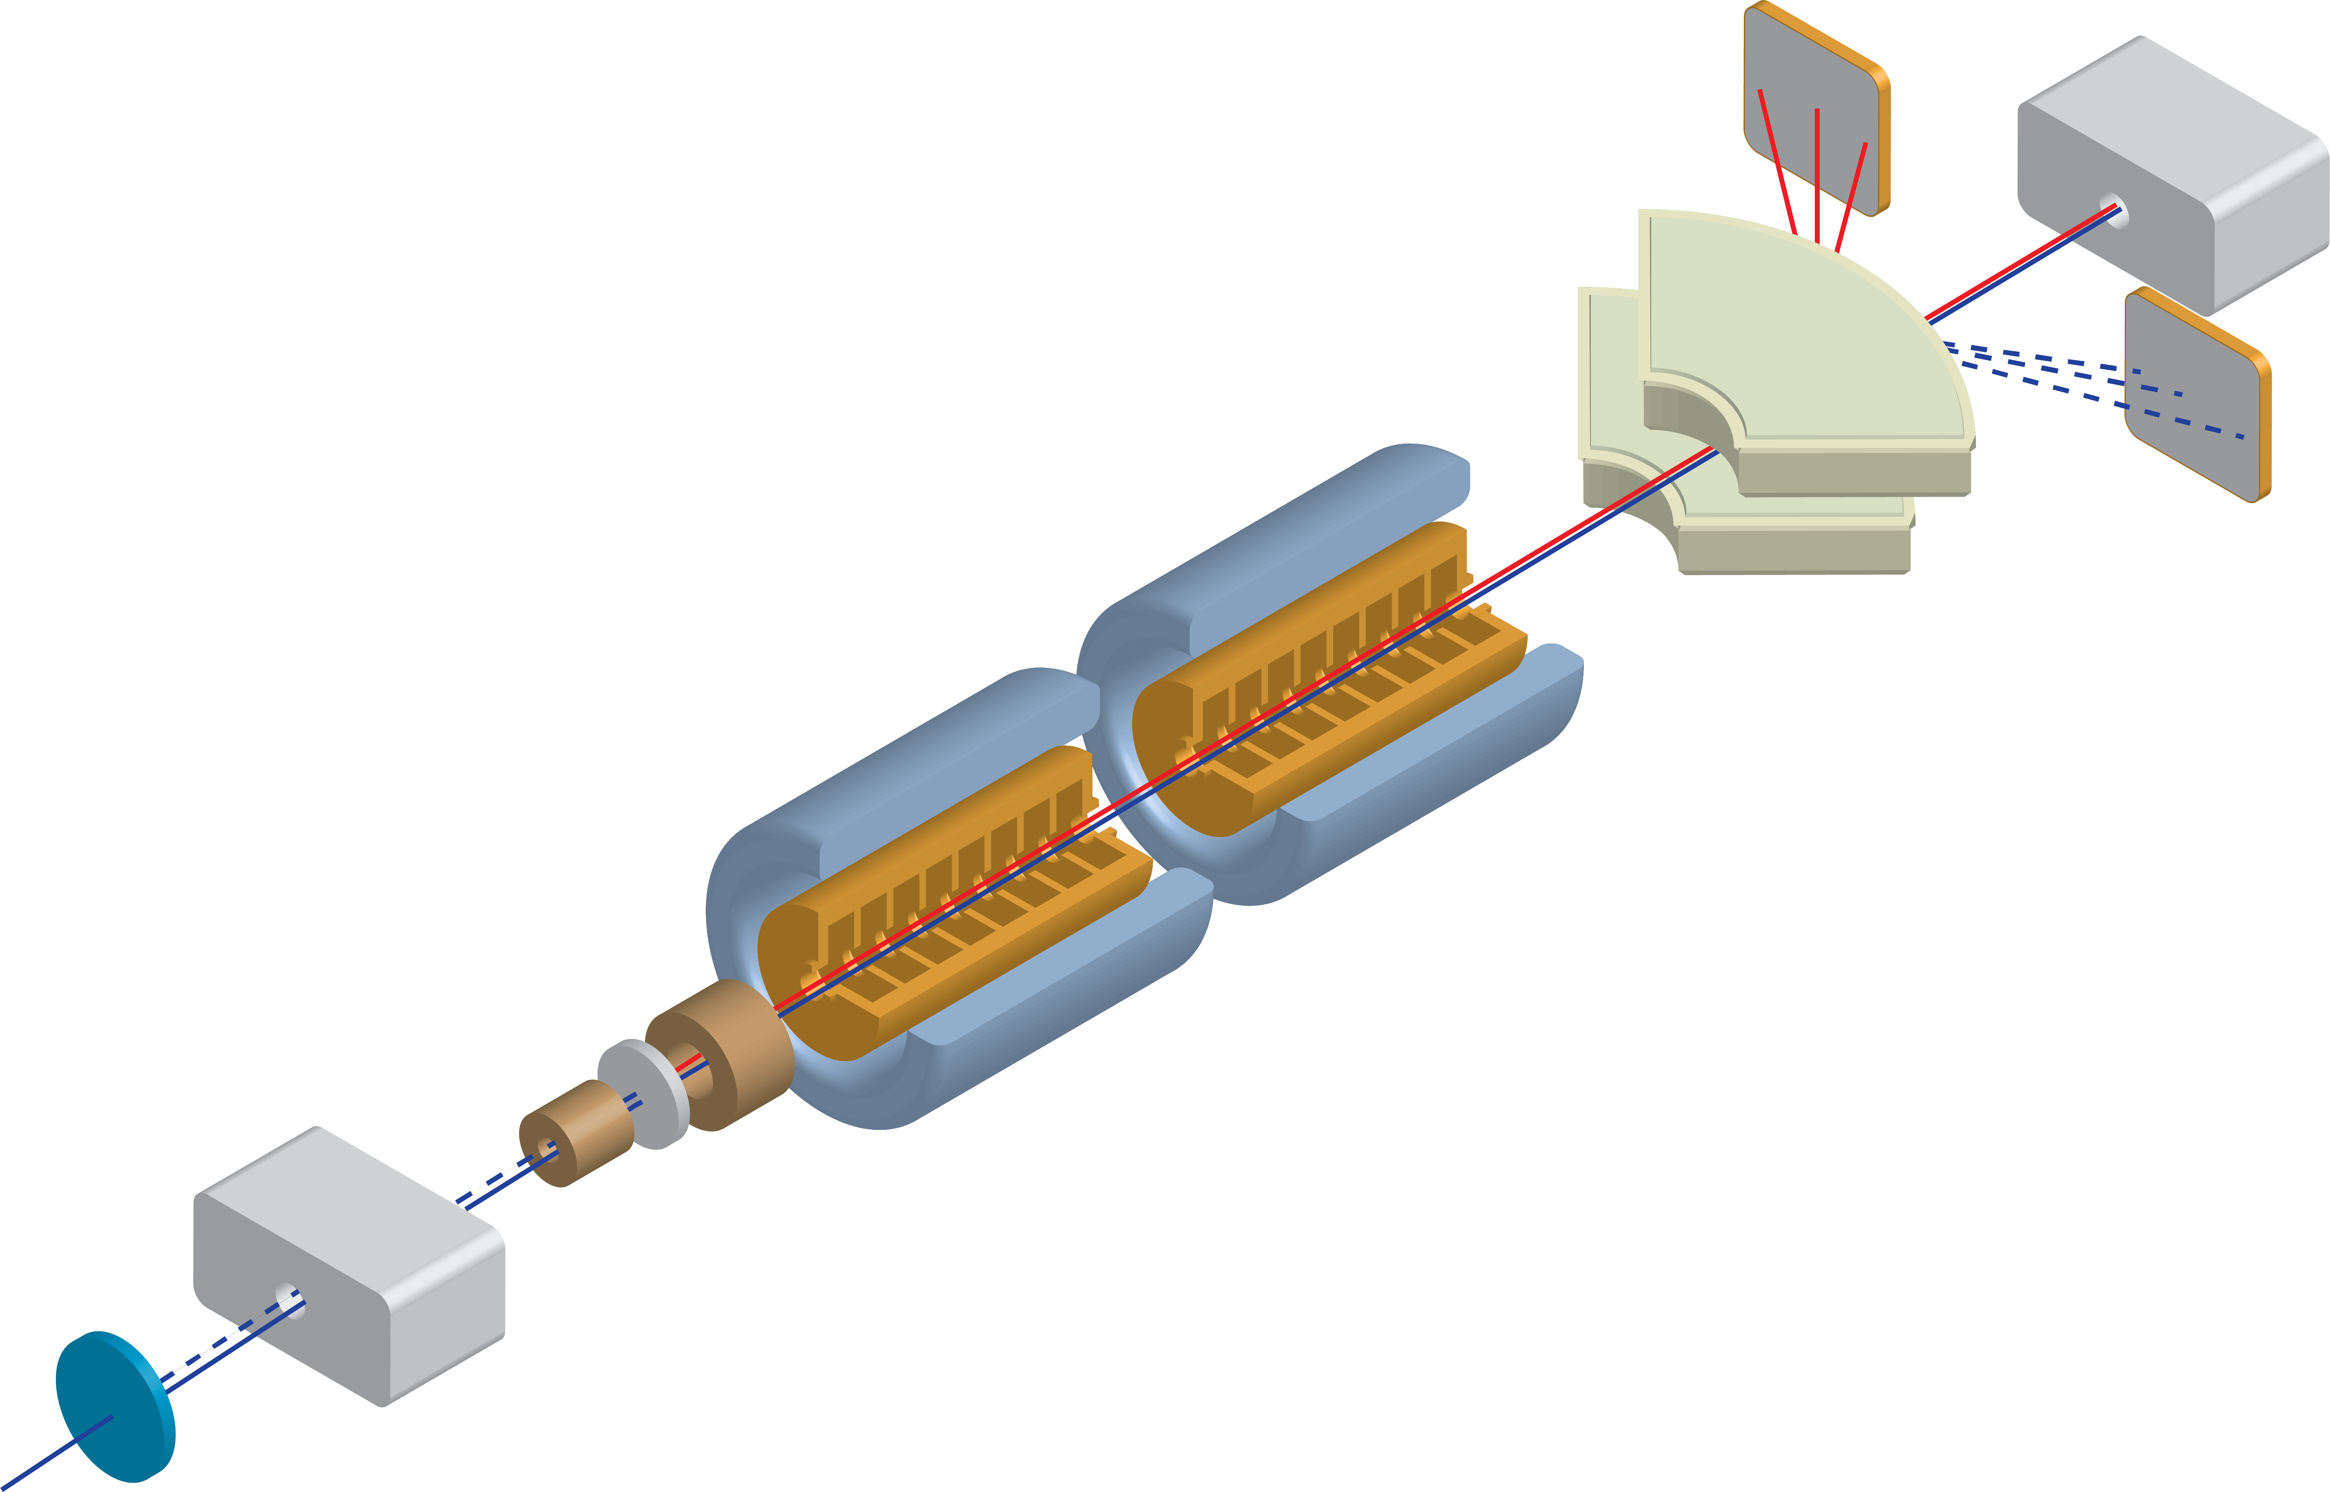
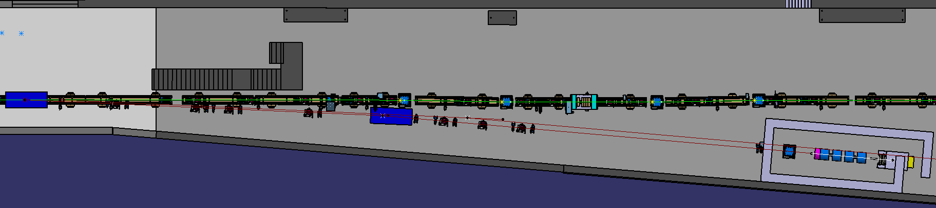
P³ Experiment at SwissFEL (PSI)
SwissFEL with its 6 GeV e- beam
is the natural candidate for
e+ source proof-of-principle for FCC-ee
CERN Dipoles
(L = 2.350 m)
Aramis chicane SARCL02
Extraction line
2.5 – 2.75 deg
P³ Bunker
Z = 432.611 m
Courtesy of D. Hauenstein and S. Reiche

Slide 3
Positron Source Parameters, P³ vs. FCC-ee
Conventional scheme with amorphous W target | P3 | FCC-ee
Beam energy [GeV] | 6 | 6
Rep. rate [Hz] | 1 (*) | 200
Bunches per pulse | 1 (*) | 2
e- charge per bunch [nC] | ≤ 0.2 | 1.19 – 1.43 (**)
Pbeam [W] | ≤ 1.2 | 2860 – 3430 (**)
Pdiss in target [W] | ≤ 0.3 | 720 – 880 (**)
e- σ_{x} [mm] | 0 – 2 | 0.5
PEDD [J/g] | ≥ 0.052(****) | 4.6 – 5.6 (**)
Target length [mm] | 17.5 | 17.5
Target diameter (***) [mm] | 25 | ≤ 25
Positron Yield | Exp. outcome | 4.7-5.7
(*) Limited by radiation protection
(**) Includes safety factor of 2
(***) Beam interaction region
(****) SwissFEL can provide very small beam size and large PEDD

Slide 4
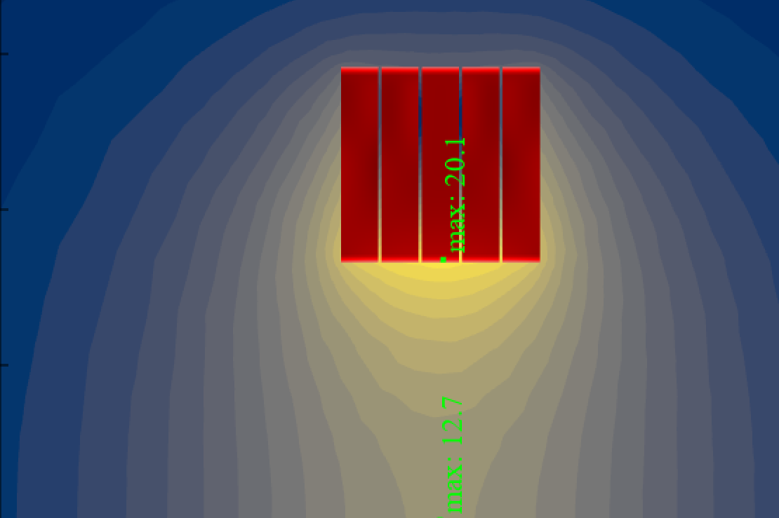
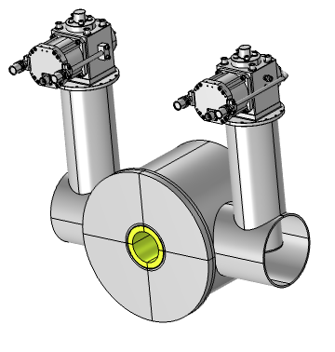
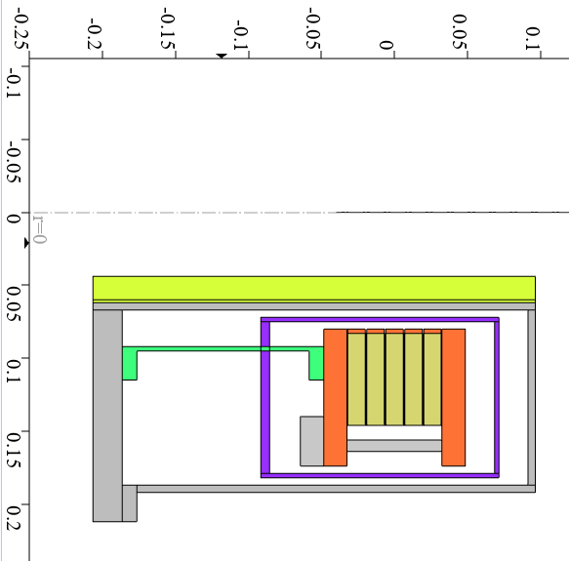
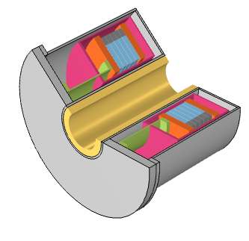
HTS AMD, Key Component to Be Tested in P³
Magnetic design
Electron beam
r_bore
Positron “beam”
Radiation shield W
 | Smaller bore Vacuum flanges integrated in cryostat | Larger bore Independent vacuum pipe with CF40
r_bore [mm] | 19.3 | 36
HTS Tape cost [kCHF] | 180 | 264
Total cost [kCHF] | 494 | 590
Mechanical concept
Coils
Thermal shield Al
Courtesy of J. Kosse
Cryostat wall

Slide 5
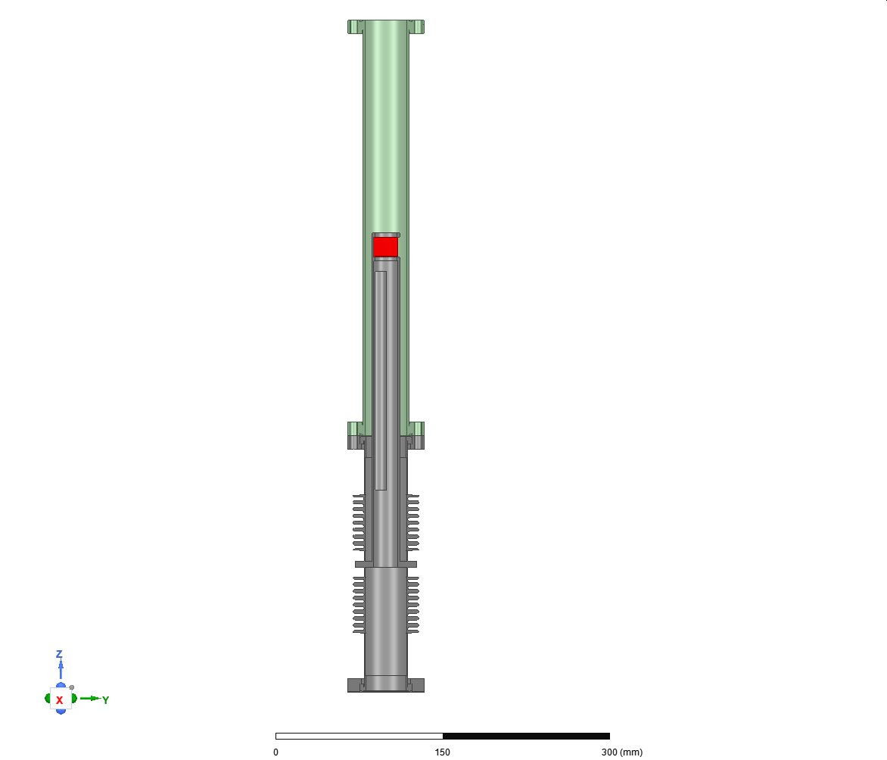
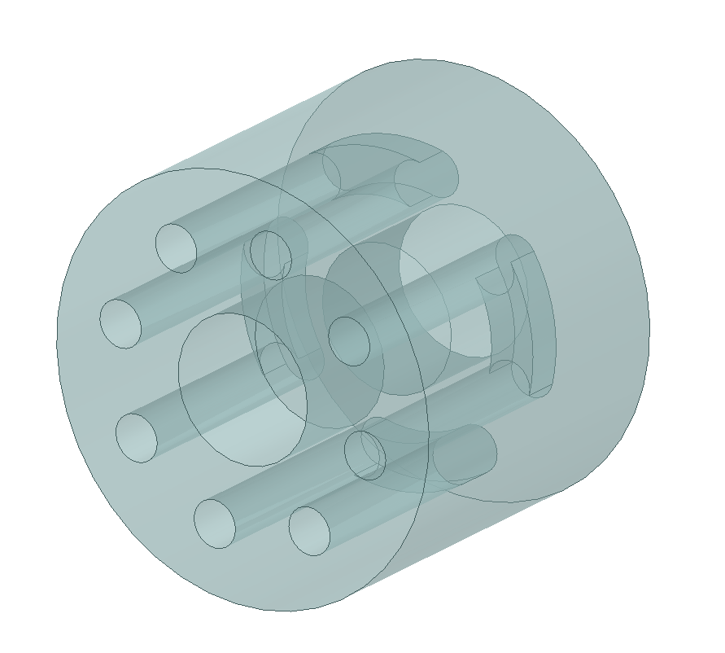
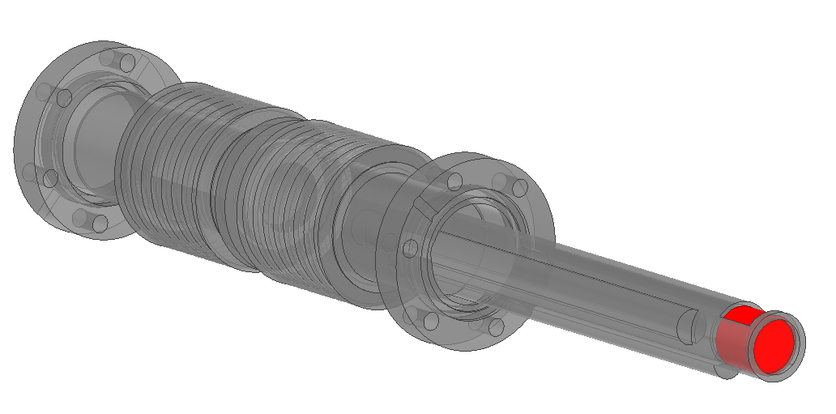
Target Positioning for P³ and
Example of Cooling for FCC-ee Target
Electron beam
Target
d_pipe = 38.6 mm
Goal: Remotely-controlled
positioning system
d_pipe = 72 mm
Cooling channels X4
Pipe radius 4 mm
ΔT outlet-inlet 5 °C
Water speed 0.5 m/s
Water flow 6 l/min
Cooling capacity 2.1 kW
P³
FCCee

Slide 6
P3 Project Main Goals
Design, production and test of
  Innovative AMD based on HTS technology
  RF SW S-band capture structures
  Dedicated diagnostic
  (In particular: Very fast BPMs can provide enough time resolution for e- and e+ bunch discrimination and intend to be a major tool for FCC-ee e⁺ source setting)
Benchmark of models and simulation codes
Validation of the simulated yield
HTS AMD main advantages:
Extremely high e+ yield
No problems with large repetition rates
Large axial aperture for target insertion and/or cooling

