Slide 1
EGI-InSPIRE SA3
N.B. Please always use EGI-InSPIRE templates!

Slide 2
Meeting Objectives
That everyone understands SA3 and how it fits in EGI-InSPIRE as a whole
That everyone understands what is expected of them as a member of
EGI-InSPIRE SA3
To perform some short-term work assignments
To answer any questions

Slide 3
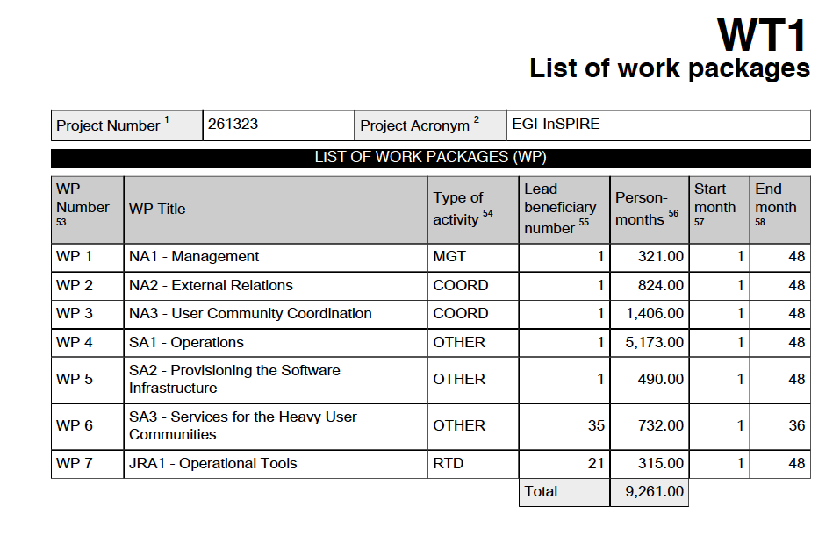
WP & task leaders in https://wiki.egi.eu/wiki/EGI-InSPIRE:Main_Page

Slide 4
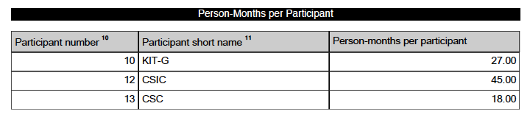
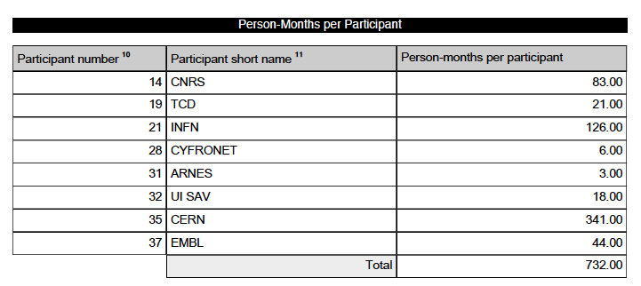

Slide 5
Task Contacts
Task | Purpose | Contact / Leader
TSA3.1 (CERN) | Management | Jamie Shiers (50%)
TSA3.2 | Shared Services & Tools Dashboards Applications Services Workflows & Schedulers MPI | Jamie Shiers
TSA3.3 | Services for HEP | Maria Girone
TSA3.4 | Services for LS | Johan Montagnat
TSA3.5 | Services for A&A | Claudio Vuerli
TSA3.6 | Services for ES | Horst Schwichtenberg

Slide 6
Participant Number | Participant Short name / Lead Beneficiary | WP 6 (SA3): Services for Heavy User Communities Person Months per Task |  |  |  |  |  | Person Months per Effort Type | Total Person Months
 |  | TSA3.1 | TSA3.2 +F+CCMST | TSA3.3 HEP | TSA3.4 LS | TSA3.5 A&A | TSA3.6 ES | General
10 | KIT-G |  |  |  |  |  | 27 | 27 | 27
 | Fraunhofer |  |  |  |  |  | 27 | 27 | 27
12 | CSIC |  | 45 |  |  |  |  | 45 | 45
 | CSIC |  | 27 |  |  |  |  | 27 | 27
 | CIEMAT |  | 18 |  |  |  |  | 18 | 18
13 | CSC |  | 18 |  |  |  |  | 18 | 18
14 | CNRS |  | 30 |  | 53 |  |  | 83 | 83
19 | TCD |  | 21 |  |  |  |  | 21 | 21
21 | INFN |  | 36 | 60 |  | 30 |  | 126 | 126
 | INFN |  |  | 60 |  |  |  | 60 | 60
 | UNIPG |  | 9 |  |  |  |  | 9 | 9
 | SPACI |  | 27 |  |  |  |  | 27 | 27
28 | CYFRONET |  | 6 |  |  |  |  | 6 | 6
31 | ARNES |  | 3 |  |  |  |  | 3 | 3
32 | UI SAV |  | 18 |  |  |  |  | 18 | 18
35 | CERN | 18 | 120 | 203 |  |  |  | 341 | 341
37 | EMBL |  | 18 |  | 26 |  |  | 44 | 44
 | TOTALS | 18 | 315 | 263 | 79 | 30 | 27 | 732 | 732

Slide 7
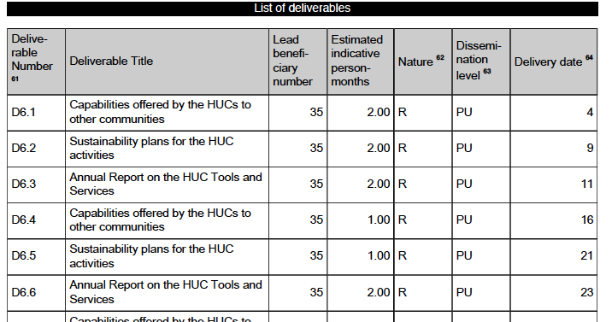
In other words, producing the deliverables is expected to cost ~1 FTE in 1st year!

Slide 8
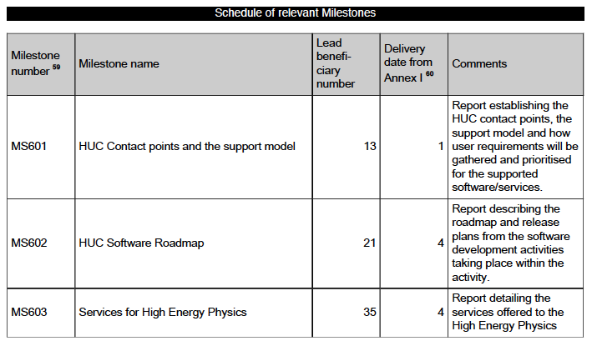
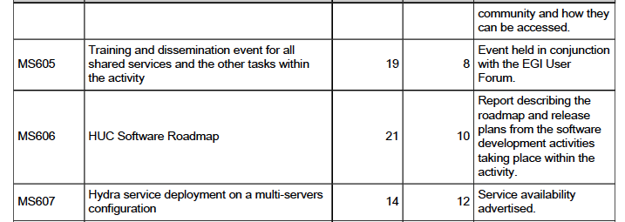

Slide 9
Additional Work
Timesheets: need to be filled, saved and validated – please do at end of each month!
In addition, we have to review other MS & D, contribute to various papers and presentations, the quarterly report, monthly timesheets, the weekly reports to the AMB, the EGI TF & UF etc.
The load has to be shared – not only within SA3 but also with other group members!
A very important D coming up is that on sustainability! We will discuss in more detail at Wednesday’s group meeting

Slide 10
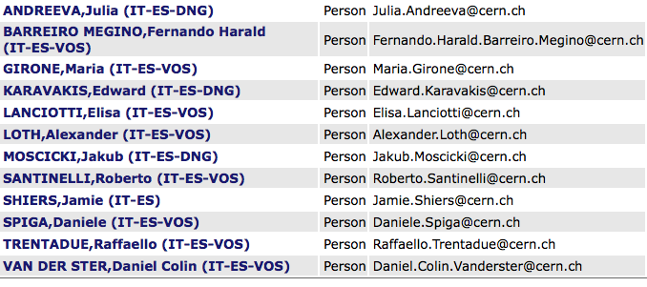
Current Staff
Two new people expected “via” INFN
  1 ATLAS, 1 CMS; candidates identified

Slide 11
Outstanding Work
D6.1 – need to respond to second review
EGI-InSPIRE paper: suggest to take HUC summaries from D6.1 where not provided
Quarterly Report: needs to clearly show the work done by EGI-InSPIRE personnel; list of conferences & papers needs to be updated
D6.2 – need to start discussing this…
UF – plan for tutorials and presentations

Slide 12
Workplan
The workplan for TSA3.2 and TSA3.3 in the Description of Work is somewhat generic
However, what we do has to be consistent with the overall project goals:
Support will also be given for the current heavy users as they move their critical services and tools from a central support model to ones driven by their own individual communities
As well as the specific WP objectives:

Slide 13
WP6 objectives
This activity provides continued support for activities currently supported by EGEE while they transition to a sustainable support model within their own community or within the production infrastructure by:
  Supporting the tools, services and capabilities required by different heavy user communities (HUCs)
  Identifying the tools, services and capabilities currently used by the HUCs that can benefit all user communities and to promote their adoption
  Migrating the tools, services and capabilities that could benefit all user communities into a sustainable support model as part of the core EGI infrastructure
  Establishing a sustainable support model for the tools, services and capabilities that will remain relevant to single HUCs

Slide 14
TSA3.2.1 Dashboards: Dashboards provide a generic framework to monitor sites and their services within a VO using tests specific to that community. Dashboards have emerged from within the HEP community, and are now being adopted by the LS community, to monitor their resources.
TSA3.2.2 Applications: The GANGA and DIANE tools are both part of the EGEE RESPECT programme which recognises software that builds on top of the gLite platform. Although initially developed for the HEP community these tools have now gained traction in other communities, as they provide simple environments to manage large collections of tasks. The requirements of these tools will be integrated into the workplan.
TSA3.3: Services for High Energy Physics (HEP)
  The HEP VO specific services are devoted to the support of the Grid interfaces of the 4 LHC experiments and are of particular importance now as we enter the exploitation phase of the world’s largest scientific machine – the Large Hadron Collider at CERN. They will ensure the LHC experiments can rely on the Grid for their data handling, as planned in the LCG TDR
  All LHC VOs require optimizations and improvements in a number of common areas: workload management data management, monitoring, service deployment and operation. These optimisations – of which specific details are provided in the task description below – are an essential part of the move to sustainable operations, as well as handling additional load and complexity expecting from LHC data acquisition, (re-)processing and analysis.
  An agile structure will be used to organise this work allowing the team to react quickly to high-priority needs of the LHC VOs as experience of the accelerator grows.

Slide 15
Who has done what?
MS603 – Services for HEP (Andrea Sciaba)
D6.1 – Capabilities of HUCs (Fernando)
  Need to respond to 2nd review
EGI-InSPIRE paper (Daniele)
  Need to complete (contributions from all HUCs)
  Target for submission is tomorrow COB
EGI-InSPIRE 2nd QR: again all HUCs have to provide material.

Slide 16
Summary
SA3 work has to be regularly reported to the project and has to be consistent with goals
We have had quite a lot of freedom but we are also under the spotlight – see D6.1 review
We have not managed to build a wider SA3 community – need to do better (repeat funding)
SA3 in the broader sense is very strongly aligned with mandate and direction of group
More on this on Wednesday

