Slide 1


LHCb Physics
S. Stone
As You Like It
For the LHCb Collaboration

Slide 2
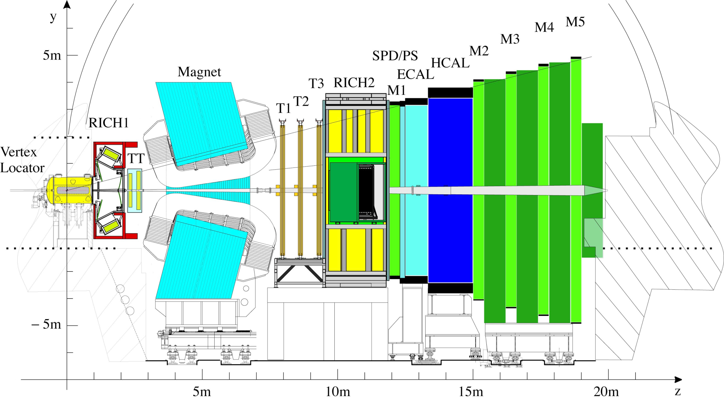
The LHCb Detector

Slide 3
Limits on New Physics
It is oft said that we have not seen New Physics, yet what we observe is the sum of Standard Model + New Physics. How to set limits on NP?
Assume that tree level diagrams are dominated by SM and loop diagrams could contain NP
Tree diagram example Loop diagram example
V_{cb} or V_{ub}

Slide 4
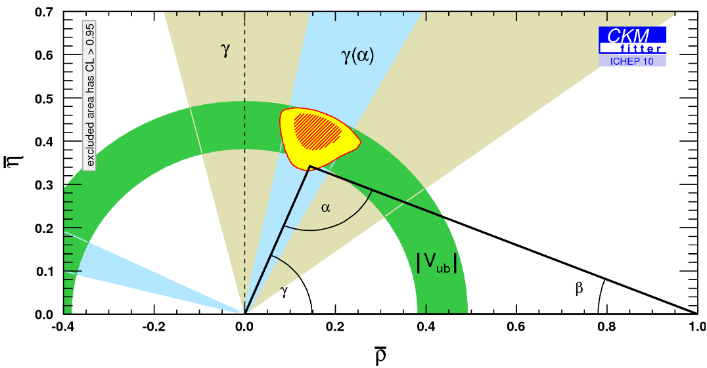
What are limits on NP from quark decays?
Tree diagrams are unlikely to be affected by physics beyond the Standard Model

Slide 5
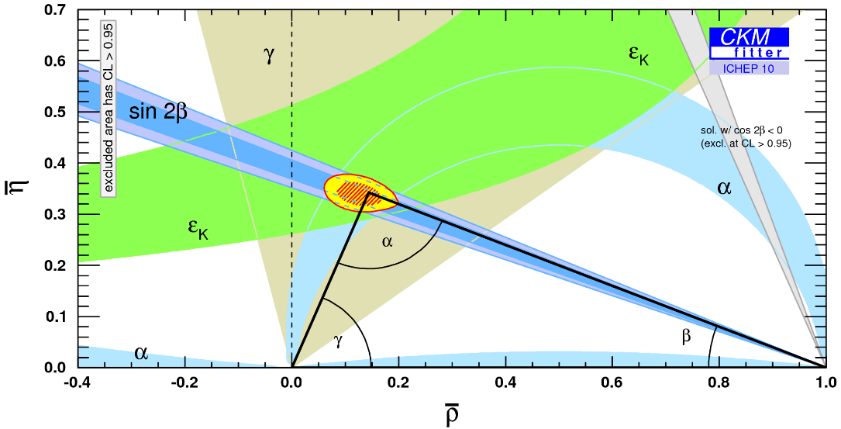
CP Violation in Bº & Kº Only
Absorptive (Imaginary) of mixing diagram should be sensitive to New Physics. Lets compare

Slide 6
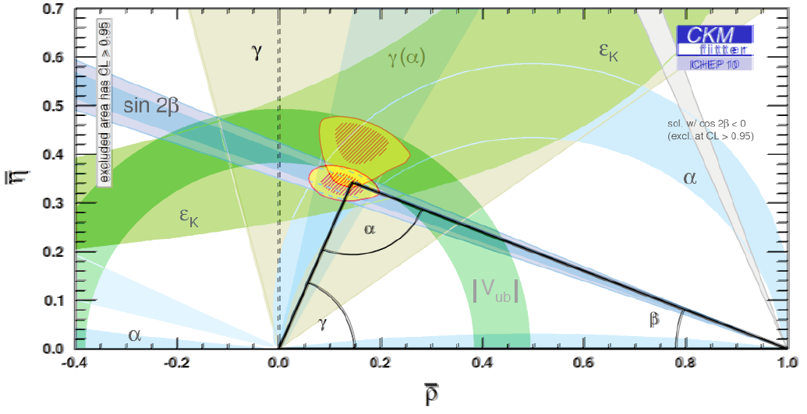
They are Consistent
But consistency is only at the 5% level
Same for B_{s} – CP violation in J/ψ φ (not including D0 A_{sl}) ⇒limits on NP are not so strong

Slide 7
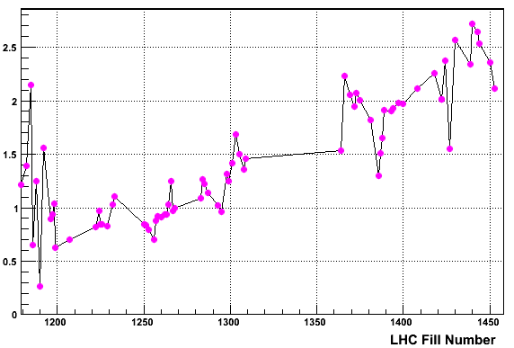
Running Conditions
Because the # of bunches in the LHC was limited we decided that the trigger had enough time to process data with multiple interactions per crossing
This gets to 6x larger μ than design
μ
# interactions/crossing
Design

Slide 8
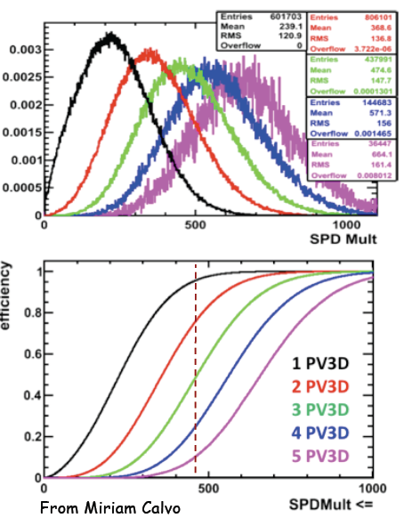
Life at large μ
For μ⁺μ⁻ triggers, take almost everything, SPD<900. Other triggers require rejecting events with large numbers of tracks. Cut on SPD multiplicity as it correlates well & is provided in L0; the cut value changed with L
This still is a large gain for all modes than the original plan of μ=0.4
1
2
3

Slide 9
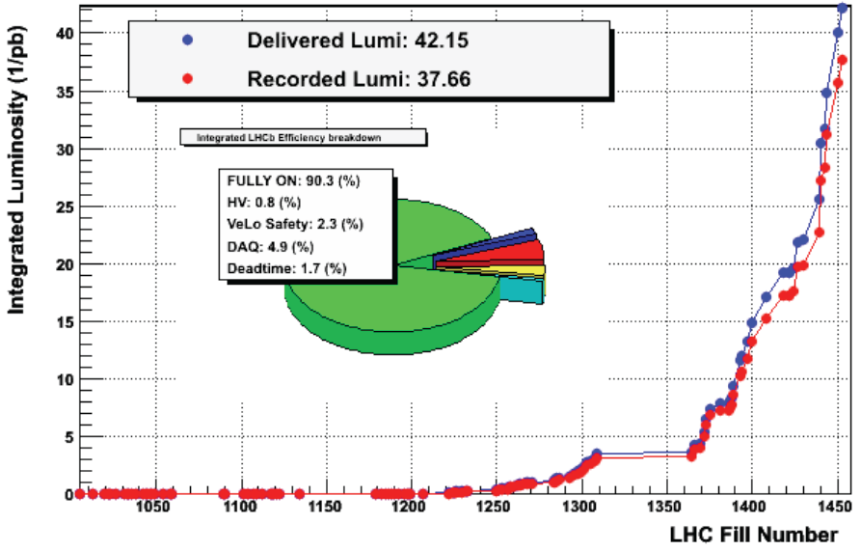
Integrated Luminosity

Slide 10
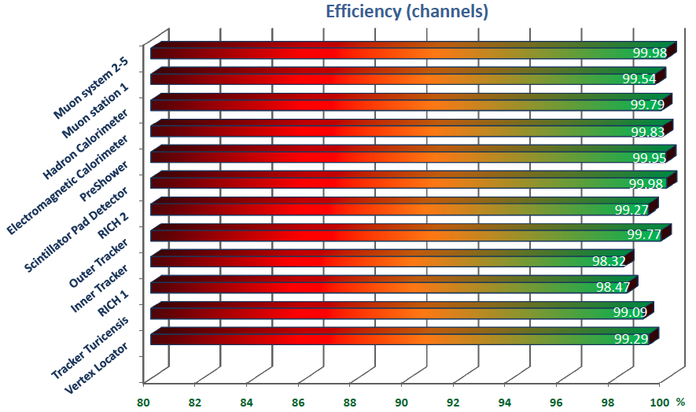
Sub-detector efficiencies
Some “small” problems: VCSELs in several systems, HV & high current problems in a few systems

Slide 11
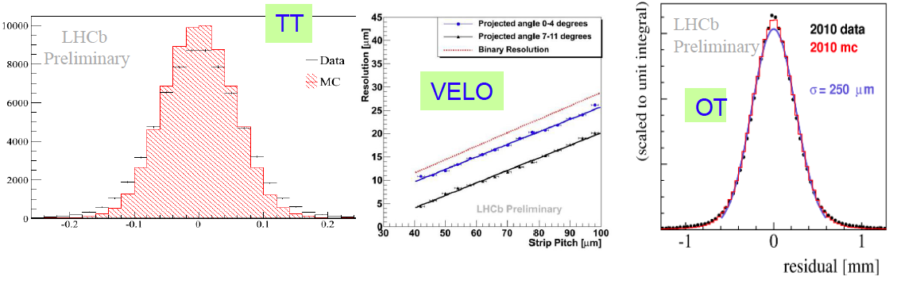
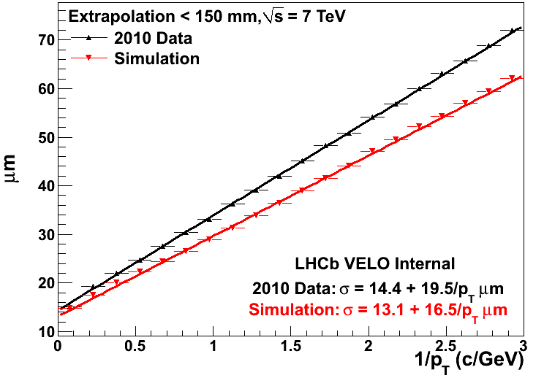

Detector Performance
Time resolution on typical B decay modes is ~60 fs, very good but, worse than the expected ~40 fs

Slide 12
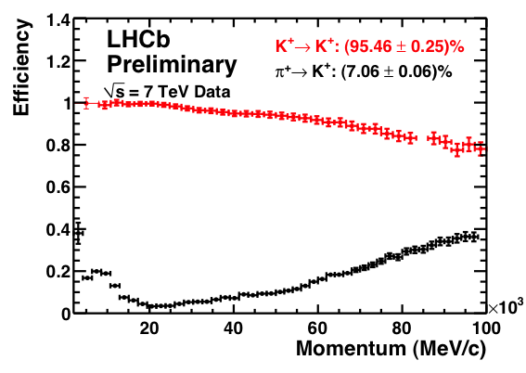
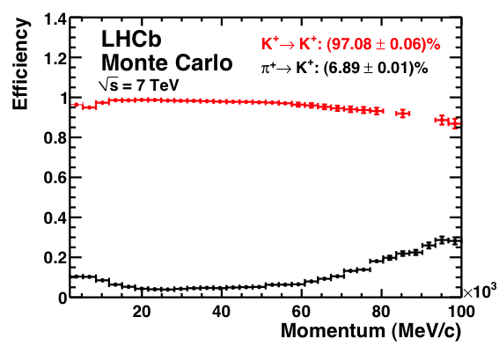
Particle ID
PID performing well
Close to MC level performance
Data
MC
Momentum GeV/c
Momentum GeV/c

Slide 13
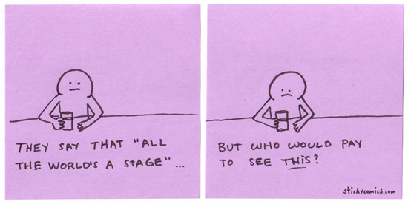
Some Interesting Near Future Measurements & Sensitivities
LHCb expectations: 37 pb⁻¹ in 2010 ✓
~ 2 fb⁻¹ for nominal yr
~ 6 fb⁻¹ for “1st run”
~60 fb⁻¹ for upgrade

Slide 14
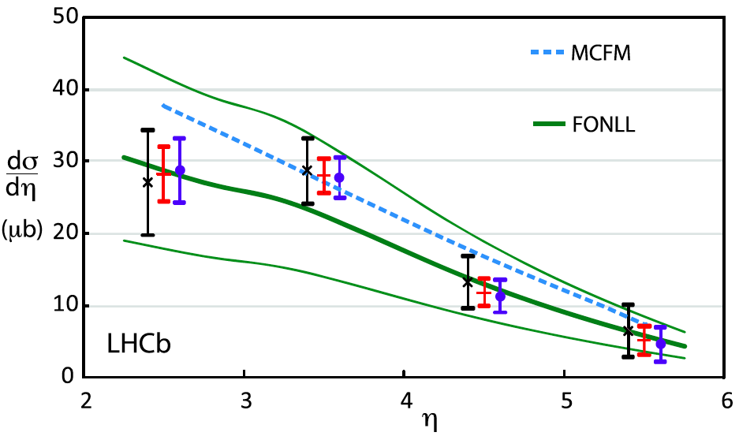
Infancy: 15 nb⁻¹
Measure σ(pp→bbX) using b→D⁰Xμ ⁻ν, Dº→K⁻π⁺,
~280 events
x -Untriggered
• - Single Muon Trigger
+ Average
Error
on theory
  In 2<η<6, (75.3±5.4±13.0) μb LEP frag
  In 2<η<6, 89.6 μb Tevatron frag
  Also measured charm cross-section, ~20x b

Slide 15
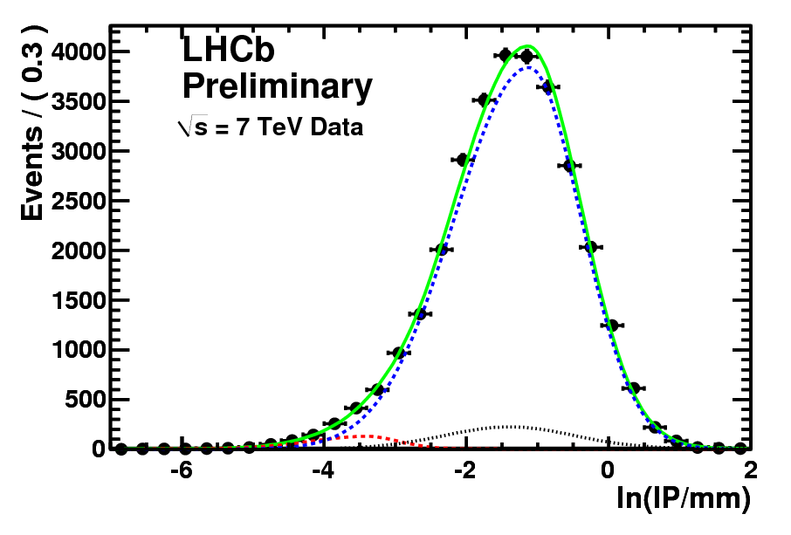
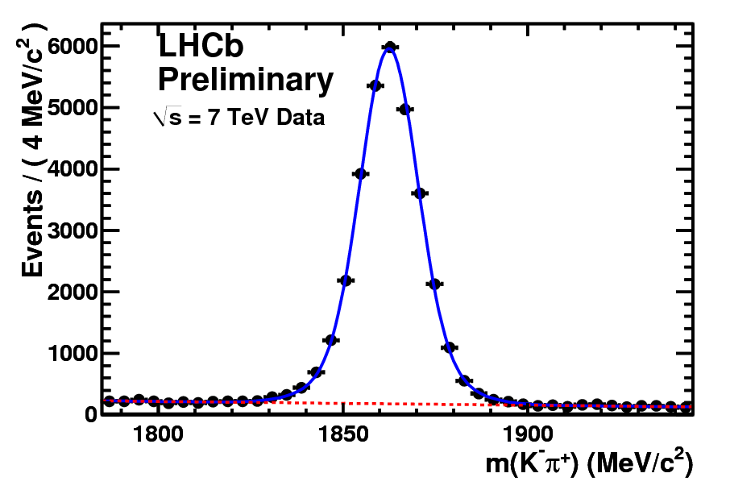
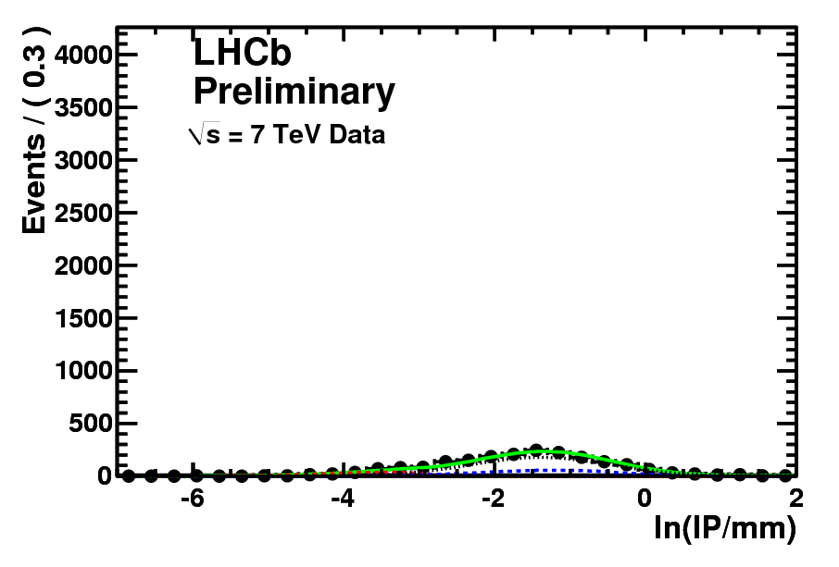
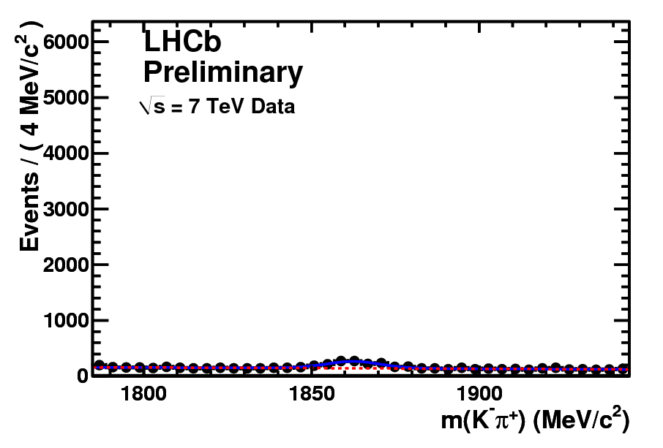
Childhood 3 pb⁻¹
RS Dfb = 28531±193 Prompt = 715±44 sideband = 1776±33
Dfb
Prompt D⁰
Fake D⁰
WS Dfb = 422±43 Prompt = 204±19 sideband = 1410±21

Slide 16
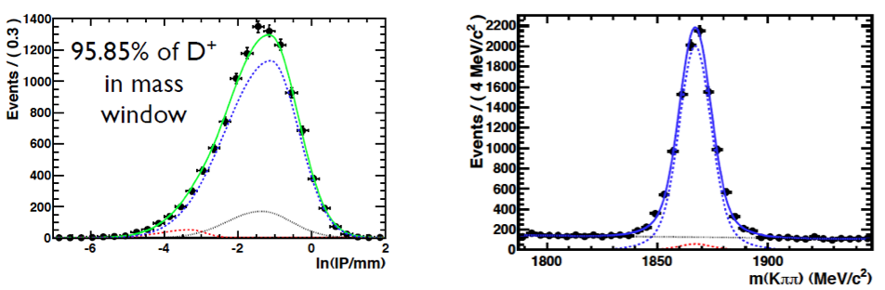
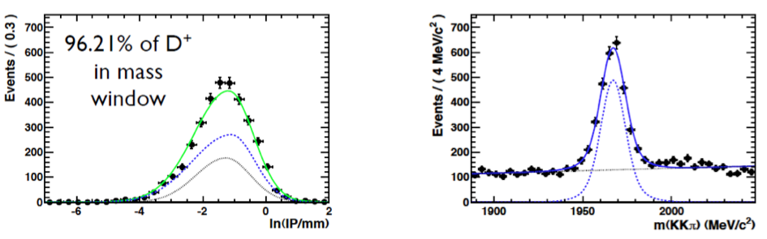
Also D⁺, D_{s}, Λ_{b}
D⁺
LHCb
Preliminary
Dfb
D⁺→K⁻π⁺
Prompt D⁰
Fake D⁰
LHCb
Preliminary
Dfb: 9406±110
D_{s}
D_{s}→K⁻K+⁻π⁺
LHCb
Preliminary
LHCb
Preliminary
Dfb: 2446±60

Slide 17
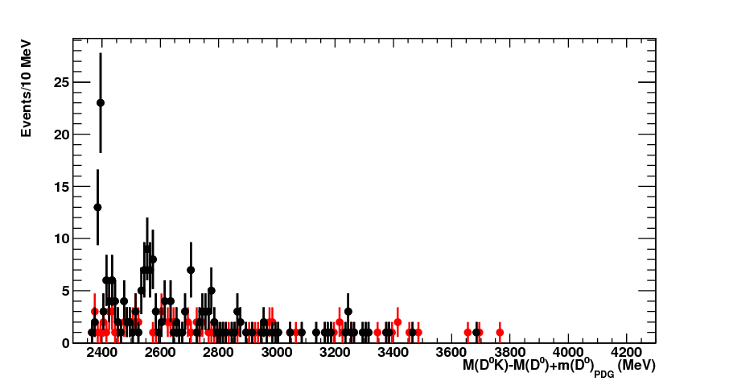
Extract B_{s} fraction
Must correct for B_{s}→DºK⁺Xμν, also Λ_{b}→DºpXμν
Will use to determine f_{s}/(f_{d}+f_{u})
D_{s1}(2536) → D*(2007)⁰ K⁺
missed π⁰ or γ
• D⁰K⁺
• WS Kaon: D⁰K⁻
Γ_{PDG} < 2.3 MeV
D_{s2}(2573) → D⁰ K⁺
Γ_{PDG}= 20±5 MeV
√s = 7 TeV
LHCb Preliminary

Slide 18
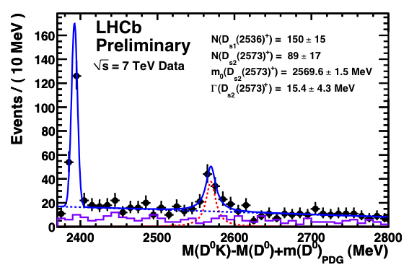
B_{s}→D_{s2}Xμν, D_{s2}→DºK⁺
New decay mode observed using 20 pb^{-1,}
Seen by D0 in 1.3 fb⁻¹ using D*⁺K_{s}, 46±9 events
Wrong sign

Slide 19
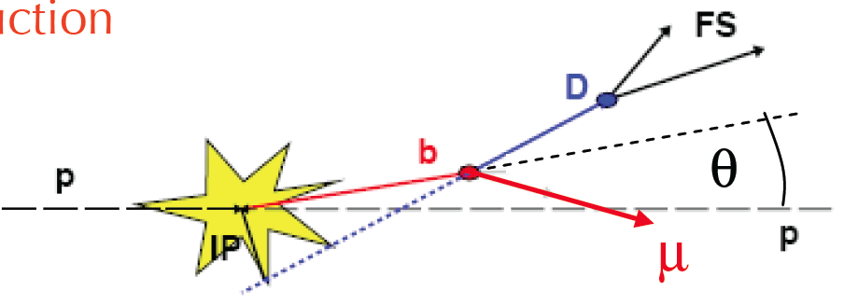
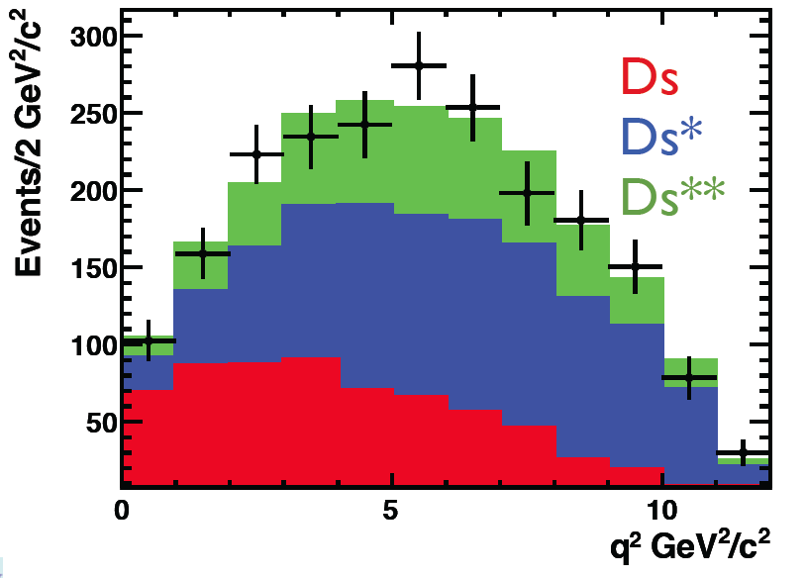
Exclusive semileptonic decays
Accurate measurement of B-flight direction allows missing neutrino reconstruction
For B_{s}→D_{s} X μν
  D_{s}: 0.26±0.06
  D_{s}*: 0.49±0.069
  D_{s}**: 0.25±0.12
  LHCb preliminary
ν
No
systematic
errors yet
LHCb Preliminary

Slide 20
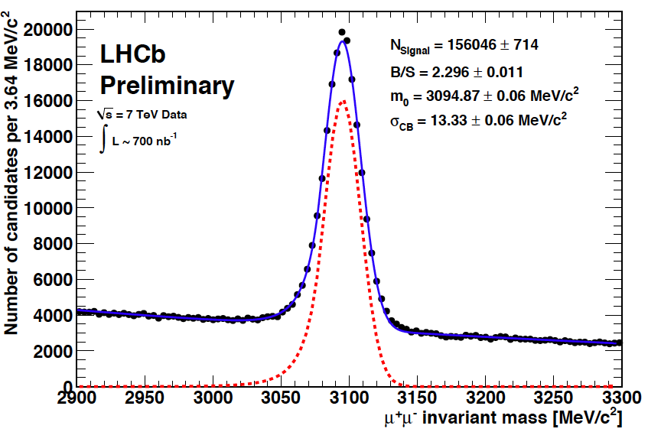
Adolescence: μ⁺μ⁻
Inclusive J/ψ→μ⁺μ⁻
0.7 pb⁻¹

Slide 21
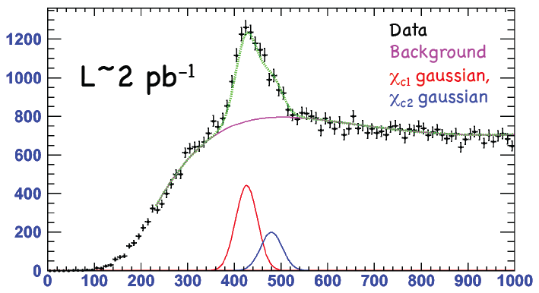
χ_{c}→γ J/ψ
M(χ_{c})-(J/ψ)
Events/10 MeV
LHCb Preliminary

Slide 22
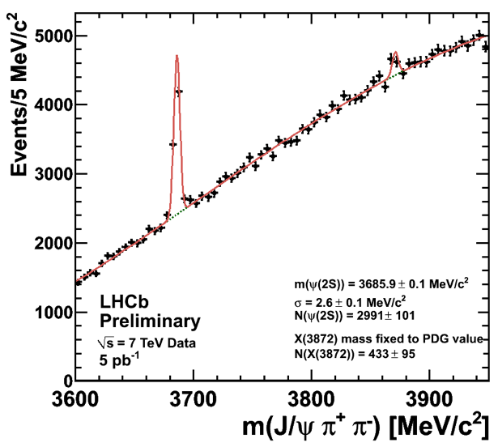
J/ψπ⁺π⁻
#ψ(2s)=2991±101
#X(3872)=433±95
Ψ(2S)
X(3872)

Slide 23
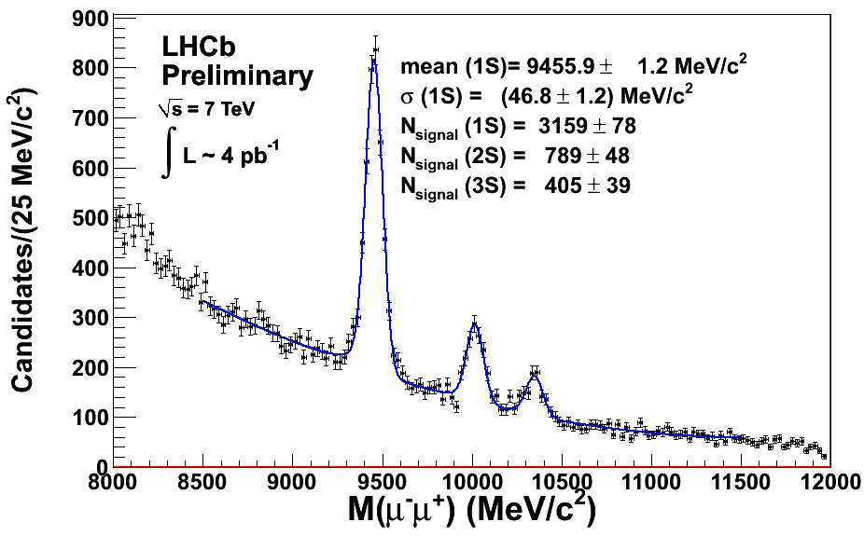
Upsilons too

Slide 24
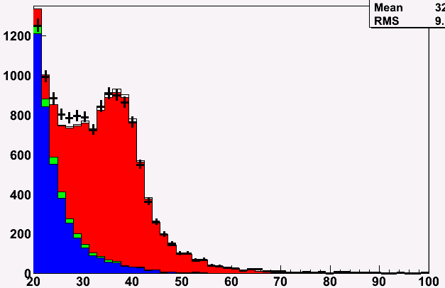
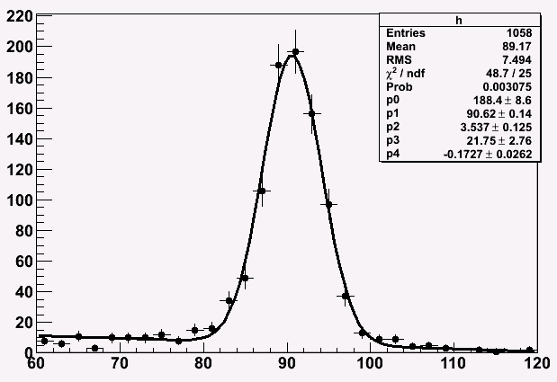
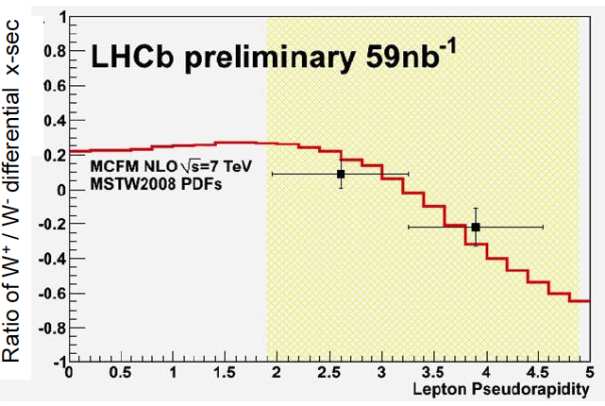
Z⁰ & W±
Require two μ⁺μ⁻, each with p_{t}>20 GeV
Require single isolated μ, with p_{t}>20 GeV & small p_{t} opposite
L~16 pb⁻¹
LHCb Preliminary
L~16 pb⁻¹
P_{t}(μ)
LHCb
Preliminary
LHCb Preliminary
M(μ⁺μ⁻)

Slide 25
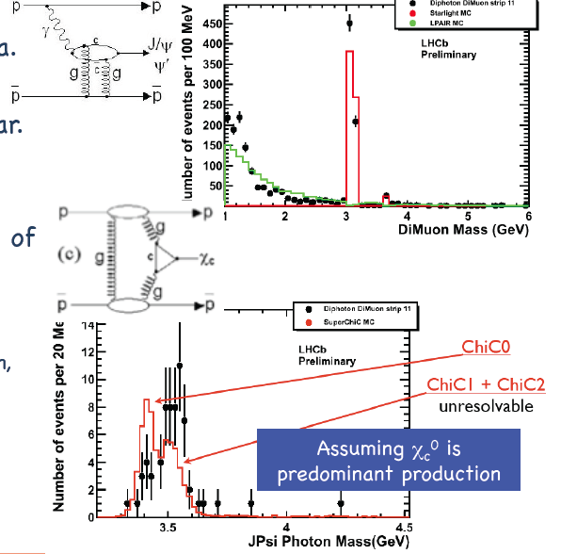
pp→ppJ/ψ(χ_{c})
We can also do γ’s πº’s
12 pb⁻¹
“Standard Candle” QCD processes, arXiv: 1005.0695 [hep=ph]

Slide 26
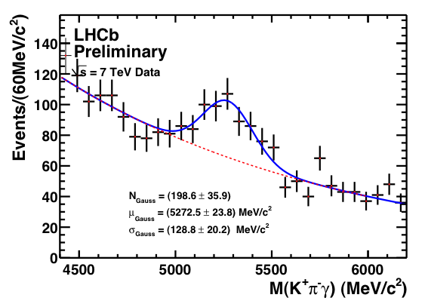
Bº→K*ºγ
37 pb⁻¹
199 events

Slide 27
Fully Reconstructed Hadronic Decays
Needed for CP Violation Studies

Slide 28
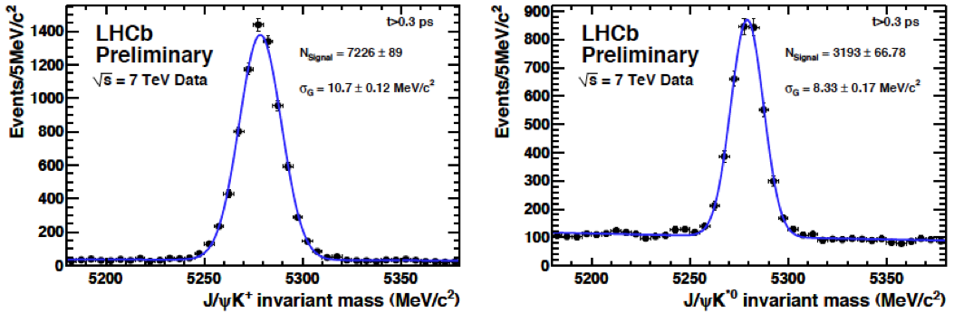
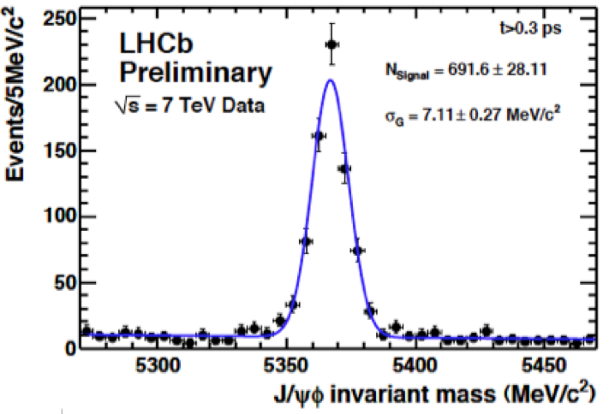
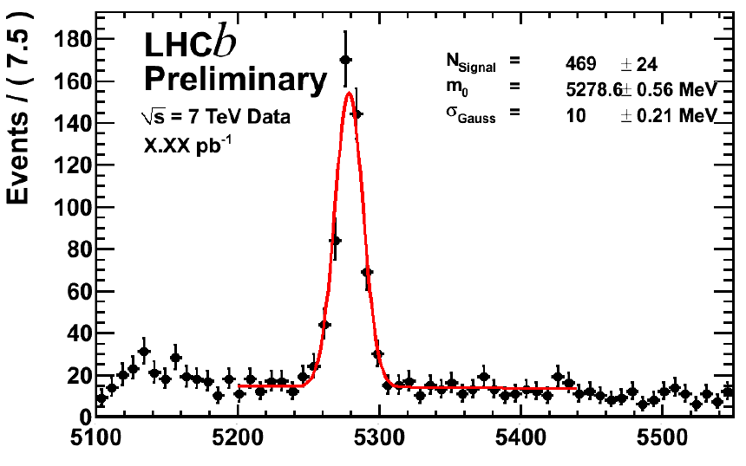
Exclusive B→ J/ψ h
~15 pb⁻¹
7226
events
J/ψ K⁺
3193
events
J/ψ K*º
B(B→J/ψ K⁺)●B(J/ψ→μ⁺μ⁻)=6x10⁻⁵
J/ψ K_{s}
692
events
405
events
J/ψ φ

Slide 29
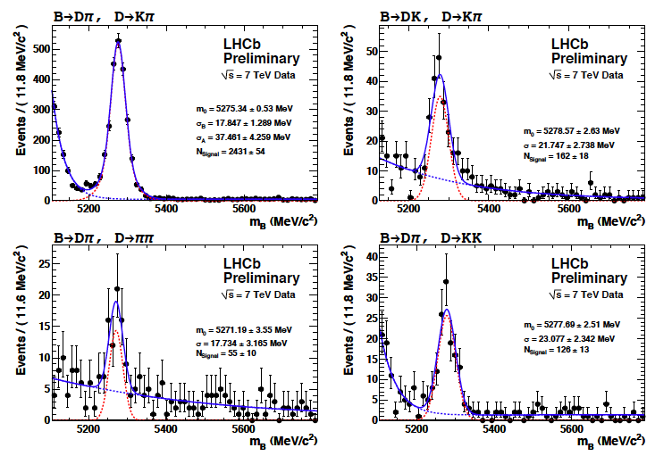
B⁻→Dºh⁻
B⁻→Dºπ⁻, Dº→K⁻π⁺
B⁻→DºK⁻, Dº→K⁻π⁺
B(B→Dºπ⁻)
●B(Dº→π⁺K⁻)
=1.9x10⁻⁴
162
events
2431
events
~12 pb⁻¹
B⁻→Dºπ⁻, Dº→π⁻π⁺
B⁻→Dºπ⁻, Dº→K⁻K⁺
55
events
126
events

Slide 30
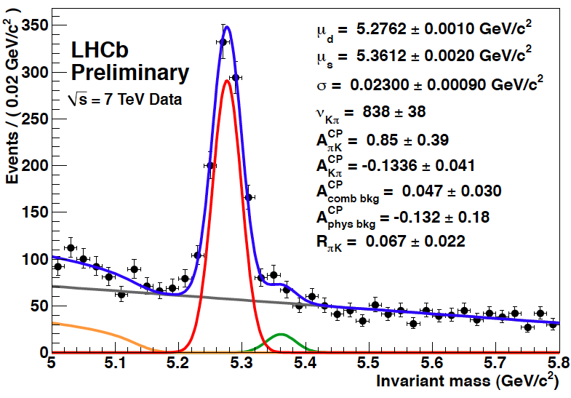
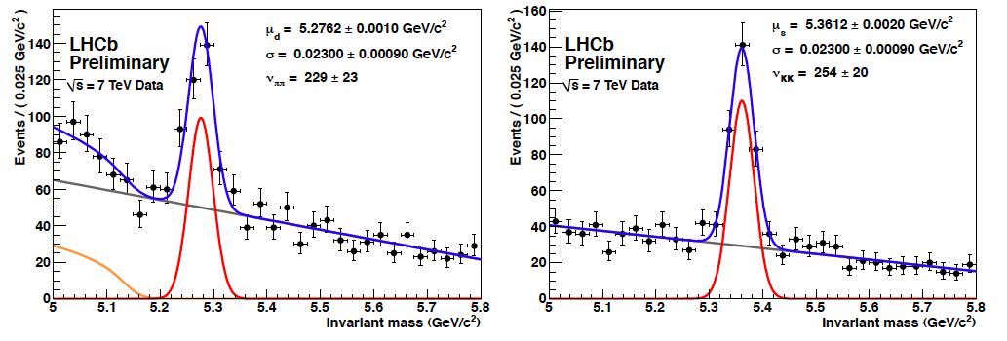


B→πK, ππ, KK
35 pb⁻¹, “loose cuts”
We will get as many Kπ in 0.5-0.7 fb⁻¹ as Belle in 1000 fb⁻¹
Bº→K±π⁺
838 events
B_{s}→K±π⁺
B(B→π⁺π⁻)=5x10⁻⁶
254 events
229 events

Slide 31
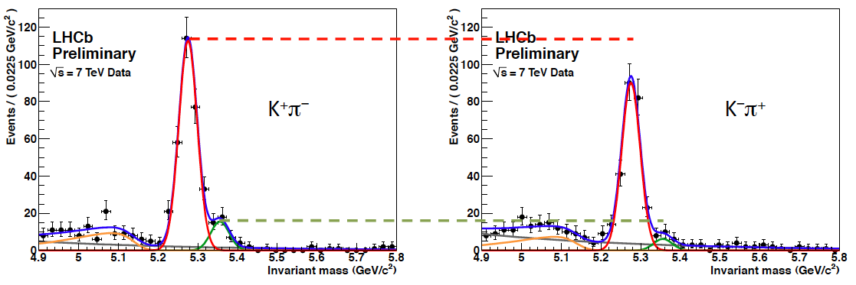
B→πK: CPV
B_{s}/Bº yield = (10.7±2.0)%, obvious CPV in both
Using loose cuts A_{CP}(Bº)=-0.134±0.041 stat error only, no corrections (HFAG: -0.098±0.012)
Using tight cuts A_{CP}(B_{s})=-0.43±0.17 stat error only, no corrections (CDF: 0.39±0.15±0.08 in 1 fb⁻¹)
Tight cuts loose
1/3 of events

Slide 32
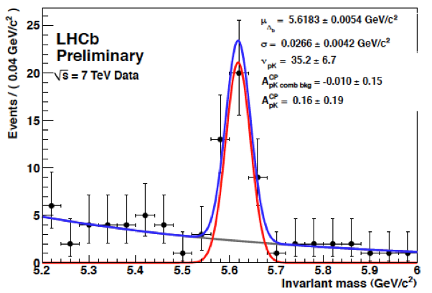
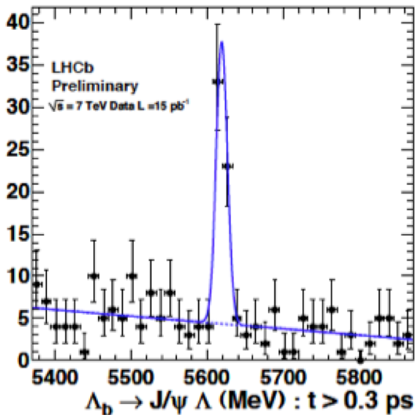
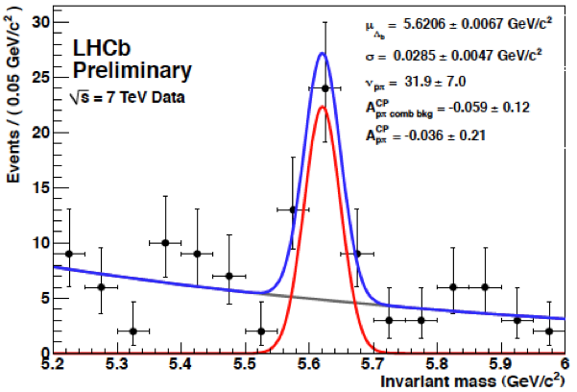
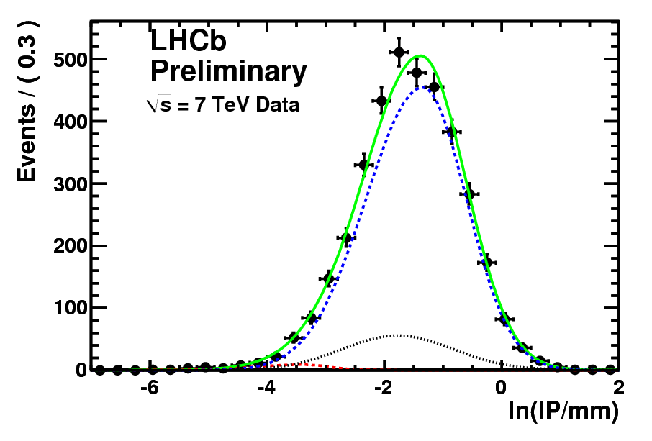
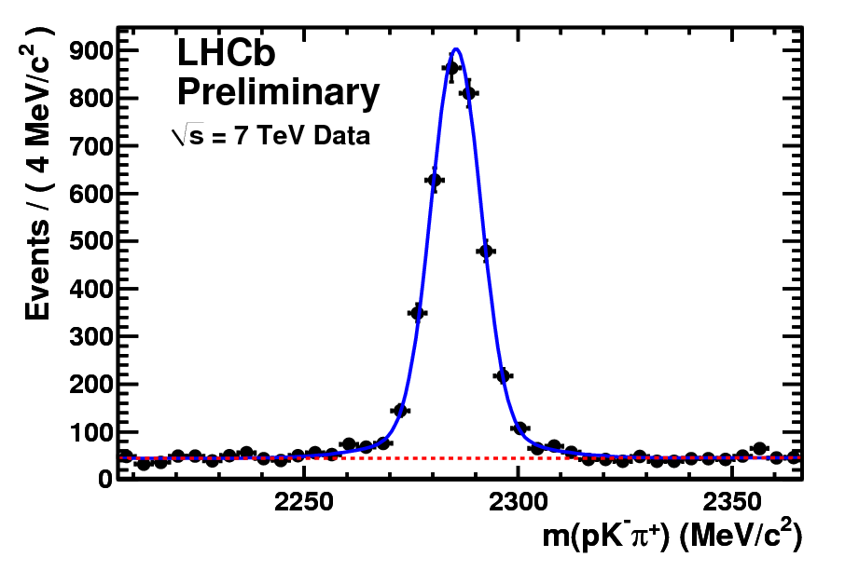
Λ_{b}’s appearing
35 events
60
events
32 events
Λ_{b} →
J/ψΛ
Λ_{b} → pK
Λ_{b} → pπ
Λ_{b}→Λ_{c}⁺Xμν, Λ_{c}⁺→pKπ Dfb = 3250±71
M(pKπ)

Slide 33
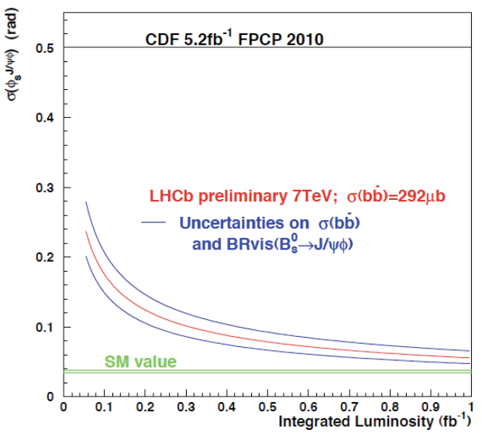
Expectations: Soldiering on
Next year make world class measurements. With a few hundred pb⁻¹ we believe we can begin to make more sensitive measurements than CDF & D0 in many cases. Ex: B_{s}→J/ψ φ
We expect to reach
sensitivities which are good
enough to see NP in e.g.
CPV in J/ψ φ + J/ψ f₀,K*μ⁺μ⁻
angular distributions, B_{s}→μ⁺μ⁻
charm CPV….

Slide 34
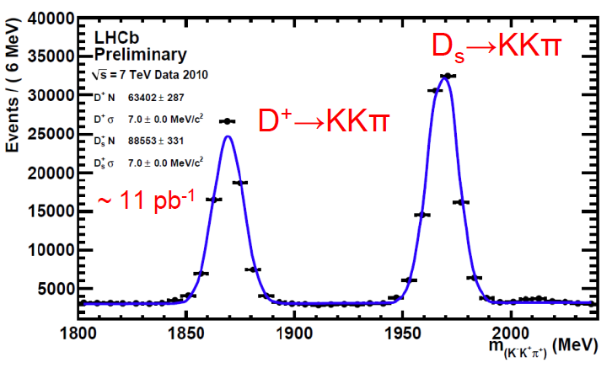
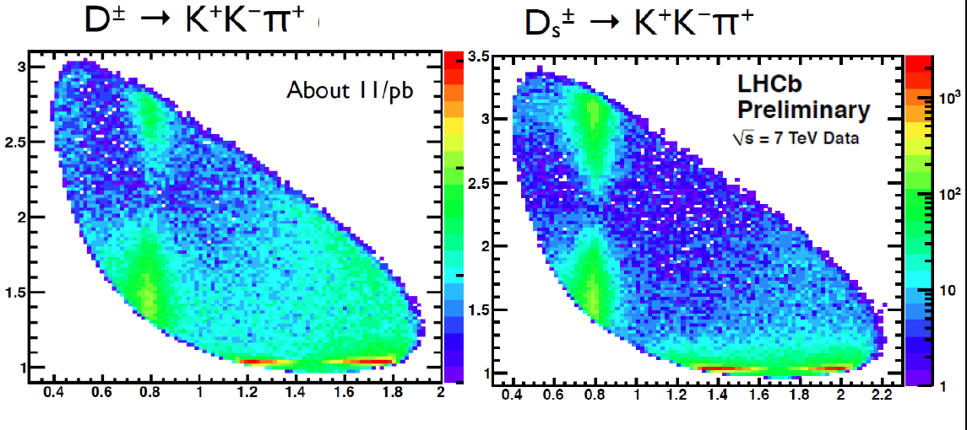
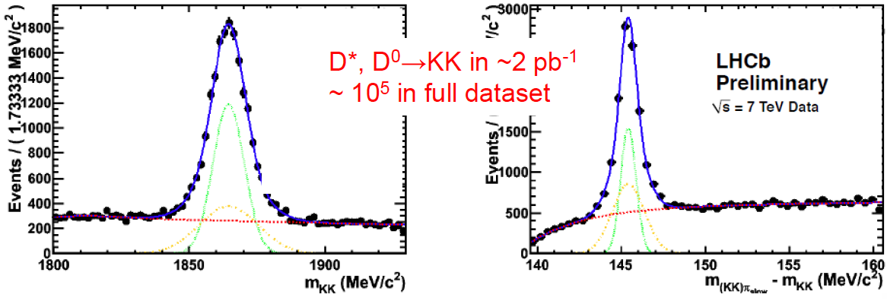
Great Prospects in Charm
M²(KK)
M²(Kπ)

Slide 35
Future acts: The LHCb Upgrade
Run at 10³³ cm⁻²/s
Requires that detector be readout at 40 MHz crossing rate ⇒ new front end electronics for most of the detector
Improve hadron trigger eff.
Improve tracking, necessary due to large numbers of tracks in multiple interaction xings
More radiation damage and trigger speed necessitates a new VELO based on pixels

Slide 36
Conclusions
“All the world's a stage, and all the men & women merely players; they have their exits and their entrances; & one man in his time plays many parts, his acts being seven ages. At first the infant…”
Perhaps we have reached adolescence
Well known decays have been seen, & we have started to observe new decay modes
We are ready to make the worlds best measurements next year & hopefully find evidence of something really interesting!
We would love to get 1-2 fb⁻¹ next year!

Slide 37
The End

Slide 38
All the world’s a stage
"All the world's a stage,
And all the men and women merely players;
They have their exits and their entrances;
And one man in his time plays many parts,
His acts being seven ages. At first the infant,
Mewling and puking in the nurse's arms;
And then the whining school-boy, with his satchel
And shining morning face, creeping like snail
Unwillingly to school. And then the lover,
Sighing like furnace, with a woeful ballad
Made to his mistress' eyebrow. Then a soldier,
Full of strange oaths, and bearded like the pard,
Jealous in honour, sudden and quick in quarrel,
Seeking the bubble reputation
Even in the cannon's mouth. And then the justice,
In fair round belly with good capon lin'd,
With eyes severe and beard of formal cut,
Full of wise saws and modern instances;
And so he plays his part. The sixth age shifts
Into the lean and slipper'd pantaloon,
With spectacles on nose and pouch on side;
His youthful hose, well sav'd, a world too wide
For his shrunk shank; and his big manly voice,
Turning again toward childish treble, pipes
And whistles in his sound. Last scene of all,
That ends this strange eventful history,
Is second childishness and mere oblivion;
Sans teeth, sans eyes, sans taste, sans everything." — Jaques (Act II, Scene VII, lines 139-166)

