Slide 1
Non-linear optics corrections at ESRF
&
status of FFC-ee simulations
S.M.Liuzzo, A.Franchi, FCC-ee meeting, 10th February 2022

Slide 2
Outline
From off-energy ORM to nonlinear optics correction (NOECO)
Experimental results @ ESRF
NOECO simulations of FCC-ee (Z)
  detect & correct a sextupole error for an ideal lattice
  detect & correct a sextupole error for a lattice with misalignments
  detect & correct a sextupole error for a lattice with quad. errors
Next steps

Slide 3
Outline
From off-energy ORM to nonlinear optics correction (NOECO)
Experimental results @ ESRF
NOECO simulations of FCC-ee (Z)
  detect & correct a sextupole error for an ideal lattice
  detect & correct a sextupole error for a lattice with misalignments
  detect & correct a sextupole error for a lattice with quad. errors
Next steps

Slide 4
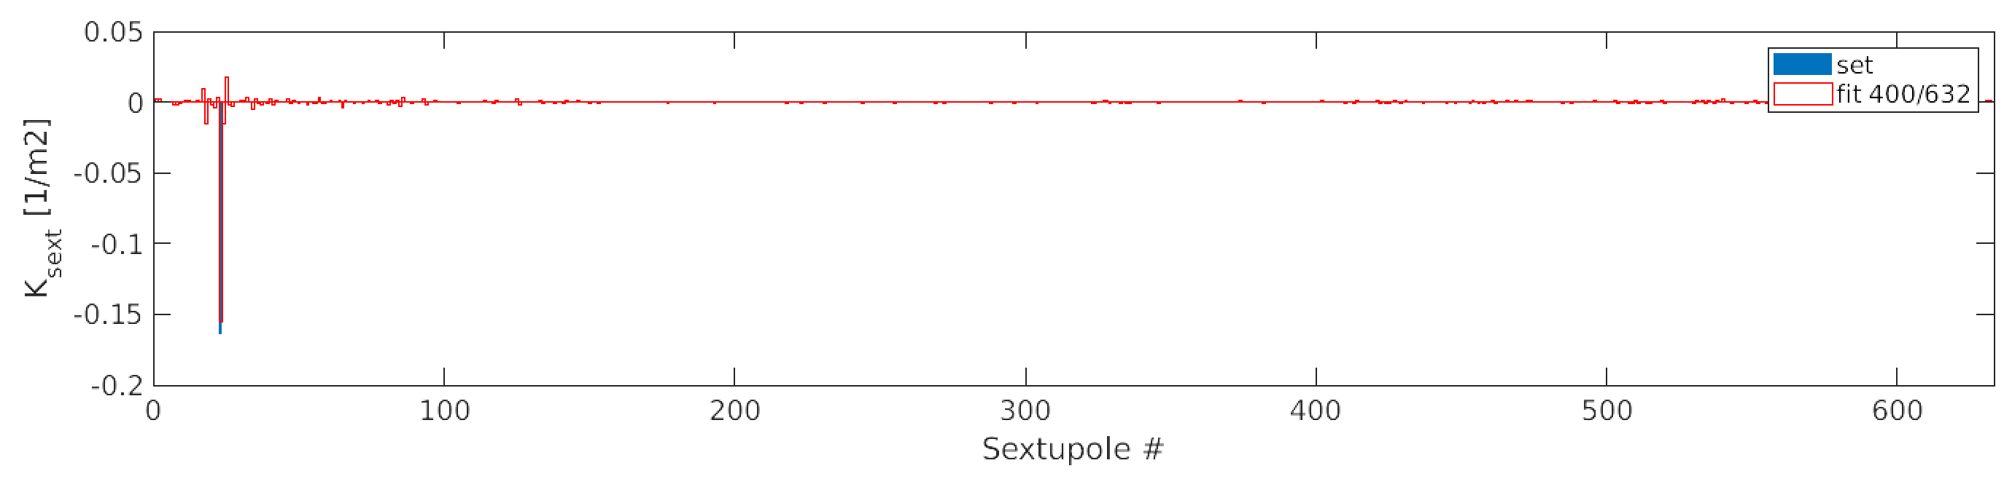
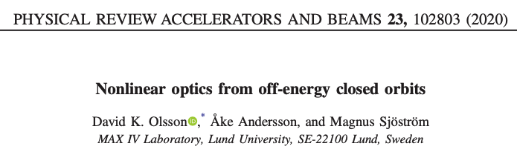
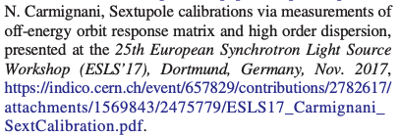
FCC-ee z V10 : noECO
FCC-ee ideal lattice, result presented at last Dec.’s workshop
Test with one large sextupole error (50%)
No other errors
Δ( ( ORM(+δ) - ORM(-δ) ) / 2δ ) / ΔK_{sext}
A.Franchi,

Slide 5
Outline
From off-energy ORM to nonlinear optics correction (NOECO)
Experimental results @ ESRF
NOECO simulations of FCC-ee (Z)
  detect & correct a sextupole error for an ideal lattice
  detect & correct a sextupole error for a lattice with misalignments
  detect & correct a sextupole error for a lattice with quad. errors
Next steps

Slide 6
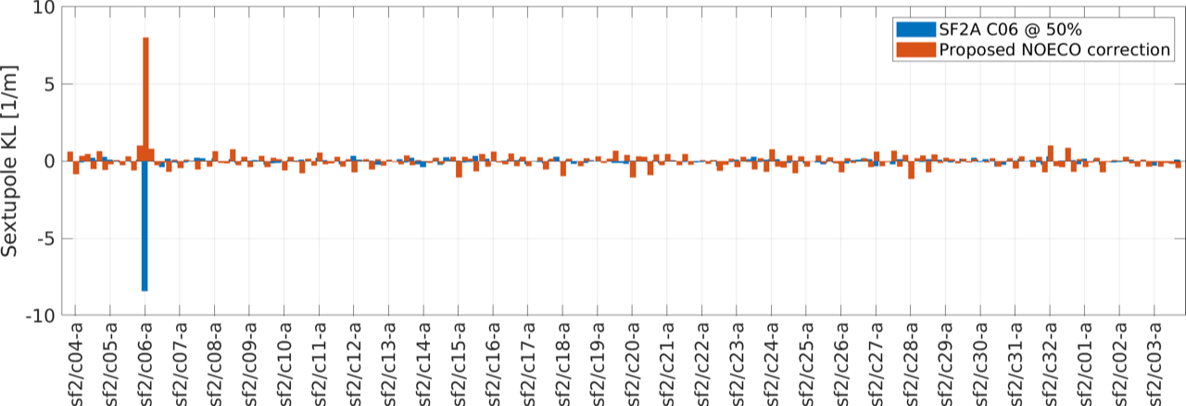
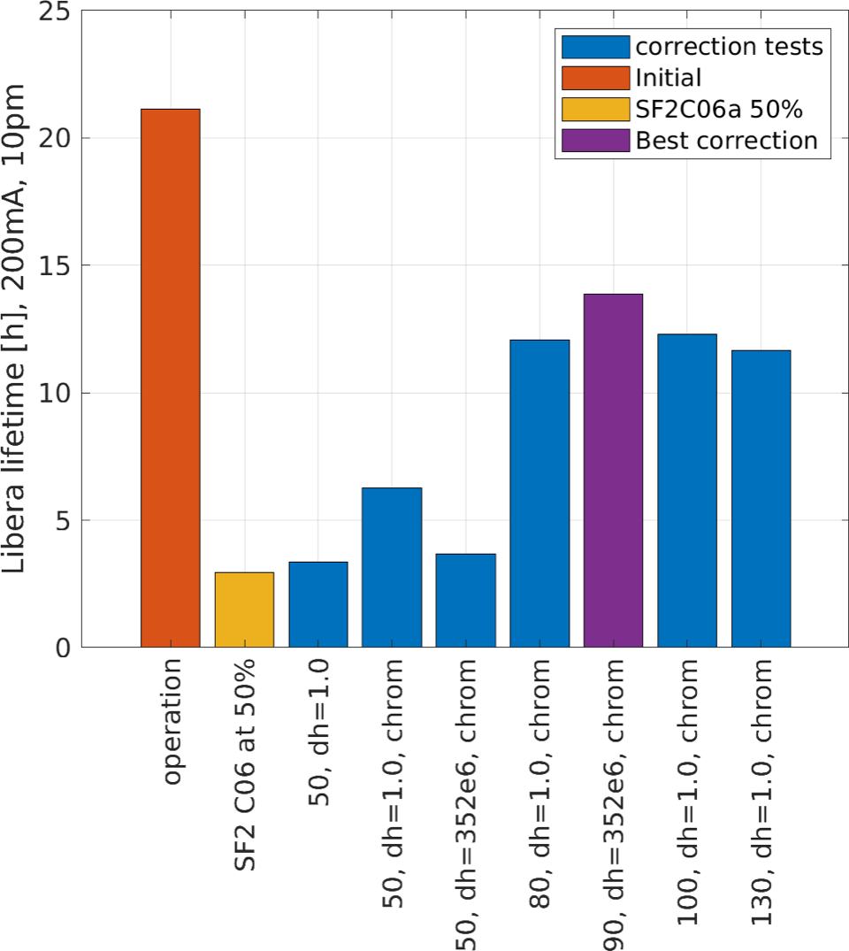
FIRST Measurements @ ESRF SR, 24th January 2022
Top: Retrieve (large) sextupole error.
Right: measured lifetime for different scenarios & numerical parameters.

Slide 7
Outline
From off-energy ORM to nonlinear optics correction (NOECO)
Experimental results @ ESRF
NOECO simulations of FCC-ee (Z)
  detect & correct a sextupole error for an ideal lattice
  detect & correct a sextupole error for a lattice with misalignments
  detect & correct a sextupole error for a lattice with quad. errors
Next steps

Slide 8
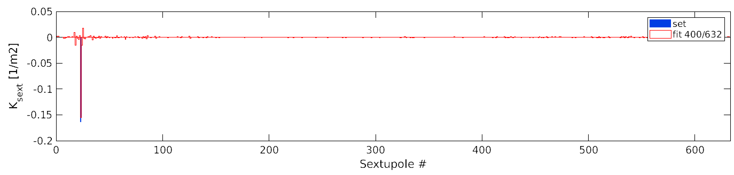
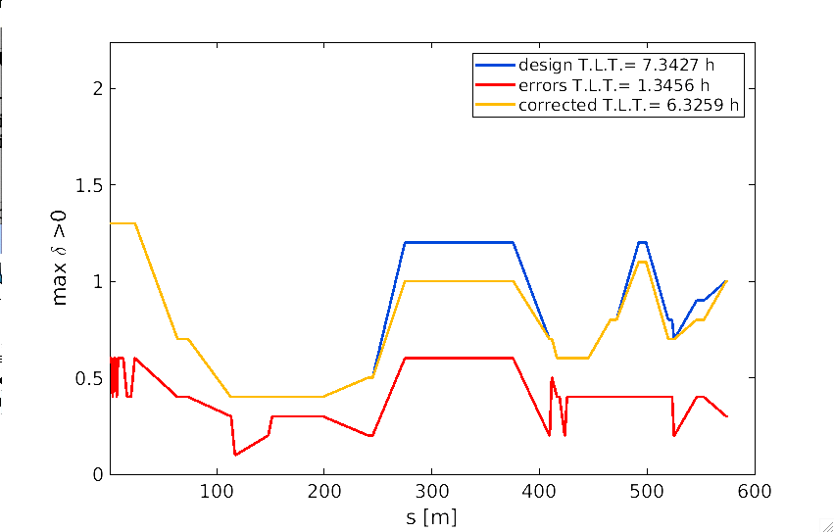
Simulations (Fit & correction) FOR FCC-ee
Test with one large sextupole error (50%)
FCC-ee ideal lattice
only ± 25 Hz RF freq. shift possible w/o making optics unstable
Top: Retrieve (large) sextupole error.
Right: computed momentum acceptance (over 600 m only) & Touschek lifetime

Slide 9
Outline
From off-energy ORM to nonlinear optics correction (NOECO)
Experimental results @ ESRF
NOECO simulations of FCC-ee (Z)
  detect & correct a sextupole error for an ideal lattice
  detect & correct a sextupole error for a lattice with misalignments
  detect & correct a sextupole error for a lattice with quad. errors
Next steps

Slide 10
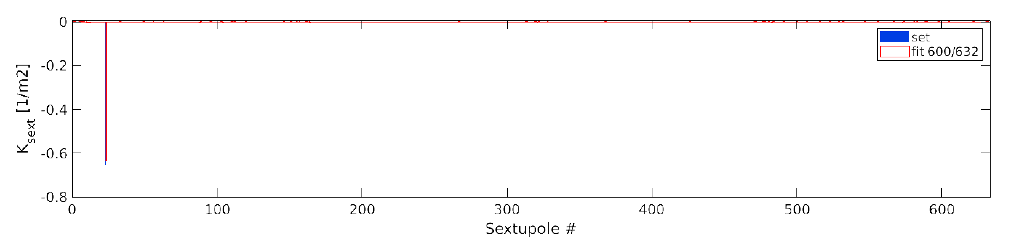
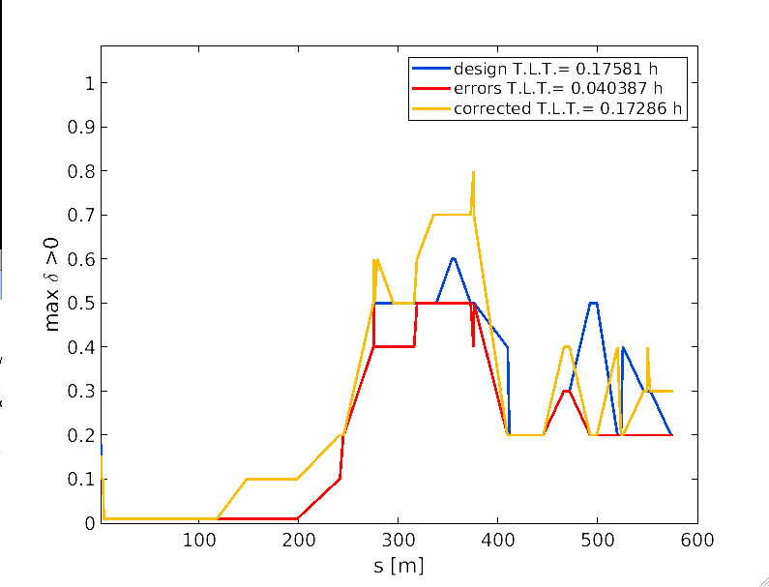
Simulations (Fit & correction) FOR FCC-ee
Test with one sextupole with inverted polarity
FCC-ee uncorrected lattice with random quad. & sext. misalignments (RMS 0.1 μm)
Top: Retrieve (large) sextupole error.
Right: computed momentum acceptance (over 600 m only) & Touschek lifetime

Slide 11
Outline
From off-energy ORM to nonlinear optics correction (NOECO)
Experimental results @ ESRF
NOECO simulations of FCC-ee (Z)
  detect & correct a sextupole error for an ideal lattice
  detect & correct a sextupole error for a lattice with misalignments
  detect & correct a sextupole error for a lattice with quad. errors
Next steps

Slide 12
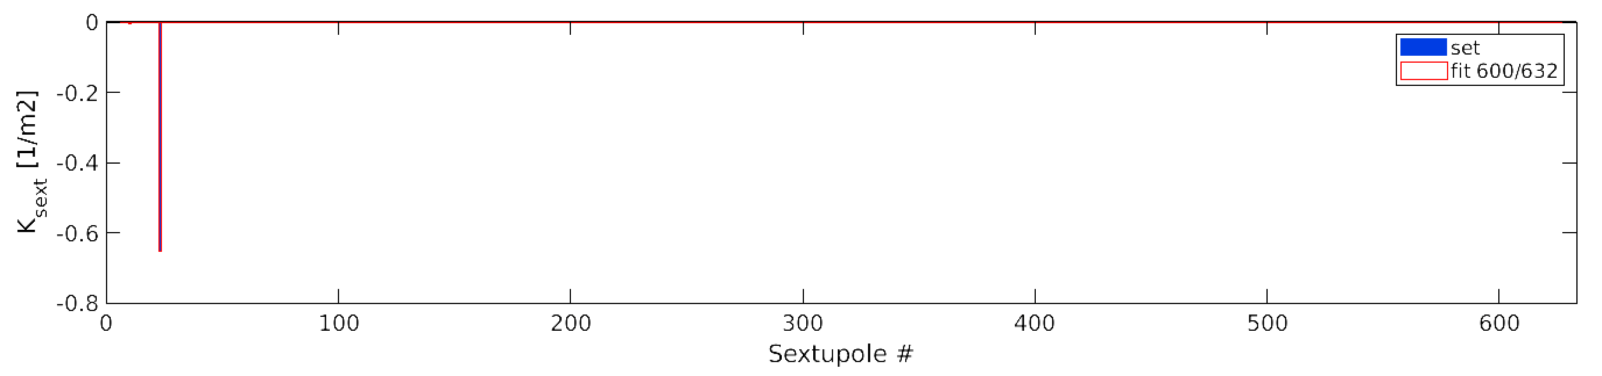
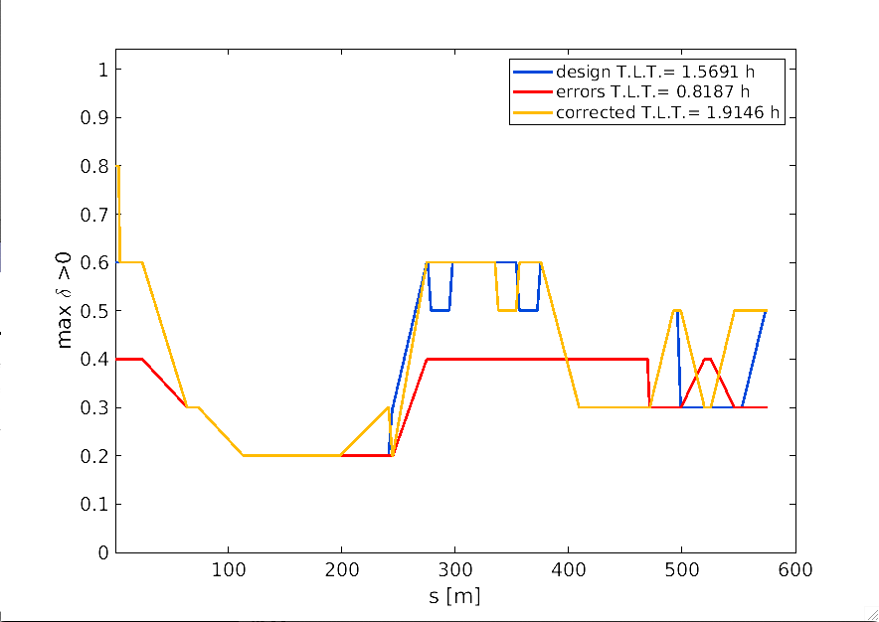
Simulations (Fit & correction) FOR FCC-ee
Test with one sextupole with inverted polarity
FCC-ee uncorrected lattice with random quad. gradient errors (RMS 3x10⁻⁵ m⁻²)
Top: Retrieve (large) sextupole error.
Right: computed momentum acceptance (over 600 m only) & Touschek lifetime

Slide 13
Outline
From off-energy ORM to nonlinear optics correction (NOECO)
Experimental results @ ESRF
NOECO simulations of FCC-ee (Z)
  detect & correct a sextupole error for an ideal lattice
  detect & correct a sextupole error for a lattice with misalignments
  detect & correct a sextupole error for a lattice with quad. errors
Next steps

Slide 14
Next steps
Short-medium term: Implement & test linear lattice correction robust enough to work for FCC-ee lattice (still in Matlab)
Long term: start migrating Matlab routines to Python (together with DESY colleagues).

Slide 15
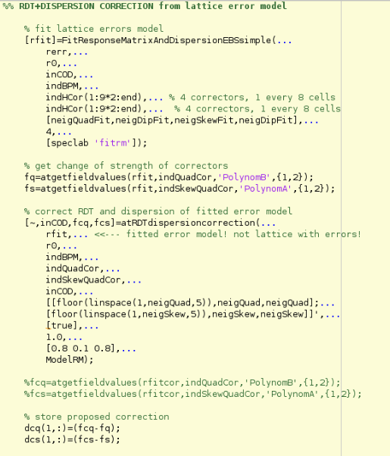
Procedure for optics correction
Fit of “measured” partial Orbit Response Matrix (slow)
→ FITTED OPTICS MODEL
Computation of normal and skew quadrupoles RDTs + dispersion and correction
→ Normal and skew quadrupole correction strengths
This is LOCO equivalent (+ RDTs)
Linear problem + generalize potentially different fit and correction locations

