Slide 1
IFNC Round table

Slide 2
Questions to the National Contact
What were the Physics-Expts and Detectors (PED) Activities in 2021 in your country (type and FTE) ?
What is the situation with the MOU and Addenda for your country ? Are there commitments related to PED ?
Relations between PED and the Accelerator community working on FCC ?
How is the FCC vs. other ee-colliders situation evolving in your country ?
Estimate of the resources (human and funds) that the labs in your country or your national institute plan to commit for FCC PED in 2022 and 2023 ?
What are the initiatives to recruit new people and to connect to other groups internationally ?
IN WHICH DOMAIN THE ADDITIONAL PERSONPOWER WILL ENGAGE ?
Do you plan a National (or Regional ) FCC workshops in 2022?
Are you building or planning to join a Regional FCC “cluster” with neighboring nations (cf. Nordic countries) ?
Can you list the persons involved at 15% FTE or more in PED activities in your country, NOW OR IN THE NEXT TWO YEARS

Slide 3
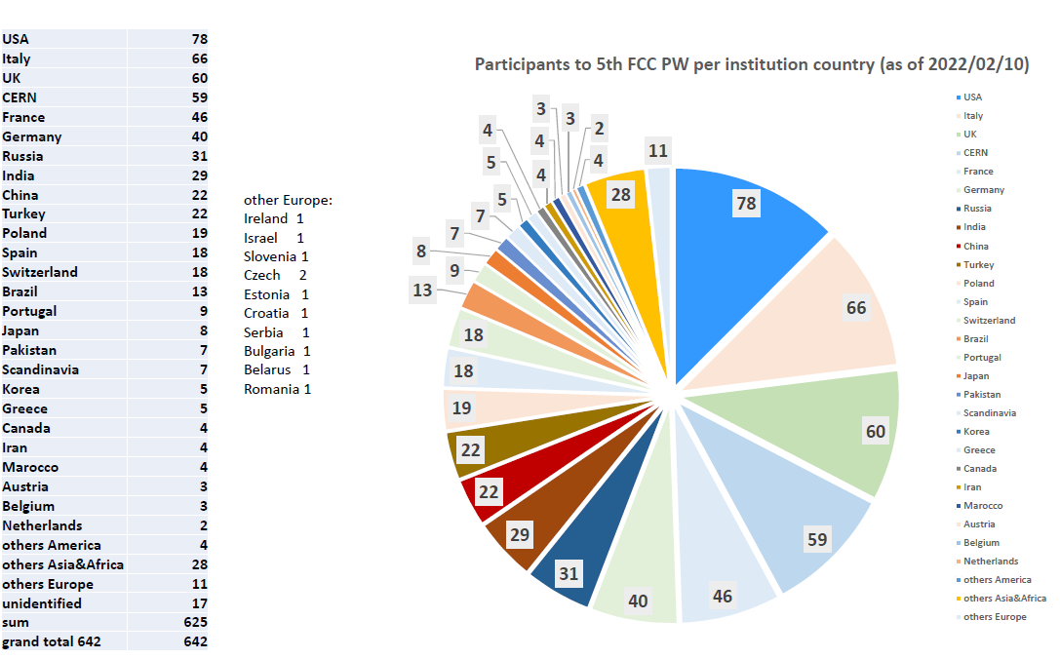
Slides
+
+
+
+
+
+
+
+
+
+
+
°
+++
+
°
+
+
+
USA | 77
Italy | 65
UK | 57
CERN | 56
France | 45
Germany | 39
Russia | 31
India | 29
China | 22
Poland | 18
Spain | 18
Switzerland | 18
Turkey | 15
Brazil | 13
Portugal | 9
Japan | 7
Pakistan | 7
Scandinavia | 7
Korea | 5
Greece | 5
Canada | 4
Iran | 4
Marocco | 4
Austria | 3
Belgium | 3
Netherlands | 2
others America | 4
others Asia&Africa | 28
others Europe | 11
unidentified | 28
sum | 606
grand total 634 | 634
°
°
+
+

Slide 4
Answers without Slides (1)
There is still no dedicated activity towards FCC in Norway.
Sincerely yours, Alex Read (Norway)
----------------
In Bulgaria there is no activity for FCC at the moment.
Best! Plamen Iaydjiev
---------------
There is no dedicated activity for FCC in Israel at the moment.
Done detector R&D but not within a dedicated FCC activity
Eilam Gross
---------------
No dedicated FCC activity to report from Slovenia for 2020/21.
There is some detector RD towards FCC-hh, beyond that all resources are allocated to (HL-)LHC and Belle2.
Best, Marko Mirkuz
-----------------
We (Pakistan) have nothing new to report.
Best regards — Hafeez Hoorani

Slide 5
Answers without Slides (2)
For Hungary, Daniel Barna reported his group's intense R&D activities related to FCC.
1. His group is working on the Sushi septum magnet (the prototype will be tested in September in Sweeden).
2. A collaboration was started on CCT magnets with Hungarian contribution.
We are not working directly on FCC Detectors.
Best Regard, Peter Levai (director of Wigner RCP)
---------------------------
At the moment there is still no official activity in Cyprus on the FCC .
Best regards, Panos Razis
----------------------------
As at the time of the previous status report, Greece has no dedicated FCC activity yet.
While there is interest, resources are stretched with the current physics program (LHC+HL-LHC).
Best, Paris Sphicas
----------------------------------

Slide 6
Korea (1)
Pyungwon Ko, Hwidong Yoo
What were the Physics-Expts and Detectors (PED) Activities in 2021 in your country (type and FTE) ?
We were quite active as follows.
Form Korea Future Collider Consortium (KFCC): more than 50 physicists have joined
4 dedicated workshops under KFCC organization were held with domestic and international invited speakers
kick-off workshop (Feb. 25, 2021): overview of FCC project, physics, and detector
Summer workshop (Aug. 26-27, 2021): discuss local activities & funding idea, interesting topics etc.
Fall workshop (Nov. 12 – 14, 2021): strategic discussion for future roadmap
Winter workshop (Jan. 6– 8, 2022): discuss overview & interesting physics topics for FCC projects
Development on dual-readout calorimeter R&D under IDEA detector concept
building prototype detector with various R&D and engineering points
5-year secured national funding: total $2M (2020 – 2024)
It’s difficult to estimate FTE for our activities but at least for the dual-readout calorimeter R&D approximately
  3 faculties (0.9 FTE), 3 postdocs (1.2 FTE), 10 graduate students (3.0 FTE), 5 undergraduate internship (1.0 FTE)

Slide 7
Korea (2)
Pyungwon Ko, Hwidong Yoo
What is the situation with the MOU and Addenda for your country ?
A) 5 institutions since 2016: Gangneung-Wonju National University, KAIST, KIAS, Korea University (Seoul, Sejong)
We had an informal meeting with CERN FCC management team at Sep. 3, 2021 (https://indico.cern.ch/event/1065948/) and more institutions with MOU and Addendum are under discussion
Are there commitments related to PED ?
A) Gangneung-Wonju National University, KAIST, KIAS, Korea University (Seoul)
Relations between PED and the Accelerator community working on FCC ?
We are discussing with accelerator community in Korea to collaborate on FCC
How is the FCC vs. other ee-colliders situation evolving in your country ?
A) Activities are pretty concentrated on the FCC project. For CEPC, physics & detector R&D are quite similar, so we are working with same direction. For ILC, Korean community’s contributions have been quite huge by middle of 2010, but they are not so active now.

Slide 8
Korea (3)
Pyungwon Ko, Hwidong Yoo
Estimate of the resources (human and funds) that the labs in your country or your national institute plan to commit for FCC PED in 2022 and 2023 ?
A) Not easy to estimate at the moment but at least the dual-readout calorimeter R&D activity is secured in 2022
$400k (totally $2M for 5 years by end of 2024)
3 faculties (0.9 FTE), 3 postdocs (1.2 FTE), 10 graduate students (3.0 FTE), 5 undergraduate internship (1.0 FTE)
More people have a plan to join this activity
What are the initiatives to recruit new people and to connect to other groups internationally ?
We are already quite active as described in our achievements. Moreover we are major team in various international collaboration, for example, in dual-readout calorimeter R&D team (EU, USA, Korea)
For recruiting, we consider two directions:
Extension of local community: accelerator community, civil engineering community
Extension of international community: consider to form Asian consortium for FCC activity
Do you plan a National (or Regional ) FCC workshops in 2022? Are you building or planning to join a Regional FCC “cluster” with neighboring nations (cf. Nordic countries) ?
A) Yes, we have several national/regional FCC workshops in this year (but the plan is not finalized yet)
B) Yes we consider with Japan, Taiwan, China, etc., but it needs to discuss carefully in KFCC first then with other countries
Can you list the persons involved at 15% FTE or more in PED activities in your country
A) Prof. Hwidong Yoo (Yonsei University), Prof. Sehwook Lee (Kyungpook National University), Prof. Jason Lee (University of Seoul) and their teams for the dual-readout calorimeter R&D

Slide 9
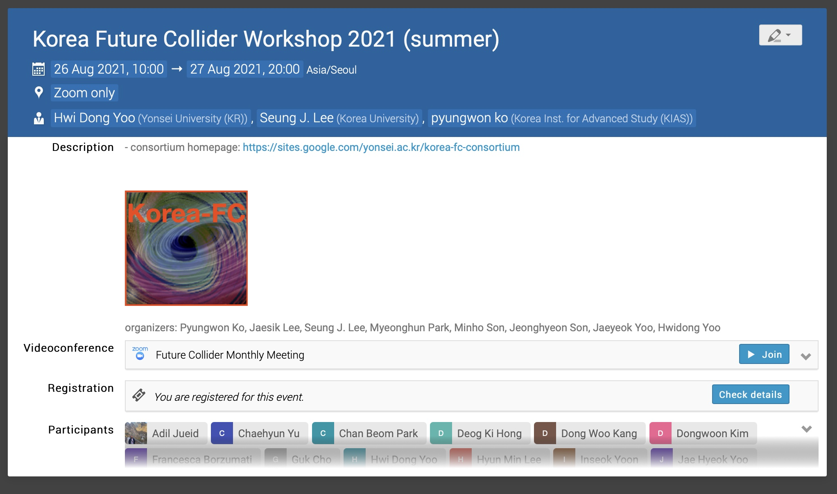
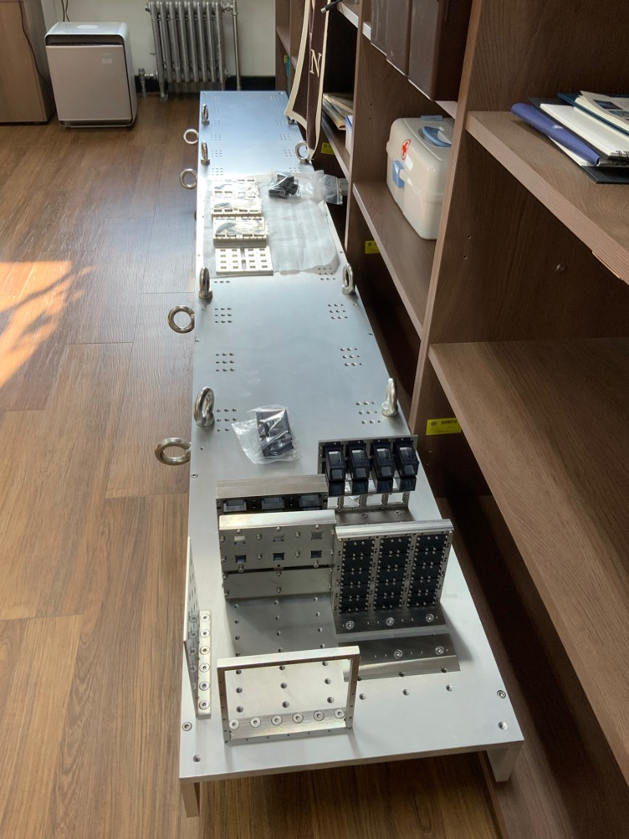
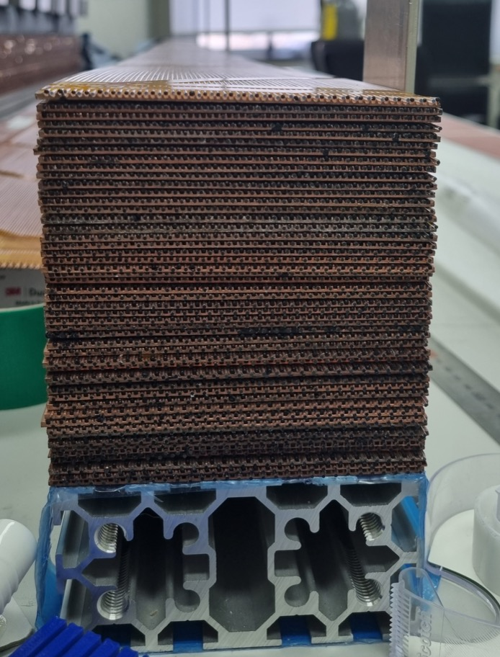
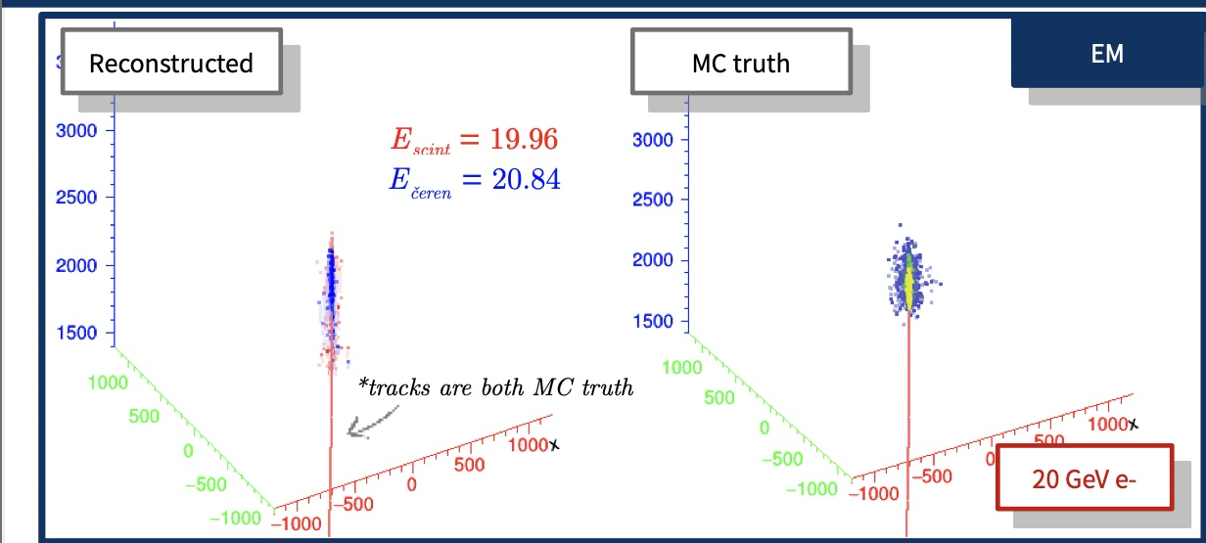
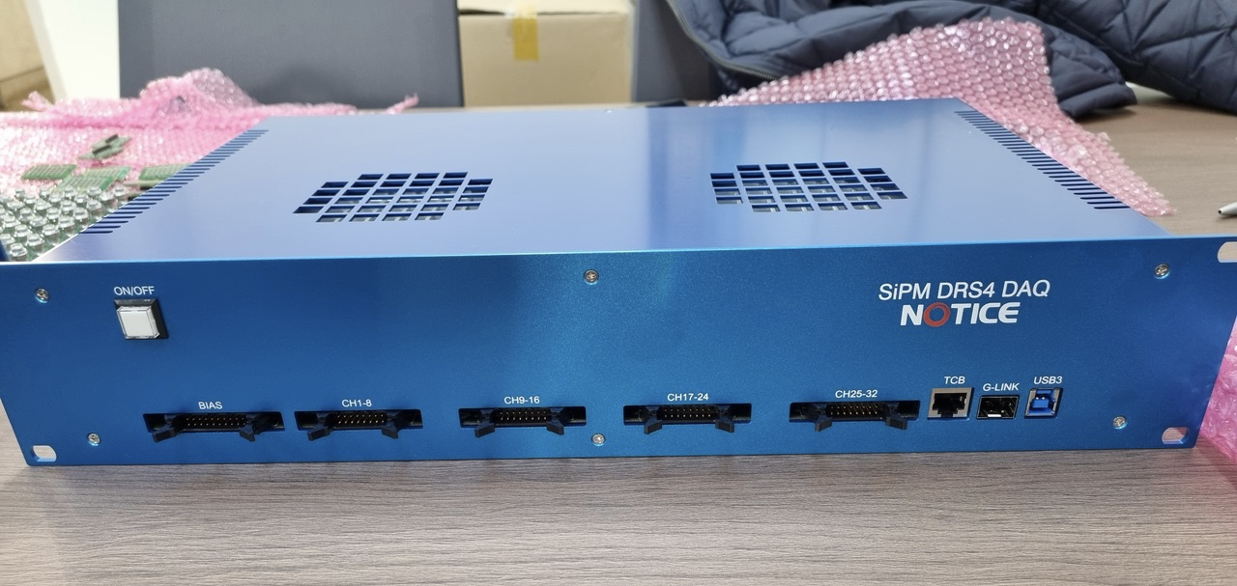
Korea (4)
Pyungwon Ko (KIAS), Hwidong Yoo (Yonsei University)
Korea Future Collider Consortium activities: 4 local workshops have been organized in 2021
  Kick-off (overview), summer (wide topics), fall (strategic), and winter (phenomenology)
  More than 50 physicists have participated in the workshops
  Informal meeting with CERN management (Sep. 3): many institutes are interested in MOU and addendum
  Start a discussion for national-wide funding and activity: initiate with NRF and Science Ministry of Science
Detector R&D: dual-readout calorimeter
  Two modules are being built for test-beam 2022 (expect at June)
  New electronics readout and assembly systems are produced
  3D metal printing based copper forming is successful
  Various simulation performance study has been done

Slide 10
United States of America (1)
Joel Butler, Dmitri Denisov,
Sarah Eno
The US is in the middle of the “Snowmass” process, which provides input for the “P5” committee to determine future US funding priorities. Until this process is over, US activity on future is constrained. Many of us spending up to 25% of our time on Snowmass activities, while there is no funding provided.
Group of ~20 US faculty (or lab equivalents) are working with our European colleagues to produce a 50 page FCC document for Snowmass. As the process continues, more will be recruited. We expect that completion of P5 process by late 2023 will enable active funding and increased participation.
Due to the Snowmass process, we do not foresee an FCC workshop in the US this year. There will be a workshop at Brown University where FCC and other colliders are discussed (https://indico.fnal.gov/event/52465/) and in Seattle (https://indico.fnal.gov/event/22303/) Sometime in 2023 FCC specific workshop can occur in US.
What were the Physics-Expts and Detectors (PED) Activities in 2021 in your country (type and FTE) ?
* Activities related to Snowmass and interactions with European colleagues working on FCC, estimate about 20 people (not FTEs).
What is the situation with the MOU and Addenda for your country ? Are there commitments related to PED ?
* US is signing initial MoUs with CERN on FCC (tunneling, magnets, etc.).
Relations between PED and the Accelerator community working on FCC ?
* Close cooperation.

Slide 11
United States of America (2)
Joel Butler, Dmitri Denisov,
Sarah Eno
How is the FCC vs. other ee-colliders situation evolving in your country ?
FCC is among other actively discussed options most notable ILC, muon collider and C3.
Estimate of the resources (human and funds) that the labs in your country or your national institute plan to commit for FCC PED in 2022 and 2023 ?
* No substantial FCC related funding before end of Snowmass/P5 process late 2023 is expected.
What are the initiatives to recruit new people and to connect to other groups internationally ?
Snowmass meetings and discussions creating excellent opportunities.
Do you plan a National (or Regional ) FCC workshops in 2022? Are you building or planning to join a Regional FCC “cluster” with neighboring nations ?
Not at this moment, while see potential in 2023 / Not at this moment.
Can you list the persons involved at 15% FTE or more in PED activities in your country
* Sarah Eno, others are at lower levels for now.

Slide 12
Turkey (1)
Ilkay Turk, Ozgur Etiksen
1- What were the Physics-Expts and Detectors (PED) Activities in 2021 in your country (type and FTE) ?:
- Particle Accelerators and Detectors Local Infrastructure and R&D Workshop, 27 Nov 2021- 28 Nov 2021.
- CERN ATLAS Experiment National Workshop, 25-26 June, 2021, Bilgi University, Istanbul.
2- What is the situation with the MOU and Addenda for your country ?
Previously signed Addendum by 4 universities (BAIB Uni, Ankara Uni, Giresun Uni, IUE Uni.) and MoU signed by 14 Univ. (BAIB Uni, Akdeniz Uni, Ankara Uni, Ege Uni, Giresun Uni, Isik Uni, Istanbul Aydin Uni, Istanbul Uni, IUE Uni, IYTE, Okan Uni, PRU, TOBB ETU and Uludag Uni.
Are there commitments related to PED?
Following a national project which will be launched in the near future, this will be clear.
3- Relations between PED and the Accelerator community working on FCC ?
(3 Accelerator PhD thesis, 1 detector PhD thesis, 1 Physics PhD, 7 PED MS thesis) (Thesis supervisor from accelerator and PED communities)
4- How is the FCC vs. other ee-colliders situation evolving in your country ?
Turkish scientist have been contributing to the FCC project since 2014. In this regard, the following were organized in Turkey.
Internationally participated workshops have been organized in 2016 and 2019.
FCC Physics, Detector And Accelerator Workshop @ Istanbul, 11-12 March, 2016 (https://indico.cern.ch/event/405973/)
FCC Physıcs, Detector And Accelerator @Antalya, 9-11 September, Antalya, 2019 (http://aknam.akdeniz.edu.tr/fcc-workshop/)

Slide 13
Turkey (2)
Ilkay Turk, Ozgur Etiksen
5- Estimate of the resources (human and funds) that the labs in your country or your national institute plan to commit for FCC PED in 2022 and 2023 ?
Recent national project funded by TAEK (new name TENMAK) has been completed in 2022. A new project with a larger team is planned about FCC PED in 2022 and 2023.
6- What are the initiatives to recruit new people and to connect to other groups internationally ?
New people is expected to participate in the planned project which can contact other group internationally.
7- Do you plan a National (or Regional ) FCC workshops in 2022?
Yes, we plan national workshop in 2022.
8- Are you building or planning to join a Regional FCC “cluster” with neighboring nations (cf. Nordic countries) ?
Not at this moment, but we able to plan to built regional FCC cluster similar to structure of the LHC experiments in the near future. We will discuss it.
9- Can you list the persons involved at 15% FTE or more in PED activities in your country?
A few people has been involved in Accelerator and Detector studies, but more involved in Physics.

Slide 14
Finland
Katri Huitu
Our activities in FCC in 2021 were entirely in materials physics part.
We have signed the MoU with FCC study. It includes FCC-hh and FCC-ee colliders and their detectors.
Currently the activity is centered around the group led by Prof. Djurabekova, and is focused on development of the superconducting RF accelerating cavities. The same group is an active partner in large international collaboration on development of RF accelerating structures for CLIC accelerators.
Contributions to PED are in planning, but not yet in practice. We contribute around 70 k€ annually to the activities related to FCC SRF cavities
The group collaborates with the group at CERN and are open to broaden the collaboration within the topic related to materials research problem.
We are a part of FCC Nordic initiative
Nobody involved at 15% FTE or more in PED. With accelerators we have 1 PhD student (Milad Ghaemi) and 0.5 postdoctoral researcher (Dr. Alvaro Lopez Cazalilla). Prof Djurabekova is at 10% FTE, Dr. Eryang Lu at 5%

Slide 15
Sweden
Rebeca Gonzalez Suarez
Uppsala: continues FCC-ee LLP work
  Master thesis: Rohini Sengupta (June 2021), Uppsala University. Co-supervised with Suchita Kulkarni “Towards Vertexing Studies of Heavy Neutral Leptons with the Future Circular Collider at CERN”
  Project: Lovisa Ryagaard and Nils Eriksson (January 2022) Uppsala University. Co-supervised with Suchita Kulkarni and Juliette Alimena – ‘’Simulation of long-lived Heavy Neutral Leptons and Axion-Like Particles at the FCC-ee’’
  Master thesis ongoing: Lovisa Ryagaard, Uppsala University. Co-supervised with Suchita Kulkarni and Juliette Alimena
MOU signed by Sweden already: Unclear about the Addenda
Accelerator community of Sweden expressed interest in following up on FCC back in 2020, not followed up
Not much discussion on FCC vs. other ee-colliders in Sweden, most visible effort at the moment: FCC-ee
Resources (human and funds) that the labs in Sweden plan to commit for FCC PED in 2022 and 2023
  Unclear, depending on funding
1/3 funding proposals submitted in 2021 mentioning FCC approved
  One open postdoc position in Uppsala, with particle FCC description
Nordic FCC workshops in mind, but no advances after the first Nordic day in 2021
Clear interest in a Nordic Cluster, second Nordic day soon could be a good idea

Slide 16
Denmark
Mogens Dam
What were the Physics-Expts and Detectors (PED) Activities in 2021 in your country (type and FTE) ?
- Definition of and Coordinating role for Detector Concepts activity (0.3 FTE)
What is the situation with the MOU and Addenda for your country ? Are there commitments related to PED ?
MoU being signed, Addendum to be formulated
Relations between PED and the Accelerator community working on FCC ?
- No accelerator community in DK
How is the FCC vs. other ee-colliders situation evolving in your country ?
In 2021, two FCC-ee MSc projects. No other ee activity in DK
Estimate of the resources (human and funds) that the labs in your country or your national institute plan to commit for FCC PED in 2022 and 2023 ?
As previous years
Do you plan a National (or Regional ) FCC workshops in 2022? ?
Are you building or planning to join a Regional FCC “cluster” with neighboring nations (cf. Nordic countries) ? - N/A
Can you list the persons involved at 15% FTE or more in PED activities in your country
Mogens Dam, Jørgen Beck Hansen (supervision of MSc project)

Slide 17
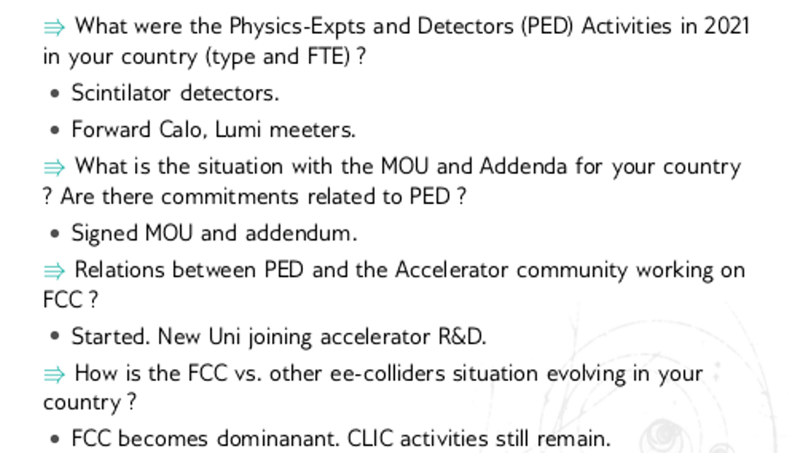
Poland (1)
Marcin Chrzaszcz, Tadeusz Lesiak

Slide 18
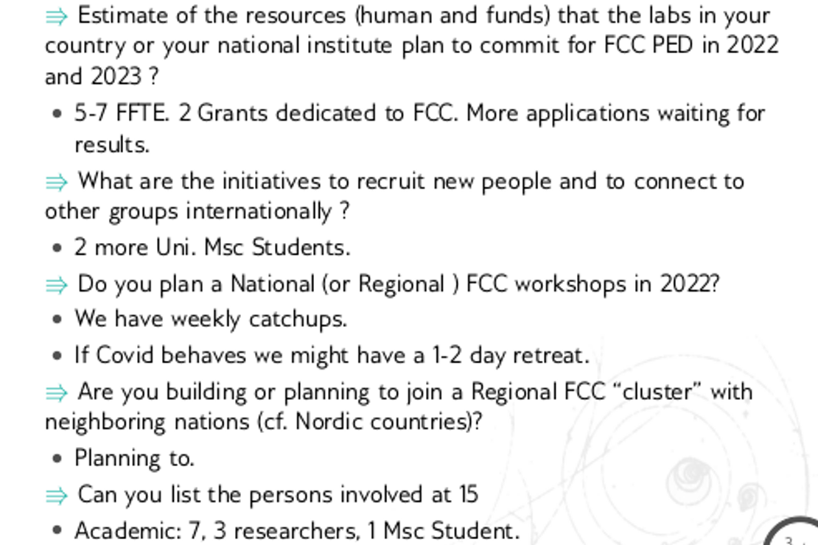
Poland (2)
Marcin Chrzaszcz, Tadeusz Lesiak

Slide 19
Czechia
Jana Faltova
What were the Physics-Expts and Detectors (PED) Activities in 2021 in your country (type and FTE) ?
- Group at CUNI (Charles University) is working on calorimeter (noble liquid technology) for FCC-ee. The work accounts ~1.0 FTE in 2021.
What is the situation with the MOU and Addenda for your country ? Are there commitments related to PED ?
CUNI signed the MOU and Addenda. Our commitments are related to calorimetry
How is the FCC vs. other ee-colliders situation evolving in your country ?
- Our main interest is FCC. Czechia is not active in any other ee-collider studies.
Estimate of the resources (human and funds) that the labs in your country or your national institute plan to commit for FCC PED in 2022/23 ?
- We plan ~ 1.0 FTE in 2022 and 2023. We have funds for the salaries.
What are the initiatives to recruit new people and to connect to other groups internationally ?
- We do not plan to recruit new people (lack of fundings) in 2022. We have a strong collaboration with CERN and IJC lab.
Do you plan a National (or Regional ) FCC workshops in 2022? Are you building or planning to join a Regional FCC “cluster” with neighboring nations (cf. Nordic countries) ?
- No
Can you list the persons involved at 15% FTE or more in PED activities in your country
- Jana Faltova, Juraj Smiesko

Slide 20
Serbia
Lidija Zivkovic
What were the Physics-Expts and Detectors (PED) Activities in 2021 in your country (type and FTE) ?
- None
What is the situation with the MOU and Addenda for your country ? Are there commitments related to PED ?
- (a) Under consideration if we need a new MoU, since we signed one few years ago. (b) While we are committed to FCC, not much has been done. but we plan to built on our experience with ATLAS, CMS and work on HL-LHC, including accelerator development
Relations between PED and the Accelerator community working on FCC ?
- None on FCC, some relations with respect to HL-LHC.
How is the FCC vs. other ee-colliders situation evolving in your country ?
- There is some activity related to linear colliders now
Estimate of the resources (human and funds) that the labs in your country or your national institute plan to commit for FCC PED in 2022/23 ?
- Current groups are small and committed to current projects which include LHC and HL-LHC. However, within these projects, we have a PhD student working on a project related to future tracking detectors, applicable to FCC. In addition, we plan to request funding for FCC.
What are the initiatives to recruit new people and to connect to other groups internationally ?
- We do not plan to recruit new people (lack of fundings) in 2022. We have a strong collaboration with CERN and IJC lab.
Do you plan a National (or Regional ) FCC workshops in 2022? Are you building or planning to join a Regional FCC “cluster”?
→ No, not at the moment
Can you list the persons involved at 15% FTE or more in PED activities in your country - None

Slide 21
Germany (1)
Frank Simon
What were the Physics-Expts and Detectors (PED) Activities in 2021 in your country (type and FTE) ?
Contributions to physics studies at a small number of institutes; involvement in PED coordination and in setting up of detector concept pillar. FTEs hard to estimate, but relatively small (lower single digits). Interest present, but (still) mostly passive. Analysis activities at DESY, KIT, MPP; others expected to join (with students / postdocs at larger FTE-fractions); also pheno projects / theory involvement at several places.
Significant detector R&D activities, which often are generic, but are applicable also to FCC PED.
What is the situation with the MOU and Addenda for your country ? Are there commitments related to PED ?
No complete overview, but there are several institutes that have signed the MOU, and are contributing to PED.
Relations between PED and the Accelerator community working on FCC ?
At this point no formalized interactions – but opportunities for exchange within FCForum meetings, and within institutes participating in both pillars.
How is the FCC vs. other ee-colliders situation evolving in your country ?
Interest in FCC-ee is increasing relative to other e+e- colliders. In a recent survey conducted by me, FCC-ee was mentioned most often as the context of PED-relevant work, more than ILC or CLIC.

Slide 22
Germany (2)
Frank Simon
Estimate of the resources (human and funds) that the labs in your country or your national institute plan to commit for FCC PED in 2022 and 2023 ?
No concrete estimate, but the trend is positive. New groups starting to become active. No BMBF funding available at this point, activities supported through individual grants; DESY and MPG resources; informal contributions at universities
What are the initiatives to recruit new people and to connect to other groups internationally ?
Discussions in KET (German Committee for Particle Physics), community engagement.
Do you plan a National (or Regional ) FCC workshops in 2022?
Yes, a FCForum meeting is planned for later in 2022 (pending evolution of pandemic). Not clear yet if this will be branded as FCC workshop, or rather more generic, with FCC focus.
Can you list the persons involved at 15% FTE or more in PED activities in your country
Hard to do – Coordination roles: Christophe Grojean, Clement Helsens, Markus Klute, Felix Sefkow, Frank Simon (not all reaching 15%) – expect in particular students / postdocs to reach higher fractions of their time.

Slide 23
Austria (1)
Jochen Schieck
What were the Physics-Expts and Detectors (PED) Activities in 2021 in your country (type and FTE) ?
  Austrian wide Workshop to ramp up activities
What is the situation with the MOU and Addenda for your country ? Are there commitments related to PED ?
  HEPHY signed the MoU, the side letter with the commitments is under discussion
Relations between PED and the Accelerator community working on FCC ?
  common workshop in 2022, but no collaboration or common efforts
How is the FCC vs. other ee-colliders situation evolving in your country ?
  mainly FCCee related activities, some generic ee related efforts
Estimate of the resources (human and funds) that the labs in your country or your national institute plan to commit for FCC PED in 2022 and 2023 ? no number available yet
What are the initiatives to recruit new people and to connect to other groups internationally ?
  start discussions with collaborators from other projects
Do you plan a National (or Regional ) FCC workshops in 2022?
  yes
Are you building or planning to join a Regional FCC “cluster” with neighboring nations
we started to think about it

Slide 24



FCC related news from Austria
Jochen Schieck
HEPHY signed the FCC MoU
  R. Schöfbeck coordinates the HEPHY FCC efforts
  detailed discussions about FCC contributions ongoing
  participation in physics and detector studies planed
FCC related theoretical investigations at the University of Vienna and the University of Graz are ongoing

Slide 25
Belgium
Jorgen d’Hondt
Development of flavour tagging methods for FCC-ee and exploring the physics potential they unlock.
Flavour tagging depends, amongst others on the detector technology, and much less on the accelerator geometry
Status: presentation at this FCC week
https://indico.cern.ch/event/1066234/contributions/4710424/attachments/2386869/4079308/S-Tagging_CNN_FCCPhysicsWorkshop.pdf
The MoU is signed by the Vrije Universiteit Brussel (VUB)
At this stage, we have a budget for two PhD students (4y each) and an adequate running budget for them
A project-specific connection between VUB (D’Hondt), DESY (Blekman) and UZurich (Canelli) for the two PhD students
No national FCC (or future collider) forum at this stage, but intentions to explore the options to cluster BE & NL

Slide 26
U.K. (1)
Andrew Pilkington
What were the Physics-Expts and Detectors (PED) Activities in 2021 in your country (type and FTE) ?
Generic detector R&D in many institutes for silicon-vertex/trackers, calorimetry. There is additional interest in DAQ and electronics for FCC.
Physics studies for ee, eh, and hh. New interest shown recently in joining such efforts.
Wilkinson and Leonidopoulos members of PED Coordination Group, who have also been active in preparing EPJC articles and organisation of FCC Physics Workshop.
What is the situation with the MOU and Addenda for your country ? Are there commitments related to PED ?
Few institutes have signed the MoU yet.
Relations between PED and the Accelerator community working on FCC ?
Close collaboration through Cockcroft and John Adams Institutes, and Daresbury and the Rutherford lab.

Slide 27
U.K. (2)
Andrew Pilkington
How is the FCC vs. other ee-colliders situation evolving in your country ?
UK has an established linear collider community involved in ILC as well as CLIC. Majority of physicists and institutes would be happy to see either FCC-ee or ILC move forward and have a positive opinion towards both facilities. Agreement between FCC-ee and ILC communities, and reflected in recent UK roadmap, that joint detector R&D support should be sought for both initiatives.
The FCC-hh and FCC-eh communities naturally focus on developing the physics/detector cases for FCC.
Estimate of the resources (human and funds) that the labs in your country or your national institute plan to commit for FCC PED in 2022 and 2023 ?
It is likely that physicists from many institutes will become active in PED-related activities, and existing detector studies will continue.
It is unlikely, however, that dedicated FCC funding at a significant level will become available during this period. We have submitted a case for improved funding for FCC-related activities to the STFC PPTAP recently, to try to improve the situation
What are the initiatives to recruit new people and to connect to other groups internationally ?
We will continue to stimulate activity in the UK institutes through workshops. This will include some training in how to run software for physics studies, to reduce barriers for new collaborators.
The UK recently restructured its activities in FCC, with clearly defined coordinators for FCC-ee (G.Wilkinson), FCC-hh (A.Pilkington) and FCC-eh (U.Klein). Pilkington acts as the overall FCC-UK national contact. The purpose of this is develop activities in each area and encouraging cross-collaboration in areas of common interest.

Slide 28
U.K. (3)
Andrew Pilkington
Do you plan a National (or Regional ) FCC workshops in 2022?
We had a national FCC-UK workshop in December 2021 and another one is likely in 2022.
We plan to have other workshops focused on specific activities (see answer to previous question).
Are you building or planning to join a Regional FCC “cluster” with neighboring nations ?
We do not plan for this currently. We focus instead on building the UK community.
Can you list the persons involved at 15% FTE or more in PED activities in your country
We estimate that most institutes have at least one physicist who will contribute to PED activities at the 15% FTE level, or higher.

Slide 29
Portugal (1)
Jose Goncalo
Just started!
  MoU signed in Nov. 2021 by LIP – Lab. for Instrumentation and Particles
Starting small:
  Started from core of people who contributed to FCC CDR, from LHC experiments & pheno.
  4 academics from different universities; 3 researchers from LIP; 1 PhD student from ATLAS
  1 very small funded project: 2 MSc grants and some travel money
...but aim to grow with recruiting:
  Colleagues from other groups, especially theory
  LIP colleagues working on detector R&D
  MSc or PhD students – advantage in having academics from 3 universities
Activity already initiated or planned for 2021:
  Theory: virtual photon scattering in FCC-ee; precision α_{S} measurements in FCC-ee; jet substructure
  Experiment: development of rad-hard plastic scintillators together with polymer research group focusing on FCC-hh; calorimetry simulation for FCC-ee
Can you list the persons involved at 15% FTE or more in PED activities in your country
Theory: 1 academic, 2 researchers; Experiment: 3 academics, 3 researchers, 1 PhD student

Slide 30
Portugal (2)
Jose Goncalo
What were the Physics-Expts and Detectors (PED) Activities in 2021 in your country (type and FTE) ?
In Portugal we have just started this activity. Generic investigation of new rad-hard scintillator materials started. Planned work on phenomenology to start later this year.
What is the situation with the MOU and Addenda for your country ? Are there commitments related to PED ?
MoU signed (5/11/2021). Addendum will take a few months to define.
Relations between PED and the Accelerator community working on FCC ?
No accelerator activity apart from wakefield acceleration in plasmas group. Initial contact made but no results so far.
How is the FCC vs. other ee-colliders situation evolving in your country ?
No other specific work on future accelerators.
Estimate of the resources (human and funds) that the labs in your country or your national institute plan to commit for FCC PED in 2022 and 2023 ?
About 1.5 FFTE may be expected on average, but small fractions of several people.
What are the initiatives to recruit new people and to connect to other groups internationally ?
Expect 2 MSc students in the next year. Also plan to reach out to colleagues in other groups.
Do you plan a National (or Regional ) FCC workshops in 2022? Are you building or planning to join a Regional FCC “cluster”
Most likely will happen only in 2023. Not yet… just started

Slide 31
Spain (1)
Juan Alcaraz
What were the Physics-Expts and Detectors (PED) Activities in 2021 in your country (type and FTE) ?
Minimal, due to pandemics and the aim to get the next meeting of the Spanish Future Collider Network in “in person” mode
What is the situation with the MOU and Addenda for your country ? Are there commitments related to PED ?
For the moment only the existing groups signing the previous MoU, and involved in technological activities (CIEMAT, CELLS/ALBA, …) stay involved. Addendas have to be discussed. New groups were contacted too, but without positive answer for the moment. There is some reluctance from their administration to get involved early in what is perceived as a “formal commitment” (even if it is only on a best effort basis) while getting involved only in PED activities, which look as secondary activities in the context of the FCC feasibility study.
Relations between PED and the Accelerator community working on FCC ?
These aspects are really well embedded in the Spanish Future Collider Network and discussions are global (also with industry). In cases like CIEMAT, communications occur in the same center and are fluid. However their objectives are a bit disconnected for the moment (development superconducting magnets for FCC versus FCC-ee PED activities, for instance).
How is the FCC vs. other ee-colliders situation evolving in your country ?
The Spanish community has been and is still strongly involved in linear collider activities. Despite that, FCC activities and, in particular common ee activities in the context of the ECFA PED initiative are being developed in an almost agnostic way regarding the collider choice. IFIC and CIEMAT groups have also prepared a coordinated project that covers all future ee collider activities (it includes ongoing FCC, ILC and ECFA PED activities).

Slide 32
Spain (2)
Juan Alcaraz
Estimate of the resources (human and funds) that the labs in your country or your national institute plan to commit for FCC PED in 2022 and 2023 ?
Unclear. We have prepared requests that will be evaluated during this year 2022, but we do not expect strong support compared with other, more urgent, matters (LHC upgrades, for instance)
What are the initiatives to recruit new people and to connect to other groups internationally ?
We are mostly relying on existing manpower working in other projects (LHC) and on new students (master thesis works, …). We are connecting to other international groups via existing FCC structures and the new ECFA PED initiative. It is unclear for the moment how much we will be able to profit from the new FC unit at CERN.
Do you plan a National (or Regional ) FCC workshops in 2022?
Yes, but not FCC-only workshops for the moment. No dates have been fixed yet, because we aim for meetings in person
Are you building or planning to join a Regional FCC “cluster” with neighboring nations (cf. Nordic countries) ?
No. At least for the moment.
Can you list the persons involved at 15% FTE or more in PED activities in your country
Regarding FCC PED: Strictly speaking (i.e. existing project paying for that activity for >=15% of the time), nobody.

Slide 33
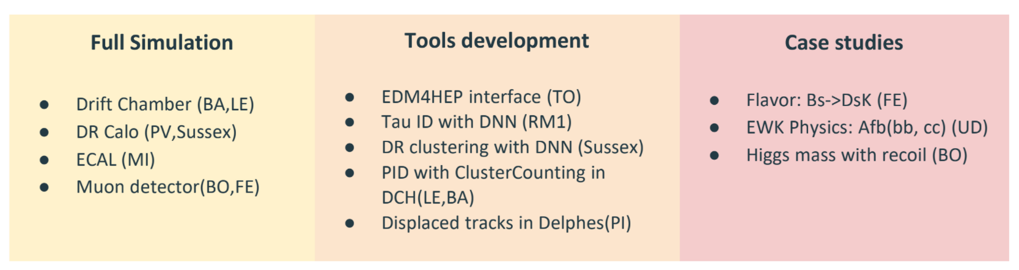
Italy (1)
Franco Bedeschi
What were the Physics-Expts and Detectors (PED) Activities in 2021 in your country (type and FTE) ?
Current activities are organized by work packages. Below is the list:
Physics studies, Simulation & Software development
Machine Detector Interface studies
Silicon Detectors (Vertex and trackers) R&D
Drift Chamber R&D
MPGD for muon chambers and pre-shower
Dual Readout Calorimetry R&D
Number of researchers/Engineers involved in 2021 is 91 people for 15.7 FTE
Relations between PED and the Accelerator community working on FCC ?
Good interaction on MDI and background studies through MDI work Package

Slide 34
Italy (2)
Franco Bedeschi
What is the situation with the MOU and Addenda for your country ? Are there commitments related to PED ?
A list of Italian institutions with a signed MoU follows. Only INFN is clearly committed to PED, but has not yet submitted addenda.
CNR-SPIN Commitment to PED? NO (Superconducting materials)
CSIL Commitment to PED? NO (Economics)
INFN Commitment to PED? YES
UNIROMA1 Commitment to PED? ~YES (Accelerator / MDI)
UNIGENOA Commitment to PED? NO (Superconducting materials with CNR-SPIN)
UNIMI Commitment to PED? NO (Economics)
UNIROMA3 Commitment to PED? NO (Economics)
How is the FCC vs. other ee-colliders situation evolving in your country ?
Main interest is FCCee (CEPC as a backup option). No major involvement in CLIC or ILC.
Estimate of the resources (human and funds) that the labs in your country or your national institute plan to commit for FCC PED in 2022 and 2023 ?
Funding scale for 2022 is 600-700 k€ with about 120 people involved. Expect growth in 2023.

Slide 35
Italy (3)
Franco Bedeschi
What are the initiatives to recruit new people and to connect to other groups internationally ?
First FCC-Italy workshop on March 21-22 – CERN similfellows program now open also for FCC - Participation in FCCee meetings and workshop organization – R&D activities within Work Packages – Involvement in EU programs (e.g. AidaInnova)
Do you plan a National (or Regional ) FCC workshops in 2022?
Yes. First FCC-Italy workshop on March 21-22
Are you building or planning to join a Regional FCC “cluster” with neighboring nations (cf. Nordic countries) ?
Not at the moment although we are preparing an ITN EU grant request that could help in this context
Can you list the persons involved at 15% FTE or more in PED activities in your country
yes, but it’s a list of 32 people in 2022. I can provide the names if needed.

Slide 36
France (1)
Roy Aleksan
Gregorio Bernardi
What were the Physics-Experiments and Detectors (PED) Activities in 2021 in your country (type and FTE) ?
Contributions to physics studies at 12 institutes; involvement in PED case studies (Higgs, QCD, Heavy Flavour, Electroweak, BSM) (40 persons / 9 FTE)
Detector R&D activities ) (microvertex, TPC, ToF, Calorimetry, RPC, wireless connections) , often developed initially for ILC, but now moving towards FCC.
Phenomenology and theory projects, ee and hh / theory involvement at several places (5 persons / 2FTE)
What is the situation with the MOU and Addenda for your country ? Are there commitments related to PED ?
4 MOU’s signed by IN2P3 and CEA Saclay for accelerators mostly in 2014,2015 . 4 MOU’s also for enterprises working on the accelerator (2017-2019). New MOU’s and Addenda for PED being prepared, related to collaboration board evolution.
Relations between PED and the Accelerator community working on FCC ?
Exchanges during the FCC-France workshops, where a full accelerator session is reserved
How is the FCC vs. other ee-colliders situation evolving in your country ?
FCC-ee priority is evolving positively relative to other e+e- colliders. ILC-France community is participating to FCC France workshops.

Slide 37
France (2)
Roy Aleksan
Gregorio Bernardi
Estimate of the resources (human and funds) that the labs in your country or your national institute plan to commit for FCC PED in 2022 and 2023 ?
Number is slowly but steadily growing. 2 Postdocs and 2 Ph.D Student are starting on FCC in 2022 + many 3-4 months trainee (~12) presenting their work in an annual Jamboree. New members are also joining/increasing their commitment
What are the initiatives to recruit new people and to connect to other groups internationally ?
European/French ANR grants are being submitted in 2022 (Calorimetry, Microvertex) to get funds and person-power.
Do you plan a National (or Regional ) FCC workshops in 2022?
Yes, a 4th FCC-France meeting (jointly with other ee colliders) is planned for November 2022 in Lyon (funding obtained). The 3rd took place in Annecy in 2021 in Hybrid mode with 50 on-site, > 80 off-site. In 2023 we could envisage a joint FCC-regional meeting, for instance with Italy with whom we are already sharing some activities
Can you list the persons involved at 15% FTE or more in PED activities in your country
Between 1 and 4 persons in each of the 12 IN2P3 and IRFU labs

Slide 38
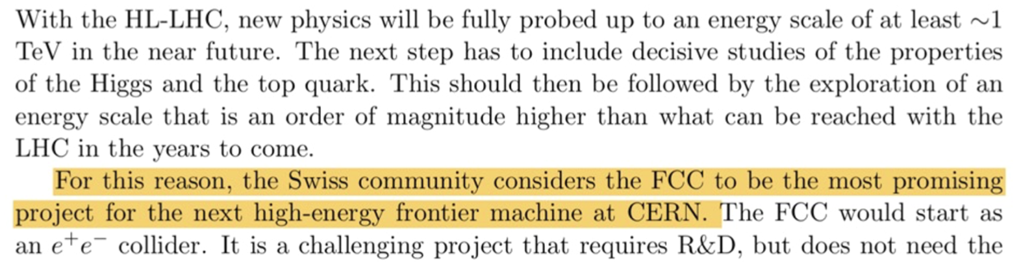
Switzerland
Michele Weber
Host country
  Strong support
  and leading involvement
  from the beginning
  From bottom-up roadmap effort
  and "political" level
CHART: accelerator R&D stimulus program (HTS, beam dynamics, injector, geology)
ETHZ, EPFL, PSI, UniBE, UniGE, UniZH long history of particle detector R&D
  Main priority on collider physics is for now the HL-LHC
  FCC as obvious continuation
  UniZH and UniGE have dedicated efforts. Physics studies and HW; at UniZH also in collaboration with VUB
Had one general workshop in Sept 2021. Next workshop in Spring 2022 and interactions with funding agency to find strategy for more concrete involvements.
Swiss roadmap for particle and astroparticle physics, 2020

Slide 39
CERN
What were the Physics-Expts and Detectors (PED) Activities in 2021 ?
Pretty much all areas of PED are covered at CERN, including overall coordination
Estimate of the resources (human and funds) that the lab plan to commit for FCC PED in 2022 and 2023
About 8-10 FTEs, distributed over more than 15 members of staff, fellows and scientific associates
What are the initiatives to recruit new people and to connect to other groups internationally
We expect to hire two postdocs on FCC PED in 2022, and have submitted 4 FCC projects to the selection committee for CERN's Summer Student programme. Our resources for the Scientific Associate (SASS) programme allowed us so far to secure a SASS dedicated to FCC starting in March '22 (P.Azzi).
Persons involved at 15% FTE or more in PED activities
  EP:
  Patrick Janot
  David D'Enterria
  Emmanuel Perez
  Martin Aleksa
  Michele Selvaggi
  Loukas Gouskos
  Anna Gaborowska
  Philip Roloff
  Andreas Salzburger
  Werner Riegler
  Patrizia Azzi (SASS)
  + 2 fellows to be hired
EP/SoftWare:
Gerri Ganis
TH:
Michelangelo Mangano
Matthew Mc Cullough
Johann Usovitsch
+ several who occasionally write papers
- typically BSM - of relevance to FCC

