Slide 1
Going beyond leading colour in parton showers
Jeff Forshaw
Soft gluon evolution & non-global logarithms with Ángeles Martínez, De Angelis, Plätzer & Seymour. JHEP 05 (2018) 044.
Parton branching at amplitude level with Holguin & Plätzer. JHEP 08 (2019) 145.
Building a consistent parton shower with Holguin & Plätzer. JHEP 09 (2020) 014.
Resummation & simulation of soft gluon effects beyond leading colour with De Angelis & Plätzer. Phys. Rev. Lett. 126 (2021) 11, 112001.
Improvement on dipole shower colour with Holguin & Plätzer. Eur. Phys. J. C81 (2021) 4, 364.
Rings & strings: a basis for understanding subleading colour & QCD coherence beyond the two-jet limit with Holguin & Plätzer. JHEP 05 (2022) 190.

Slide 2
Soft gluon evolution in the colour flow basis
Rings and Strings
QCD coherence beyond the azimuthally averaged, two-jet limit
Bonus: a remarkable result

Slide 3
All-orders summation of log-enhanced contributions (e.g. soft, collinear, high-energy):
A fascinating theoretical challenge (Reggeization, NGL, SLL/CVL, Regge ⬄ NGL duality)
A basis for Monte Carlo simulation codes used by the experiments ⬄ good approximation to full matrix elements in regions of phase-space where fixed-order calculations break down
A remarkable amount of progress can be made using classical branching algorithms

Slide 4
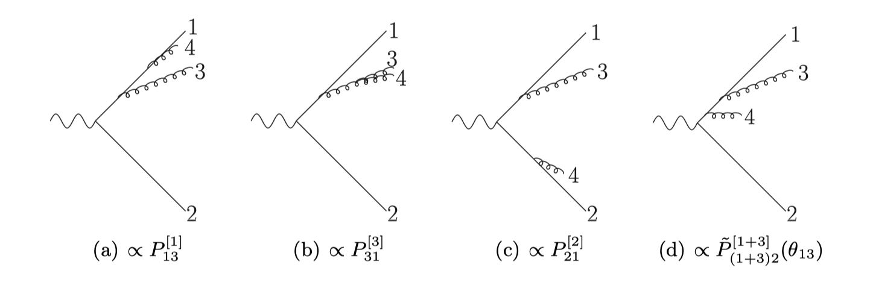
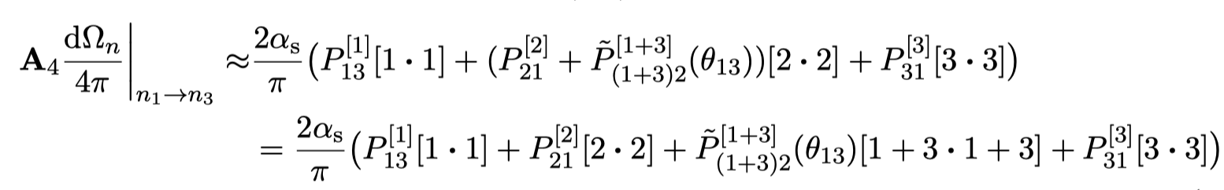

Angular ordered showers

Slide 5
NLL accuracy of inclusive, global, double-logarithmic, two-jet observables in e⁺e⁻ (early 90s, Catani, Webber, Marchesini)
Less accurate more generally. Azimuthal averaging also limits accuracy.

Slide 6
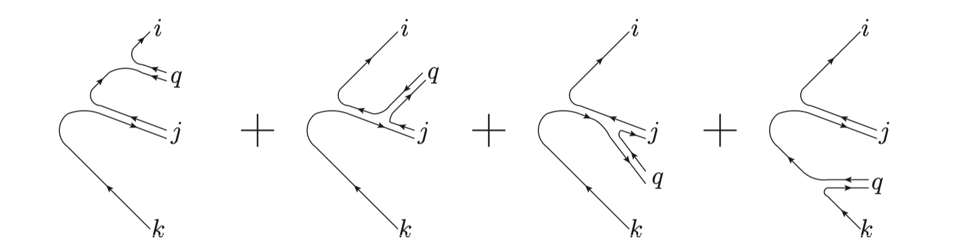
Dipole showers
Large N_{c} limit (= LC)
Accurate for all (global and non-global) observables at LL and LC
Can be improved by matching to angular-ordered showers (full-colour, NLL in e+e-)
Significant progress in systematically improving accuracy by PanScales collaboration
https://gsalam.web.cern.ch/gsalam/panscales/

Slide 7
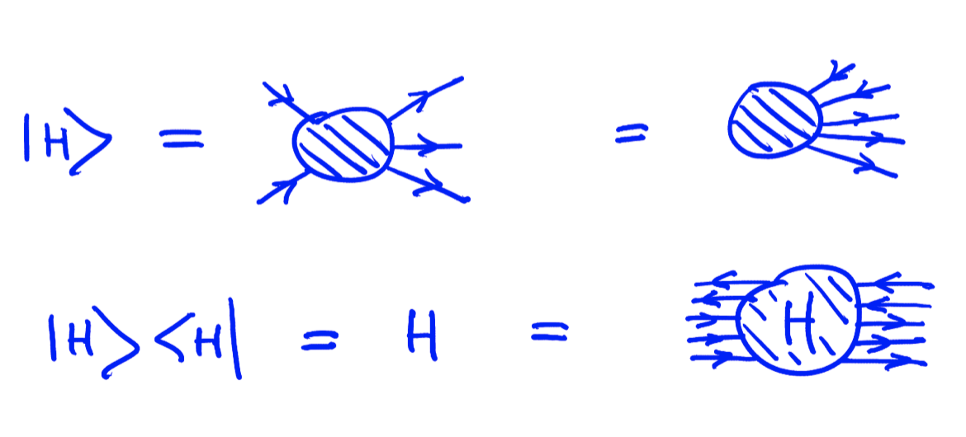
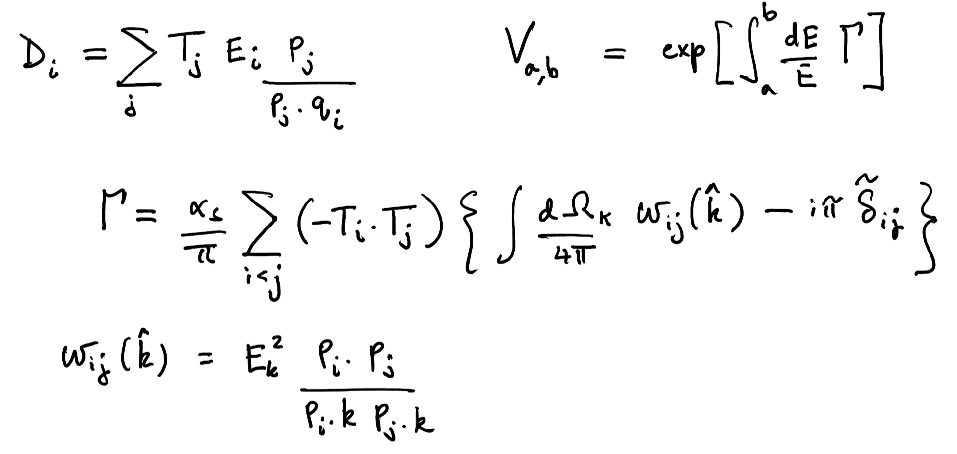
Amplitude evolution: going beyond the leading-colour approximation
See also Nagy & Soper
Deductor

Slide 8
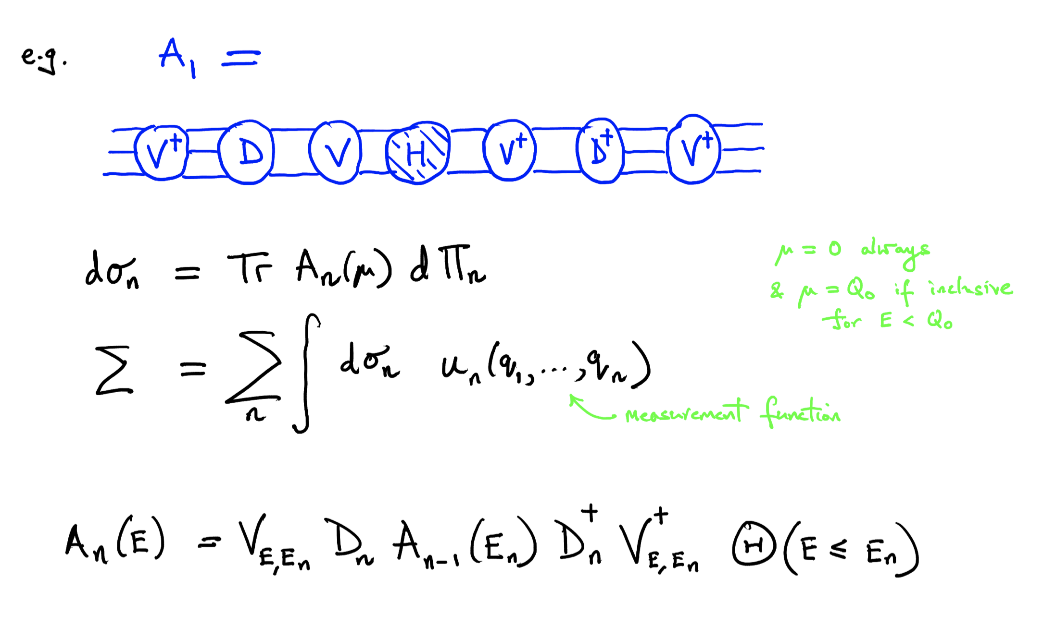
The leading N_{c} part of this hierarchy = BMS equation = dual to the BK equation
This hierarchy should be dual to JIMWLK (Weigert Nucl.Phys. B685 (2004) 321, hep-ph/0312050 )
Collinearly improved in
Generalized for NLL and hadronization in Plätzer 2204.06956 [hep-ph]
Forshaw, Holguin, Plätzer JHEP 1908 (2019) 145 arXiv:1905.0868

Slide 9
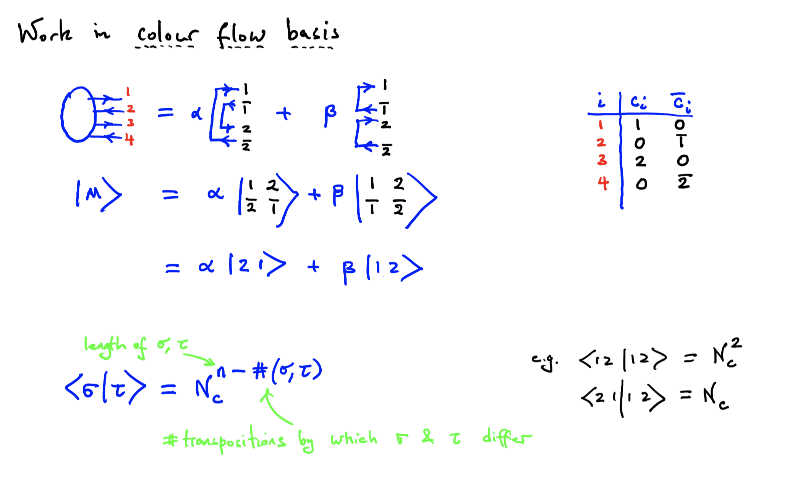
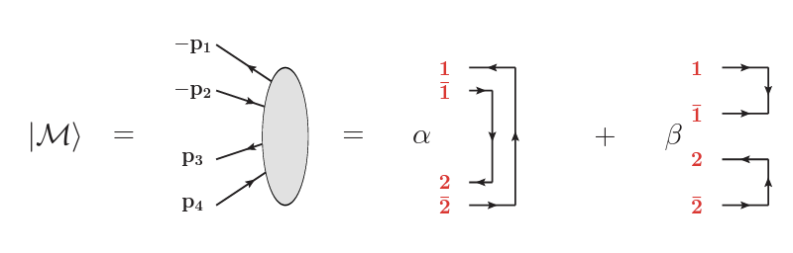
Colour evolution

Slide 10
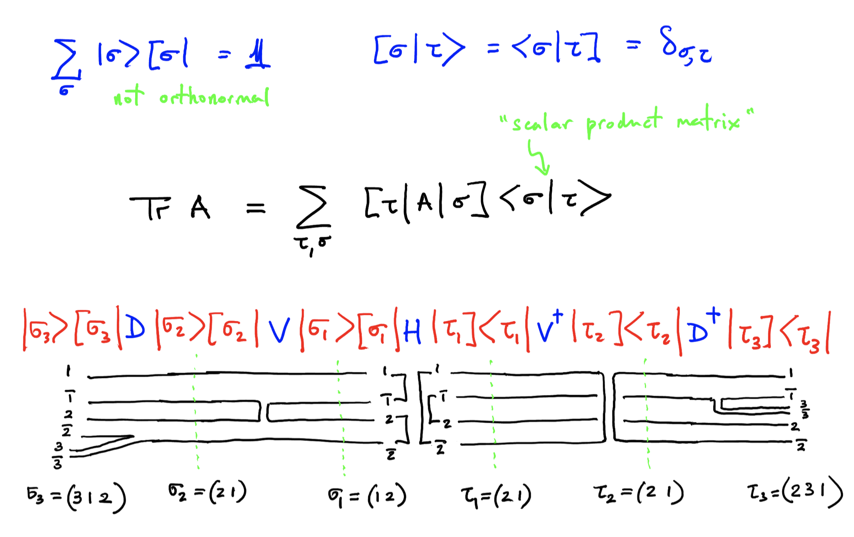

Slide 11
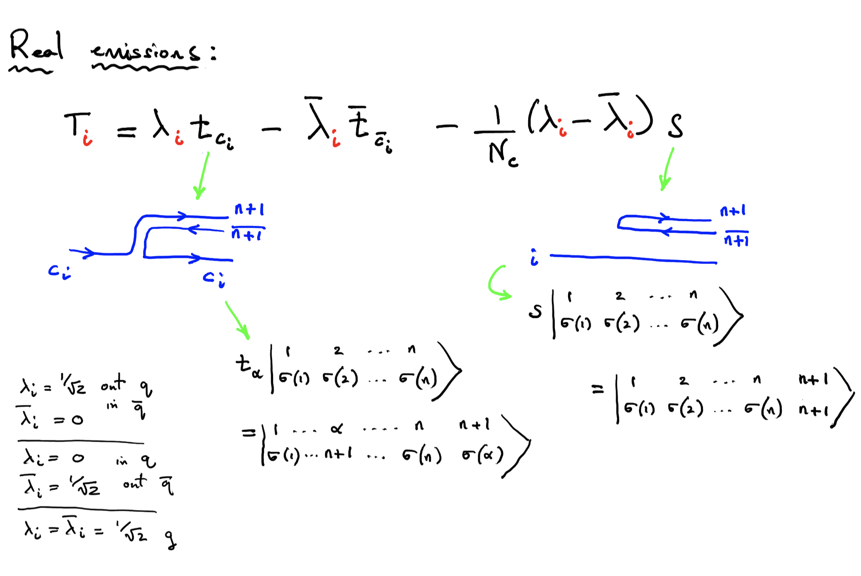

Slide 12
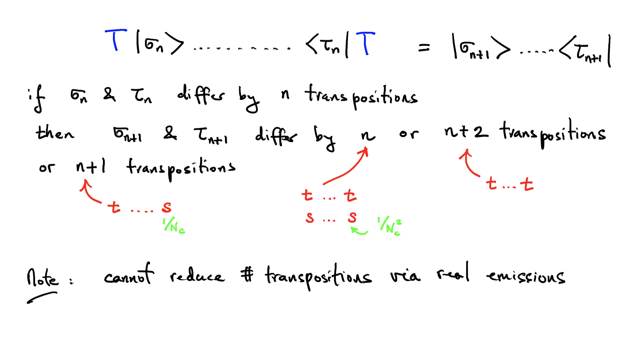

Slide 13
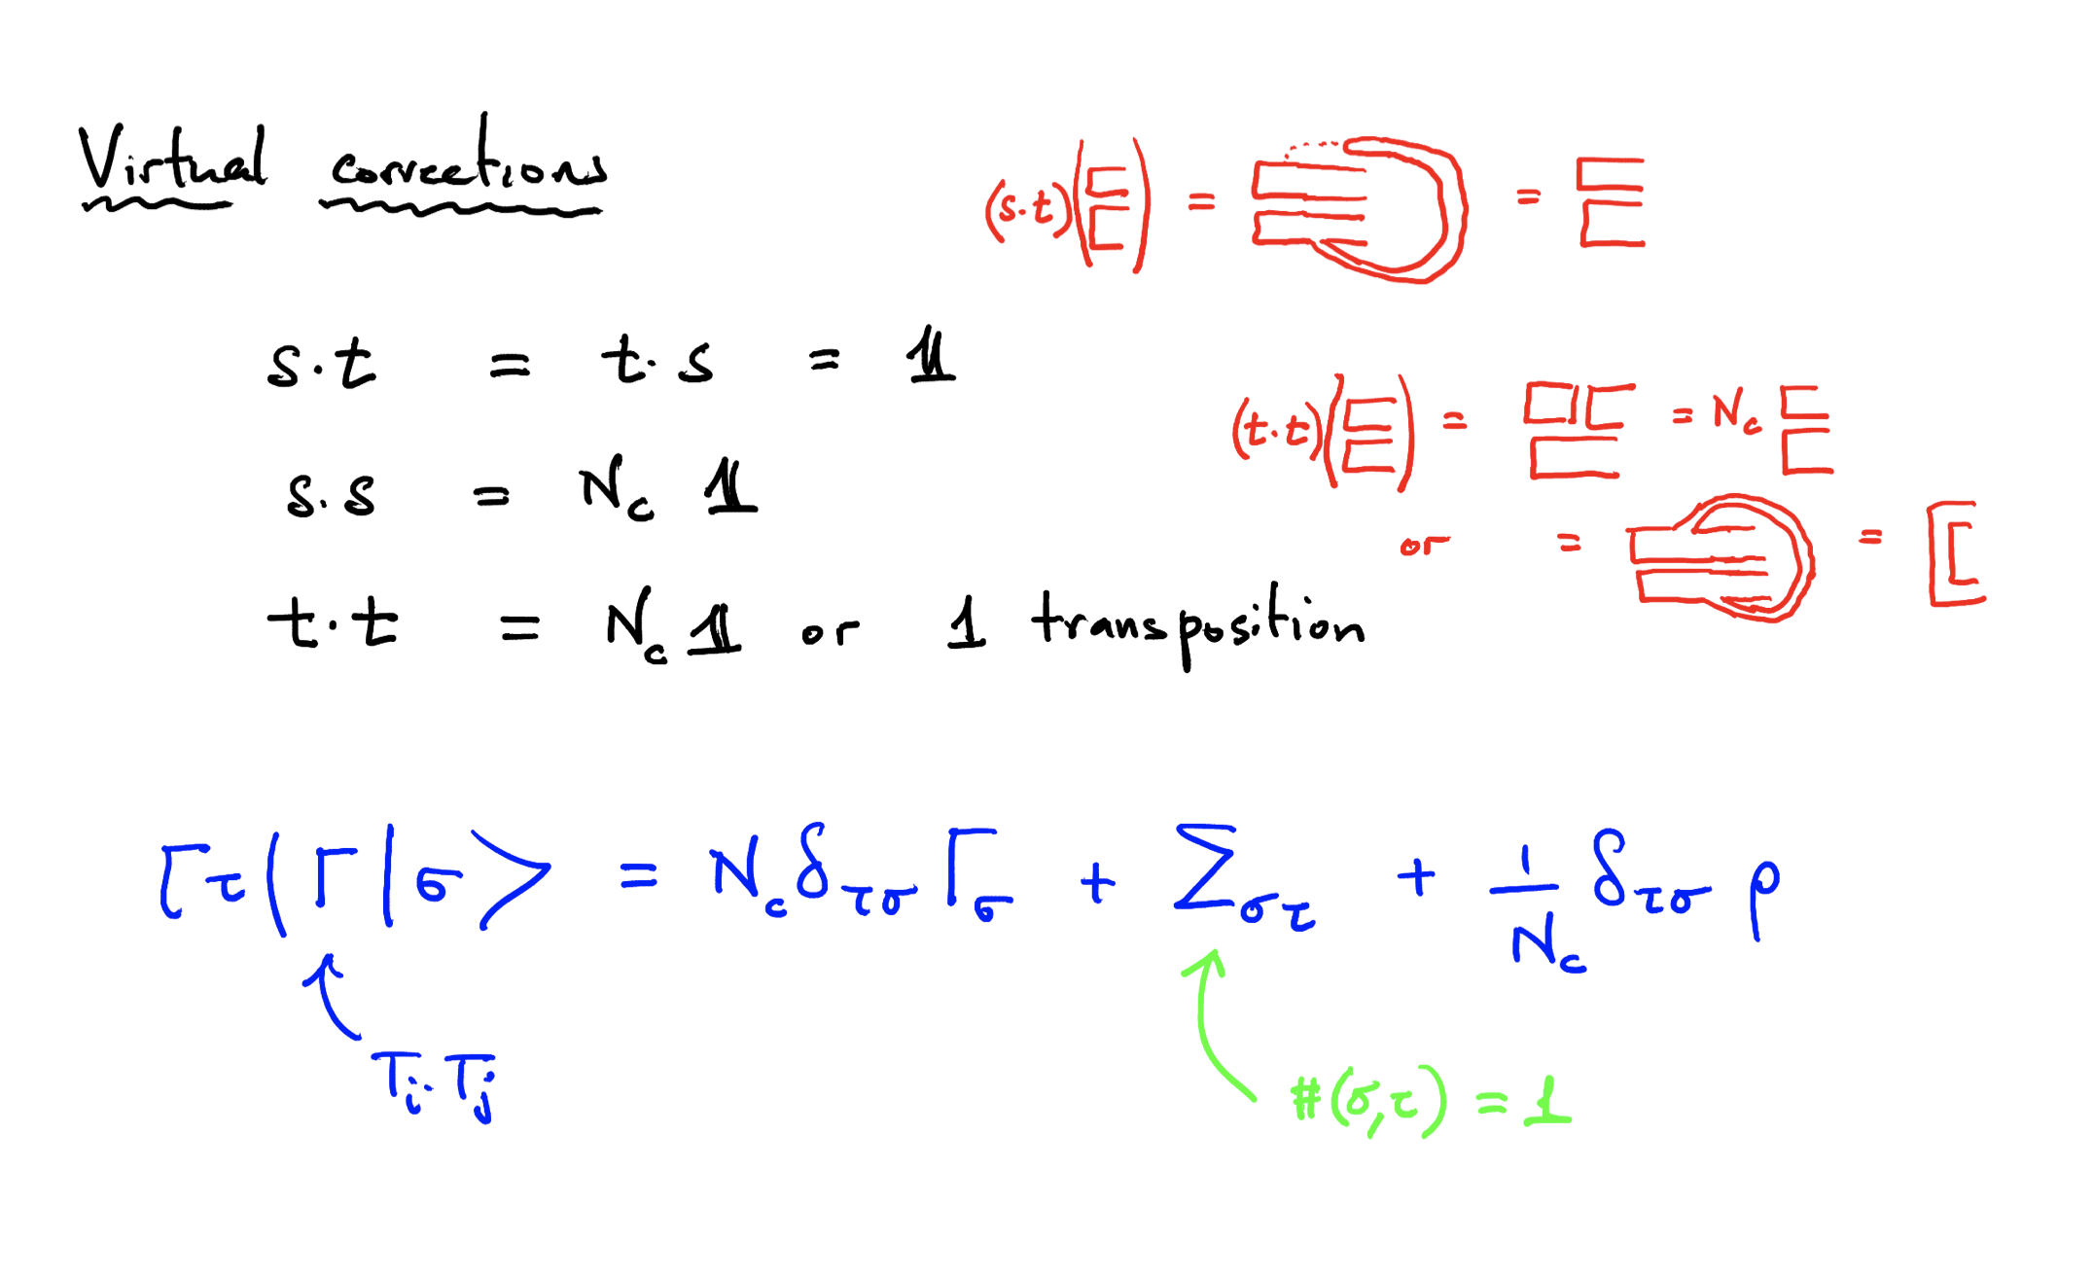

Slide 14
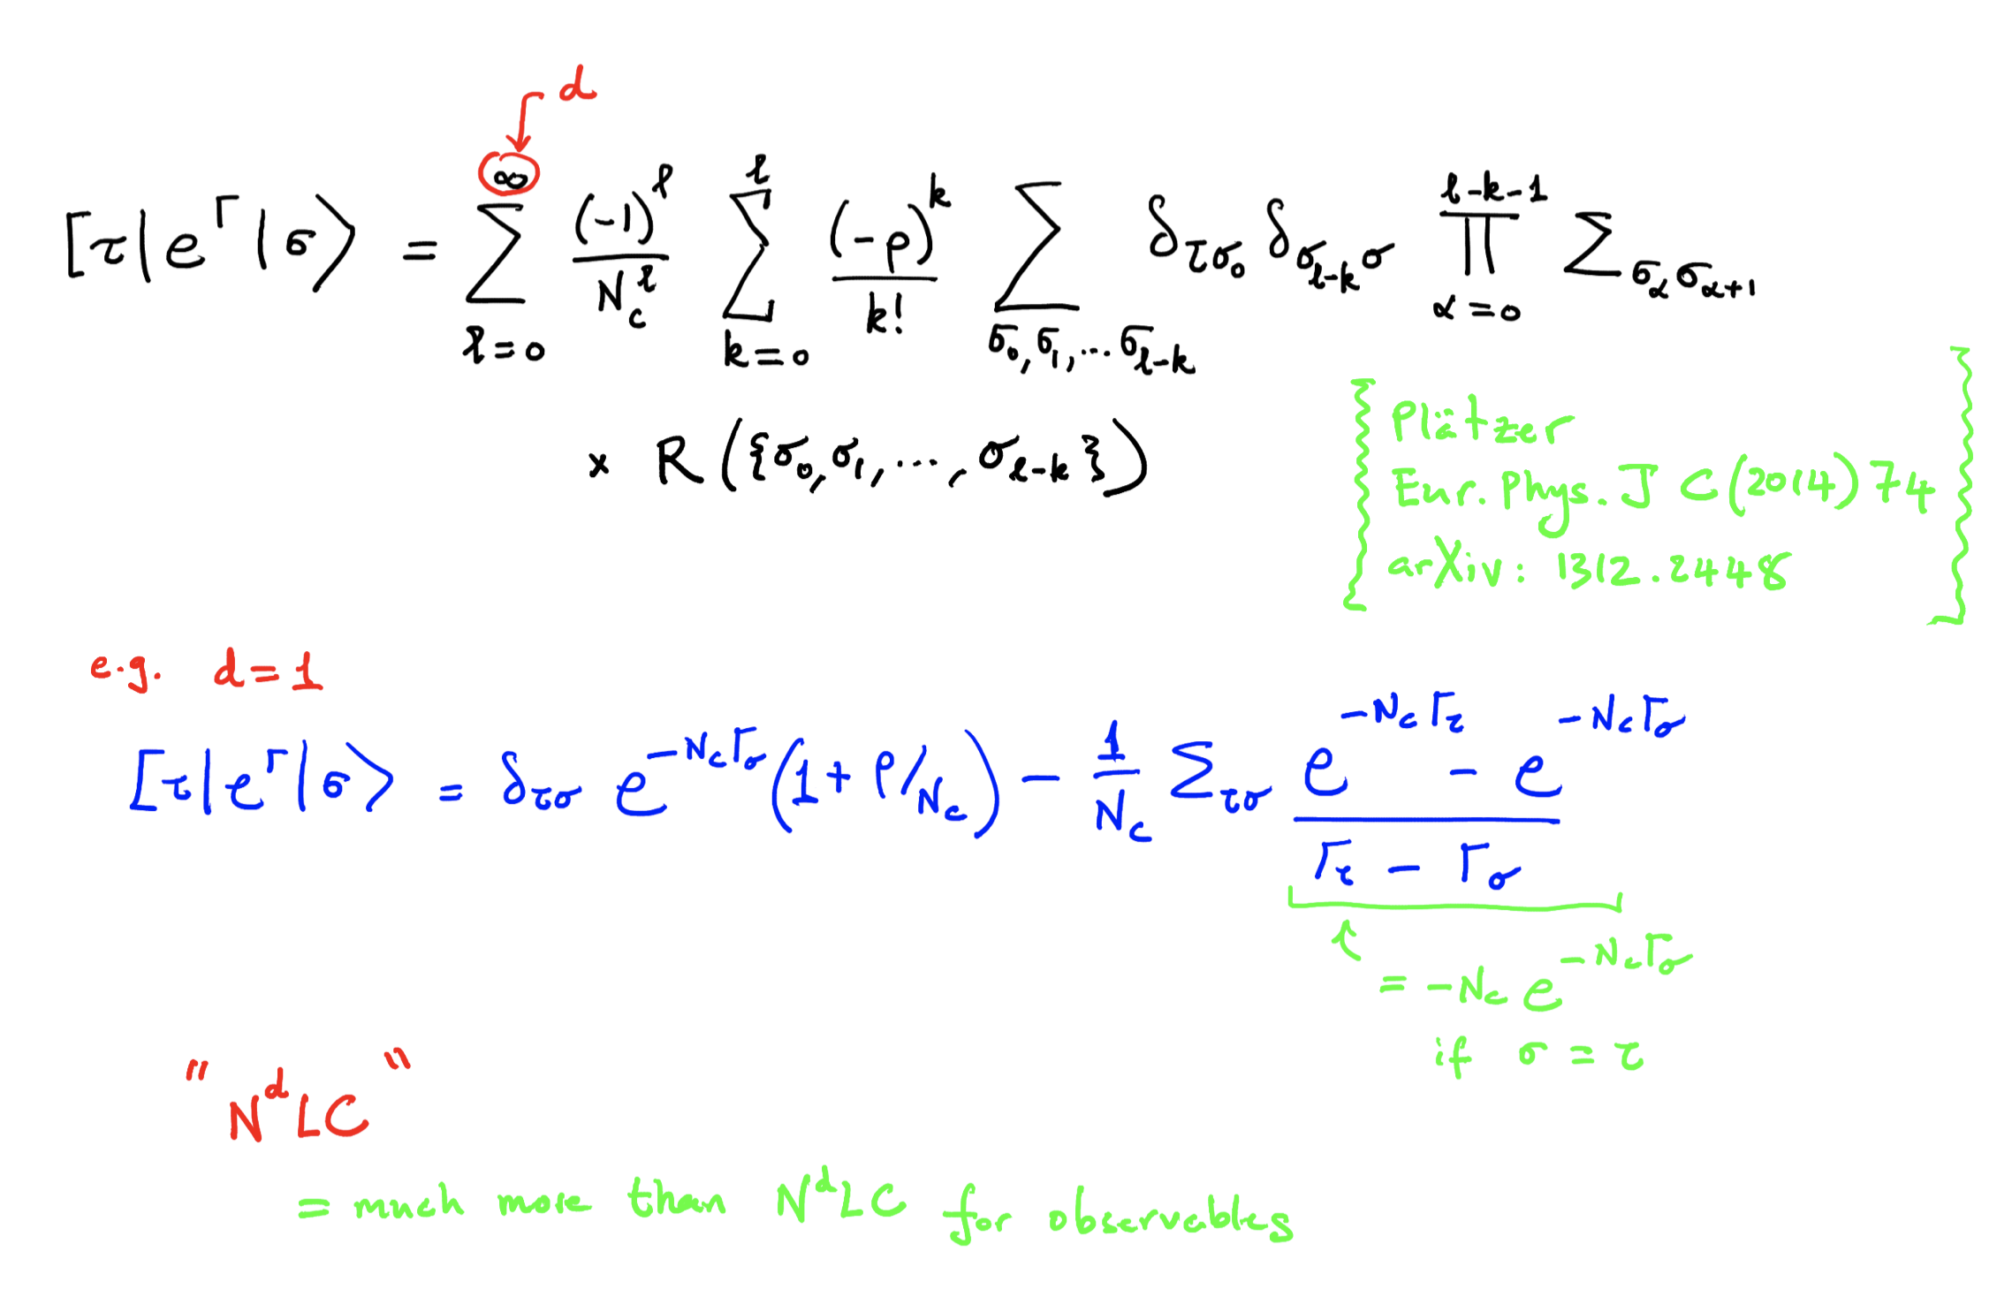

Slide 15
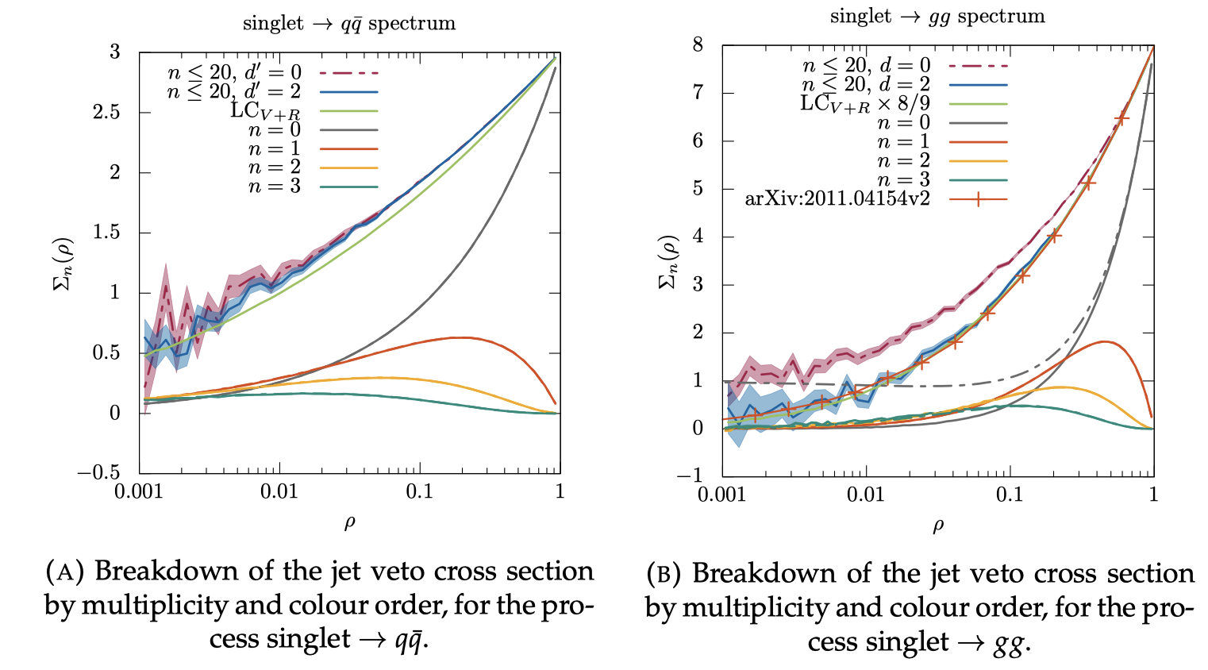

Slide 16
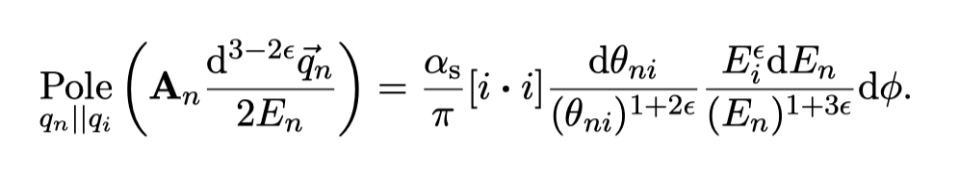
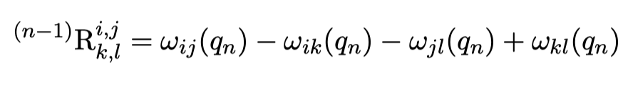
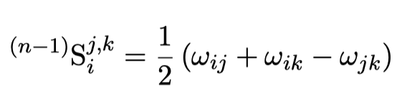
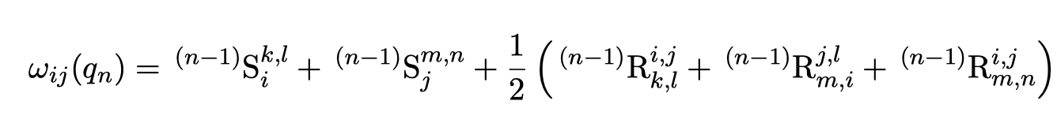
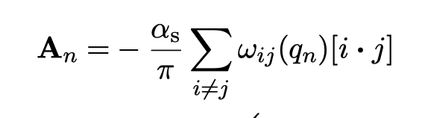

Dipoles, Rings & Strings

Slide 17
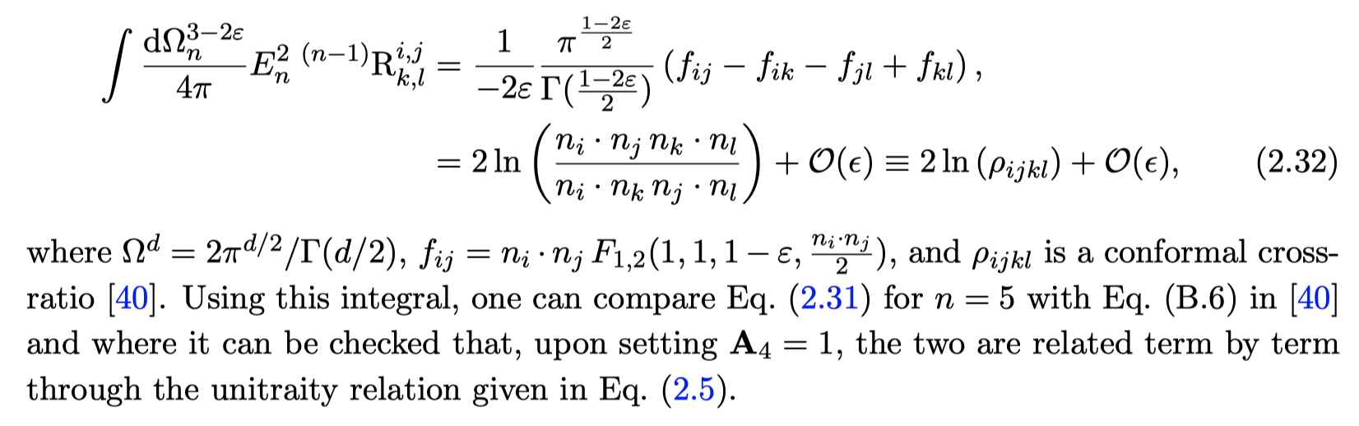
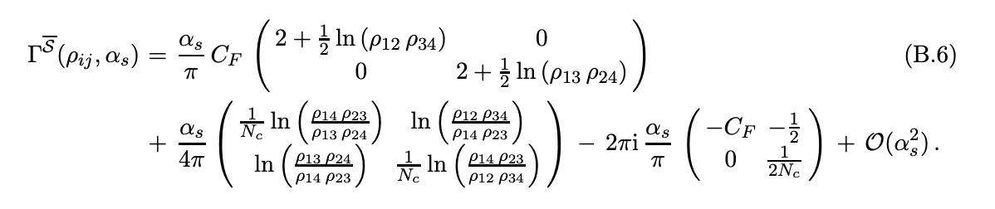
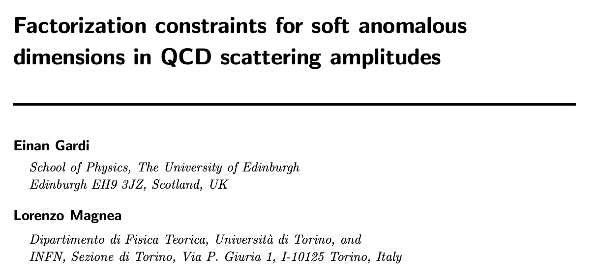

Slide 18
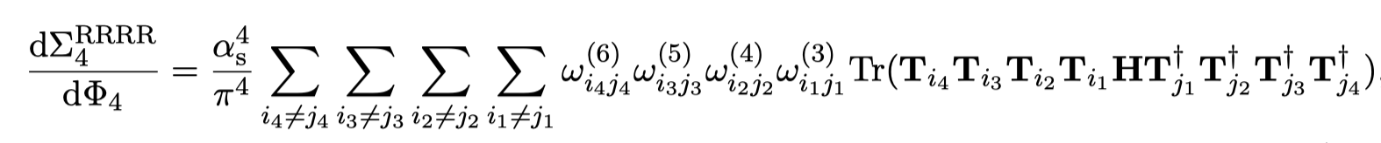
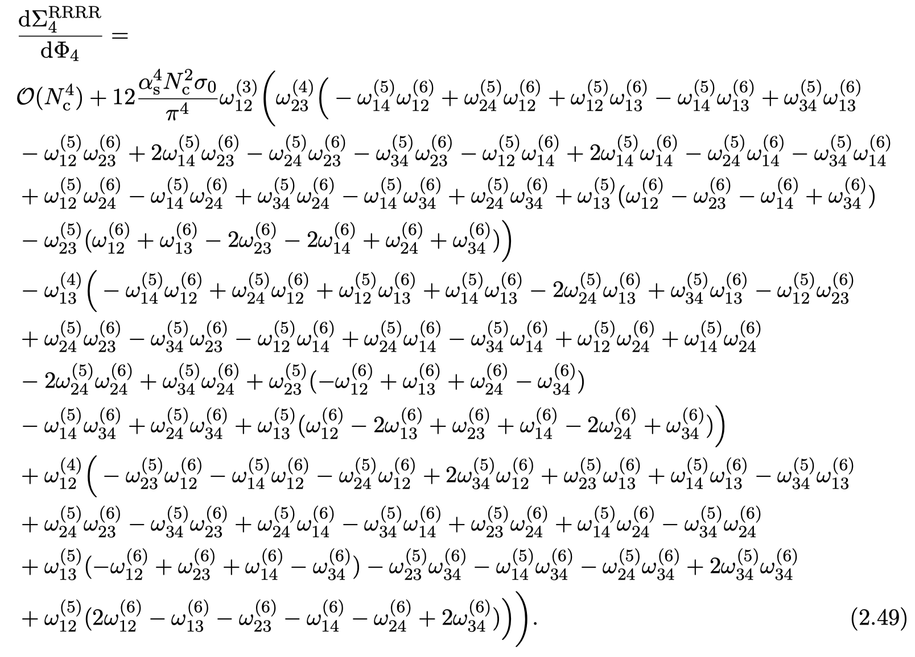
H to gg + 4 gluons

Slide 19


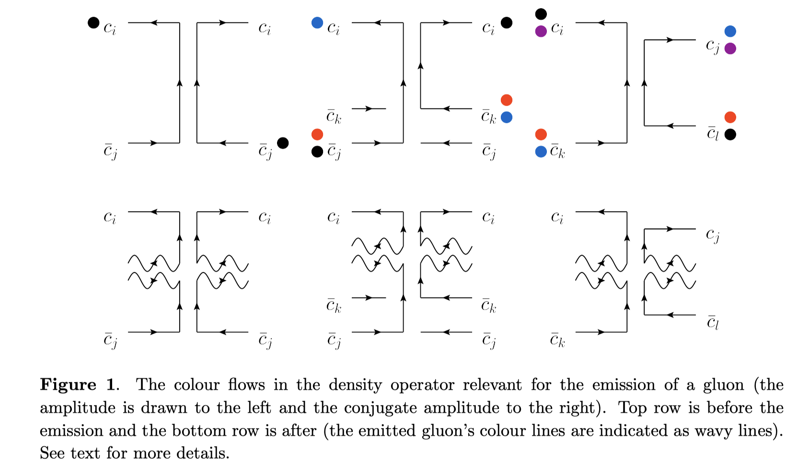

Rings & Strings in CVolver

Slide 20
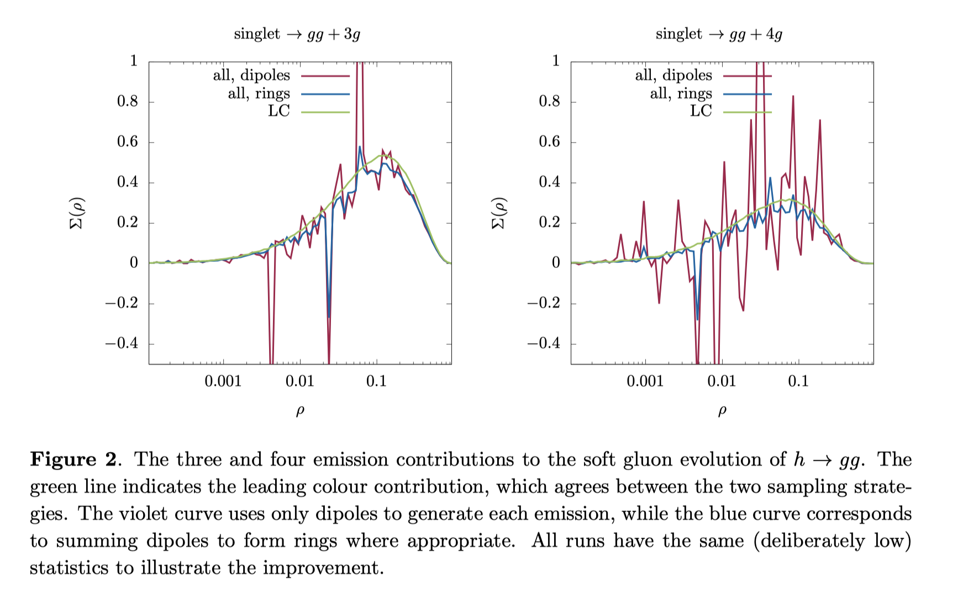

Slide 21
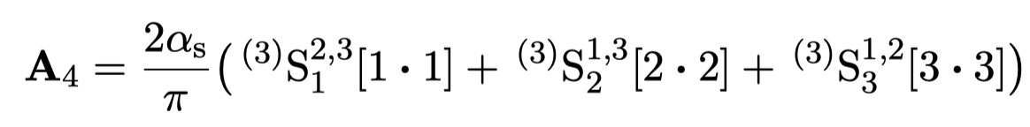
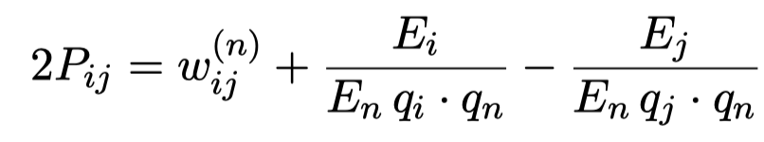
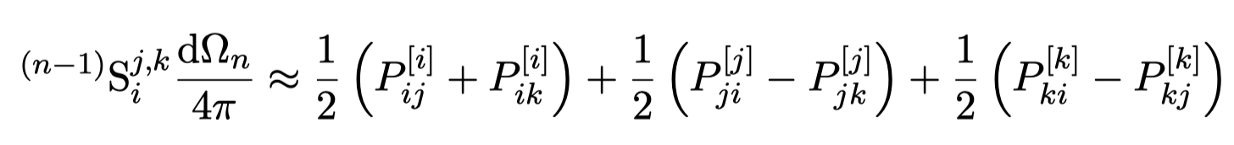
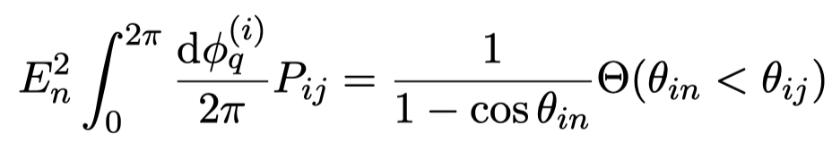
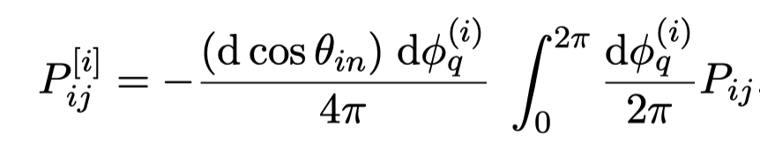
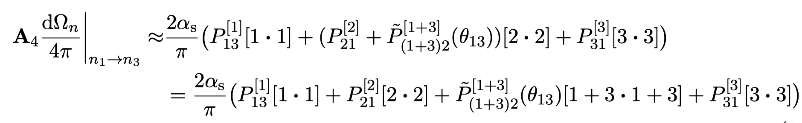

QCD coherence in the two-jet limit

Slide 22
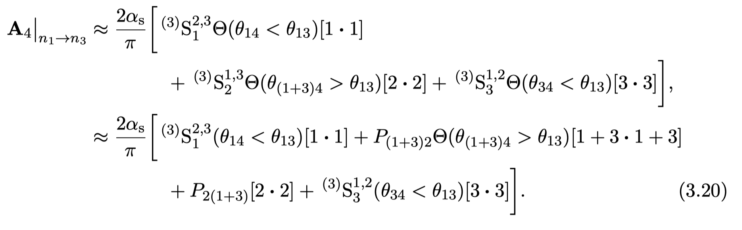

Valid in ANY frame (not just back-to-back) in which 1 and 2 are hard relative to 3.

Slide 23
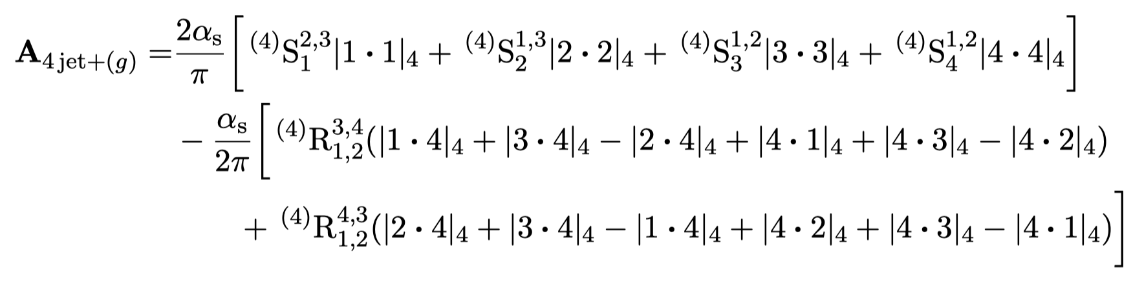
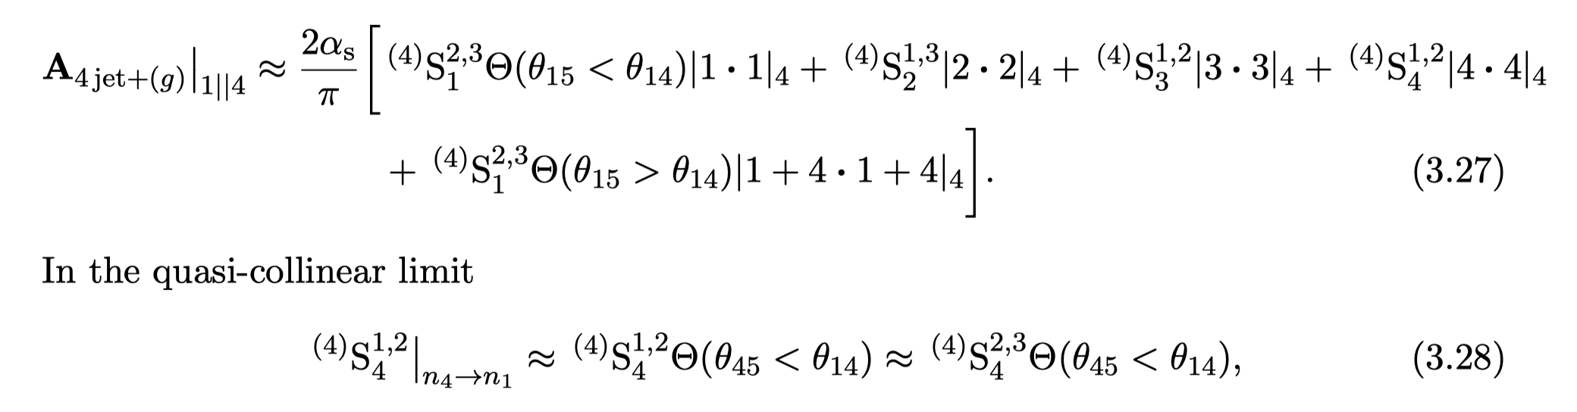


QCD coherence beyond the two-jet limit

Slide 24
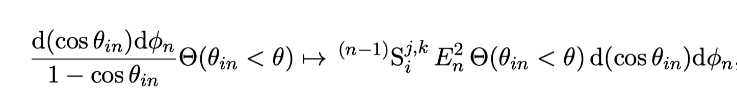
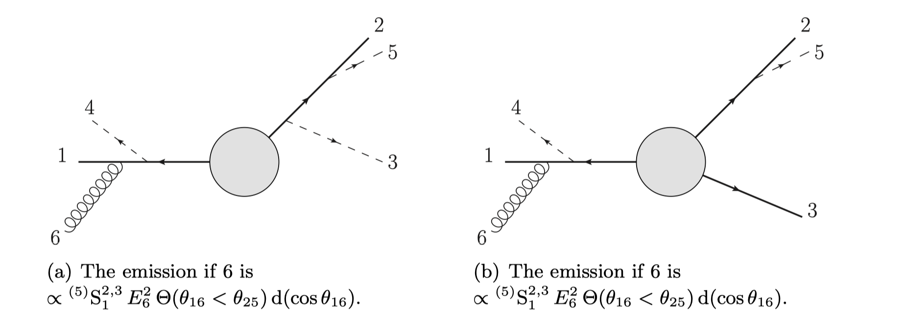
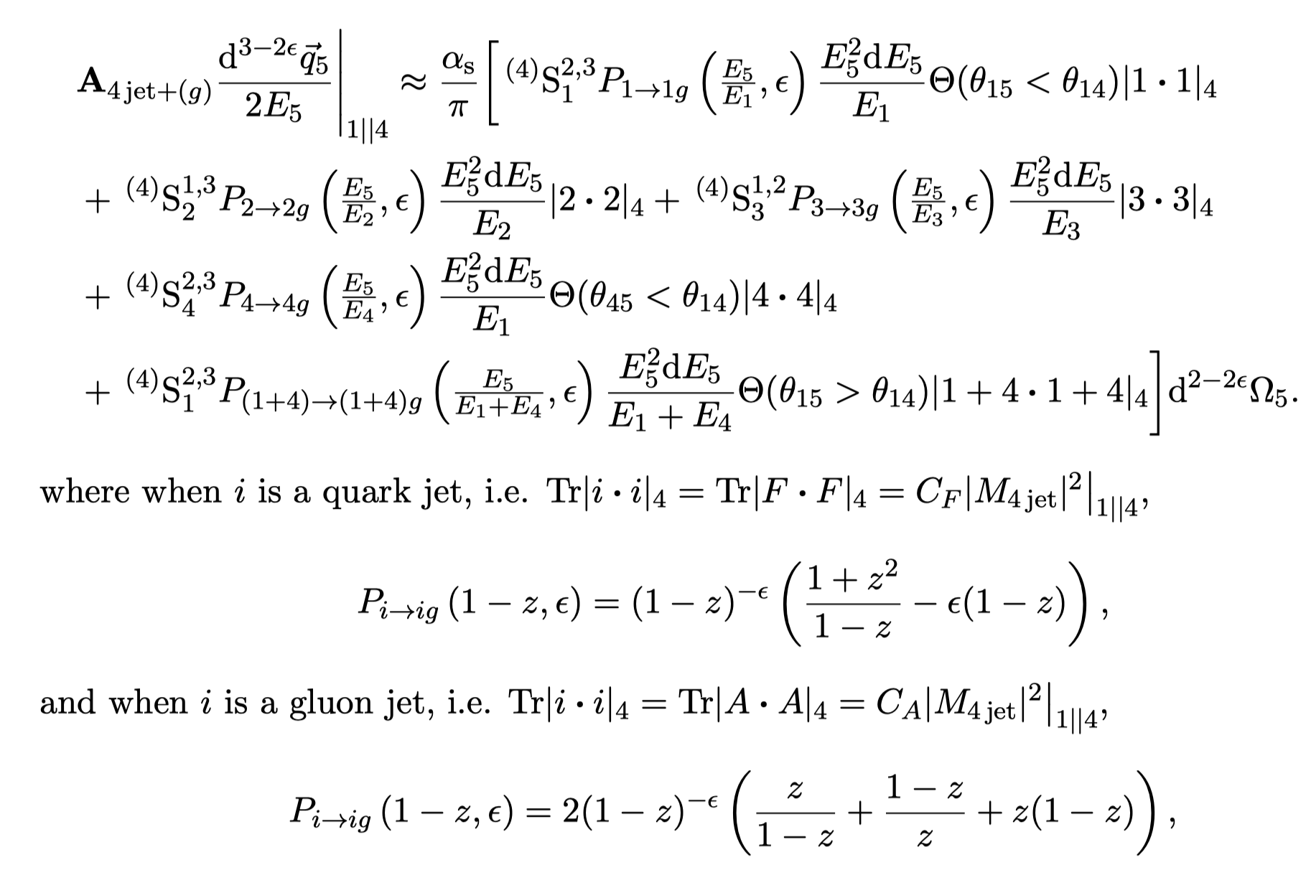
Modifying HERWIG

Slide 25
A remarkable result
Catani-Grazzini: all-orders amplitude-level factorization in the soft limit:
At one-loop:

Slide 26
….can be re-written in a more manifestly IR finite way
Ángeles-Martínez , JRF, Seymour Phys.Rev.Lett. 116 (2016) 21, 212003 JRF, Holguin, Pathak Phys.Rev.D 104 (2021) 9, L091501
Pathak, JHEP 06 (2022) 118

Slide 27
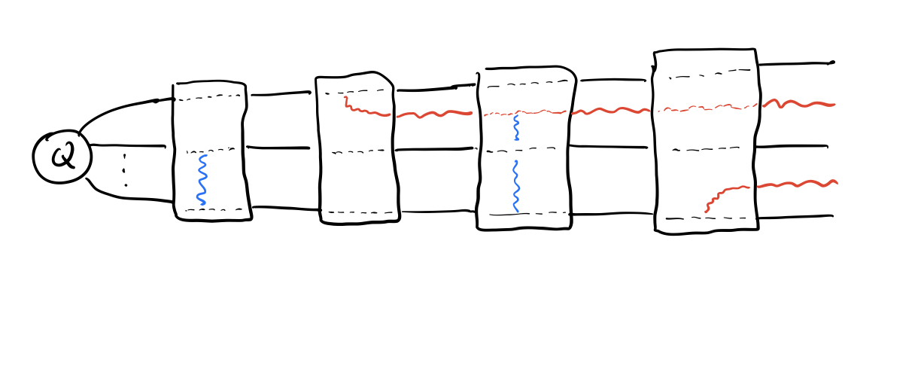

Slide 28
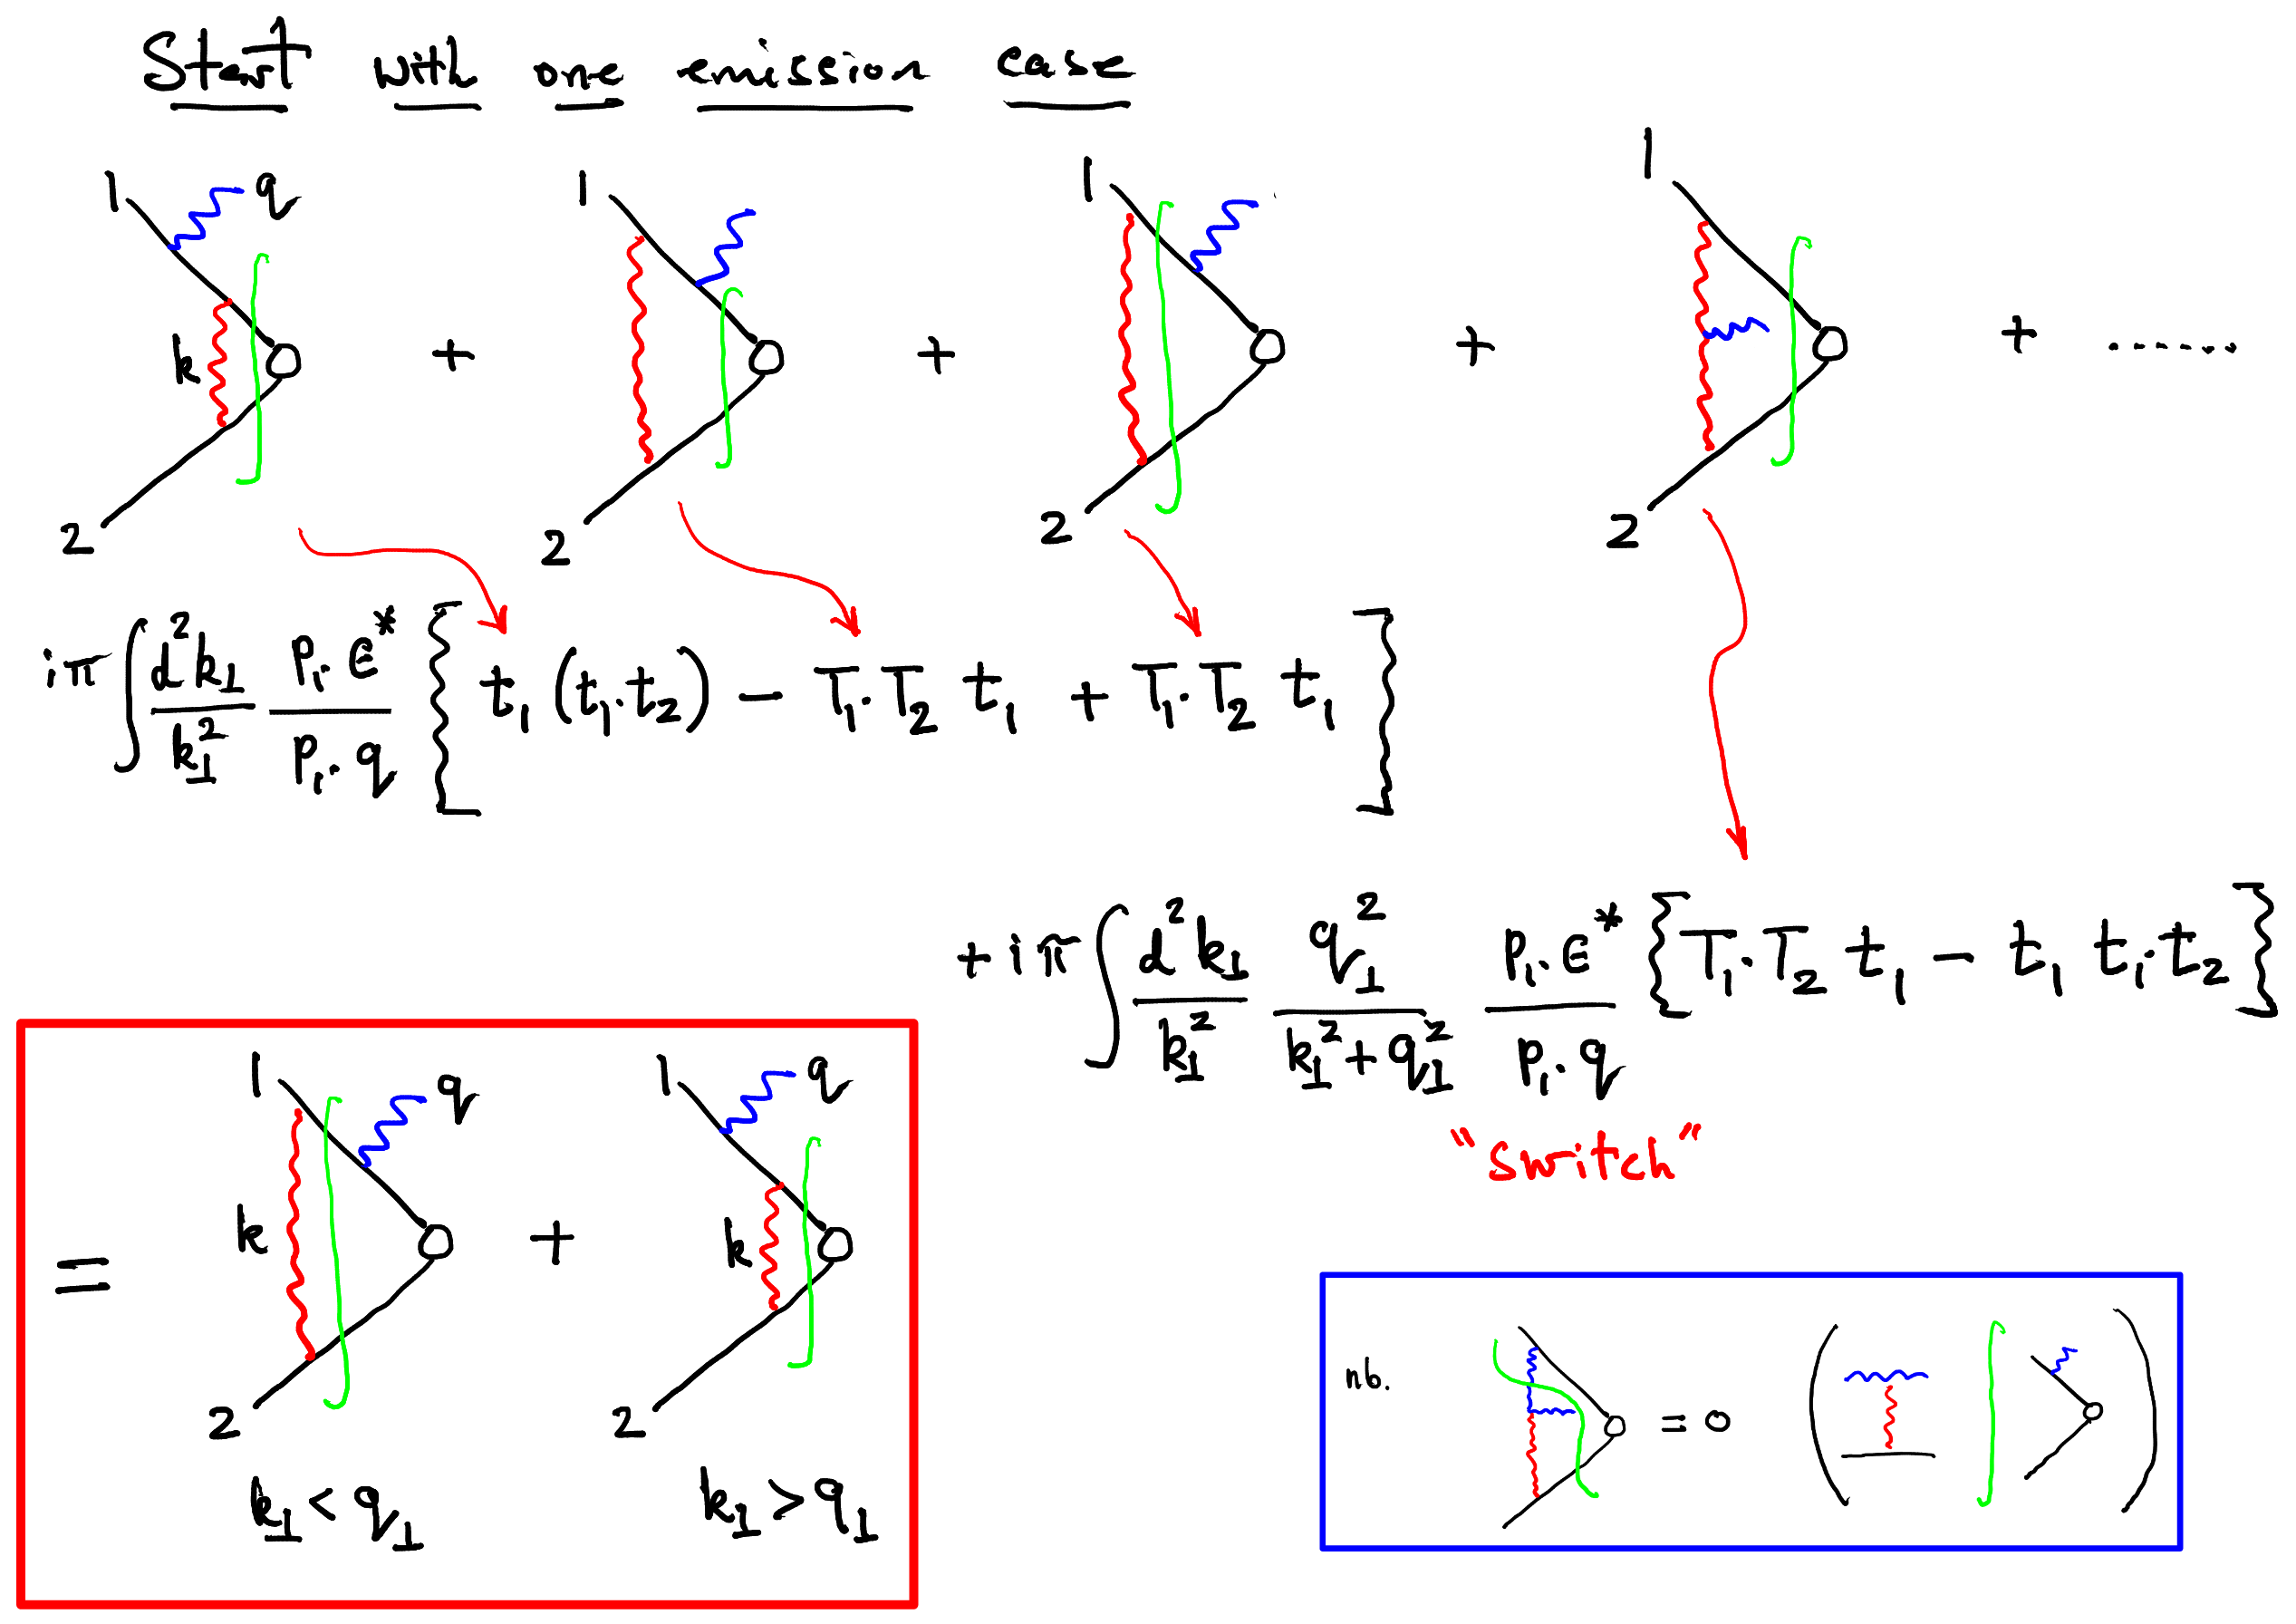

Slide 29
Conclusions
First steps to full-colour evolution: CVolver
Rings & Strings help reduce fluctuations
Strings can be used to go beyond azimuthally averaged angular-ordered showers
Amplitude evolution: loops bounded by adjacent real emissions

Slide 30
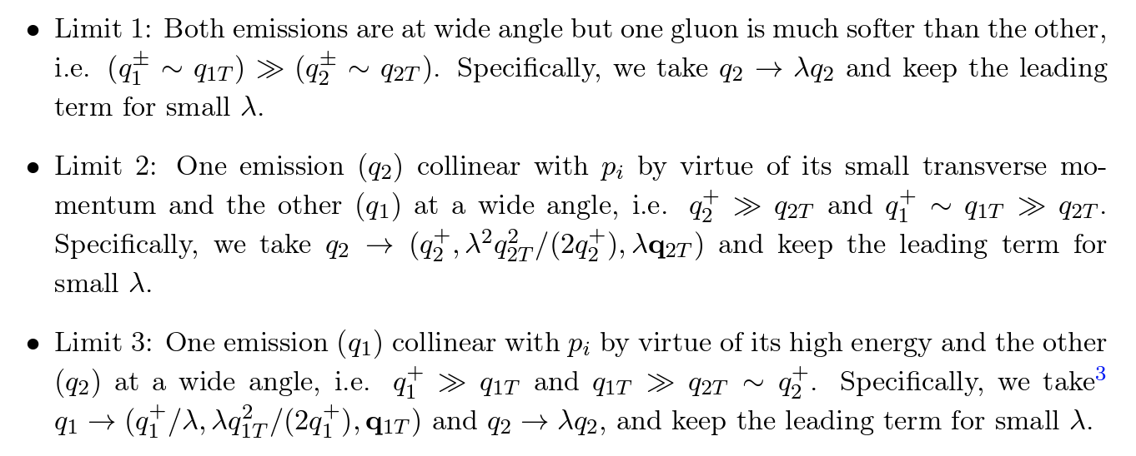

Slide 31
Limit 3

