Slide 1
Consolidation and upgrade of the North Area beam instrumentation
Inaki Ortega & Jocelyn Tan (SY-BI)
North Area Consolidation Project Approval Review
23-24 February 2021 – CERN

Slide 2
Introduction
Most of the beam instrumentation is 40 years old and shows a degraded performance:
Insufficient for normal operation.
Increases radiological risk.
Impossibility to go to higher intensities.
Hinder future projects in the framework of the European Strategy for Particle Physics.
The IEFC mandated in 2018 the creation of the ‘Experimental Areas Beam Instrumentation Working Group’:
Inventory of the present situation.
Evaluate state of the hardware and possibilities of maintenance.
Study R&D needs.
Define baseline requirements post-LS2.
The present consolidation & upgrade proposal for BI has been reached by consensus in the WG.
The deliverables of the EABI-WG can be consulted on EDMS:
“North Area consolidation requests for BE-BI”, EDMS 2206350
“Final report of the EABI Working Group”, EDMS 2222321
“Inventory of the present situation”, EDMS 2159595
Notes:
Most of the beam instrumentation, in both primary and secondary lines, is 40 years old and shows a degraded performance:
Proves to be insufficient for an efficient normal operation. Has caused downtime (BLM)
Increases radiological risks. Activation risk around splitters, as mentioned for example by Matthew Fraser.
Impossibility to go to higher intensities.
Hinder future projects in the framework of the ESPP, such as PBC and BDF.
The IEFC mandated in 2018 the creation of the EABI-WG, which is made up of over 30 members from different groups of the ATS Departments, consolidation projects, representatives of the major experiments, as well as the PS and SPS coordinator.
The WG provided the following deliverables:
1- Inventory of the present situation – identification of shortcomings and impact on operation.
2- Evaluation of the state of the hardware, possibilities and difficulties for maintenance and long-term availability of expertise.
3- Study of present and future R&D needs.
4- Baseline requirements for post-LS2 and LS3, including associated resources.
The deliverables are available in EDMS

Slide 3
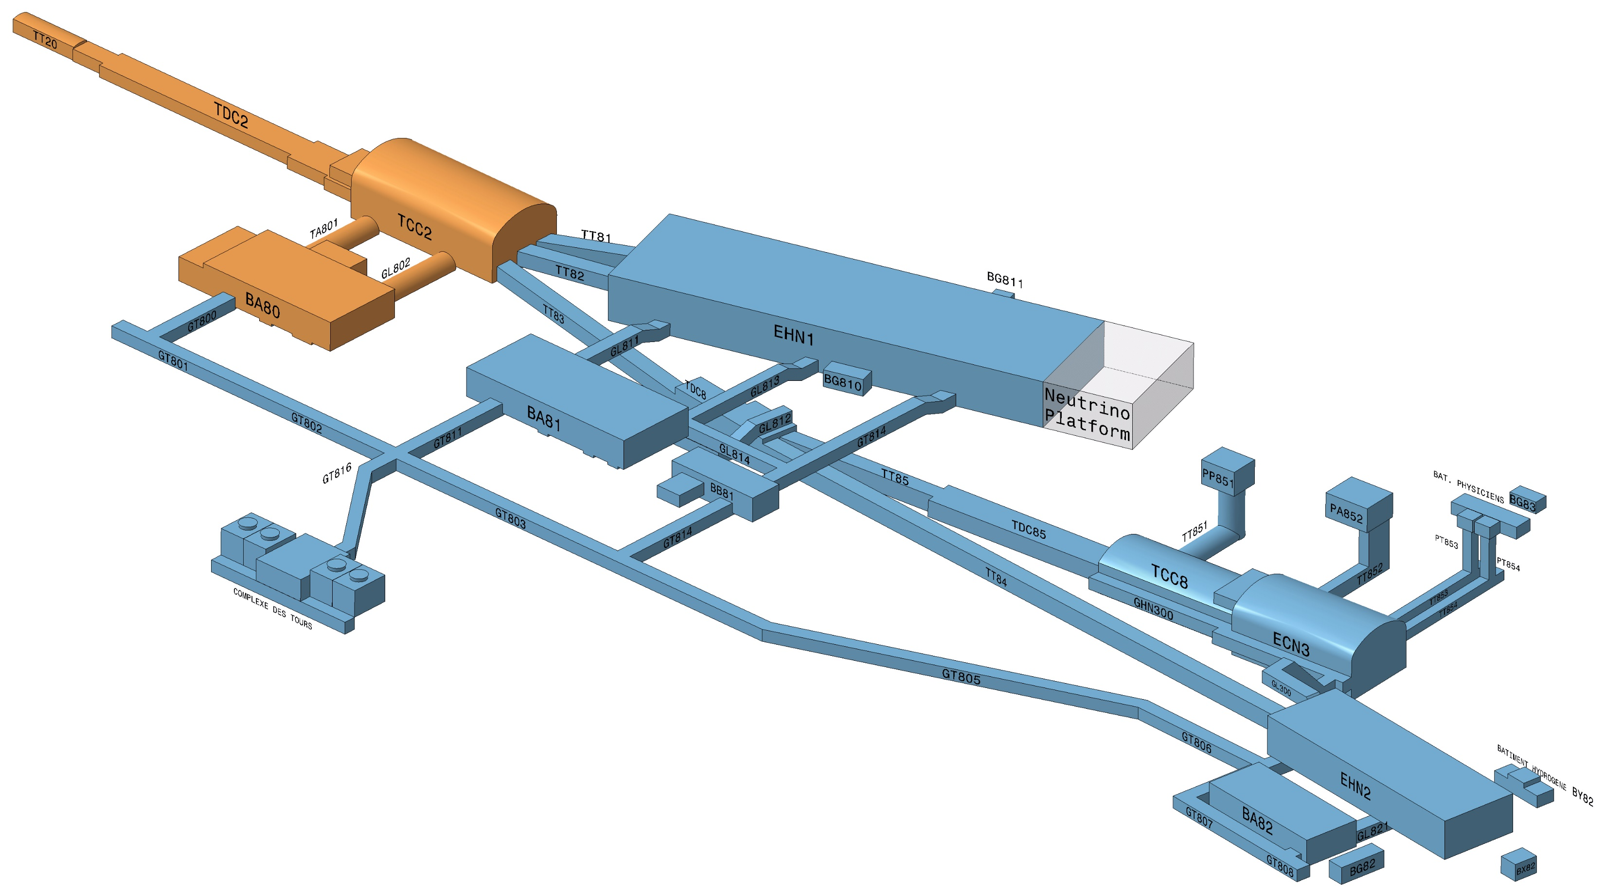
Beam instrumentation in the primary lines (LSS2, TT20, TDC2, TCC2)
4 stations of secondary emission monitors:
  beam intensity (BSI)
  beam position (BSP)
  beam profile (BSG)
3 stations of radiator screen profile monitors (BTV)
30 beam loss monitors (BLM)
Notes:
I’ll present now the inventory and status of the instrumentation in the primary lines:
4 stations containing different combinations of secondary emission monitors: BSI (full foils), BSP (split-foils) and BSG (grids).
3 stations of BTV
30 BLM

Slide 4
Beam instrumentation in the primary lines (LSS2, TT20, TDC2, TCC2)
4 stations of secondary emission monitors:
  beam intensity (BSI)
  beam position (BSP)
  beam profile (BSG)
Status:
Performance severely degraded due to ageing and radiation damage.
3 stations of radiator screen profile monitors (BTV)
30 beam loss monitors (BLM)
Notes:
The performance of all equipment is severely degraded due to ageing and radiation damage -> as many colleagues have pointed out before: no longer reliable.
Some of the BTV are in extremely high radiation areas.
The BLM system has experienced failures that led to facility stop. Urgent re-cabling performed during LS2, but complete system needs consolidation.

Slide 5
Beam instrumentation in the primary lines (LSS2, TT20, TDC2, TCC2)
Proposed solutions for the secondary emission monitors:
beam intensity (BSI): replace complete system (tank + instrument + electronics)
beam position (BSP): replace by SEM grids
Notes:
I’ll present now the proposed solution for the different instruments.
For the BSI: this option is preferred because it also offers the possibility to adapt the design to attempt achieving <1% systematic error, as requested by the SPS Losses and Activation WG.
For the BSP: SEM grids are preferred due to limited usefulness of BSPs.

Slide 6
Beam instrumentation in the primary lines (LSS2, TT20, TDC2, TCC2)
Proposed solutions for the BTV:
replace complete system (tank + screen + camera) by modern alternative.
Notes:
For the BTV: this is the standard procedure and the most efficient. The new system would reduce significantly the dose to personnel.

Slide 7
Beam instrumentation in the primary lines (LSS2, TT20, TDC2, TCC2)
Proposed solutions for the BLM:
replace complete system with same detectors that will be used in the SPS consolidation.
Notes:
For the BLM: a general BLM consolidation for the SPS is funded for LS3 -> use the same ionization chamber technology.

Slide 8
Beam instrumentation in the primary lines (LSS2, TT20, TDC2, TCC2)
Consequences of non-consolidation:
Problematic beam extraction and steering through TT20 and splitters:
  Loss of operation time.
  Increased radiological risk.
Large systematic errors in number of protons on target.
Impossibility to increase beam intensity as requested.
Incompatibility with future projects: PBC & BDF
Notes:
These are the consequences of non-consolidation.

Slide 9
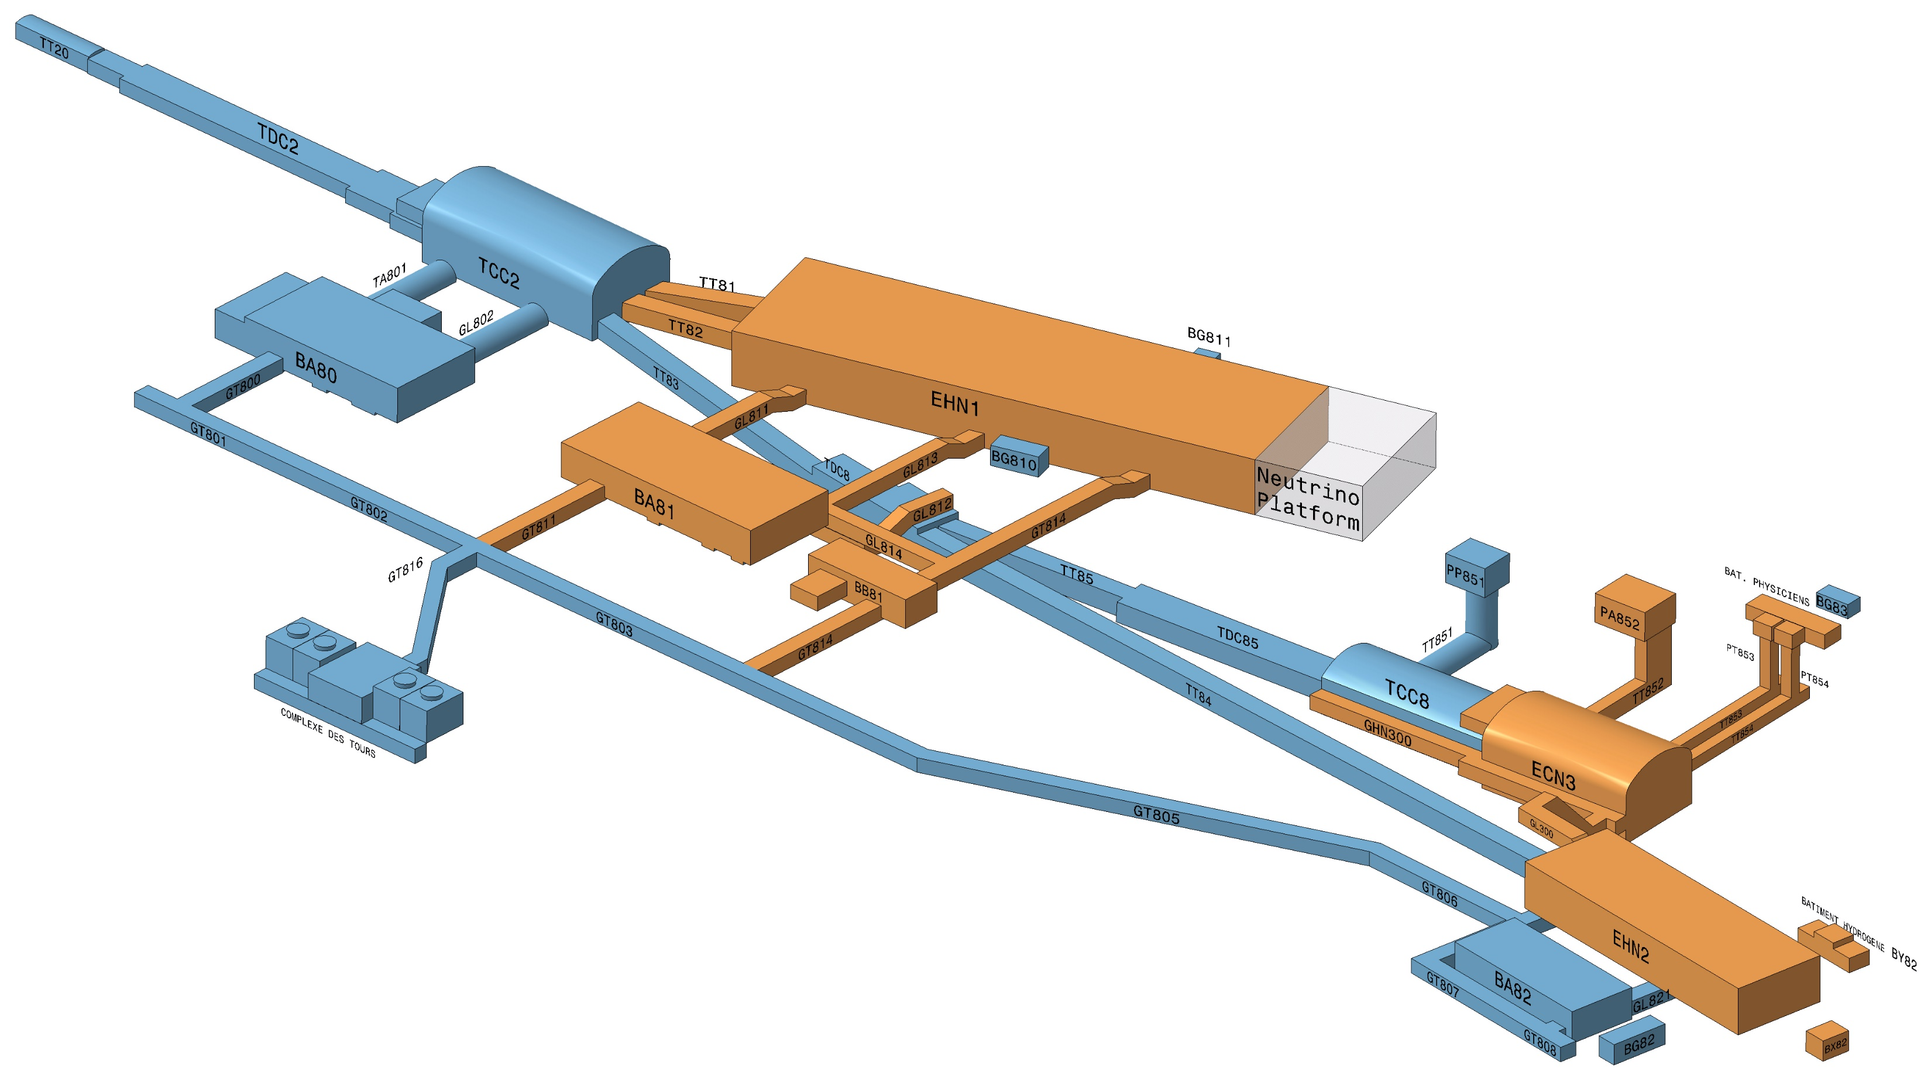
Beam instrumentation in the secondary lines (H2, H4, H6, H8, M2, K12)
Beam profile monitoring:
Multi-wire proportional chambers (XWCA): 29 operational + 21 spare.
Delay wire chambers (DWC): 16 operational + 19 spare.
Scintillating finger scanner (FISC): 56 operational + 5 spare.
Notes:
I will now present the inventory and status of the BI in the secondary lines.
I’ll start with profile monitoring, which is composed of MWPC, DWC and FISCs.

Slide 10
Beam instrumentation in the secondary lines (H2, H4, H6, H8, M2, K12)
Beam profile monitoring:
Status:
Performance severely degraded due to ageing and radiation damage, including spares.
Lost expertise.
Multi-wire proportional chambers (XWCA): 29 operational + 21 spare.
Delay wire chambers (DWC): 16 operational + 19 spare.
Scintillating finger scanner (FISC): 56 operational + 5 spare.
Good status in general.
Notes:
Most of the wire chambers show severe degradation due to ageing and radiation damage, including the spare units.
The expertise to repair or produce them has been lost.
The status of the FISC is good in general because their maintenance is very easy (replace filament and PMT).
There is a common issue to all these monitors: they cannot cover properly all intensity ranges in the North Area.

Slide 11
Beam instrumentation in the secondary lines (H2, H4, H6, H8, M2, K12)
Beam intensity monitoring:
Scintillating paddles (XSCI): 32 operational + 10 spare.
Secondary emission monitors (XION): 3 operational + 2 spare.
Notes:
Concerning beam intensity monitors, we have 2 families of instruments:
Scintillating paddles for low and medium intensities.
Secondary emission monitors filled with gas (XION) for higher intensities.

Slide 12
Beam instrumentation in the secondary lines (H2, H4, H6, H8, M2, K12)
Beam intensity monitoring:
Scintillating paddles (XSCI): 32 operational + 10 spare.
Status: some XSCI show radiation damage.
Secondary emission monitors (XION): 3 operational + 2 spare.
Status: severe calibration problems. Unknown status of gas inside.
Notes:
This is the status of the intensity monitors:

Slide 13
Beam instrumentation in the secondary lines (H2, H4, H6, H8, M2, K12)
Particle identification:
Cherenkov Threshold Counters (XCET): 8 operational + spare parts.
CEDAR: 2 operational + 3 spare + unknown situation of other spares.
Electromagnetic calorimeter (XEMC): 3 operational + 2 spare.
Notes:
I’ll pass now to the particle identification monitors:

Slide 14
Beam instrumentation in the secondary lines (H2, H4, H6, H8, M2, K12)
Particle identification:
Cherenkov Threshold Counters (XCET): 8 operational + spare parts.
Status: gas system is obsolete. Mirrors must be replaced.
CEDAR: 2 operational + 3 spare + unknown situation of other spares.
Status: gas system is obsolete. Thermal housing is severely degraded.
Electromagnetic calorimeter (XEMC): 3 operational + 2 spare.
Status: motorisation must be replaced. Outdated readout electronics.
Notes:
The XCET and CEDAR have a common gas system, which is obsolete.
The motorization of the XEMC is unreliable and has caused incidents in the past (stuck inside the beam).
The readout of the XEMC is outdated and incompatible with modern control systems.

Slide 15
Beam instrumentation in the secondary lines (H2, H4, H6, H8, M2, K12)
Proposed solution for beam profile monitoring:
Replace most of the XWCA, DWC and FISC by XBPFs, the new scintillating fibre monitor developed by SY-BI → standard profile monitor in CERN Neutrino Platform and East Area.
Notes:
The preferred solution for profile monitoring is to replace the XWCA, DWC and FISC by the XBPF.
The expertise to produce chambers is lost and would consume many resources.
XBPF can cover all intensity ranges, has easy maintenance, is vacuum compatible and is becoming the standard in the experimental areas: Neutrino Platform and East Area.

Slide 16
Beam instrumentation in the secondary lines (H2, H4, H6, H8, M2, K12)
Proposed solutions for beam intensity monitoring:
XSCI: build new scintillating paddles. Replace voltage dividers by modern transistorised version.
XION: recondition monitors.

Slide 17
Beam instrumentation in the secondary lines (H2, H4, H6, H8, M2, K12)
Proposed solutions
for particle identification:
Replace XCET and CEDAR gas systems with the new one developed for the East Area Renovation → standardisation to the North Area.
XCET reconditioning: produce new mirrors.
XCET mechanics: implement design from EAR → solves non-conformity safety issues.
CEDAR reconditioning: repair thermal housing.
XEMC: produce new motorisation. Replace photomultiplier readout.
Notes:
As a note, the whole gas distribution network of the North Area will be renovated in Phase 2 (Gas WP).
XCET mechanics: the new design is compatible with higher pressure, which extends the dynamic range of the monitor as requested by future experiments.

Slide 18
Beam instrumentation in the secondary lines (H2, H4, H6, H8, M2, K12)
All systems in the secondary lines share a common issue:
The readout electronics are outdated and need urgent replacement. Limited number of spares.

Slide 19
Beam instrumentation in the secondary lines (H2, H4, H6, H8, M2, K12)
Consequences of non-consolidation:
Difficulty in setting up the secondary beams → loss of beam time.
Impossibility to increase beam intensity.
Particle identification functionality can be compromised.

Slide 20
Proposed upgrades for the primary lines (LSS2, TT20, TDC2, TCC2)
Needed to ensure efficient operation and in line with the European Strategy for Particle Physics (PBC and BDF):
Improved spill monitoring.
Continuous, longitudinal beam loss monitor for LSS2 and splitters.
New beam position system in front of T2 ion splitter.
Improved profile measurement in LSS2.
Add diagnosis to P42 beam line.

Slide 21
Proposed upgrades for the primary lines (LSS2, TT20, TDC2, TCC2)
Needed to ensure efficient operation and in line with the European Strategy for Particle Physics (PBC and BDF).
Improved spill monitoring.
Collaboration with PBC for R&D on technologies to go to 200 MHz and beyond.
Continuous, longitudinal beam loss monitor for LSS2 and splitters.
R&D has already started in SY-BI.
Notes:
1- Spill monitor: two technologies being explored (Cherenkov radiator placed in the beam, as studied by the UA9 experiment), OTR light from a thin foil.
2- Two technologies available: gas-filled coaxial cable or optical fibre. R&D on optical fibre has already started in BI.

Slide 22
Proposed upgrades for the primary lines (LSS2, TT20, TDC2, TCC2)
Needed to ensure efficient operation and in line with the European Strategy for Particle Physics (PBC and BDF).
New beam position system in front of T2 ion splitter.
Install 1 dual-plane SEM grid.
Improved profile measurement in LSS2.
Replace existing monitors with higher resolution SEM grids.
Add diagnosis to P42 beam line.
Install 3 dual-plane SEM grids.

Slide 23
Proposed upgrades for the secondary lines (H2, H4, H6, H8, M2, K12)
Needed to ensure efficient operation and in line with the European Strategy for Particle Physics (PBC and BDF):
R&D on a new radiation-hard beam profile monitor.
R&D on a new heavy ion beam profile monitor.
XCET and CEDAR: R&D on new readout techniques for higher intensities.
Notes:
Our profile monitors are not suited for some high radiation areas in the tunnels.
We don’t have dedicated instrumentation for heavy ions.

Slide 24
Examples of operation issues related to beam instrumentation
Drastic increase of beam losses around LSS2 and splitters.
Spill quality is a serious problem for COMPASS and NA62 → loss of beam time / reduced beam intensities.
Lack of instrumentation in T2 ion splitter → loss of beam time for NA61.
Lack of instrumentation in P42: unexplained increase of beam spot size at T10 target → loss of beam time for NA62.
The UA9 proton run in 2017 was completely lost due to insufficient beam instrumentation in the primary lines.
Beam conditions change frequently in the secondary lines. Beam setup is difficult with old profile monitors → loss of beam time.
Notes:
I’ll present now some examples of operation issues related to the beam instrumentation:
- Drastic increase of beam losses around LSS2 and splitters. The SLAWG had to invest enormous efforts and MD time due to missing BLM, missing beam profile data and inadequate beam intensity information.
- Spill quality is a serious problem for COMPASS and NA62, which have lost for this reason many days of physics or operated at reduced beam intensities.
- The beam spot size at the T10 target has more than doubled in 2018. Despite the efforts from many groups, the problem is not yet understood due to lack of beam instrumentation. It has caused, so far, one week of physics lost for NA62.

Slide 25
Consolidation strategy
Objectives:
Establish priorities to span consolidation and upgrade items across the three phases of NA-CONS: urgent items LS2, Phase 1 and Phase 2.
Make a clear distinction between consolidation and upgrade items.
Find synergies with PBC and BDF.
The EABI-WG met recently to review the priorities and make potential savings in Phase 1 → new version 2.3 of the ‘NA-CONS BI request’ proposal (EDMS 2206350):
~500 kCHF savings: students funded by PBC.
~600 kCHF in primary lines moved to Phase 2.
~500 kCHF in secondary lines moved to Phase 2.
Detailed cost breakdown in spare slides.

Slide 26
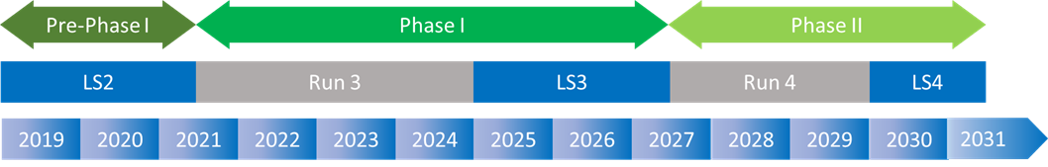
Timeline – primary lines
Urgent items
BSI, BSG, BTV, BLM for TT20, P42 |  | Production | Installation
Fast Spill, Long. BLM |  | R&D | Production | Installation
BSG for LSS2, T2 |  | Production | Installation
Notes:
I’ll present now timeline of the works to be done for the primary lines:
- Urgent items take place during LS2.
- Standard BI equipment (no need for R&D) will be produced gradually during run 3 and installed during LS3.
- R&D items should kick-off this year to be ready for a production before LS3 and installation in LS3.
- The SEM grids for LSS2 and T2 are standard and can be produced during run 4 and installed in LS4. I should remark that the SEM grids for LSS2 have been moved from Phase 1 to Phase 2.

Slide 27
Timeline – secondary lines
- Electronics renovation - Rad-hard profile |  | R&D – prototyping | Production | Install.
XBPF – 15 units |  | Prototyping | Production | Install.
Consolidation XSCI/CEDAR/XCET |  | Production | Install.
XBPF – 50 units |  | Production | Install.
- Heavy ion profile - XCET/CEDAR upgrade |  | R&D | Prod. | Install.
Notes:
I’ll present now the timeline for the secondary lines:
The electronics renovation and the rad-hard profile monitor share a similar timeline: they should begin this year, 2021, in order to do the necessary R&D, begin a production before LS3 and installation in LS3.
The XBPF need some prototyping in Phase to adapt the design to the North Area and study the motorization. The number of XPBF in Phase 1 has been reduced to 15 units in Phase 1, thus making 50 units for Phase 2.
The consolidation items for the XSCI, CEDAR and XCET would take place during run 4, for a deployment in LS4.
Due to the large production of XBPF in Phase 2, a large production phase is expected.
The R&D for the heavy ion profile monitor and the XCET/CEDAR upgrade would be as shown.

Slide 28
Cost breakdown
Item | Total (kCHF) | Consolidation | Upgrade
Phase 1 – Primary lines | 1538 | 1158 | 380
Phase 1 – Secondary lines | 1715 | 1490 | 225
Phase 2 – Primary lines | 420 | - | 420
Phase 2 – Secondary lines | 2735 | 1635 | 1100
Urgent items LS2 | 165 | - | -
Total | 6573
Total primary lines: 1958 kCHF
Total secondary lines: 4450 kCHF
Notes:
Here is the cost breakdown by NA-CONS phase, primary or secondary line and consolidation or upgrade item.
A total per beam line is presented at the bottom.

Slide 29
Spending profile: original proposal vs amendment
Original proposal (v 2.2)
Version 2.3 (reprofiled)
PHASE 1
LS3
PHASE 2
PHASE 1
LS3
PHASE 2
Notes:
Here we can see the spending profile as proposed originally and after the request to reprofile and move items to Phase 2.
We can see a smoother profile in the new version, without the high peak in LS3 of the original version.

Slide 30
Personnel resources
SY-BI has the necessary manpower to undertake NA-CONS.
Personnel resources | 2021 | 2022 | 2023 | 2024 | 2025 | 2026 | 2027 | 2028 | 2029 | 2030
Needed staff [FTE] | 2.2 | 2.8 | 3.1 | 3.7 | 4.1 | 4.9 | 4.2 | 2.8 | 2.5 | 2
Pledged staff [FTE] | 2.2 | 2.8 | 3.1 | 3.7 | 4.1 | 4.9 | 4.2 | 2.8 | 2.5 | 2
Missing staff [FTE] | 0 | 0 | 0 | 0 | 0 | 0 | 0 | 0 | 0 | 0
M2P [kCHF] | 104 | 164 | 140 | 50 | 80 | 130 | 220 | 210 | 80 | 10

Slide 31
Variation in maintenance and operation after consolidation
Cost of maintenance and operation will be lower after consolidation:
Lower failure rate of new equipment.
Less human intervention needed.
Example: beam line modifications in EHN1 done manually at present. XBPF integrated in vacuum and equipped with in/out motorisation → lower need of human intervention → resources savings.

Slide 32
Risk assessment
Radiological risk is addressed by promoting the primary lines in Phase 1.
Gas vessels of the XCET are not conform with safety regulations.
EAR design solves this issue.
Non-readiness risk:
Most consolidation items are standard and carry a low risk: BSG, BTV, BLM and BXBPF.
R&D items show a risk of missing LS3 if they do not start in 2021:
  Longitudinal BLM
  Fast spill monitor
  Radiation-hard profile monitor

Slide 33
Thank you very much for your attention

Slide 34
Spare slides

Slide 35
Urgent items LS2
Monitor / System | Required works | Cost estimate (kCHF)
VME crates EHN1 | VME crates + extender interfaces | 150
Longitudinal spill detector | Refurbish present BTV monitor in TT20 for tests after LS2 | 5
XCET | Replace vacuum pipes + windows | 120
 | Replace obsolete gas control system | 40
 | Replace obsoletes gas panel | 60
CEDAR | Replace obsolete gas control system | 15
XSCI | Replace voltage dividers | 10
SUB TOTAL |  | 400 → 165
Part of ‘Gas WP’ → moved to Phase 2

Slide 36
Phase 1: primary lines consolidation
Monitor / System | Required works | Cost estimate (kCHF)
BSI | Consolidation | 240
BSP | Replace by SEM grids | 240
BTV | Consolidation | 180
BLM | Detectors | 60
 | Electronics | 80
 | Cabling / installation | 110
Cabling | Cabling in TDC2/TTC2 included above
FSU | Mechanics, Electronics, Installation | 160
Student | BSI & BTV | 88
SUB TOTAL |  | 1158

Slide 37
Phase 1: primary lines upgrade
Monitor / System | Required works | Cost estimate (kCHF)
Fast Spill Detector | Produce a new system (OTR or Cherenkov) | 100
Longitudinal BLM LSS2 | Produce new longitudinal BLM | 100
LSS2 SEM Upgrade | Produce 6 new dual plane SEM grid | 360
P42 SEM Upgrade | Produce 3 new dual plane SEM grid for P42 | 180
Fellow | Fast Spill Detector | 300
Student | Longitudinal BLM | 150
SUB TOTAL |  | 1190 → 380
Moved to Phase 2
Covered by PBC
R&D started last year in SY-BI

Slide 38
Phase 1: secondary lines consolidation
Monitor / System | Required works | Cost estimate (kCHF)
Electronics renovation | Produce new readout boards | 675
XBPF for M2, K12 and partly EHN1 | Produce 15 XBPF. FISC vacuum tanks are reused when possible. | 410
 | Prototyping and production of 5 new vacuum tanks | 150
 | Prototyping and production of motorisation | 150
FSU | XBPF (1MY) & electronics production (0.5MY) | 120
Fellow | XBPF design modifications & radiation-hard profile monitor | 300
SUB TOTAL |  | 1805 → 1490
Number of units reduced to 15 in Phase 1

Slide 39
Phase 1: secondary lines upgrade
Monitor / System | Required works | Cost estimate (kCHF)
Rad-hard profile monitor | R&D and production of 5 rad-hard profile monitors. Vacuum tanks and motorisation included. | 200
Fellow | R&D on heavy ion monitor. | 120
SUB TOTAL |  | 320 → 225
Fellow originally shared between Phase 1 and Phase 2 → moved to Phase 2

Slide 40
Phase 2: primary lines upgrade
Monitor / System | Required works | Cost estimate (kCHF)
T2 ion splitter | Produce 1 dual plane SEM grid | 60
LSS2 SEM Upgrade | Produce 6 new dual plane SEM grid | 360
SUB TOTAL |  | 420

Slide 41
Phase 2: secondary lines consolidation
Monitor / System | Required works | Cost estimate (kCHF)
XSCI | Produce new units | 40
CEDAR | Repair thermal housing | 240
XCET | Repair mirror system | 80
 | Produce mechanical parts following EAR design (tubes and windows) | 120
XBPF for EHN1 | Produce 50 XBPF. FISC vacuum tanks are reused when possible. | 625
 | Produce 20 vacuum tanks | 225
 | Motorisation | 185
FSU | XBPF (1MY) & electronics production (0.5MY) | 120
SUB TOTAL |  | 1635

Slide 42
Phase 2: secondary lines upgrade
Monitor / System | Required works | Cost estimate (kCHF)
Heavy ion profile monitor based on XBPF | R&D and production of 15 heavy ion profile monitors. | 200
CEDAR | Upgrade of read-out for higher intensities | 300
XCET | Upgrade of read-out for higher intensities | 200
Fellow | R&D on heavy ion profile monitor and other upgrades | 300
Student | XCET & XCED high-intensity read-out | 100
SUB TOTAL |  | 1100

Slide 43
Implementation of primary lines consolidation
Resources request | 2021 | 2022 | 2023 | 2024 | 2025 | 2026 | 2027 | 2028 | 2029 | 2030 | SUM
BSI/BSP [kCHF] | 10 | 50 | 100 | 130 | 130 | 60 |  |  |  |  | 480
BTV [kCHF] |  |  | 60 | 60 | 40 | 20 |  |  |  |  | 180
BLM [kCHF] |  | 40 | 50 | 50 | 50 | 60 |  |  |  |  | 250
FSU Mech. & install. [FTE·Yrs] |  |  |  | 30 | 50 | 80 |  |  |  |  | 160
Student BSI / BTV [FTE·Yrs] | 44 | 44 |  |  |  |  |  |  |  |  | 88
 |  |  |  |  |  |  |  | TOTAL |  |  | 1158

Slide 44
Implementation of primary lines upgrade
Resources request | 2021 | 2022 | 2023 | 2024 | 2025 | 2026 | 2027 | 2028 | 2029 | 2030 | SUM
Fast Spill [kCHF] |  | 10 | 20 | 30 | 20 | 20 |  |  |  |  | 100
LSS2 Long. BLM [kCHF] | 10 | 20 | 20 | 30 | 20 |  |  |  |  |  | 100
P42 SEM Upgrade |  |  | 40 | 40 | 60 | 40 |  |  |  |  | 180
 |  |  |  |  |  |  |  | TOTAL |  |  | 380
Resources request | 2021 | 2022 | 2023 | 2024 | 2025 | 2026 | 2027 | 2028 | 2029 | 2030 | SUM
T2 ion splitter [kCHF] |  |  |  |  |  |  | 60 |  |  |  | 60
LSS2 SEM Upgrade [kCHF] |  |  |  |  |  |  | 80 | 100 | 120 | 60 | 360
 |  |  |  |  |  |  |  | TOTAL |  |  | 420

Slide 45
Implementation of secondary lines consolidation
Resources request | 2021 | 2022 | 2023 | 2024 | 2025 | 2026 | 2027 | 2028 | 2029 | 2030 | SUM
Cons of NA readout boards [kCHF] | 20 | 50 | 50 | 150 | 255 | 150 |  |  |  |  | 675
XBPF monitors for M2, K12, & partly EHN1 [kCHF] | 10 | 30 | 60 | 100 | 100 | 95 |  |  |  |  | 395
FSU XBPF & boards prod. [FTE·Yrs] |  |  | 20 | 20 | 30 | 50 |  |  |  |  | 120
Fellow XBPF design & test [FTE·Yrs] | 60 | 120 | 120 |  |  |  |  |  |  |  | 300
 |  |  |  |  |  |  |  | TOTAL |  |  | 1490
Resources request | 2021 | 2022 | 2023 | 2024 | 2025 | 2026 | 2027 | 2028 | 2029 | 2030 | SUM
XSCI [kCHF] |  |  |  |  |  |  |  |  | 20 | 20 | 40
CEDAR / XCET |  |  |  |  |  |  | 40 | 120 | 160 | 120 | 440
XBPF for EHN1 |  |  |  |  |  |  | 300 | 360 | 200 | 175 | 1035
FSU XBPF & boards prod. [FTE·Yrs] |  |  |  |  |  |  | 50 | 40 | 20 | 10 | 120
 |  |  |  |  |  |  |  | TOTAL |  |  | 1635

Slide 46
Implementation of secondary lines upgrade
Resources request | 2021 | 2022 | 2023 | 2024 | 2025 | 2026 | 2027 | 2028 | 2029 | 2030 | SUM
Heavy ion profile monitor |  |  |  |  |  |  | 10 | 30 | 80 | 80 | 200
CEDAR / XCET readout upgrade for higher int. |  |  |  |  |  |  | 50 | 130 | 180 | 140 | 500
Fellow for heavy ion profile monitor & XCET upgrade |  |  |  |  |  |  | 120 | 120 | 60 |  | 300
Student for CEDAR / XCET readout |  |  |  |  |  |  | 50 | 50 |  |  | 100
 |  |  |  |  |  |  |  | TOTAL |  |  | 1100

