Slide 1
TCLPX - TCTPXH prototypes labelling on parts
François-Xavier Nuiry – Regis Seidenbinder – Dylan Baillard
11-03-2022 : 1st version

Slide 2
TCTPXH

Slide 3
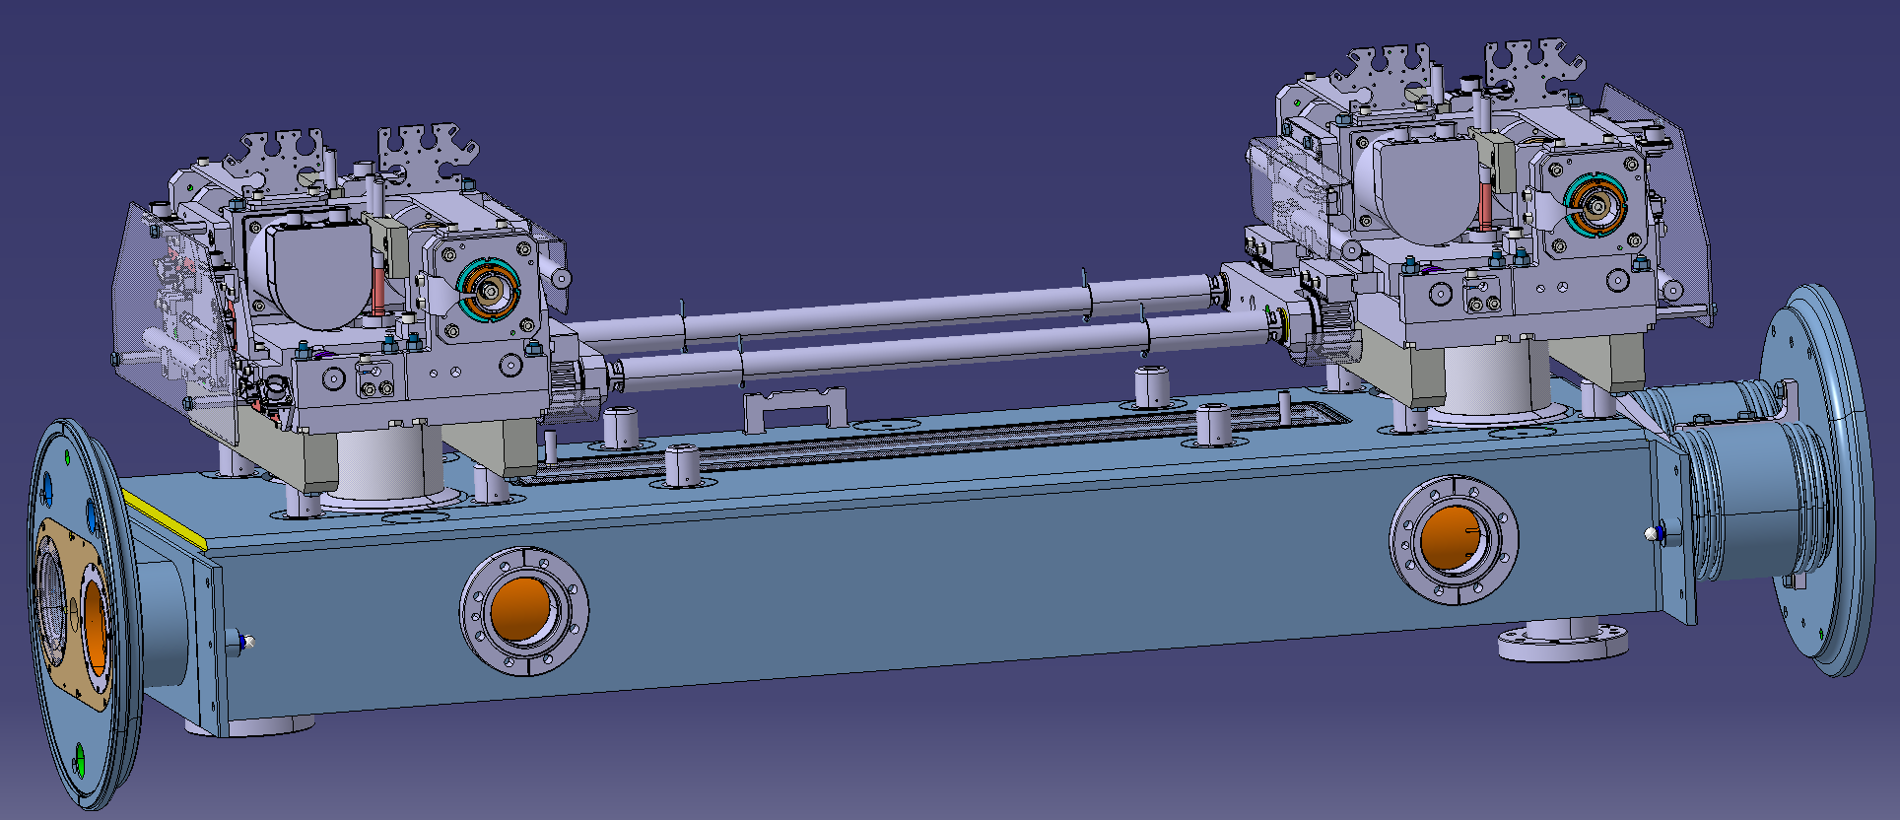
Label on final TCTPXH assembly
1 asset number:
→Manual engraving of the complete assembly name: HCTCTPXH__001-CR000001

Slide 4
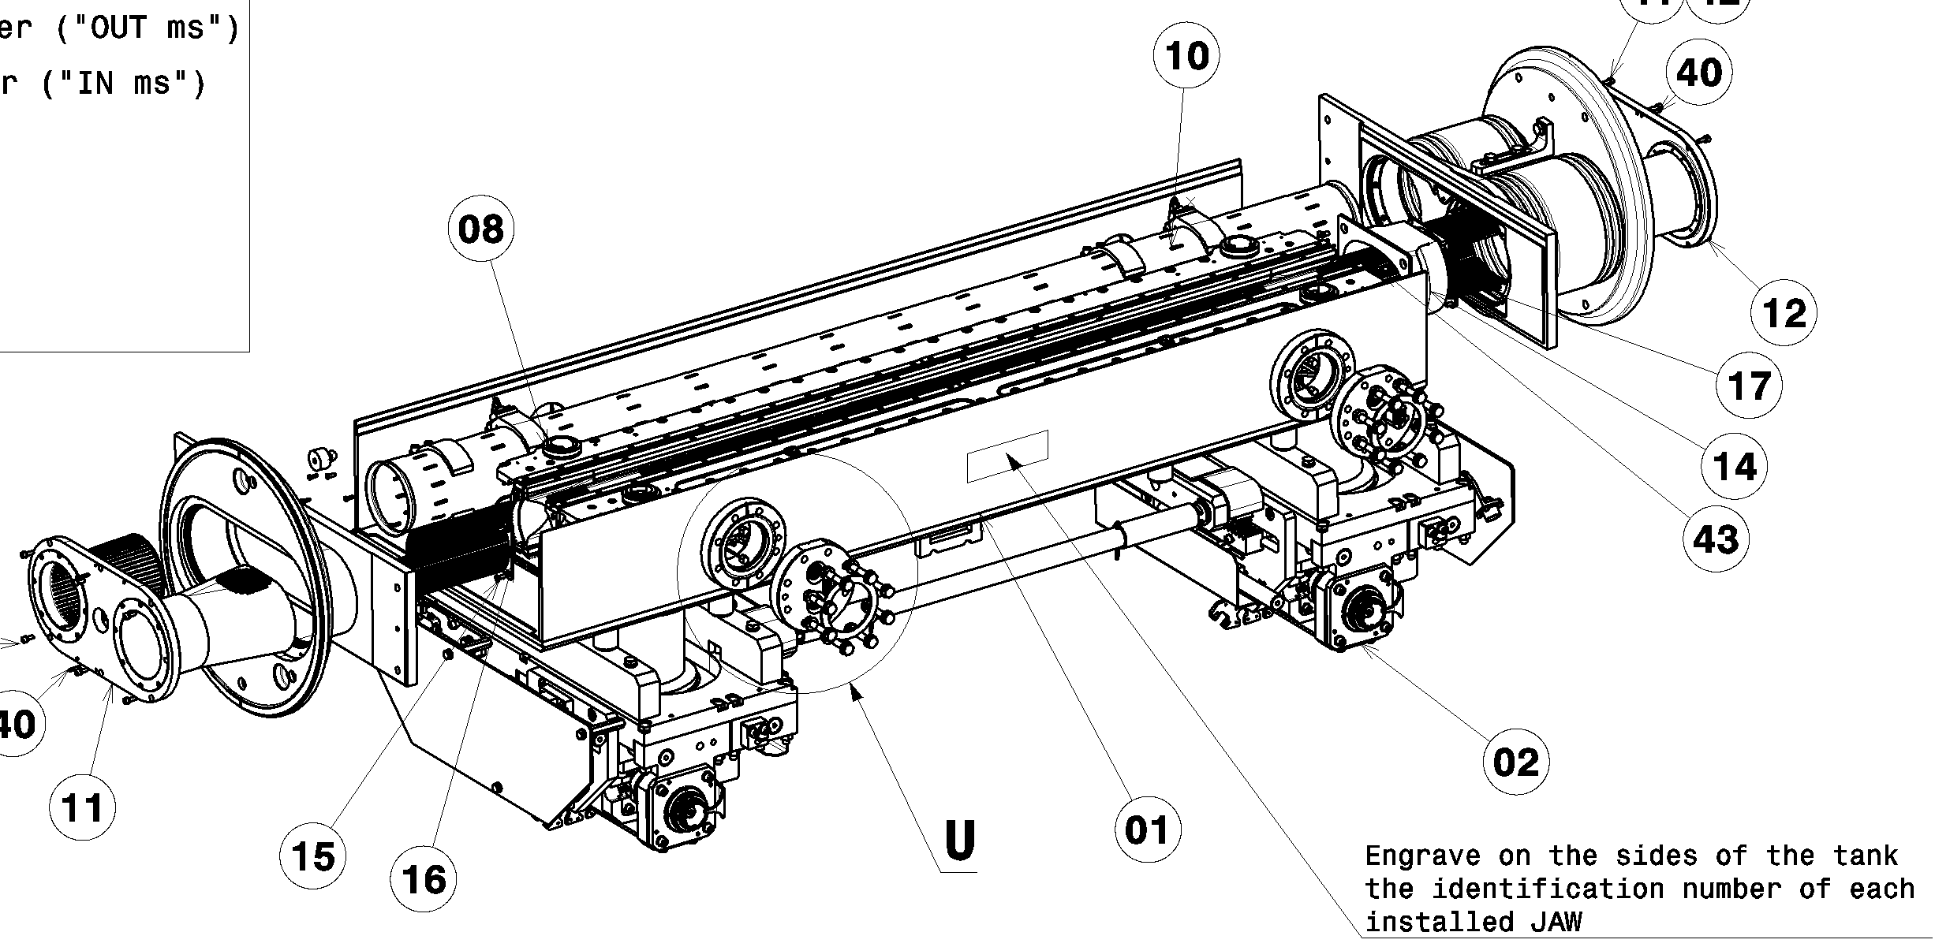
Additional labels on TCTPXH tank: recall of jaws identifications on tank
HCTCTPXH__005-CR000001
HCTCTPXH__004-CR000001

Slide 5
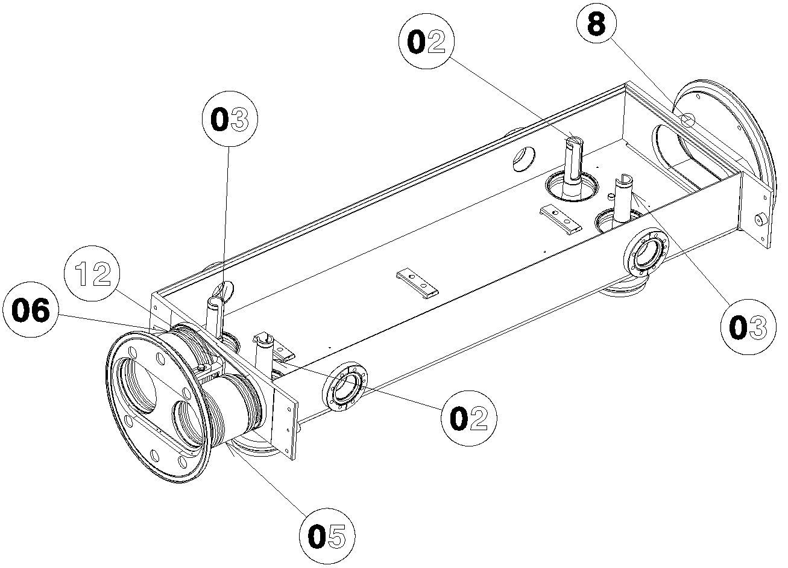
Label on TCTPXH tank
Vacuum tank: 1 asset number:
→ Engraved on the tank: HCTCTPXH__002-CR000001

Slide 6
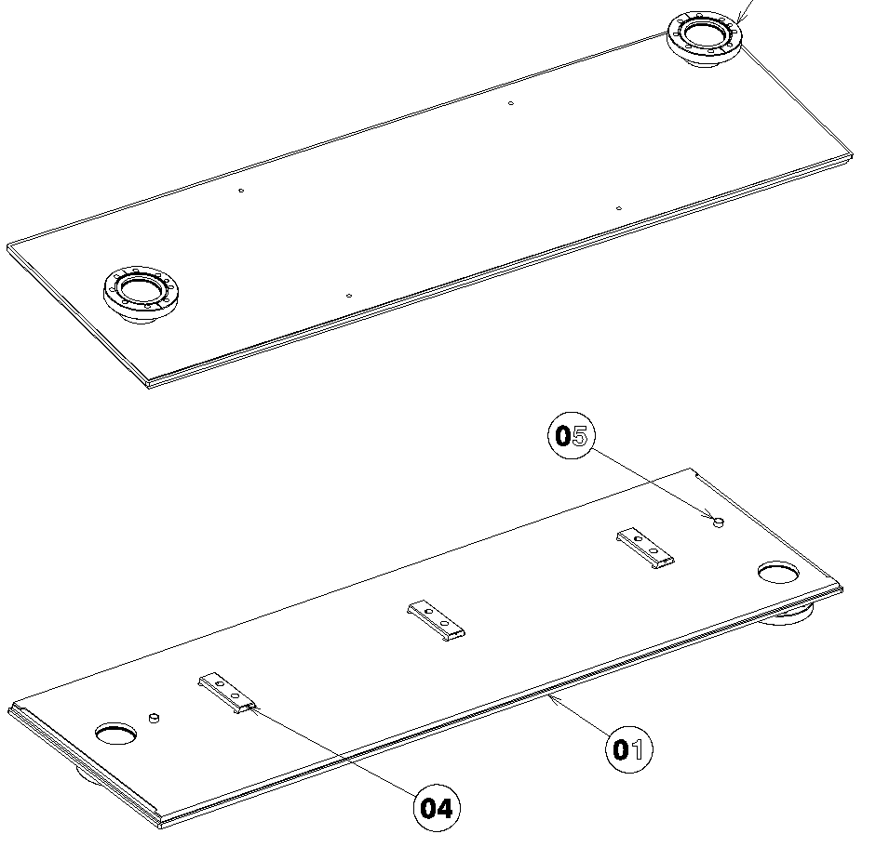
Label on TCTPXH tank cover
HCTCTPXH__047-CR000001

Slide 7
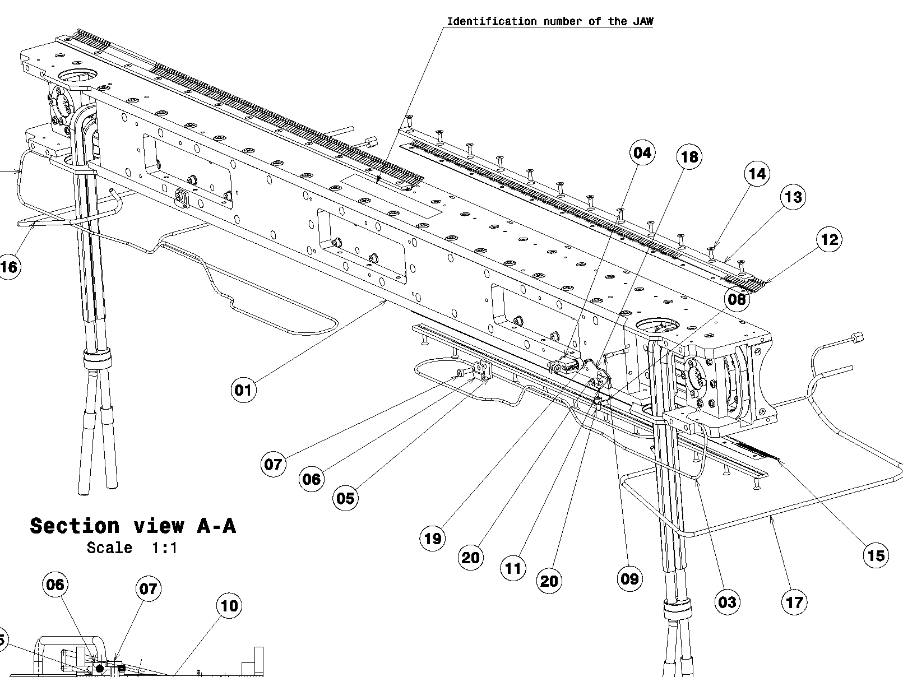
Label on TCTPXH right jaw
HCTCTPXH__004-CR000001

Slide 8
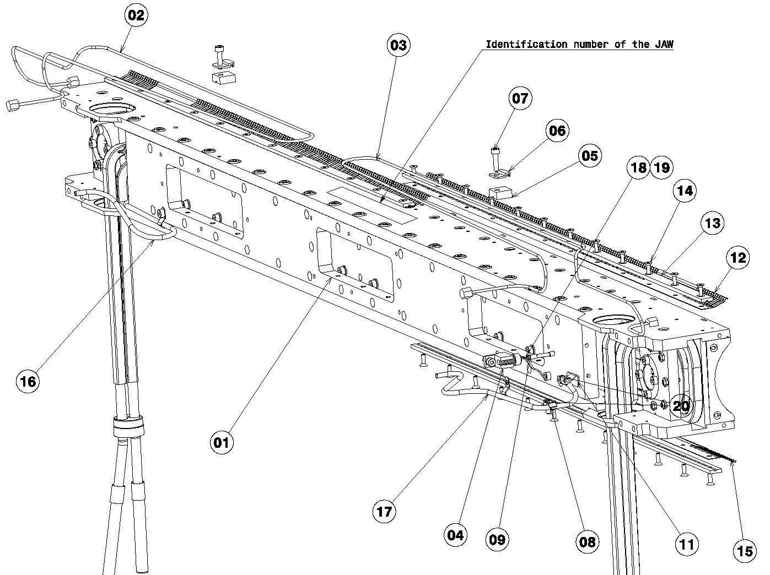
Label on TCTPXH left jaw
HCTCTPXH__005-CR000001

Slide 9
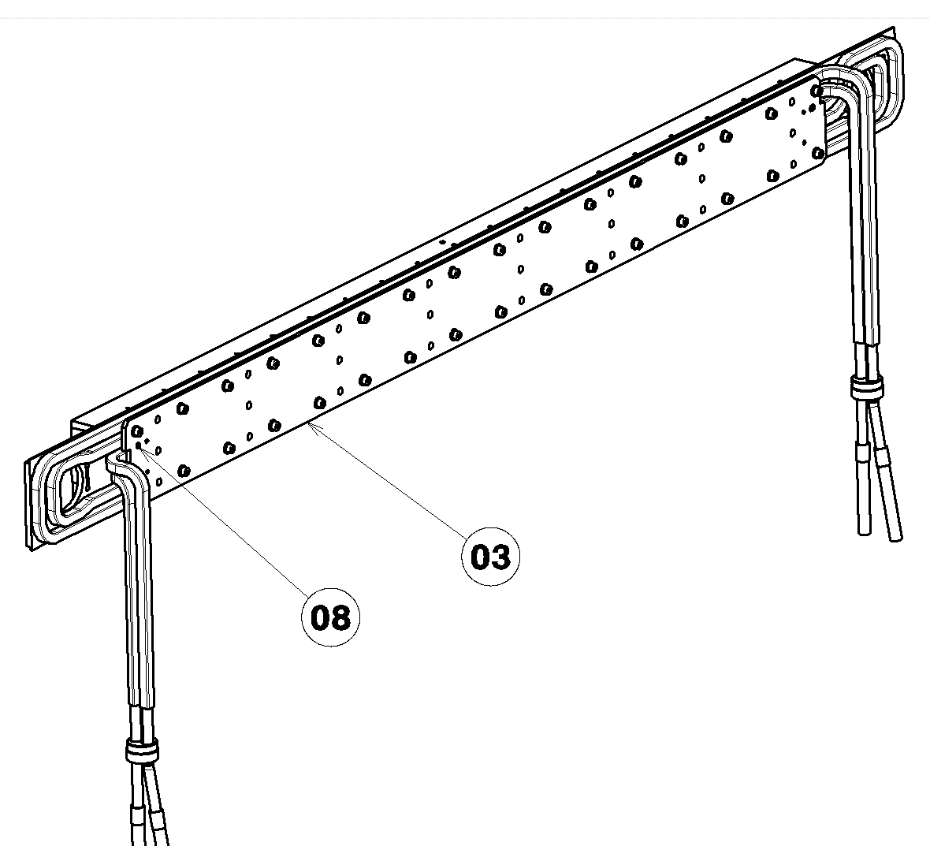
Label on TCTPXH jaw block assembly
HCTCTPXH__020-CR000001 or 2

Slide 10
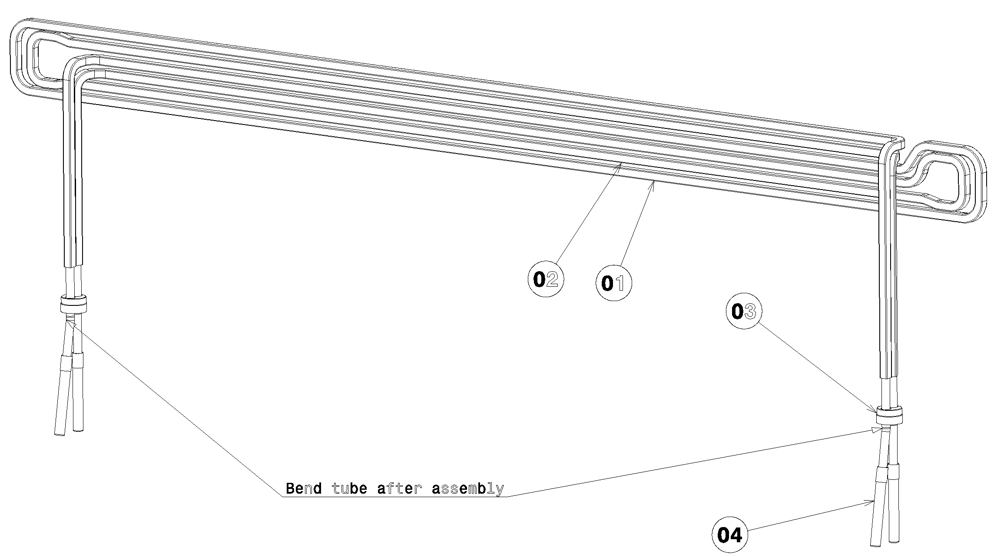
Label on TCTPXH jaw brazed cooling circuit
HCTCTPXH__023-CR00000X

Slide 11
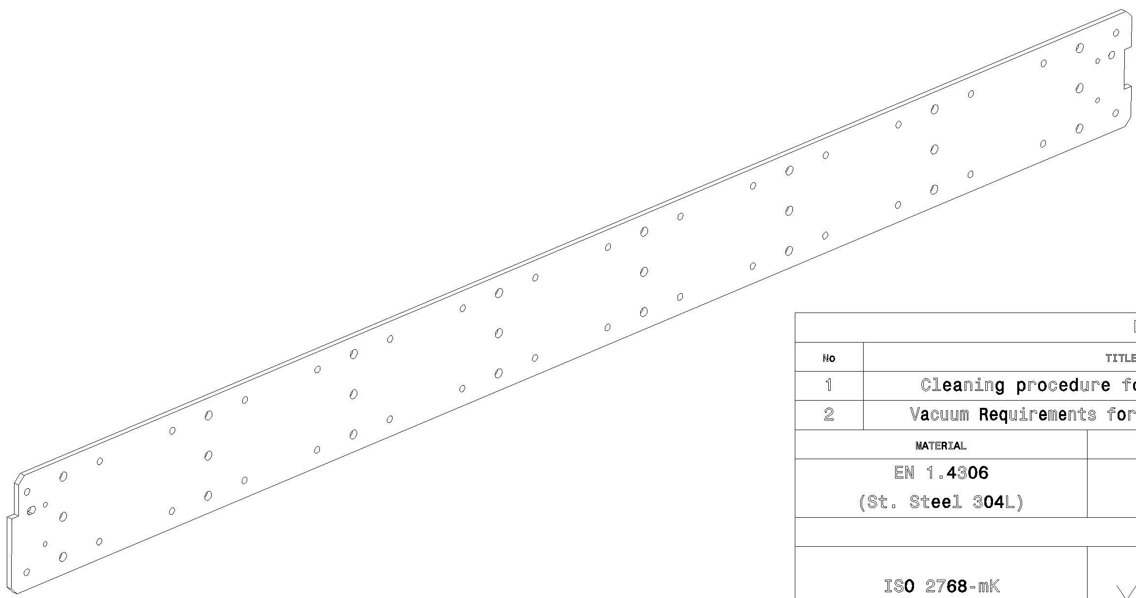
Label on TCTPXH jaw block’s back plate
HCTCTPXH__068-CR00000X

Slide 12
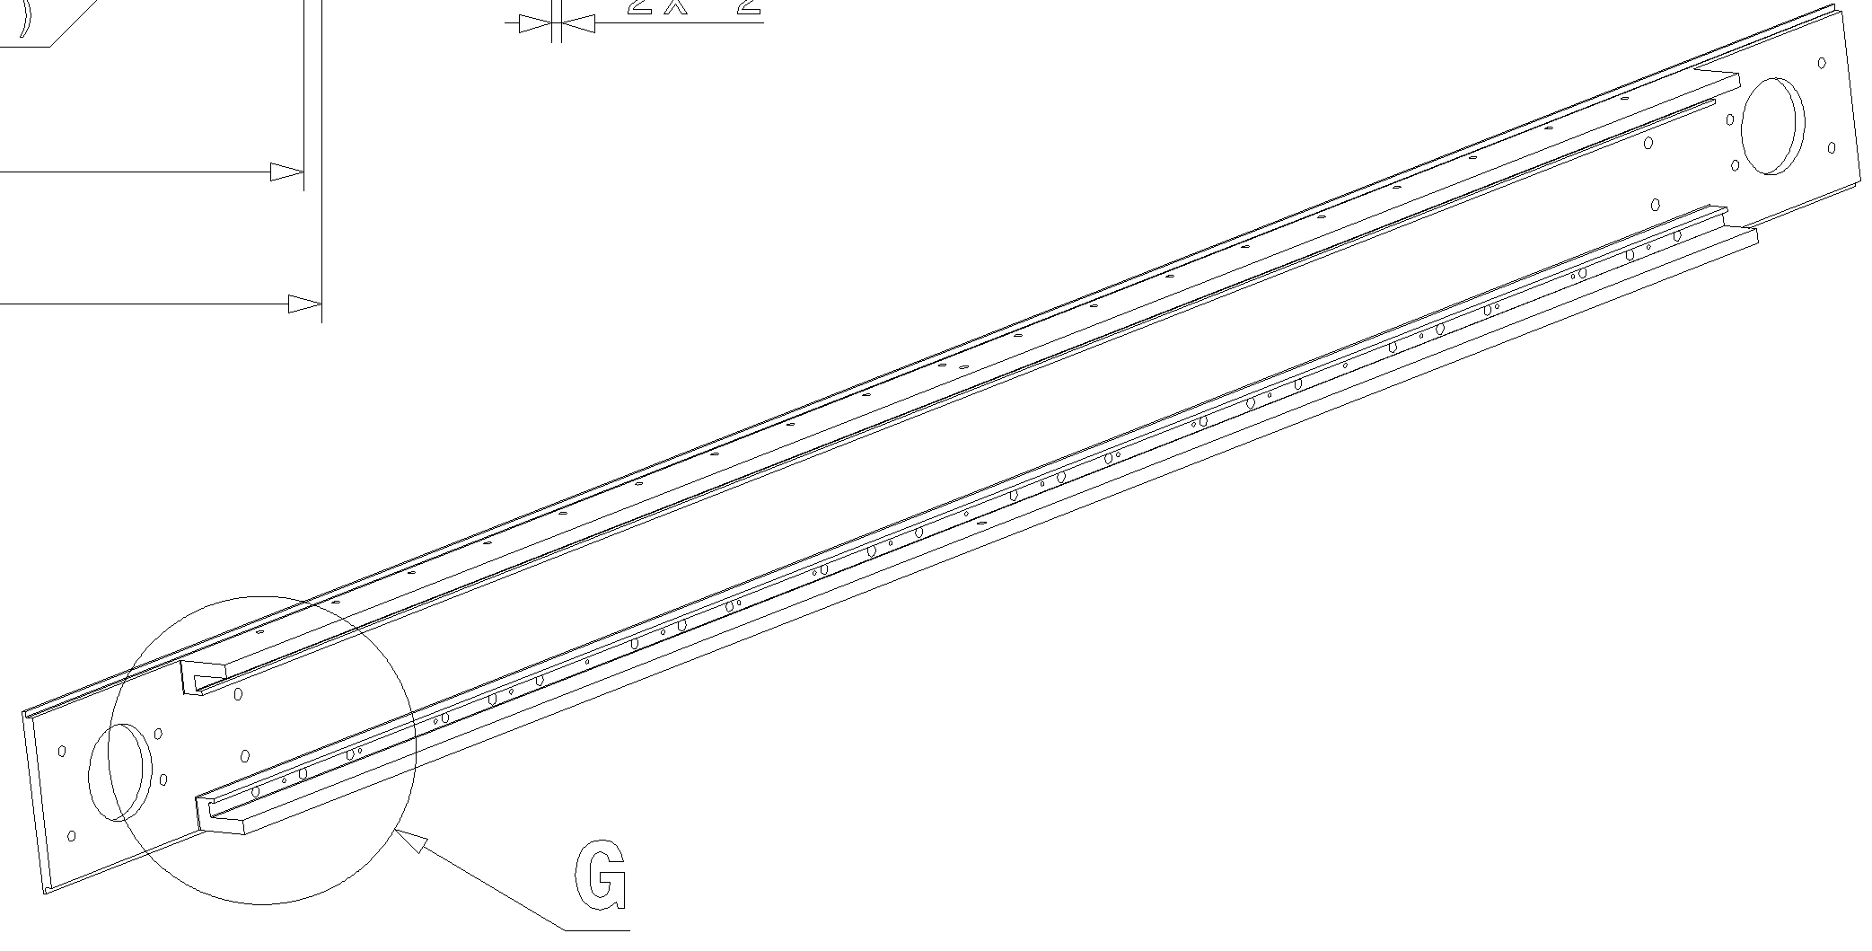
Label on TCTPXH jaw housing
HCTCTPXH__024-CR00000X

Slide 13
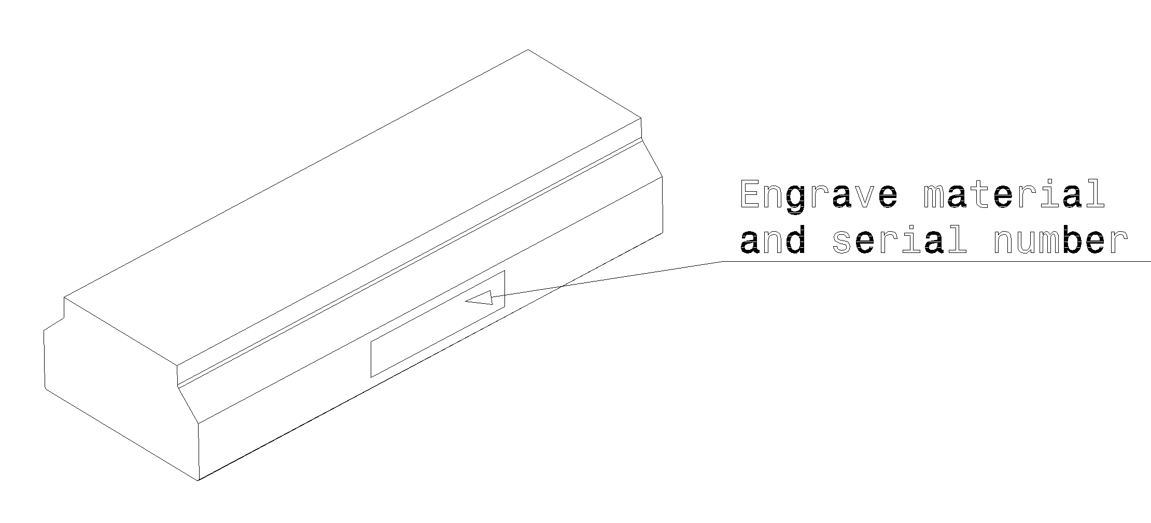
CuCD block
HCTCTPM__001-NR0000XX
(now only S1, S2, final strategy to be discussed)

Slide 14
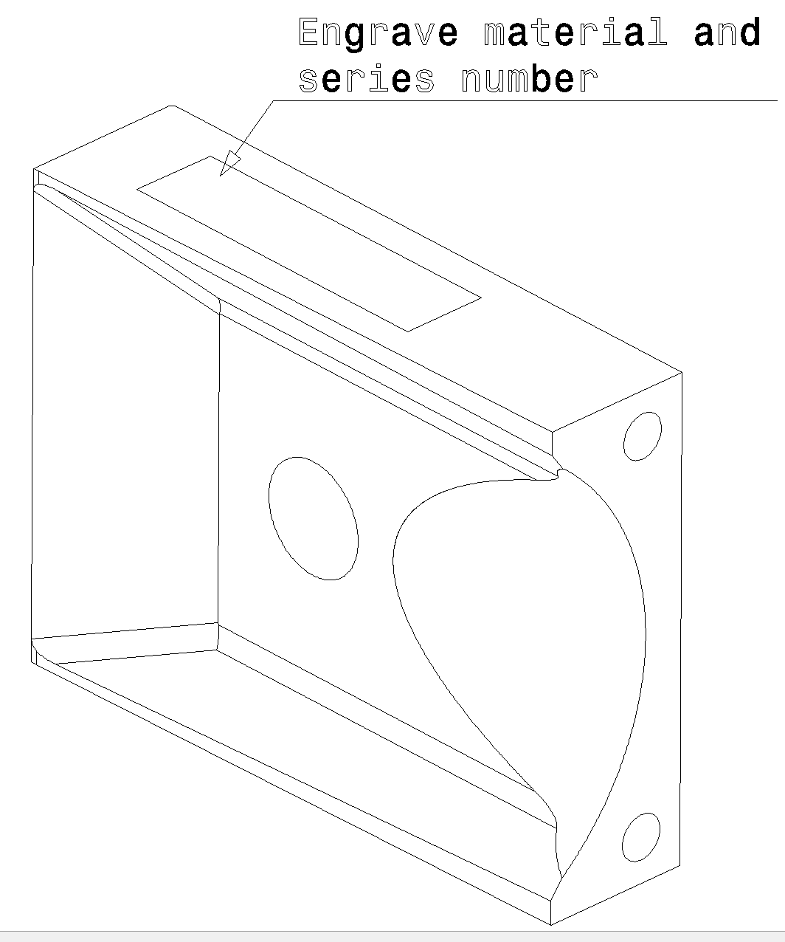
MoGr tapering
HCTCTPXH022-NR00000X

Slide 15
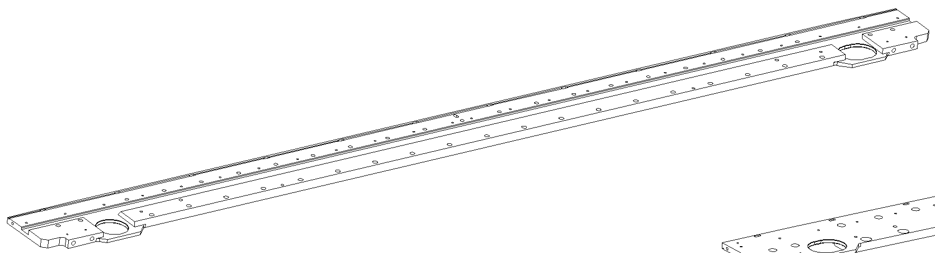
Label on TCTPXH jaw back stiffener plate 1
HCTCTPXH__027-CR00000X

Slide 16
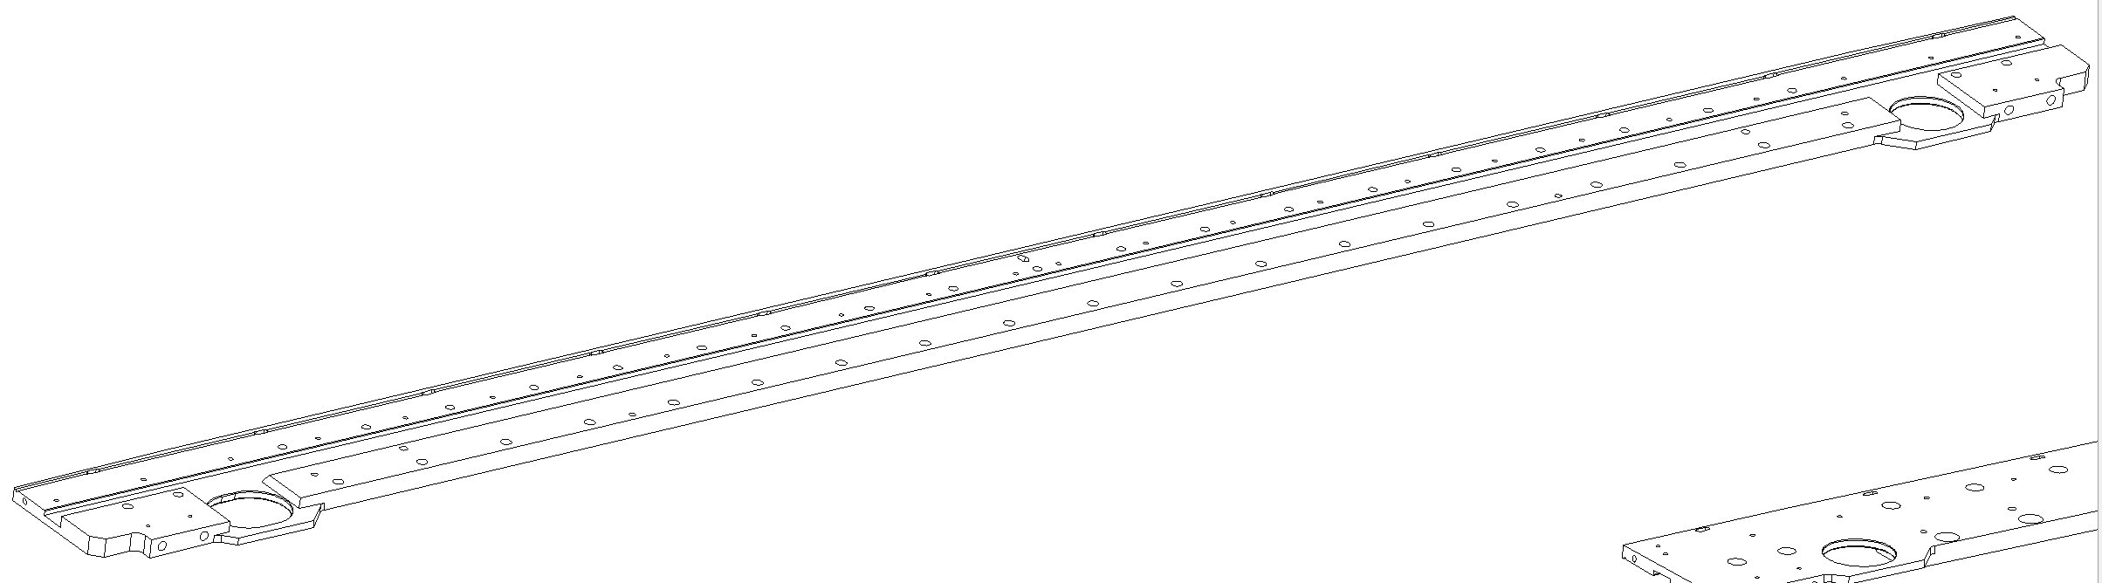
Label on TCTPXH jaw back stiffener plate 2
HCTCTPXH__028-CR00000X

Slide 17
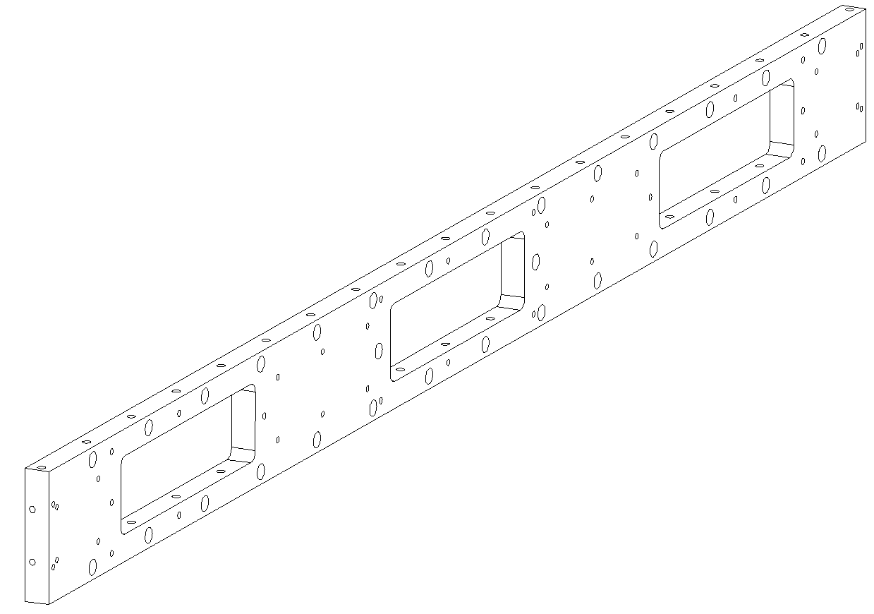
Label on TCTPXH jaw back stiffener
HCTCTPXH__073-CR00000X
On the back face

Slide 18
TCLPX

Slide 19
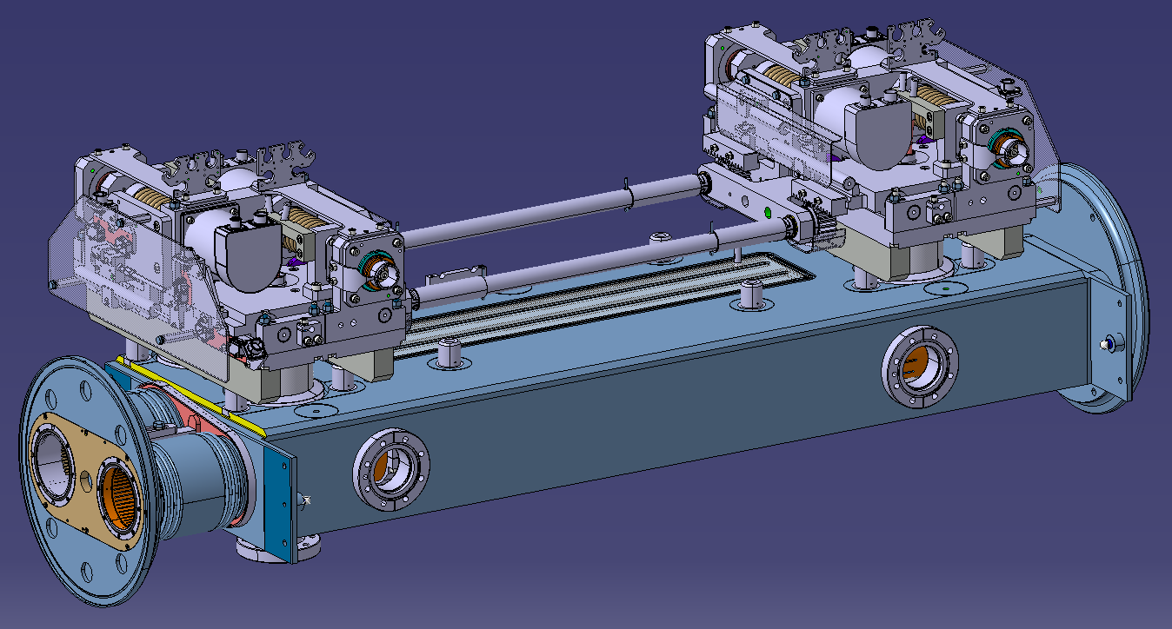
Label on final TCLPX assembly
→Manual engraving of the complete assembly name: HCTCLPX__001-CR000001

Slide 20
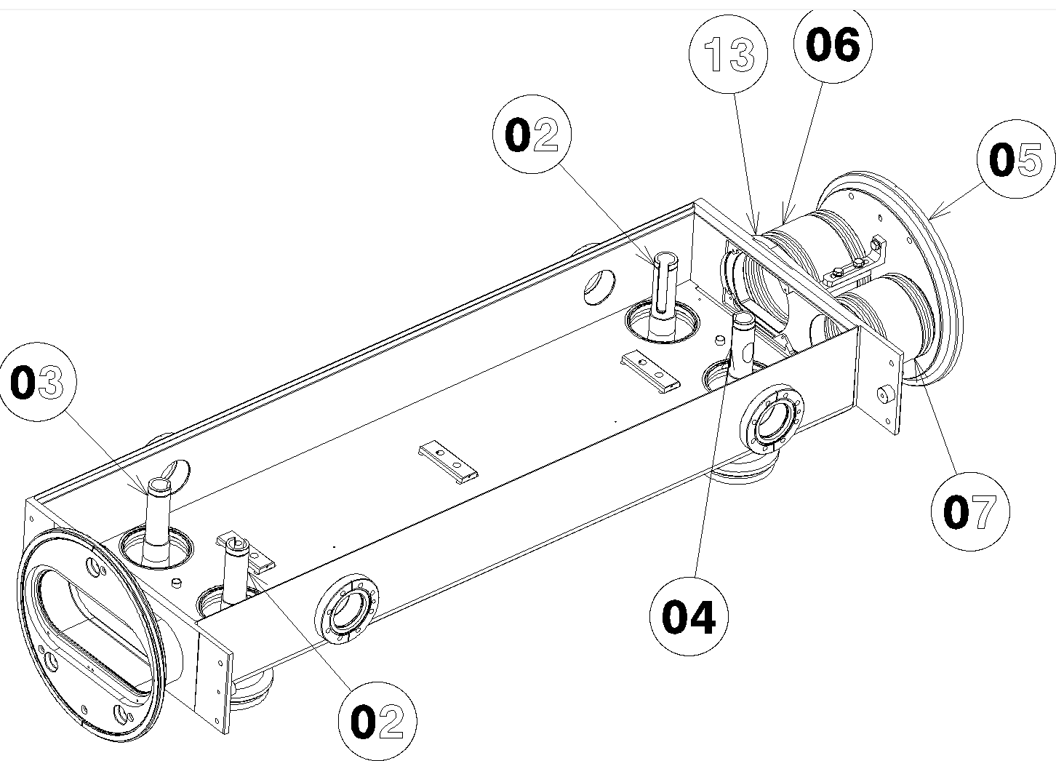
Label on TCLPX tank
Vacuum tank: 1 asset number:
→ Engraved on the tank: HCTCLPX__002-CR000001

Slide 21
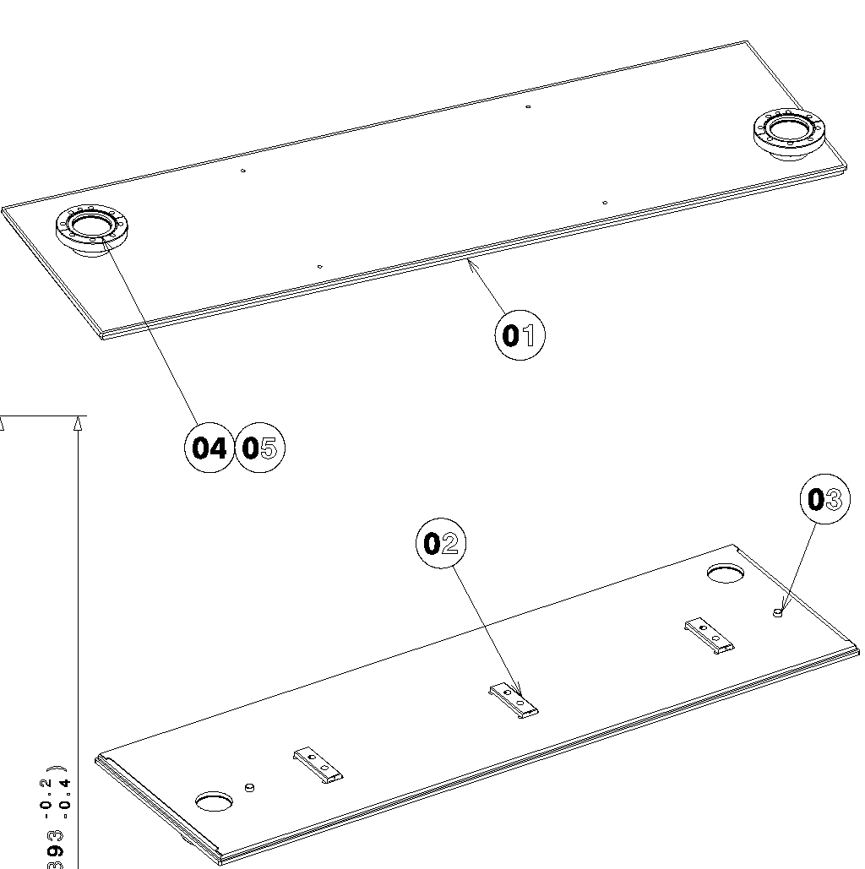
Label on TCLPX tank cover
HCTCLPX__008-CR000001

Slide 22
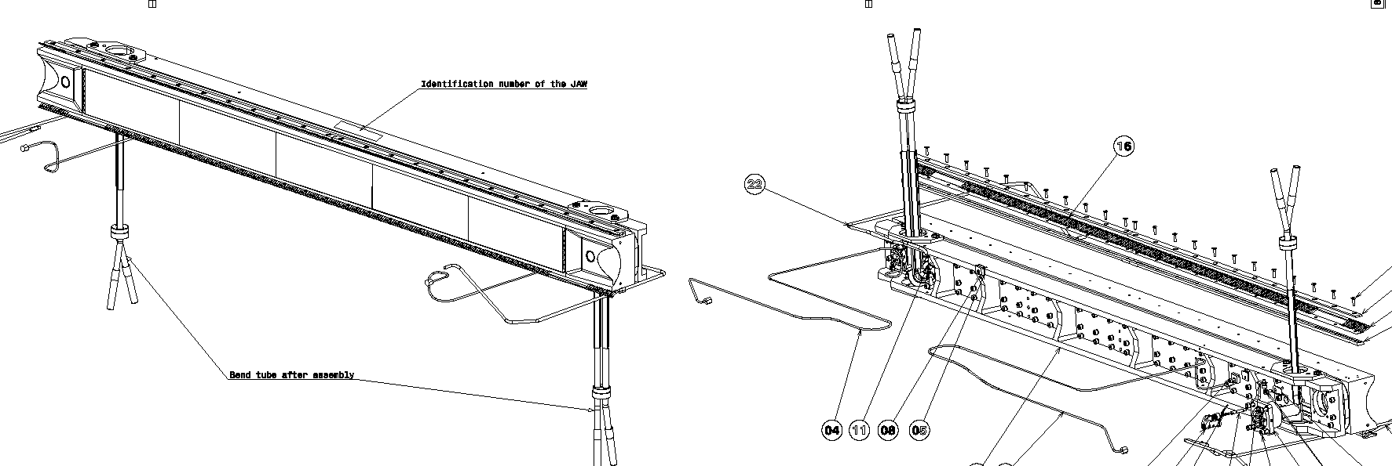
Label on TCLPX right jaw
HCTCLPX__004-CR000001

Slide 23
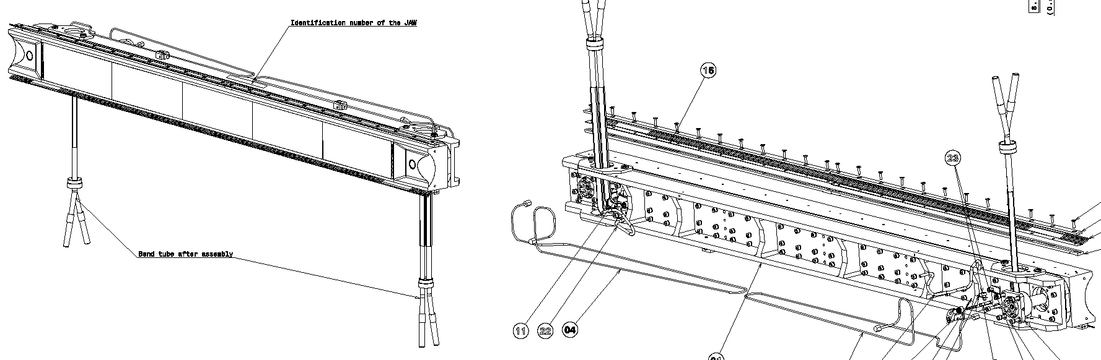
Label on TCLPX left jaw
HCTCLPX__005-CR000001

Slide 24
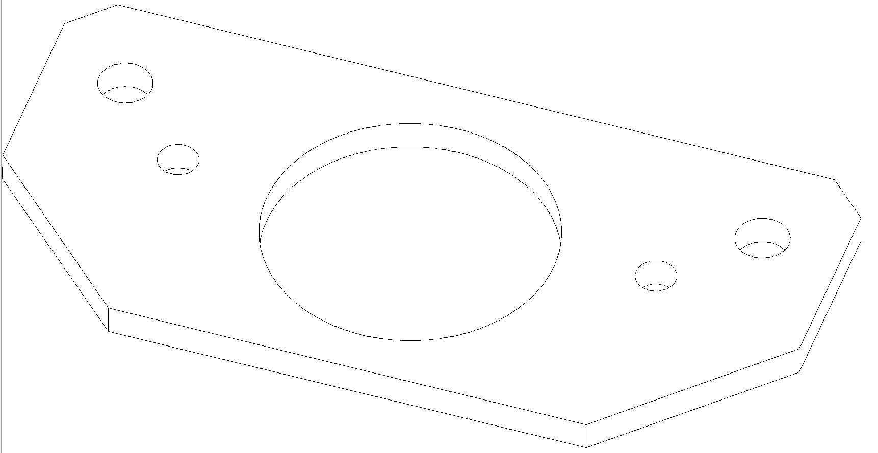
TCLPX Fix guiding plates
HCTCLPX__026-CR00000X

Slide 25
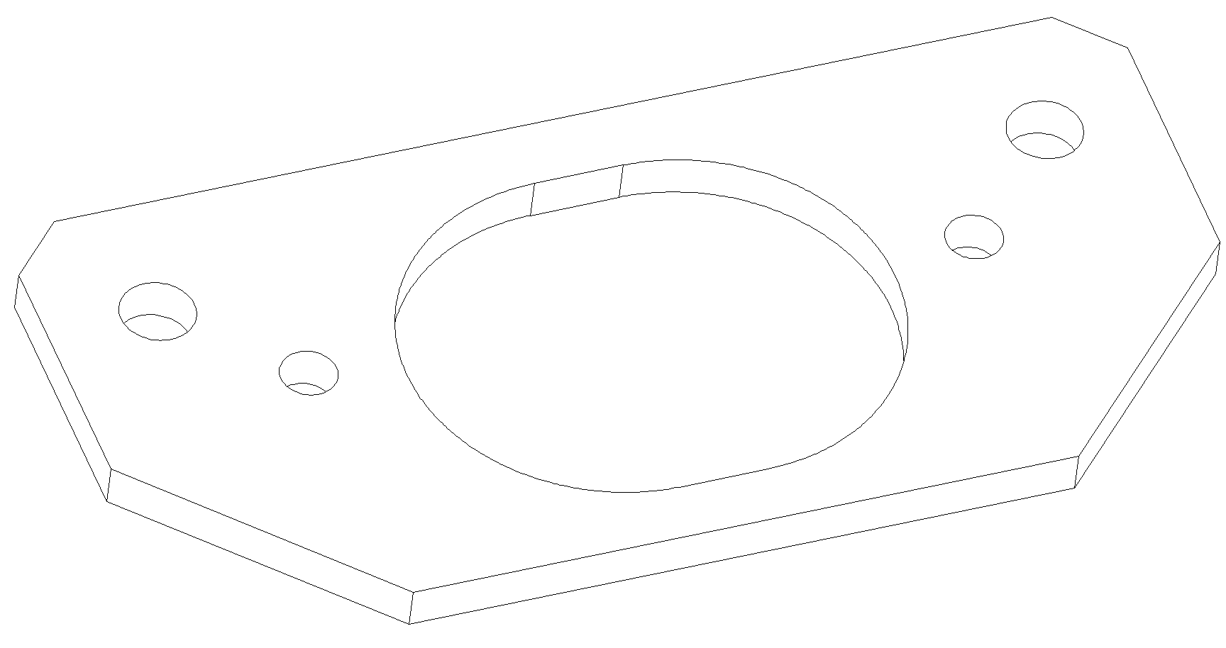
TCLPX guiding plates
HCTCLPX__027-CR00000X

Slide 26
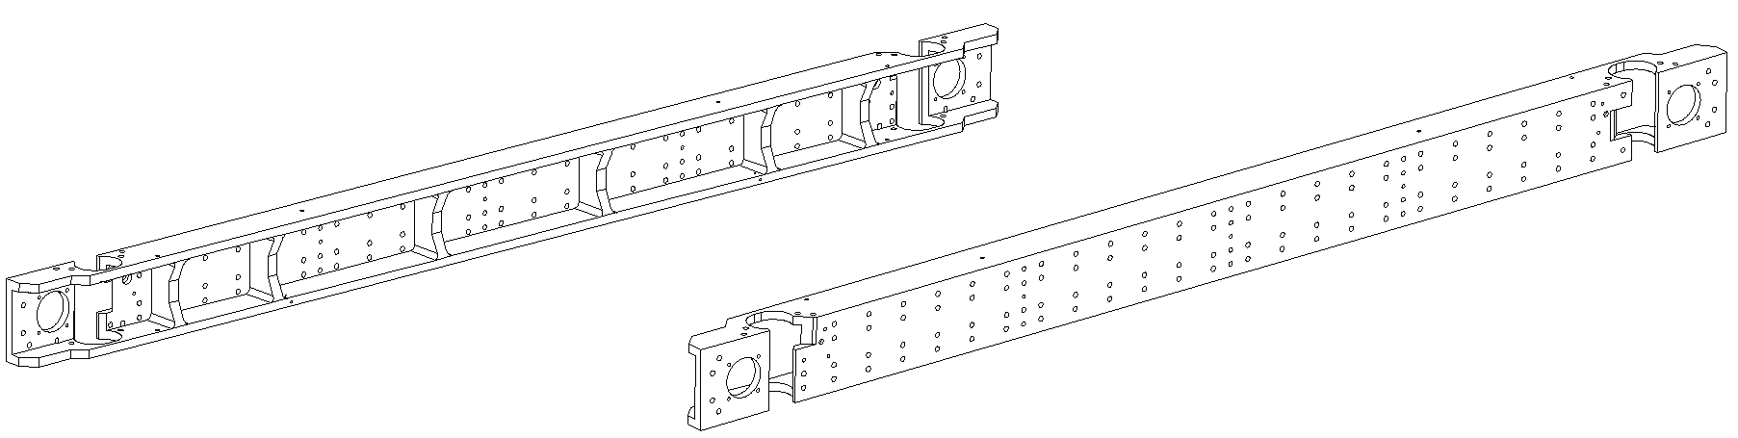
Label on TCLPX jaw back stiffener
HCTCLPX__020-CR00000X

Slide 27
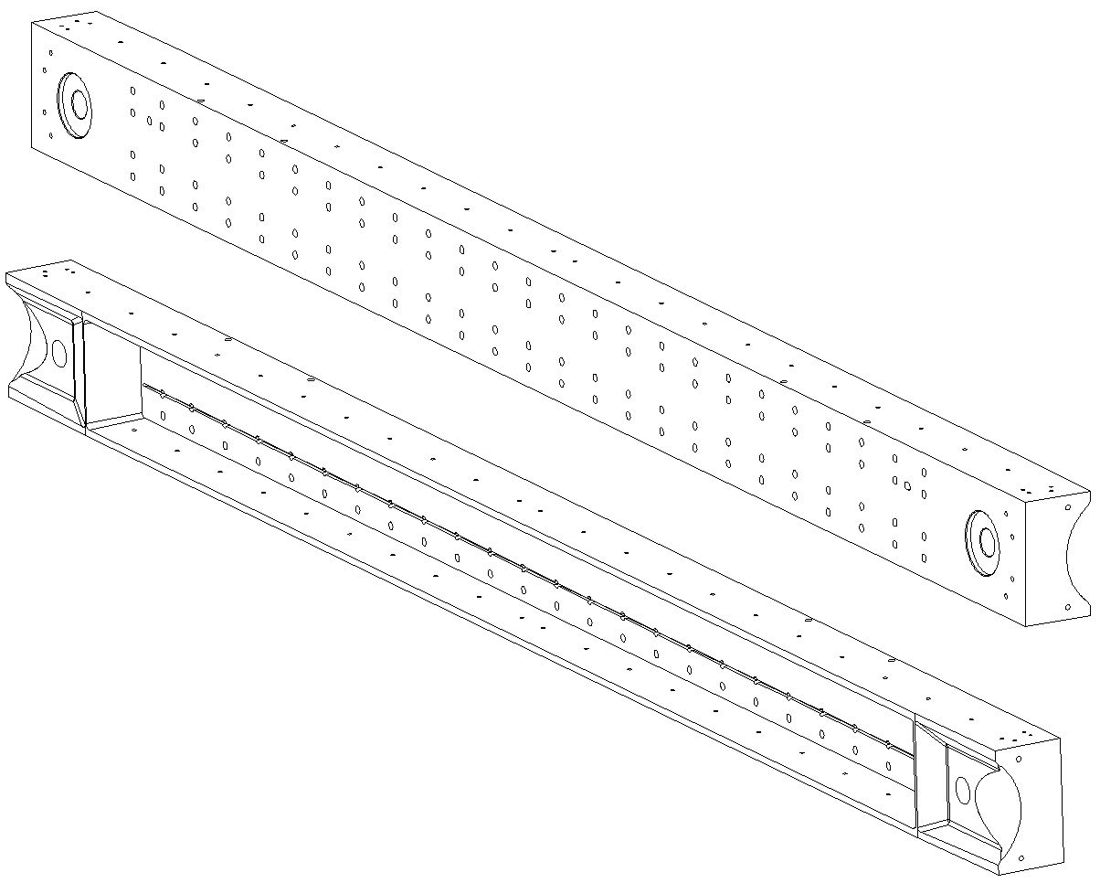
Label on TCLPX jaw housing
HCTCLPX__021-CR00000X

Slide 28
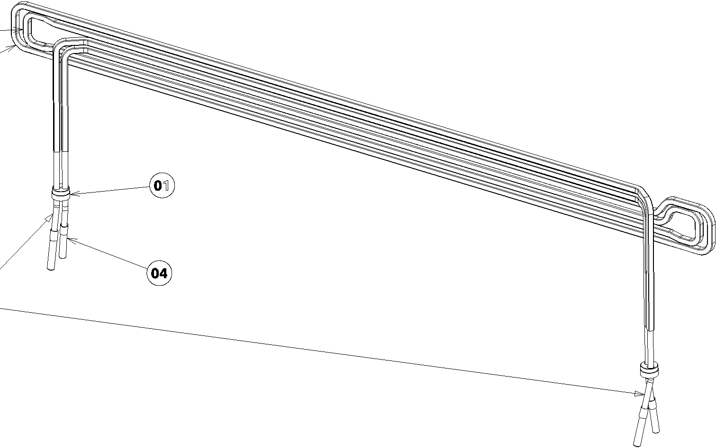
Label on TCLPX jaw cooling circuit
HCTCLPX__022-CR00000X

Slide 29
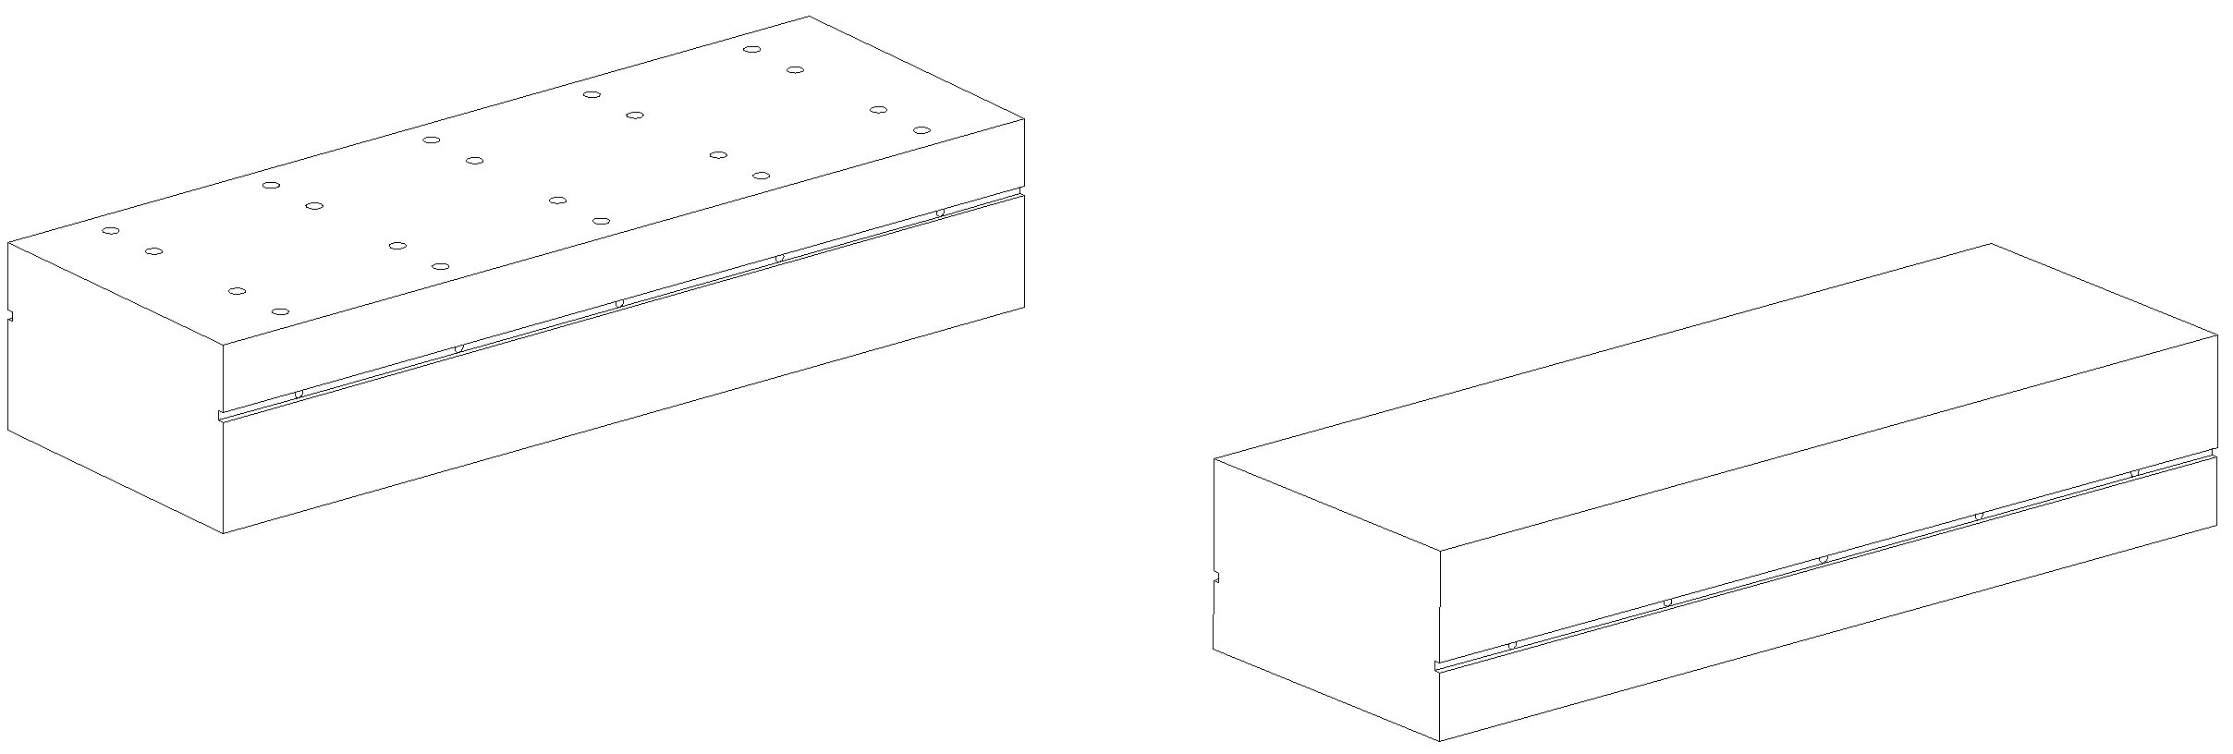
TCLPX Inermet central block
HCTCLPX__018-1P00000X → Label on packing?

Slide 30
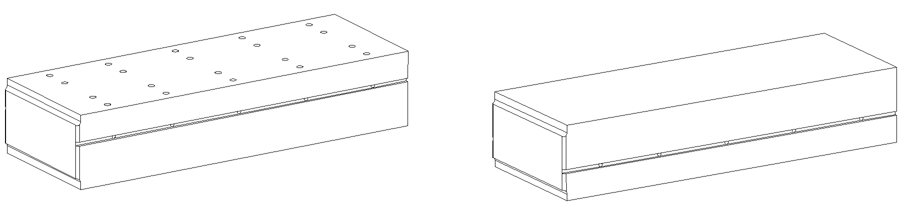
TCLPX Inermet extremity block
HCTCLPX__017-1P00000X → Label on packing?

Slide 31
Tables

Slide 32
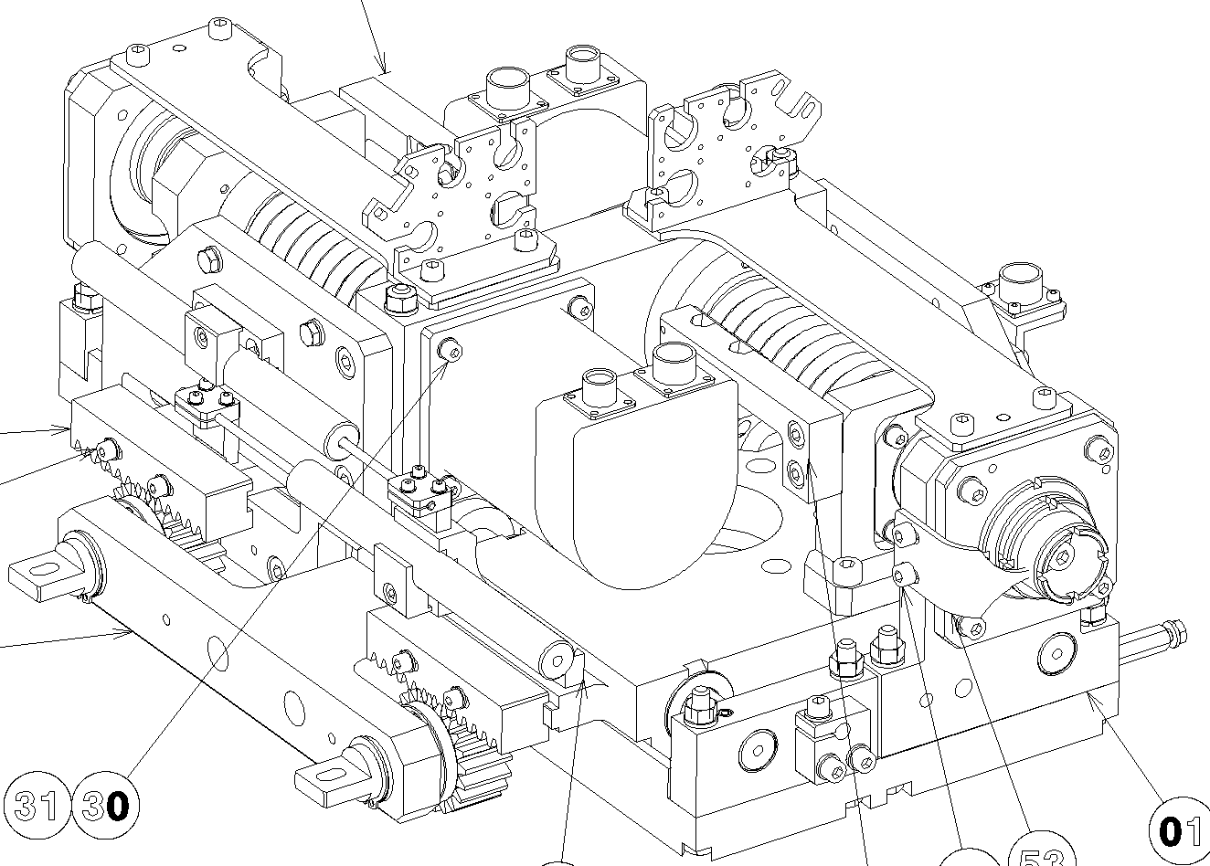
Labels on HCTCTPXH__003-CR00000X & HCTCLPX__003-CR00000X
3 asset numbers:
→One engraving for the complete assembly: HCTCTPXH__003-CR00000X or HCTCLPX__003-CR00000X;
→Two for screws (one for each), given by stickers: HCTCLPX__163-RV00000X
Engrave
Sticker
Sticker

Slide 33
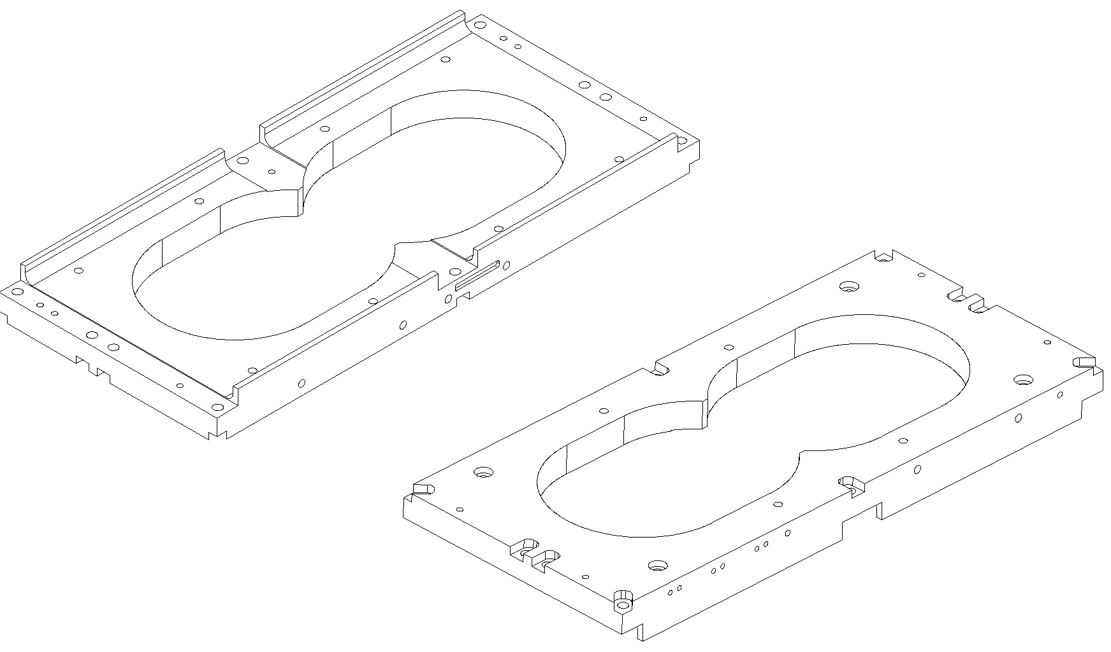
Labels on tables sub assemblies
HCTCLPX__121-CR00000X

Slide 34
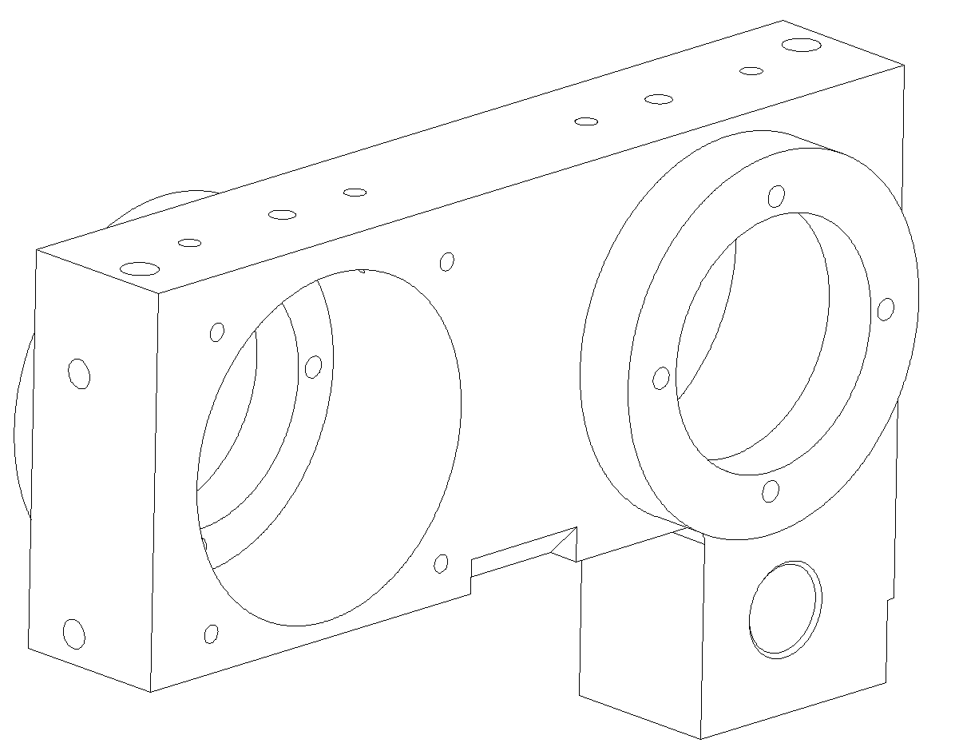
Labels on tables sub assemblies
HCTCLPX__122-CR00000X

Slide 35
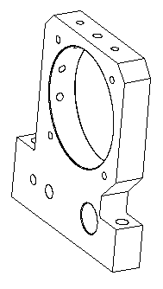
Labels on tables sub assemblies
HCTCLPX__123-CR00000X

Slide 36
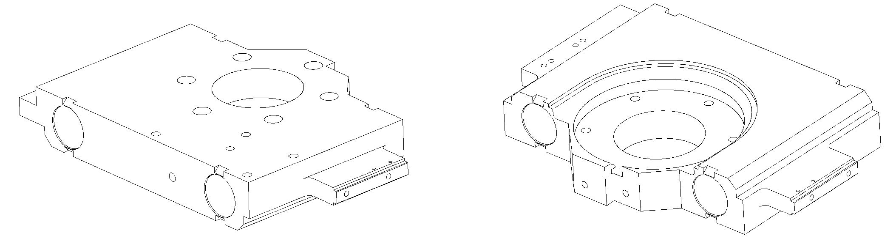
Labels on tables sub assemblies
HCTCLPX__124-CR00000X

Slide 37
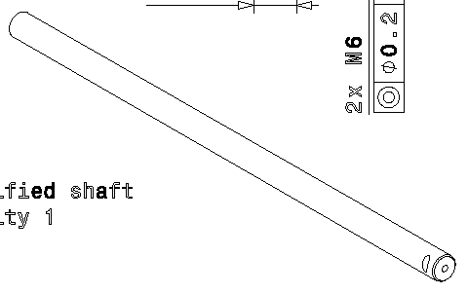
Labels on tables sub assemblies
HCTCLPX__126-CR00000X

Slide 38
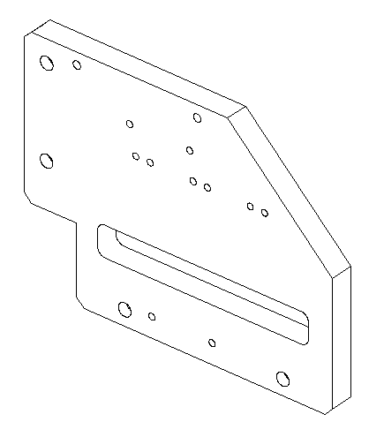
Labels on tables sub assemblies
HCTCLPX__127-CR00000X

Slide 39
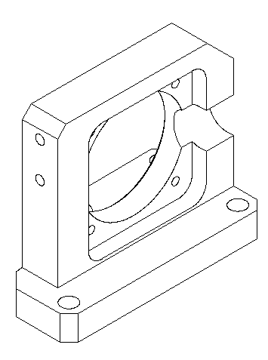
Labels on tables sub assemblies
HCTCLPX__129-CR00000X

Slide 40
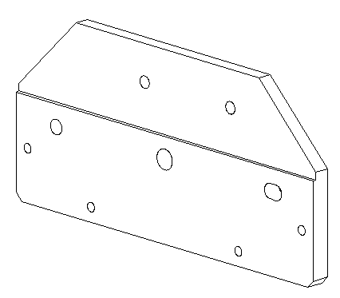
Labels on tables sub assemblies
HCTCLPX__137-CR00000X

Slide 41
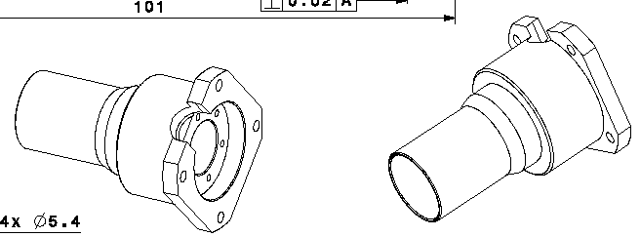
Labels on tables sub assemblies
HCTCLPX__140-CR00000X

Slide 42
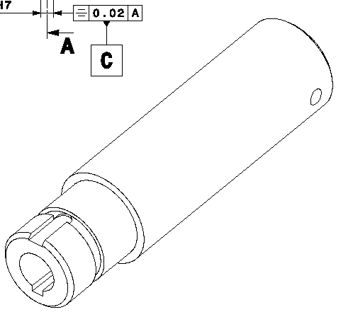
Labels on tables sub assemblies
HCTCLPX__142-CR00000X

Slide 43
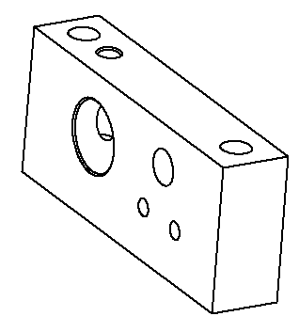
Labels on tables sub assemblies
HCTCLPX__224-CR00000X

Slide 44
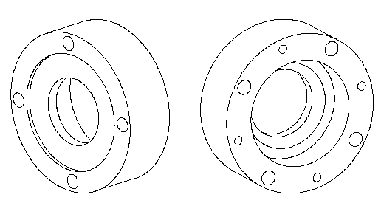
Labels on tables sub assemblies
HCTDIS_260-CR00000X

