Slide 1
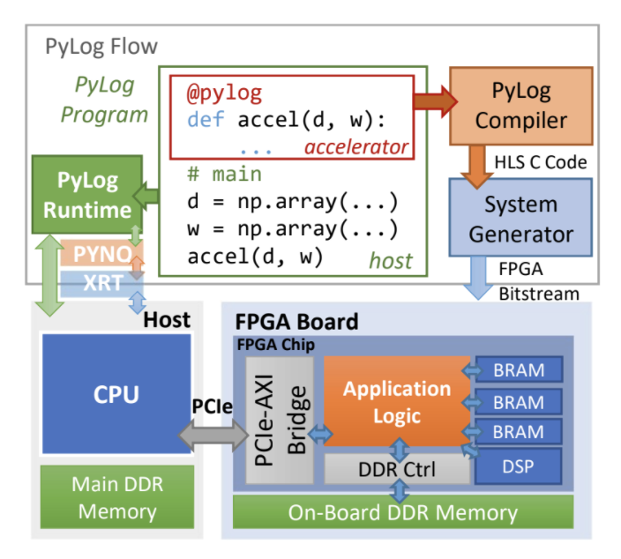
PyLog: An Algorithm-Centric Python-Based FPGA Programming and Synthesis Flow
Our Team:
Sitao Huang
Kun Wu
Jialiang Zhang

Slide 2
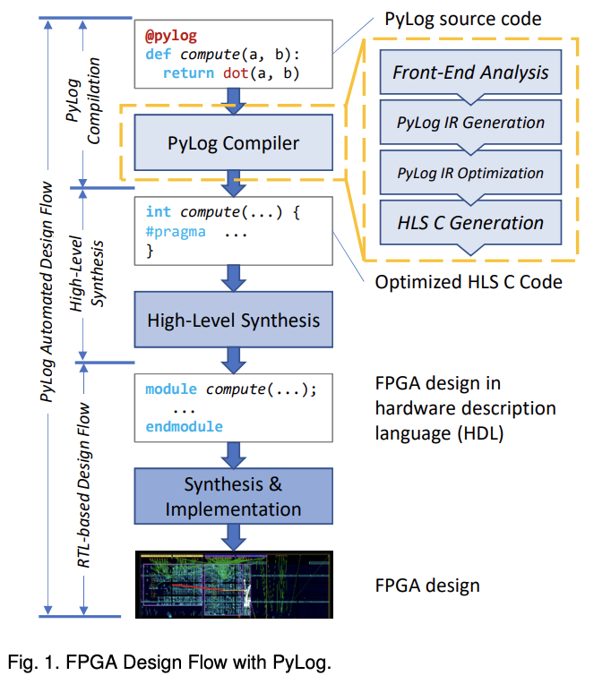
PyLog (1): Background – Goals
Python based compile workflow
Software programming model
No FPGA/HW expertise required
Supporting backend optimizations
Supporting single-kernel multi-version implementation

Slide 3
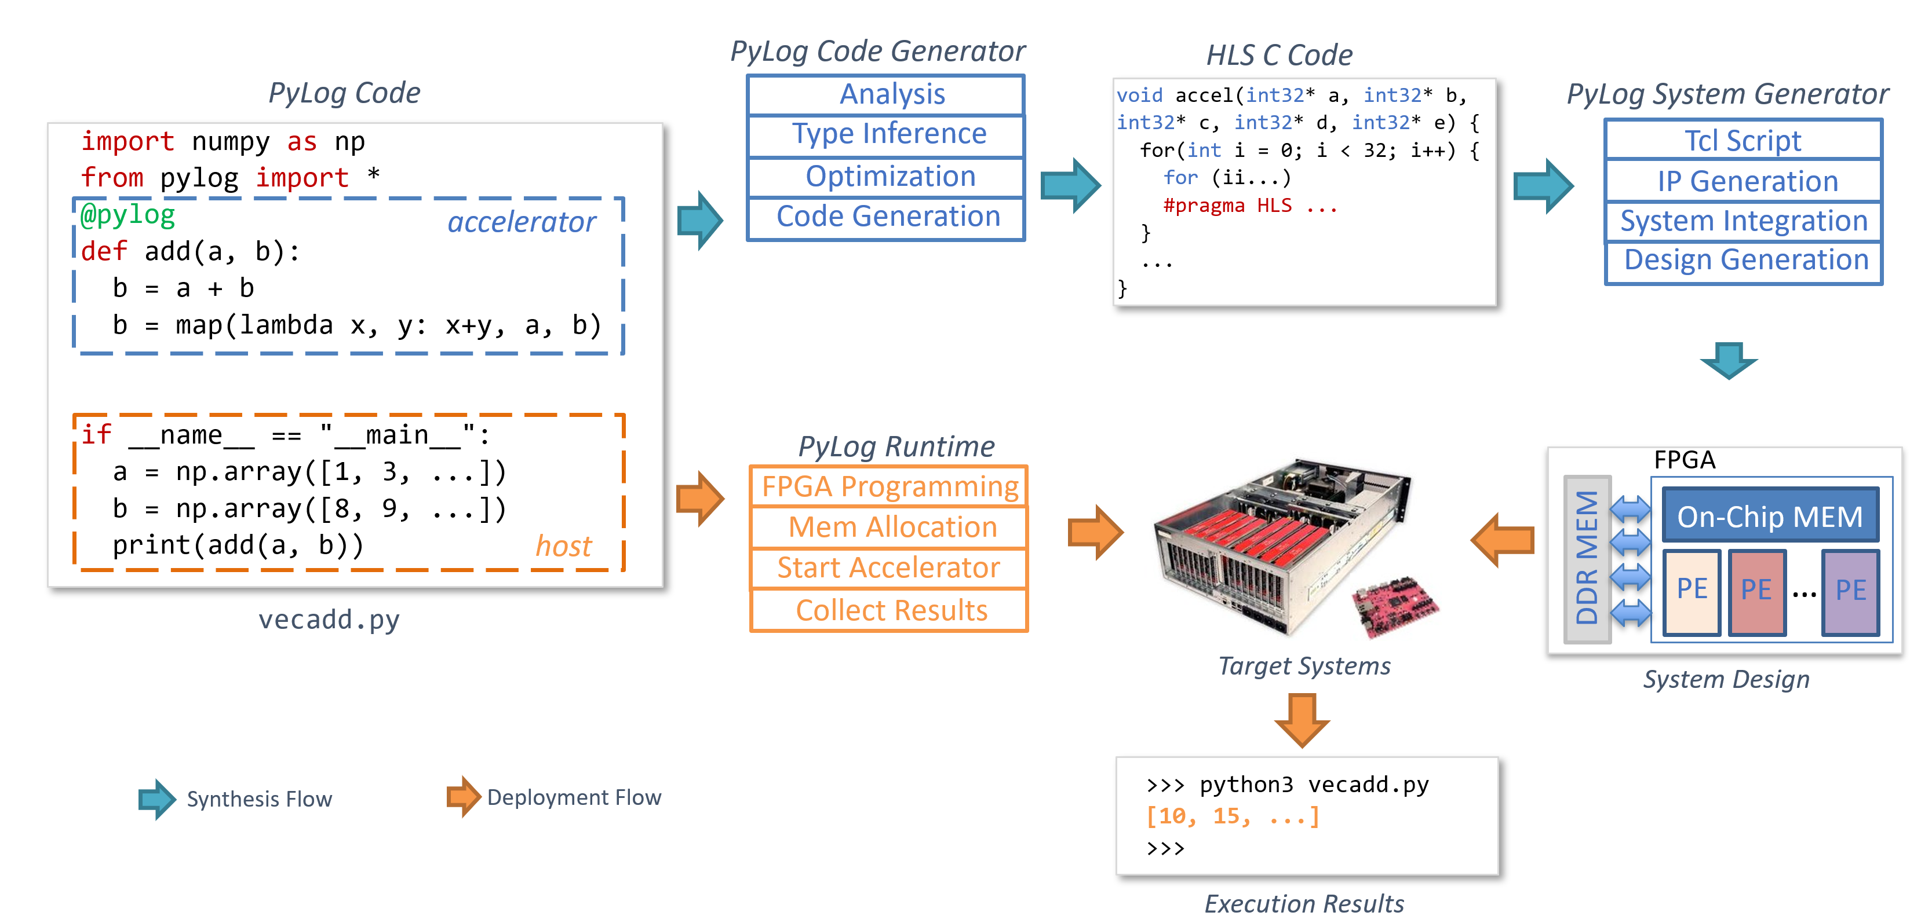
PyLog (1): Background – PyLog Workflow

Slide 4
PyLog (1): Background – PyLog Workflow
Current Issues:
PyLog only supports optimizations of a certain amount of functions from Numpy
User-defined functions cannot be optimized automatically
Solution:
Use a backend support to explore the optimizations

Slide 5
PyLog (2):Progress – Backend Support
PyLog Generated C code
(Without Pragmas)
PyLog Backend
Modified C code
(With HLS/Merlin/… Pragmas)

Slide 6
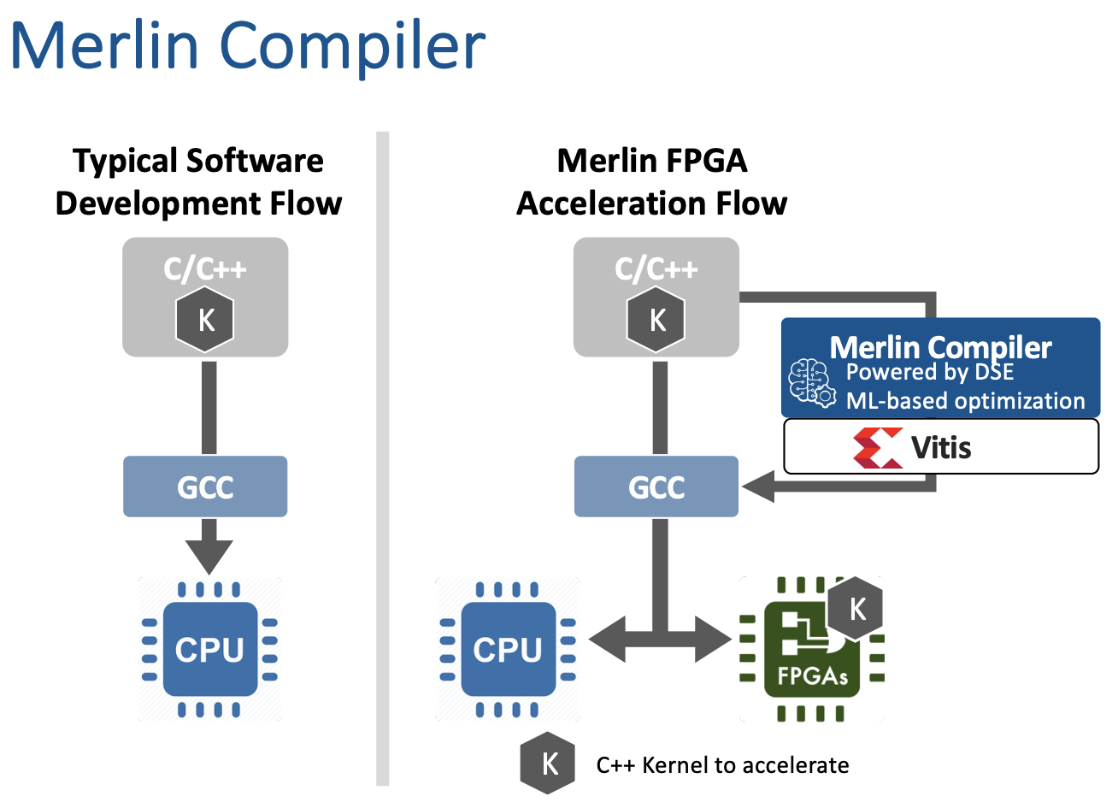
PyLog (1):Backend – Merlin Compiler

Slide 7
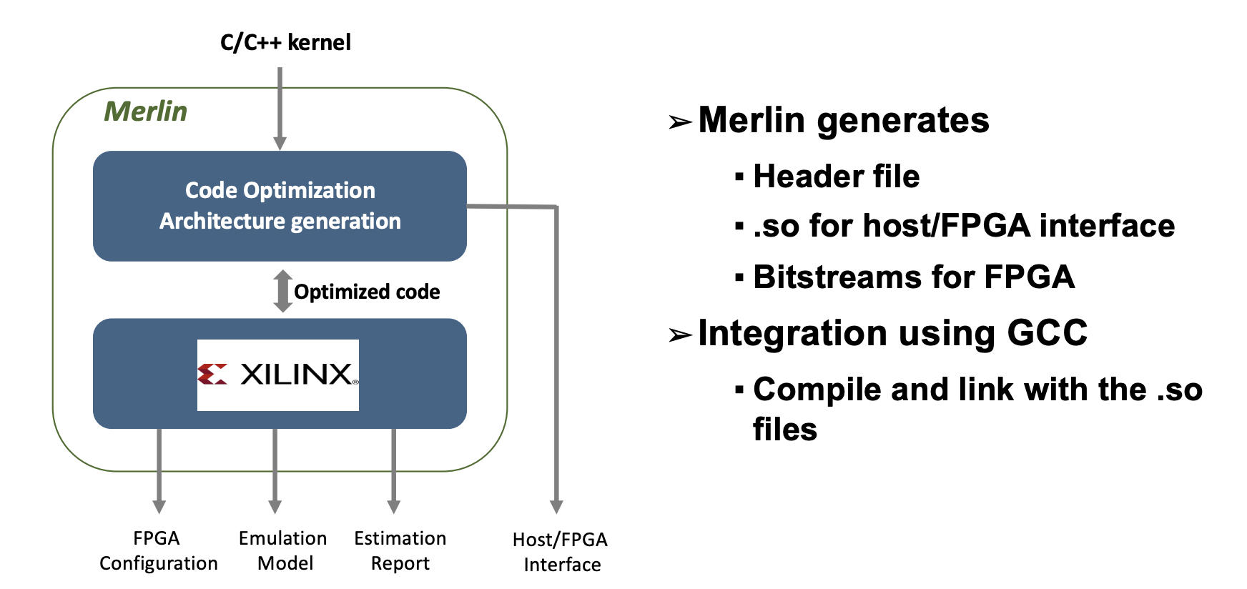
PyLog (1):Backend – Merlin Compiler

Slide 8
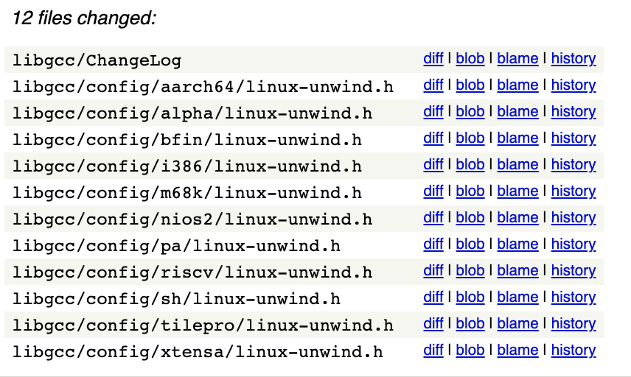
PyLog (2):Progress – Merlin Compiler Support
Mainly working on setup Merlin now
Originally built with docker on CentOS machine
Only support GCC 4.8.4, Clang 6.0.0, LLVM 6.0.0
Solution:
  Building libraries from source code
  Try ScaleHLS

Slide 9
PyLog (3): Future Works
1) Support ScaleHLS on the backend and generate optimized designs
2) Evaluate optimized benchmarks
3) Support single-kernel multi-version generation

Slide 10
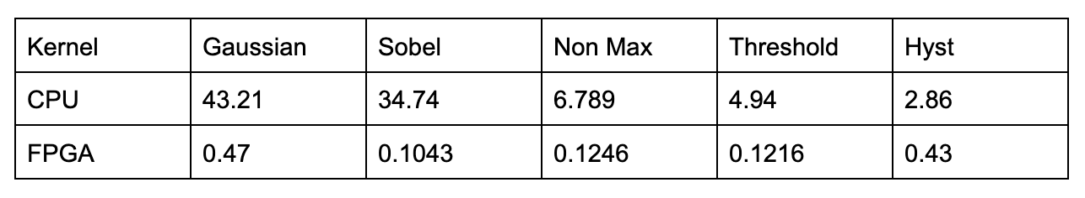
PyLog (3): Primary Results for Benchmark
Progress Update:
Unit: seconds

Slide 11
PyLog (4): Future Work Overview
CPU-FPGA mapping mechanism
Multi-kernel Communication protocol
Explore design choices to improve performance of current benchmarks

Slide 12
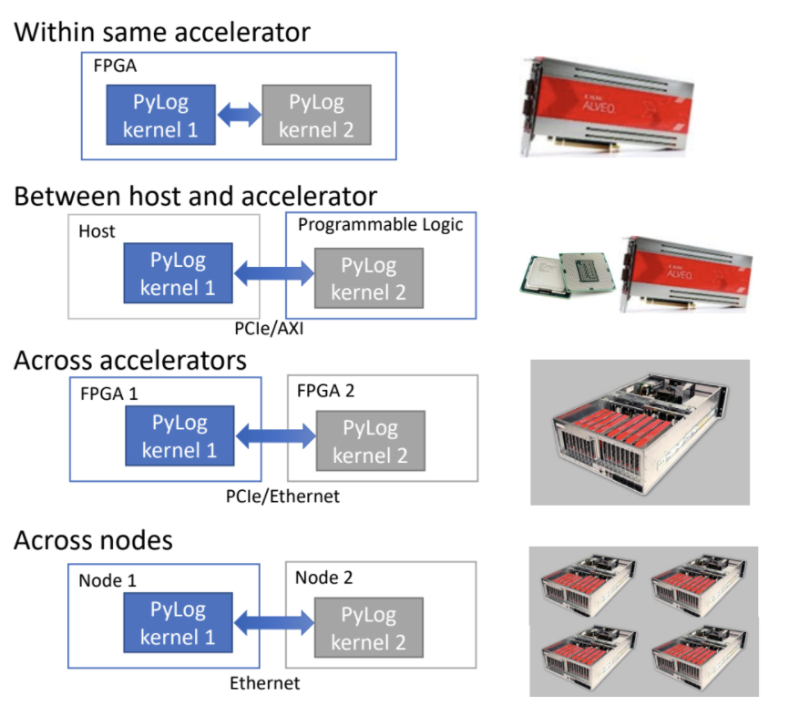
PyLog (4): Single Kernel Multi-Version Framework
Generalize kernel definition in Pylog to support multiple kernels
Compiler chooses different kernel-device mappings
Case A: Multiple kernels mapped to same/muti FPGA’s IPs
Case B: CPU-FPGA mapping
Case C: Multiple FPGAs
Case D: Multiple nodes

