Slide 1

CTMC 2021 Financial Review
Club Treasurer – Jamie Pinnell

Slide 2
Membership Situation
The year 2021 was an interesting one for all of us, and as such, this presentation will be short but sweet.
As We were mainly unable to operate as a club due to CERN restrictions, we decided any paid members from 2020 would not need to pay for 2021. as such we maintained our count of 10 members, including M. Flockhart, our honourary member.
From 2022, payment will be required, as of today we have received payment from 7 of our members, and M. Flockhart will retain his honourary status.

Slide 3
Purchases Made
We have made several purchases as agreed with the commitee last year, but didn’t make many more moves as the COVID situation massively restricted our ability to operate. Having said that, we have got some gear that we think is quite exciting.
We now have a full Cinewhoop drone, 6s power, with batteries, and fully padded for safety, set up with goggles and a radio!
We have also purchased a plane and a glider, also paired with our new club radio!
We have also made available a new charger for all of our battery needs, as well as restocking some of the consumables and tools for electronics.
For those who aren’t 100% confident, we have also invested in a new flight simulator which should now be up and running. A drone flight simulator should soon follow

Slide 4
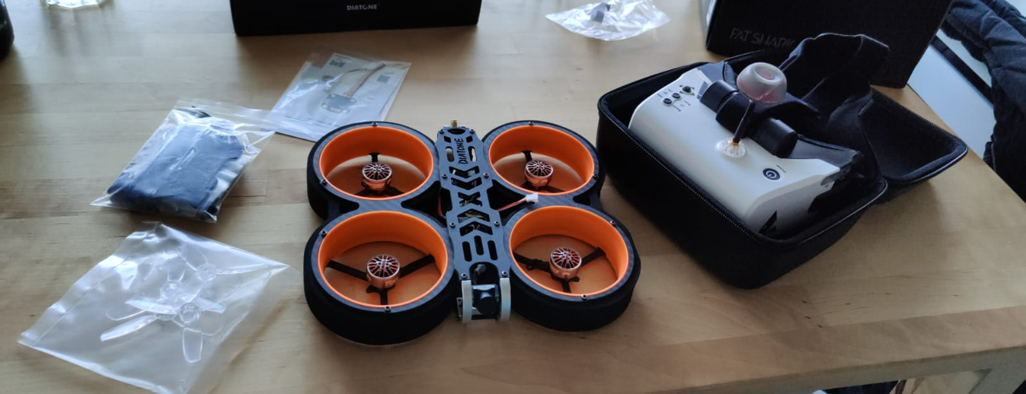
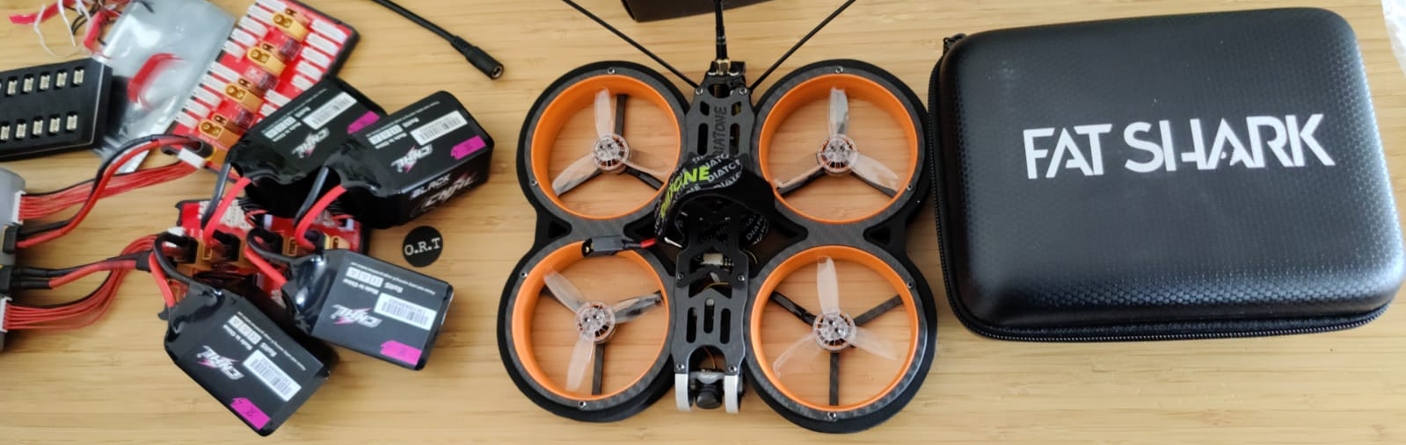
Cinewhoop
Apologies for the terrible photography, I’m a pilot not a camera man.

Slide 5
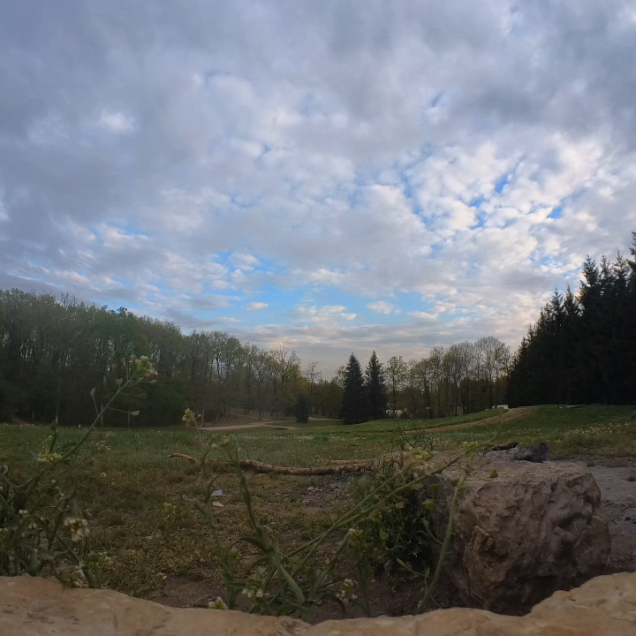

Slide 6
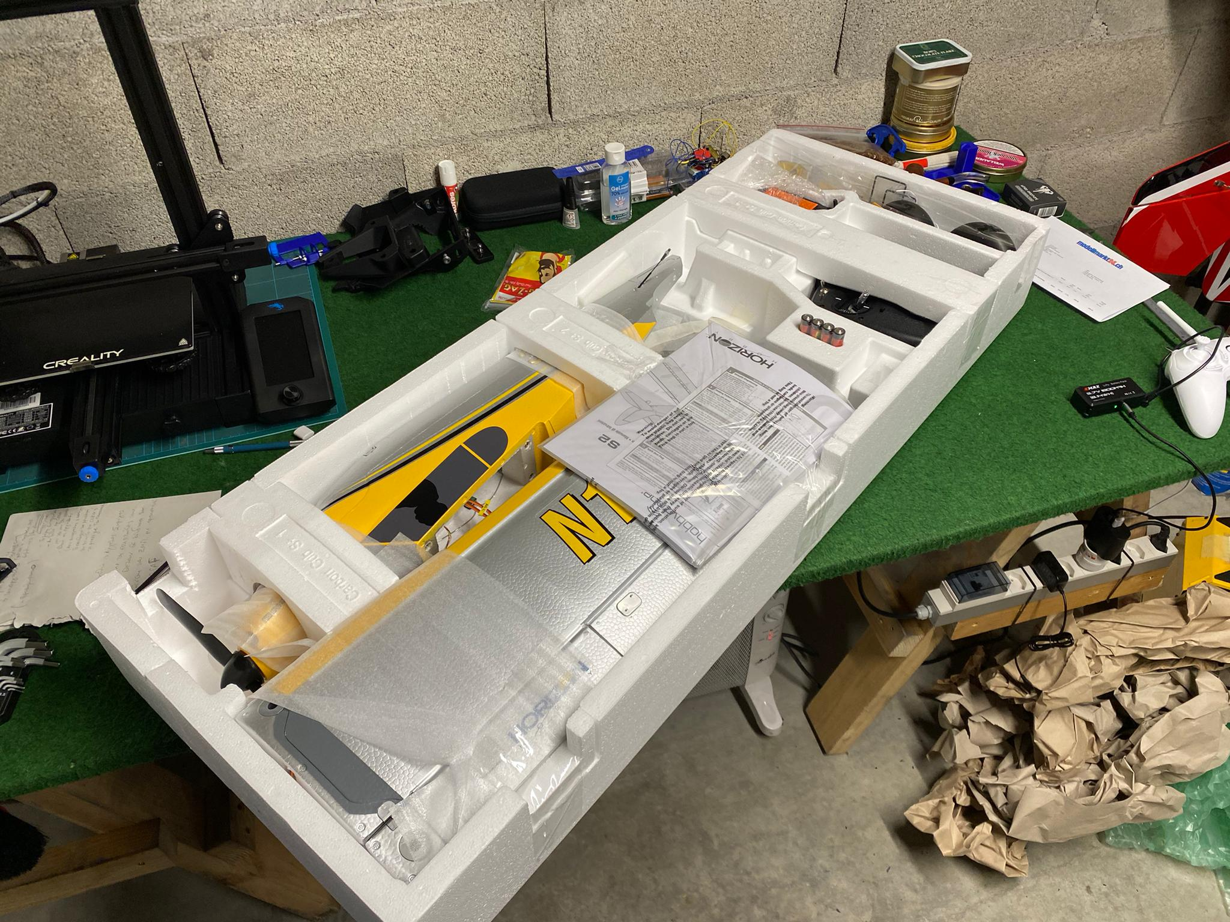
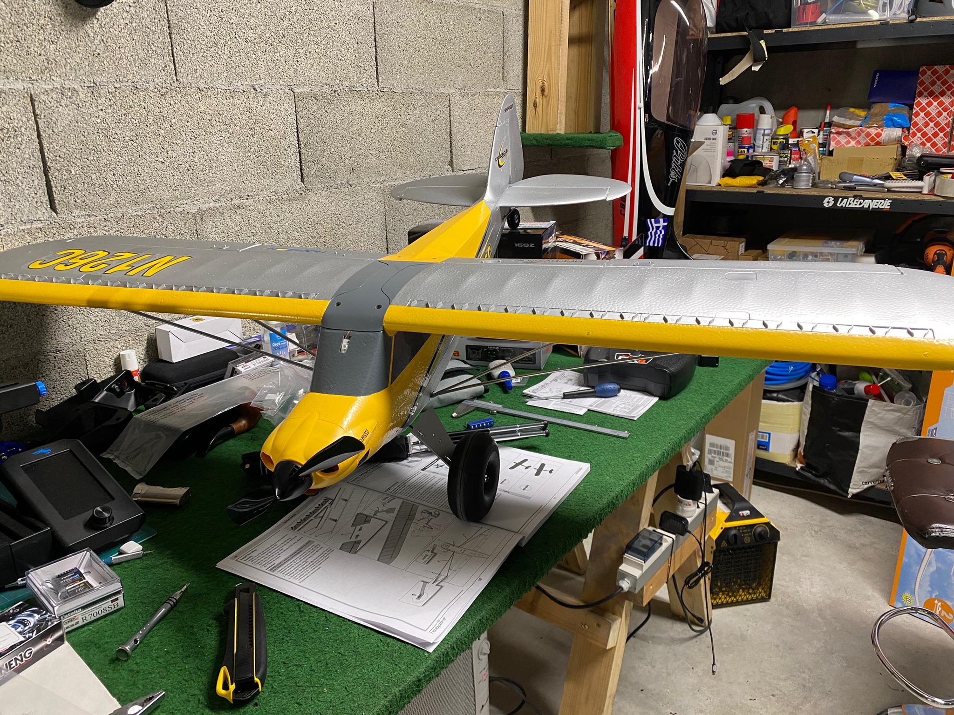
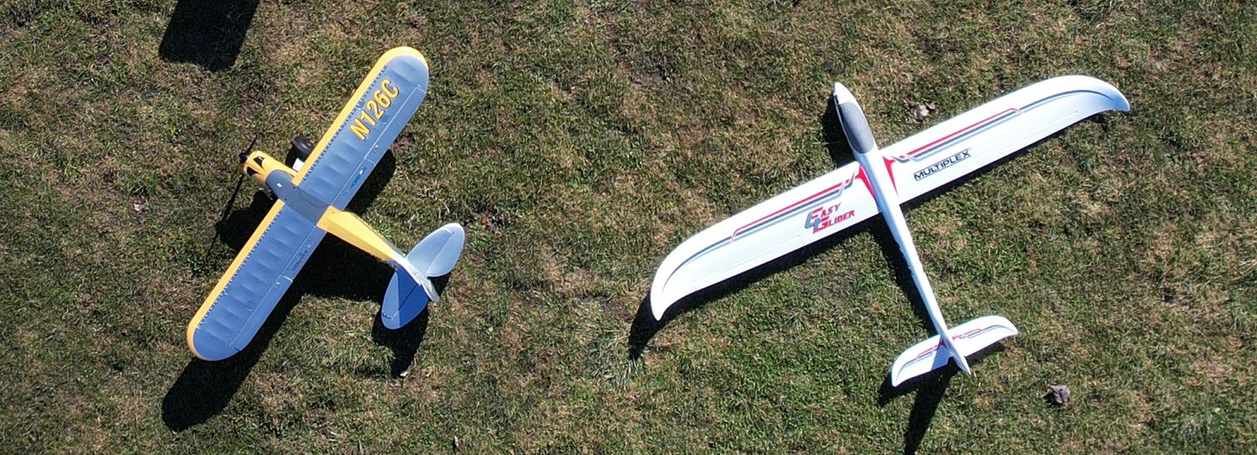
Planes

Slide 7
In & Outs – Short but Sweet…
Reason | Quantity | Ins (Chf) | Out (Chf)
Membership Fees | 3 | 150
Charger | 1 |  | 50
Cinewhoop Kit | 1 |  | 614.62
Planes, Radio, Lipos | ~~ |  | 2140.20
Plane supports | 1 |  | 64.44
Electronic lock | 1 |  | 967
Bank fees | 2 |  | 5.30
Total |  | 150 | 3846.86
Start of the Year Balance | 23,488 CHF
2021 End Balance | 19,791.92 CHF
*The Cinewhoop Drone Radio and receiver was not paid until recently so will show up in 2022 review

Slide 8
2022 Purchases
So we have talked about potential equipment purchases for the coming year now that we can function:
A 3D router, or CNC is still on the table. A laser cutter for balsa has been suggested but I prefer to keep the idea of a cnc for carbon/aluminium fibre parts
An FPV simulator for the drone community
The committee has discussed the possibility of having a stock of cameras, possibly a GoPro or DJI Action 2 and an InstaGo2 for the club, as well as a photography drone DJI Air 2S. These will be reservable for outings or even trips away, subject to a deposit and will be a great addition to the planes and drones.

Slide 9
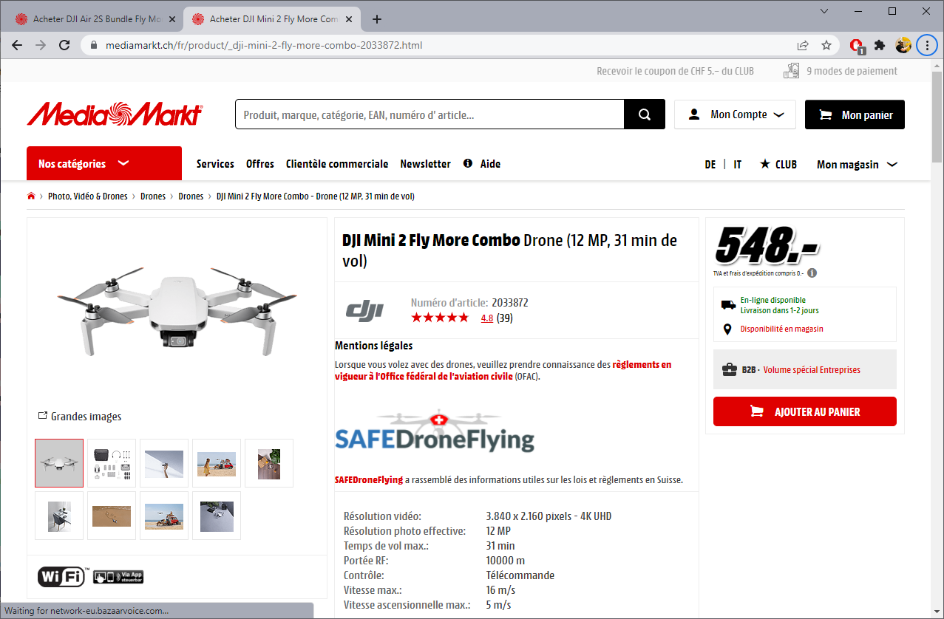
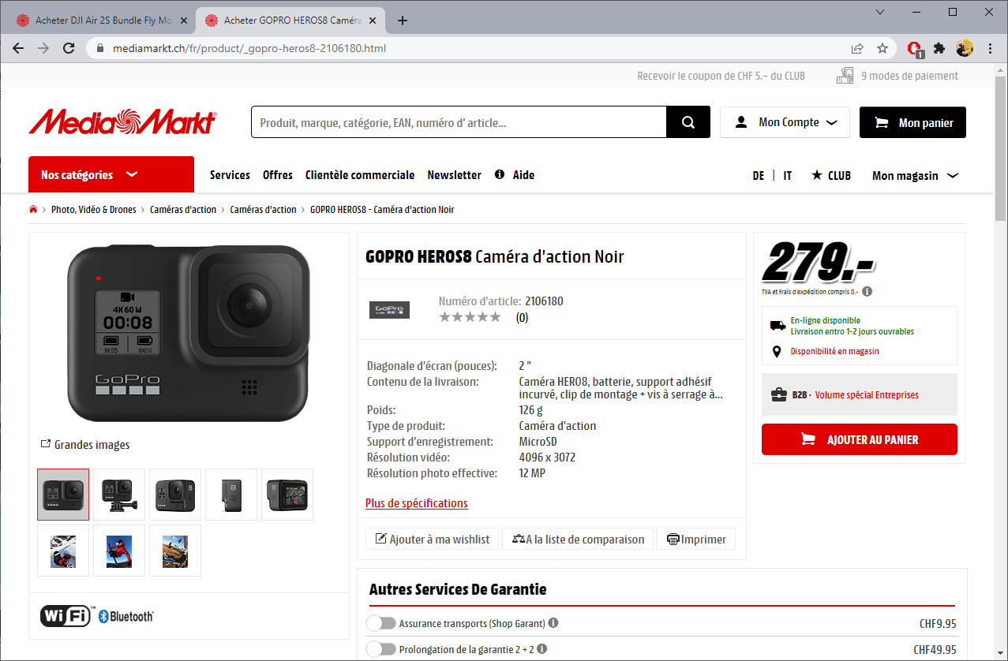
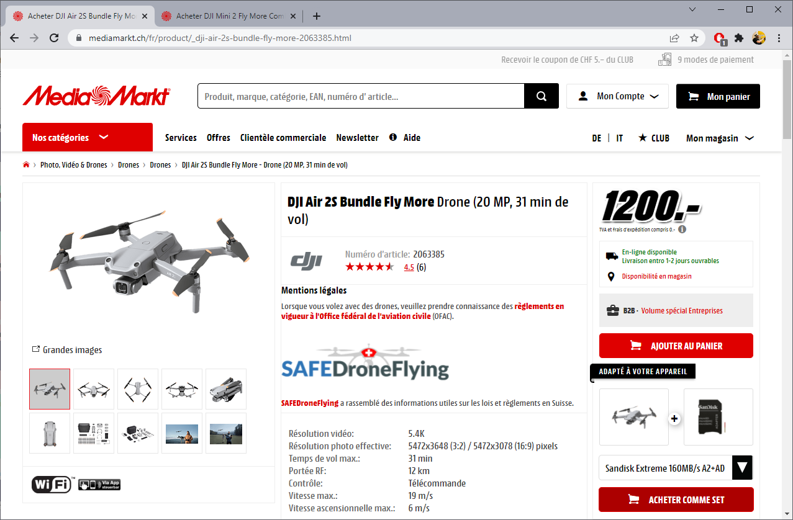
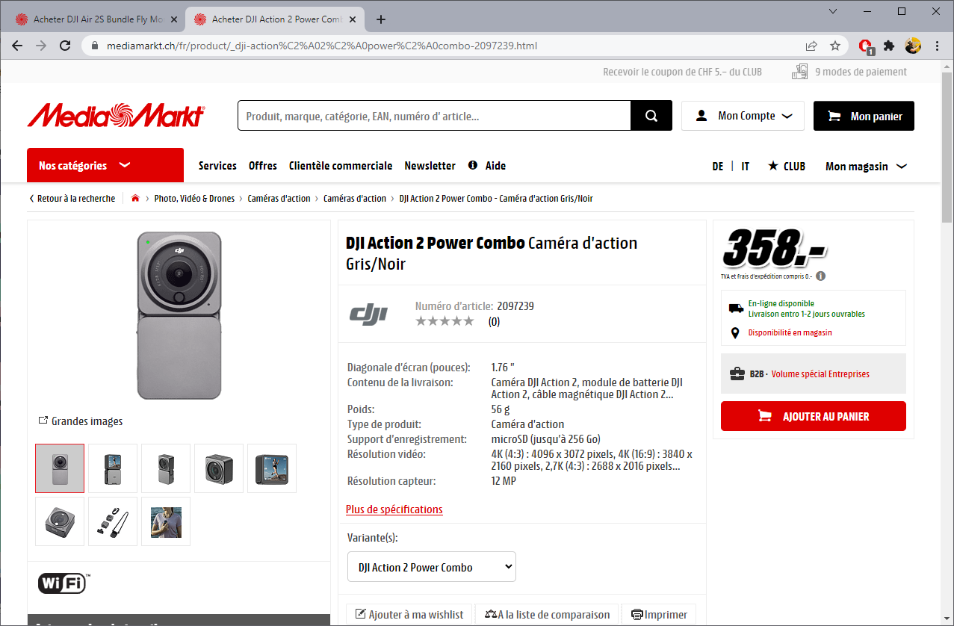
Withdrawl of any equipment will be subject to a deposit, and anyone wishing to borrow the club drone for any activities will be subject to approval from me, the treasurer, as responsible for the drones, this may include a short test in competence.

Slide 10
2022 Purchases
As we look towards having an open day in spring, we will be purchasing some publicity for the club, some large stand flags, potentially a table cloth and maybe a couple of t-shirts subject to quotations with suppliers. We will also look for volunteers on that subject.
We will soon have a functioning association with the Ailes de Sergy club and will so incur costs for that association for 2022.
As we will now be able to access our clubhouse we will also have various costs incurred in cleaning up and getting it ready for more members, including removal of the defunct lathe.

Slide 11
But More Importantly
Get anyone you know that might be interested into the club!
Right now we are focussed on planes and drones BUT we want to have our hands in on cars, trains, helicopters, everything!! So lets get the word out!

