Slide 1
Décret Tertiaire
SCE Department contribution
Site and Civil Engineering Department
C. Martel
9.2.2022

Slide 2
Agenda
Law evolution in Europe & France
Subjection
Objectives
Measures and penalties
Application
Comments

Slide 3
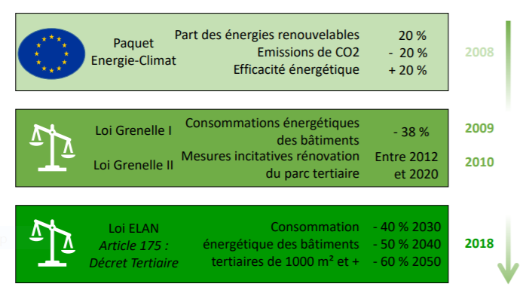
Law evolution in Europe & France
23 W/m2
6 W/m2

Slide 4
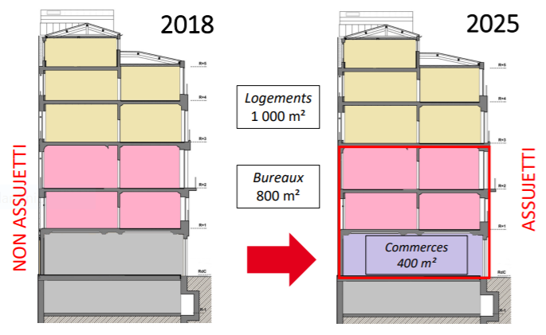
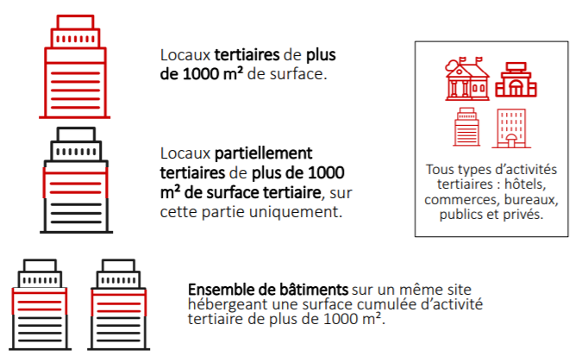
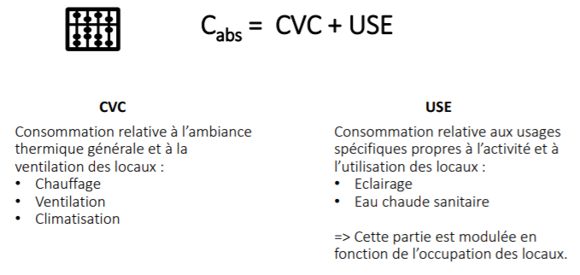
Subjection
23 W/m2
6 W/m2

Slide 5
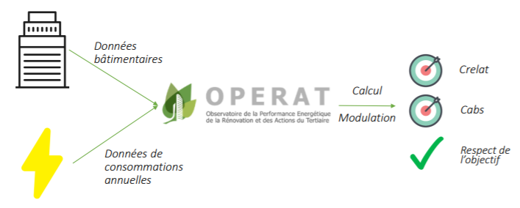
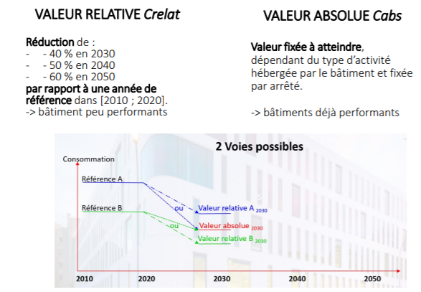
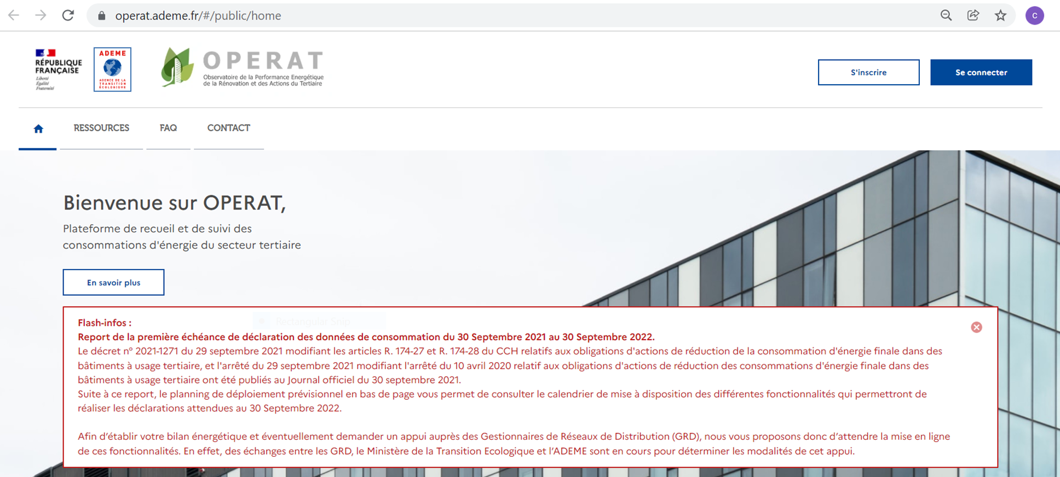
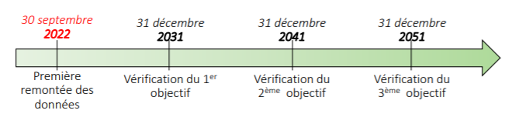
Objectives
23 W/m2
6 W/m2

Slide 6
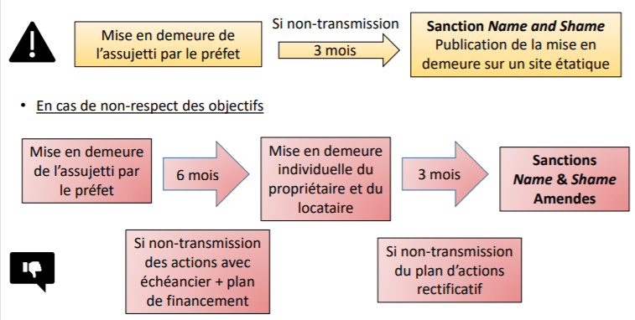
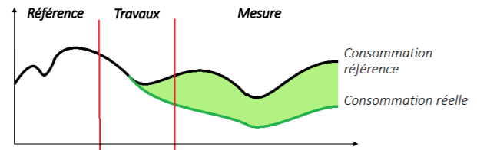
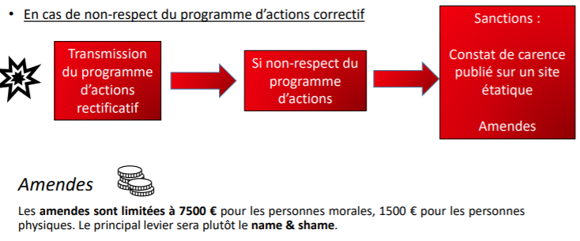
Measures and penalties
23 W/m2
6 W/m2

Slide 7
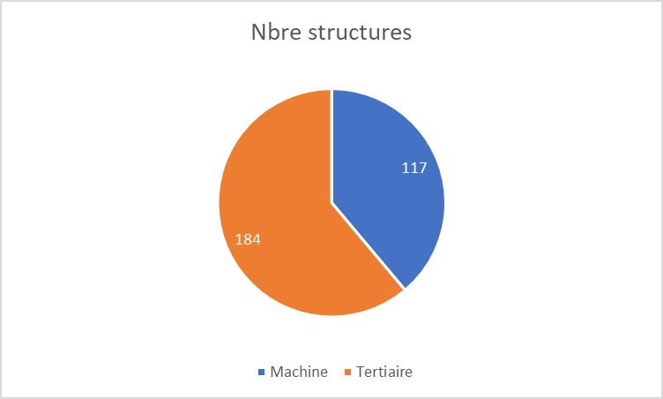
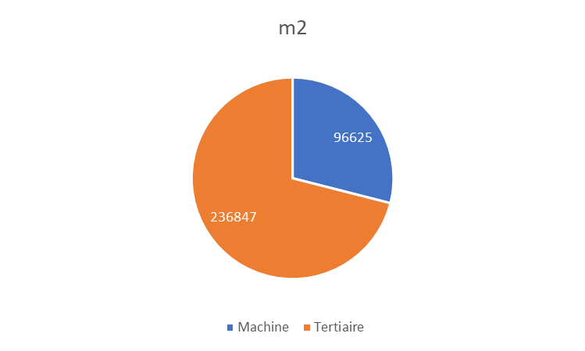
Application
759 structures au total du CERN , pour 638 712 m2
(- local stockage- local technique- réservoir - hors meyrin -hors prévessin)= 301 structures pour 335 705 m2
MACHINE + Blanks: 117 structures pour 96 625 m2
TERTIAIRE: 184 structures pour 236 847 m2
23 W/m2
6 W/m2
SAM-CE and PPM: windows, façade and roof insulation, air sealing , including thermal bridges thermiques.
SAM-IN: Double flow ventilation, lighting with management, energy policy.
Nbre structures | Nbre compteur/structure | kCHF/compteur | kCHF
200 | 2 | 6 | 2400
200 | 5 | 1.5 | 1500
 |  |  | 3900
400 | 2 | 6 | 4800
400 | 5 | 1.5 | 3000
 |  |  | 7800

Slide 8
Comments
23 W/m2
6 W/m2
No counters at CERN.
EN and SCE synergy is required.
Possibility of treatment per site versus granularity per building (TBC).
Exemption for state buildings.
Interest in isolating processes.
Consideration of invoices in the absence of meters.
Reference year: >= 2010 (elec <> gas)
Synergy with ISO 50001.
Synergy with GE.

