Slide 1

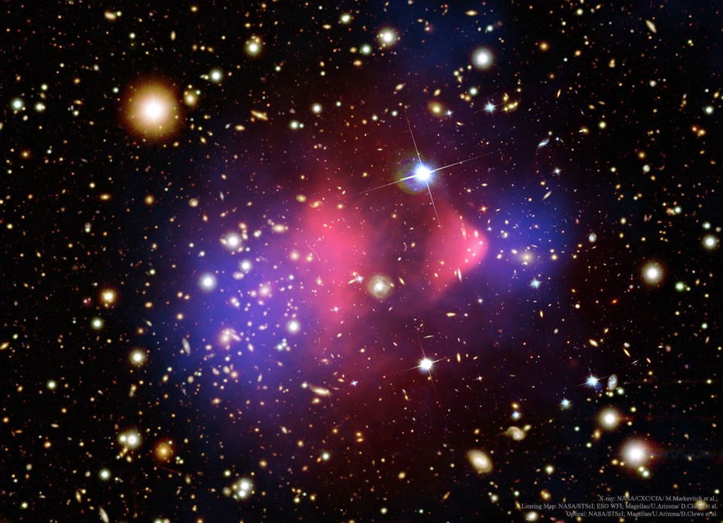
Searching for Vector Dark Matter at Fixed Target Experiments
Taylor R. Grayª
In collaboration with Riccardo Catenaª
ªChalmers University of Technology
Supported by a research grant from the Wallenberg foundation
Fysikdagarna Lund University 2022

Slide 2
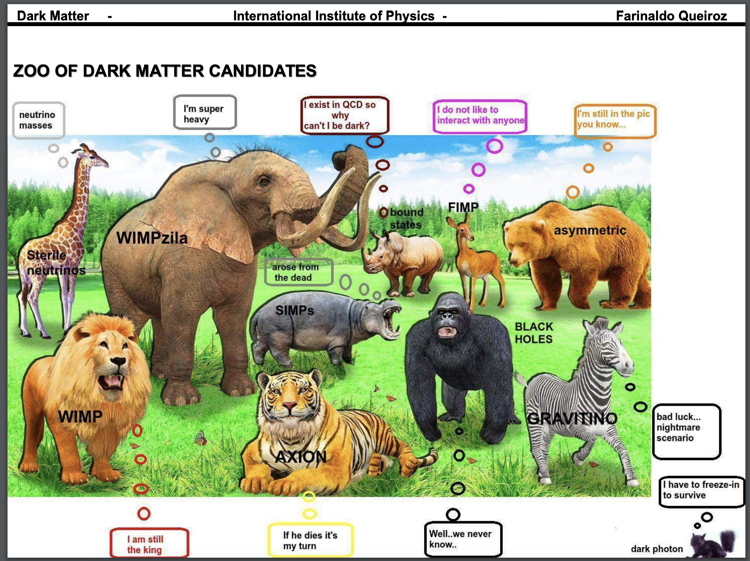
F. Queiroz

Slide 3
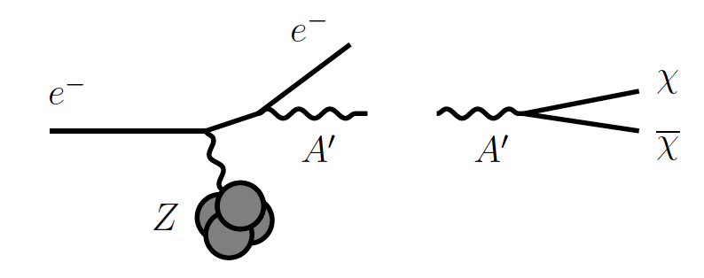
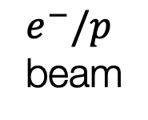



Sub-GeV Dark Matter
Fixed Target
Detector
GeV-TeV scale thermal DM already widely tested
Sub-GeV DM is largely experimentally unexplored..
  Out of reach of nuclear recoil direct detection exps
Future exps such as LDMX will be sensitive to it!
$e^{−}/p$ beam
$$A′$$
$$χχ$$
(LDMX was discussed this morning in Ruth Pöttgen’s talk!)

Slide 4
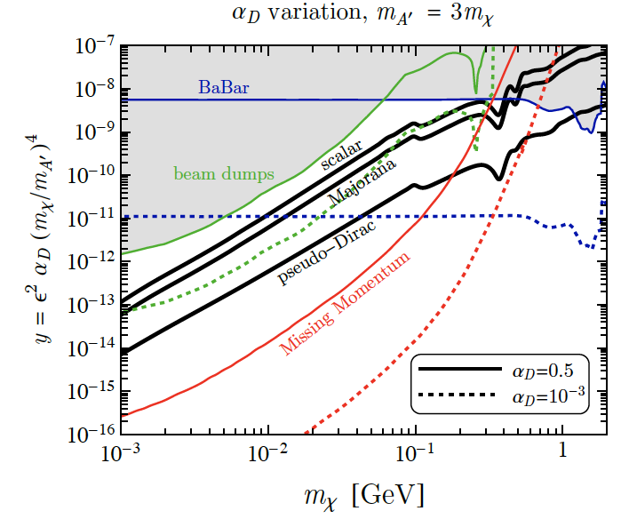
Sub-GeV Dark Matter
Spin-0
GeV-TeV scale thermal DM already widely tested
Sub-GeV DM is largely experimentally unexplored..
  Out of reach of nuclear recoil direct detection exps
Future exps such as LDMX will be sensitive to it!
How about spin-1 DM?
LDMX
Spin-1/2
(LDMX was discussed this morning in Ruth Pöttgen’s talk!)
arXiv:1807.0170

Slide 5
The Goal
Broaden the already existing studies on sub-GeV DM at fixed target experiments.
Extend the SM with the most general renormalizable spin-1 DM model compatible with Lorenz and Gauge symmetry.

Slide 6
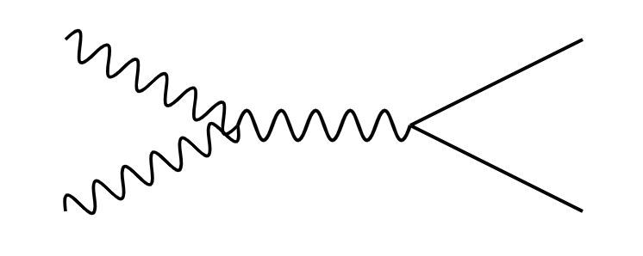

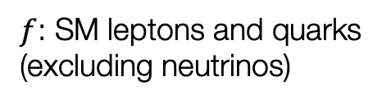

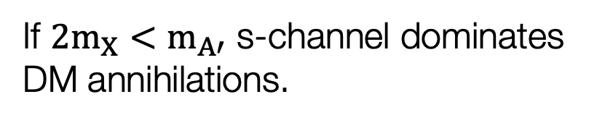








Spin-1 Dark Matter with a Dark Photon Mediator
$b_{5}$: real
$b_{6}$: complex
$b_{7}$: complex
$h_{3}$: real
$$X$$
$$f$$
$$h_{3}≡εe$$
$$A′$$
$$X^{†}$$
$$\overline{f}$$
$f$: SM leptons and quarks (excluding neutrinos)
If ${2m}_{X}<m_{A′}$ s-channel dominates DM annihilations.

Slide 7
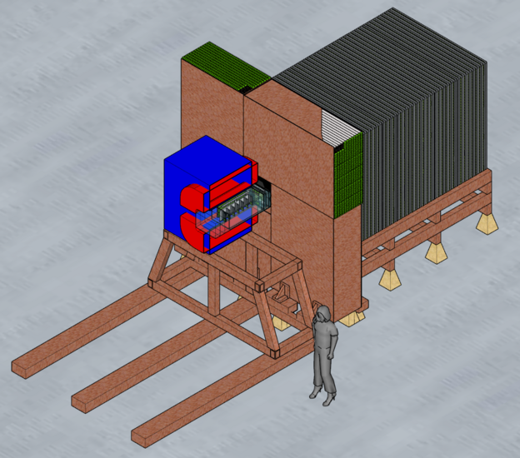
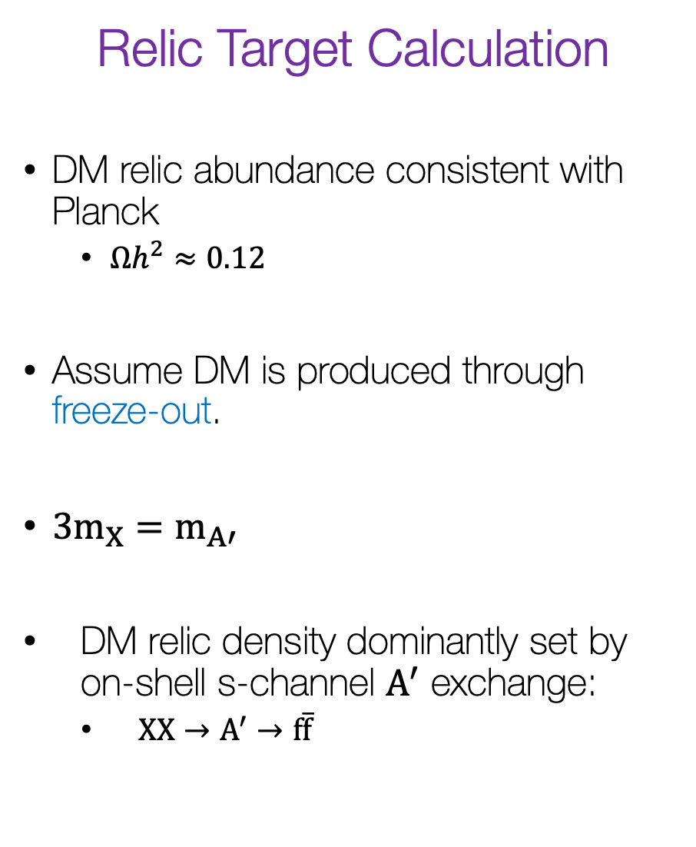
Relic Target Calculation
DM relic abundance consistent with Planck
  $Ωh^{2}≈0.12$
Assume DM is produced through freeze-out.
${3m}_{X}=m_{A′}$
DM relic density dominantly set by on-shell s-channel $A^{′}$ exchange:
  $XX→A^{′}→f\overline{f}$
Experimental Reach
Place exclusion/projection bounds on parameter space.
  Current + future experiments
  Cosmological bounds
(LDMX )

Slide 8

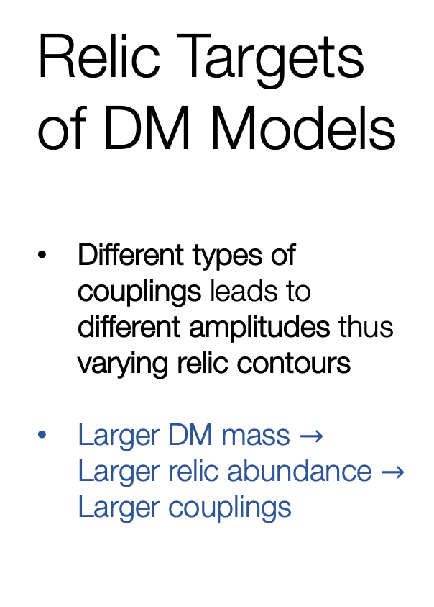
Relic Targets of DM Models
Different types of couplings leads to different amplitudes thus varying relic contours
Larger DM mass $→$ Larger relic abundance $→$ Larger couplings
Muon channel becomes allowed
Hadronic resonances
$$m_{χ}=3m_{A′}$$

Slide 9
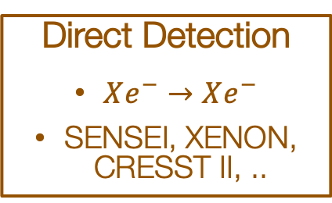
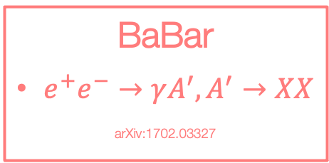
Limits/Projections
(See poster by Joshua Greaves!)
Electron Bremsstrahlung
+ (In)visible Decay
Proton Beam Dumps with Downstream DM Detector
CMB
Injection of EM particles into the universe during its early history leads to changes in CMB anisotropies
arXiv:1506.03811
If $BR\left(A^{′}→χχ\right)≫BR\left(A^{′}→ff\right)$: invisible decay limits
LSND
arXiv:1107.4580
LDMX
Missing Energy/Momentum
See talks by Ruth Pöttgen and Timon Emken arXiv:1808.05219
SLAC E137
arXiv:1406.2698
Mini-Boone
arXiv:1702.02688
NA64
arXiv:1906.00176
Direct Detection
$Xe^{−}→Xe^{−}$
SENSEI, XENON, CRESST II, ..
BaBar
$e^{+}e^{−}→γA^{′}, A^{′}→XX$
arXiv:1702.03327

Slide 10
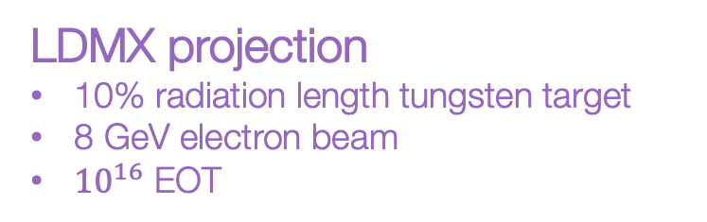

Experimental Limits/Projections on DM Models
only $b_{5}$ non-zero
BaBar
LDMX projection
10% radiation length tungsten target
8 GeV electron beam
${10}^{16}$ EOT
Beam Dumps
LDMX
Vector DM is the first model probed by LDMX!

Slide 11







BaBar
BaBar
Beam Dumps
Beam Dumps
$ℑ[b_{6}]$ non-zero:
$ℜ[b_{6}]$ non-zero:
LDMX
Will be probed at upcoming experiment LDMX!
LDMX
BaBar
BaBar
Beam Dumps
Beam Dumps
$ℑ[b_{7}]$ non-zero:
$ℜ\{[b_{7}]$ non-zero:
LDMX
LDMX
Already Excluded!

Slide 12
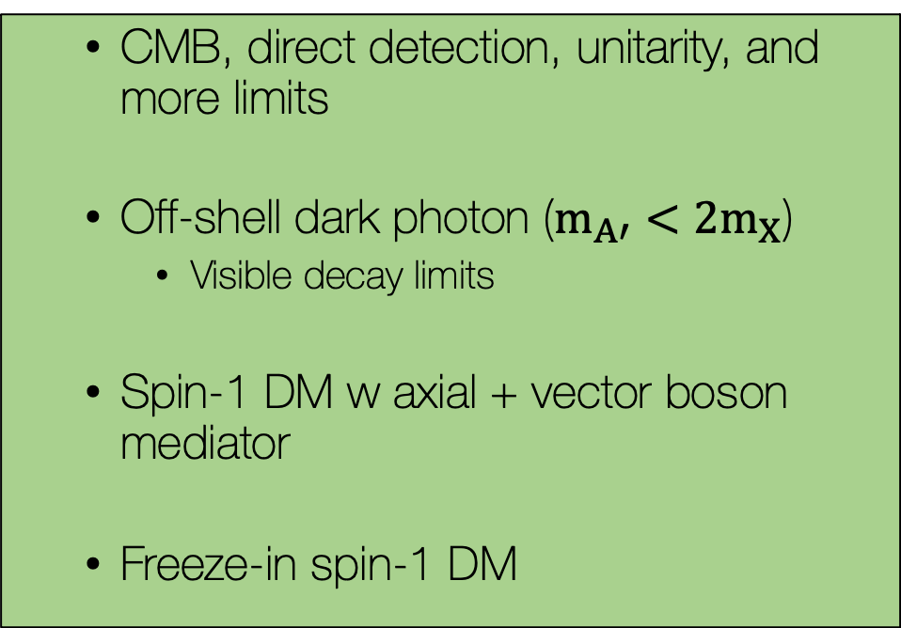
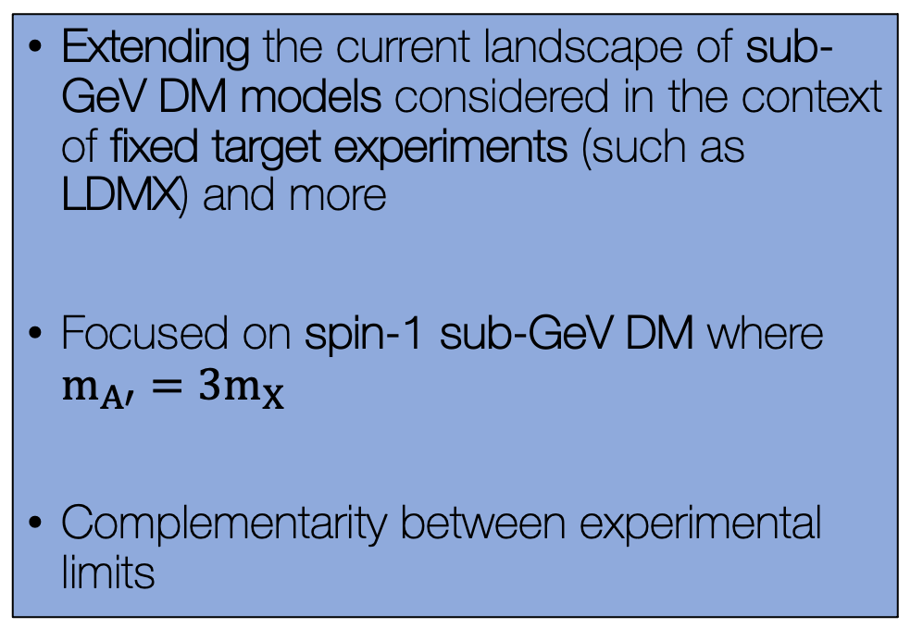
Summary and Future Work
Extending the current landscape of sub-GeV DM models considered in the context of fixed target experiments (such as LDMX) and more
Focused on spin-1 sub-GeV DM where $m_{A′}=3m_{X}$
Complementarity between experimental limits
  CMB, direct detection, unitarity, and more limits
  Off-shell dark photon ($m_{A′}<2m_{X}$)
    Visible decay limits
  Spin-1 DM w axial + vector boson mediator
  Freeze-in spin-1 DM
Thank You

Slide 13
Backup Slides

Slide 14
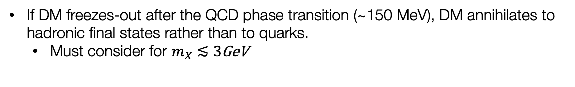
Hadronic Resonances
If DM freezes-out after the QCD phase transition (~150 MeV), DM annihilates to hadronic final states rather than to quarks.
  Must consider for $m_{X}≲3$GeV

Slide 15
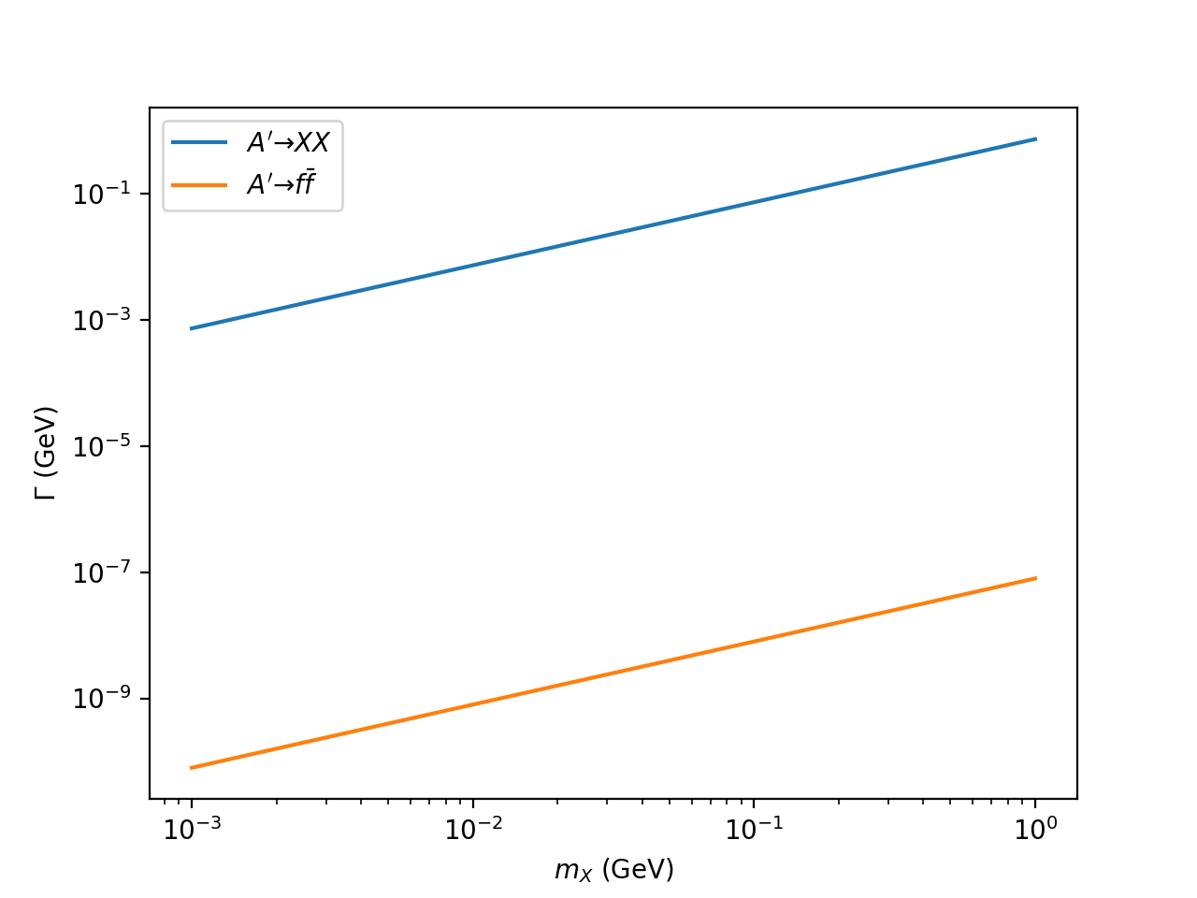
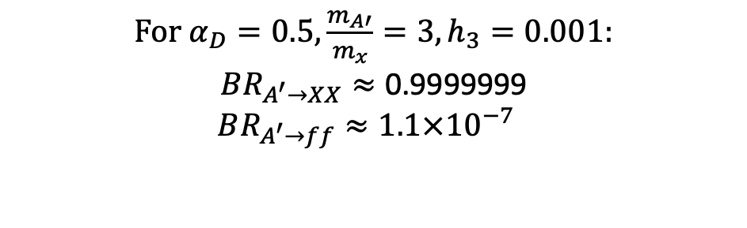

Why $BR_{A^{′}→XX}>BR_{A^{′}→\overline{f}f}$ is a good assumption
For $α_{D}=0.5,\frac{m_{A′}}{m_{x}}=3,h_{3}=0.001$:
$$BR_{A^{′}→XX}≈\text{0.999999}\text{9}$$
$$BR_{A^{′}→ff}≈\text{1.1}×{10}^{−7}$$

Slide 16
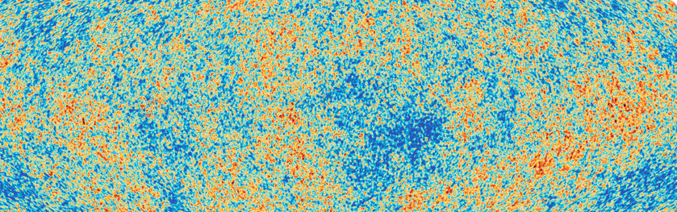
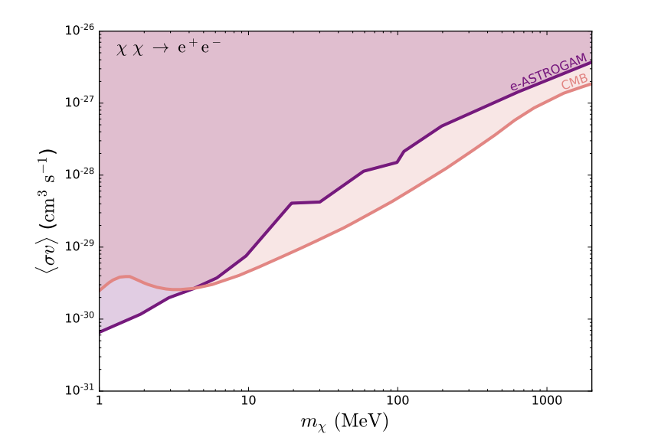
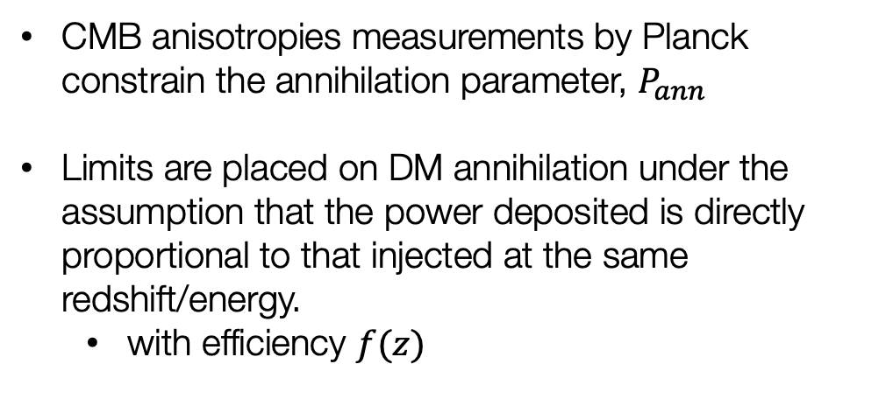
CMB Bounds
p-wave: arXiv:1308.2578
s-wave: arXiv:1506.03811
(Planck 2018)
CMB anisotropies measurements by Planck constrain the annihilation parameter, $P_{ann}$
Limits are placed on DM annihilation under the assumption that the power deposited is directly proportional to that injected at the same redshift/energy.
  with efficiency $f(z)$
arXiv:1801.05447

Slide 17
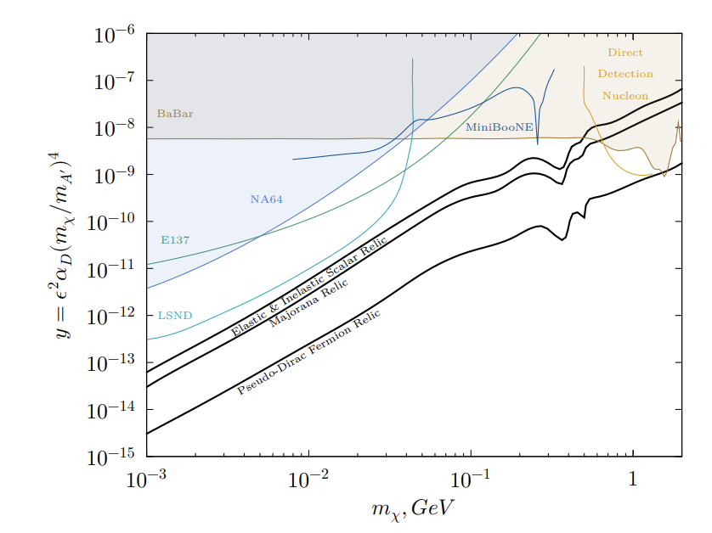
Electron Beam Dumps
E137
arXiv:1406.2698
Dark matter produced from electron-target collisions
20 GeV beam incident on a set of aluminum plates interlaced with cooling water.
Downstream detector
NA64
arXiv:1710.00971
100 GeV electron beam incident on a lead target
Event: single electron produced and missing energy

Slide 18
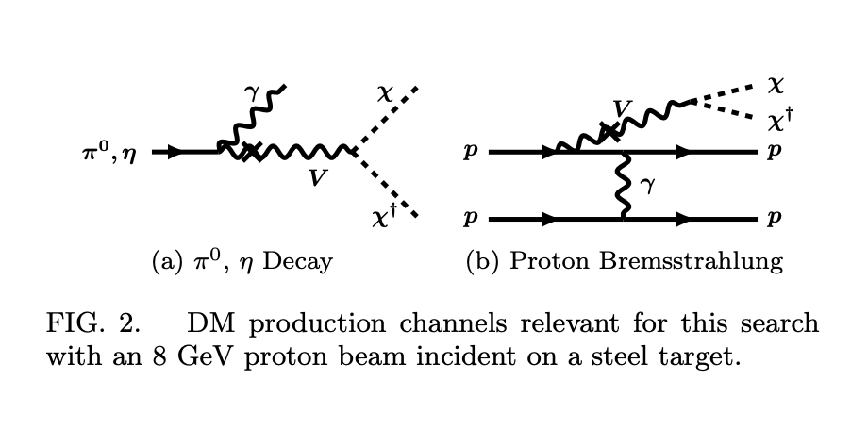
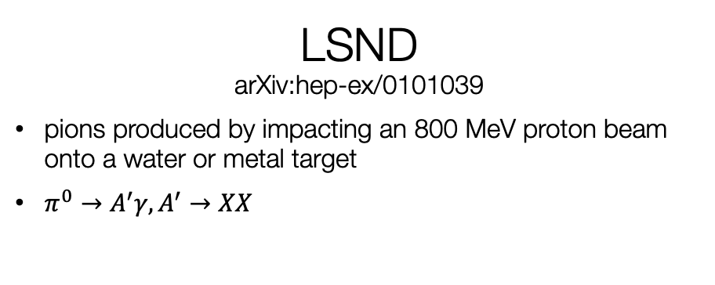
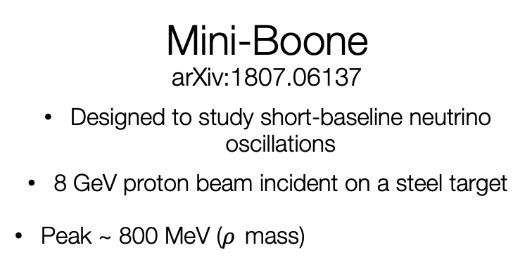
Proton Beam Dumps arXiv:1107.4580
Mini-Boone
arXiv:1807.06137
Designed to study short-baseline neutrino oscillations
8 GeV proton beam incident on a steel target
Peak ~ 800 MeV ($ρ$ mass)
DM scatterings mimic neutrino scatterings!
  (Neutral current-like elastic scatterings)
LSND
arXiv:hep-ex/0101039
pions produced by impacting an 800 MeV proton beam onto a water or metal target
$π^{0}→A^{′}γ,A^{′}→XX$

Slide 19

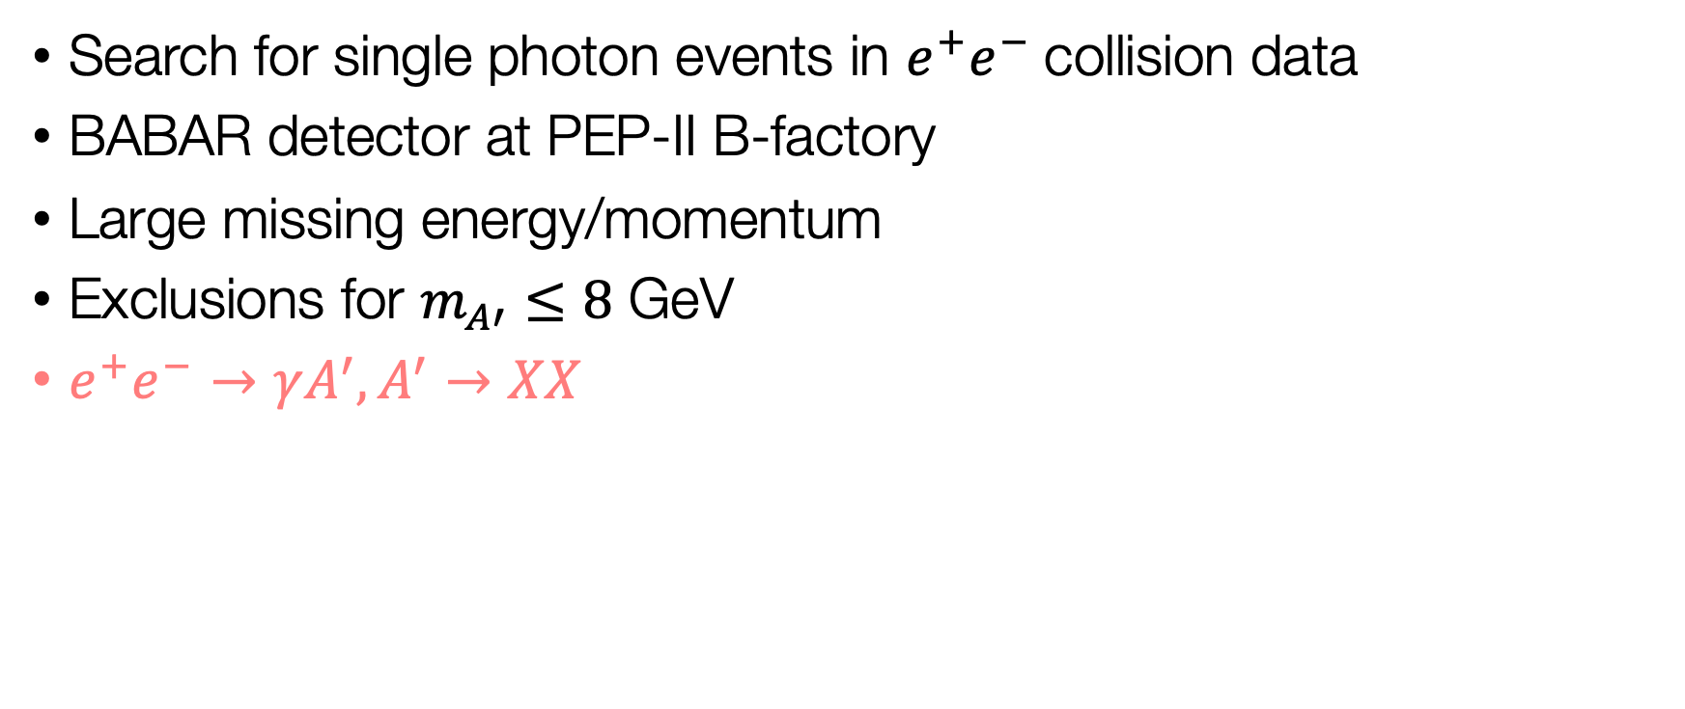
BaBar arXiv:1702.03327
Search for single photon events in $e^{+}e^{−}$collision data
BABAR detector at PEP-II B-factory
Large missing energy/momentum
Exclusions for $m_{A′}≤8$ GeV
$e^{+}e^{−}→γA^{′}, A^{′}→XX$

Slide 20
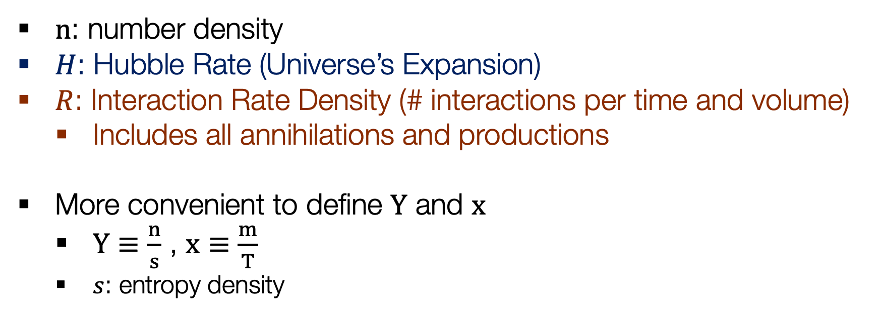
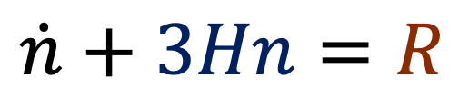
Calculating Dark Matter Abundance:
The Boltzmann Equation
$$\dot{n}+3Hn=R$$
Universe’s Expansion
Particle Physics
$n$: number density
$H$: Hubble Rate (Universe’s Expansion)
$R$: Interaction Rate Density (# interactions per time and volume)
  Includes all annihilations and productions
More convenient to define $Y$ and $x$
  $Y≡\frac{n}{s}$ , $x≡\frac{m}{T}$
  $s$: entropy density

Slide 21
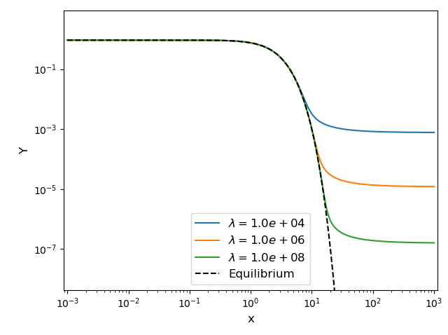
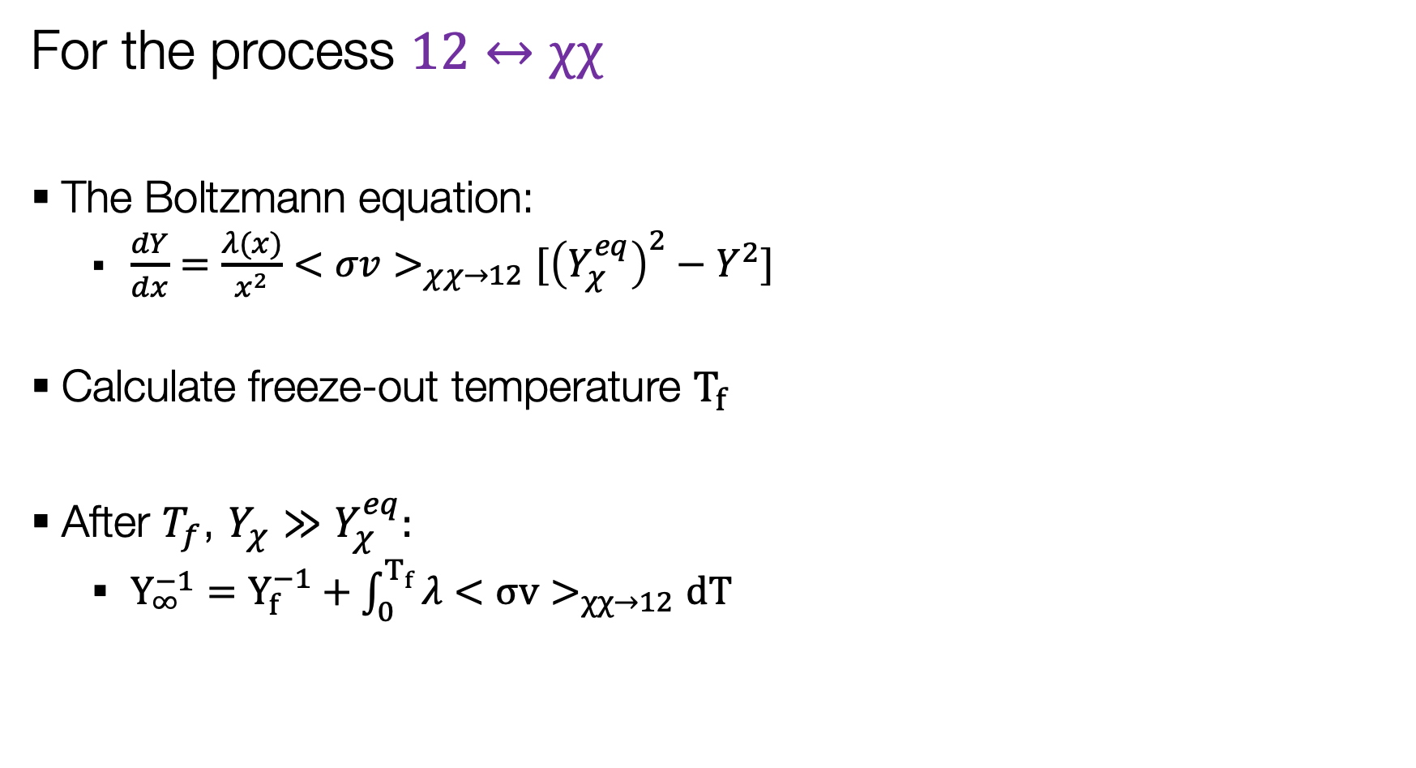
Freeze-Out Calculation
For the process $12↔χχ$
The Boltzmann equation:
  $\frac{dY}{dx}=\frac{λ(x)}{x^{2}}<σv>_{χχ→12}[{\left(Y_{χ}^{eq}\right)}^{2}−Y^{2}]$
Calculate freeze-out temperature $T_{f}$
After $T_{f}$, $Y_{χ}≫Y_{χ}^{eq}:$
  $Y_{∞}^{−1}=Y_{f}^{−1}+\int_{0}^{T_{f}}{λ<σv>_{χχ→12}dT}$

Slide 22
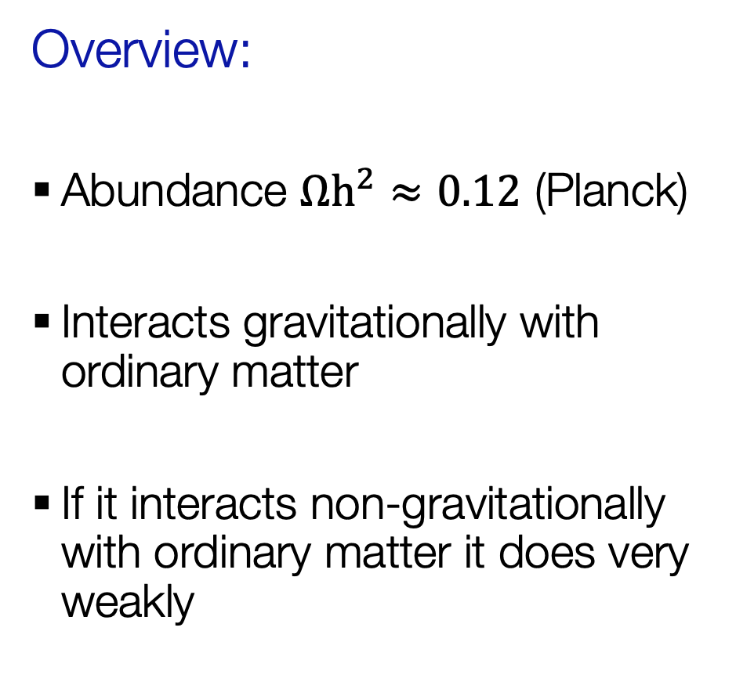
Dark Matter Evidence and Overview
Evidence:
Galaxy clusters
Rotation curves of galaxies
Large scale structure
Cosmic Microwave Background (CMB)
Overview:
Abundance $Ωh^{2}≈0.12$ (Planck)
Interacts gravitationally with ordinary matter
If it interacts non-gravitationally with ordinary matter it does very weakly
NASA, ESA, J. Mack (STScI) and J. Madrid (Australian Telescope National Facility)

