Slide 1

  Sourcing @CERN

Slide 2
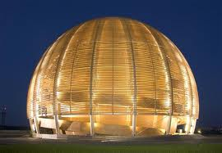

REMINDER : Recruitment vs. Sourcing approach
Recruitment
passive
Attract candidates
Sourcing
active
proactively fetch candidates

Slide 3
  Main Sources & Actions
  Where should we promote our jobs/CERN ?
CERN Jobs
Job/career portals
Schools and Universities
TECH EVENTS
ERT
Soc. &Pro. networks

Slide 4
  Main Sources & Actions
  Where should we promote our jobs/CERN ?
CERN Jobs
Job/career portals
Schools and Universities
TECH EVENTS
ERT
Soc. &Pro. networks

Slide 5









  Social & professional networks
Pro
Soc

Slide 6
  Social & professional networks
MASSIVE IMPACT!
Social & professional networks can help us to make the difference in our sourcing activities:
Become more Visible for our audience
Attract the talent for tomorrow
Promote JOBS & CERN’s image
(HR marketing: branding/EVP, values, benefits, success stories, life at CERN, etc.)

Slide 7
Pro
Soc
Promote the JOBS/CERN
Get Visible
Attract the talent for tomorrow
10 mio
85 mio
120 mio
105 mio
1000
500 mio
www
40 mio
850 mio
ex.: We need a technician in Cryogenics!
RECRUITMENT UNIT PLAN

Slide 8
  What do we do on S&P networks?
  To update information (in line with RU Plan)
    Promote:
      Jobs at CERN
      EVP-Videos- photos
      Benefits
      Success stories
      Our website
  To source candidates and invite them to join CERN group
  To join relevant groups and stay informed about what they are doing

Slide 9
Irene and Michel
Sharon and Agnes
Virginie and Cathy
Cathy and Virginie
Anna and Leila
5 min/per day
+
1h/week
Workload?
Virginie, Caroline and Michel
Leila and Laura
Leila and Laura
Leila and Laura

Slide 10
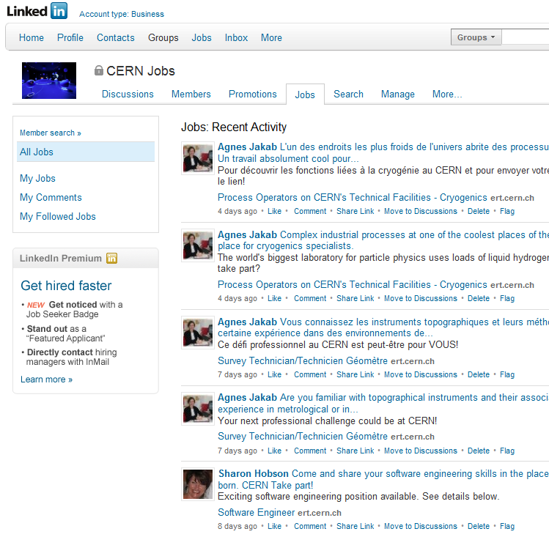
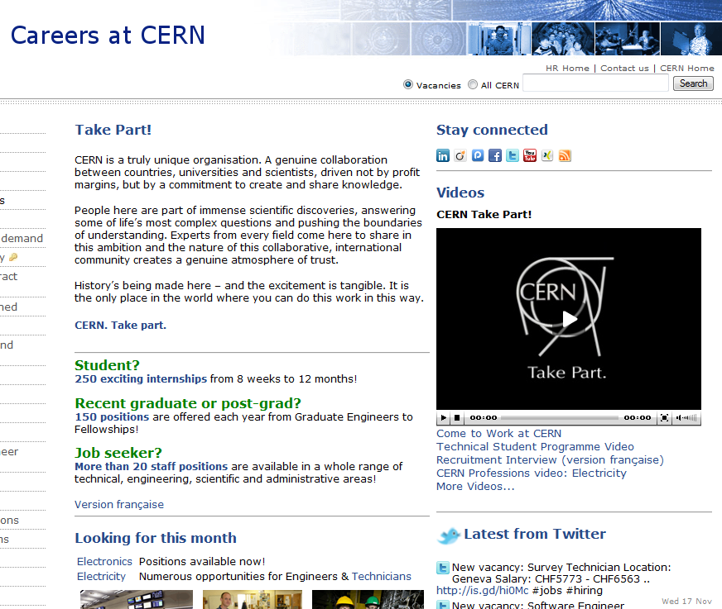
  Example : LinkedIn (Professional network)

Slide 11
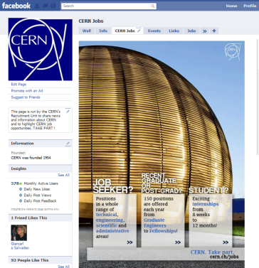
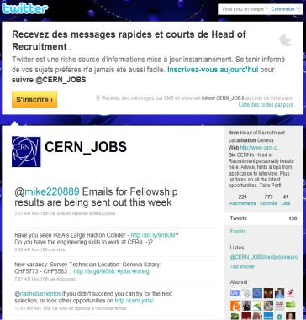
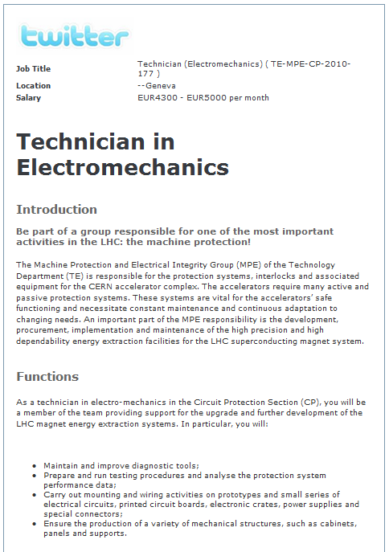
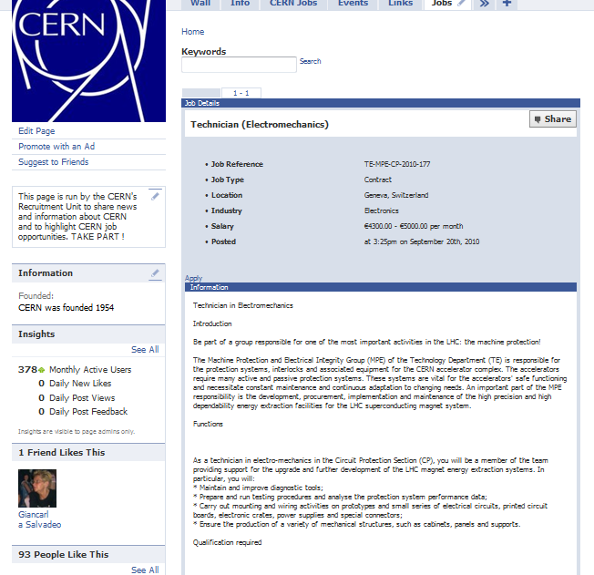
  A few more examples…
facebook.com/CERNjobs
twitter.com/CERN_jobs

Slide 12
  how do we measure the impact?

Slide 13
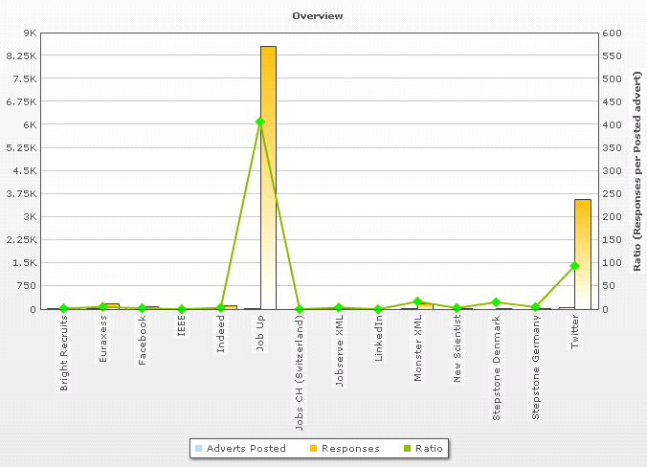
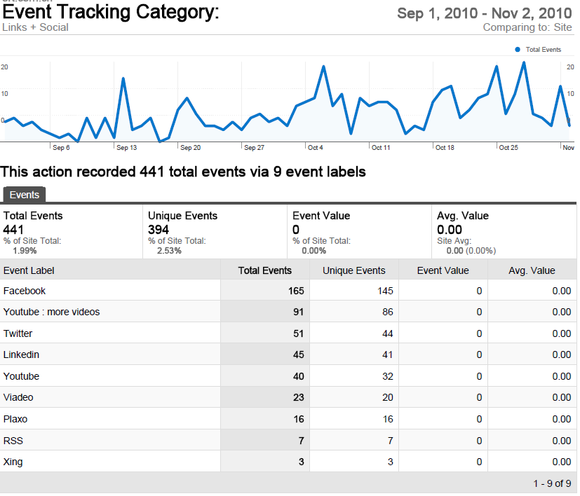
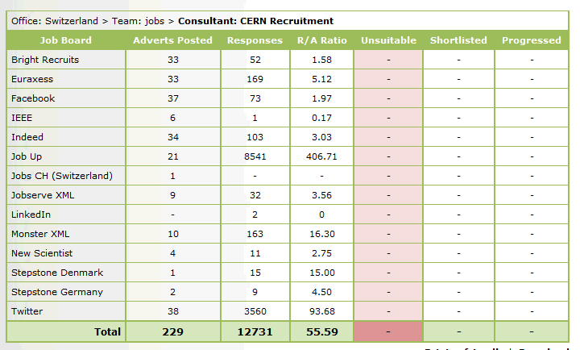
  Applicant tracker
  (Via BroadBean)
  Google
  analytics
  Applicant tracking system

Slide 14
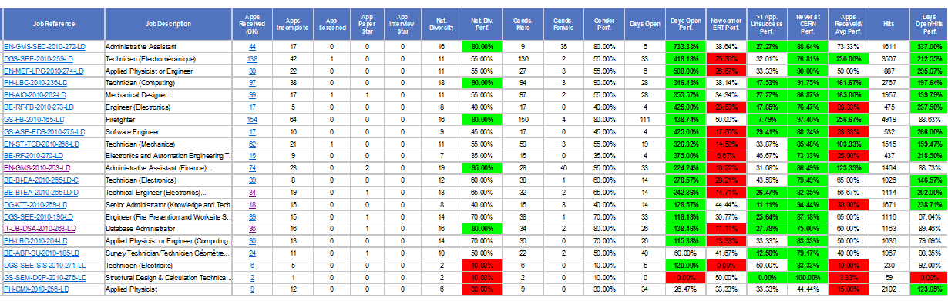
  In House Reporting tool

Slide 15
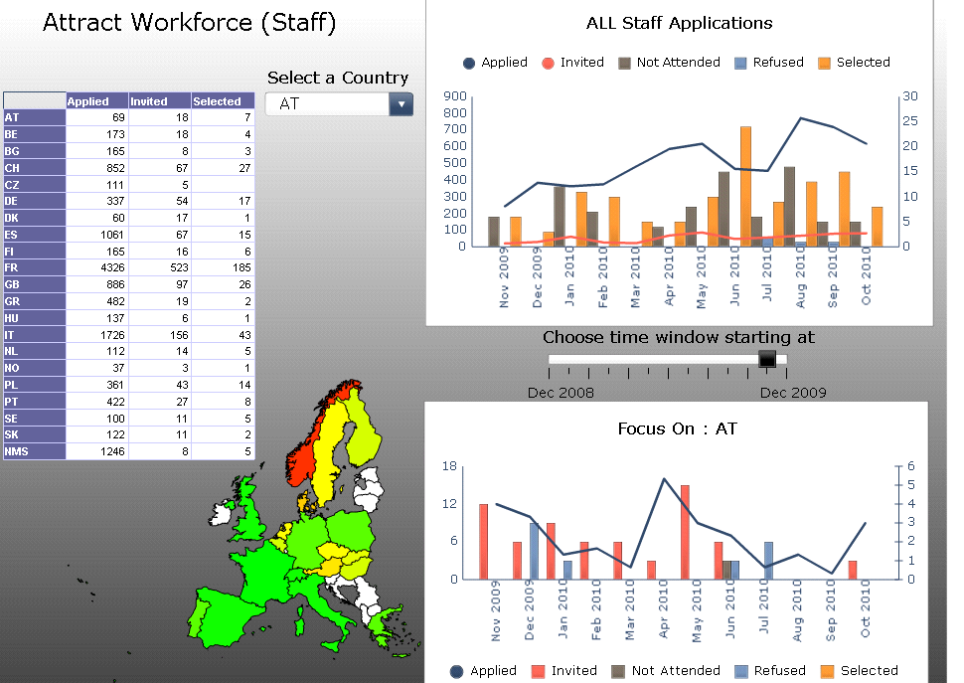
High-level KPIs

Slide 16
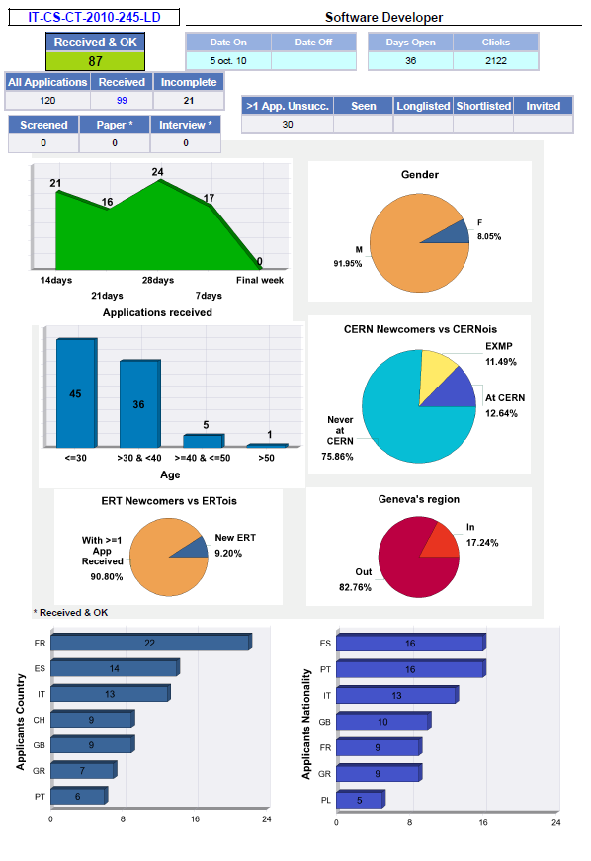
  In house
  Boxi report

Slide 17
…any questions
on social and professional networks?

Slide 18
  Main Sources & Actions
  Where should we promote our jobs/CERN ?
CERN Jobs
Job portals
Schools and Universities
TECH EVENTS
ERT
Soc. &Pro. networks

Slide 19
  Main Sources & Actions
Job/career portals
TARGETED IMPACT!
Job/Career portals can help us to make the difference in
our recruitment activities:
Become more Visible for our audience
Recruit the talent for tomorrow
Promote JOBS & CERN’s image
(HR marketing: branding/EVP, values, benefits, success stories, life at CERN, etc.)

Slide 20

  Main Sources & Actions
…There is a huge number of job portals worldwide…

Slide 21
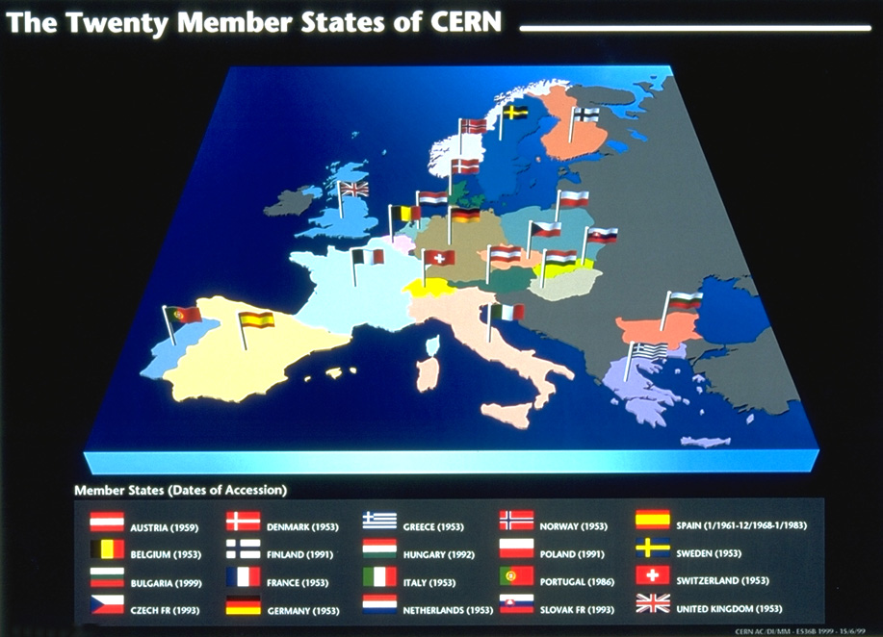

Is it there any chance to reach
20 countries with one click?
YES !

Slide 22
Web-based platform
State-of-the-art multi-posting technology
Centralized applicant tracking tool
Accurate cost control system

Slide 23








How it works?
CERN Jobs

Slide 24
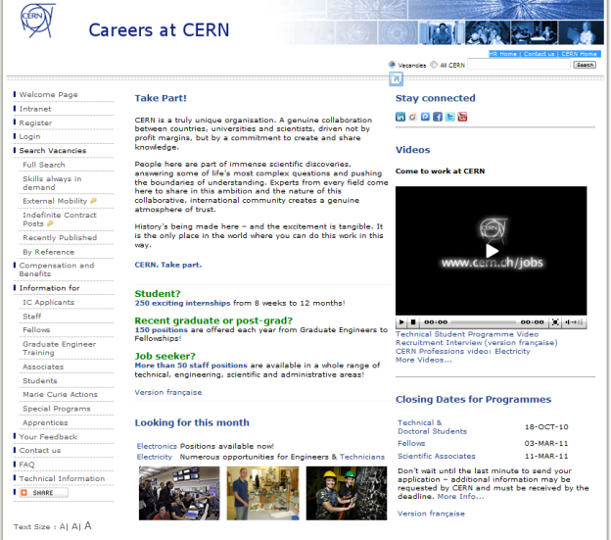
How it works?
Tracks candidates applications

Slide 25






































The network within the network

Slide 26
…any questions
on job portals or Broadbean?

Slide 27
  Main Sources & Actions
  Where should we promote our jobs/CERN ?
CERN Jobs
Job/career portals
Schools and Universities
TECH EVENTS
ERT
Soc. &Pro. networks

Slide 28
The Outreach committee is managing all activities related with:
Academic institutions & Technical events
…within our 20 Member States.
Outreach committee members are :
Nadege Bordon : outreach procedures
Leila Chouraifi-El Baradei : budget, partnerships
Caroline Dumont : website
Virginie Galvin : furniture, brochure, etc
Bartosz Kowalski : Stats
Clementine Lehtinen : preferred consultant

Slide 29
The Outreach committee sourcing challenges are :
To allow CERN to participate to:
  Events
  Forums
  Recruitment fairs
  (…)
To closely collaborate with the Recruitment Unit to:
  Increase CERN’s visibility for difficult recruits:
    Opérateurs faisceau / TI (Technical Infrastructure) / cryo)
    Techniciens du vide
    Design électronique
    Techniciens en cooling & ventilation et Radio protection
To identify new academic and technical events in line with CERN recruitment needs.

Slide 30
…any questions
on outreach committee activities?

Slide 31
  Main Sources & Actions
  Where should we promote our jobs/CERN ?
CERN Jobs
Job/career portals
Schools and Universities
TECH EVENTS
ERT
Soc. &Pro. networks

Slide 32
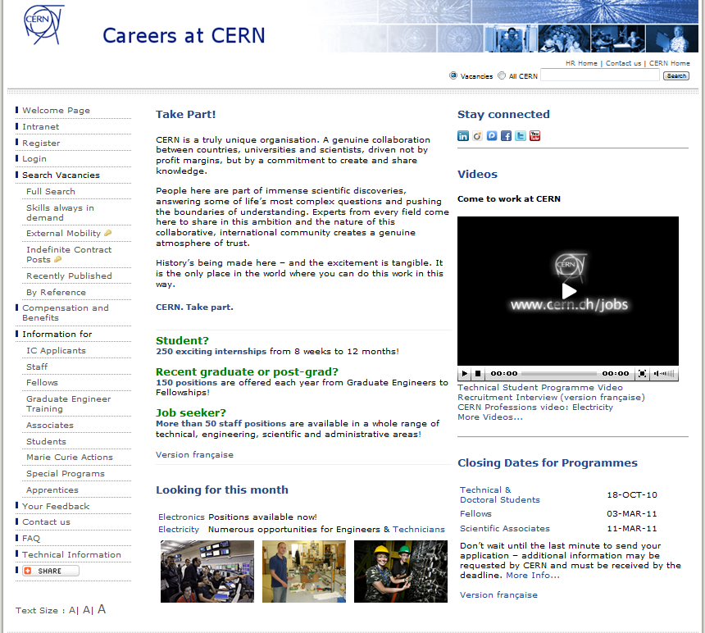
  Main Sources & Actions
e-RT
Always looking for
new talented candidates!

Slide 33
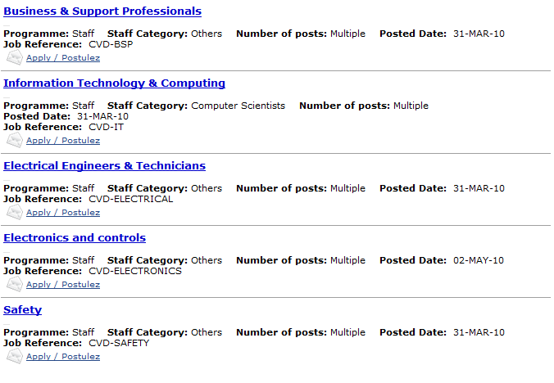

Skills always in demand!
CV Drop-boxes
(CVD)

Slide 34
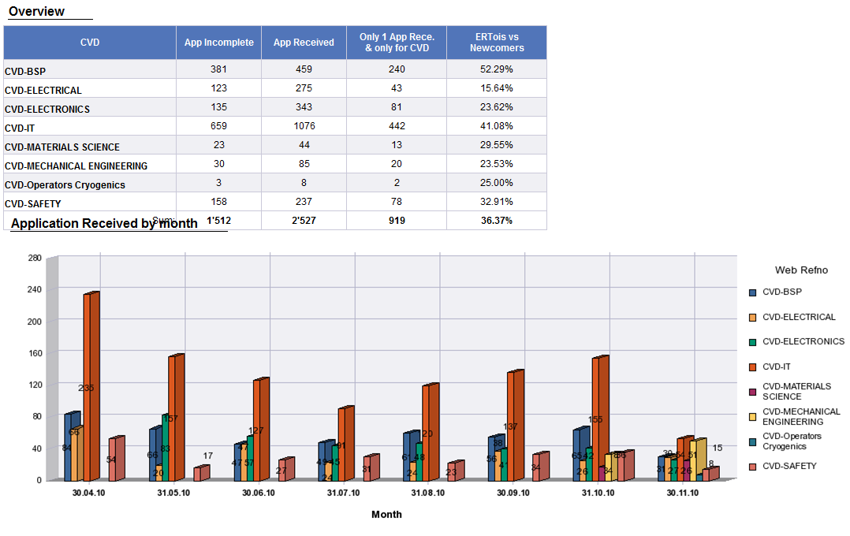
Drop your CV here!
Business & Support Professionals
IT& Computing
Electrical Engineers & Technicians
Electronics and controls
(…)

Slide 35
Drop your CV here!
Business & Support Professionals
To proactively inform the RU about new suitable candidates
Information Technology & Computing
To proactively inform
the HRAs and the Departments about new suitable candidates
Electrical Engineers & Technicians
Electronics and controls
Safety

Slide 36
CERN Jobs
Job/career portals
Schools and Universities
TECH EVENTS
ERT
Soc. &Pro. networks
  Thanks!

