Slide 1
LHCb Beam Interlocks
Beam Permits
Injection Permits

Slide 2
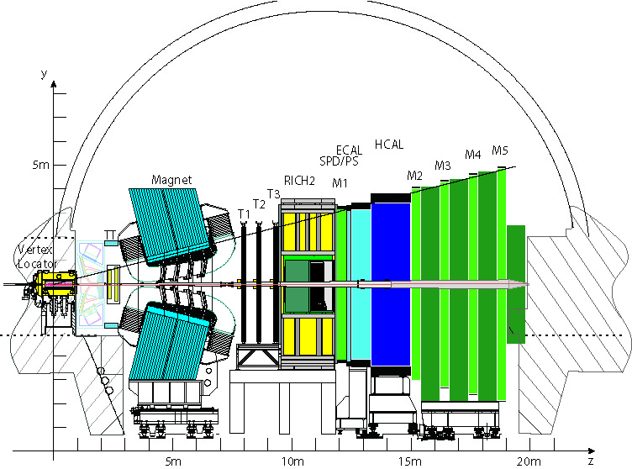
Beam and Injection Permits
Three ‘hard’ sources of Beam Permit interlocks
  Beam Condition Monitor
  Vertex Locator
  LHCb Dipole
One ‘hard’ source of Injection Permit interlock
  Beam Loss Scintillator
  (Beam Condition Monitor)
+ ‘soft’ by Experiment Control System
BLS
BCM-U
BCM-D
DIPOLE
VELO

Slide 3
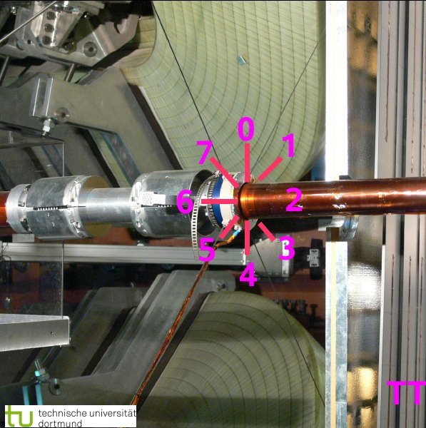
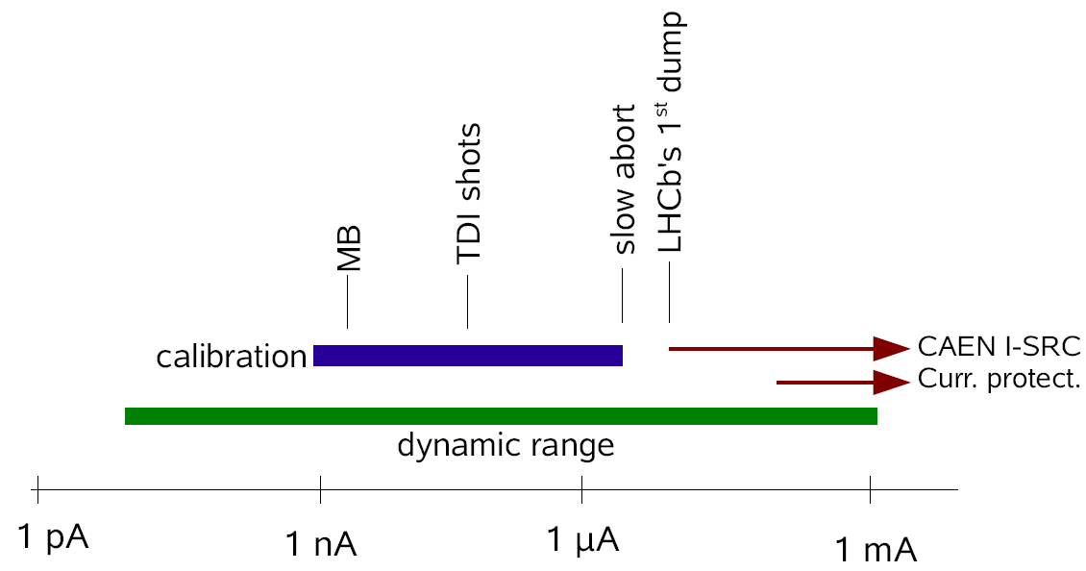
Beam Permits
Beam Condition Monitor (BCM) – Main LHCb Life Guard
  2 stations (Upstream/Downstream) of 8 diamonds each 5/4cm from beam axis
  40μs integration – 36 pA/mips
  Running sums 2x40μs and 32x40μs
    Sum based on diamond 2-6 to account for possibly dead and noisy diamonds
    Available in CCC divided by dump threshold as BKG1 (BKG2)
  Directly connected to non-maskable BIS – always operational
    Dump criteria based on three adjacent diamonds for the 2x40us running sum
  System has no dependence on control/software
    Immediately operational on power-up
    Reset after dump normally by software but may be done with hardware
  Dump thresholds ‘hardcoded’ in VHDL code
    Easy compilation and loading by expert
  Whole system powered by same power as LHC in sector 78
  Entire spare system stored at P8 (except diamonds!)

Slide 4
Beam Permits – cont’d
Beam Condition Monitor – cont’d
  PostMortem processing upon PM signal via GMT
  Beam Permit (Injection Permit) = false during PM processing O(2-3 min)
    Rearming automatic if dump was not triggered by BCM
    Rearming requires manual rearm if triggered by BCM
LHCb Vertex Locator
  Movable device : garage position at 30mm, DAQ position 5mm
  Moving in/out O(2.5min)
  Interlock logic combination of GMT safe flags and VELO position
    Permit True:
      ((VELO_out) and (any Beam_Mode))
      or ((VELO_in) and (Movable_Devices_Allowed))
      Where Movable_Devices_Allowed ~ Stable Beams or Unstable Beams
      And VELO_out is defined as >28mm

Slide 5
Beam Permits – cont’d
LHCb Vertex Locator – cont’d
  GMT flag Safe Stable Beam=false is used to decide withdrawing VELO
    Might become automatic
  Consequence:
    VELO must be retracted before switching to ADJUST or DUMP
      Handshakes!
      Retracting before DUMP logic should change….
  VELO interlock system relies on a BCM_OK
  Position system and interlock on LHCb UPS
    Withdraws automatically on power cut
    Also possible to retract VELO manually…
  PostMortem processing triggered by GMT PM telegram

Slide 6
Beam Permits – cont’d
LHCb Dipole Magnet
  Controlled by LHC
  Magnet Safety System under responsibility of PH/DT1
  Interlock logic based on SC parameters:
    Temperature
    Cooling
    Power converter etc
    Polarity?
  LHCb Magnet failure
    Slow influence on orbit, typically O(σ) in several 100 ms
    Power converter: Reaction time to dump beam ~100 ms
    Cooling failure: Transmit beam interlock 10ms before power converter switches off
  Magnet Safety System on UPS

Slide 7
Injection Permit
Prevent injection while experiment is in incompatible mode
Prevent further injection after ‘dirty transfers’
  Without dumping existing beam
Prevent further transfers during physics
Incompatible mode
  Any interfill activity which involves switching on detectors or VELO_in
    Normally switch to false (if not already done) after dumping each physics fill (calibrations)
  Some interventions on ‘life supporting’ systems
  Injection Permit controlled manually and automatically by ECS
  Rely on Handshakes to issue Injection Permit
  Obviously will not be needed in repeated LHC tests during MDs etc

Slide 8
Injection Permit – cont’d
‘Dirty transfers’ measured by Beam Loss Scintillators
  Prevent repeated splashes not seen by CCC immediately
  25ns integration and readout of fast losses
  Using injection prepulse via BST to integrate 3-10 turns after each transfer
  Experiment off during injection so ‘high threshold’
  Will only be activated in automatic mode once experience has been gained
Injection Permit interface same as BCM
  Safe power, operational without software etc
Beam Loss Scintillator system on LHCb UPS

