Slide 1
Collimator Remote Commissioning w/o Beam
Plans and Status
R. Assmann
for the collimator commissioning team
O. Aberle, R. Assmann, C. Bracco, R. Losito, A. Masi, S. Redaelli, A. Rossi, D. Wollmann
MPP 2.10.2009

Slide 2
Meaning of “Safe” for us
Three kinds of interlocks, derived from fully independent hardware sensors:
  MP interlock: Collimators must always generate an interlock if their gap is inconsistent with the present beam energy ➔ guarantees MP and should not be adjusted.
  Cleaning interlock: Collimators must always generate an interlock if a single motor runs off its time-dependent reference position beyond a maximum allowed error (“interlock threshold” around reference position) ➔ guarantees cleaning performance and probably needs more frequent adjustments.
  Self-protection interlock: Collimators must generate an interlock if the jaw temperature is abnormal.
Even though signals are fully independent, there is important redundancy and cross-coverage between different interlocks.
Overall system has been designed as cleaning system not a protection system ➔ limited passive protection due to phase space coverage. Be aware! DO NOT assume that everything beyond 6 sigma (TCP setting) is safe – it is not!
Cleaning design, performance and settings are discussed in collimation WG.
However, the system provides some passive protection and some collimators are crucial part of the injection/dump protection: important that MPP is aware about the work done and provides any necessary input.
Everybody is very busy: No feedback received for collimator commissioning plan sent around 1 month ago. Now it is time or it will be too late!

Slide 3
Collimator Remote Commissioning without Beam
All collimators fully operational. Have completed full STI/OP/ABP HW commissioning.
Only small fraction of remote tests important for MP (see procedure):
  MP gap interlocks (energy-dependent) must function as specified.
  Collimator position interlocks (time-dependent) must work. For many collimators determined by cleaning requirements.
  Collimator temperature interlocks must work (collimator self protection).
Reference positions (cleaning & protection) will be determined with beam-based alignment and cannot be established now in mm. However, prepare now:
  Establish reference positions in sigma.
  Establish interlock windows in sigma/mm around reference positions.
Most work of remote collimator commissioning aiming at checking initial precision:
  Not needed to establish protection.
  Needed to minimize setup time (start with good positions).
  Needed to understand cleaning dynamics.
We spend time on precision (sensor calibration) now, even if not needed for MP.
Goal: Safe and very precise system with at least 2 weeks integrated and realistic running experience before beam (in addition to 2009 running).

Slide 4
Scope of Collimator Remote Commissioning w/o Beam
All movable collimators and absorbers in the rings and the transfer lines (100 devices).
Not included:
  TCDQ. We need OK for remote commissioning. Note: TCS at the TCDQ is included.
  Roman pots. Not declared ready for remote commissioning.
Our offer beginning of September:
  Include all devices that are declared ready in these tests.
  Note, that any device must have completed full hardware commissioning up to the CCC interface before we can take it (like done for the 100 collimators and absorbers).
  Due to limited resources cannot have commissioning campaigns per single device.
  We must operate large ensembles of collimators and analyze performance.
As collimators are independent from other LHC elements:
  Profit to run independent collimator ramp cycles. We can test fully from injection, over ramp to squeeze.
  OP can and have run/watched the collimator ramp cycles (thanks for the help).
  Work is not included in the dry run sequence but is run by combined ABP/OP/STI team within the collimation project: O. Aberle, R. Assmann, C. Bracco, R. Losito, A. Masi, S. Redaelli, A. Rossi, D. Wollmann.
Must integrate with other LHC activities, once the magnets are ramped.

Slide 5
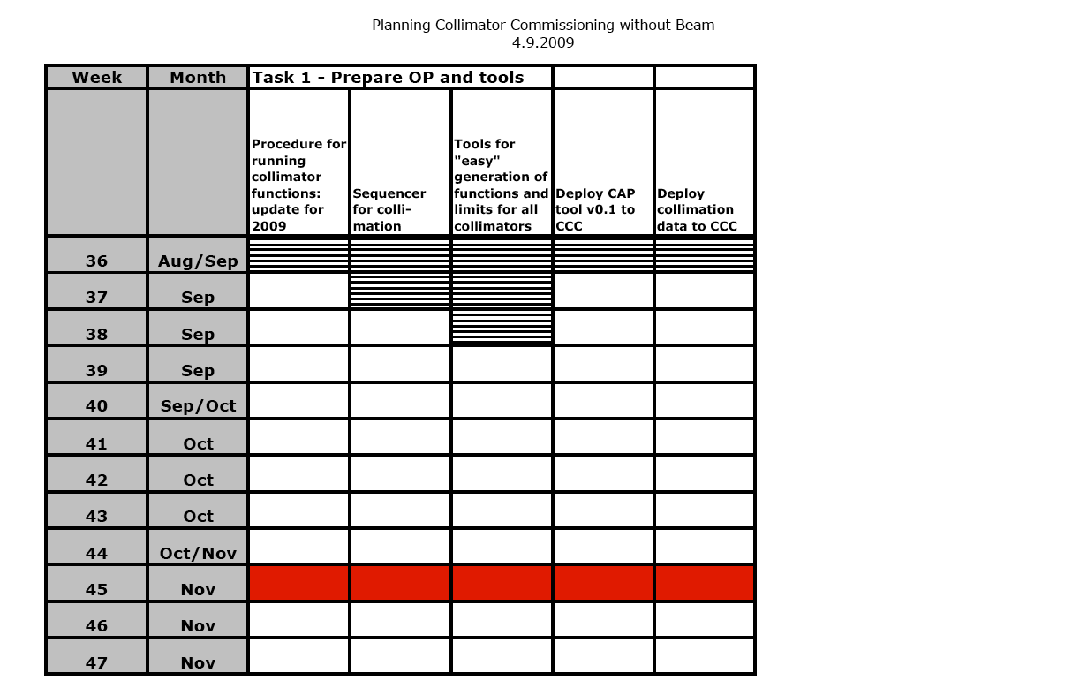
✔
✔
✔
✔

Slide 6
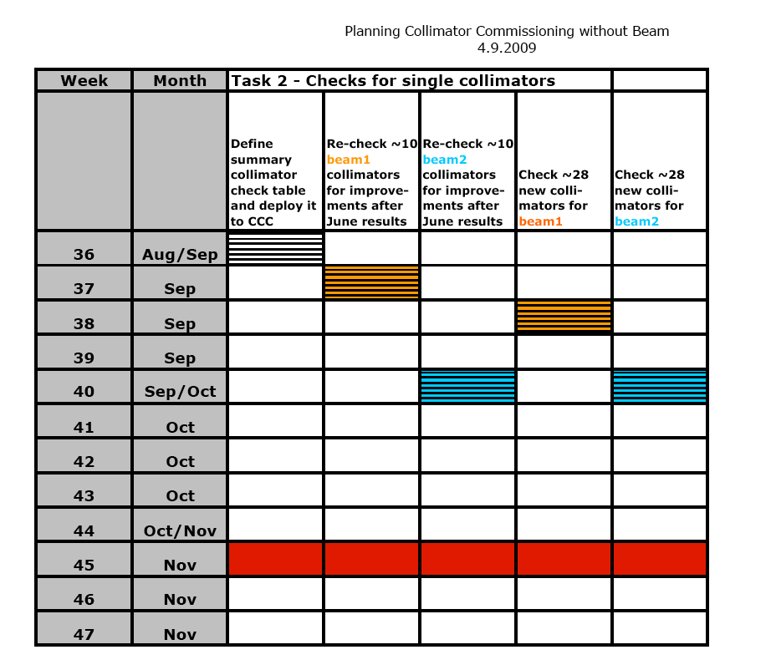
14 beam1 + TI2/8 collimators retested for calibration:
larger than expected offsets in switches (not critical for operation but longer initial BBA).
STI group review of causes. Understood.
This week: Tests of interlock connection (Bruno, Alessandro et al).
Interruption of program…
✔
✔
✔

Slide 7
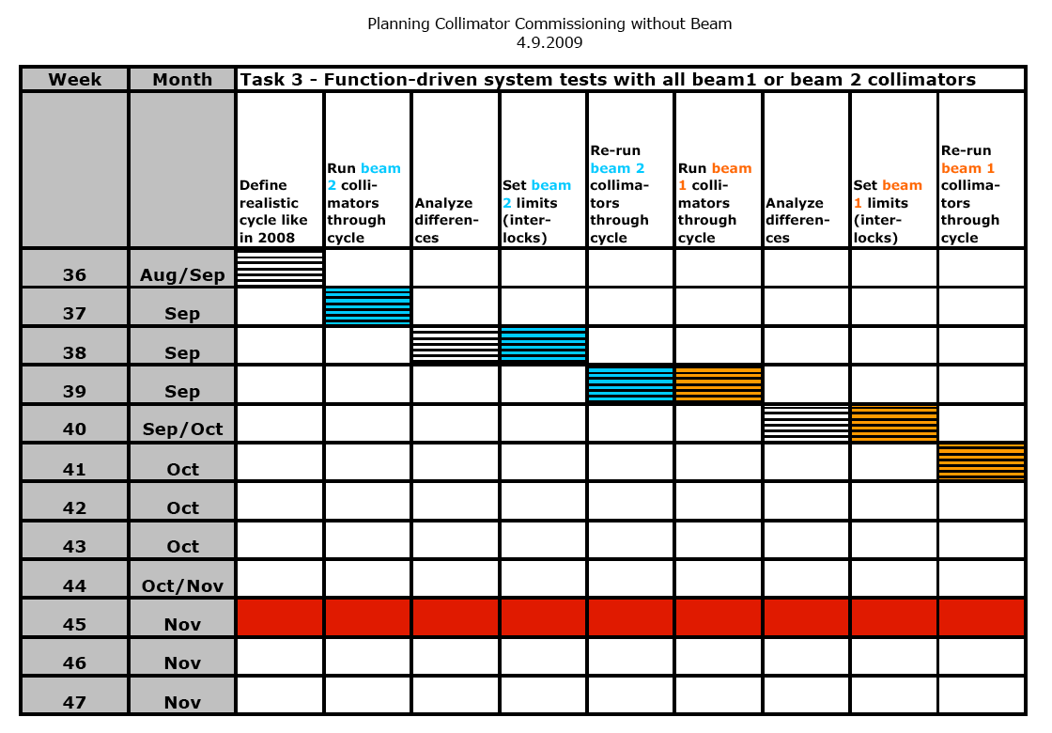
Many tests optional, can be shortened or skipped if needed. OK for now!
✔
✔
✔
Plan to profit from machine test ramps to run collimators in parallel!

Slide 8
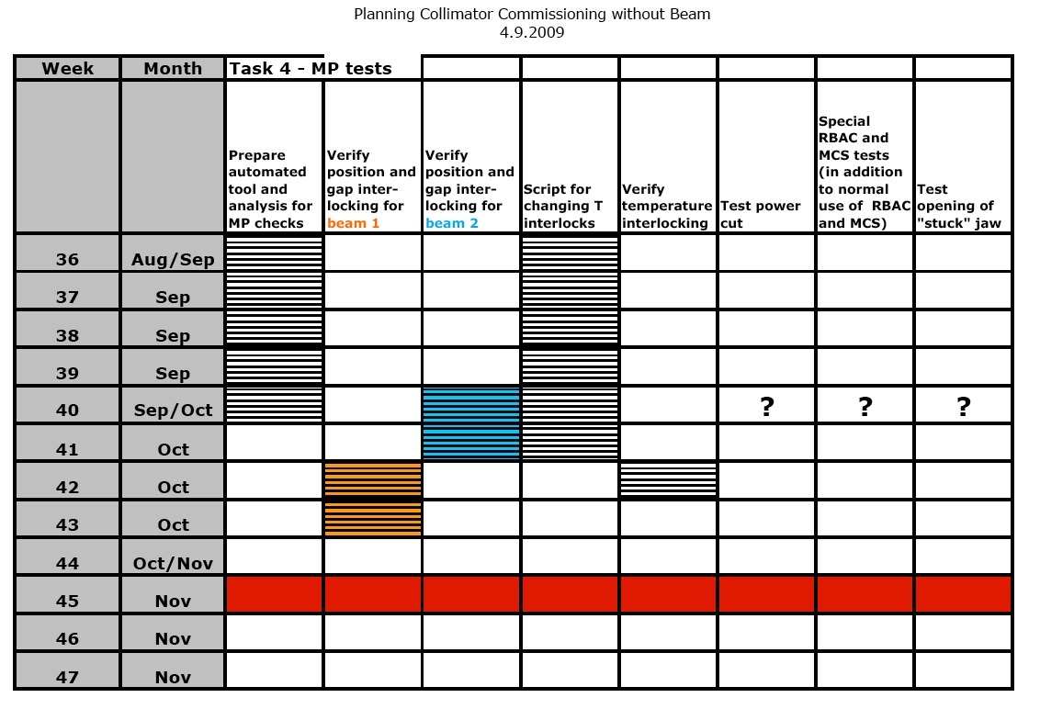
Three MP tasks that must be completed to declare system safe!
Optional tests to improve recovery time in case of problems.
Note: MCS not yet active due to expert requirements. RBAC OK.
On this essential work we might run some days late. OK!

Slide 9
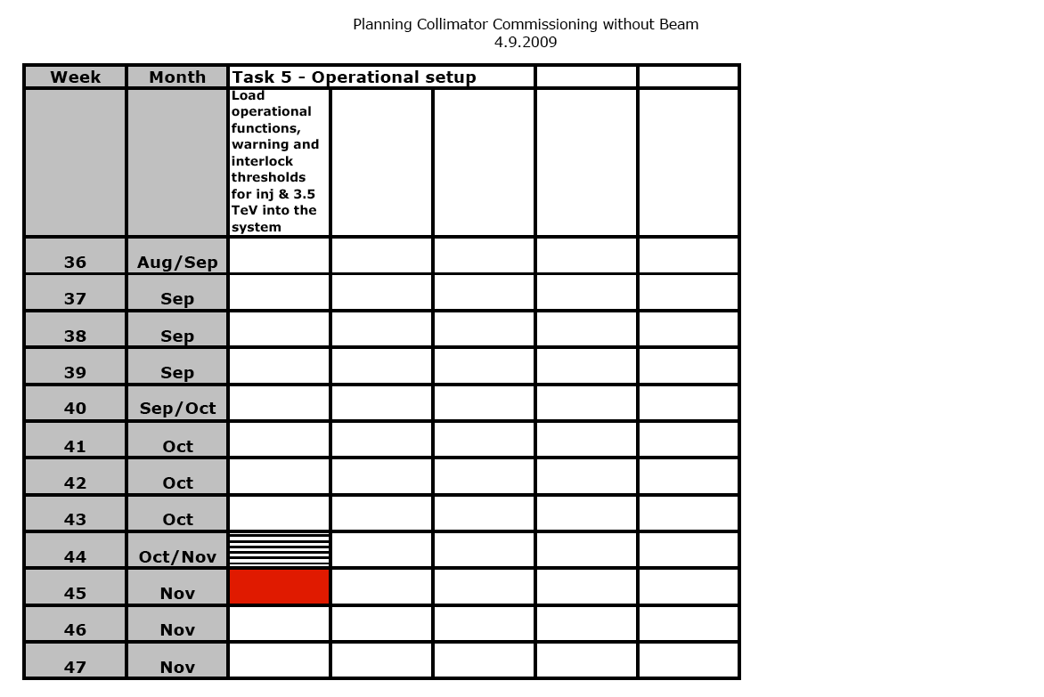

Slide 10
Conclusion for Commissioning
All collimators fully operational. Have completed full STI/OP/ABP HW commissioning.
No major problems in remote commissioning. Found mainly some offsets in end switches which are being understood and will be fixed ➔ faster beam-based setup.
About 2 weeks delay with respect to initial plan: spent to improve precision, to deploy/test RBAC+MCS, and to do additional tests (interlock tests). We are still OK but time becomes critical to avoid a last minute rush.
Important: Complete, as promised, the MP tests in the next 3 weeks for both beams
➔ system safe afterwards.
Important: Fix the normalized settings (see Adriana’s summary) and fix the interlock thresholds on gap and positions (to be done, thanks to Brennan for TCDQ input).
We should not discuss this in the CCC when we need it. Should all be prepared, ready and tested beforehand.

Slide 11
Notes on Collimator Settings and Boundary Conditions
Collimator settings and commissioning studied since several years. Documented in several Chamonix presentations and PhD’s of G. Robert-Demolaize and C. Bracco.
Optimized collimator setup strategies were defined and worked out in detail, arriving at the so-called “intermediate” collimator settings as 2009 baseline.
Intermediate collimator settings make use of aperture to relax operational tolerances during ramp and squeeze. Price to pay: A larger minimal n1 must be respected, meaning limitations in the β*.
The “phase I” collimation system is ready for tight settings but the machine stability and reproducibility will decide whether these settings can be safely achieved in 2009. Also, new worry from TCDQ studies for very tight settings (B. Goddard et al).
Tighter settings can be tried at end of physics for a couple of hours to see whether machine conditions allow these.
Propose to have intermediate settings in the commissioning plan and use tight settings as optional step.
Here, explain different settings and boundary conditions for operation.

Slide 12
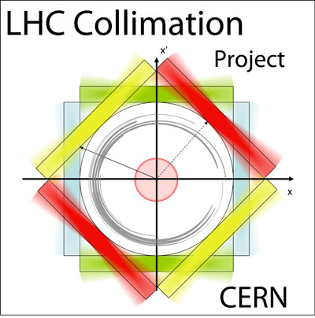
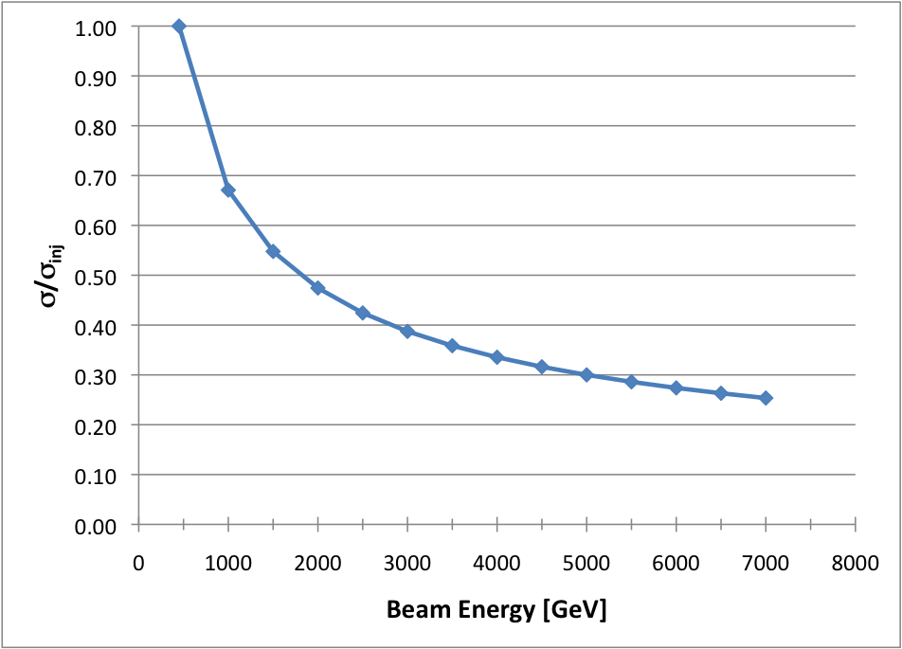
Important Reminder: Beam Size σ Scaling
(adiabatic damping)
factor ~3
➔ The same “sigma setting” is a much smaller absolute setting at higher energy!

Slide 13
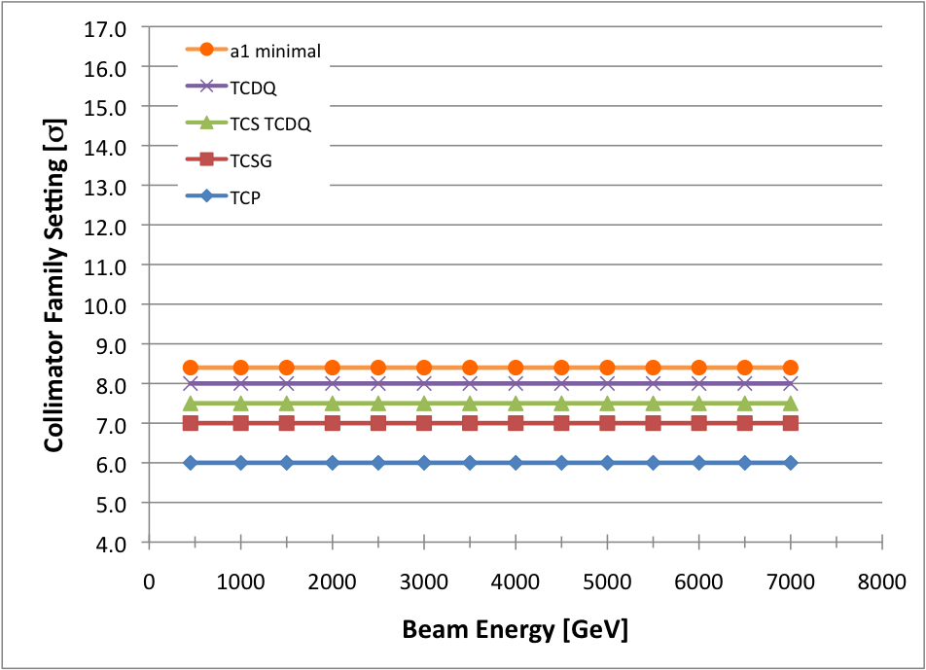
Possibility 1: Scaled Collimation Settings
Keep collimators at the same number of sigma’s ➔ absolute gaps are reduced as the beam size shrinks
a_{norm} = normalized settings [σ]
a_{real} = absolute settings [mm]
➔ Not favored for early running due to very tight tolerances at higher energies (~3 times smaller tolerances at 3.5 TeV than at injection – total tolerance budget ~350 μm).

Slide 14
Reminder: Tolerances from Collimator Families
The LHC collimation system acts as a global system with settings closely connected between different IR’s.
Here focus on a some critical collimator families:
  Primary collimators TCP in IR7.
  Secondary collimators TCSG in IR7.
  Dump protection from TCS TCDQ and TCDQ in IR6.
Other families will be set in accordance with the settings of these families (TCP@IR3, TCSG@IR3, TCT, TCLA, TCL, TCLI, TDI, TCDI). Detailed settings from A. Rossi.
Critical is also the shadowed ring aperture a₁ which is given in the figures (related to required n₁ aperture parameter of the LHC through a₁ = 1.21*n₁).
The system only works if the hierarchy is respected, e.g. the primary collimators always remain the closest devices to the beam, the secondary collimators always remain the second closest devices to the beam, …
Therefore the distance in settings gives the available overall tolerance budget: We want to maximize distance in settings as much as possible.
Tolerances are eaten up by closed orbit changes, beta beat changes, collimator positioning errors, … during injection, ramp, snapback and squeeze.
Tolerance budget ranges from 1mm (injection) to 0.2mm (7TeV, β*=0.55m).

Slide 15
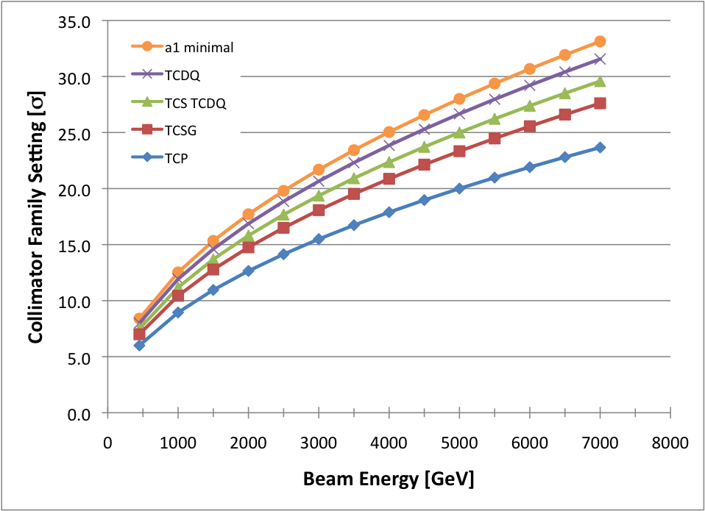
Possibility 2: Constant Real Collimation Settings
(no reduction in collimator settings with respect to injection)
➔ Not possible for protection and performance issues (no squeeze possible).
Maximizes tolerances. First ramps will be done this way.

Slide 16
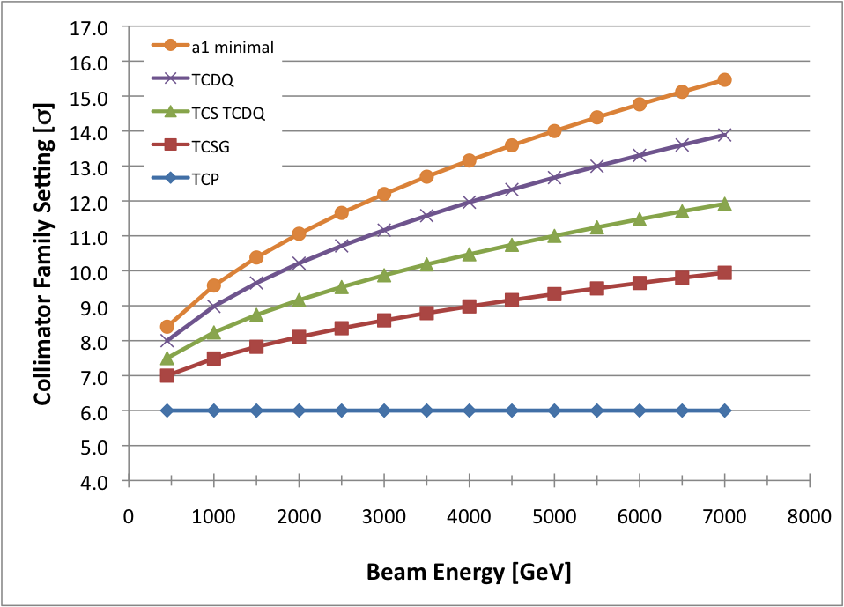
Possibility 3: Intermediate Collimation Settings
➔ Baseline for 2009/10 run, providing good protection, cleaning and tolerances.

Slide 17
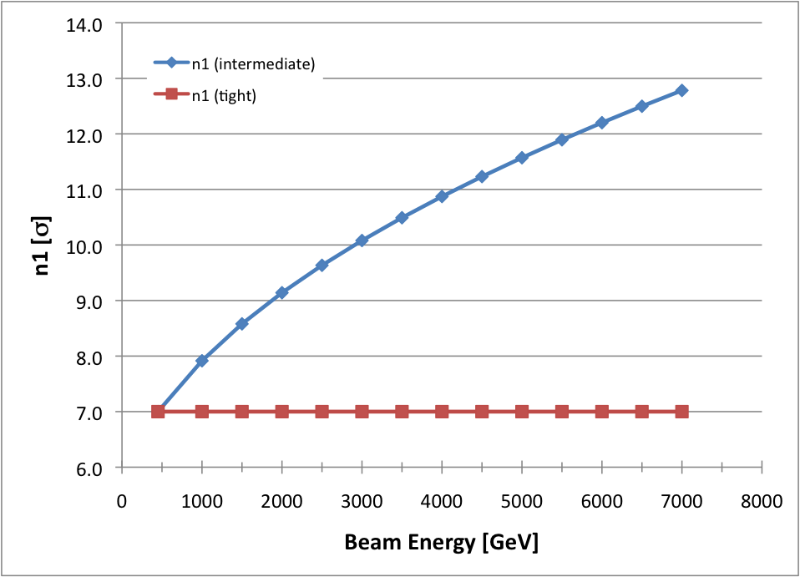
Condition: n₁ must be ≥ the minimal n₁ which is properly shadowed (minimal allowed n₁)
We buy increased operational tolerances with aperture.
Aperture which is used is not available for beta squeeze.
Consequence is reduced peak luminosity.
In the end trade-off between “operational efficiency/integrated luminosity” and “peak performance”.
Minimal allowed n₁
At 3.5 TeV: n₁ ≥ 10.5 for intermediate collimation settings

Slide 18
Summary
Commissioning should stage all important LHC parameters, as already worked out for β*, beam-beam tune shift, intensity and stored energy (see plans M. Lamont, M. Ferro-Luzzi, et al).
Another crucial parameter is the available LHC aperture at top energy, affected by the beam energy, β* and crossing angles.
Propose to respect a minimal aperture of n₁ = 10.5 at 3.5 TeV for the 2009/2010 run.
The margin (with respect to the nominal n₁=7 aperture) would then be used for intermediate collimator and protection settings.
Result would be less critical protection and an increased total tolerance budget for LHC operation ➔ better operational stability while we learn with the machine.
We will certainly try tighter settings as we move along, reducing collimation gaps and operational tolerances in steps.

