Slide 1
Muon Collider
EU Design Study – WP6 task3
Accelerator Ring Magnets
F. Boattini
24.02.2022

Slide 2

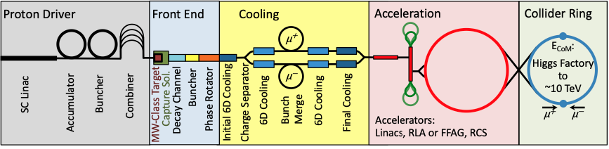
Proposed Tasks
Task 1. Coordination, Integration and Communication
Task 2. Target, Capture and Cooling Magnets (MC.HFM.SOL)
Task 3. Accelerator Magnets (MC.FR)
Task 4. Collider Ring Magnets (MC.HFM.HE)
Task 1
Task 2
Task 3
Task 4

Slide 3
Task 3 - Accelerator Complex (MC.FR)
Overall IMCO goal:
2020 update of EU Strategy for Particle Physics, puts “muon beams and muon colliders” among the five strategic R&D paths.
For 2026: […] “develop a muon collider concept at 10 TeV and explore a 3 TeV staging to mitigate technology and operational challenges”. (ESPPU2020) Based on results of the study, a CDR investment may or may not be decided by the next ESPPU
Low land use
KPIs
High luminosity per wall-plug power consumption (10TevMC < 3TeV CLIC)
Sinergy with other technology and physic programs
Task3 goal:
For 2026: study a muon accelerator magnets+powering design for 10TeV with 3TeV stage with conceptual design of magnets and power system with cost and land estimation.

Slide 4
Task 3 - Accelerator Complex (MC.FR)
CERN SY-EPC
  Study and demonstration of integrated storage, conversion and magnet system
    Concepts for energy storage and powering
    Power conversion
  Contact person: Dr. F. Boattini
LNCMI
  Energy storage and fast powering
    Experience in high-power supplies (recent acquisition of 90 kJ, 2 GW pulsed supply)
  Contact person: Dr. J. Beard
TU Darmstadt
  Modelling and simulation of superconducting magnet systems in combination with the power electronic supplies
    Electromagnetic calculations in 2D and 3D, including NC and SC steady-state and transient effects
    Model reduction to achieve coupling to suitable circuital model
    Sensitivity analysis and optimization of magnet design
  Contact person: Prof. H. De Gersem
University of Bologna
  Design and analysis of accelerator magnets and powering
    Contribution to the conceptual design of AC+DC SC+NC and all-SC magnet systems: magnetic field computations, coupling between insert and outsert, quench simulation, AC loss calculation
    Interaction with the designers of the power electronics (UNIBO)
  Contact person: Prof. M. Breschi
University of Twente
  Contribute to the design and conductor effort
    HTS conductors, forced flow cables, for fast cycling magnets
  person: Prof. H. ten Kate (initial), Prof. A. Kario

Slide 5
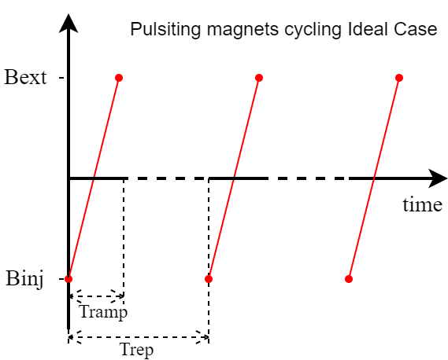
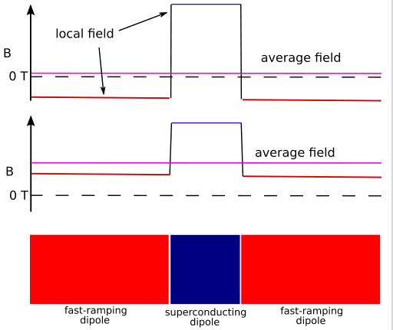
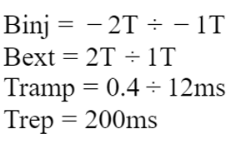
Task 3 – hypothetic design of the accelerator
 | courtesy of D. Schulte
Collider COM energy | 3TeV collider |  | 10 TeV
 | RCS1 | RCS2 | RCS3
Einj [GeV] | 60 | 300 | 1500
Eext [GeV] | 300 | 1200(*) | 5000
peak ramping field [T] | -2 ÷ +2 | -2 ÷ +2 | -2 ÷ +2
Tramp [ms] | 0.4 | 2 | 11.67
dB/dt [kT/s] | 10 | 2 | 0.35
Total accelerator length [km] | 2.8 | 13.8 | 38
ramp magnets length [km] | 1.26 | 6.28 | 18.3
  (*) probably a typo, it should be 1500 GeV
Alternate fixed field (SC) dipoles with fast ramping resistive magnets
dB/dt → 0.35 ÷ 10 kT/s
Fixed (SC) field → ≈ 10T
Repetition rate of 5 ÷ 10Hz
Linear Ramp
Alternate fixed field (SC) dipoles with fast ramping resistive magnets

Slide 6
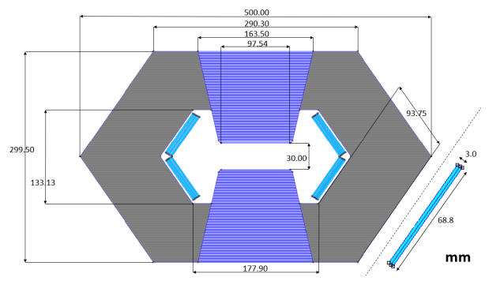
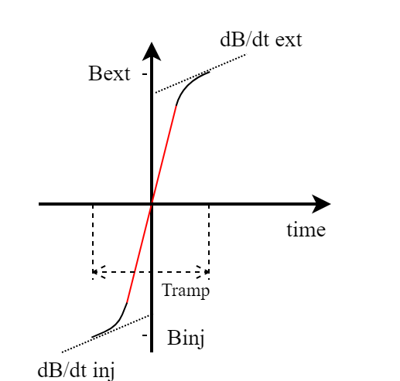
Task 3 – MAP dipoles
MAP design for Dipoles
 | courtesy of D. Schulte
Collider COM energy | 3TeV collider |  | 10 TeV
 | RCS1 | RCS2 | RCS3
Einj [GeV] | 60 | 300 | 1500
Eext [GeV] | 300 | 1200 (*) | 5000
peak ramping field [T] | -2 ÷ +2 | -2 ÷ +2 | -2 ÷ +2
Tramp [ms] | 0.4 | 2 | 11.67
dB/dt [kT/s] | 10 | 2 | 0.35
Total accelerator length [km] | 2.8 | 13.8 | 38
ramp magnets length [km] | 1.26 | 6.28 | 18.3
  (*) probably a typo, it should be 1500 GeV
  Calculated dipole magnetic energy
  RCS1 → 12 MJ
  RCS2 → 64 MJ
  RCS3 → 100 MJ
  Calculated dipole magnetic power in linear ramp
  RCS1 → 60 GW
  RCS2 → 64 GW
  RCS3 → 17 GW
Can we bend it a bit?

Slide 7
Task 3 – The big questions
dB/dt → 0.35 ÷ 10 kT/s
  For resistive magnets: what are the limits of dB/dt
  what losses should we expect?
  Can we use SC for pulsating field directly? Where? What field?
Tens of MW ?
Peak Power → 17 ÷ 64 GW with linear ramp
  What power converter topology? Cap discharge + active filter?
  What are the limitations of power electronics (active filter and switches for LC discharge)
  What dimensions and cost should we expect?
Billions € ?
Magnet Energy → 12 ÷ 100 MJ
  NRG storage in capacitors seems most direct selection. NRG levels not incredible but high repetition rate, fast discharge, voltage reversal etc..
  Safety is II order in feasibility but not in cost and space requirements.
  What dimensions and cost should we expect?

Slide 8
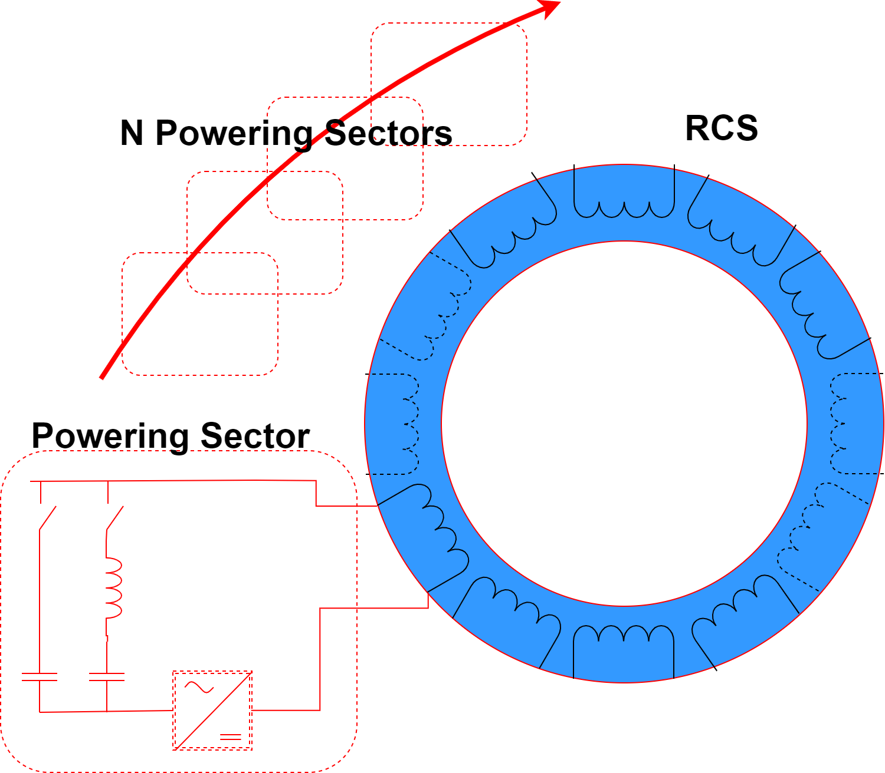
Task 3 – sub task proposal
dB/dt
10-20 years perspective ?
Muon acceleration and collision
(MC panel)
WP6 task3
Pulsed SC on RCS:
Redesign RCSs with full ramping magnets and check where pulsed SC could be used
Conceptual Magnet design:
Dimensioning according to topology
Energetic model for power converters
Losses model (for resistive magnets)
Cost model
SC related computations
Cryogenic requirements? (for SC magnets)
NRG in vacuum chamber
Vs
Energy of Magnets
N of turns
N of sectors/magnets
Current shape Vs losses
Conceptual Power converter design:
Topology alternatives
Losses model (including cables)
Cost model
cooling requirements?

Slide 9
Task 3 – Technical R&D for a CDR
R&D proposals for accelerator magnets and power supply
Material for pulsed and fixed SC
Technology for magnet realization
Normal conducting fast ramping magnet samples for model verification ?
Others?
Conceptual Magnet design:
Dimensioning according to topology
Energetic model for power converters
Losses model (for resistive magnets)
Cost model
SC related computations
Cryogenic requirements? (for SC magnets)
Power electronics models to test limits of realization (switches, AF..) (mainly by industries)
Storage elements testing for ageing (capacitors, inductors…)
Conceptual Power converter design:
Topology alternatives
Losses model (including cables)
Cost model
cooling requirements?
This program could start in five years

Slide 10

Task 3 – Milestones and deliverables for 2026
WP submitted for INFRADEV
Infratech?
2022
2023
2024
2026
Deliverables
REPORT
REPORT
Preliminary concept evaluation:
Topology studies for hybrid DC-AC or full AC magnets and power converters combined solutions
Preliminary magnets and power converter design with focus on simplified models for optimization and cost/space evaluation
Final concept evaluation:
Conceptual design of SC and resistive magnets for the complete RCS.
Conceptual design of the power converters.
Cost/Space estimation
Identification of the R&D requirements for a CDR
Milestones

