Slide 1
LHC Collimator
Phase Coverage
Thanks to Delphine Jacquet

Slide 2
Content
1. Introduction
2. Phase coverage throughout LHC cycle
3. Summary

Slide 3
Content
1. Introduction
2. Phase coverage throughout LHC cycle
3. Summary

Slide 4
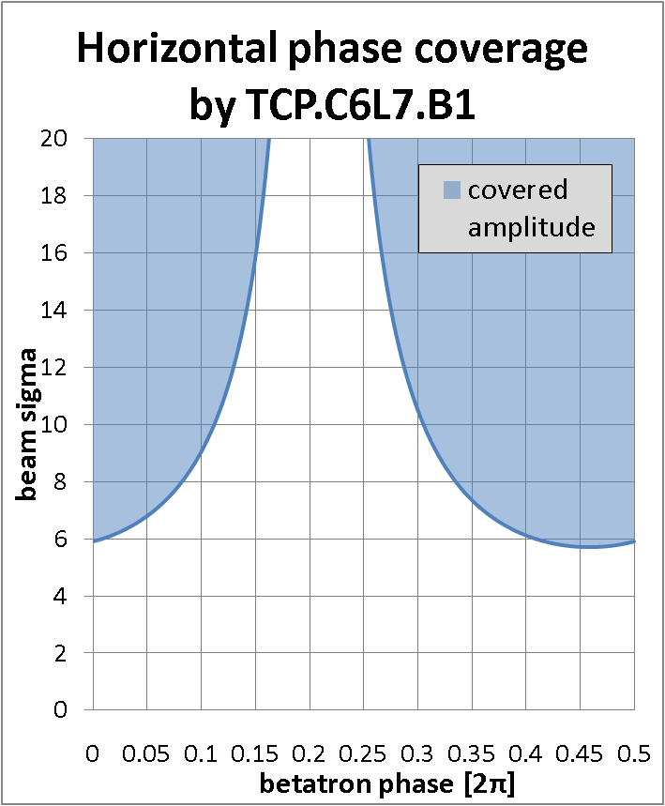
Collimator Phase Coverage
Collimator
A
G_{Col}
φ₂
φ_{Col}
φ₁
betatron phase
G_{col} = A ∙ sin(φ_{Col} – φ)

Slide 5
Content
1. Introduction
2. Phase coverage throughout LHC cycle
3. Summary

Slide 6
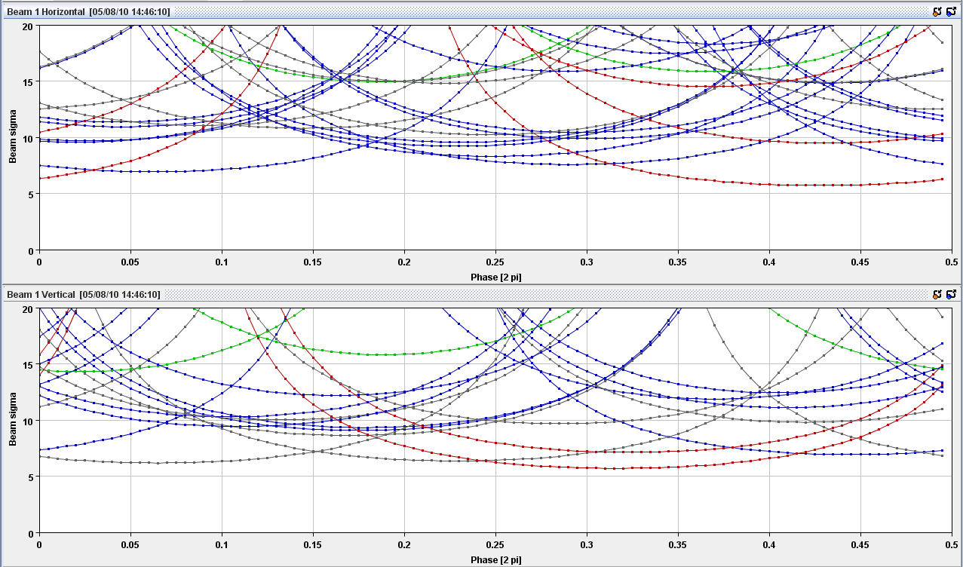
Injection B1
9σ
TCSG.4R6.B1
TCSG.6R7.B1
TCSG.B4L7.B1
TCP.C6L7.B1
TCLIB.6R2.B1
TCLIA.4R2
TCP.D6L7.B1
TCSG.D4L7.B1

Slide 7
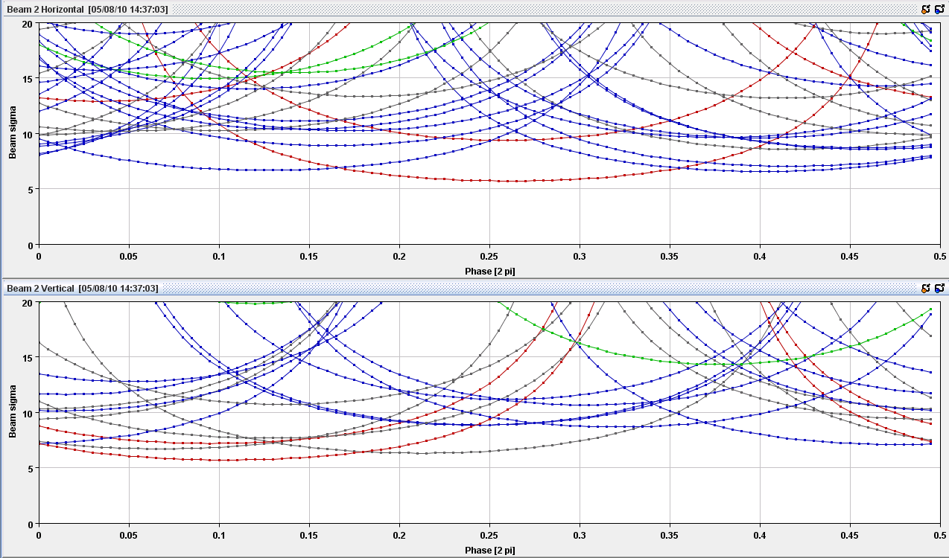
Injection B2
TCSG.6L7.B2
TCSG.B4R7.B2
TCP.C6R7.B2
TCSG.A4R7.B2
TCSG.D4R7.B2
TCP.D6R7.B2
TCLIB.6L8.B2

Slide 8
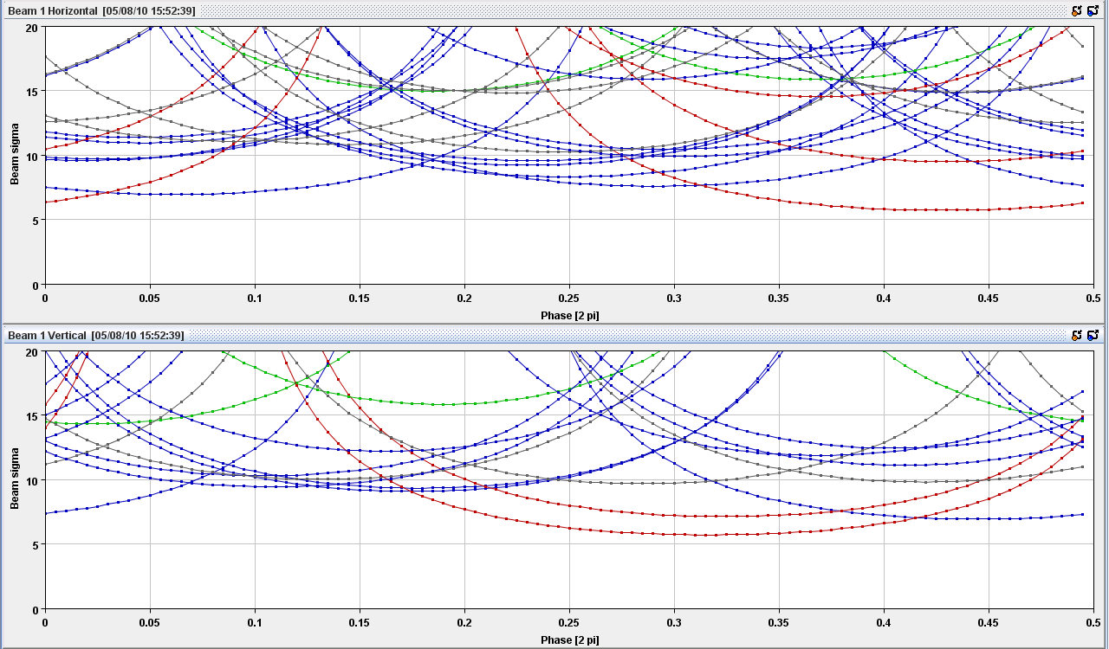
After Injection B1
TCSG.4R6.B1
TCSG.6R7.B1
TCSG.B4L7.B1
TCP.C6L7.B1
9.5σ
TCSG.A4R7.B1
TCSG.D5R7.B1
TCP.D6L7.B1
TCSG.D4L7.B1

Slide 9
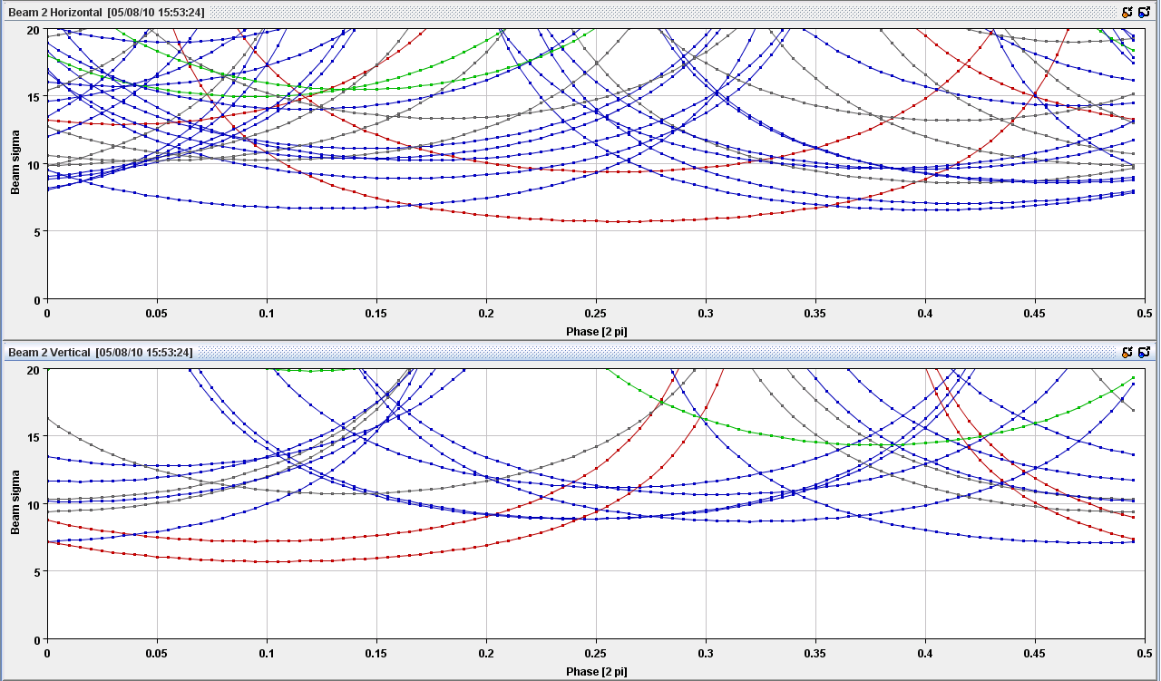
After injection B2
TCSG.6L7.B2
TCSG.B4R7.B2
TCP.C6R7.B2
TCSG.E5L7.B2
TCSG.A4R7.B2
TCSG.D4R7.B2
TCP.D6R7.B2

Slide 10
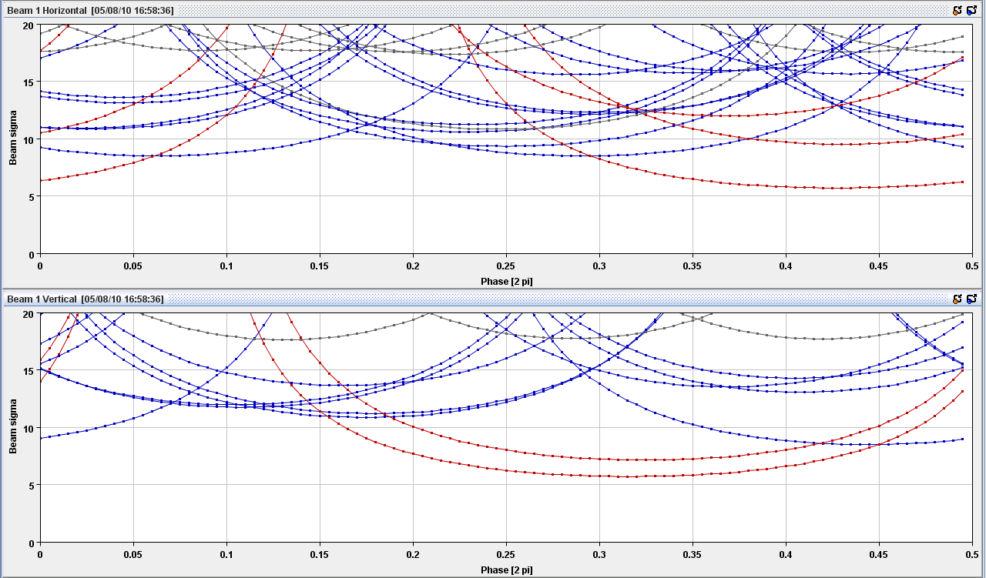
3.5 TeV, β*=11 m B1
TCSG.4R6.B1
TCSG.6R7.B1
TCSG.B4L7.B1
TCP.C6L7.B1
12.1σ
TCSG.A4R7.B1
TCSG.D5R7.B1
TCSG.D4L7.B1
TCP.D6L7.B1

Slide 11
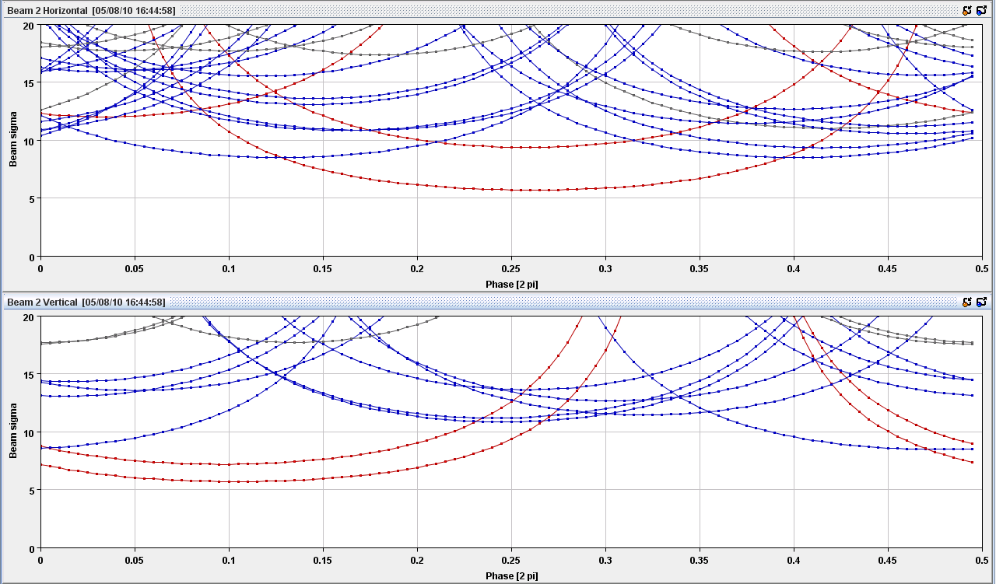
3.5 TeV, β*=11 m B2
TCSG.6L7.B2
TCSG.B4R7.B2
TCP.C6R7.B2
11.7σ
TCSG.A4R7.B2
TCSG.D5L7.B2
TCSG.D4R7.B2
TCP.D6R7.B2

Slide 12
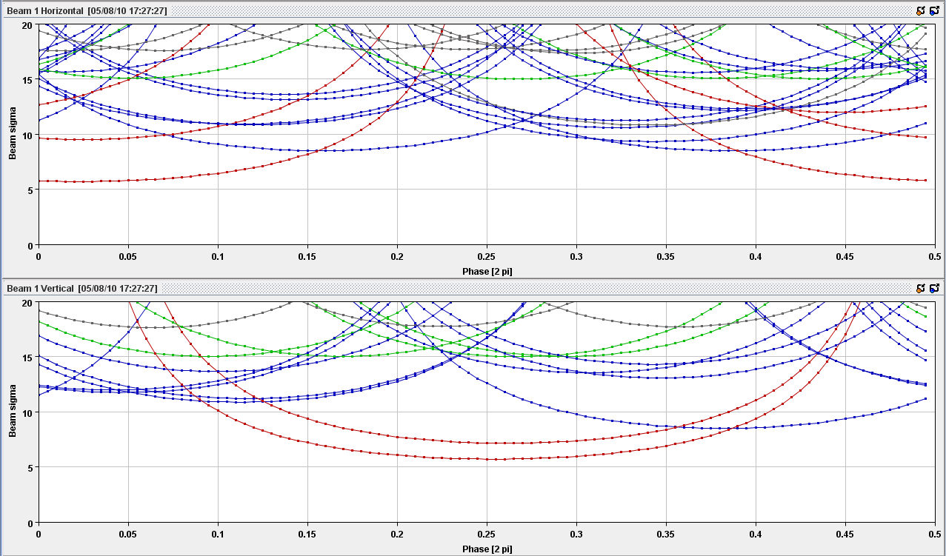
3.5 TeV, β*=3.5 m B1
TCSG.4R6.B1
TCSG.6R7.B1
TCSG.B4L7.B1
TCP.C6L7.B1
12.1σ
TCSG.D5R7.B1
TCSG.D4L7.B1
TCSG.A4R7.B1
TCP.D6L7.B1

Slide 13
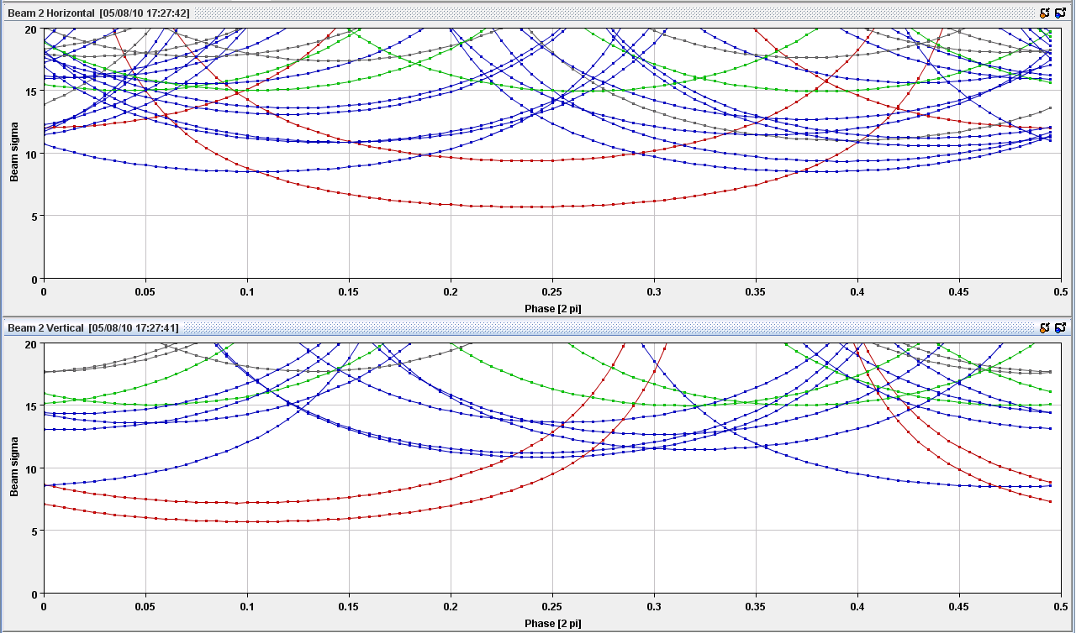
3.5 TeV, β*=3.5 m B2
TCSG.6L7.B2
TCSG.B4R7.B2
TCP.C6R7.B2
11.7σ
TCSG.A4R7.B2
TCSG.D5L7.B2
TCSG.D4R7.B2
TCP.D6R7.B2

Slide 14
Content
1. Introduction
2. Phase coverage throughout LHC cycle
3. Summary

Slide 15
Summary
Total coverage by TCPs and TCSGs in IP7, TCSG.4R6.B1 (B1 H) and TCLI in IP2 and IP8
Injection: Max uncovered amplitude: ≈ 9σ (B1 H, B2 H)
After injection: Max uncovered amplitude: ≈ 9.5σ (B1 V)
Flat Top: Max uncovered amplitude: 10.7σ (B1 H), 12.1σ (B1 V), 11.1σ (B2 H), 11.7σ (B2 V)
Squeeze (3.5m): only phase changes relative to flat top

Slide 16
Thank you
for your Attention
Tobias Baer
CERN BE/OP
Tobias.Baer@cern.ch
Office: +41 22 76 75379

Slide 17
Conditions
Based on Delphine Jacquet’s collimator application.
Assuming ε_{n}=3.5 μm rad.
Collimator positions are acquired from HW, β and tune from LSA optics.
For skewed collimators the effective gap in the center of the horizontal/vertical plane is taken into account.
Color coding: TCP, TCSG, TCT, Other.

Slide 18
Betatron phases
Beam 1:
Beam 2:
 | Horizontal |  | Vertical
 | Injection | Collision | Injection | Collision
MKI | X | X | 0.148 – 0.196 | X
MKD | 0.731 – 0.743 | 0.826 – 0.837 | X | X
ADT | 0.156 – 0.160 | 0.235 – 0.239 | 0.325 – 0.331 | 0.257 – 0.263
 | Horizontal |  | Vertical
 | Injection | Collision | Injection | Collision
MKI | X | X | 0.100 – 0.136 | X
MKD | 0.923 – 0.934 | 0.900 – 0.911 | X | X
ADT | 0.156 – 0.160 | 0.117 – 0.122 | 0.431 – 0.434 | 0.424 – 0.427

