Slide 1
Beam dump by ALICE on 28/10/10 @ 20:04:21
Antonello Di Mauro (CERN)
MPP, 12/11/10

Slide 2
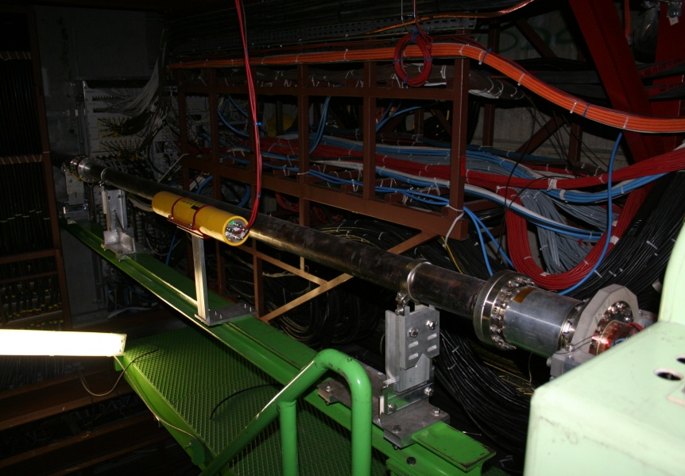
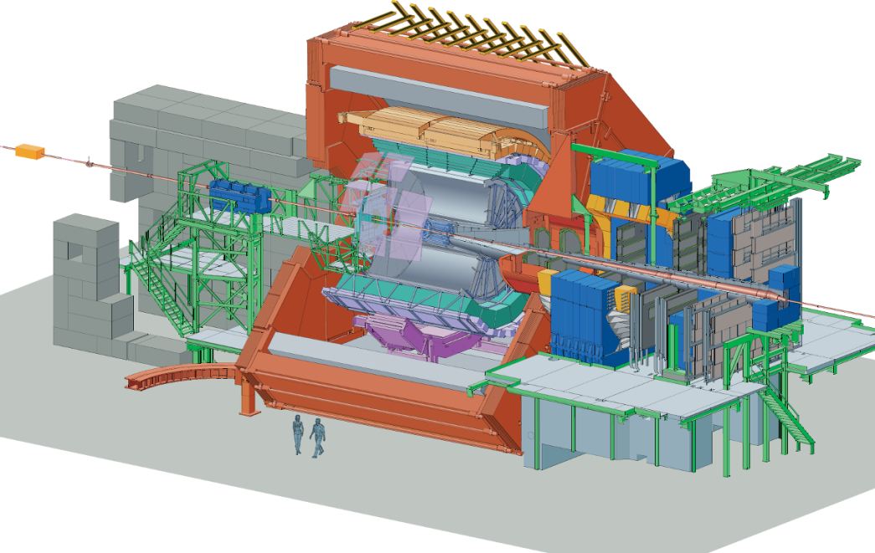
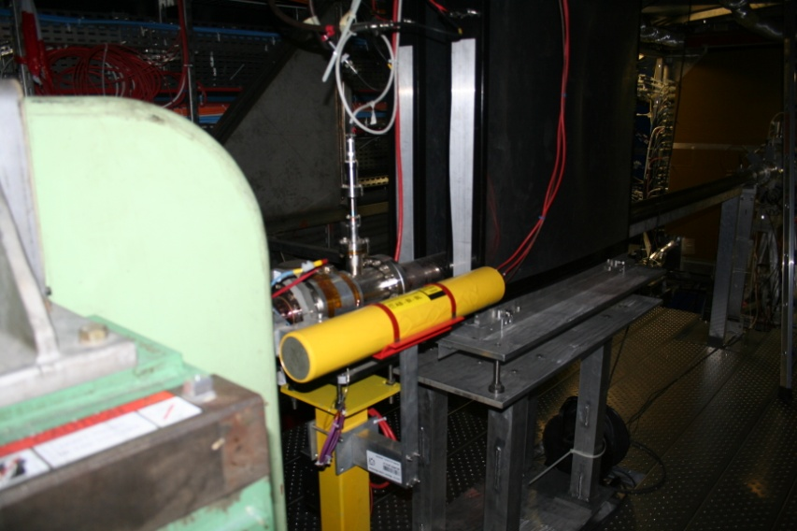
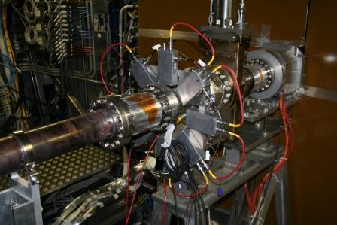
Beam Conditions Monitoring
BLM-MWBMD
BCM-A
8 sensors
z = + 6 m, r = 10 cm
BCM C
7 sensors
z = -18.5 m, r=10 cm
Beam abort conditions:
At least 3 sensors RS1 above threshold for two consecutive frames
At least 3 sensors RS2 above threshold
SumRS32 (= avg of RS32 excluding the two highest and the lowest) above threshold
Thr_RS1= 1500 nA, Thr_RS2= 750 nA, Thr_RS32=20 nA

Slide 3
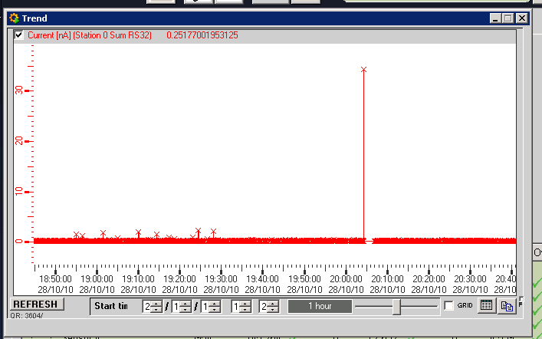
BCM signals on 28/10/10
Sensor | RS1 (nA) | RS2 (nA) | RS32 (nA)
A0 | 172 | 161 | 69
A1 | 200 | 189 | 78
A2 | 147 | 140 | 60
A3 | - | 70 | 30
A4 | - | - | 24
A5 | - | - | 16
A6 | 160 | - | 26
A7 | 170 | - | 32
RS32 dump-threshold
It seems a “slow” process,
dump originated by RS32,
RS1 @ ~10% of dump-threshold

Slide 4
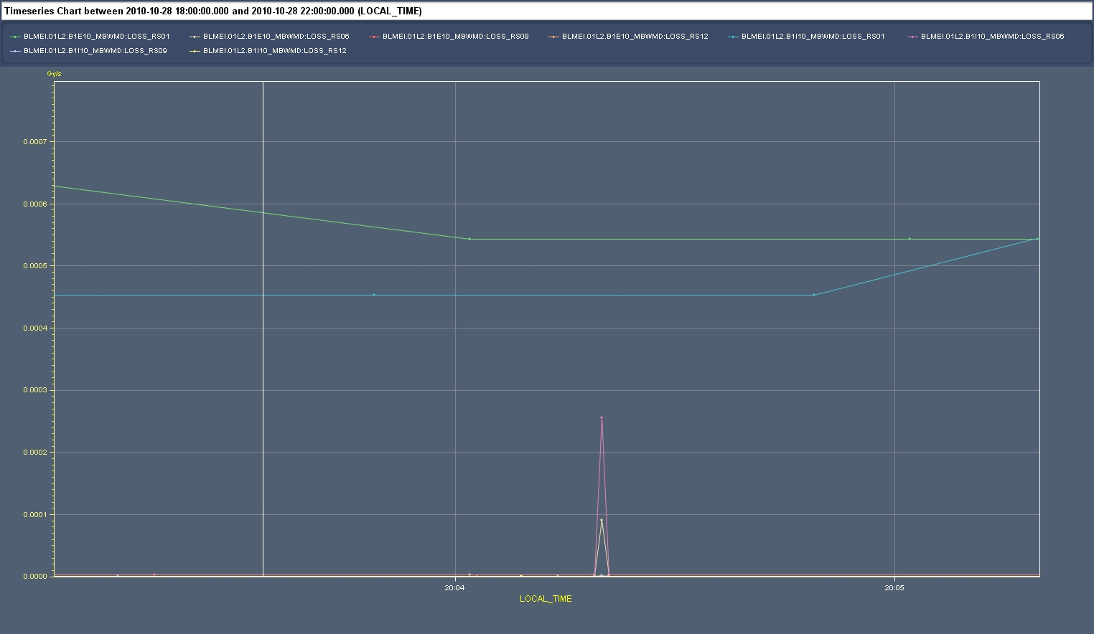
Signals in UX25 BLMs
Small signal visible only above RS09

Slide 5
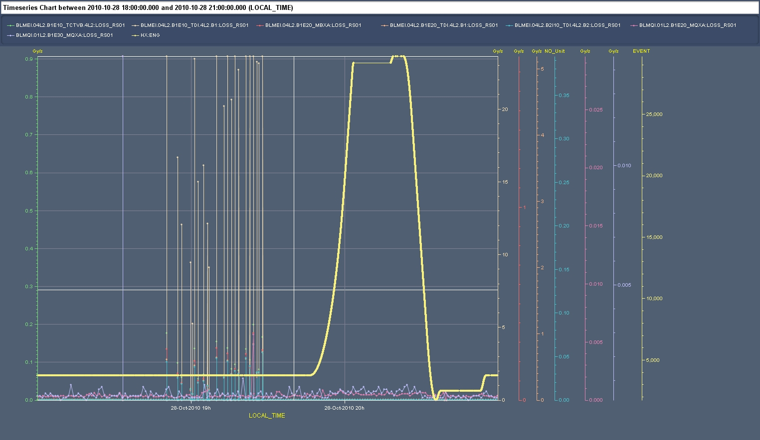
No signals from other BLMS RS1
ALICE dump

Slide 6
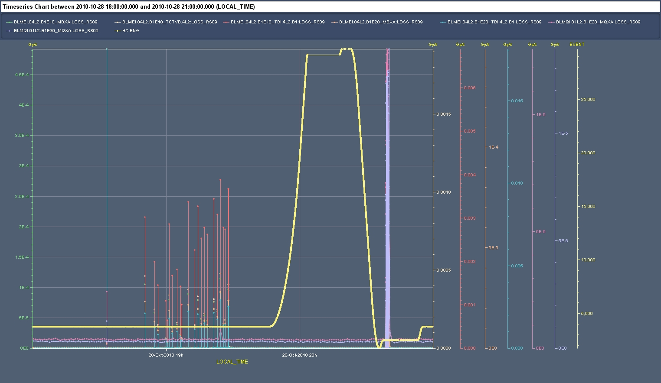
No signals from other BLMS RS9
ALICE dump

Slide 7
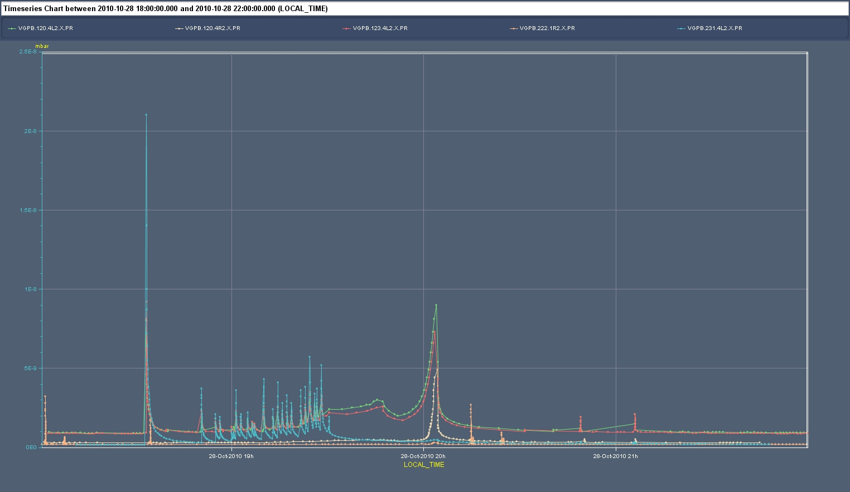
Vacuum activity around P2

Slide 8
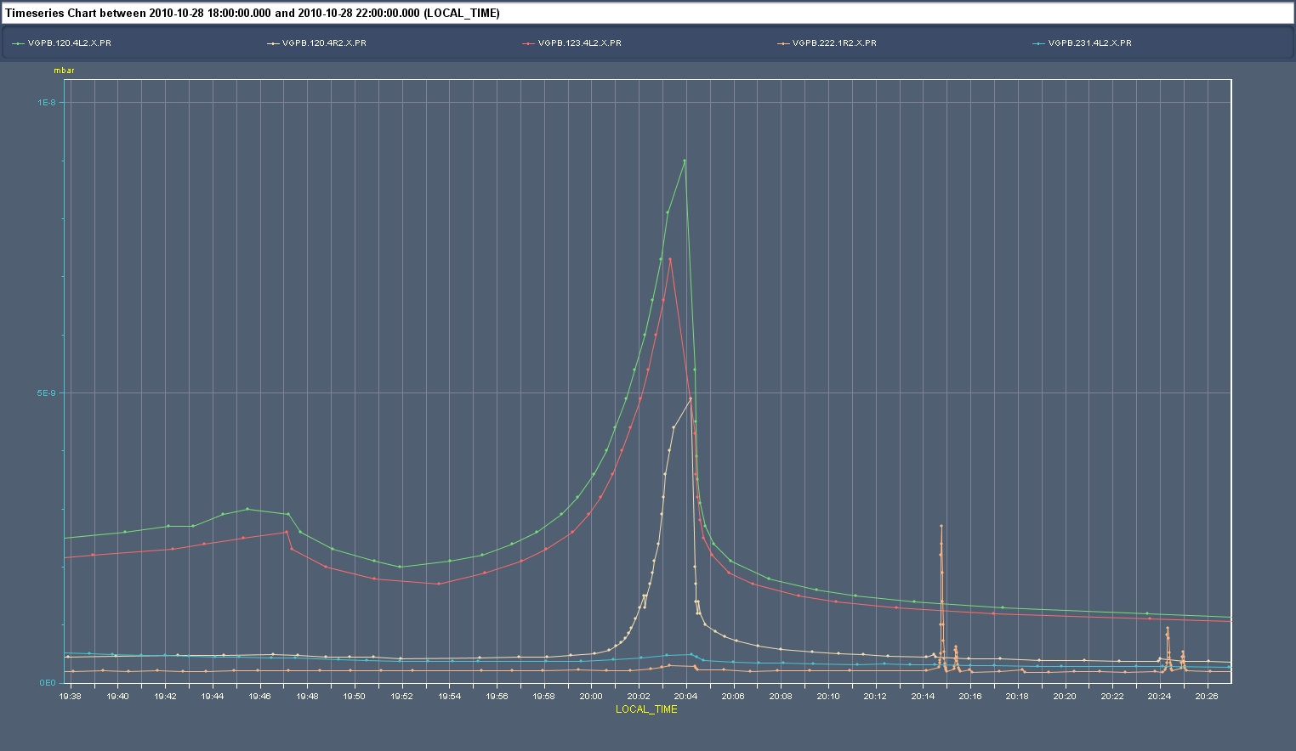
Vacuum activity around P2

Slide 9
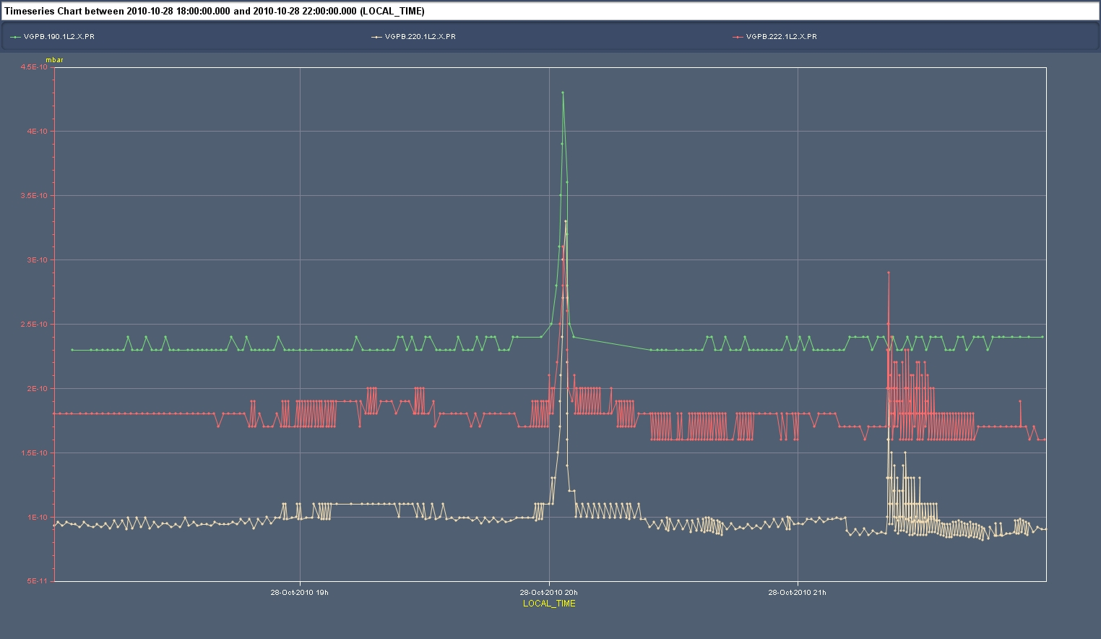
Vacuum activity around P2
Gauges at 22 and 19 m from IP2

Slide 10
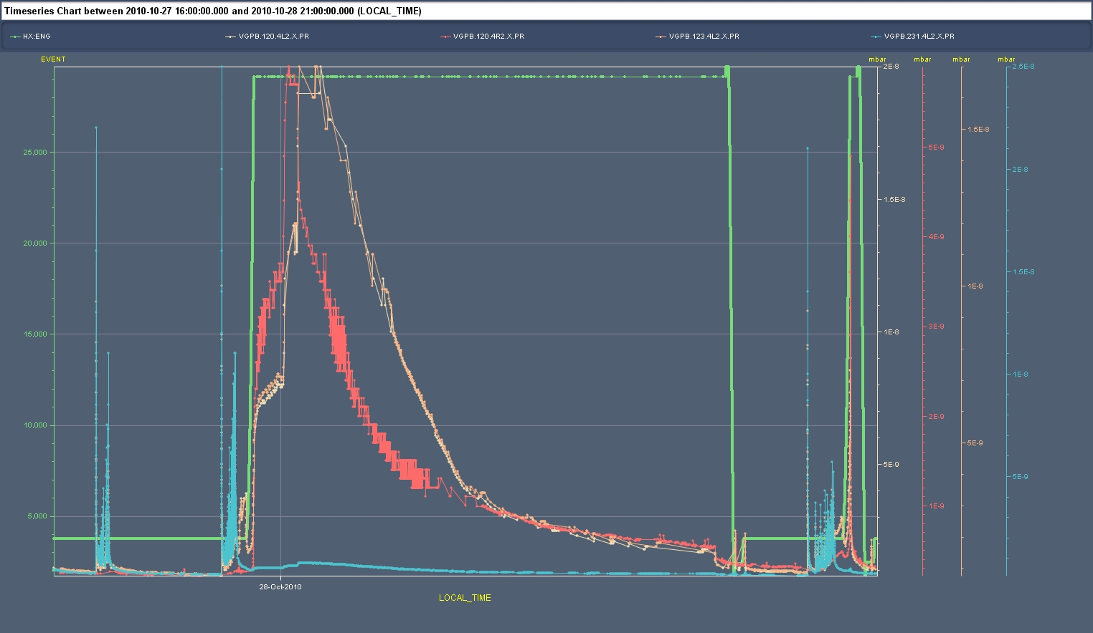
Observations form previous fill
Even larger vacuum “losses”
ALICE dump

Slide 11
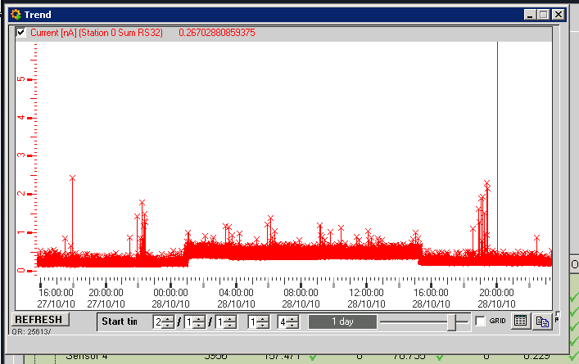
Observations form previous fill
ALICE dump

Slide 12
Summary
Signal losses only visible on long RS both in BCM and in UX25 BLMs
Correlation with vacuum activity around P2 rather weak…

