Slide 1
BGI magnets
BGI magnets – arranged in compensating pairs (data from M. Sapinski).
  B = 0.215 T for PC @ 100 A (in fact only 50 A in each magnet – in //).
  Magnetic length = 0.85 m.
  One magnet: BL = 0.183 Tm >> kick = 122 μrad @ 450 GeV
The magnets are arranged in pairs to be ramped transparently – see next slides – and should therefore have no impact in case of powering failure (PC off).
Presently the BGI PCs (RGMWH/V) are connected to the WIC (magnet protection) and to the BIS.
  WIC in Pt4 is managing ONLY the BGI circuits.
  A powering failure leads to a beam dump.
  Proposal to disconnect the WIC (the BGIs) from the BIS.

Slide 2
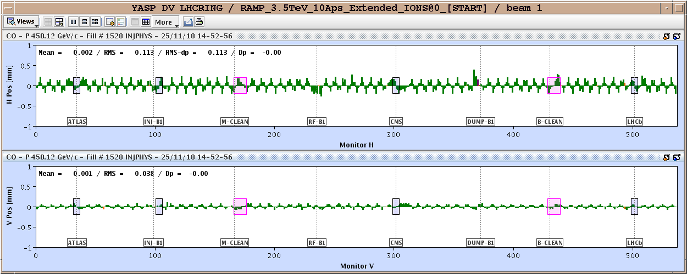
Beam 1 - orbit shift test
Orbit difference 100 A – 20 A at 450 GeV.
  Residual kicks equivalent to 0.5 – 1 μrad (~1% imbalance).

Slide 3
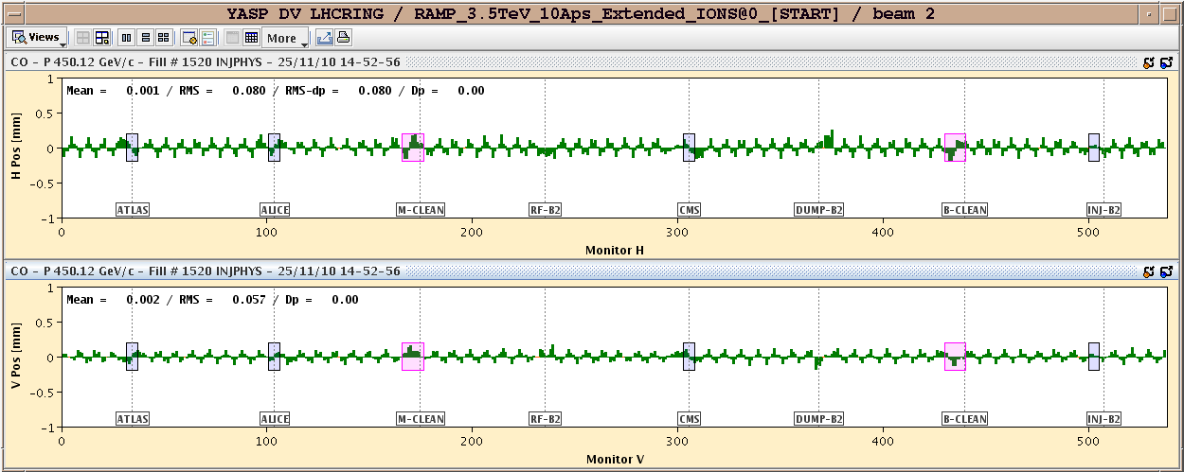
Beam 2 orbit shift
Orbit difference 100 A – 20 A at 450 GeV.
  Residual kicks equivalent to 0.5 – 1 μrad (~1% imbalance).

Slide 4
Summary
RMS orbit differences at injection (Δ = 80 A):
Beam | Hor. RMS (μm) | Ver. RMS (mm)
1 | 113 | 38
2 | 80 | 57
Quite minor orbit perturbations – we could therefore disconnect the IR4 WIC from the BIS (since it only handles the BGI magnets).

