Slide 1
Updates on β* for 2011
R. Bruce, R.W. Assmann
Acknowledgment:
T. Baer, W. Bartmann, C. Bracco, S. Fartoukh, M. Giovannozzi,
B. Goddard, W. Herr, S. Redaelli, R. Tomas, G. Vanbavinckhove,
J. Wenninger, S. White, D. Wollmann

Slide 2
Introduction
Only limits from aperture considered
Triplet Aperture
Absorbers
Tertiary
Secondary
Dump Protection
Primary
2010
Intermediate
nominal
5.7 σ
8.5 σ
17.7 σ
9.3 σ
15.0 σ
17.5 σ ?
6.0 σ
8.8 σ
17.2 σ
10.2 σ
12.8 σ
13.9 σ ?
8.3 σ
beam
6.0 σ
7.0 σ
10.0 σ
7.5 σ
8.4 σ ?
Hierarchy between cleaning stages must be preserved to guarantee protection (should account for β-beat and orbit variation)
To optimize β*, we have to review
  Triplet aperture
  Margins in cleaning hierarchy

Slide 3
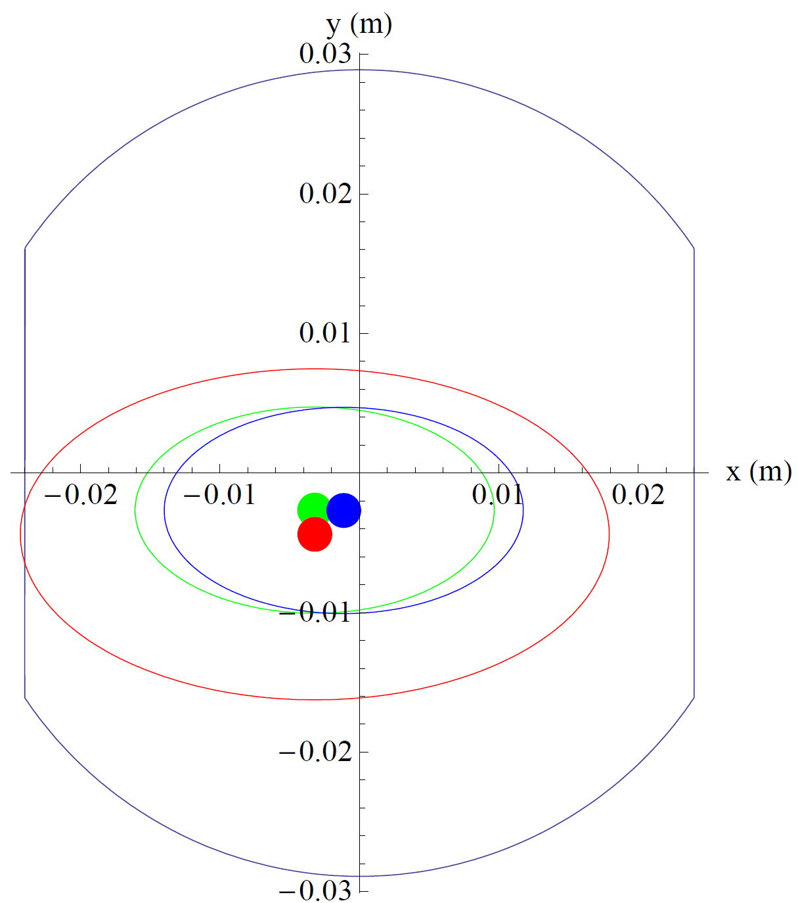

Aperture calculations
(review)
Using 2 methods:
n1
scaling of measured injection aperture
  Assume pessimistically
  injection aperture=global limit+2 σ
  Only one plane matters with good approximation - reduce to 1D
  Scale beam size to pre-collision
  (larger β_{x} and γ), add orbit
  offsets in relevant plane
  Solve for top energy aperture
Additional assumption: reduce
separation to nominal value 0.7 mm
MQXB.B2L1
s= -40.8 m
2mm separation

Slide 4
Parameters in aperture calculation
Scaling
  All mechanical and alignment errors already included in measurement – nothing changes between injection and top energy
  2mm orbit uncertainty (difference between orbit during measurement and top energy)
    More detailed analysis done, all runs from sept 18 to nov 30, data sampled every 2 minutes in stable beams, excluding points from van der Meer scan
  β-beat must be accounted for
    Assuming 5% reproducibility and measured β-beat
n1
  2.3 mm orbit variation (BPMs in triplets, difference to ideal MAD-X orbit)
  10% β-beat

Slide 5
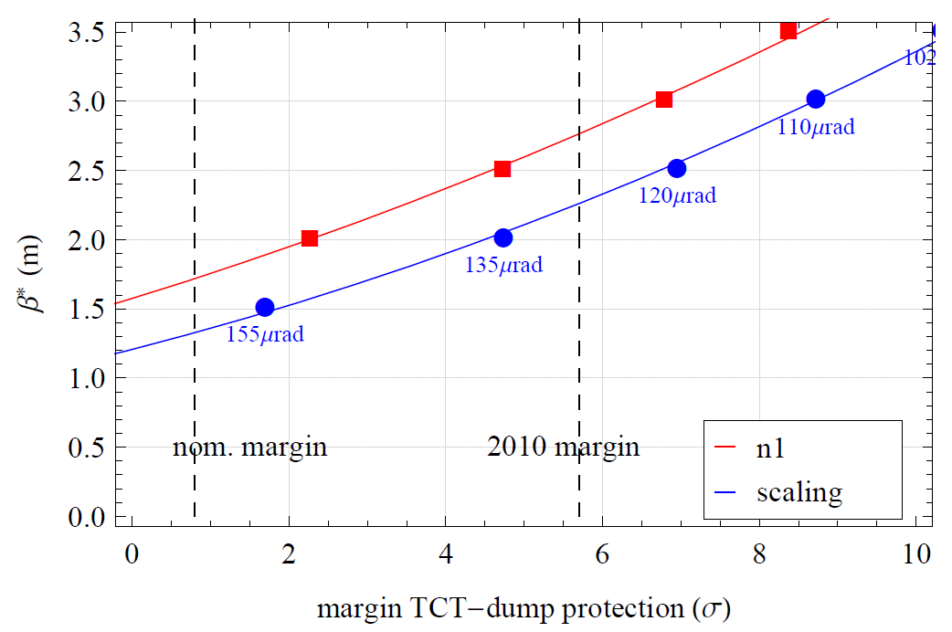
New β* without changing margins

Slide 6
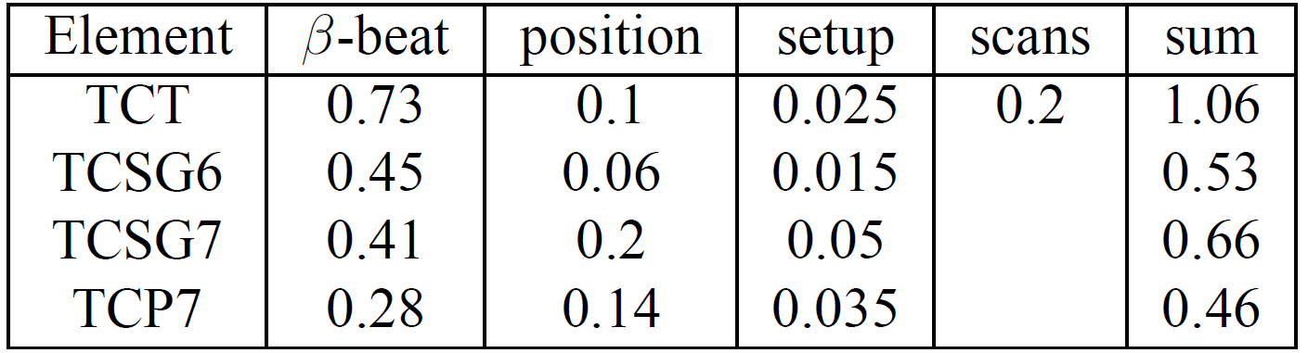
Margins in cleaning hierarchy
Orbit: separate analysis on following slides
10% β-beating. Bias in correction at TCT-triplet wanted
40 μm positioning error
10 μm setup error
Small lumi scans can be included in the margin

Slide 7

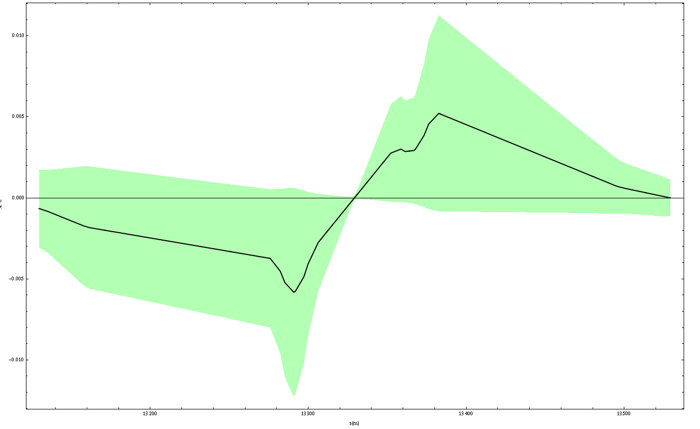

Orbit movements TCT-triplet
Reduction in margin
Correlated orbit movement at TCT and triplet considered
Because of phase advance, orbit movements in the same direction will cancel at the first triplet and add up at the second
Reduction in margin calculated in both planes for each triplet separately over full data set
1.6 σ covers all triplets 99% of the time in stable beams for IR1, IR5, IR8
2.4 σ needed in IR2 (large static orbit offsets)
Triplet
TCT
IP
Triplet

Slide 8
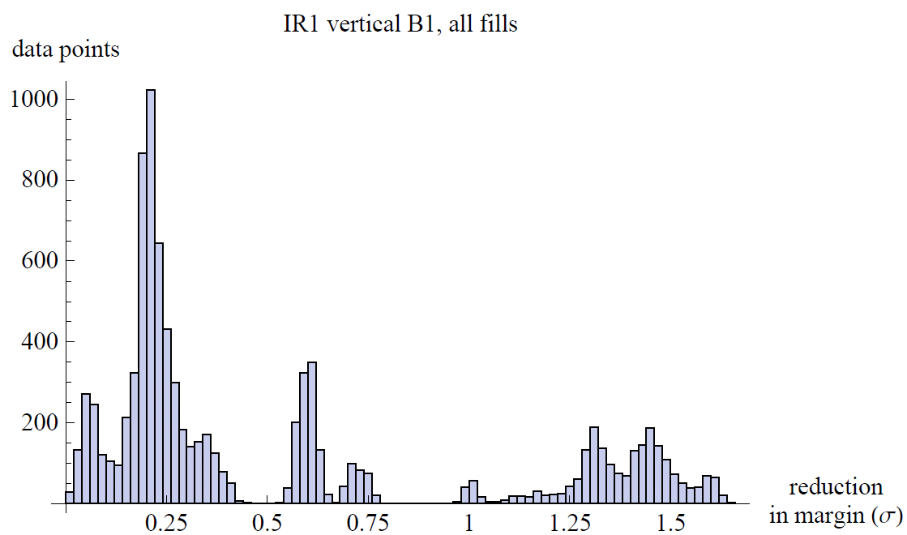
Example: IR1 B1 V

Slide 9
Margins between collimators
A similar analysis (but more pessimistic, without phase considerations) shows
  99% of the time in stable beams, all horizontal TCTs are shadowed by the dump protection with a 1.1σ margin (presently 5.7σ total margin)
  We should not reduce the margin between IR7 and dump protection
  We should not reduce the margin between primary and secondary collimators in IR7 (possible loss in cleaning efficiency)

Slide 10
Damage risks
What does a 99% coverage mean in terms of damage risks?
  Assume 1 asynchronous dump per year
  Assume 1% of the time the margin dump-TCT is violated (uncorrelated to async. dump)
  Assume 1/3 of the time spent in stable beams
  => 1 event in 300 years could be dangerous for the TCTs
  Assume 1% of the time the margin TCT-triplet is violated
  => 1 event in 30000 years could be dangerous for the triplets
  This considers only orbit. Simultaneously all other errors have to add up pessimistically at both locations.
  => The real risk is much lower!
  In case of the TCT being hit by a bunch there is no catastrophic damage, most likely it will be scratched and we can use a spare surface (see talk A. Bertarelli in Chamonix)
To further reduce the risk we propose interlocks or warnings before the orbit runs out of limit

Slide 11
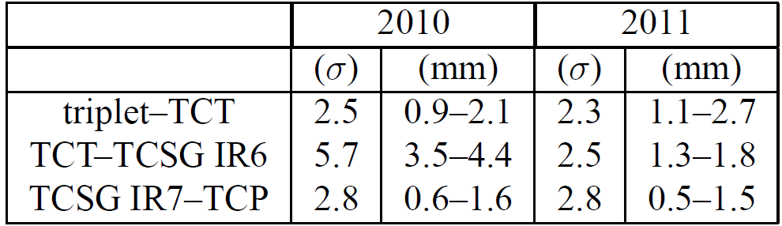
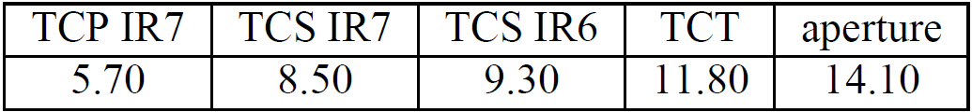
Proposed margins and settings
Summing linearly we get the margins
and the settings
Assuming IP2 remains at larger margins. Proposed settings very similar to what was used in 2010 run with β*=2.0m

Slide 12
Operational proposals
Reduce the separation at the IPs to its nominal value of 0.7 mm
Measure the triplet aperture locally
β-beating below 10%, reproducibility 5%, bias at TCTs/triplets
Interlocks or warnings to reduce damage risk further
New settings to be qualified with loss maps and async. dump tests. Problems => margins and β* to be increased
cleaning hierarchy to be verified on a regular basis
Detailed study to correlate n1 calculation and measurements

Slide 13
Reach in β*
Minimum β* calculated for three options, using n1 and scaling method:
  2010 margins
  2011 margins (as calculated on previous slide)
  Nominal collimator settings with increased beam-beam separation
Assumptions in calculations:
  Always taking min margin over all IPs, planes and beams
  Minimum β* given by intersection between interpolation and desired margin (see slide 9)
  Using nominal 0.7 mm separation and nominal emittance
  Using measured β-beat at injection and top energy with 5% reproducibility, 10% β-beat in n1 calculation
  Assuming max 2 mm orbit shift in pessimistic direction between measurement at injection and top energy , 2.3 mm orbit in n1
  Assuming 12 σ beam-beam separation (larger than nominal)
  Triplet aperture at injection assumed 2 σ larger than global limit

Slide 14
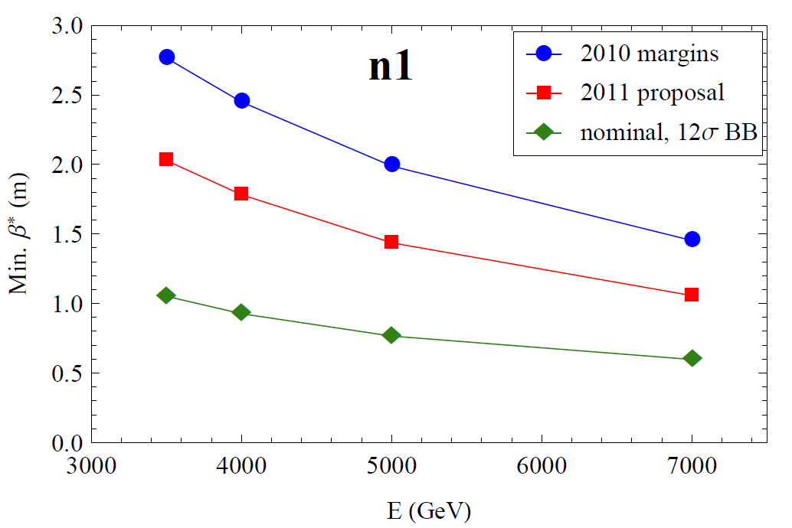
Results n1

Slide 15
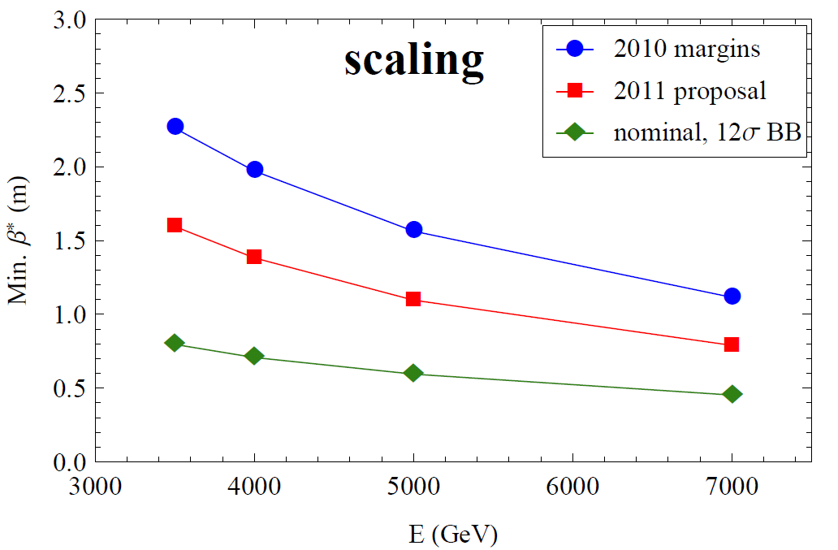
Results with aperture scaling

Slide 16
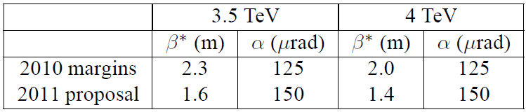
Conclusions
Reviewed both aperture estimate and margins
  Measurements show larger aperture, orbit and β-beat better than traditionally used in n1-model
  TCTs can be moved in closer to dump protection
Choice of β* should maximize performance without risking safety
Proposal: start at 4 TeV, β*=1.5m, 2011 margins
  Measure local triplet aperture
  Collimator settings to be qualified through provoked losses before being used during runs

Slide 18
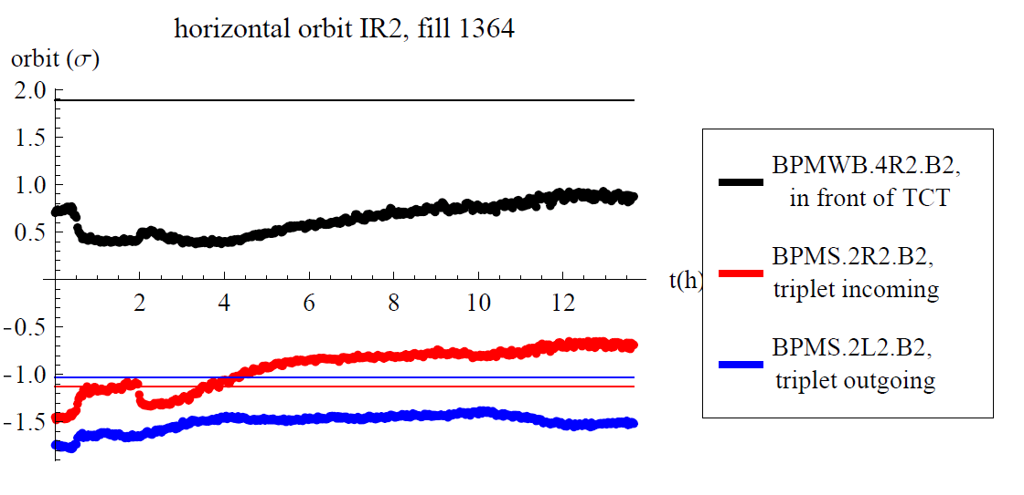
Backup – orbit during fill IR2

Slide 19
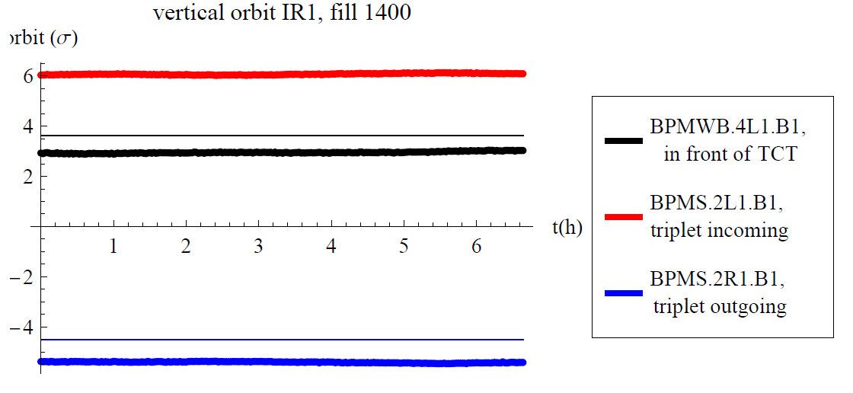
Backup – orbit IR1

