Slide 1
MPS envelope for CODs
This year we should give a clear envelope for faulty orbit correctors at injection – i.e. above which kick strength they must be repaired to continue operation wrt continuing with a bump in the machine.
The margins must take into account the total aperture and the margins needed for:
  Injection protection
  Injection oscillations
  Orbit interlocks
  Missing COD bumps <<<
  COD must not affect ‘vital’ systems (collimation, LBDS, Xing and separation bumps…).

Slide 2
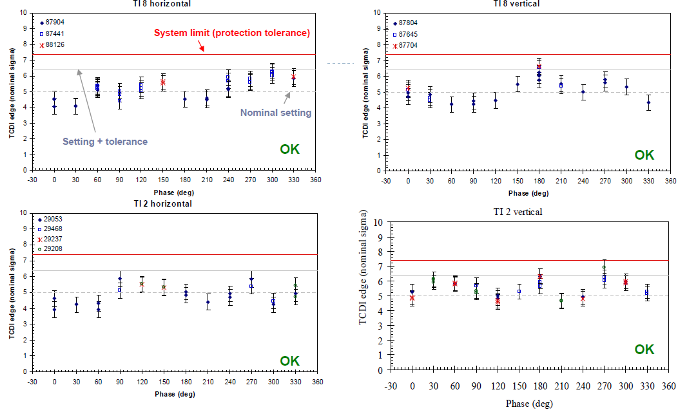
Injection protection (TCDI): assume 7.5 sigma (from V. Kain et al)

Slide 3
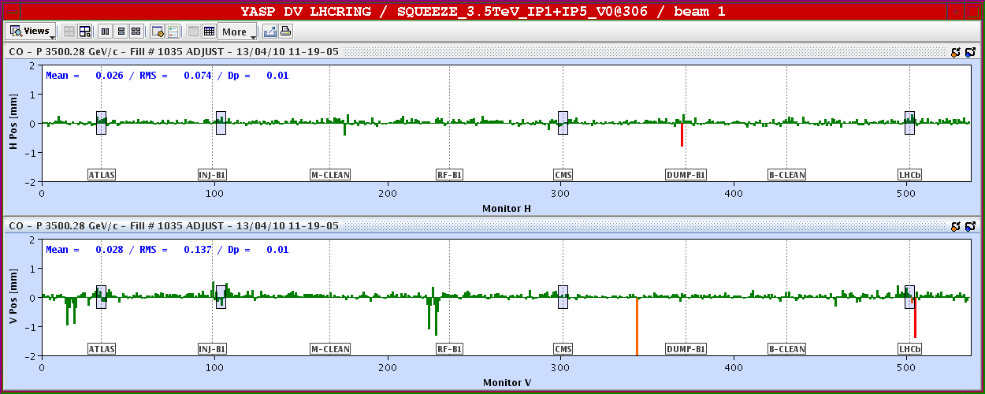
Missing COD effect
In the arcs, a missing COD will lead to a creation of 2 π-bumps. The limit on the COD is defined by the max. excursion.
  Plus keep a margin of 0.5 sigma (0.5 mm) for orbit (on top of missing COD effect).
Bumps around missing correctors !

Slide 4
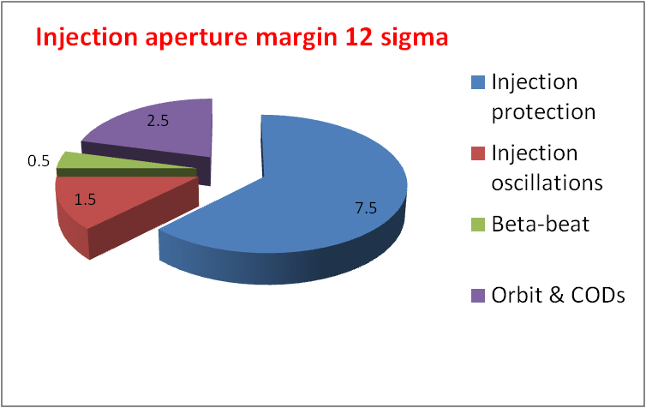
COD kick margin
Possible splitting of the total aperture margin at injection (assumed here to be 12 sigma) into the different components.
  - NB: 1 sigma ≈ 1 mm
NB: numbers indicate margin in sigma
This translates into a maximum missing kick of 22 microrad.

Slide 5
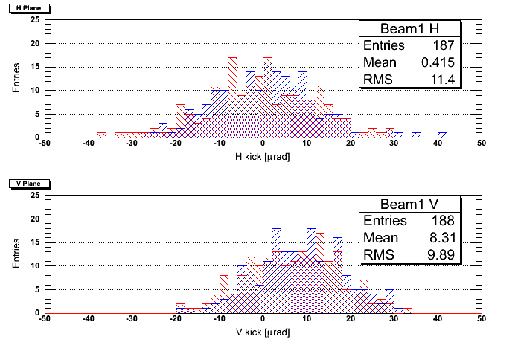
Maximum kick range
Dependence of maximum kick on margin used for injection protection.
Injection protection margin (sigma) | Max. missing kick (urad) | % CODs above max. kick
7.5 | 22 | 7
8 | 16 | 24
8.5 | 11 | 39
Open inj. protection by 0.7 sigma
Kick distribution for 2010 ion orbit at injection

Slide 6
Possible envelope
Tentative first order envelope – to be finalized for end of March !
CODs must be repaired if:
  LSS1/2/5/8: located between Q8.L and Q8.R.
  LSS3/7 : if it affects the collimation (exact limit to be verified).
  LSS6 : between Q8.L and Q8.R (tbc).
  LSS4 ? Damper !!
  Rest of the machine: if the missing kick is larger than XX microrad at injection – exact value to be defined.
  What if the COD falls into none of those categories and is PICed (120 A)?
(There is now also a simple tool in the CCC steering that allows the OP crews to evaluate the impact of a missing COD in a few clicks.)

