Slide 1
Additional CIBU connection for LBDS in IR6
N.Magnin
MPP meeting - 27.05.2011

Slide 2
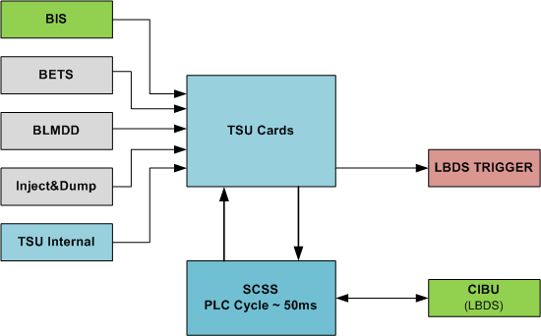
LBDS connections to BIS overview
TSU has 6 clients (BIS input only)
SCSS (slow) is monitoring TSU state
SCSS is connected to BIS (in/out)

Slide 3
Case study: TSU BIS client request
BIS is opened (any client around LHC)
(Dumped event is sent)
TSU detects BIS client request
TSU sends LBDS trigger
SCSS detects TSU not ready
(min 50ms delay)
SCSS opens LBDS BIS loops
Sequence of events:
Sequence is OK

Slide 4
Case study: SCSS request
SCSS detects a problem
SCSS opens LBDS BIS loops
(Dumped event is sent)
TSU detects BIS client request
TSU sends LBDS trigger
Sequence of events:
Sequence is OK

Slide 5
Case study: TSU other clients request
TSU detects a client request (not BIS)
TSU sends LBDS trigger
SCSS detects TSU not ready
(min 50ms delay)
SCSS opens LBDS BIS loops
(Dumped event is sent)
Sequence of events:
Sequence is BAD:
BIS opened >50ms after LBDS trigger !!!

Slide 6
Problems: Who is first BIS client ?
The LBDS opening BIS late, other BIS clients can open BIS earlier.
Example: Dump of beam 1, 25.05.2011 02:43:02
BRF goes off and losses detected during dump
Sequence of events:
BRF goes off at point 6
TSU detects loss of BRF
TSU sends LBDS trigger
Beam dumped with some losses
BLM opens BIS
(Dumped event is sent)
SCSS detects TSU not ready (min 50ms delay)
SCSS opens LBDS BIS loops
Trace in LHC logbook:
Global Post Mortem Event
Event Timestamp: 25/05/11 02:43:02.838
Fill Number: 1805
Accelerator / beam mode: PROTON PHYSICS / STABLE BEAMS
Energy: 3500160 [GeV]
Intensity B1/B2: 11019 / 11044 [e^10 charges]
Event Category / Classification: PROTECTION_DUMP / MULTIPLE_SYSTEM_DUMP
First BIC input Triggered: First USR_PERMIT change:
Ch 11-BLM_MSK: A T -> F on CIB.UA63.L6.B2
Result: BLM appears as first client instead of LBDS !

Slide 7
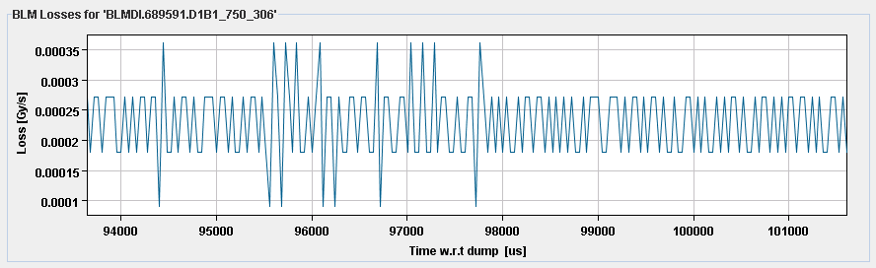
Problems: Beam dumped event is late
The LBDS BIS opening late, the Beam dumped event is sent late.
This is a problem for some LHC control equipments that react on this event.
Example: Dump of beam 1, 07.05.2011 - 14:00:57
BLM post operation buffers for XPOC system
Result: BLM buffers contain data acquired ~100ms after dump !
XPOC system failed on BLM timestamp error .

Slide 8
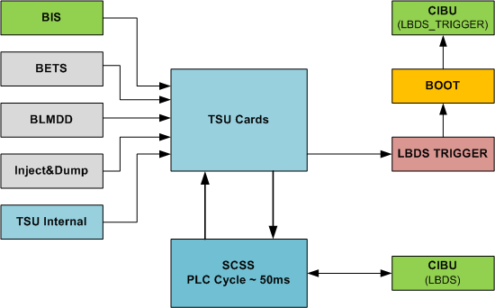
Proposed solution
To open the LBDS BIS earlier after LBDS trigger:
Add CIBU crates for new “LBDS_TRIGGER” client
Add “BOOT” crates.
(BIS Opening On Trigger)
The BIS is opened after each LBDS trigger for a short duration (min 200ms).
This gives enough time to SCSS to react and open the LBDS BIS loops.

Slide 9
Case study: TSU client request (new)
TSU detects a client request
TSU sends LBDS trigger
BOOT detects LBDS trigger
BOOT opens LBDS_TRIGGER BIS
(Dumped event is sent)
SCSS detects TSU not ready
(min 50ms delay)
SCSS opens LBDS BIS
BOOT closes back LBDS_TRIGGER BIS
(min 150ms delay)
Sequence of events:
Sequence is OK

Slide 10
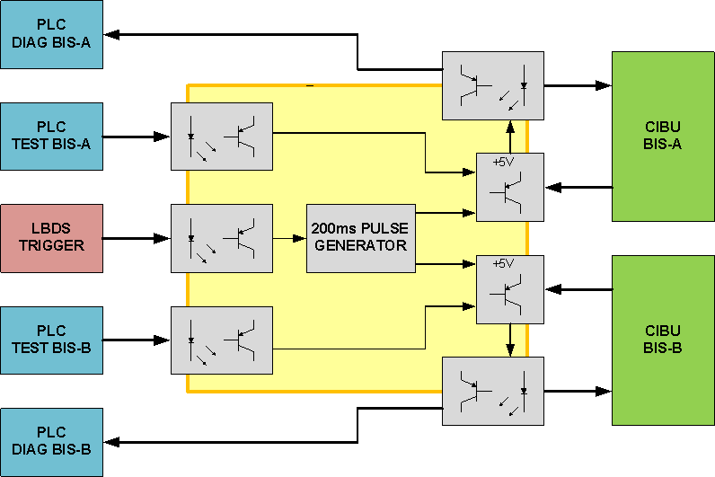
BOOT card: Block diagram
Features:
Input for LBDS trigger (with opto-coupler)
Pulse generator
Connection to CIBU (without opto-coupler: we must provide the current to CIBU input)
Input/output for SCSS to check BIS loops
(with opto-coupler)

Slide 11
Realisation: How long is needed ?
Before TS:
- EC:
  Design/prototype of BOOT card: ~1 week
  Production of min. 3 cards: ~2 weeks (?)
  Tests and Validation in LAB: ~2 days
BIS:
  Review schematics of BOOT card
  Prepare two new CIBU
During TS:
EC/BIS:
  Install two CIBU and BOOT systems in LHC: 1 day
  Commissioning of new BIS connection: 1 day
More than 3 week needed (optimistic…)

Slide 12
Conclusion
This problem is not a safety issue for LHC.
…But it generates post operation diagnosis problems and add some confusion in the understanding of beam dump event history.
=> We should find a solution ASAP
Questions:
Is the proposed solution satisfactory ?
If yes, is it reasonable to plan this for next TS (20.06.2011 – 22.06.2011) ?

