Slide 1
Machine Protection and
Interlocking of proton-ion operation
A first iteration
J. Wenninger

Slide 2
P-ion operation
For p-ion operation, one of the rings will be filled with a proton beam, the other one with ions (so far Pb).
It is likely that each ring must be able to alternatively (in different fills !!) receive protons or ions.
  Must not rely on a fixed mapping between ring and particle species.
Aim of this presentation is to give some ideas (and proposals for interlocks) to prevent injecting the wrong particle type in either ring from the SPS
  Assume that the injected beams are unsafe.
  ‘Design’ injection (extraction) interlock.

Slide 3
Proton ion filling scheme?
Assume 100 ns proton beam with 4 standard length batches:
  72 bunches, 2E10 p/b → ~2E12 protons
  Just above setup beam with nominal emittance.
Define a protection strategy to cope with unsafe beams.

Slide 4
Proton vs Pb at injection
At injection to the LHC the only noticeable difference between p and ions (Pb) is the RF frequency (due to the slower speed of ions):
  Difference of 5.3 kHz between protons and ions (higher for p).
  Magnetic settings are ~identical – see 2010.
If the RF frequencies are wrong (p for ions or vice-versa):
  Energy shift at extraction from the SPS of ±1.3% - still within the SPS aperture (but not easy with large intensity).
  Energy shift in the LHC of ±4.1% - far outside the LHC acceptance. The beam will be not circulate and be lost on aperture (normally a collimator).

Slide 5
Ring mismatch
Attempt to inject a proton beam from the SPS into a ring setup for Pb in the LHC (or vice-versa):
  Frequency is off by ±5.3 kHz for the SPS beam, leading to an energy error of ±1.3% at extraction from the SPS.
  It is not clear if the re-phasing SPS-LHC would work or if the beam would survive in the SPS (at the limit of the aperture, non-linear Q’ etc) – but it cannot be excluded → assume the beam could be extracted.
  If the beam leaves the SPS it will be lost in TI2/TI8 due to the limited dp/p aperture of the lines (±0.4 %)
  → the beam will never make it into the LHC.
  → LHC is safe – we must protect TI2 and TI8 !

Slide 6
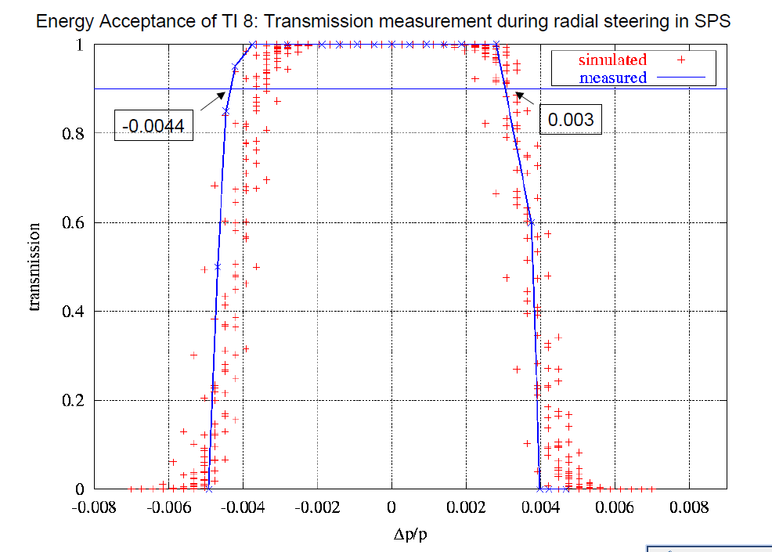
TI2/8 energy acceptance
The energy acceptance of the TI2/8 lines is around 0.4 %
TI8 test 2005
(V. Kain)

Slide 7
How can one differentiate ions and p?
Concentrate here on ‘useable’ signals…
LHC:
  RF frequency difference of 5.3 kHz.
SPS:
  RF frequency at extraction – unfortunately no fast measurement available.
  Radial position (centered) – arc BPMs.
  RF low-level controls settings (timings, delays ….).
  Momentum of the beams at injection:
    26 GeV for protons.
    17 GeV (proton equivalent setting) for Pb.
  Need to merge information dispersed across SPS+LHC → mostly SIS interlocks

Slide 8
SIS interlock proposal - 2011
Proton conditions – applied for each ring
  LHC: RF frequency within 1kHz of proton reference.
    Monitoring at 0.2 Hz, accuracy ~ 20 Hz.
  LHC : particle type in CPTY telegram = proton.
  SPS: user name LHCx or LHCFASTx (x = 1,2,3,4…).
  SPS: injection line TT10 settings consistent with 26 GeV:
    Current interlock on 2 dipole and 2 main quadrupole strings.
Pb conditions – applied for each ring
  LHC : RF frequency within 1kHz of Pb reference.
    Monitoring at 0.2 Hz, accuracy ~ 20 Hz.
  LHC : particle type in CPTY telegram = Pb
  SPS : user name LHCIONx (x = 1,2,3,4…).
  SPS : injection line TT10 settings consistent with 17 GeV:
    Current interlock on 2 dipole and 2 main quadrupole strings.

Slide 9
SIS continued
SIS will allow injection into a given ring if the settings are consistent with ions or with protons.
  Flexible – no a priori knowledge on which ring is used for which species.
  Will also work to avoid injecting ions during p-p runs (and vice-versa).
The TT10 injection is used and not the SPS main dipole current (also a good candidate) due to ‘technical’ issues with the current readout.
  May disappear in the near future when FGC SW is deployed in the LHC (2012??).

Slide 10
SPS Extraction Interlock (BIS)
It is possible to include 2 arc BPMs (dispersion > 2 m) into the beam position interlock at extraction (→ BIS).
  ‘Effectively’ ensures that the RF frequency is correct and that the beam is centered.
  Replaces the SPS RF frequency measurement.

Slide 11
Status & outlook
Given the limited risk (? tbc) and the geographical distribution of the information needed for interlocking, the SIS (+BPM at extraction) solution should be adequate for 2011/2012.
  Everything in place by September.
Local test SIS version with SPS user and LHC RF frequency.
  Will go to production next week (maskable).
Arc BPMs added to SPS extraction interlock : next week.
TT10 PC settings : after next TS (latest).
More possibilities:
  The SPS BETS systems used to provide the SPS energy information may also used to provide the injection momentum – tbc.

